Slide 1
Differences in Usage Between Casual Riders and Membership Holders
Jason Heller
Last Updated: 8/30/22

Slide 2

About the Data
Results were extrapolated from Cyclistic’s datasets from August 2021 to July 2022.
Attributes of the data were split between membership holders and casual riders to compare how the two groups interact with the service differently.

Slide 3
Assessing the Data
There are some issues with the reliability of the data, such as missing data and changes in formatting over time.
The data is from a first-party source
The data is sufficient to do comparisons between membership holders and casual riders
The data is current at the time this case study was conducted
The data supplied was released under a license that allows for its use in this case study
The data is credible, and there are no signs of misrepresentation

Slide 4
Cleaning the Data

Slide 5
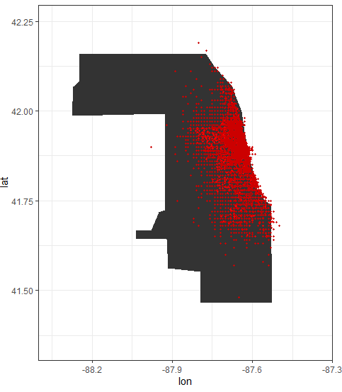
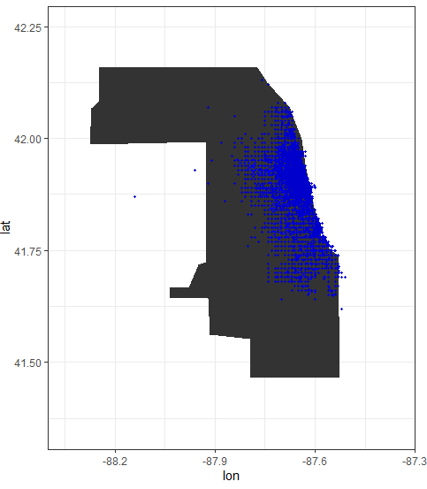
Validating GPS Locations
Starting/Ending GPS Locations Between..
Casual Riders
Membership Riders
Comparing GPS locations side-by side, we see there are a few GPS locations that fall outside the general area of Chicago, some are even located in Lake Michigan. However, the points generally match up to the Chicago area.
We will keep the data as-is, since we are only looking at the bigger picture here.
Due to the lack of data regarding the route of the rides, we will not draw conclusions between start/end locations and ride lengths.

Slide 6
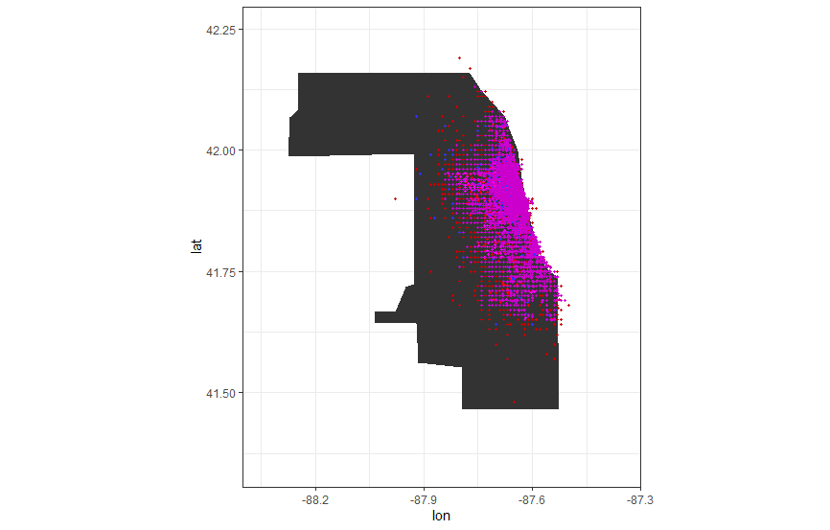
Comparing GPS Locations Between Ridership Types
Overlaying GPS locational data between casual and membership riders reveals little difference between the two datasets
It appears most arrivals/destinations are most dense closer to the more urban parts of Chicago, close to the Michigan river.

Slide 7
Differences in Rider Volume

Slide 8
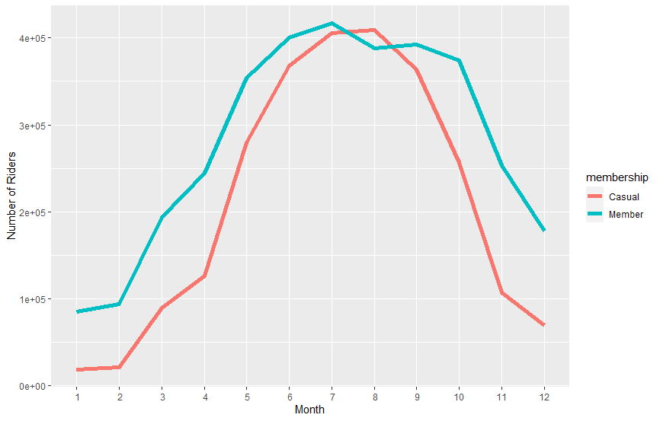
Looking at Demand on a Monthly Basis
Overall, the service sees the most traffic in the summer (May to September) and declines in the colder months
In the summer, member and casual ridership is similar, however members will ride more often in the winter compared to casual riders.
Casual ridership is very low in the winter months

Slide 9
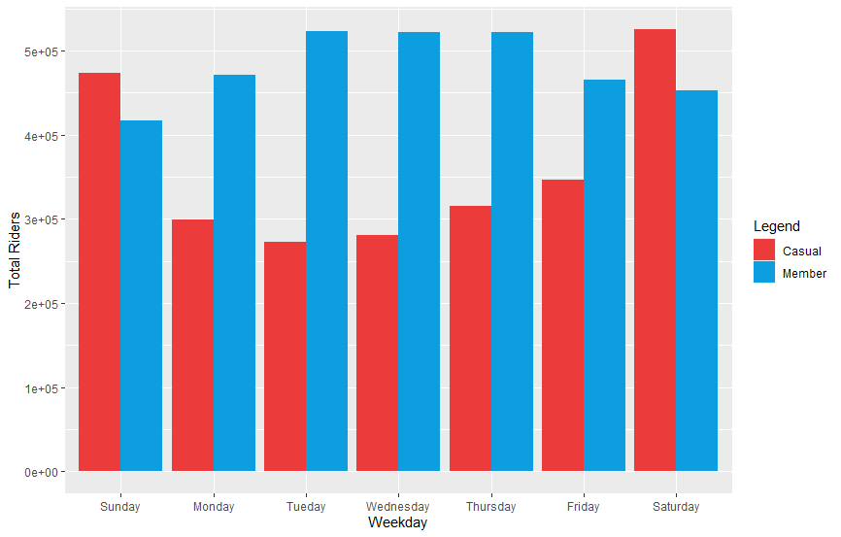
Total Riders Per Day for Each Rider Type
Members ride the most in the middle of the week (Tuesday to Thursday) whereas casual riders use the service mostly on the weekend
Casual ridership surpasses member ridership on weekends

Slide 10
Differences in Ride Duration

Slide 11
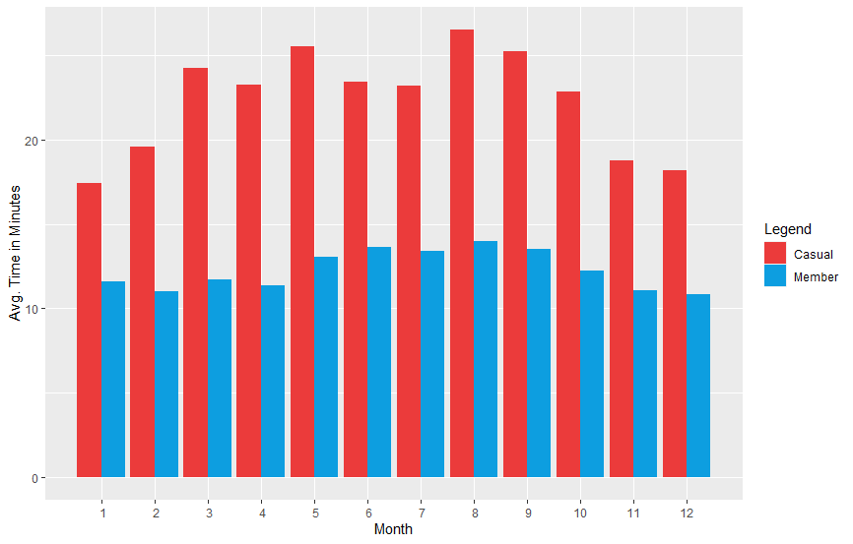
Average Ride Length per Month
On average, casual riders ride a significantly longer amount of time when compared against riders with memberships.
While both groups ride more in the summer months, riders with memberships tend to ride a consistent amount of time throughout the year.

Slide 12
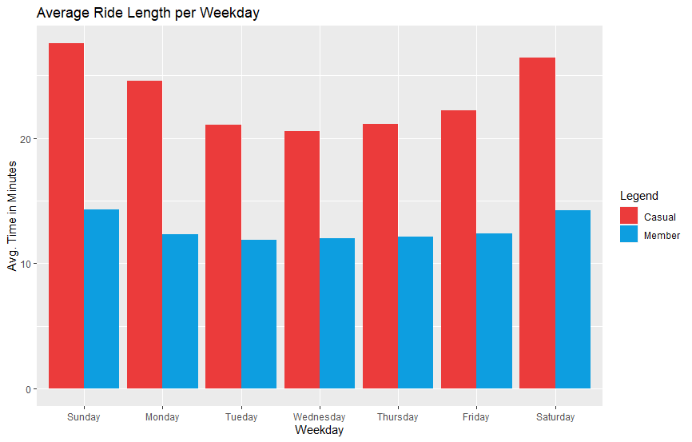
Average Ride Length per Day
Casual riders ride roughly twice as long compared to membership holders, with longer ride lengths on weekends.
Again, membership ride length averages are more consistent throughout the week.

Slide 13
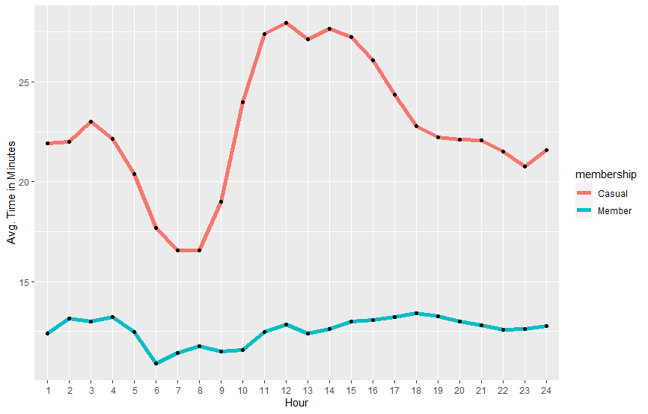
Zooming in to Ride Length on an Hourly Basis
Casual ridership times dip in the morning hours and spike during the noon to evening hours.
Riders with memberships follow more consistent riding patterns throughout the day.

Slide 14
Conclusions : Casuals
There are more casual riders in the summer
Casual ridership is very low in the winter months
Casual riders ride more often on weekends
Ride more in the afternoon/evening and less during the early morning
Casual riders ride a significantly longer time when compared to members

Slide 15
Conclusions : Members
Ride consistently throughout the year
Ride shorter but more consistent times when compared to casuals
Mostly ride in the middle of the week

