Slide 1
Climate Change – CO2 Emissions
Jason Hernandez
Jason Fung
Kevin Lee

Slide 2
Data Exploration
Data Source primarily from World Bank
API_EN.ATM.CO2E.PC_DS2_en_csv_v2_713061.csv – CO2 Emissions
API_NY.GNP.PCAP.CD_DS2_en_csv_v2_714122.csv – National Income
API_GNI_CLASS.csv – Income Categories
API_NY.GDP.MKTP.CD_DS2_en_csv_v2_713242.csv – GDP
API_SP.POP.TOTL_DS2_en_csv_v2_713131.csv – Population

Slide 3
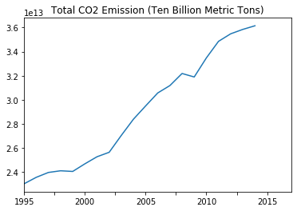
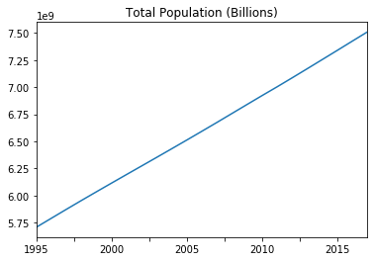
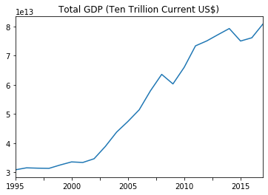
CO2 Emission Over Time
Total world CO2 emissions, population, and GDP

Slide 4
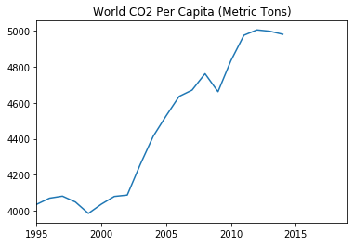
CO2 Per Capita Over Time
We noticed that CO2 emissions peaked in 2013, and slightly tapered off from then. Unfortunately, this dataset ended with 2014.

Slide 5
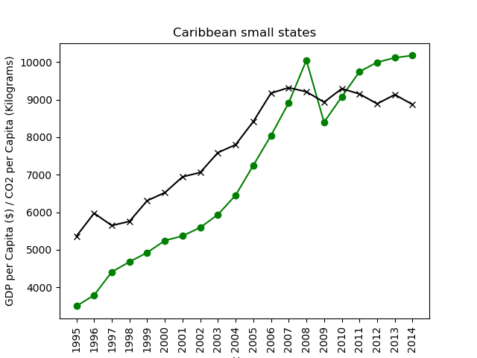
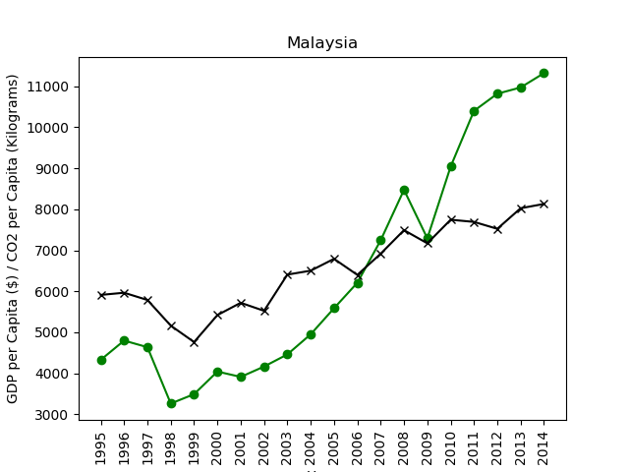
Individual countries show very different patterns

Slide 6
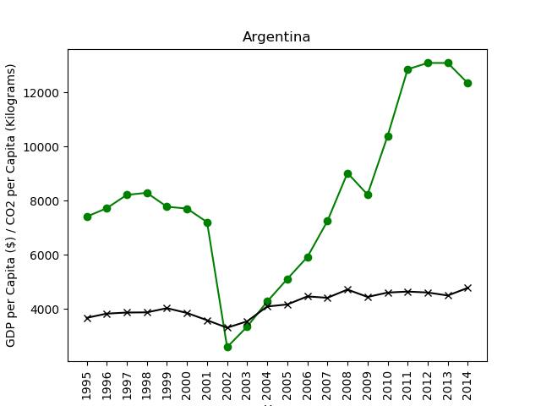
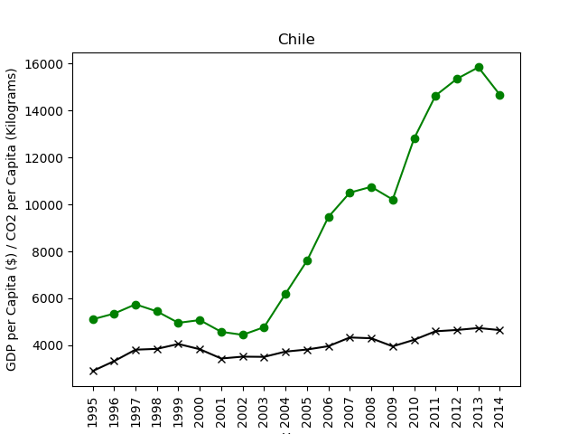
Individual countries show very different patterns

Slide 7
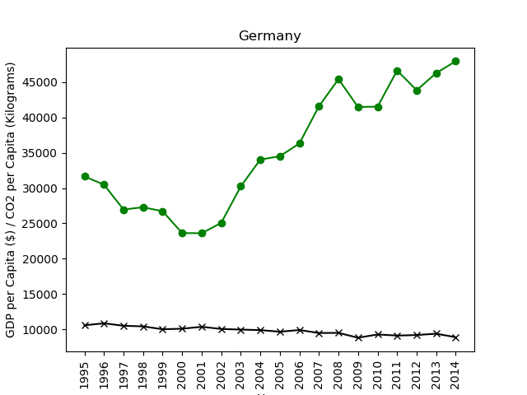
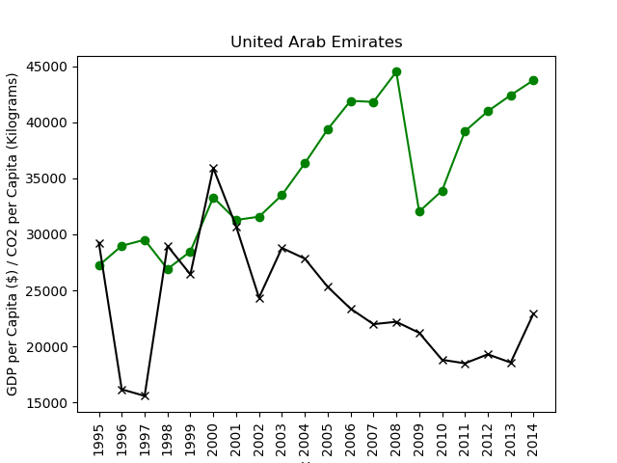
Individual countries show very different patterns

Slide 8
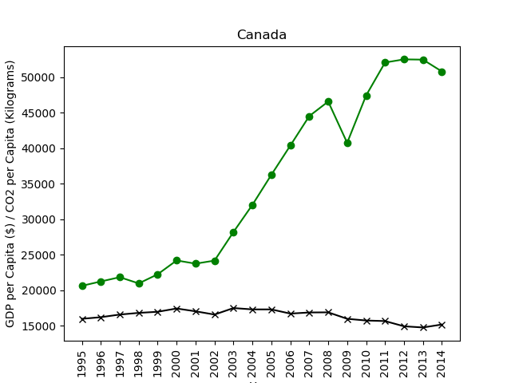
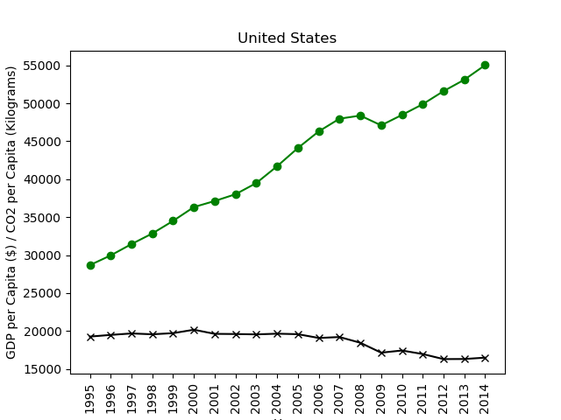
Individual countries show very different patterns

Slide 9
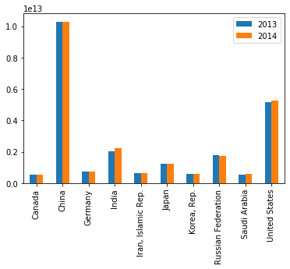
Top 10 CO2 Emitting Countries, total emissions
Chart of Bar Graph

Slide 10
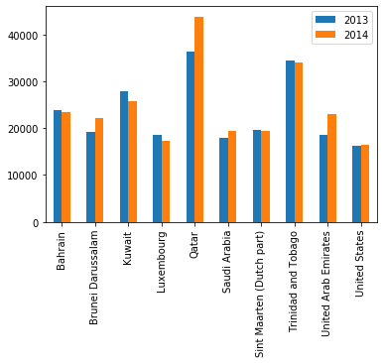
Top 10 CO2 Emitting Countries, per capita
Chart of Bar Graph

Slide 11
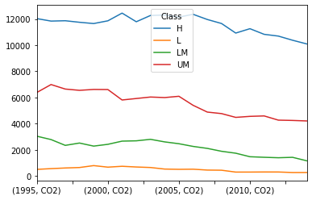
How do CO2 emissions change in countries of different income levels?
As expected, CO2 emissions correlate with national income, with the highest income countries also having the highest emissions.
On the other hand, per capita CO2 has been declining even as total CO2 has increased, and the decline appears most pronounced in the highest income countries. However, it is difficult to see the decline in the lowest income countries. So let us look at the income classes separately.

Slide 12
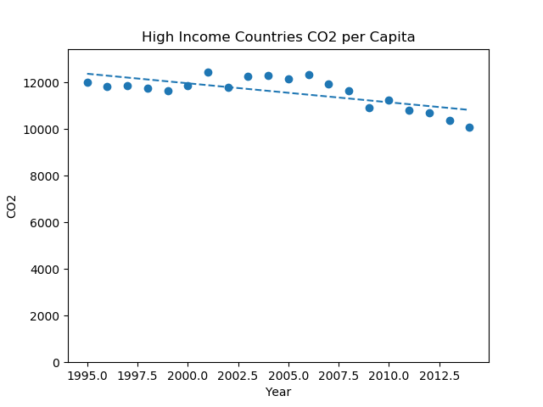
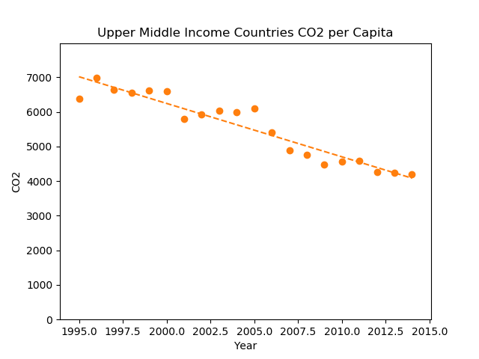
Comparing high and upper-middle income countries

Slide 13
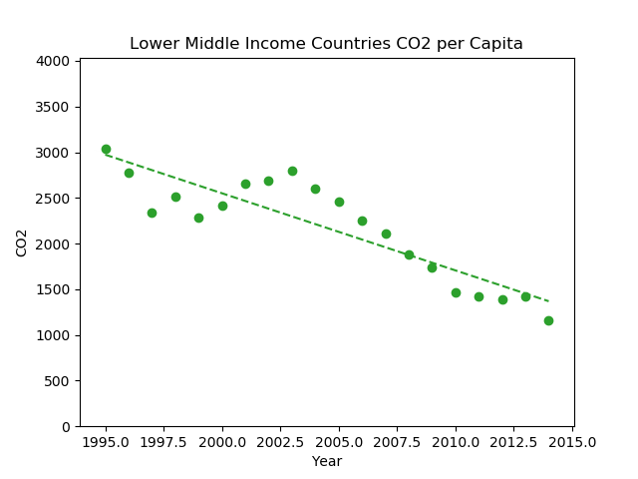
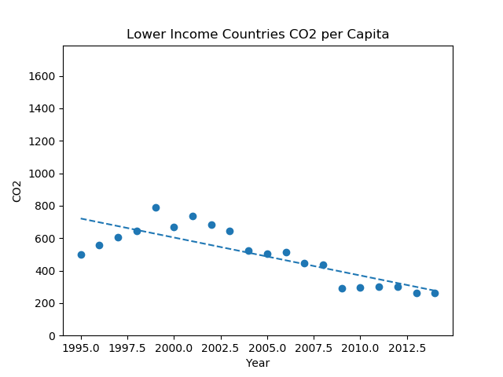
Comparing lower-middle and low income countries

