Slide 1


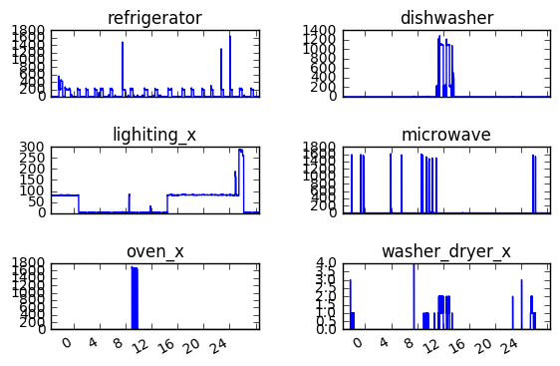
ENERGY SIGNAL DISAGGREGATION AND CLASSIFICATION
EJ Baik, Jason Hu, Srinikaeth Thirugnanasambandam
DEPARTMENT OF ENERGY RESOURCES ENGINEERING, STANFORD UNIVERSITY
Introduction
Methods
Disaggregation - Results
Appliance-specific energy usage feedback provides consumers with a better understanding of the impact of their consumption behavior, and may lead to behavioral changes that improve energy efficiency.
Energy disaggregation (also referred to as non-intrusive load monitoring) is the task of inferring individual loads of the system from an aggregated signal.
Once a signal is disaggregated, the signals need to be classified according to the appropriate appliance.
With the increasing interest in energy efficiency and recent relevance of machine learning, there is a lot of potential for both predicting and classifying appliance-specific load signals using a wide range of machine learning algorithms.
Disaggregation
Classification - Results
Dataset
Figure 2. House 1 and House 3 appliance loads over one day
Figure 1. House 1 appliance loads over one day
Use Reference Energy Disaggregation Data Set (REDD) dataset
Appliance specific consumption data from six households
Data collected every 3 seconds over the course of 6-10 days
3 Different Types of Classification
Type 1: Train and test on House 1 data
Type 2: Train and test on aggregated House 1 and House 3 data
Type 3: Train on House 1 and test on House 3 data
Feature Extraction
Conclusions
 | Type 1 | Type 2 | Type 3
Training Set Error | 0.811 | 0.565 | 0.211
Test Set Error | 0.810 | 0.566 | 0.810
Energy signal classification was conducted using softmax regression
Type 1 results indicate that softmax regression may be an effective method of energy signal classification
Type 2 and especially Type 3 results highlight the difficulties of energy disaggregation and classification over a wide range of houses due to distinct individualities
References
Krevor, S. C. M., Pini, R., Zuo, L. and Benson, S. M. (2012) Relative permeability and trapping of CO2 and water in sandstone rocks at reservoir conditions. Water Resources research, v. 48, W02532.
CS 229 Poster Session, Machine Learning, Fall 2017 – 12 December 2017

