Slide 1
Bug #54
If a home , auto and personal loan are taken out by Tom, 3 versions of Tom appear in the database.

Slide 2

Resources
github.com/isidore/Talks/blob/master/Peel_and_Slice.md
Notes:
https://github.com/isidore/Talks/blob/master/Peel_and_Slice.md#peel-and-slice

Slide 3
Fixing Legacy Code
run it
Computer
Reproduce
Logger
Debugger
Head
Read
Printout
Refactor

Slide 4
The Peel

Slide 5
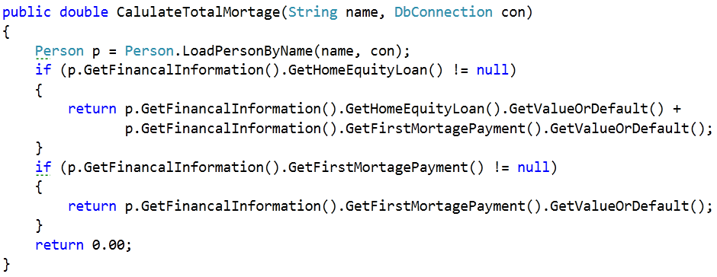

Slide 6
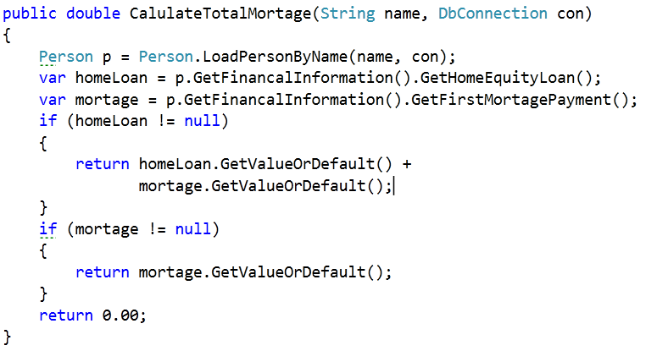

Slide 7
public double calculateTotalMortgage(String name, Connection con)
{
Person p = Person.loadPersonByName(name, con);
double total = 0.00;
if (p.getFinancalInformation().getHomeEquityLoan() != null)
{
total = p.getFinancalInformation().getHomeEquityLoan()
+ p.getFinancalInformation().getFirstMortagePayment();
}
else if (p.getFinancalInformation().getFirstMortagePayment() != null)
{
total = p.getFinancalInformation().getFirstMortagePayment();
}
return total;
}

Slide 8
public double calculateTotalMortgage(String name, Connection con)
{
Person p = Person.loadPersonByName(name, con);
Double homeEquityLoan = p.getFinancalInformation().getHomeEquityLoan();
Double firstMortagePayment =p.getFinancalInformation().getFirstMortagePayment();
double total = 0.00;
if (homeEquityLoan != null)
{
total = homeEquityLoan + firstMortagePayment;
}
else if (firstMortagePayment != null)
{
total = firstMortagePayment;
}
return total;
}

Slide 9
The Slice
return sample

Slide 10
public void escalateProblems(Loan[] loans, Connection conn)
{
for (Loan loan : loans)
{
if (loan.isOverDue() && (loan.getAmount() > 5000))
{
loan.saveStatus("Critical", conn);
}
else if (loan.isOverDue() && (loan.getAmount() > 50))
{
loan.saveStatus("Escalated", conn);
}
}
}

Slide 11
return sample
return sample

Slide 12
Pop Quiz: Question 1
When called with “ntsc” as the TvType, What does the code do?
Creates 30 Frames #30 – 0
Run it to find out

Slide 13
Pop Quiz: Question 2
To get this code to run, how should you handle web.Request.Params["TvFormat"]
Peel
Slice

Slide 14
Pop Quiz: Question 3
To get this code to run, how should you handle maker.CreateFrame("" + i);
Peel
Slice

Slide 15
Resources
VS 2010 / MsTest / Code Coverage
Mock Utility : RhinoMock http://www.ayende.com/projects/rhino-mocks.aspx

Slide 16
Resources
Eclipse/ Junit
EclEmma Code Coverage
EasyMock
YouTube - http://lfal.co/PeelAndSlice

Slide 17
Resources
github.com/isidore/Talks/blob/master/Peel_and_Slice.md
Notes:
https://github.com/isidore/Talks/blob/master/Peel_and_Slice.md#peel-and-slice

Slide 18


Contact
@Jason Kerney
Jason.kerney@gmail.com
@Llewellyn Falco
llewellynfalco.blogspot.com

