Slide 1
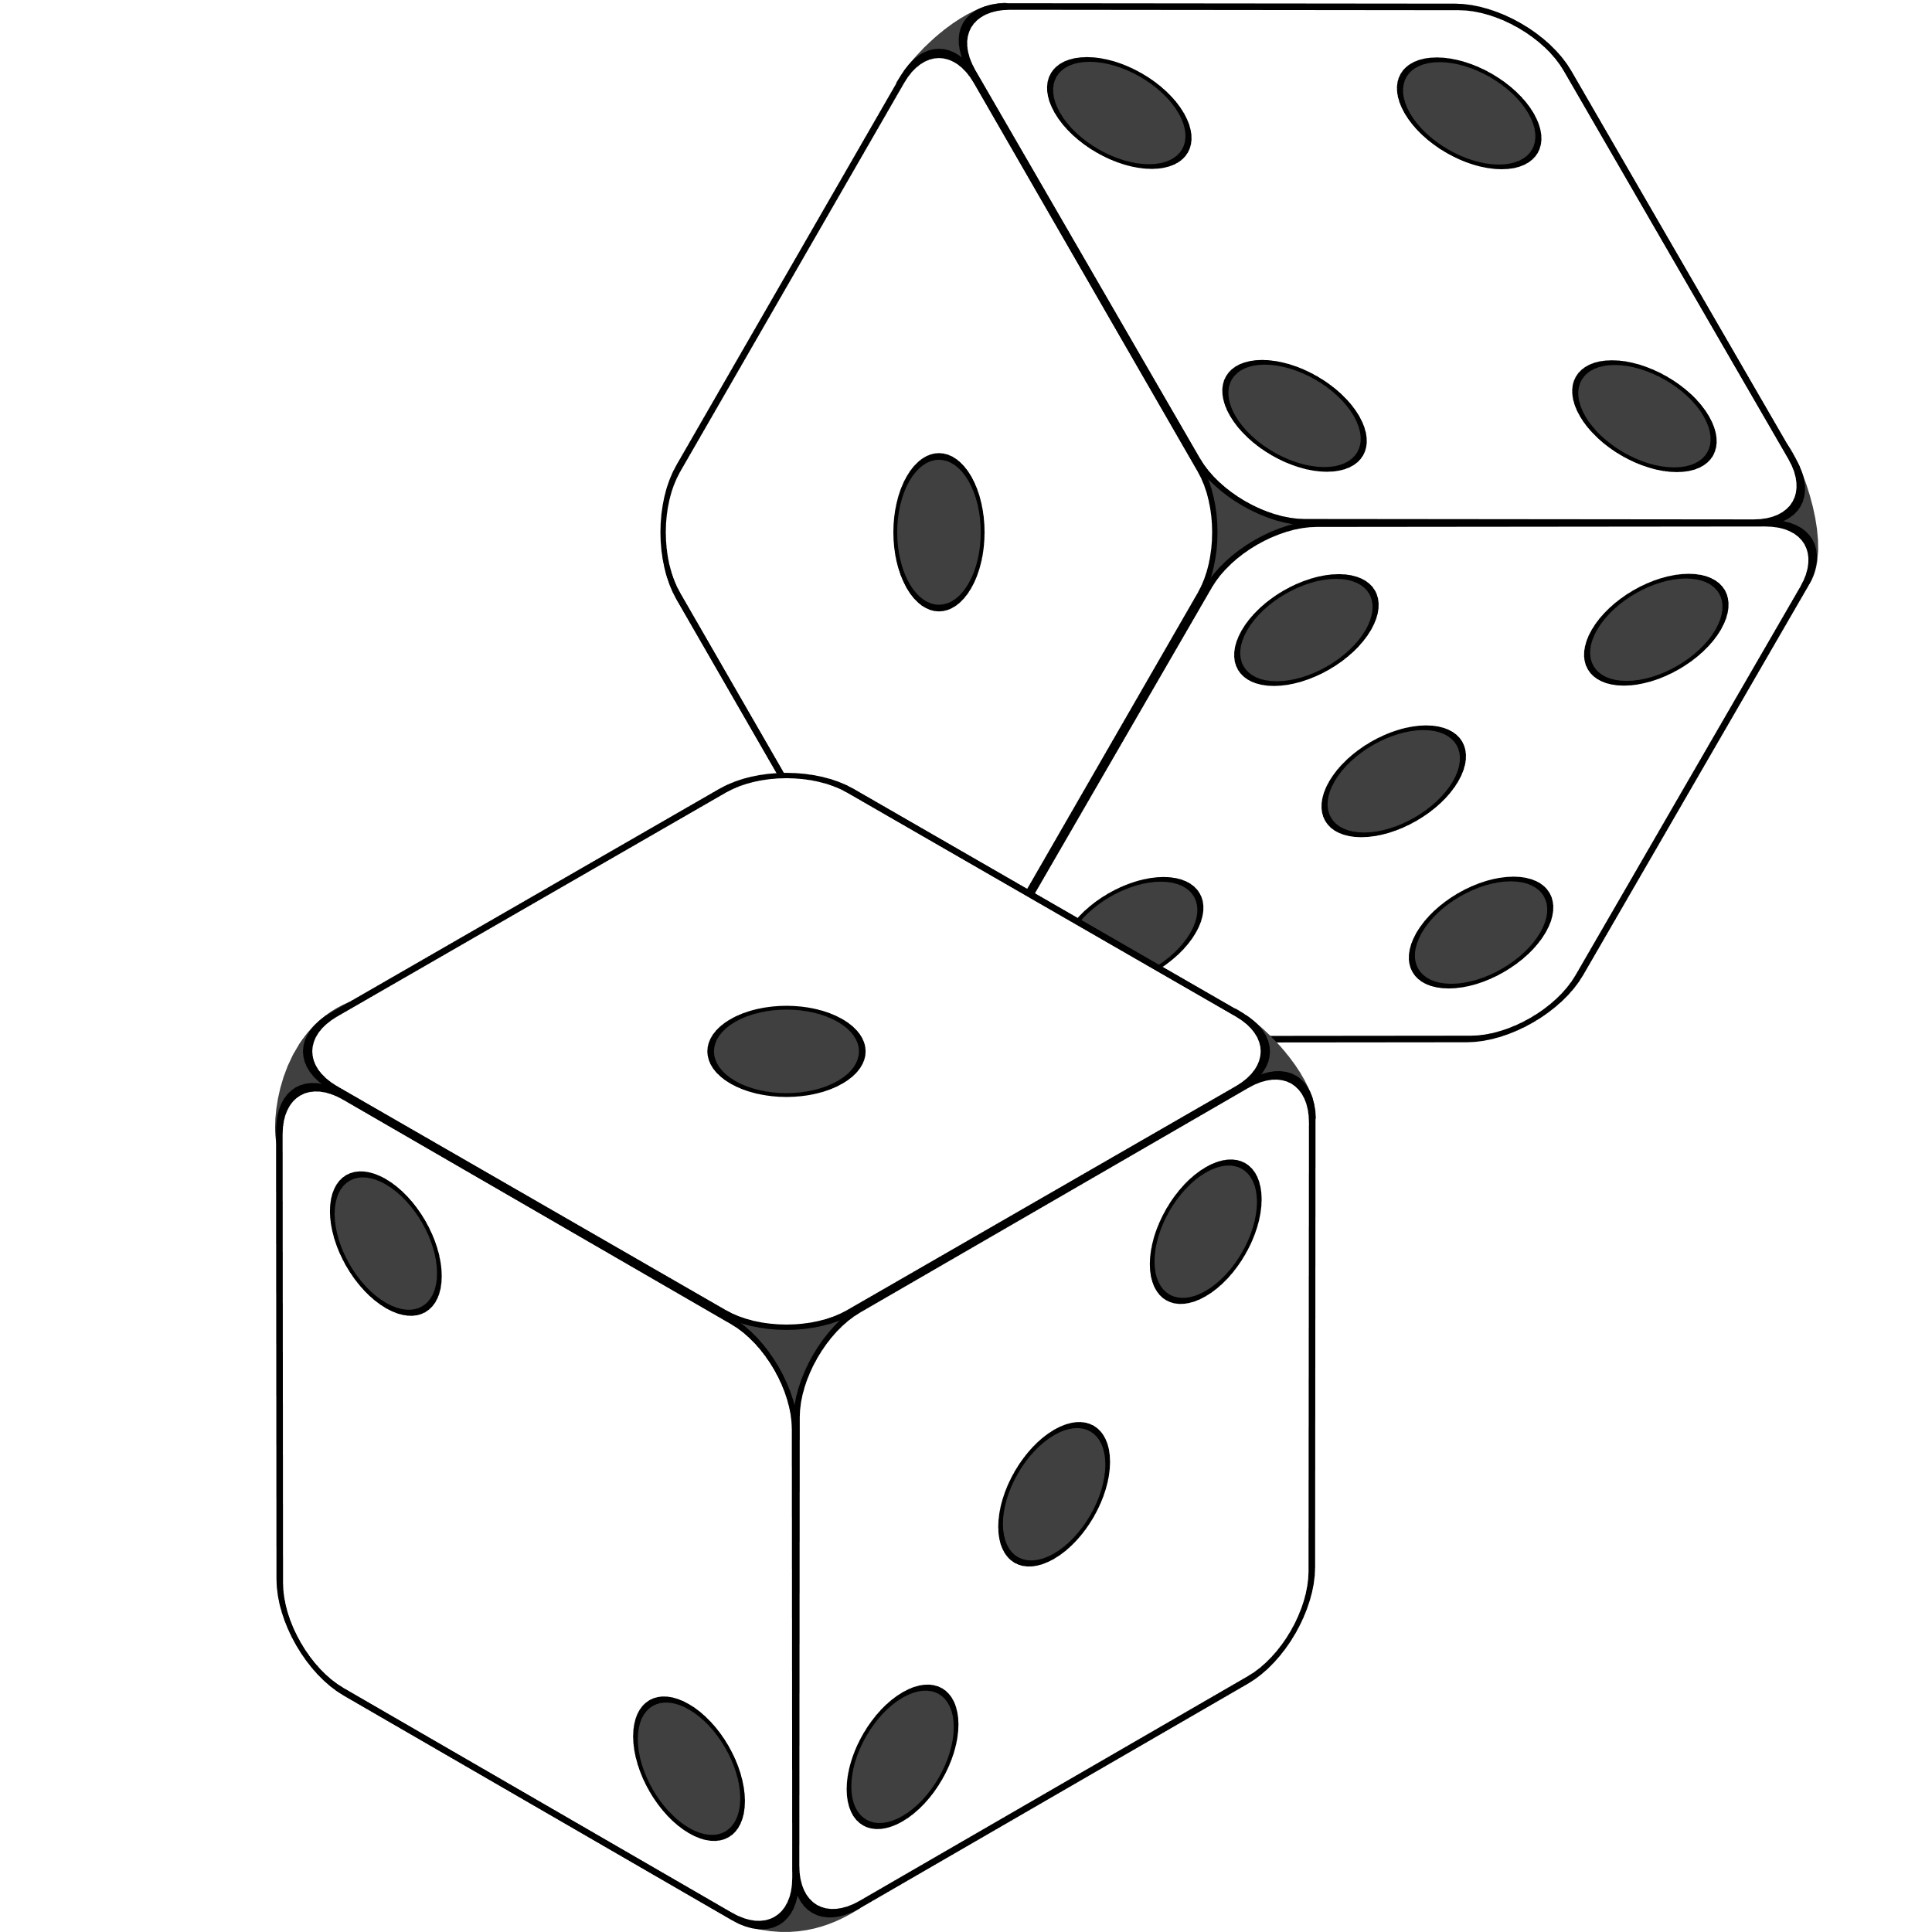

Game Type: Name
?
Global Game Requirements
Must be playable (a win or tie condition is possible).
Must be explainable (can be taught, learned, and demonstrated).
Must be fun and engaging for players.
2 – 6 players.
Must be original. (Variations of known games are permitted but must feel original)
Must have a unique name.
Name Game Requirements
The game must have a ….
For a game to be won ….

Slide 2

Game Type: Cooperative
Game Type: Speed
Game Type: Traditional
Game Type: Knockout
Global Game Requirements
Global Game Requirements
Global Game Requirements
Global Game Requirements
Must be playable (a win or tie condition is possible).
Must be playable (a win or tie condition is possible).
Must be playable (a win or tie condition is possible).
Must be playable (a win or tie condition is possible).
Must be explainable (can be taught, learned, and demonstrated).
Must be explainable (can be taught, learned, and demonstrated).
Must be explainable (can be taught, learned, and demonstrated).
Must be explainable (can be taught, learned, and demonstrated).
Must be fun and engaging for players.
Must be fun and engaging for players.
Must be fun and engaging for players.
Must be fun and engaging for players.
2 – 6 players.
2 – 6 players.
2 – 6 players.
2 – 6 players.
Must be original. (Variations of known games are permitted but must feel original)
Must be original. (Variations of known games are permitted but must feel original)
Must be original. (Variations of known games are permitted but must feel original)
Must be original. (Variations of known games are permitted but must feel original)
Must have a unique name.
Must have a unique name.
Must have a unique name.
Must have a unique name.
Cooperative Game Requirements
Speed Game Requirements
Traditional Requirements
Knockout Requirements
The game must have a win/lose condition for all players together.
The game must have a win condition for a single player.
The game must have a win condition for a single player.
The game must have a win condition for a single player.
For a game to be won, each player must have taken an action.
Win condition must be encouraged by speed of reaction of players.
For a game to be won, each player must have taken an action.
The win condition must be encouraged through directly impacting another player’s ability to win.
Ties are allowed.
Ties are allowed.
Ties are allowed and result in everyone losing.

Slide 3
Game Type: Team vs Team
Game Type: One vs Many
Global Game Requirements
Global Game Requirements
Must be playable (a win or tie condition is possible).
Must be playable (a win or tie condition is possible).
Must be explainable (can be taught, learned, and demonstrated).
Must be explainable (can be taught, learned, and demonstrated).
Must be fun and engaging for players.
Must be fun and engaging for players.
2 – 6 players.
2 – 6 players.
Must be original. (Variations of known games are permitted but must feel original)
Must be original. (Variations of known games are permitted but must feel original)
Must have a unique name.
Must have a unique name.
Team vs Team Requirements
One vs Many Requirements
The game must have a win condition for a single team.
The game must have a win condition for the solo player.
For a game to be won, each team must have taken an action. (Actions may be performed by the team, or as individuals in the team.)
The game must have a win condition for the team.
Ties are allowed and result in the solo player winning.
Ties are allowed.

