Slide 1
TermProject_Presentation
Chien Lin Jason Nero Sarah Sublett - Group 1

Slide 2
Ever Go to a Boxing Match and a Hockey Game Breaks Out?
Or an Exploration into the Incidence of Fights in Professional Hockey Games.
Chien Lin
Jason Nero
Sarah Sublett
DSCI 445 - Group 1
5 December 2022

Slide 3
Motivation
General interest in the impact of fines imposed by the NHL to curb fighting during professional hockey games.
Fighting at the professional level encourages similar behavior in junior leagues, and fighting can lead to serious injuries.

Slide 4
Data
Utilizing fight data from hockeyfights.com and general hockey statistics from hockeydb.com and hockey-reference.com
Refined fight data to years 2017-2021 due to incomplete data
Initial data set included over 2000 entries and was refined to 156 entries
Each entry represents the number of fights each team had per year evaluated
32 teams in the NHL
1,312 games per regular season, with each team playing 82

Slide 5
Variables Evaluated
Total fights
Years
Teams
Goals (for, against, total)
Season (pre, regular, and post)
Attendance
Win, Loss, and Win/loss percentage
Overall NHL ranking per season
Points (combination of goals and assists)

Slide 6
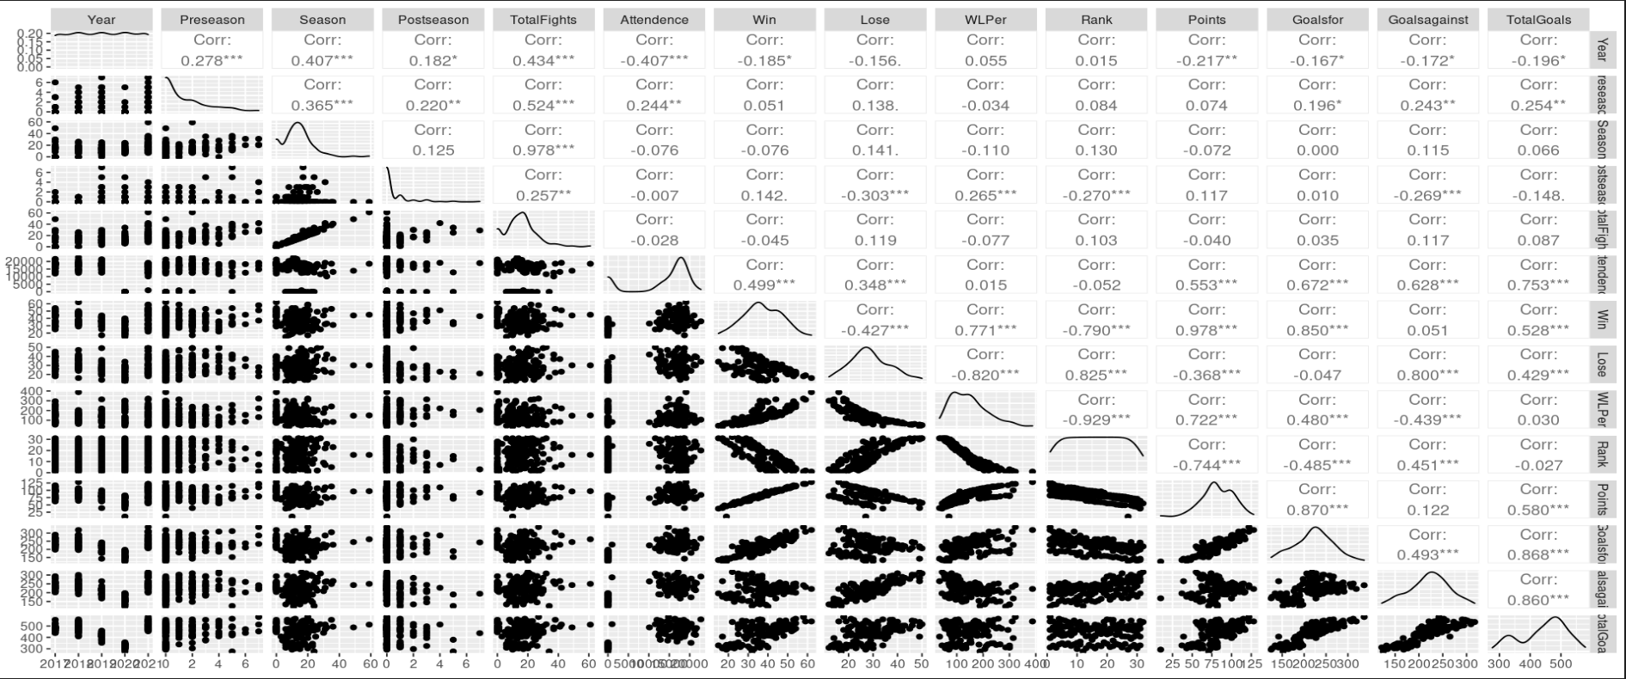
Correlation map
Correlation Map of all Variables

Slide 7
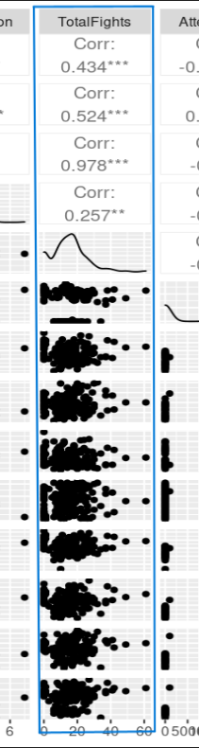
Zoom in of Correlation Map
Total fights correlation

Slide 8
Application of DSCI 445 Concepts
Utilized:
ggplot
lm
splitting dataset to train and test
Ridge regressions
adjusted R-squared
BIC
Cross Validation!

Slide 9
Challenges with Data
Readily available or consolidated data, had to combine multiple sources to form dataset
Several teams were created during the time frame, creating incomplete information
Utilized omit.na code to compensate
pre-fight, post-fight, and in-season fighting
availability of more information on the specifics of the fight (time in the game, type, number of people in the fight, instigator versus respondent of the fight, etc).

Slide 10
Findings
It could appear that none of the variables are statically significant, with the exception of the fights subcategories, which makes sense Totalfights is based on them.
Surprisingly, Montreal Canadians, during the initial look, appeared to be statistically significant, yet in more robust analysis, it was not.
Year/TotalFights: Interesting to see that in 2020 there was no physical attendance due to COVID restrictions; fights still occurred and in somewhat in line with other years.

Slide 11
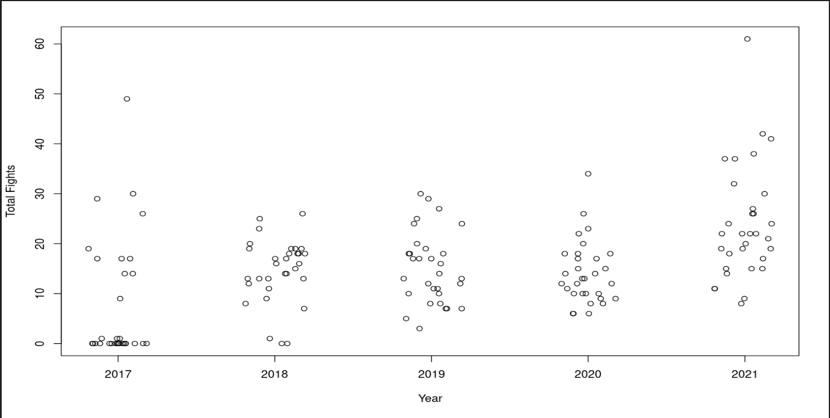
Plots of Interest
Fights per Year

Slide 12
Future Work
Explore additional variables and develop or acquire a more robust dataset to perhaps look at different violations and the impact of the fines on fighting.
More time to further evaluate the data.

Slide 13
References
Hockey fight statistics. Hockey Fights. (n.d.). Retrieved December 2, 2022, from https://www.hockeyfights.com/stats
Hockey statistics and history for the NHL and more! hockey DB. (n.d.). From https://www.hockeydb.com/
NHL stats, history, scores, standings, playoffs, Schedule & Records. Hockey. (n.d.). From https://www.hockey-reference.com/

