Slide 1
GSERM: Text Mining & NLP R Basics
June 17, 2019
Ted Kwartler

Slide 2









Introduction
Education
https://www.linkedin.com/in/edwardkwartler/
Work
Side Hustles

Slide 3
Agenda – all times are suggested
Start | End | Monday - June 17
8:45 | 9:15 | Coffee
9:15 | 10:15 | Syllabus, Intro to R, R Setup
10:15 | 10:30 | Break
10:30 | 12:00 | What is TM? String Manipulation Keyword Search & Density Misspelling
12:00 | 1:30 | Lunch
1:30 | 2:00 | Bag of Words tm Class & Functions qdap Functions Lemmatization Meta-Document Information
2:00 | 2:30 | WFM
2:30 | 3:15 | Lab: Clean a corpus of tweets & construct WFM

Slide 4
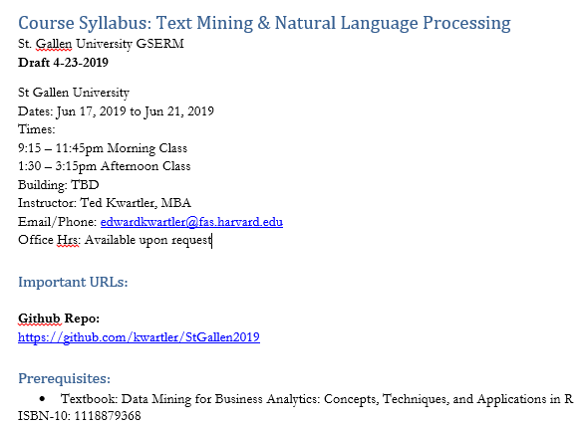
Syllabus Review

Slide 5
Intro to R
Learning Objectives
What is R?
What is R Studio?
Scripting Structure in this course
Why? This ensures a basic fluency before the course really starts.

Slide 6

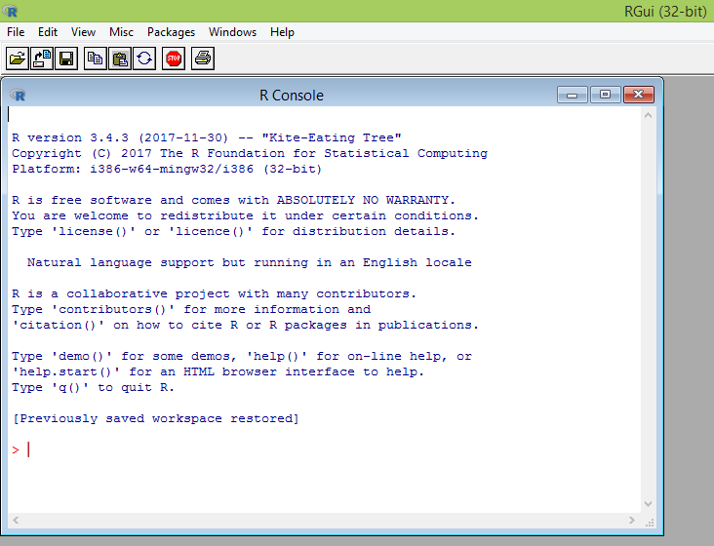
What is R?
Flexible
Open source
Academic & growing in industry
Language agnostic, SQL, Weka, C, Fortran, Java etc
R is a language & environment for statistical computing and graphics. It is the most popular statistical software in circulation today, and is used by more than 2 million data scientists & statisticians worldwide.
How Companies Use R to Compete in a Data-Driven World, Data-informed.com

Slide 7

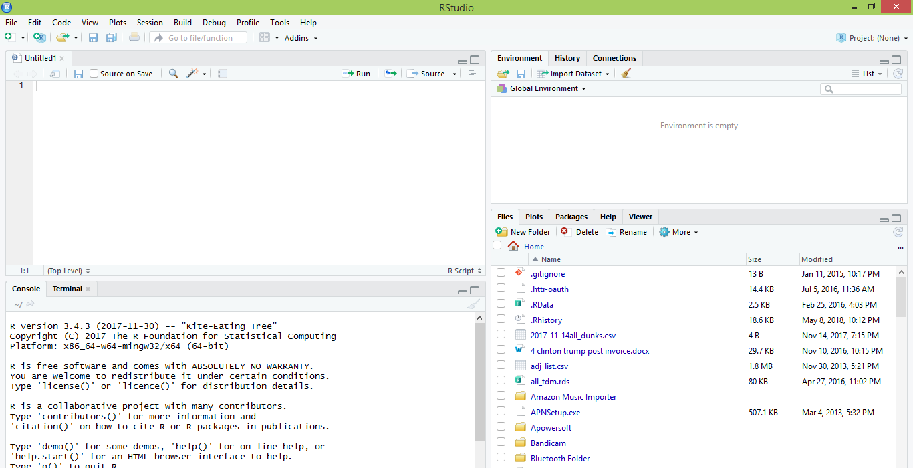
What is R Studio?
IDE – Integrated Development Environment
Adds additional functionality e.g. git, shiny projects, markdown templates
R studio is the most popular IDE for R although there are others & you don’t actually need it to execute R code.

Slide 8
What is the relationship between R & R studio?
Nice interface & additional functionality for faster programming, analysis & production.
Statistical & graphing software
R Studio sits atop of the installed R version. Without base R, R studio cannot function. By programmatically accessing base R, R Studio improves the interface and functionality.

Slide 9
R Studio has four main panes
Scripting
Environment
Commands are written & adjusted here then executed in the console. Then saved for future quick execution.
List of objects & values
e.g. loaded “excel” files
Files, Plots, Packages, Help
Console
Find files, load packages, see visualizations and quickly find help
Execution of scripts and commands, data exploration and code results
R Studio works on Linux, Windows and iOS.

Slide 10
R: Where is it being used?
Media
Google
Facebook
Twitter
Foursquare
Kickstarter
New York Times
Economist
Services
Zillow
Trulia
eHarmony
DataSong
PredictWise
Nationwide
Finance
Lloyd’s Bank
Credit Suisse
American Century
Australia and New Zealand Banking Group
Technology
SAS
Oracle
IBM
Teradata
Coursera
SAP
DataCamp
Alteryx
TIBCO
OneTick
Amazon
Google
Microsoft
U.S Government
Food & Drug
Administration
National Weather
Service
National Institute
of Standards
in Technology
R is ubiquitous in various industries used for analysis, prototyping and visualization. However, more often python is used in production environments.

Slide 11
Ok, it’s awesome but…
Pros
Cons
VERY extensible
10K+ packages
Built by stats, made for stats
Free, open source
Cutting edge
Diverse applications
Outstanding graphical capabilities
Large community based help
Tough to do “big data”
In memory data constraints w/o extra effort
Official documentation is terse
Not as polished as a commercial application
Slow compared to lower level languages
Production worthy apps can be difficult to create
Large community based help

Slide 12
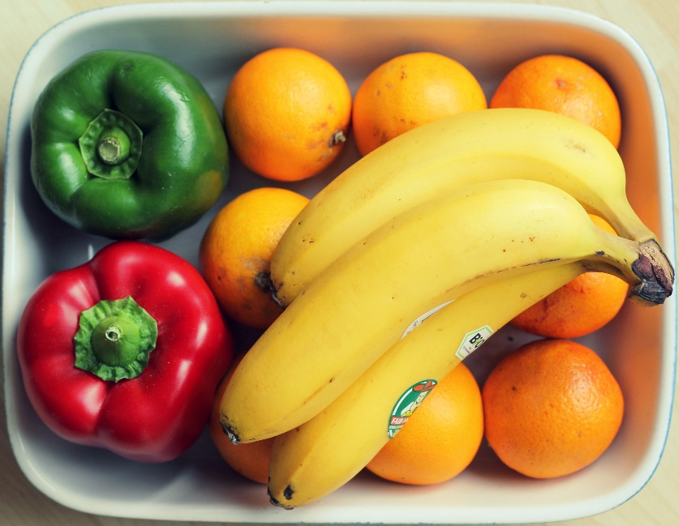
A basic R workflow
Let’s eat a banana for breakfast. Where is the fruit?
setwd(‘ted/fruit/basket’)
The item of interest needs to be in the “working directory”

Slide 13
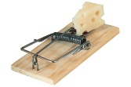
R Trap!
WINDOWS (local laptop):
In setwd() the slashes have to be switched (or “escaped”)!
setwd("~/desktop")
> setwd("~\desktop")
Error: '\d' is an unrecognized escape in character string starting ""~\d"

Slide 14

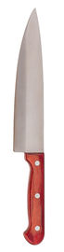
R uses functions, libraries & objects
Found the fruit basket! What tools do I need?
setwd(“ted/fruit/basket”)
library(knife)
library(peel)
Change R into a breakfast preparing machine with specialized libraries.

Slide 15

Another trap!
Before loading a library use
install.packages(“name of package”).
You only need to do this once per environment
But, will need to repeat it w/each new environment!

Slide 16

R uses functions, libraries & objects
Now R is a cutting & peeling machine, let’s pick our fruit.
setwd(“ted/fruit/basket”)
library(knife)
library(peel)
banana <- read.fruit(“Banana.csv”)
Must
Be In the working directory or full path declared
Be inside quotes
Have correct capitalization, spacing & spelling matter.
R now has the object called banana in memory ie “opening a spreadsheet”

Slide 17

What if my file is Excel or ???
R can open many files types with different functions
CSV
Excel
SaS
SPSS
Rds, rda, fst etc
Connections
Databases (SQL, mongoDB)
S3 Buckets
APIs
Recommendation: to get started stick with CSV. Most software can export CSV.

Slide 18
R uses functions, libraries & objects
Function
Input
Output
R uses predefined functions to accomplish things.

Slide 19

R uses functions, libraries & objects
halfBanana <- cutinhalf(banana )
Output
Function
(
Input
)
“ <- ” is the assignment operator

Slide 20


R uses functions, libraries & objects
setwd(“ted/fruit/basket”)
library(knife)
library(peel)
banana <- read.fruit(“Banana.csv”)
halfBanana <- cutinhalf(banana )
halfBanana <- peel ( halfBanana)
Output
Function
(
Input
)
Results of an object can be used in the next function.

Slide 21
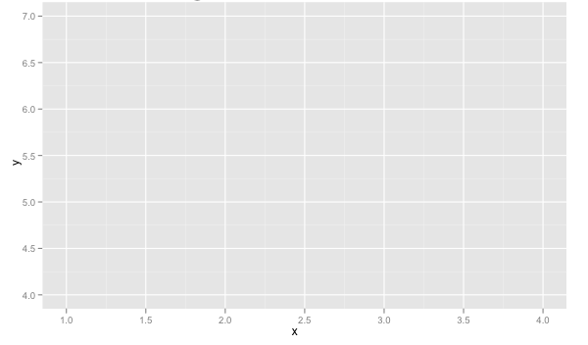
R uses functions, libraries & objects
setwd(“ted/fruit/basket”)
library(knife)
library(peel)
banana <- read.fruit(“Banana.csv”)
halfBanana <- cutinhalf(banana)
halfBanana <- peel(halfBanana)
plot(halfBanana)
Function
(
Input
)
You don’t always have to declare an output object & you can also save items to disk.

Slide 22




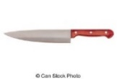

Workflow review
1
Use setwd() to point to your files & where to save outputs.
2
Load some customized libraries with library() for your specific analysis and methodology. Sometimes we will also create customized functions not in a library to aid our analysis.
3
Read in the file so the object is “in-memory” with read.csv() or similar.
4
Apply a function(s) from a library to adjust or create new objects in memory. The pseudo code for this is:
object<-function(applied to object)
5
Consume the results by saving, plotting etc.

Slide 23
Agenda – all times are suggested
Start | End | Monday - June 17
8:45 | 9:15 | Coffee
9:15 | 10:15 | Syllabus, Intro to R, R Setup
10:15 | 10:30 | Break
10:30 | 12:00 | What is TM? String Manipulation Keyword Search & Density Misspelling
12:00 | 1:30 | Lunch
1:30 | 2:00 | Bag of Words tm Class & Functions qdap Functions Lemmatization Meta-Document Information
2:00 | 2:30 | WFM
2:30 | 3:15 | Lab: Clean a corpus of tweets & construct WFM

Slide 24
2 Options for R
Local Laptop
Cloud
OS:
Mac
Linux/Ubuntu
Windows
OS:
Linux/Ubuntu is most popular
Considerations:
Limited to RAM on laptop
No troubleshooting by prof
Considerations:
RAM is scalable
Cost
Requires technical fluency (command line)
Troubleshooting from prof

Slide 25
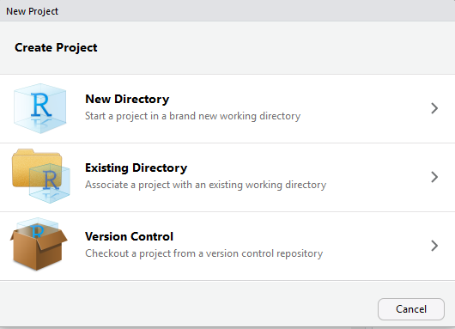
If LOCAL: setup a new project & do a “git pull”
https://github.com/kwartler/StGallen2019
In R Studio
File
New Project…
Version Control

Slide 26
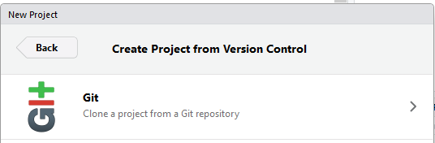
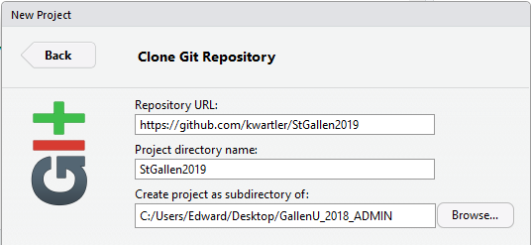
If LOCAL: setup a new project & do a “git pull”
https://github.com/kwartler/StGallen2019
In R Studio
File
New Project…
Version Control
Select Git
Add URL, folder name & destination for files

Slide 27

If LOCAL: setup a new project & git pull
https://github.com/kwartler/StGallen2019
In R Studio
File
New Project…
Version Control
Select Git
Add URL, folder name & destination for files
EACH Class session perform a Git Pull to update files
Since we are using git, use “Save As” on your scripts in a different directory to avoid conflicts.

Slide 28
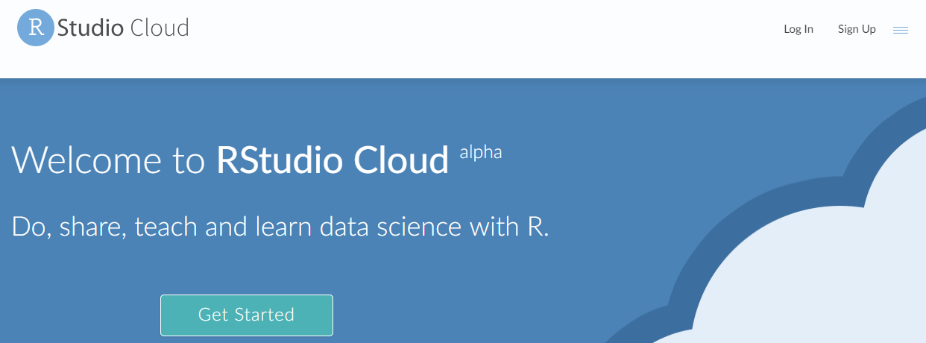
Easiest for this class…free hosted cloud instance
Sign up at:
https://rstudio.cloud/
Instructions for Set up can be found here:
https://github.com/kwartler/StGallen2019/blob/master/Rstudio_Cloud_Instructions.docx

Slide 29
Libraries to install…we cover a lot in this course.
Please review the readme file of the Student repo!!

Slide 30
Break
15 minute break while packages install.
Come ask the prof if you have issues/questions.

Slide 31
Agenda – all times are suggested
Start | End | Monday - June 17
8:45 | 9:15 | Coffee
9:15 | 10:15 | Syllabus, Intro to R, R Setup
10:15 | 10:30 | Break
10:30 | 12:00 | What is TM? String Manipulation Keyword Search & Density Misspelling
12:00 | 1:30 | Lunch
1:30 | 2:00 | Bag of Words tm Class & Functions qdap Functions Lemmatization Meta-Document Information
2:00 | 2:30 | WFM
2:30 | 3:15 | Lab: Clean a corpus of tweets & construct WFM

Slide 32
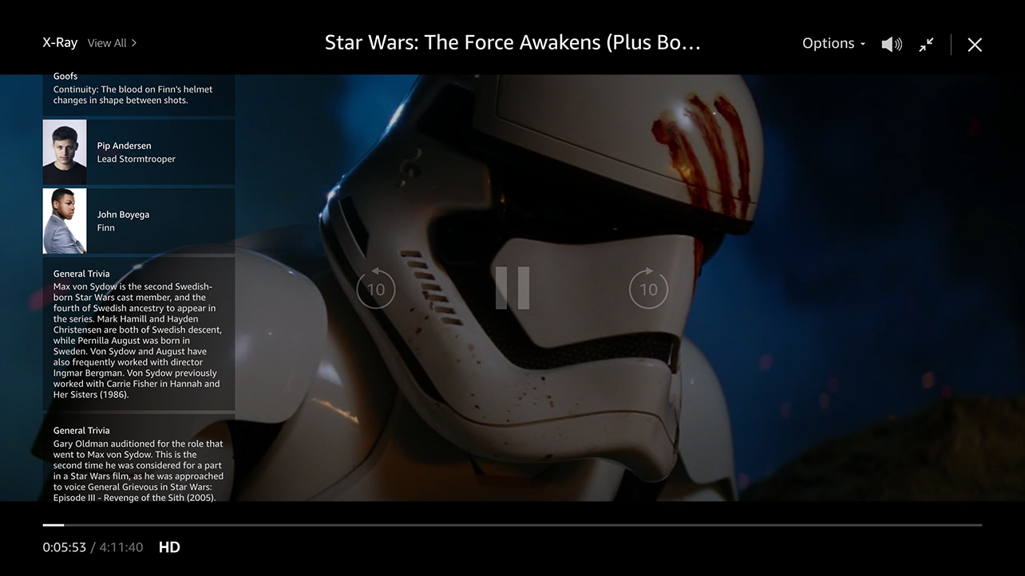
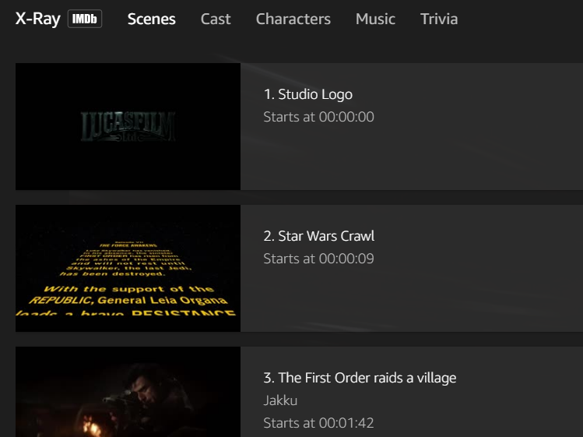
Amazon X-Ray: A basic R-Script
Left Hand Screen:
Actor Information & Trivia
Center “Pop-over” Screen:
Scenes, Cast, Characters, Music & Trivia

Slide 33
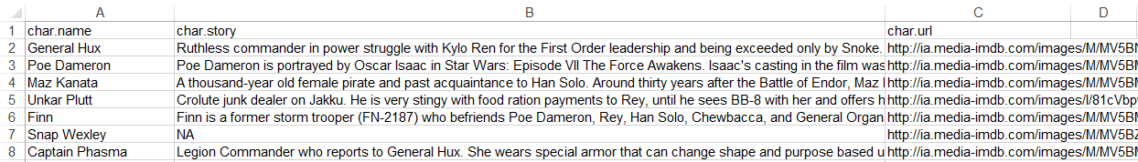
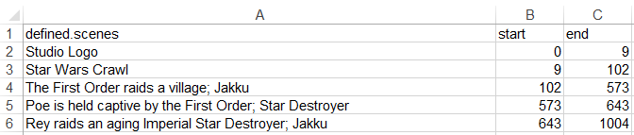
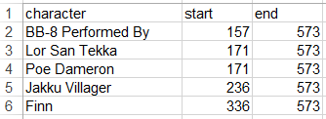
Let’s explore Amazon’s x-ray feature
Character Background
Official Scenes
Character Appearances

Slide 34



Let’s practice!
Open A_Amazon_Xray.R
Your choice!
Learning Outcome: Following a consistent workflow, load, clean, & analyze real data with multiple data types to establish basic familiarity.

Slide 35
Do or Do Not There is No Try…

Slide 36
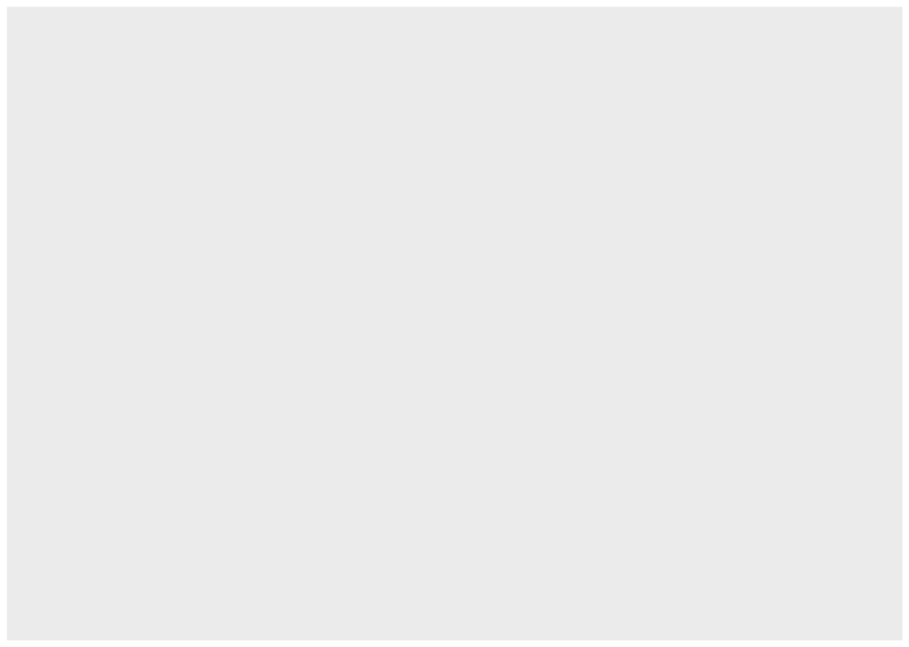
ggplot2 is the grammar of graphics
ggplot(scenesDF, aes(colour=scenesDF$name))
Layers are declared and added in sequence to construct a visual.

Slide 37
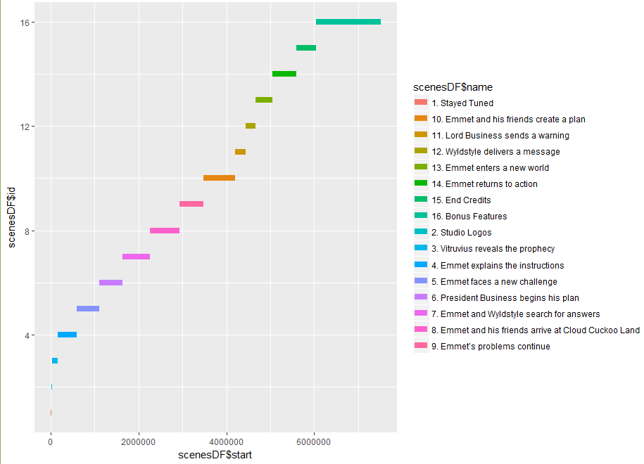
ggplot2: adding a layer
ggplot(scenesDF, aes(colour=scenesDF$name)) +
geom_segment(aes(x=scenesDF$start, xend=scenesDF$end,
y=scenesDF$id, yend=scenesDF$id),size=3)

Slide 38
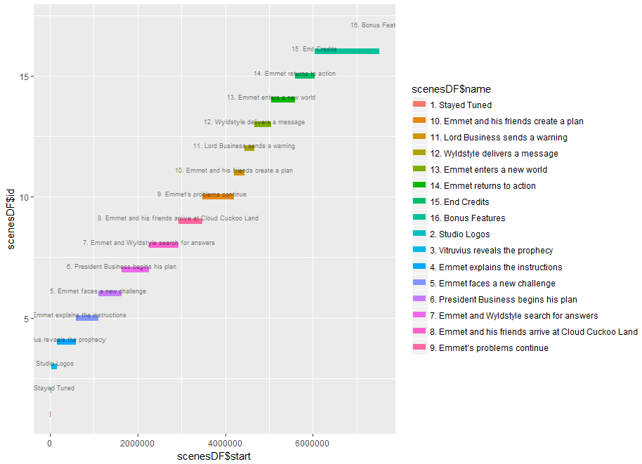
ggplot2: adding a layer of text
ggplot(scenesDF, aes(colour=scenesDF$name)) +
geom_segment(aes(x=scenesDF$start,xend=scenesDF$end,y=scenesDF$id,yend=scenesDF$id),size=3) +
geom_text(data=scenesDF, aes(x=scenesDF$end, y=scenesDF$id, label = scenesDF$name),
size = 2.25, nudge_y = 1.15,color = 'black', alpha = 0.5)

Slide 39
gpplot2: Adding an aesthetics layer
ggplot(scenesDF, aes(colour=scenesDF$name)) +
geom_segment(aes(x=scenesDF$start,xend=scenesDF$end,y=scenesDF$id,yend=scenesDF$id),size=3) +
geom_text(data=scenesDF, aes(x=scenesDF$end, y=scenesDF$id, label = scenesDF$name),
size = 2.25, nudge_y = 1.15,color = 'black', alpha = 0.5) +
theme_gdocs() + theme(legend.position="none")

Slide 40
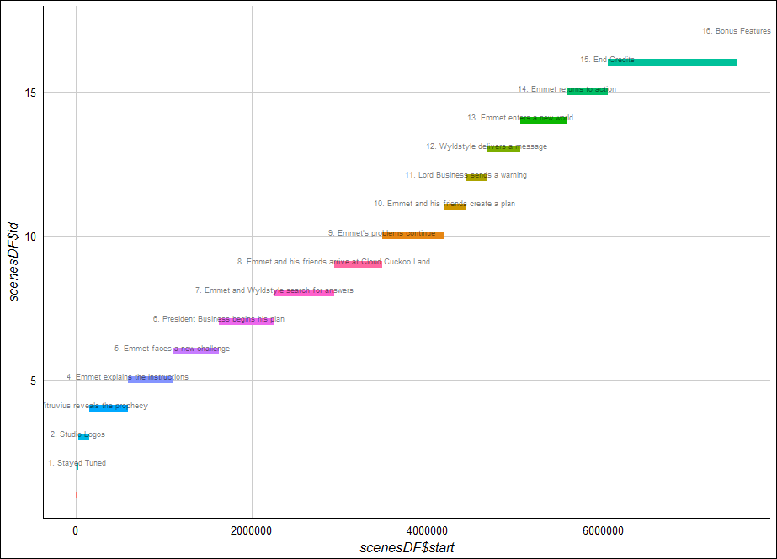

Slide 41
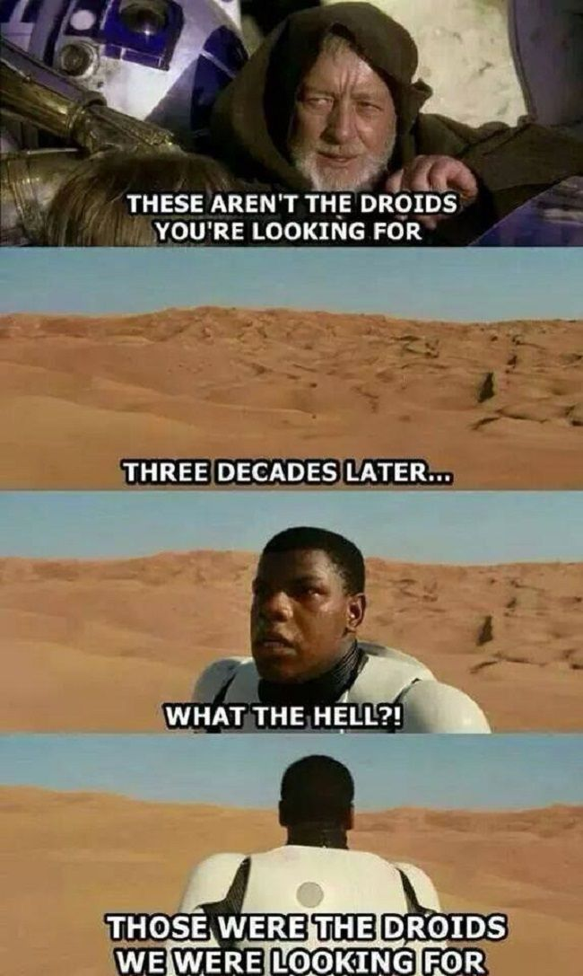
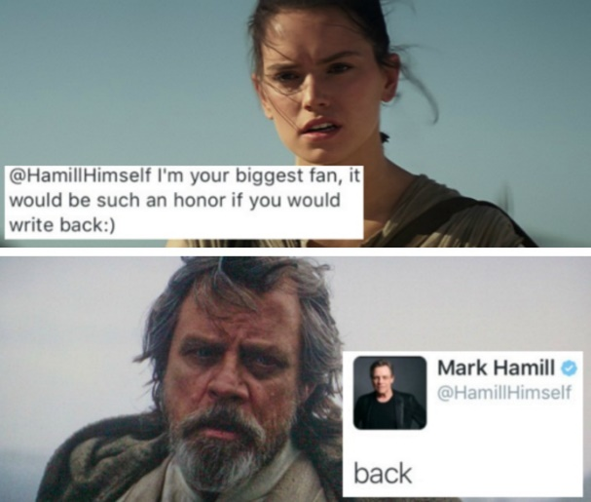

Let’s Practice…
Open B_Amazon_Xray.R
Learning Outcome: change movies, examine and make another plot with less guidance.

Slide 42


Slide 43
Agenda – all times are suggested
Start | End | Monday - June 17
8:45 | 9:15 | Coffee
9:15 | 10:15 | Syllabus, Intro to R, R Setup
10:15 | 10:30 | Break
10:30 | 12:00 | What is TM? String Manipulation Keyword Search & Density Misspelling
12:00 | 1:30 | Lunch
1:30 | 2:00 | Bag of Words tm Class & Functions qdap Functions Lemmatization Meta-Document Information
2:00 | 2:30 | WFM
2:30 | 3:15 | Lab: Clean a corpus of tweets & construct WFM

