Slide 1
GSERM: Text Mining & NLP Data Science/NLP Ethics
June 20, 2019
Ted Kwartler

Slide 2
Agenda – all times are suggested
Start | End | Thursday- June 20
8:45 | 9:15 | Coffee
9:15 | 10:15 | Ethics
10:15 | 10:45 | Personal Reflection Time – start your reflection paper
10:45 | 12:00 | Regression
12:00 | 1:30 | Lunch
1:30 | 2:30 | Classifications methods for text
2:30 | 3:15 | Lab

Slide 3
Definition of Ethics
ethics plural in form but singular or plural in construction : the discipline dealing with what is good and bad and with moral duty and obligation; a guiding philosophy
https://www.merriam-webster.com/dictionary/ethic

Slide 4
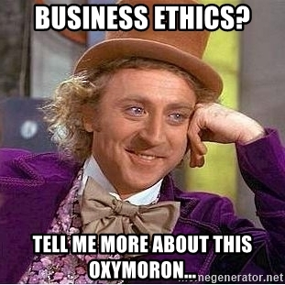
Within a business context

Slide 5
Within a business context
In 1970, Milton Friedman famously argued that the only social responsibility of business was to maximize profits.

Slide 6
Within a business context
“The only business of business is business” -President Calvin Coolidge

Slide 7
What about in the context of data, machine learning & AI?

Slide 8
What about in the context of data, machine learning & AI?
Does using data, text analysis and machine learning algorithms justify all actions since the underlying operations are just math?

Slide 9
What about in the context of data, machine learning & AI?
The use of data and text mining approaches can be audited, so are the outcomes of those efforts justified?

Slide 10
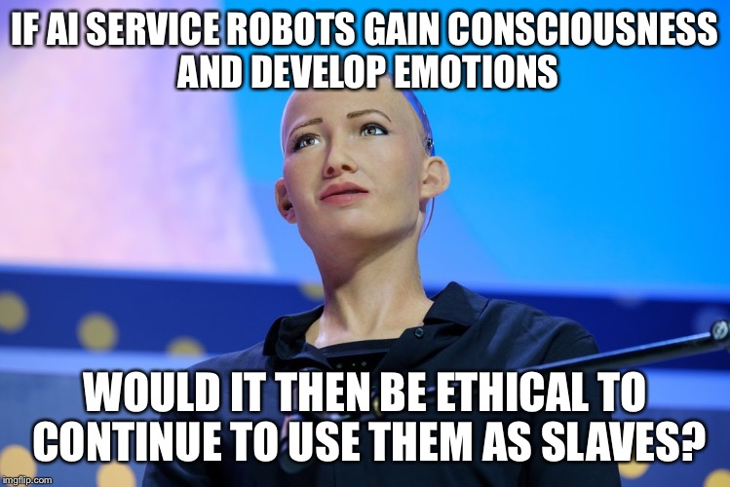
What about in the context of data, machine learning & AI?

Slide 11

IBM Watson’s Cancer Recommendations
What is the article about? Describe IBM’s technology.

Slide 12
IBM Watson’s Cancer Recommendations
Is Watson’s seemingly amazing technology free from moral obligation?

Slide 13
IBM Watson’s Cancer Recommendations
Is there a business and data ethics question?

Slide 14
IBM Watson’s Cancer Recommendations
Is there bias in the textual data underlying the technology?

Slide 15
IBM Watson’s Cancer Recommendations
Who are the stakeholders?

Slide 16
IBM Watson’s Cancer Recommendations
Was it marketing ignorance, merely aspirational claims, or truly conscience deception? Does that matter to patients?
Do Technical researcher, and machine learning engineers have a duty to inform others about the bias? Does the duty to inform shortcomings stop at management?
Do business leaders have a duty to question the choices and practices of technical creators?
What duty do the customers have to thoroughly review the underlying technology?

Slide 17

MSFT Tay
Who was Tay?

Slide 18
MSFT Tay
Is there a business and data ethics question? Who was impacted?

Slide 19
MSFT Tay
What did the technical practitioners and leaders miss?
What could have been done to mitigate the impact?

Slide 20
MSFT Tay
Harmless marketing stunt that turned ugly? As practitioners if we have to filter the training data and provide guardrails do we invite censorship & bias?

Slide 21
MSFT Tay
What if Tay was supposed to make cancer recommendations, pick stocks for your retirement, recommend purchases, or schedule an important appointment?

Slide 22
MSFT Tay
Is there a business and data ethics question? Who was impacted?
If so, what did the practitioners and leaders miss?
What could have been done to mitigate the impact?
Letting it loose with public info allowed the technology to be corrupted almost immediately. However, once the researcher/data scientist applies limitations to inputs, bias is introduced.

Slide 23

AMZN Alexa
What is alexa?
Is the technology helpful?

Slide 24
AMZN Alexa
In some cases, real humans are listening to Alexa utterances…
…
…
Is this a problem?

Slide 25
AMZN Alexa
In some cases, real humans are listening to Alexa utterances…
…
Audio
Phonemes Identified
&
matched to existing dictionary
Customer Intent
&
Response ID’ed
Audio Response
Alexa is a natural language understanding technology. Although unclear, it is likely mapping phonemes to text (speech to text) or numeric representations mapping ultimately to customer intent.

Slide 26
AMZN Alexa
Real humans are listening in some cases to Alexa utterances…
…
???
!@?
Hyderabad
Boston
No Match
to Phonemes or intent ID’ed
Text annotations
Audio transcription
Cu Intent Labeled
Added to training set
Buried Terms of Service? Do people know? Do people care? Is there an ethical consideration?

Slide 27
Researchers & Social Media

Slide 28

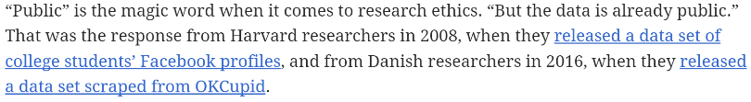
Researchers & Social Media
“for some researchers, whether the data is public is the only thing that matters”

Slide 29
Researchers & Social Media
Subject context: “breakfast” vs “medical” tweets
Amplification: to followers, to scientists, to academic papers, to journalists
Author context/Safety: “public” figures, at-risk populations (LGBTQ), political protesters
Researcher context: “spot the trans” person technology, state-sponsored spying/persecution
Is the sentiment “they should have known” good enough to meet an ethical threshold?

Slide 30
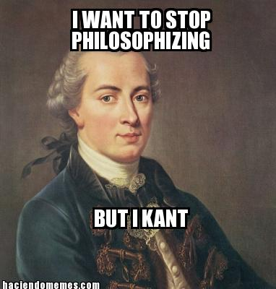
Some Popular Ethical Paradigms
Name | Proponent | Description | Example
Categorical Imperative | Kant | Make your action a universal law to see if it is ethical. Taken to an extreme, if the action becomes illogical, then it is immoral. | For stealing property…if everyone stole all property whenever they wanted then property itself loses all value making your act illogical. Therefore stealing is unethical.

Slide 31
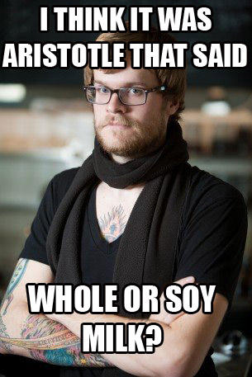
Some Popular Ethical Paradigms
Name | Proponent | Description | Example
Golden Mean | Plato/Socrates/Aristotle | Virtuous actions are between two extremes, deficiency and excess. At times, extremities are needed but mostly the middle (mean) is the moral choice. | Sometimes you should be courageous but not always…that would lead to a reckless death. Sometimes you need to be fearful but not always that would lead to unfulfilled opportunity as a coward.

Slide 32
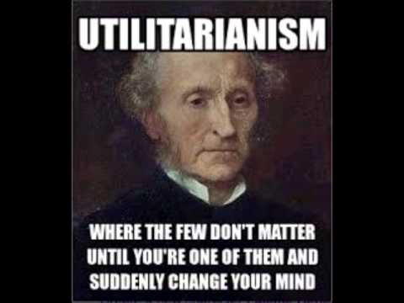
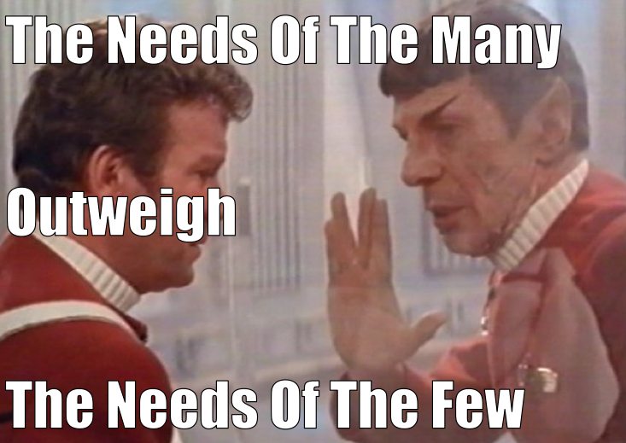
Some Popular Ethical Paradigms
Name | Proponent | Description | Example
Utilitarianism Self –interest Common Good | Mill | Ethical decisions are those that maximize happiness and minimize pain. “it’s ok to hurt a small group to maximize the gain for the larger group.” | Vaccines can cause significant problems so the government set up a fund to help victims of vaccine side affects. Vaccines benefit society by eradicating disease.

Slide 33
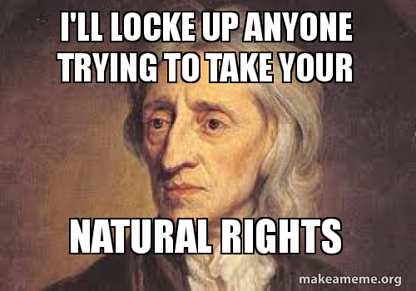
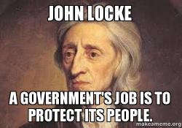
Some Popular Ethical Paradigms
Name | Proponent | Description | Example
Rights based | Locke | Humans beings are an “end” not a “means” and should be treated that way. | All human being have the right to dignity and other debated rights. Does this extend to animals (animal rights activists versus animal welfare proponents…free range chickens ? Could this extend to technology like conscience robots?

Slide 34
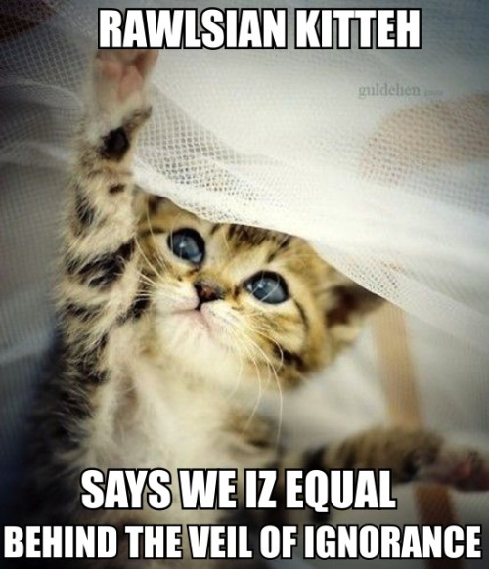
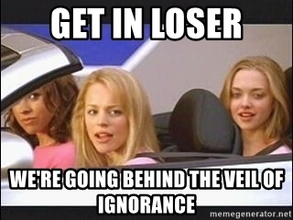
Some Popular Ethical Paradigms
Name | Proponent | Description | Example
Veil of Ignorance | Rawls | Moral decisions should be made with a “veil” so that you don’t know your own intellect, race, gender etc. The choice you make in this pretense is the moral obligation. This veil lets you focus on the “least advantaged in society” (as opposed to greatest number). | When deciding wages for employees there is a veil so that ignoring gender and race are not factors, since they do not impact job performance. This decision is made even if the decision make is a white male because their personal background is not a factor.

Slide 35
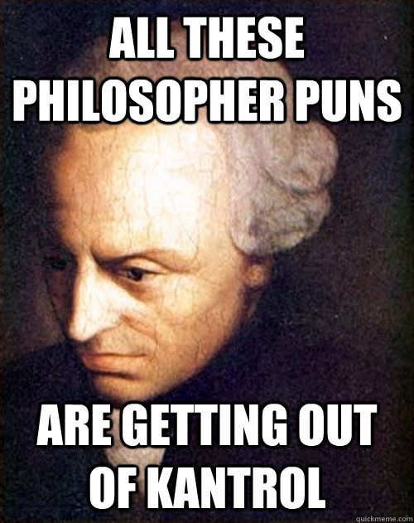
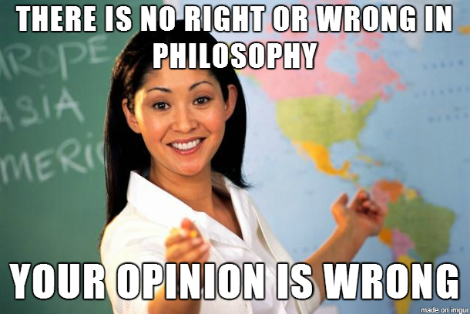
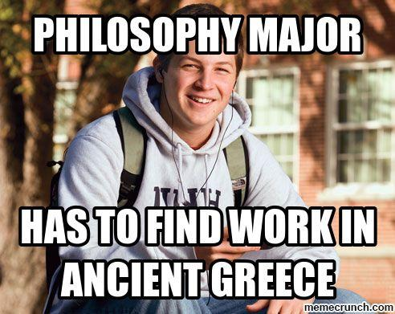
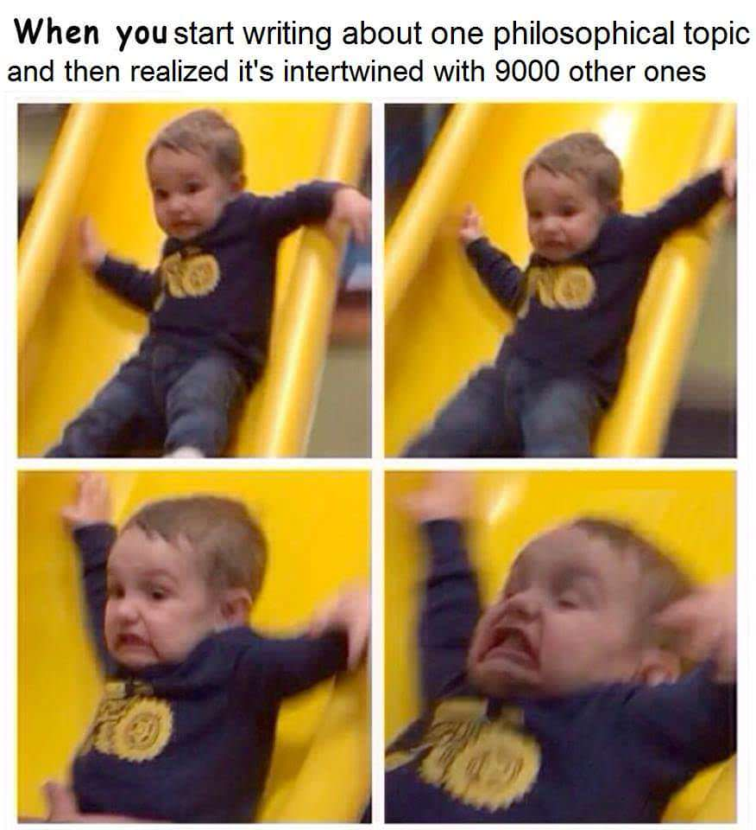
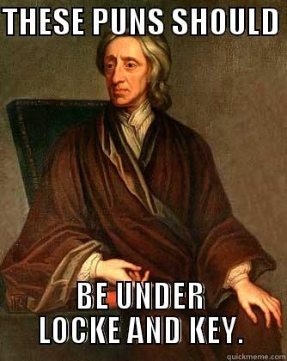
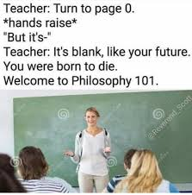
Some Popular Ethical Paradigms
Take some time to reflect on how you would react and which of these (and others perspectives) resonate with you.

Slide 36
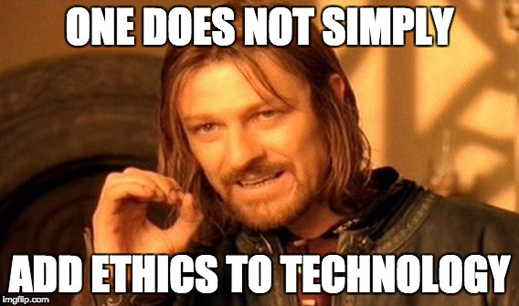
Technology is a means to an end. Stating data mining of any kind represents progress is misleading. What end is ultimately achieved?

Slide 37
Popular Ethical Paradigms
As you become a business leader or researcher or technician, having predefined values will help you in the moment.

