Slide 1
GSERM: Text Mining & NLP Data Science/NLP Ethics
June 20, 2019
Ted Kwartler

Slide 2
Agenda – all times are suggested
Start | End | Thursday- June 20
8:45 | 9:15 | Coffee
9:15 | 10:15 | Ethics
10:15 | 10:45 | Personal Reflection Time – start your reflection paper
10:45 | 12:00 | Regression
12:00 | 1:30 | Lunch
1:30 | 2:30 | Classifications methods for text
2:30 | 3:15 | Lab

Slide 3
Definition of Ethics
ethics plural in form but singular or plural in construction : the discipline dealing with what is good and bad and with moral duty and obligation; a guiding philosophy
https://www.merriam-webster.com/dictionary/ethic

Slide 4
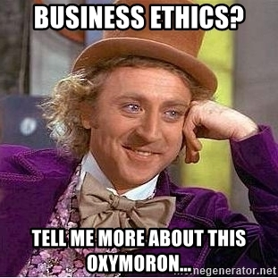
Within a business context
In 1970, Milton Friedman famously argued that the only social responsibility of business was to maximize profits.
“The only business of business is business” -President Calvin Coolidge

Slide 5
My definition…
A set of behavioral standards informing and justifying your actions while transacting business, performing duties etc.

Slide 6
What about in the context of data, machine learning & AI?

Slide 7
What about in the context of data, machine learning & AI?
Does using data and algorithms justify all actions since the underlying operations are just math?

Slide 8
What about in the context of data, machine learning & AI?
The use of data and mining approaches can be audited, so are the outcomes of those efforts justified?

Slide 9
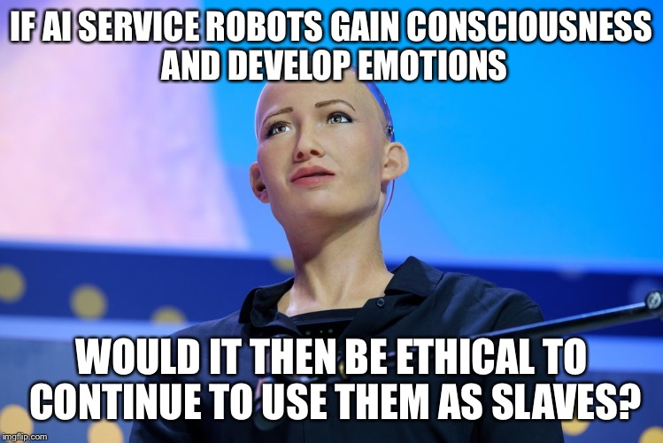
What about in the context of data, machine learning & AI?

Slide 10

IBM Watson’s Cancer Recommendations
Is Watson amazing technology free from moral obligation?

Slide 11
IBM Watson’s Cancer Recommendations
Is there a business and data ethics question? Who was impacted?
If so, what did the practitioners and leaders miss?
What could have been done to mitigate the impact?
Is there bias in the text mining project data?
What duty do the technical folks have to inform of limitations to sales, business and customers?

Slide 12
IBM Watson’s Cancer Recommendations
Is there a business and data ethics question? Who was impacted?
If so, what did the practitioners and leaders miss?
What could have been done to mitigate the impact?
Was it marketing ignorance, merely aspirational claims, or truly conscience deceptive? Does that matter to patients?
Do business leaders have a duty to question the choices and practices of technical creators?
What duty do the customers have to thoroughly review the underlying technology?

Slide 13

MSFT Tay
Is there a business and data ethics question? Who was impacted?
If so, what did the practitioners and leaders miss?
What could have been done to mitigate the impact?

Slide 14
MSFT Tay
Is there a business and data ethics question? Who was impacted?
If so, what did the practitioners and leaders miss?
What could have been done to mitigate the impact?
Harmless marketing stunt that turned ugly? If we have to filter the training data and provide guardrails do we invite censorship & bias?

Slide 15
MSFT Tay
Is there a business and data ethics question? Who was impacted?
If so, what did the practitioners and leaders miss?
What could have been done to mitigate the impact?
What if Tay was supposed to make cancer recommendations, pick stocks for your retirement, recommend purchases, or schedule an appointment?

Slide 16
MSFT Tay
Is there a business and data ethics question? Who was impacted?
If so, what did the practitioners and leaders miss?
What could have been done to mitigate the impact?
Letting it loose with public info allowed the technology to be corrupted almost immediately. However, once the scientist applies limitations to inputs, bias is introduced.

Slide 17

AMZN Alexa
Real humans are listening in some cases to Alexa utterances…
…
…

Slide 18
AMZN Alexa
Real humans are listening in some cases to Alexa utterances…
…
Audio
Phonemes Identified
&
matched to existing dictionary
Customer Intent
&
Response ID’ed
Audio Response
Alexa is a natural language understanding problem.

Slide 19
AMZN Alexa
Real humans are listening in some cases to Alexa utterances…
…
???
!@?
Hyderabad
Boston
No Match
to Phonemes or intent ID’ed
annotations
Audio transcription
Cu Intent Labeled
Added to training set
Buried Terms of Service? Do people know? Do people care? Is there an ethical consideration?

Slide 20
Researchers & Social Media

Slide 21

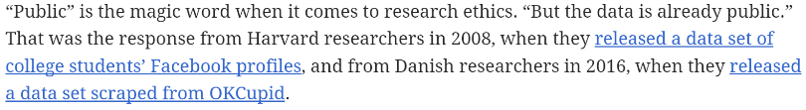
Researchers & Social Media
“for some researchers, whether the data is public is the only thing that matters”

Slide 22
Researchers & Social Media
Subject context: “breakfast” vs “medical” tweets
Amplification: to followers, to scientists, to academic papers, to journalists
Author context/Safety: “public” figures, at-risk populations (LGBTQ), protester
Researcher context: “spot the trans” person technology, state-sponsored spying/persecution
Is the sentiment “they should have known” good enough to meet an ethical threshold?

Slide 23
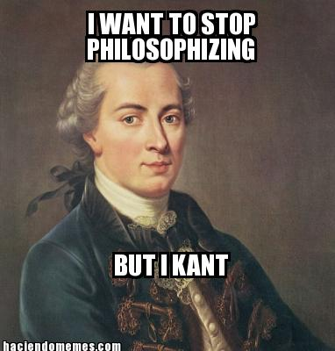
Some Popular Ethical Paradigms
Name | Proponent | Description | Example
Categorical Imperative | Kant | Make your action a universal law to see if it is ethical. Taken to an extreme, if the action becomes illogical, then it is immoral. | For stealing property…if everyone stole all property whenever they wanted then property itself loses all value making your act illogical. Therefore stealing is unethical.

Slide 24
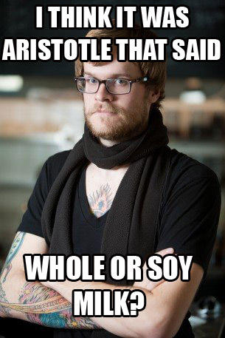
Some Popular Ethical Paradigms
Name | Proponent | Description | Example
Golden Mean | Plato/Socrates/Aristotle | Virtuous actions are between two extremes, deficiency and excess. At times, extremities are needed but mostly the middle (mean) is the moral choice. | Sometimes you should be courageous but not always…that would lead to a reckless death. Sometimes you need to be fearful but not always that would lead to unfulfilled opportunity as a coward.

Slide 25
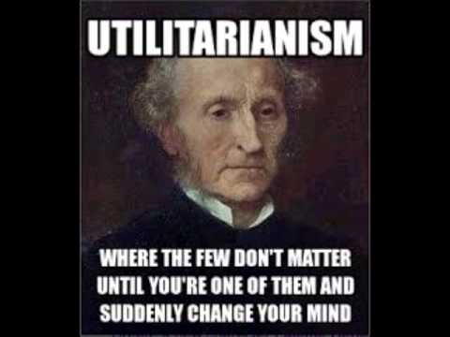
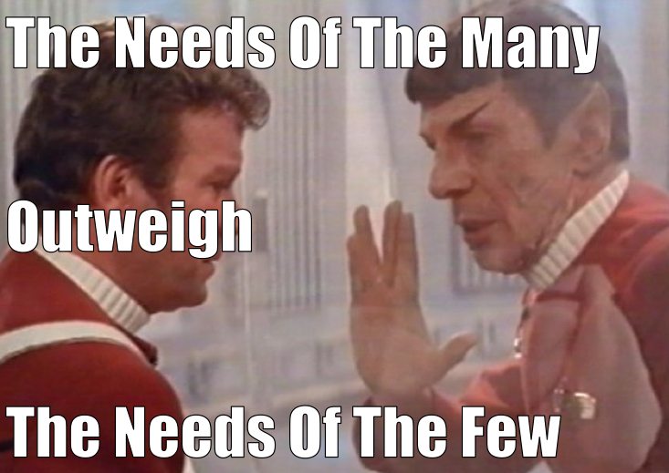
Some Popular Ethical Paradigms
Name | Proponent | Description | Example
Utilitarianism Self –interest Common Good | Mill | Ethical decisions are those that maximize happiness and minimize pain. “it’s ok to hurt a small group to maximize the gain for the larger group.” | Vaccines can cause significant problems so the government set up a fund to help victims of vaccine side affects. Vaccines benefit society by eradicating disease.

Slide 26
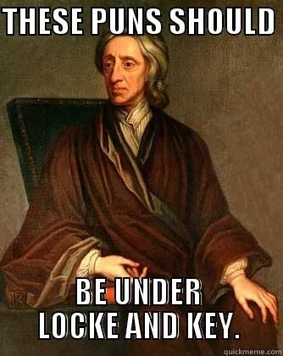
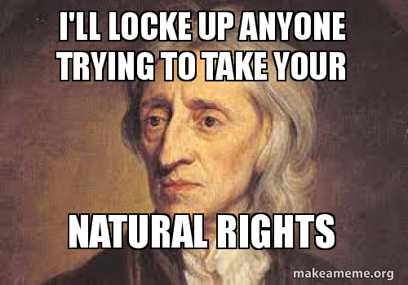
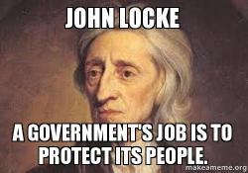
Some Popular Ethical Paradigms
Name | Proponent | Description | Example
Rights based | Locke | Humans beings are an “end” not a “means” and should be treated that way. | All human being have the right to dignity and other debated rights. Does this extend to animals? Conscience robots?

Slide 27
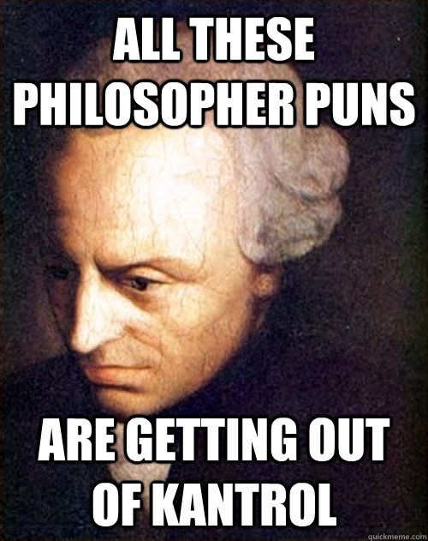
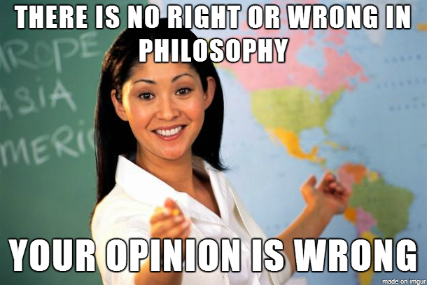
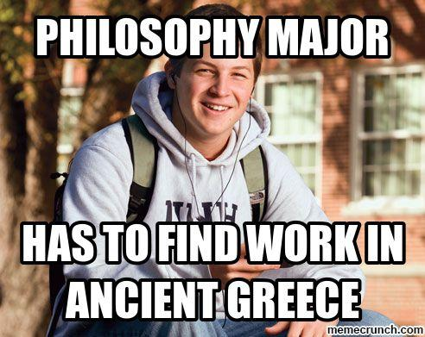
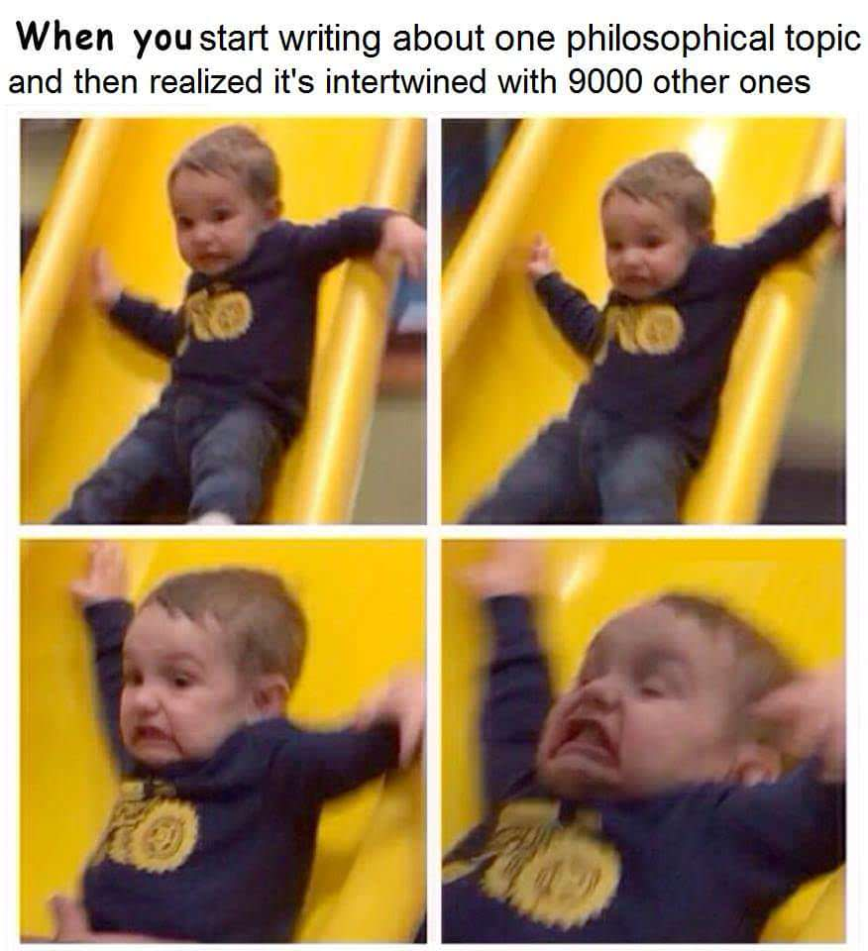

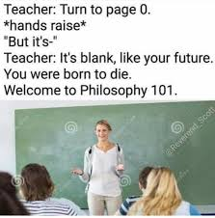
Some Popular Ethical Paradigms
Take some time to reflect on how you would react and which of these (and others perspectives) resonate with you.

Slide 28
Popular Ethical Paradigms
As you become a business leader or researcher or technician, having predefined values will help you in the moment.

Slide 29
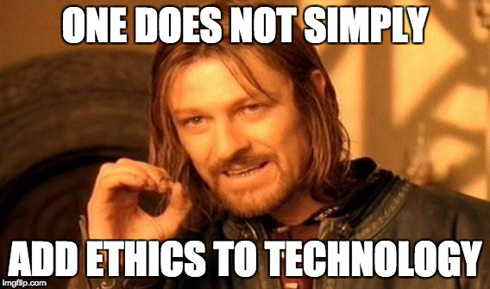
Technology is a means to an end. Stating data mining of any kind represents progress is misleading. What end is ultimately achieved?

