Slide 1
GSERM: Text Mining & NLP Common TM Visuals
June 18, 2019
Ted Kwartler

Slide 2
Agenda – all times are suggested
Start | End | Tuesday - June 18
8:45 | 9:15 | Coffee
9:15 | 9:30 | Review
9:30 | 10:00 | Basic Visualization & Zipf’s Law
10:00 | 11:00 | Bar Charts, Word Associations, Dendrograms
11:00 | 11:15 | Break
11:15 | 12:00 | Word Networks, Tokenization/Word Clouds
12:00 | 1:30 | Lunch
1:30 | 2:30 | Commonality, Comparison Clouds
2:30 | 3:15 | TF-IDF, Pyramid, bar bell plots

Slide 3
Getting a Word Frequency Matrix
beerFreq<-colSums(beerDTMm)
beerFreq<-data.frame(word=names(beerFreq),frequency=beerFreq)
Document Term Matrix
Word Frequency Matrix
 | Term1 | Term2 | Term3 | … | Term_n
Tweet1 | 0 | 1 | 1 | 0 | 0
Tweet2 | 0 | 1 | 0 | 0 | 0
Tweet3 | 0 | 0 | 0 | 3 | 0
… | 0 | 0 | 0 | 1 | 1
Tweet_n | 0 | 0 | 0 | 1 | 0
word | freq
Term1 | 0
Term2 | 2
Term3 | 3
… | 5
Term_n | 2

Slide 4
Open A_text_organization_REVIEW.R
Learning Objective: Review text cleaning, organization and the word frequency matrix.

Slide 5
Agenda – all times are suggested
Start | End | Tuesday - June 18
8:45 | 9:15 | Coffee
9:15 | 9:30 | Review
9:30 | 10:00 | Basic Visualization & Zipf’s Law
10:00 | 11:00 | Bar Charts, Word Associations, Dendrograms
11:00 | 11:15 | Break
11:15 | 12:00 | Word Networks, Tokenization/Word Clouds
12:00 | 1:30 | Lunch
1:30 | 2:30 | Commonality, Comparison Clouds
2:30 | 3:15 | TF-IDF, Pyramid, bar bell plots

Slide 6
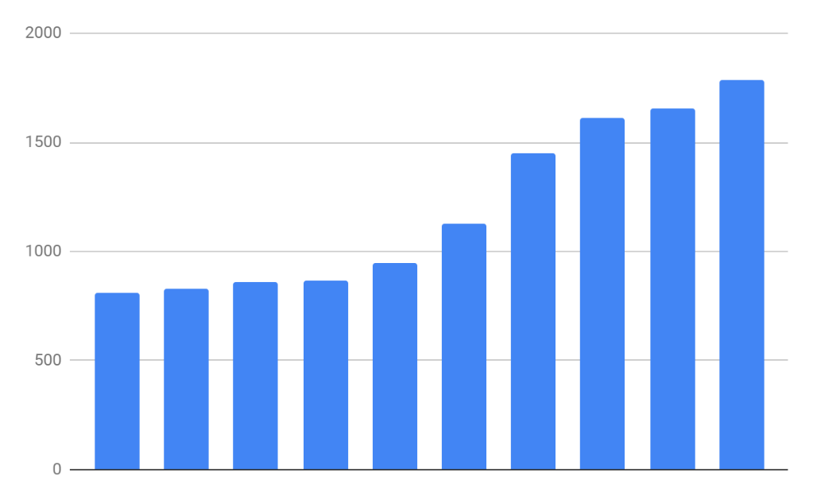
Basic Bar Charts
Word Frequency Matrix
word | freq
Term1 | 0
Term2 | 2
Term3 | 3
… | 5
Term_n | 2
Rectangles are representative of frequency of term

Slide 7
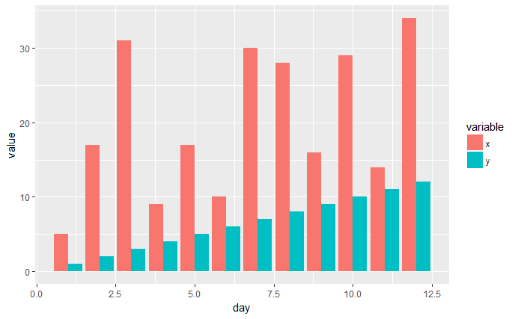
Side by Side Charts
Side by Side bar charts let you compare frequency by category

Slide 8
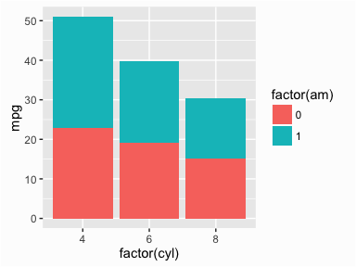
Stacked Bar Charts
Stacked bar charts lets you compare proportion within a category

Slide 9
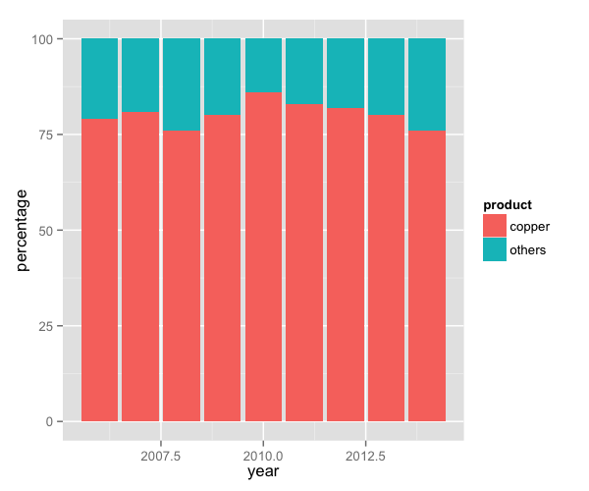
Proportional Stacked Bar Charts
Proportional stacked bar charts let you compare proportion across categories

Slide 10
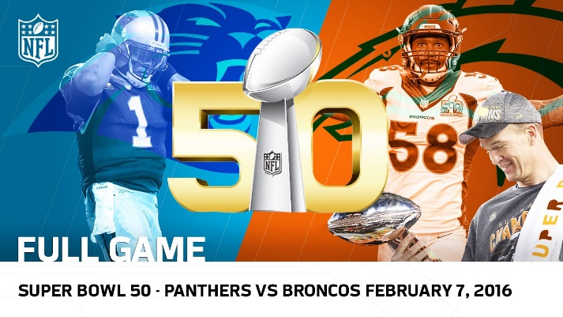
What frequency distribution should we expect?
Many words in natural language but also a steep decline in actual usage. Follows a predictable pattern.

Slide 11
Top 100 terms
This predictable pattern is called “Zipf’s Law”

Slide 12
Zipf’s Law is observed in human behavior
Swiss Cities
UK Cities
Population density often falls into this type of distribution

Slide 13
Zipf’s Law is observed in business
Insurance - 2016 Direct Premiums Written ($)
Tech – 2018 US Cloud Compute Mkt Share
AWS
MSFT
GOOG
Others
Alibaba
IBM
Many industries become natural monopolies. Without this natural maturing the industry is hyper competitive “Coke vs Pepsi”
https://www.insure.com/car-insurance/largest-auto-insurance-companies-by-market-share.html
https://www.canalys.com/newsroom/cloud-market-share-q4-2018-and-full-year-2018

Slide 14
Zipf’s Law
The frequency of a word is inversely related to its rank in a word frequency matrix.
Observation or Word A appears N times
Word B is expected to appear N/2
Word C is expected to appear N/3
Word D is expected to appear N/4
…
…
Term Rank
In language this means we should expect coming words to dominate.
https://www.worlddata.info/average-income.php

Slide 15
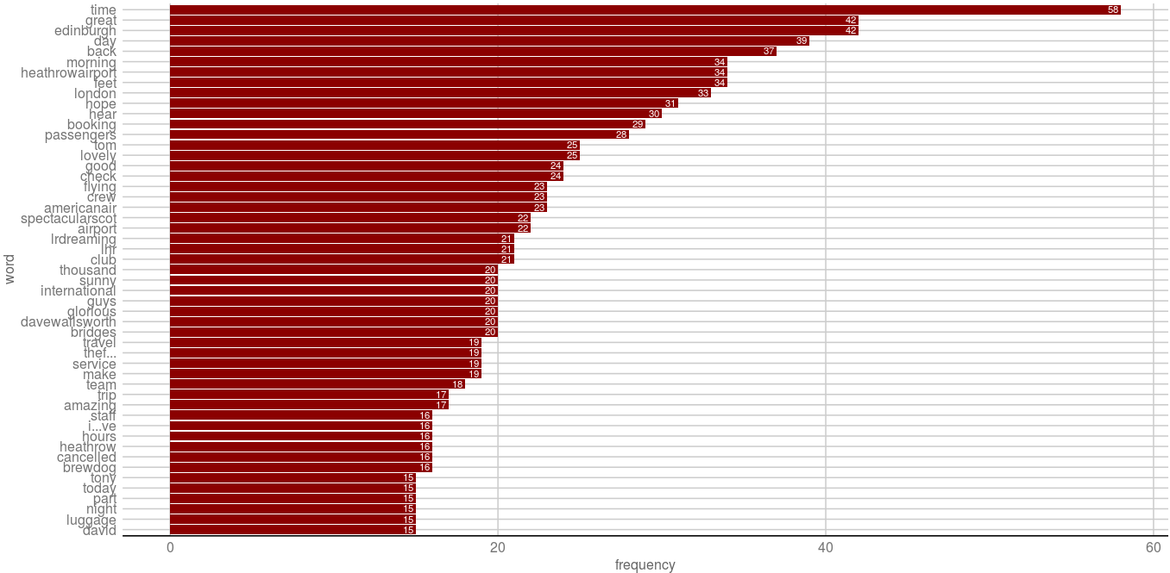
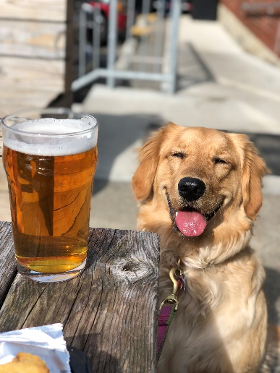
Open B_Associations_Dendrogram_WordNetworks.R
Visualizing the WFM
Brewdog?! Let’s investigate

Slide 16
BrewDog!! Word Association
Tuning Parameter: Adjust 0.30 to get the terms that are associated .30 or more with the unexpected term terms.
# Inspect word associations
associations<-findAssocs(beerTDM, 'brewdog', 0.30)
Any word that appears at least 30% of the time with “brewdog” in document will be returned.
Word Association is similar to correlation. Unlike correlation, terms can only be positively associated. This is because there are so many terms that most everything would be negatively “correlated” ( actually associated).

Slide 17
Brewdog!! Word Association
# Make a dot plot
assocDF <- data.frame(terms=names(associations[[1]]),
value=unlist(associations))
assocDF$terms <- factor(assocDF $terms, levels= assocDF $terms)
ggplot(assocDF, aes(y=terms)) +
geom_point(aes(x=value), data=assocDF, col='#c00c00') +
theme_gdocs() +
geom_text(aes(x=value,label=value),
colour="red",hjust="inward", vjust ="inward" , size=3)
Changing terms into factors lets ggplot2 order them

Slide 18
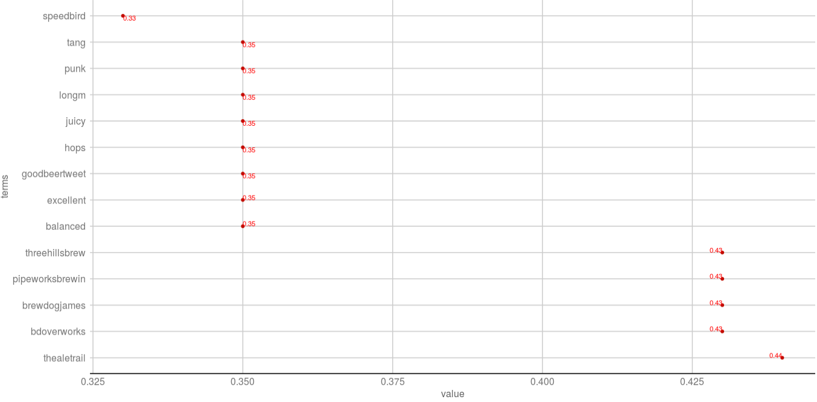

Back to B_Associations_Dendrogram_WordNetworks.R
“thealetrail” has the highest word association with “brewdog”
@TheAleTrail: Worth the wait. This is excellent. @brewdog @British_Airways #Speedbird100 balanced juicy hops with a tang of bitterness…

Slide 19

Association is NOT frequency.
“brewdog” appears 16 times
“thealetrail” is the most associated term
“thealetrail” appears 5 times.
“thealetrail” is NOT frequent within the corpus. Instead given a search term “brewdog” it is highly associated. “thealetrail” in the context of “brewdog” is frequently associated but still seldom used in the grander context.

Slide 20
Dendrograms: Hierarchical Clusters
Real Rainfall Data
City | Annual Rainfall (in)
Portland | 43.5
Boston | 43.8
New Orleans | 62.7
Which two are most similar? What approximate value would “connect” the two?

Slide 21
Dendrograms: Hierarchical Clusters
Rainfall Data as a Dendrogram
63
44
New Orleans
Boston
Portland
Boston & Portland are a cluster at height ~44, losing precision to create the cluster.

Slide 22
Dendrograms: Hierarchical Clusters
Real Rainfall Data
Rainfall Data as a Dendrogram
63
City | Annual Rainfall
Portland | 43.5
Boston | 43.8
New Orleans | 62.7
44
New Orleans
Boston
Portland
Visualizes hierarchical data. For text, the frequency distances are calculated to create the hc object.

Slide 23
Dendrograms: Hierarchical Clusters
Keep in Mind a Dendrogram
Rainfall Data as a Dendrogram
Reduces information much like average is a reduction of many observations’ values
Word clusters emerge often showing related terms/phrases
Term frequency is used to construct the word cluster. Put another way, term A & term B have similar freq. distances & are considered a cluster
63
44
New Orleans
Boston
Portland

Slide 24


Distance Matrix
Fake TDM
The default is to use the Euclidean distance although others i.e. Manhattan can be explored.

Slide 25

Distance Matrix
Fake TDM
The result is a symmetrical matrix of distances (1/2) is blank bc redundant.

Slide 26
Distance Matrix
Fake TDM
Tweet1: “thealetrail” = 1; “lost” = 3; (3-1) = 2
Tweet2: “thealetrail” = 0; “lost” = 0; (0-0) = 0
Tweet3: “thealetrail” = 2; “lost” = 0; (2-0) = 2
Calculation:
sqrt(2) + sqrt(0) + sqrt(2) = 1.41 + 0 + 1.41 = 2.82

Slide 27

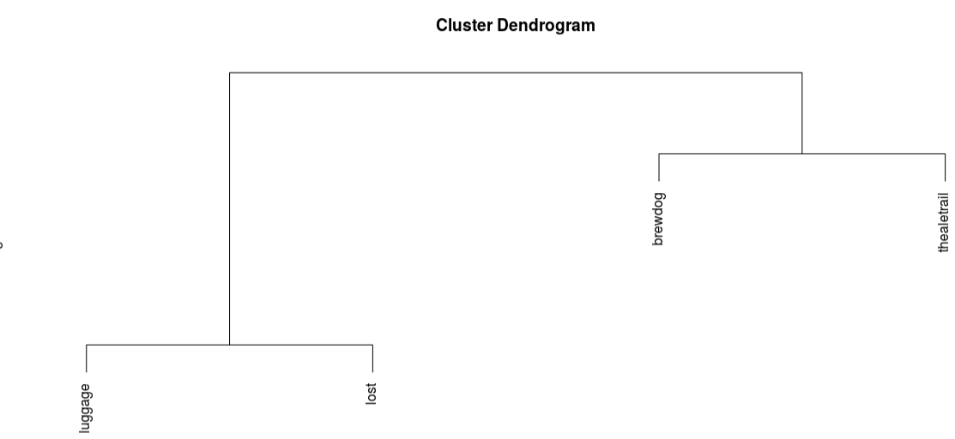
Distance Matrix
Fake TDM
Lost luggage has low distances meaning they are together a lot. Thus lower is smaller distances.

Slide 28

B_Associations_Dendrogram_WordNetworks.R

Slide 29
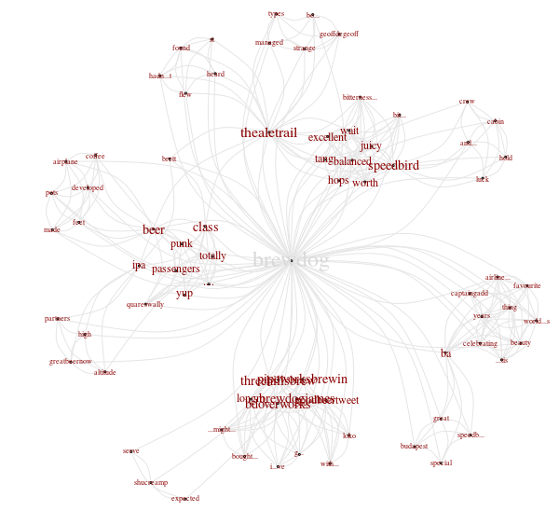
Word Networks…Social Network Analysis
Always hard to interpret, what terms are associated with the initial string at varying degrees of separation. Ie associations of associations

Slide 30
Agenda – all times are suggested
Start | End | Tuesday - June 18
8:45 | 9:15 | Coffee
9:15 | 9:30 | Review
9:30 | 10:00 | Basic Visualization & Zipf’s Law
10:00 | 11:00 | Bar Charts, Word Associations, Dendrograms
11:00 | 11:15 | Break
11:15 | 12:00 | Word Networks, Tokenization/Word Clouds
12:00 | 1:30 | Lunch
1:30 | 2:30 | Commonality, Comparison Clouds
2:30 | 3:15 | TF-IDF, Pyramid, bar bell plots

Slide 31
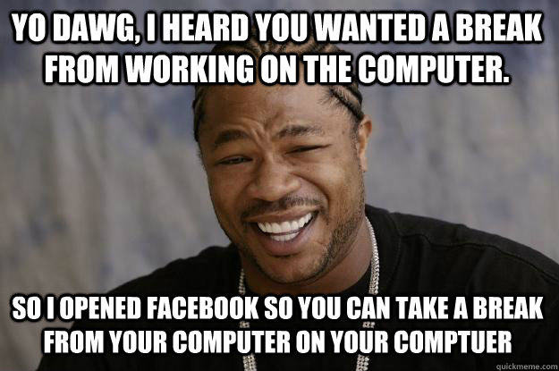
Break!
If you want to practice build a frequency barplot with the “beer.csv” data
Find associations with “zombie” in “beer.csv”
Create a dendrogram to identify any phrases in “beer.csv”
OR
Take a break, get some coffee ☺

Slide 32
Agenda – all times are suggested
Start | End | Tuesday - June 18
8:45 | 9:15 | Coffee
9:15 | 9:30 | Review
9:30 | 10:00 | Basic Visualization & Zipf’s Law
10:00 | 11:00 | Bar Charts, Word Associations, Dendrograms
11:00 | 11:15 | Break
11:15 | 12:00 | Word Networks, Tokenization/Word Clouds
12:00 | 1:30 | Lunch
1:30 | 2:30 | Commonality, Comparison Clouds
2:30 | 3:15 | TF-IDF, Pyramid, bar bell plots

Slide 33

Unigram Tokenization
“Text mining is so fun. So do text mining!
*with common stopwords
Thus far, we have performed unigram tokenization of terms.

Slide 34
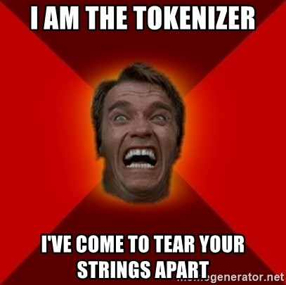
Changing Tokenization Schema
Within R
#bigram token maker
bigramTokens <-function(x)
unlist(lapply(NLP::ngrams(words(x), 2), paste, collapse = " "), use.names = FALSE)
wineTDM<-TermDocumentMatrix(txtCorpus, control=list(tokenize=bigramTokens))
First create a function defining tokenization then add as a control parameter to TDM or DTM.

Slide 35
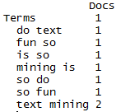
Changing Tokenization Schema
“Text mining is so fun. So do text mining!
#bigram token maker
bigramTokens <-function(x)
unlist(lapply(NLP::ngrams(words(x), 2), paste, collapse = " "), use.names = FALSE)
wineTDM<-TermDocumentMatrix(txtCorpus, control=list(tokenize=bigramTokens))
Now the TDM has two terms instead of one.
Tokenization is the process of chopping up a string into predefined units called tokens.

Slide 36
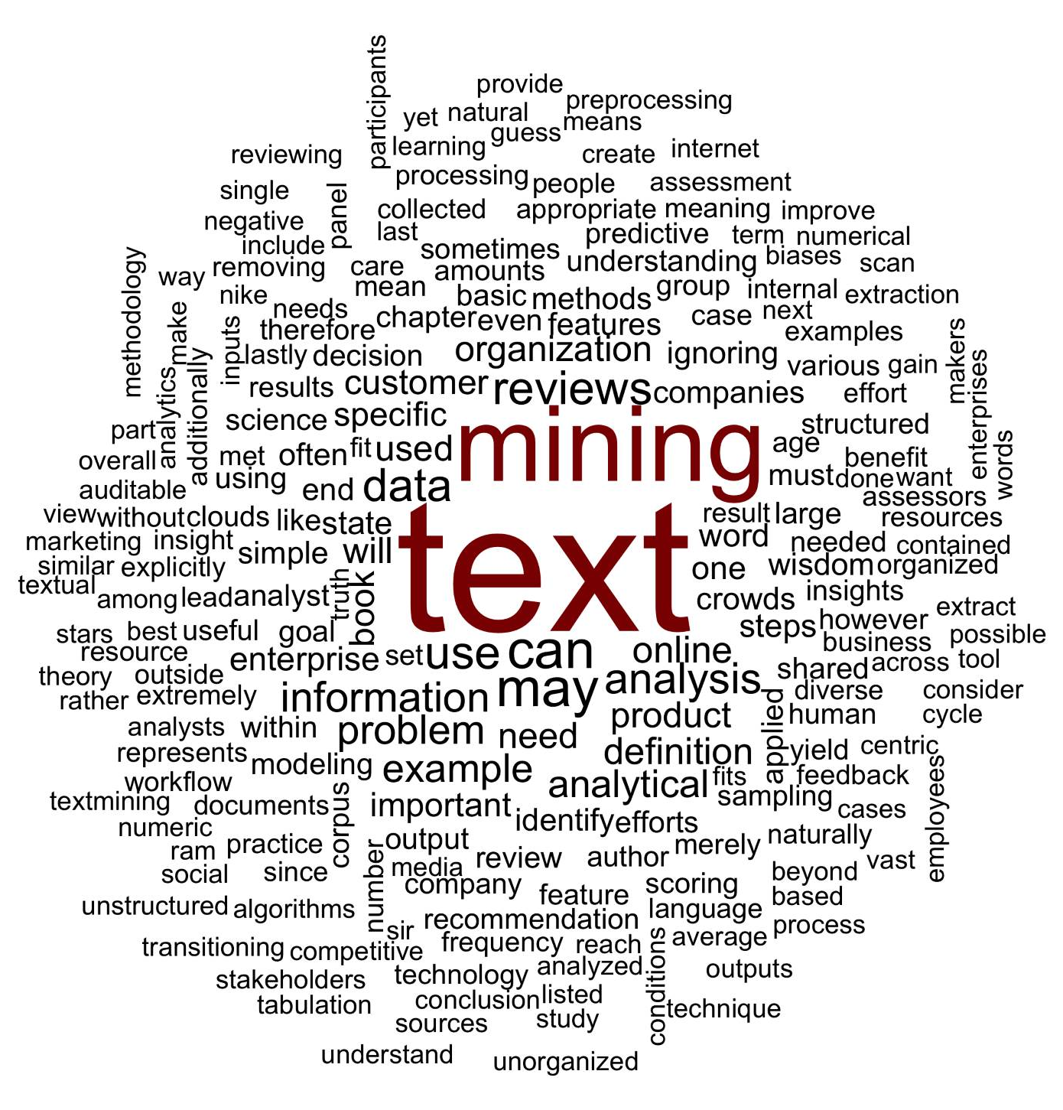
What is a word cloud?
Maligned and overused, a word cloud is a frequency visualization.

Slide 37
To make a wordcloud start with a WFM
In R…
# Get Row Sums & organize
wineTDMv <- sort(rowSums(wineTDMm), decreasing = TRUE)
wineDF <- data.frame(word = names(wineTDMv), freq = wineTDMv)
Term Document Matrix
Word Freq Matrix
 | Tweet1 | Tweet2 | Tweet3 | Tweet4 | … | Tweet_n
Term1 | 0 | 0 | 0 | 0 | 0 | 0
Term2 | 1 | 1 | 0 | 0 | 0 | 0
Term3 | 1 | 0 | 0 | 2 | 0 | 0
… | 0 | 0 | 3 | 0 | 1 | 1
Term_n | 0 | 0 | 0 | 1 | 1 | 0
word | freq
Term1 | 1
Term2 | 2
Term3 | 3
… | 5
Term_n | 2

Slide 38
Then sort it decreasing = TRUE
In R…
# Get Row Sums & organize
wineTDMv <- sort(rowSums(wineTDMm), decreasing = TRUE)
wineDF <- data.frame(word = names(wineTDMv), freq = wineTDMv)
word | freq
Term1 | 1
Term2 | 2
Term3 | 3
… | 5
Term_n | 2
word | freq
… | 5
Term3 | 3
Term2 | 2
Term_n | 2
Term1 | 1

Slide 39
Setting a pre-made color palette for your WC
In R…
# Review all Pallettes
display.brewer.all()
# Choose a color & drop light ones
pal <- brewer.pal(8, "Blues")
pal <- pal[-(1:2)]

Slide 40
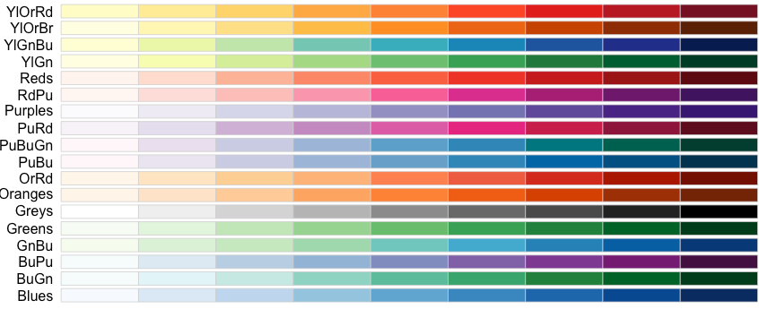
Setting a pre-made color palette for your WC
In R…

Slide 41
Let’s practice!
C_SimpleWordCloud.R

Slide 42
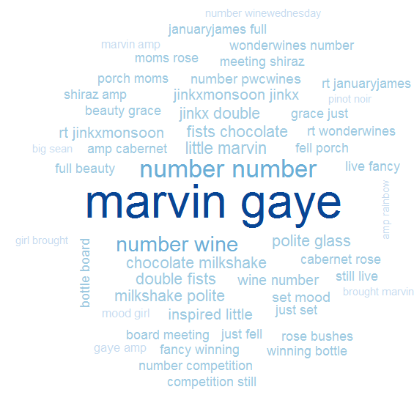
C_SimpleWordCloud.R
Bigram Tokenization has captured “marvin gaye”
A word cloud is a frequency visualization. The larger the term (or bigram here) the more frequent the term.
You may get warnings if certain tokens are to large to be plotted in the graphics device.
Be careful with your preprocessing steps!

Slide 43
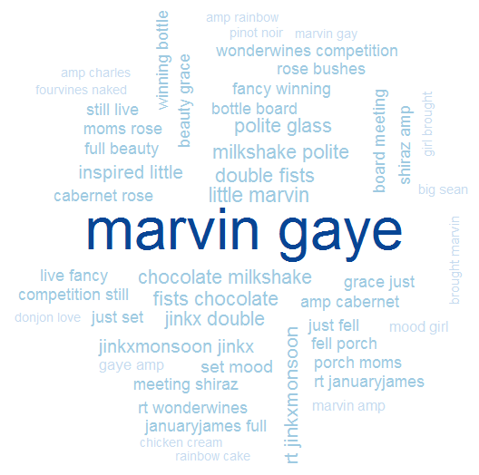
C_SimpleWordCloud.R
In cleanCorpus() the function replace_symbol() changes numeric with the generic string “number” so be careful with your preprocessing steps!

Slide 44
Another WC package
D_d3_wordcloud.R

Slide 45
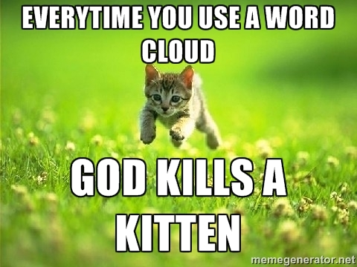
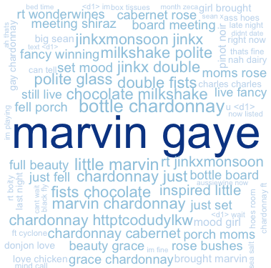
WCs are boring with a single corpus.
Single Corpus
wordcloud( )

Slide 46
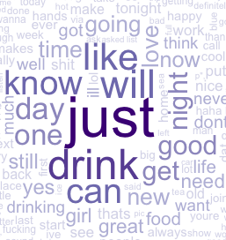
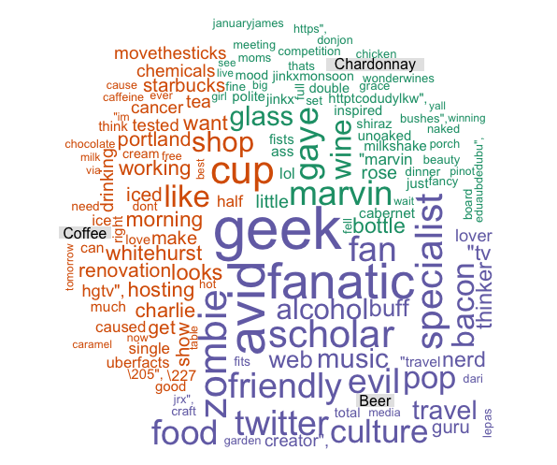
With 2+ Corpora, WCs are more insightful
Multiple Corpora
comparison.cloud( )
commonality.cloud( )
comparison.cloud( )
comparison.cloud( )

Slide 47
Dealing with many text files is tricky.
Option 1
# Read in multiple files as individuals; list.files(); dir()
txtFiles <- c('chardonnay.csv','coffee.csv','beer.csv')
for (i in 1:length(txtFiles)){
assign(txtFiles[i], read.csv(txtFiles[i]))
cat(paste('read completed:',txtFiles[i],'\n'))
}
Using a loop each file is an individual object.

Slide 48
Dealing with many text files is tricky.
Option 2
# Read in multiple files as individuals; list.files(); dir()
txtFiles <- c('chardonnay.csv','coffee.csv','beer.csv')
# Read them into a single list with individual elements
allDocs <- pblapply(txtFiles,read.csv)
With lapply functions each document is a list element of a single object.

Slide 49

Manipulating multiple corpora
Combined/Collapsed
into a 2 document corpus
CorpusA – 1000 Tweets
Clean & Collapse
CorpusB – 1000 Tweets
Clean & Collapse

Slide 50
The new WC will examine inner and disjoins

Slide 51
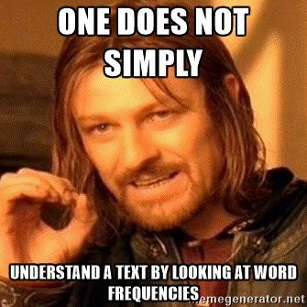
Lets make some improved word clouds
E_CommonalityCloud.R

Slide 52
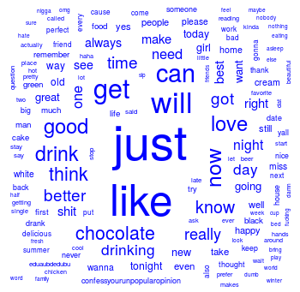
What tokens are in common?

Slide 53
Introducing TF-IDF Term Frequency Inverse Document Frequency
So far, you have used simple term frequency to identify informative words.
Term frequency * inverse-document-frequency
If a term appears often, it must be important to the corpus.
But, if a term appear in many documents, it can’t be distinctive or informative
Increasing
importance
Offsetting
importance
Chardonnay is highly frequent in the tweets, but since it appears in all documents it isn’t informative.

Slide 54
The TF of TF-IDF
Term frequency = Term Occurrence / total unique terms in a document
Term Frequency isn’t just a count. It is normalized because unique terms will naturally increase the longer the document.

Slide 55
Inverse Document Frequency
Inverse Document Frequency =
log(total documents in corpus) / number of documents with term in it
IDF is the natural log of total documents divided by the number of documents containing a specific token.
Notes:
Pg 101 in book has explanation

Slide 56
Original Term Frequency
In 1000 documents suppose token “coffee” occurs 1000 times
TF = 1000

Slide 57
TF-IDF Simple Example
In 1000 documents each of 10 words suppose token “coffee” occurs 1000 times
TF = 1000 / 10 #normalizes to doc length
TF = 100
IDF = log(1000) / 1000
IDF = 6.90 /1000
IDF = .0069
*Caveat – the results in R are normalized/scaled by default.
TF-IDF = 100 * .0069
TF-IDF = .69
Coffee TF = 1000 will look VERY important but TFIDF = 0.69 will correctly have minimal impact for analysis.

Slide 58
Applying TF-IDF to a DTM/TDM
In R…
# Control Paramter
ctrl <- list(weighting = weightTfIdf)
# Apply in TDM/DTM construction
drinkTDM <- TermDocumentMatrix(allDrinks, control = ctrl)
# Change to a simple matrix
drinkTDMm <- as.matrix(drinkTDM)
You can pass in more than one control parameter like tokenization & weighting.

Slide 59
What about disjoint tokens?
F_ComparisonCloud.R

Slide 60
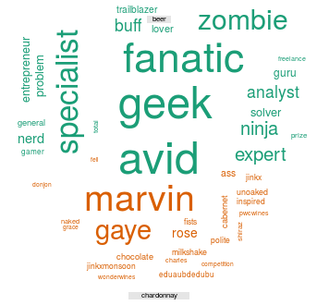
What tokens are in not in common (disjoint)?

Slide 61
Agenda – all times are suggested
Start | End | Tuesday - June 18
8:45 | 9:15 | Coffee
9:15 | 9:30 | Review
9:30 | 10:00 | Basic Visualization & Zipf’s Law
10:00 | 11:00 | Bar Charts, Word Associations, Dendrograms
11:00 | 11:15 | Break
11:15 | 12:00 | Word Networks, Tokenization/Word Clouds
12:00 | 1:30 | Lunch
1:30 | 2:30 | Commonality, Comparison Clouds
2:30 | 3:15 | TF-IDF, Pyramid, bar bell plots

Slide 62
What about proportional similarities?
The problem is that if corpusA has 1 instance & corpus has 1000 they appear as shared.

Slide 63
Steps for a pyramid plot…collapse
Combined/Collapsed
into a 2 document corpus
CorpusA – 1000 Tweets
Clean & Collapse
CorpusB – 1000 Tweets
Clean & Collapse

Slide 64
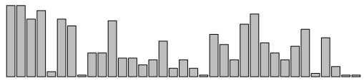
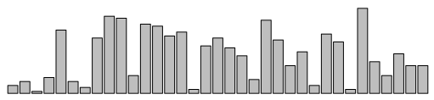
Steps for a pyramid plot…ID common tokens & frequency

Slide 65
Build a “pyramid plot” of frequencies
termA
termB
…
TermN

Slide 66
Open G_Pyramid_BarBell_plots.R

Slide 67
Lab/Homework
30Min : Create Tesco & Carrefour or other corpus visuals
Wordcloud, comparison.cloud(), dendrogram
30Min: Read parts of Chapters 4/5 of Text Mining in Practice w/R
All sections & subsections within 4.1, 4.2, 4.3
All sections & subsections within 5.1, 5.3

