Slide 1


Isabella Zhai
Fan Li
Jason Yu
Jaysen Shi
Music Recommendation

Slide 2
CONTENT
01
02
03
04
Dataset & analytic goals
Preprocessing & time efficiency
Machine learning outcome
Lesson Learned

Slide 3

DATA
This dataset represents a snapshot of the Yahoo! Music community's preferences for various songs. The dataset contains over 717 million ratings of 136 thousand songs given by 1.8 million users of Yahoo! Music services. The data was collected between 2002 and 2006. Each song in the dataset is accompanied by artist, album, and genre attributes. The users, songs, artists, and albums are represented by randomly assigned numeric id's so that no identifying information is revealed. The mapping from genre id's to genre, as well as the genre hierarchy, is given. There are 2 sets in this dataset. Part one is 1.4 Gbytes and part 2 is 1.1 Gbytes.

Slide 4
ANALYTIC GOALS
Using content based method to predict music rating
GREEN
Using collaborative based method to recommend music
Compare the results of different Recommendation methods

Slide 5
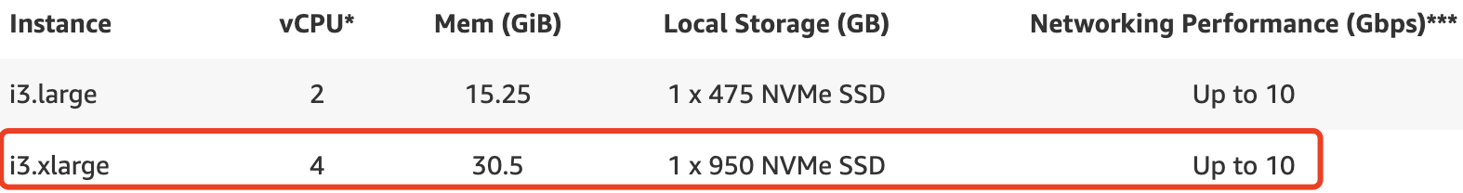
SPECIFICATIONS

Slide 6
Pre-Processing
Split the data into two slices: 80% of the data are using for training, and 20% of the data are using for validation
For efficiency concerns, we further split the dataset by taking a subset of the data.
We added this additional random sampling step because the original dataset was too big to process. For example, it took more than 3hrs originally to do cross validation.
Data Stored on AWS S3
Data cleaning through Spark
Concatenated together all the ratings tables, which contain songid, userid, and ratings
Conducted several stages of merge and groupby to add the song attributes information to the existing rating records

Slide 7


OUTCOME & COMPARISON
Random Forest
Decision Tree
Logistic Regression
SparkML ALS
Accuracy: 0.32
Accuracy: 0.32
RMSE: 1.098
Accuracy: 0.36
F1 score: 0.19
F1 score: 0.15
F1 score: 0.27
Execution time: about 100mins
Execution time: 04:56:07
* Note: with cv
Execution time: 58:55
Execution time: 45:35

Slide 8
Collaborative Filtering
Spark ML has a built in Collaborative Filtering method. The model based collaborative filtering learns the user and item embeddings through matrix factorization by minimizing the RMSE (Root Mean Square Error) between the available ratings and their predicted values.
Alternating Least Squares (ALS) matrix factorization attempts to estimate the ratings matrix as the product of two lower-rank matrices. The general approach is iterative. During each iteration, one of the factor matrices is held constant, while the other is solved for using least squares. The newly-solved factor matrix is then held constant while solving for the other factor matrix.
ALS = ALS(userCol="userId", itemCol="movieId", ratingCol="rating", nonnegative = True, implicitPrefs = False, coldStartStrategy="drop")
Evaluator = RegressionEvaluator ( metricName="rmse", labelCol="label", predictionCol="prediction")

Slide 9
Decision Tree
Trained decision tree model using DecisionTreeClassifier()
Hyperparameters used
Max depth: 10
Max bins: 32
Min instances per node: 1
Metrics Used
MulticlassClassificationEvaluator()
Accuracy
F1 Score
Training Results
Accuracy: 0.31636
F1 Score: 0.15288
Test Results
Accuracy: 0.31689
F1 Score: 0.15330
Overall notebook runtime
58 minutes 55 seconds

Slide 10
Random Forest
Trained random forest model using RandomForestClassifier()
Hyperparameters used (with 3 fold cv)
Max depth: 20
Number of trees: 10
Metrics Used
MulticlassClassificationEvaluator()
Accuracy
F1 Score
Training Results
Accuracy: 0.325
F1 Score: 0.199
Test Results
Accuracy: 0.320
F1 Score: 0.194
Overall notebook runtime
4.49 hr

Slide 11
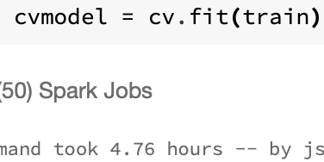
Logistic Regression
SparkML LogisticRegression
5-fold cross-validation on even smaller subset of data with [0, 0.01, 0.1] regularization parameter
The best model from cv had regParam = 0.01, but the result may be different for the original subset
Trained 3 logistic regression models for each regParam in [0, 0.01, 0.1]
Best model: regParam = 0.1
Train, test accuracy: 0.396, 0.359
Train, test f1: 0.307, 0.269

Slide 12
Lessons Learned
Cache
Using cache method wisely on frequently accessed dataframe can reduce processing time.
Content based model
Using simple content based model (Eg. predict rating with given artist id or genre type) does not giving promising prediction results
One-hot vs Embeddings
The models we used to predict ratings used one-hot encoded features. We believe that models that can make use of feature embeddings i.e. matrix factorization, neural networks may be able to predict ratings better than the models we trained

Slide 13
Conclusion
The modeling results were not as good as we thought they would be.
From experience, we think embedding based approach would be better for generating more precise recommendations. In addition, it would be helpful if we have more feature from the dataset helping us to identify the user and item attributes. Nevertheless, it was a very rewarding experience.

