Slide 1
Data.table
Yichien Chou

Slide 2
What is data.frame?
A table or a two-dimensional array-like structure in which each column contains values of one variable and each row contains one set of values from each column.

Slide 3
What is Data.table package?
Extension of data.frame
The package for reducing programming and compute time tremendously

Slide 4
Why use Data.table package?
1. Speed and cleaner syntax
2. No need to specify the variable name over and over
3. Faster and better file reading with fread

Slide 5
Key functions
data.table()
… : Usual recycling rules are applied to vectors of different lengths to create a list of equal length vectors.
keep.rownames : If ... is a matrix or data.frame, TRUE will retain the rownames of that object in a column named rn.
check.names : logical. If TRUE then the names of the variables in the data frame are checked to ensure that they are syntactically valid variable names and are not duplicated.
key : Character vector of one or more column names which is passed to setkey.
stringsAsFactors : Logical (default is FALSE). Convert all character columns to factors.

Slide 6
Key Arguments
dataname [ i, j, by]
i : Subset rows similar to data.frame, but you don’t need to use $ repetitively.
j : Select or compute on columns.
by : Grouping by columns by specifying a list of columns of character vector of column names or even expression.
keyby : Grouping columns to automatically sort the grouped result.
.SD and .Sdcols : To operate on multiple columns using already familiar base functions.

Slide 7
Other Arguments
with : By default with=TRUE and j is evaluated within the frame of x; column names can be used as variables.
nomatch : When a row in i has no match to x, nomatch=NA means NA is returned. NULL means no rows will be returned for that row of i.
mult : When i is a list (or data.frame or data.table) and multiple rows in x match to the row in i, mult controls which are returned: "all" (default), "first" or "last".
which : TRUE returns the row numbers of x that i matches to. If NA, returns the row numbers of i that have no match in x. By default FALSE and the rows in x that match are returned.
verbose : TRUE turns on status and information messages to the console. Turn this on by default using options(datatable.verbose=TRUE).

Slide 8
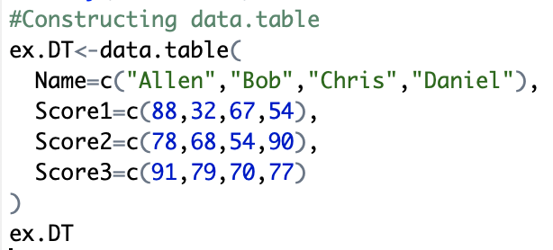
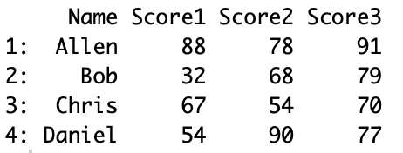
Example
The data.table inherit data.frame, so data.tables can be used exactly like data.frames.

Slide 9
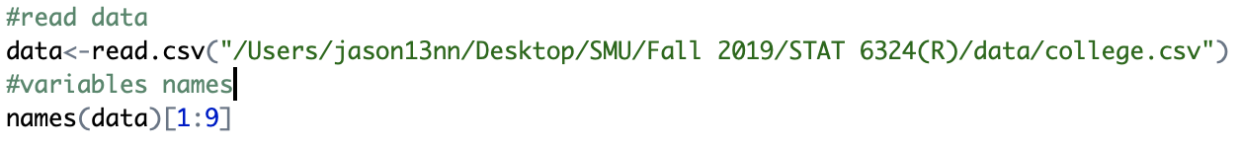
Example

Slide 10


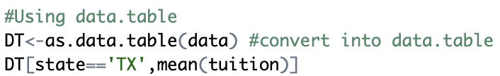
Example

Slide 11
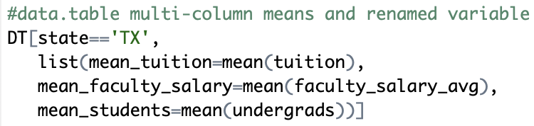
Example

Slide 12

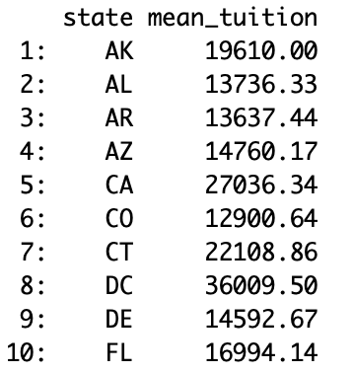
Example

Slide 13
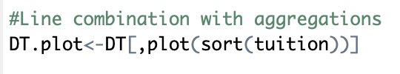
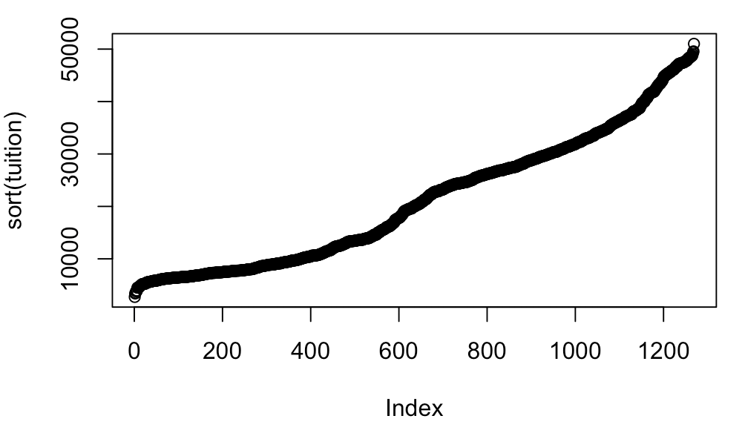
Example

Slide 14
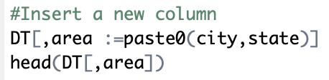
Fast insertion

Slide 15
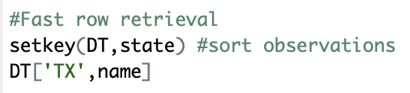
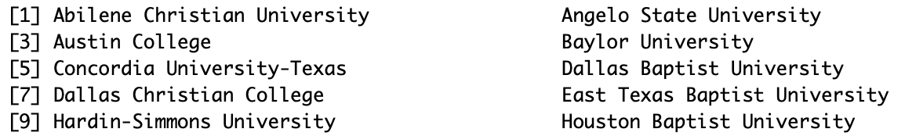
Row retrieval

Slide 16
Summary
1. More terse
2. Faster
3. Less memory
4. Beneficial for aggregation

Slide 17
Thank You!

