Slide 1
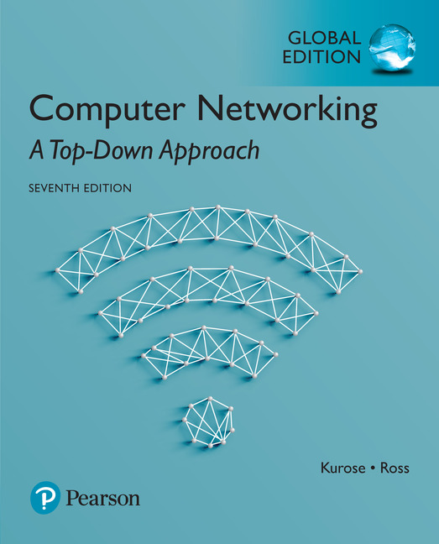

Chapter 1
Introduction
A note on the use of these Powerpoint slides:
We’re making these slides freely available to all (faculty, students, readers). They’re in PowerPoint form so you see the animations; and can add, modify, and delete slides (including this one) and slide content to suit your needs. They obviously represent a lot of work on our part. In return for use, we only ask the following:
Computer Networking: A Top Down Approach
If you use these slides (e.g., in a class) that you mention their source (after all, we’d like people to use our book!)
If you post any slides on a www site, that you note that they are adapted from (or perhaps identical to) our slides, and note our copyright of this material.
Thanks and enjoy! JFK/KWR
All material copyright 1996-2016
J.F Kurose and K.W. Ross, All Rights Reserved
7th Edition, Global Edition
Jim Kurose, Keith Ross
Pearson
April 2016
Introduction
1-1

Slide 2
Info
Text Book:
教科書： Computer Networking: A Top Down Approach Featuring the Internet, 7th edition. Jim Kurose, Keith Ross Addison-Wesley
參考書：Data & Computer Communications, Sixth Edition, William Stalling, Prentice Hall
Introduction
1-<number>

Slide 3
Info
Outline:
簡介網際網路背景與技術 - introduction
網路層級架構 - hierarchical model
網際網路應用層 – HTTP/FTP/EMAIL/P2P concept
網際網路傳輸層 – TCP/UDP concept
網際網路IP 層 – IPv4/IPv6 concept
網際網路路由技術 – RIP/OSPF/BGP concept
網路鏈結層 – MAC/Ethernet/Switch concept
網際網路實習 - Twitch.tv(US$970 million acquired by Amazon), Crawler, …
Introduction
1-<number>

Slide 4
Info
Weighted scores:
期中考試 (mid-term exam) 30%
期末考試 (final-term exam) 30%
作業與實驗 (homework and project) 40%
  Term Project: Individual or Team (plus scores)
Introduction
1-<number>

Slide 5
Info
Outline:
簡介網際網路背景與技術
網路層級架構
網際網路應用層 – HTTP/FTP/EMAIL/P2P 等原理
網際網路傳輸層 – TCP/UDP原理
網際網路IP 層 – IPv4/IPv6原理
網際網路路由技術 – RIP/OSPF/BGP等原理
網際網路實習
Introduction
1-<number>

Slide 6
What you are going to learn?
國內網通產業公司 ? 產品 ? (industry)
SOHO Router
  LAN/WAN/WLAN/ADSL/Cable/WiMAX/GPRS/EDGE/3G/3.5G/4G/BT/BLE
  Ether switch
  DHCP client/server
  NAT
  NTP
  VPN
  VoIP Gateway
  PPPoE
  uPnP
Introduction
1-<number>

Slide 7
What you are going to learn?
  IDS / IPS
  P2P Download Box
  Wireless Video (presentation gateway)
  Wireless Audio
  Storage (NAS, Samba)
  DMZ (Demilitarized Zone)
  Firewall / Waterwall
  AnyIP
  Home Security/Automation
  Printer Server
  Wireless USB
  IPTV (Set-Top-Box)
Introduction
1-<number>

