Slide 1
Small Data
where n=me

Slide 2
What is big data?
An example?

Slide 3
What is BIG?
Adjective
Of considerable size or extent
E.g. big buildings, big staff cuts, her big eyes
E.g. a big girl, my big sister
E.g. a small company with big plans, a big gambler, a big tennis fan
Of considerable importance or seriousness
E.g. it’s a big decision; he made a big mistake
Source: Oxford Dictionaries

Slide 4
Big Data Characteristics
Volume
Velocity
Data streams in at an unprecedented speed and must be dealt with in a timely manner.
Variety
Data comes in all types of formats
Source: https://www.sas.com/en_us/insights/big-data/what-is-big-data.html

Slide 5
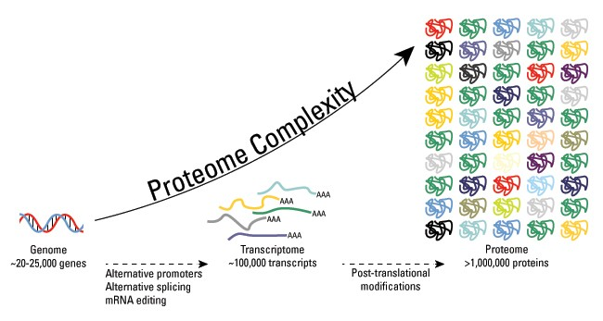
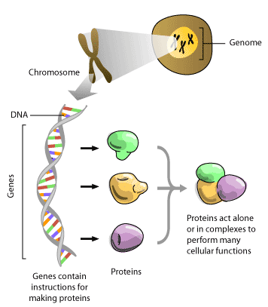
-omics
genomics
The branch of molecular biology concerned with the structure, function, evolution, and mapping of genomes.
proteomics
The study of proteomes and their functions.
metabolomics
The scientific study of the set of metabolites present within an organism, cell, or tissue.

Slide 6
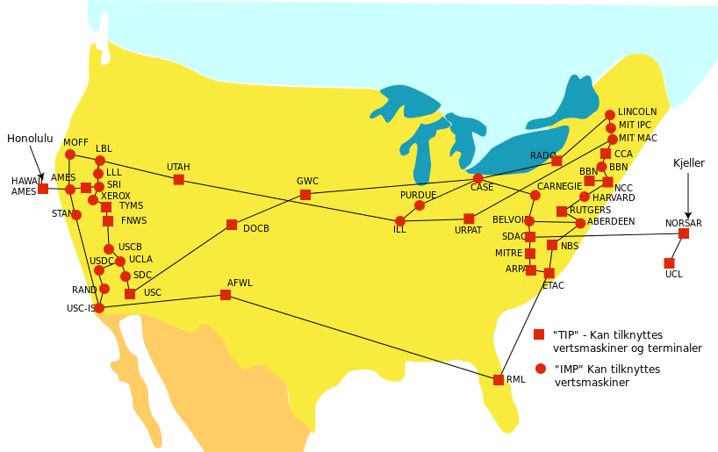
Arpanet
Advanced Research Projects Agency Network
Established in 1969, decommissioned in 1990
An early packet switching network and the first network to implement the protocol suite TCP/IP
Both technologies became the technical foundation of the Internet

Slide 7
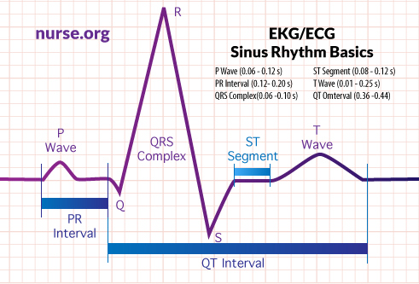
FDA: Food and Drug Administration
HIPAA: Health Insurance Portability and Accountability Act
Crohn’s disease
A type of inflammatory bowel disease
EKG: electrocardiography

Slide 8
What personal data can be collected? Who has the data now?
“trail of data breadcrumbs”, including behaviours
Personalized data-driven insights
Insights ranging from early warning signs of problem, to indicator of gradual improvement

Slide 9
The right time to mine our digital traces
Costs
Digital traces are recorded by the service providers
Benefits for service providers
Marketing and sustaining customer engagement
New service offerings based on small data and personal data repository

Slide 10
Assignment III

Slide 11
Assignment III
Find an example of a company making use of social media
Snapshots of the example
Describe what they do and comment on whether using social media help their businesses. Why or why not?
In paragraphs (min. 100 words)
Filename: [YourStudentId_assignment3.docx, .txt or .pdf]
Upload to e-learning system, find “Assignment III” folder
Deadline: Wednesday, 23 May, 11:30pm
Late submission will not be accepted

Slide 12
Before the next class
Printout
7 hbr.org-To-Get-More-Out-of-Social-Media-Think-Like-an-Anthropologist-2.pdf

