Slide 1
Chapter 12
Analysis of Variance
https://www.youtube.com/watch?v=-yQb_ZJnFXw
https://www.youtube.com/watch?v=ITf4vHhyGpc

Slide 2
Chapter 12 Overview
Introduction
12-1 One-Way Analysis of Variance
12-2 The Scheffé Test and the Tukey Test
12-3 Two-Way Analysis of Variance

Slide 3
Chapter 12 Objectives
Use the one-way ANOVA technique to determine if there is a significant difference among three or more means.
Determine which means differ, using the Scheffé or Tukey test if the null hypothesis is rejected in the ANOVA.
Use the two-way ANOVA technique to determine if there is a significant difference in the main effects or interaction.

Slide 4
變異數分析
變異數分析的基本概念
單因子
變異數分析
二因子
變異數分析
設立兩個假設
多重比較法
檢定統計量
決策法則

Slide 5
Section 12-2
The Scheffé Test and the Tukey Test

Slide 6
12-2 The Scheffé Test and the Tukey Test
When the null hypothesis is rejected using the F test, the researcher may want to know where the difference among the means is.
The Scheffé test and the Tukey test are procedures to determine where the significant differences in the means lie after the ANOVA procedure has been performed.

Slide 7
The Scheffé Test
In order to conduct the Scheffé test, one must compare the two means at a time, using all possible combinations of means.
For example, if there are three means, the following comparisons must be done:

Slide 8
Formula for the Scheffé Test
MSW
where and are the means of the samples being compared, and are the respective sample sizes, and the within-group variance is or MSW.

Slide 9
F Value for the Scheffé Test
To find the critical value F′ for the Scheffé test, multiply the critical value for the F test by k − 1:
There is a significant difference between the two means being compared when F_{s} is greater than F′.

Slide 10
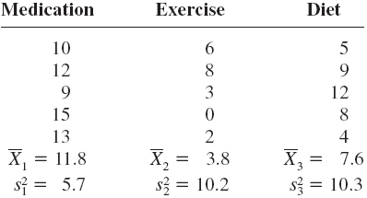
Example: Lowering Blood Pressure
A researcher wishes to try three different techniques to lower the blood pressure of individuals diagnosed with high blood pressure. The subjects are randomly assigned to three groups; the first group takes medication, the second group exercises, and the third group follows a special diet. After four weeks, the reduction in each person’s blood pressure is recorded. At α = 0.05, test the claim that there is no difference among the means.

Slide 11
Example: Lowering Blood Pressure
Step 1: State the hypotheses and identify the claim.
H₀: μ₁ = μ₂ = μ₃ (claim)
H₁: At least one mean is different from the others.

Slide 12
Example: Lowering Blood Pressure
Step 2: Find the critical value.
Since k = 3, n = 15, and α = 0.05,
d.f.N. = k – 1 = 3 – 1 = 2
d.f.D. = n – k = 15 – 3 = 12
The critical value is 3.89, obtained from Table H.

Slide 13
Example: Lowering Blood Pressure
Step 3: Compute the test value.
Find the mean and variance of each sample (these were provided with the data).
Find the grand mean, the mean of all values in the samples.
c. Find the between-group variance, MSB or .

Slide 14
Example: Lowering Blood Pressure
Step 3: Compute the test value. (continued)
c. Find the between-group variance, MSA, MSB, .
Find the within-group variance, MSW, .
MSB=
MSW=
W

Slide 15
Example: Lowering Blood Pressure
Step 3: Compute the test value. (continued)
e. Compute the F value.
Step 4: Make the decision.
Reject the null hypothesis, since 9.17 > 3.89.
Step 5: Summarize the results.
There is enough evidence to reject the claim and conclude that at least one mean is different from the others.

Slide 16
Example: Lowering Blood Pressure
The ANOVA table:
Source | Sum of Squares | d.f. | Mean Squares | F
Between Within (error) | 160.13 104.80 | 2 12 | 80.07 8.73 | 9.17
Total | 264.93 | 14
CV: F(2,12) = 3.89

Slide 17
Example: Lowering Blood Pressure
Using the Scheffé test, test each pair of means in last example (Lowering Blood Pressure) to see whether a specific difference exists, at α = 0.05.

Slide 18
Example: Lowering Blood Pressure
Using the Scheffé test, test each pair of means in last example (Lowering Blood Pressure) to see whether a specific difference exists, at α = 0.05.

Slide 19
Example: Lowering Blood Pressure
The critical value for the ANOVA for the example:
α = 0.05, d.f.N. = 2, and d.f.D. = 12
In this case, the critical value is multiplied by k – 1:
Since only the F test value for part a ( versus ) is greater than the critical value, 7.78, the only significant difference is between and , that is, between medication and exercise.

Slide 20
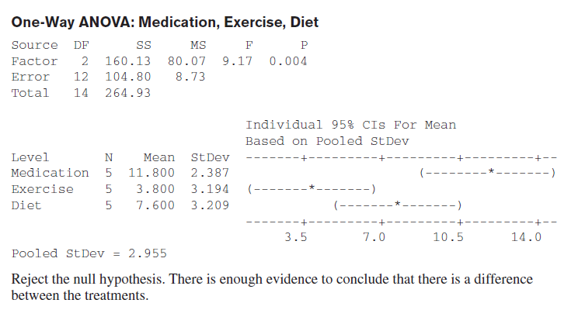

Slide 21
An Additional Note
On occasion, when the F test value is greater than the critical value, the Scheffé test may not show any significant differences in the pairs of means. This result occurs because the difference may actually lie in the average of two or more means when compared with the other mean. The Scheffé test can be used to make these types of comparisons, but the technique is beyond the scope of this book.

Slide 22
The Tukey Test
The Tukey test can also be used after the analysis of variance has been completed to make pairwise comparisons between means when the groups have the same sample size.
The symbol for the test value in the Tukey test is q.

Slide 23
Formula for the Tukey Test
Where and are the means of the samples being compared, n is the size of the sample, and the within-group variance is or MSW.

Slide 24
Example: Lowering Blood Pressure
Using the Tukey test, test each pair of means in the example of Lowering Blood Pressure to see whether a specific difference exists, at α = 0.05.

Slide 25
Example: Lowering Blood Pressure
Using the Tukey test, test each pair of means in the example of Lowering Blood Pressure to see whether a specific difference exists, at α = 0.05.

Slide 26
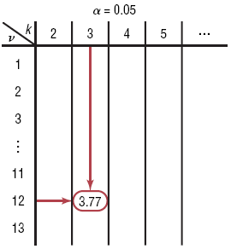
Example: Lowering Blood Pressure
To find the critical value for the Tukey test, use Table N.
The number of means k is found in the row at the top, and the degrees of freedom for are found in the left column (denoted by v).
Since k = 3, d.f. = 12, and α = 0.05, the C.V. is 3.77.

Slide 27
Example: Lowering Blood Pressure
Hence, the only q value that is greater in absolute value than the critical value is the one for the difference between and . The conclusion, then, is that there is a significant difference in means for medication and exercise.
These results agree with the Scheffé analysis.

Slide 29
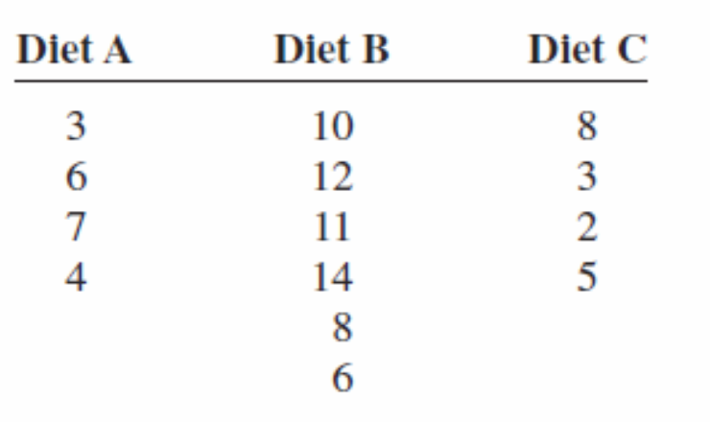
A researcher wishes to see whether there is any difference in the weight gains of athletes following one of three special diets. Athletes are randomly assigned to three groups and placed on the diet for 6 weeks. The weight gains (in pounds) are shown here. At a 0.05, can the researcher conclude that
there is a difference in the diets?

Slide 30
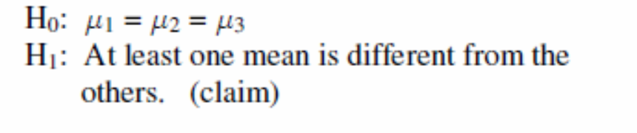
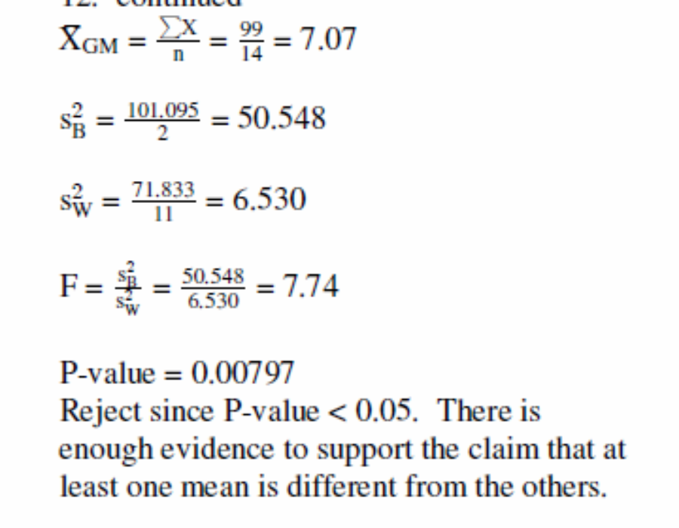

Slide 32
Section 12-3
Two-Way Analysis of Variance

Slide 33
12-3 Two-Way Analysis of Variance

Slide 34
Example: Two-Way NOVA
A research wishes to test the effects of two different types of plant food and two different types of soil on the growth of certain plants.
 |  | Soil type
 |  | I | II
Plant food | A1 | Group 1 | Group 2
 | A2 | Group 3 | Group 4
Two independent variables:
→ the type of plant food
→ the type of soil
One dependent variable:
→ The plant growth

Slide 35
Example: Two-Way NOVA
Questions:
Whether there is a difference in means of heights of plants growing using different soil?
Whether there is a difference in means of heights of plants growing using different foods?
Whether there is an interaction effect between type of plant food used and type of soil used on plant growth?
 |  | Soil type
 |  | I | II
Plant food | A1 | Group 1 | Group 2
 | A2 | Group 3 | Group 4

Slide 36
Example: Two-Way NOVA
The plant growth
Plant food II
The plant growth
Plant food II
Plant food I
Plant food I
Type I
Type II
Soil
Type I
Type II
Soil

Slide 37
12-3 Two-Way Analysis of Variance
The purposes of the two-way ANAVA
To test the effects of two independent variables or factors on one dependent variable.
To test the interaction effect of the two variables
Variables
Two independent variables– categorical
One dependent variable– continuous

Slide 38
Two-Way Analysis of Variance
Variables or factors are changed between two levels (i.e., two different treatments).
The groups for a two-way ANOVA are sometimes called treatment groups.
A two-way ANOVA has several null hypotheses. There is one for each independent variable and one for the interaction.

Slide 39
Two-Way ANOVA Summary Table
Source | Sum of Squares | d.f. | Mean Squares | F
Factor A Factor B Interaction A X B Within (error) | SS_{A} SS_{B} SS_{A×B} SS_{W} | a-1 b-1 (a-1)(b-1) ab(n-1) | MS_{A} MS_{B} MS_{A×B} MS_{W} | F_{A} F_{B} F_{A×B}
Total | SST | n-1

Slide 40
Assumptions for Two-Way ANOVA
The populations from which the samples were obtained must be normally or approximately normally distributed.
The samples must be independent.
The variances of the populations from which the samples were selected must be equal.
The groups must be equal in sample size.

Slide 41
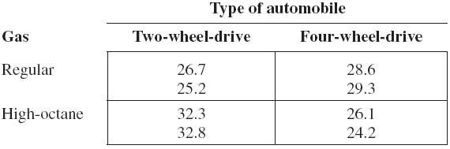
Example 12-5: Gasoline Consumption
A researcher wishes to see whether the type of gasoline used and the type of automobile driven have any effect on gasoline consumption. Two types of gasoline, regular and high-octane, will be used, and two types of automobiles, two-wheel- and four-wheel-drive, will be used in each group. There will be two automobiles in each group, for a total of eight automobiles used. Use a two-way analysis of variance at α = 0.05.

Slide 42
Example 12-5: Gasoline Consumption
A researcher wishes to see whether the type of gasoline used and the type of automobile driven have any effect on gasoline consumption. Two types of gasoline, regular and high-octane, will be used, and two types of automobiles, two-wheel- and four-wheel-drive, will be used in each group.
Research question:
Is there difference in means of gasoline consumption for differing type of gasoline and type of automobile?
Two factors:
Factor A: type of gasoline—
two levels: regular and high-octane
Factor B: type of automobile—
two levels: two-wheel- and four-wheel-drive

Slide 43
Example 12-5: Gasoline Consumption
Step 1: State the hypotheses.
The hypotheses for the gasoline types are
H₀: There is no difference between the means of gasoline consumption for two types of gasoline.
H₁: There is a difference between the means of gasoline consumption for two types of gasoline.

Slide 44
Example 12-5: Gasoline Consumption
Step 1: State the hypotheses.
The hypotheses for the types of automobile driven are
H₀: There is no difference between the means of gasoline consumption for two-wheel-drive and four-wheel-drive automobiles.
H₁: There is a difference between the means of gasoline consumption for two-wheel-drive and four-wheel-drive automobiles.

Slide 45
Example 12-5: Gasoline Consumption
Step 1: State the hypotheses.
The hypotheses for the interaction are these:
H₀: There is no interaction effect between type of gasoline used and type of automobile a person drives on gasoline consumption.
H₁: There is an interaction effect between type of gasoline used and type of automobile a person drives on gasoline consumption.

Slide 46
Example 12-5: Gasoline Consumption
Step 2: Find the critical value for each.
Since α = 0.05, d.f.N. = 1, and d.f.D. = 4 for each of the factors, the critical values are the same, obtained from Table H as
Step 3: Find the test values.
Since the computation is quite lengthy, we will use the summary table information obtained using statistics software such as Minitab.

Slide 47
Two-Way ANOVA Summary Table
Source | Sum of Squares | d.f. | Mean Squares | F
Factor A Factor B Interaction A X B Within (error) | SS_{A} SS_{B} SS_{A×B} SS_{W} | a-1 b-1 (a-1)(b-1) ab(n-1) | MS_{A} MS_{B} MS_{A×B} MS_{W} | F_{A} F_{B} F_{A×B}
Total | SST | n-1

Slide 48
Example 12-5: Gasoline Consumption
Two-Way ANOVA Summary Table
Source | Sum of Squares | d.f. | Mean Squares | F
Gasoline A Automobile B Interaction A X B Within (error) | 3.920 9.680 54.080 3.300 | 1 1 1 4 | 3.920 9.680 54.080 0.825 | 4.752 11.733 65.552
Total | 70.890 | 7

Slide 49
Example 12-5: Gasoline Consumption
Step 4: Make the decision.
Since F_{B} = 11.733 and F_{AXB} = 65.552 are greater than the critical value 7.71, the null hypotheses concerning the type of automobile driven and the interaction effect should be rejected.
Step 5: Summarize the results.
Since the null hypothesis for the interaction effect was rejected, it can be concluded that the combination of type of gasoline and type of automobile does affect gasoline consumption.

Slide 50
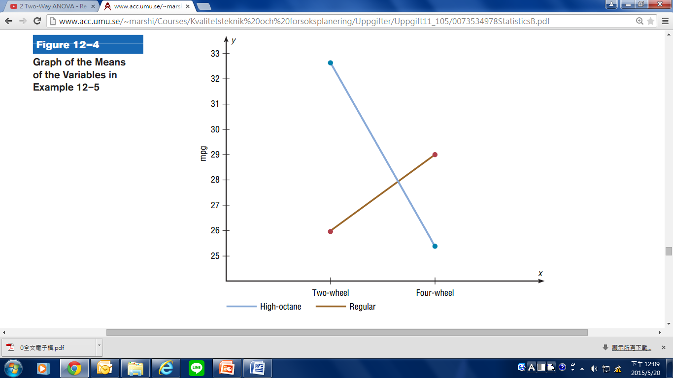
Main effect of Example 12-5
Gas | Type of automobile
 | Two-wheel drive | four-wheel drive
Regular
High-

Slide 51
