Slide 1

Vanguard Marketplace
Ruby on Rails web application

Slide 2
Introduction
Purpose of the project
How I approached it
What Difficulty I faced
How long it took
Why I chose my design
What did I not like about my design
What will I improve on next time

Slide 3

Features
Navbar
Homepage
Listing Page
Sold Listings page
Edit listings
User authorisation
Third party API (S3, Stripe API)
Forms using Formspree
Bootstrap
Heroku used as application host

Slide 4
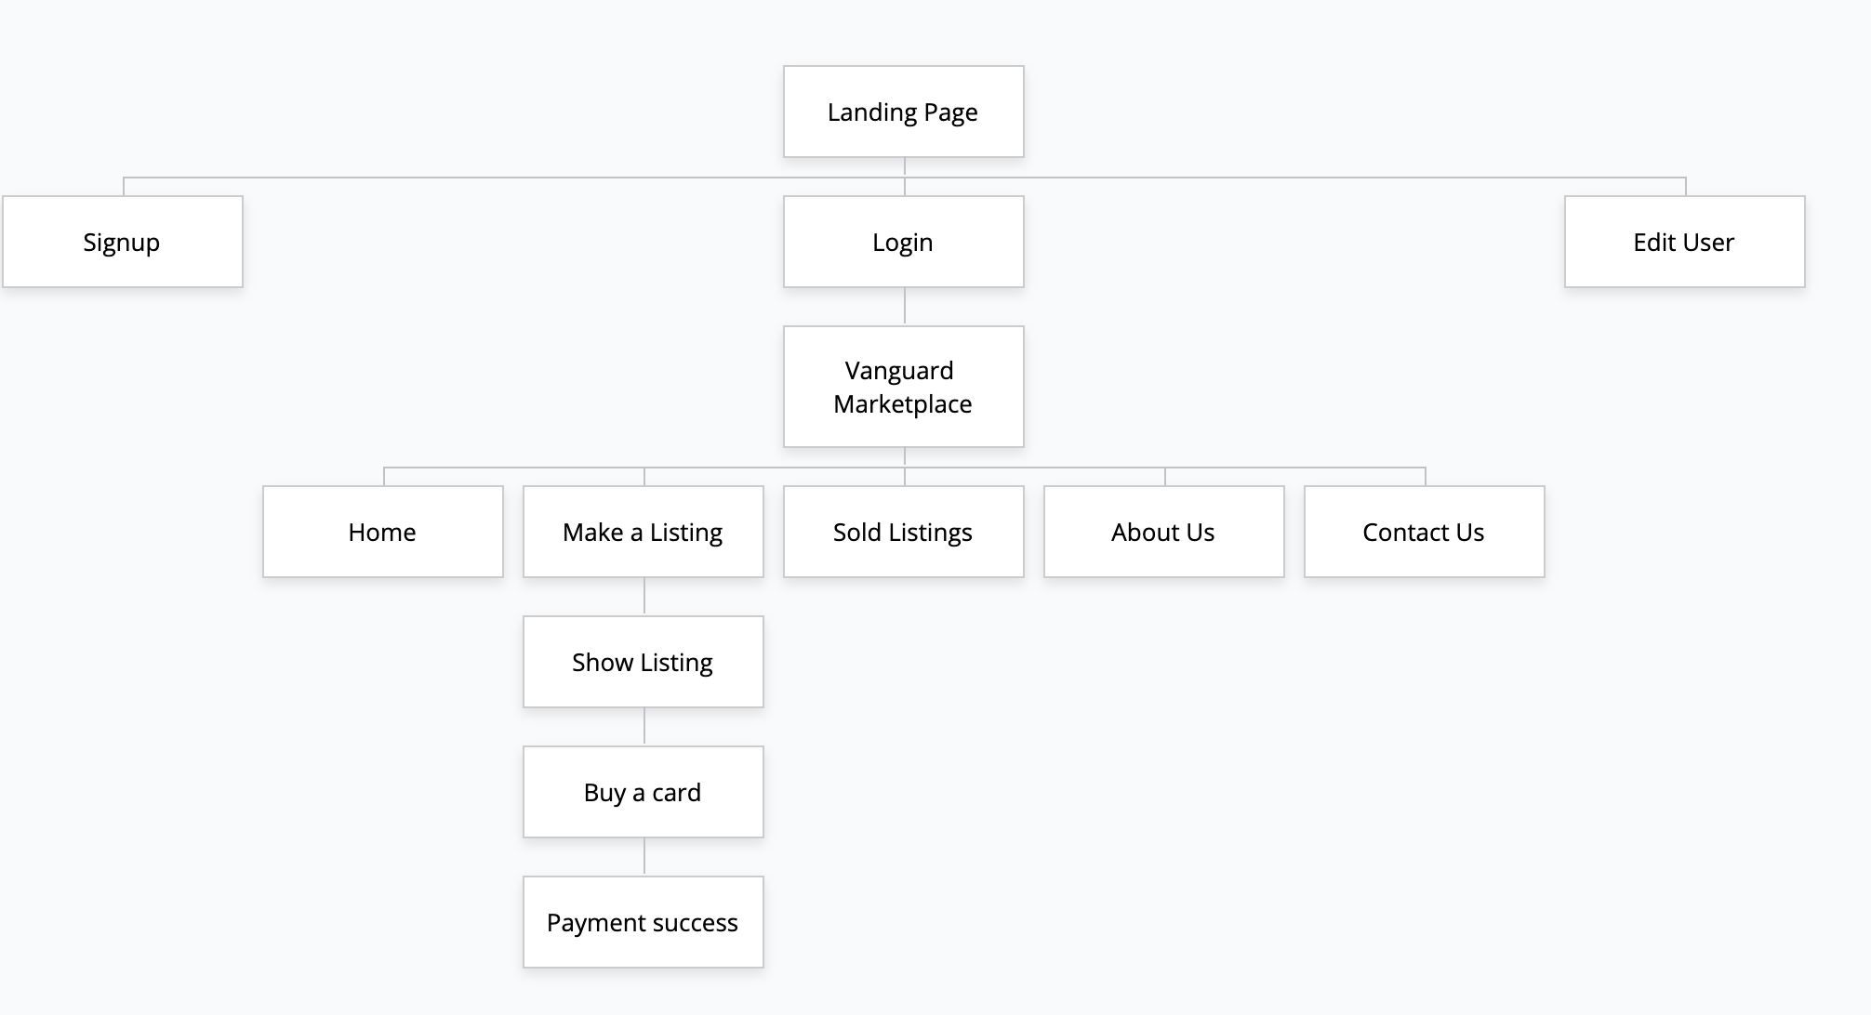
Sitemap for Portfolio

Slide 5
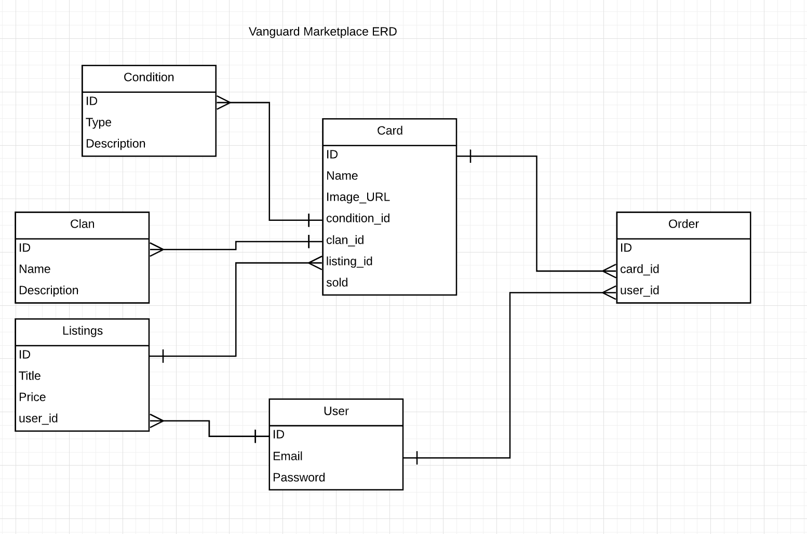
Entity Relationship Diagram

Slide 6
Wireframes
Wanted my marketplace wireframe to look similar to my portfolio for the navbar and design
Had a few ideas in mind on how the marketplace would look like
Was one of the hardest parts of the project other than ERD

Slide 7
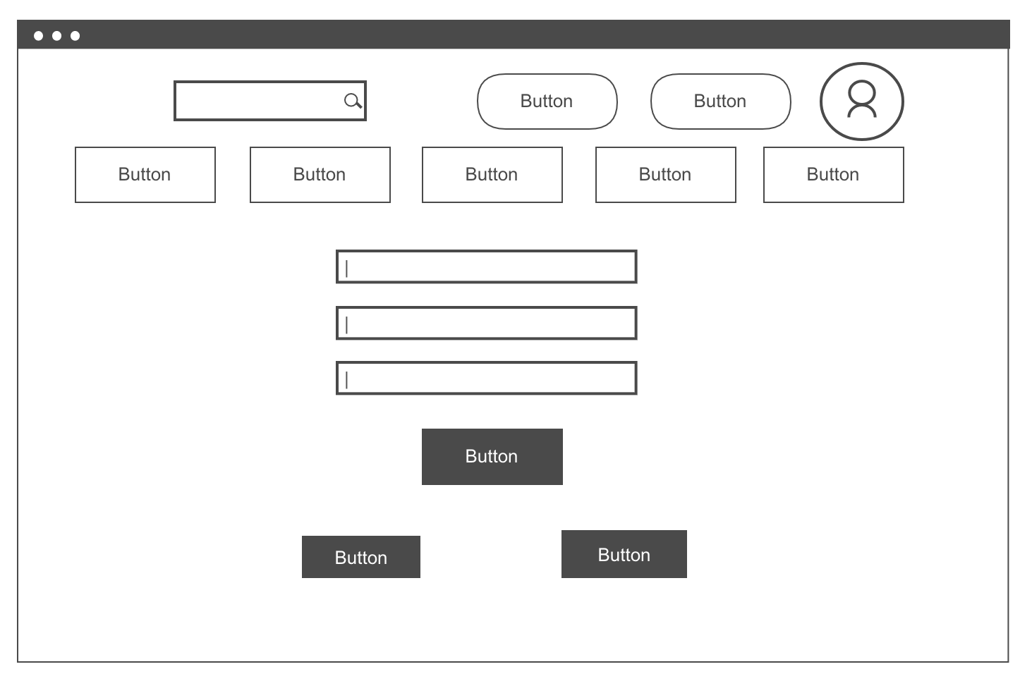
Login page
Searchbar
User details
Navbar
Login Details
Login button
Signup
Forgot password

Slide 8
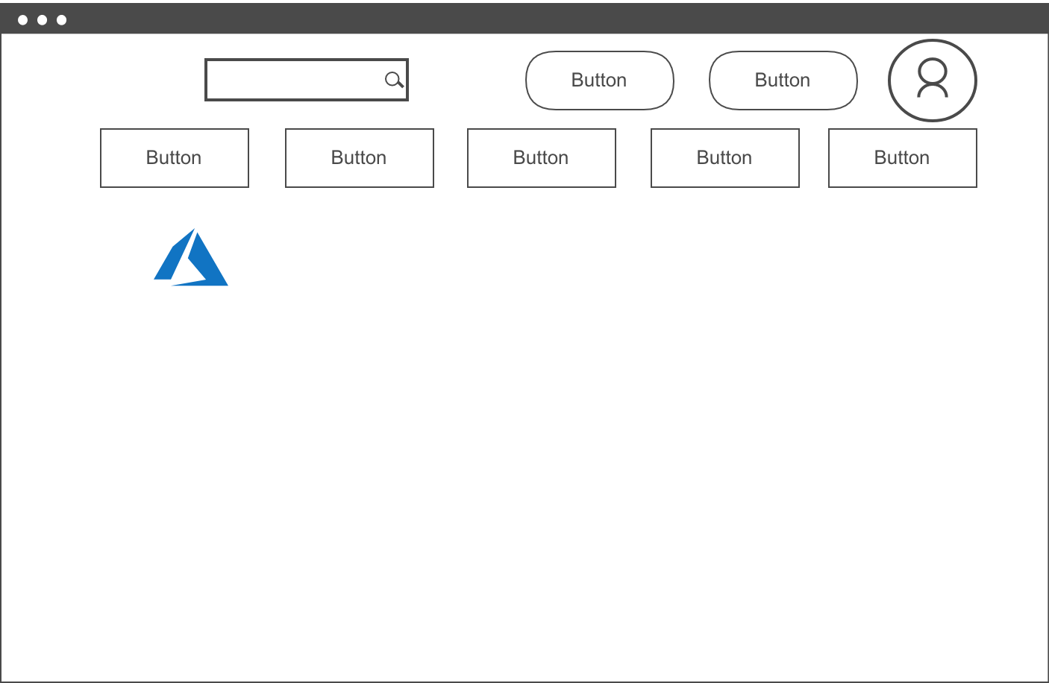
HomePage
Searchbar
User details
Navbar
Logo

Slide 9
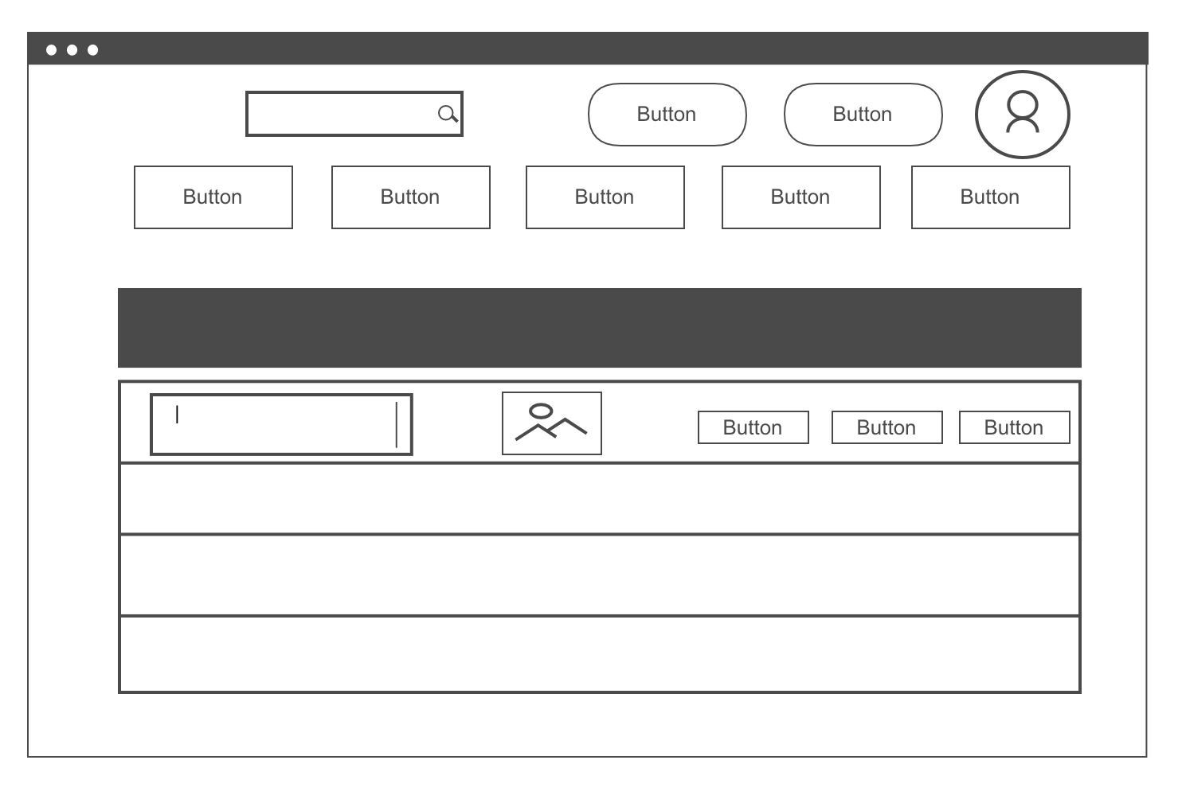
Listings Page
Searchbar
User Details
Navbar
Listing
Show Edit Destroy
Picture

Slide 10
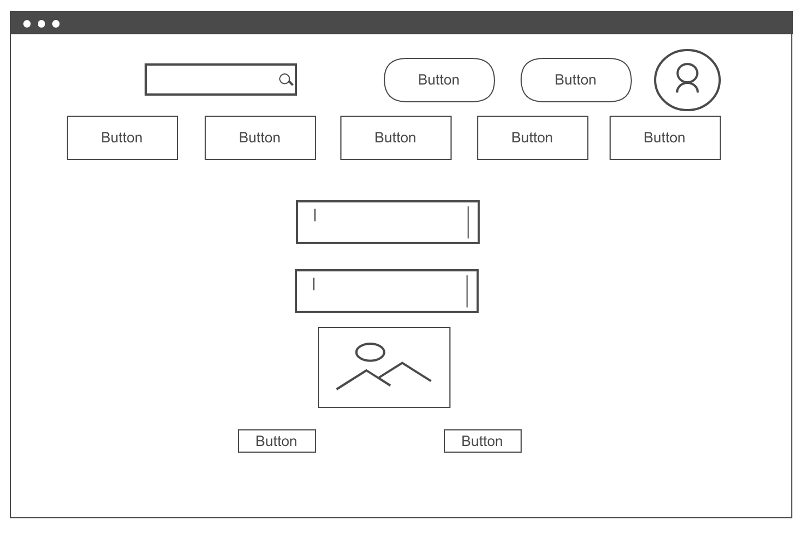
Show/Buy Page
Searchbar
User Details
Navbar
Listing Details
Card Listing Picture
Buy / List for sale button
Back

Slide 11
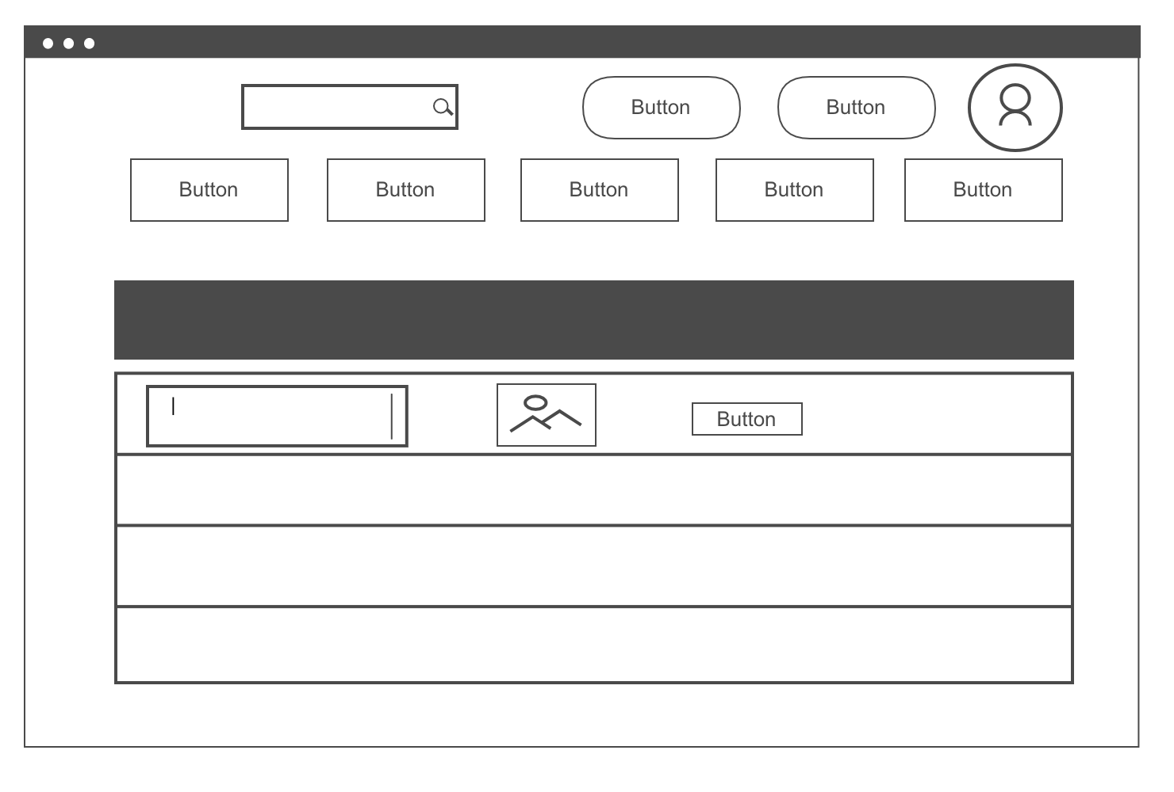
Sold Listings Page
Searchbar
User Details
Navbar
Listing
Destroy
Picture

Slide 12
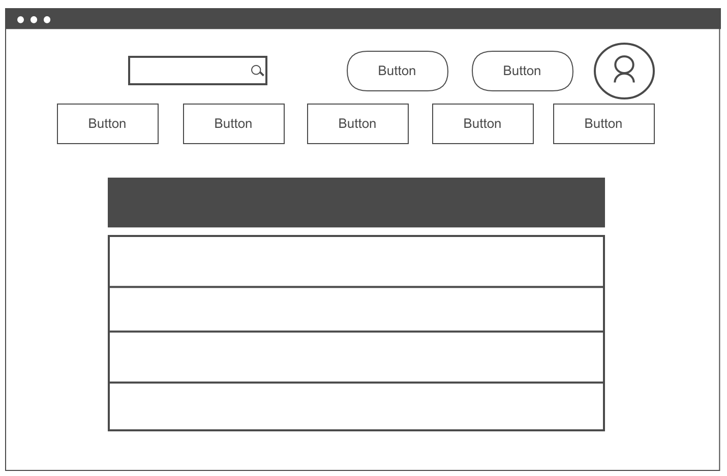
About Us Page
Searchbar
User Details
Navbar
Title
Text

Slide 13
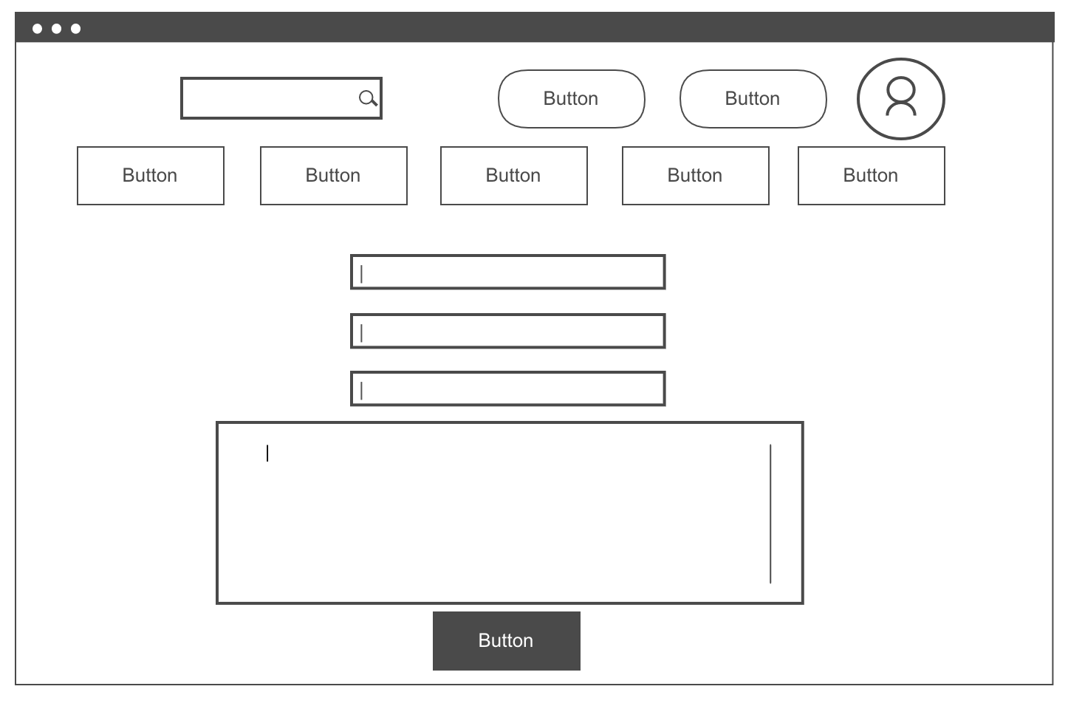
Contact us Page
Searchbar
User Details
Navbar
User Details form
Message content
Submit button

Slide 14

Heroku live application
https://cryptic-oasis-30547.herokuapp.com/

Slide 15
Thank you very much for listening!

