Slide 1

Vanguard Marketplace
Ruby on Rails web application

Slide 2
Introduction
Purpose of the project
How I approached it
What Difficulty I faced
How long it took
Why I chose my design
What did I not like about my design
What will I improve on next time

Slide 3

Features
Navbar
Homepage
Listing Page
Sold Listings page
Edit listings
User authorisation
Third party API (S3, Stripe API)
Forms using Formspree
Bootstrap
Heroku used as application host

Slide 4
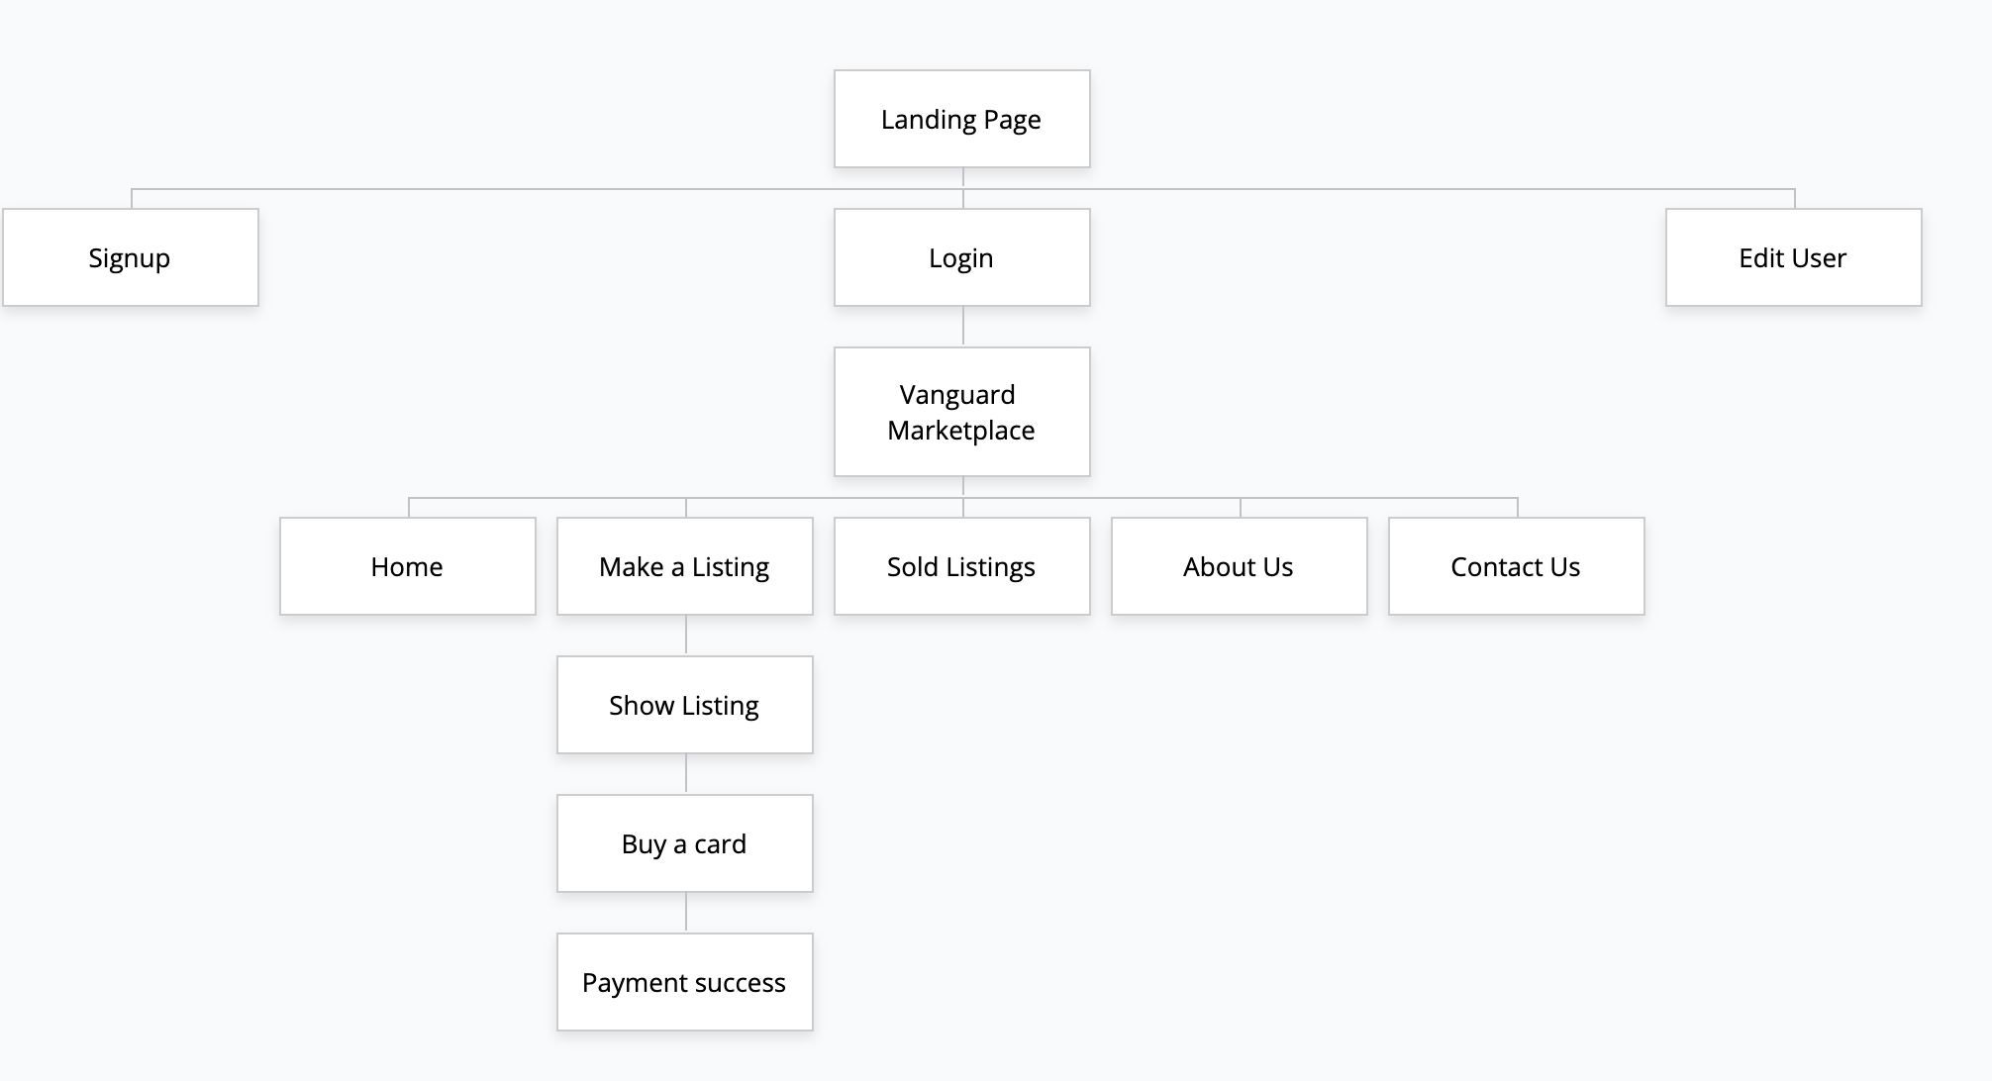
Sitemap for Portfolio

Slide 5
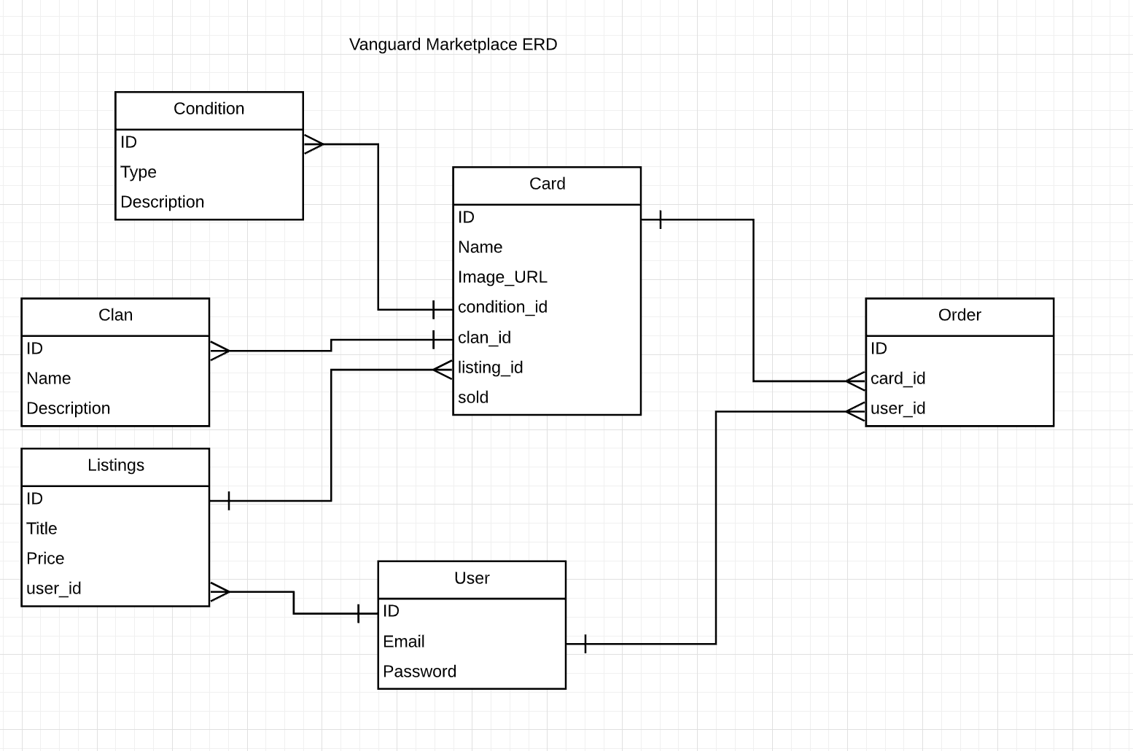
Entity Relationship Diagram

Slide 6
Wireframes
Wanted my marketplace wireframe to look similar to my portfolio for the navbar and design
Had a few ideas in mind on how the marketplace would look like
Was one of the hardest parts of the project other than ERD

Slide 7
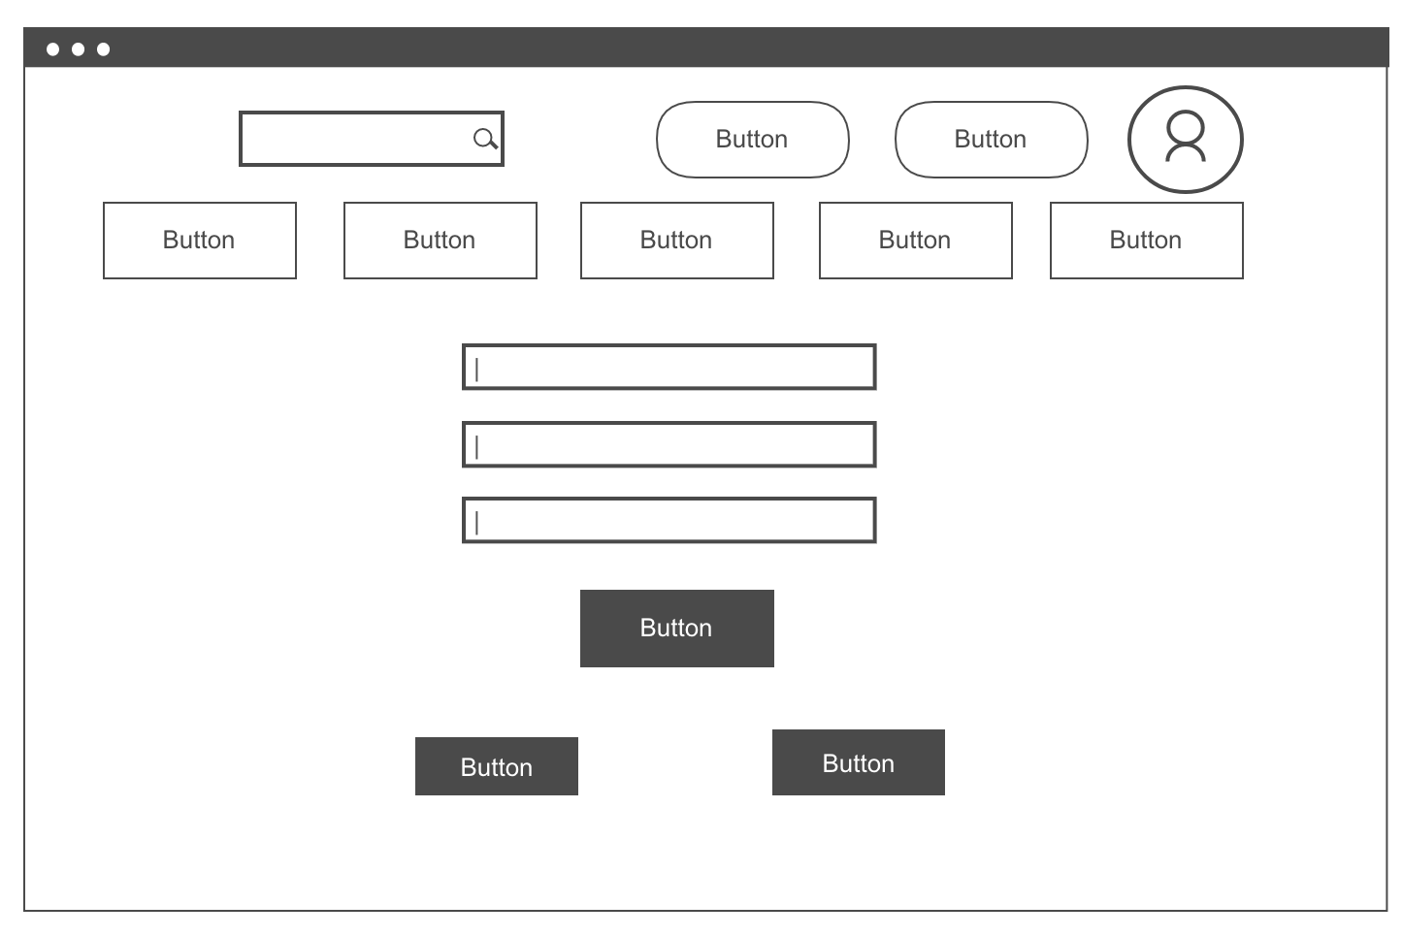
Login page

Slide 8
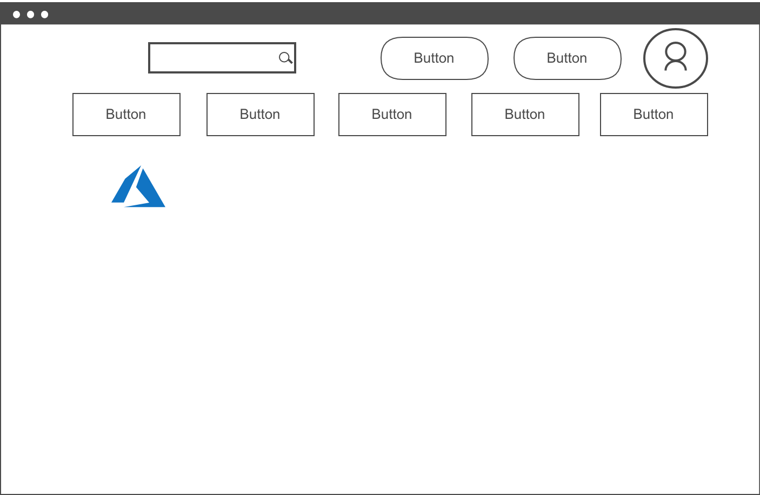
HomePage

Slide 9
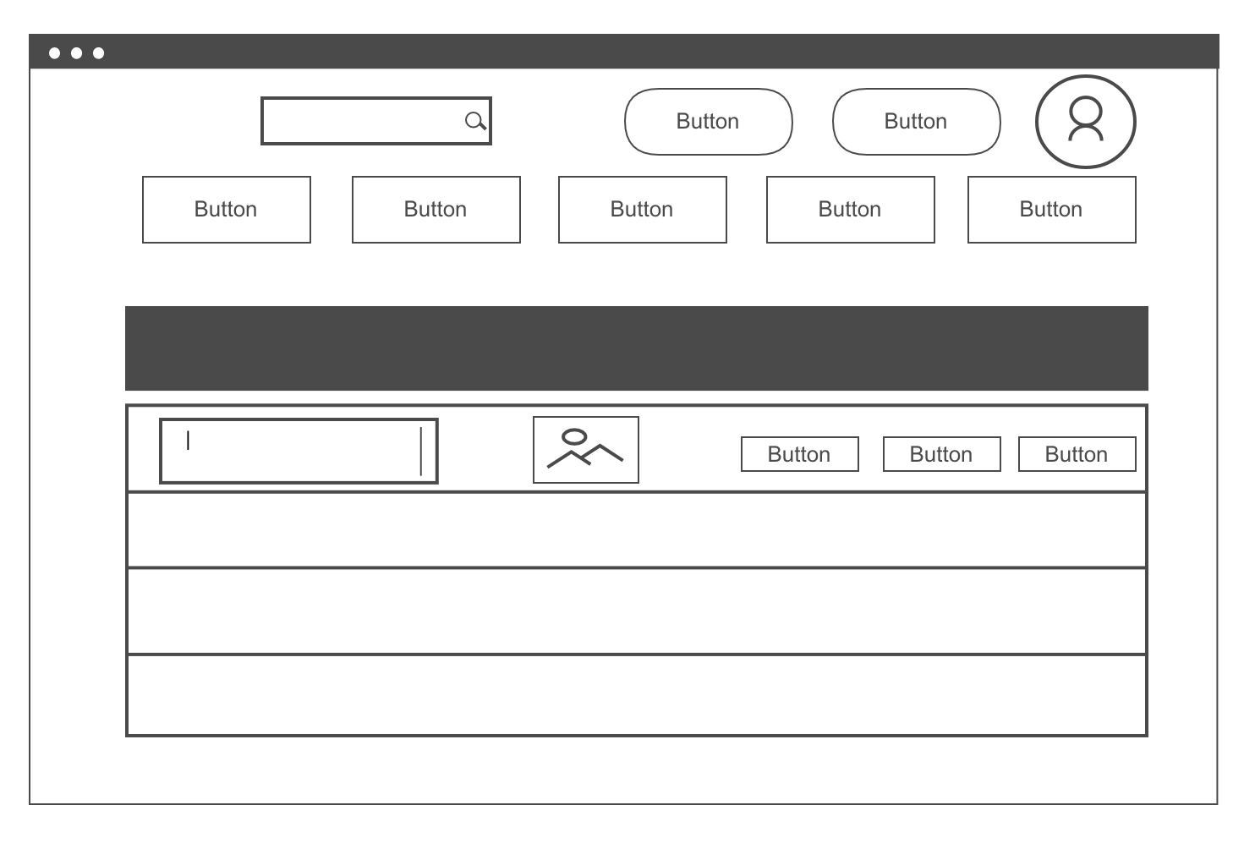
Listings Page

Slide 10
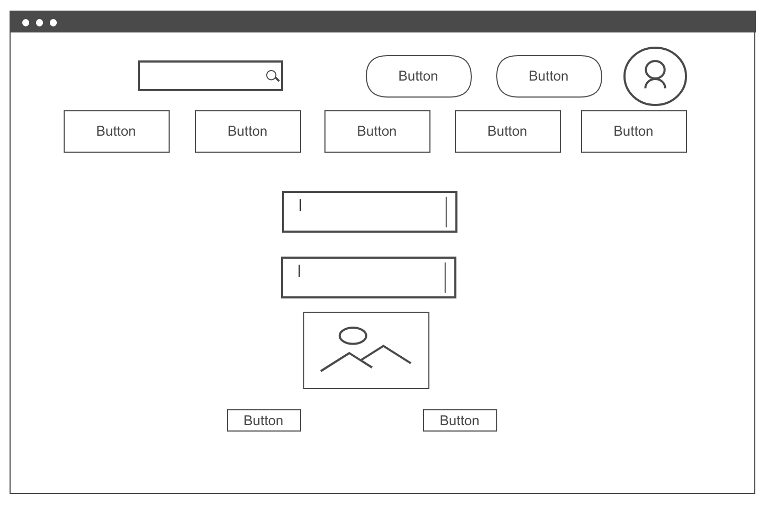
Show/Buy Page

Slide 11
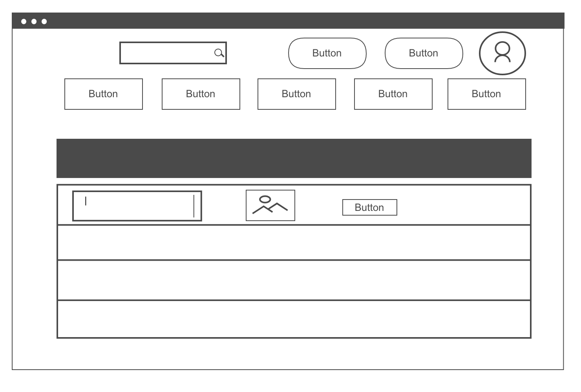
Sold Listings Page

Slide 12
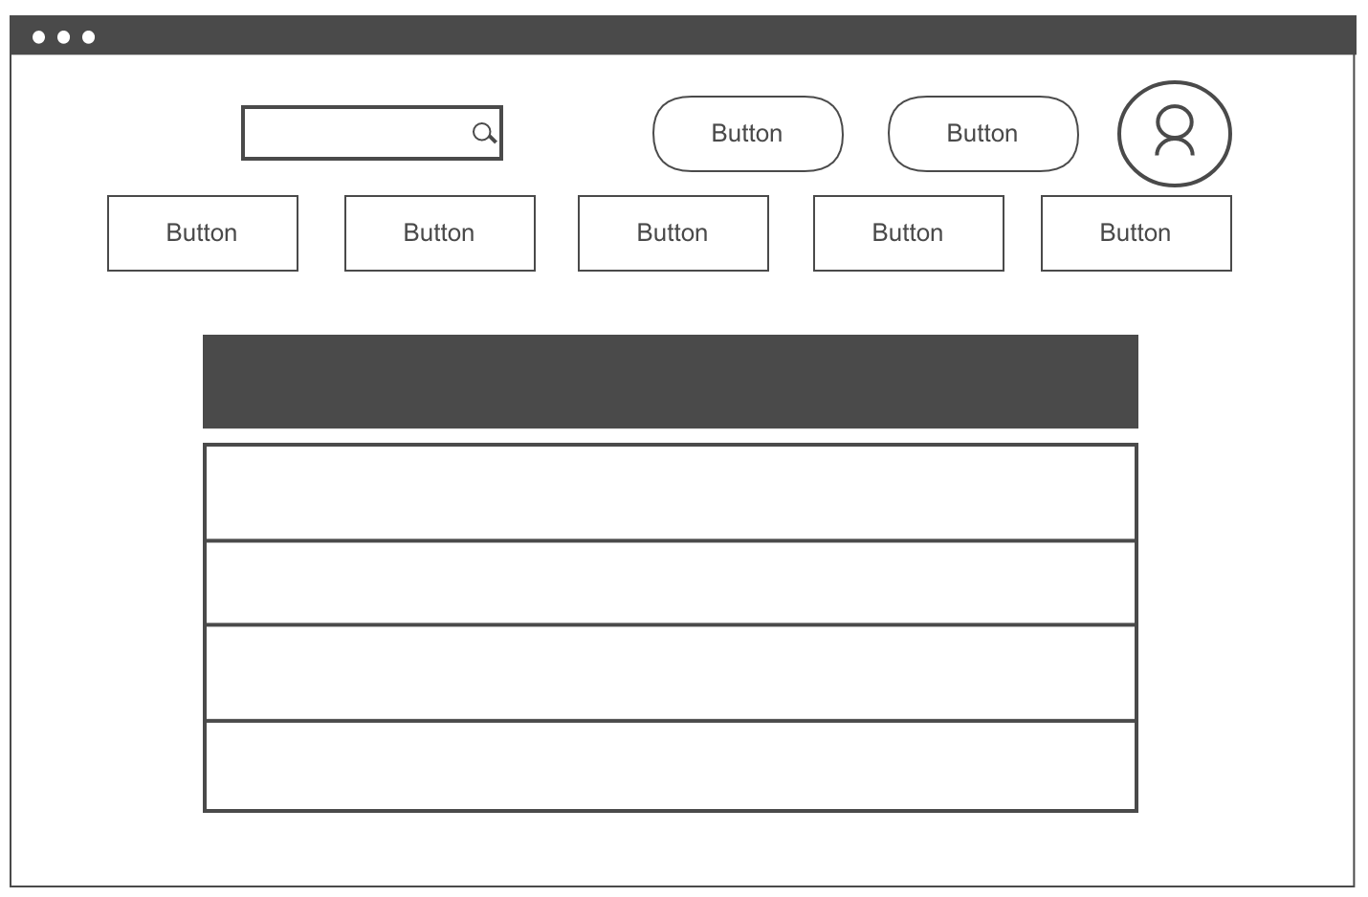
About Us Page

Slide 13
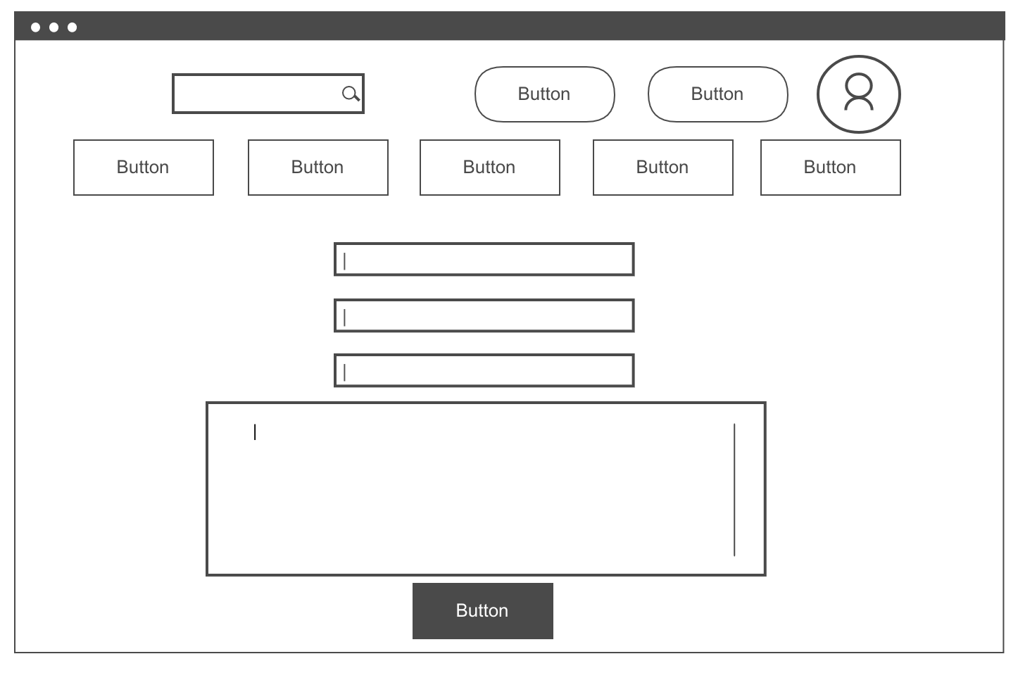
Contact us Page

Slide 14

Thank you very much for listening!

