Slide 1
Chapter One Probability
Sample space（样本空间）
Probability measure（概率测度）
Probability computation（概率计算）
Conditional probability（条件概率）
Independence（独立性）

Slide 2
Chapter One Probability
Sample space（样本空间）
Probability measure（概率测度）
Probability computation（概率计算）
Conditional probability（条件概率）
Independence（独立性）

Slide 3





Background
Toss two coins separately and record the results of Head or Tail. The sample space is
$$Ω=\{HH,HT,TH,TT\}$$
Let$A=\left\{the first coin is head\right\}, B=\{the second coin is head\}$ be two events.
Intuitively
There is no relationship between A and B. They are independent from each other.
Mathematically
A, B independent
(独立)
$$P\left(A | B\right)=P\left(A\right),P\left(B | A\right)=P(B)$$
$$P\left(AB\right)=P\left(A | B\right)P(B)$$
$$=P\left(B | A\right)P(A)$$
$$=P\left(A\right)P(B)$$

Slide 4


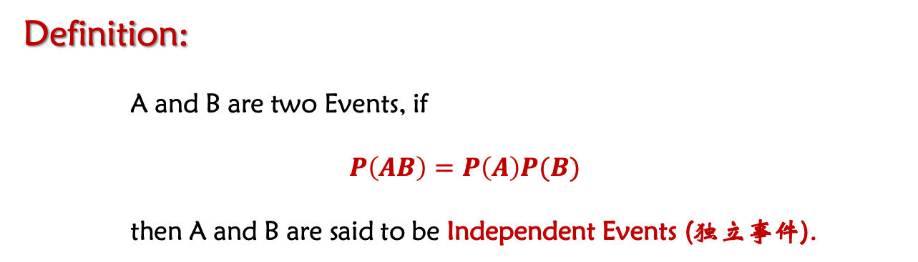


Mathematically
A,B independent
(独立性)
$$P\left(A | B\right)=P\left(A\right),P\left(B | A\right)=P(B)$$
$$P\left(AB\right)=P\left(A | B\right)P(B)$$
$$=P\left(B | A\right)P(A)$$
$$=P\left(A\right)P(B)$$
Definition:
A and B are two Events, if
$$P\left(AB\right)=P\left(A\right)P(B)$$
then A and B are said to be Independent Events (独立事件).

Slide 5







Question: What is the difference between disjoint and independence?
Analysis:
Independent (独立)
$P\left(AB\right)=P\left(A\right)P\left(B\right)$ can happen together
Disjoint (不相容)
$AB=Φ$ $A, B$cannot happen together $P\left(AB\right)=$ 0
Therefore,
if $P\left(A\right)>0$ or $P\left(B\right)>0$,
A, B independent
Independent and disjoint can NOT happen at the same time
A, B disjoint
Question: if A,B independent, how about $A,\overline{B}$ ?
Analysis:
If $P\left(AB\right)=P\left(A\right)P(B)$, then
$$P\left(AB\right)=P\left(A\right)\left(1−P\left(\overline{B}\right)\right)=P\left(A\right)−P\left(A\right)P(\overline{B})$$
$$∴P\left(A\right)P\left(\overline{B}\right)=P\left(A\right)−P(AB)$$
$$=P\left(A−AB\right)=P(A\overline{B})$$
Thus, if A, B are independent, then A and $\overline{B}$ are independent, $\overline{A} and B$ are independent, $\overline{A} and \overline{B}$ are independent.

Slide 6
Exercise: The difference between disjoint and independence
1. Assume that A and B are independent, and $P\left(A\right)>0,P\left(B\right)>0$, which choice(s) is(are) correct?
a. P(B|A)>0 b. P(A|B)=P(A)
c. P(A|B)=0 d. P(AB)=P(A)P(B)
2. Assume that A and B are disjoint, and $P\left(A\right)>0,P\left(B\right)>0$, which choice(s) is(are) correct?
a. P(B|A)>0 b. P(A|B)=P(A)
c. P(A|B)=0 d. P(AB)=P(A)P(B)

Slide 7


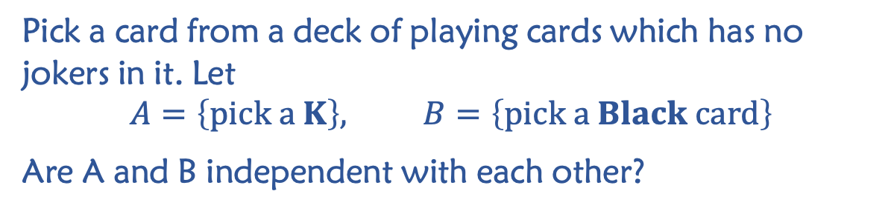



Example:
Pick a card from a deck of playing cards which has no jokers in it. Let
$$A=\left\{pick a K\right\}, B=\left\{pick a Black card\right\}$$
Are A and B independent with each other?
Answer:
$$P\left(A\right)=\frac{4}{52}$$
$$P\left(B\right)=\frac{26}{52}=\frac{1}{2}$$
?
$$P\left(AB\right)=P\left(A\right)P(B)$$
Spade
$$P\left(AB\right)=\frac{2}{52}=\frac{1}{26}$$
Diamond
Heart
Then,
Club
$$P\left(AB\right)=P\left(A\right)P(B)=\frac{1}{26}$$
Thus, events A and B are independent from each other.
Notes:
Even if A and B are independent, it does not mean that they are disjoint.
Independence and disjoint can not happen at the same time.

Slide 8
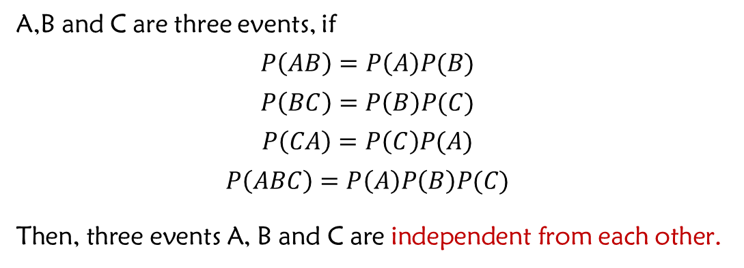
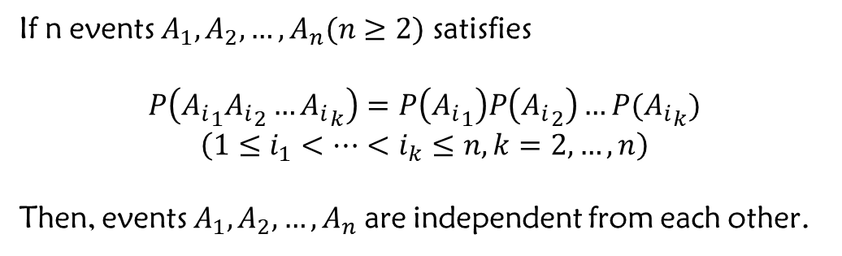
The Independence of Three Events (三个事件的独立性)
Definition:
A,B and C are three events, if
$$P\left(AB\right)=P\left(A\right)P(B)$$
$$P\left(BC\right)=P\left(B\right)P(C)$$
$$P\left(CA\right)=P\left(C\right)P(A)$$
$$P\left(ABC\right)=P\left(A\right)P\left(B\right)P(C)$$
Then, three events A, B and C are independent from each other.
The independence of n Events (n个事件的独立性)
Definition:
If n events $A_{1},A_{2},…,A_{n}(n≥2)$ satisfies
$$P\left({A_{i}}_{1}{A_{i}}_{2}…{A_{i}}_{k}\right)=P\left({A_{i}}_{1}\right)P\left({A_{i}}_{2}\right)…P({A_{i}}_{k})$$
$$\left(1≤i_{1}<…<i_{k}≤n, k=2,…,n\right)$$
Then, events $A_{1},A_{2},…,A_{n}$ are independent from each other.

Slide 9
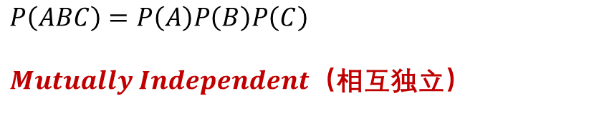



The relation between pairwise independence and mutually independence
(两两独立和相互独立的关系)
Question
$$P\left(AB\right)=P\left(A\right)P(B)$$
NO!
A, B, C are independent from each other?
$$P\left(BC\right)=P\left(B\right)P(C)$$
？
$$P\left(CA\right)=P\left(C\right)P(A)$$
Events A, B, C are $Pairewise Independent$（两两独立）
$$P\left(ABC\right)=P\left(A\right)P\left(B\right)P\left(C\right)$$
$Mutually Independent$（相互独立）
Notes:
With the condition P(ABC)=P(A)P(B)P(C), A, B, C are called Mutually Independent. Otherwise, they are Pairwise Independent.

Slide 10


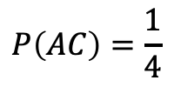
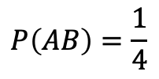



The relation between pairwise independence and mutually independence
(两两独立和相互独立的关系)
Example:
$$Ω=\left\{ω_{1},ω_{2},ω_{3},ω_{4}\right\},$$
$$A=\left\{ω_{1},ω_{2}\right\}, B=\left\{ω_{1},ω_{3}\right\}, C=\left\{ω_{1},ω_{4}\right\}$$
Then
$$P\left(A\right)=P\left(B\right)=P\left(C\right)=\frac{1}{2}$$
And
$$P\left(AB\right)=\frac{1}{4}$$
$$=P\left(A\right)P(B)$$
$$P\left(AC\right)=\frac{1}{4}$$
$$=P\left(A\right)P(C)$$
$$P\left(BC\right)=\frac{1}{4}$$
$$=P\left(B\right)P(C)$$
Thus, events A, B and C are pairwise independent (两两独立).
But $P\left(ABC\right)=\frac{1}{4}≠P\left(A\right)P\left(B\right)P(C)$, not mutually independent (相互独立)

Slide 11



Question
$$P\left(AB\right)=P\left(A\right)P(B)$$
NO!
A, B, C are independent from each other
$$P\left(BC\right)=P\left(B\right)P(C)$$
$$P\left(CA\right)=P\left(C\right)P(A)$$
Are certain event $Ω$ and a random event A independent from each other?
$P\left(AΩ\right)=\left(A\right); P\left(A\right)P(Ω)$ = $\left(A\right)$
Are impossible event $Φ$ and a random vent A independent from each other?
$P\left(AΦ\right)=0; P\left(A\right)P(Φ)$ = $P\left(A\right)$ * $0$ = $0$
Are events {Person A has cold} and {Person B has cold} independent from each other?
Notice:
Event Independence depends on the context in practice.

Slide 12

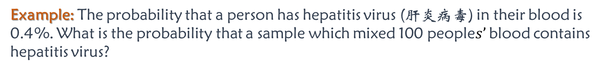

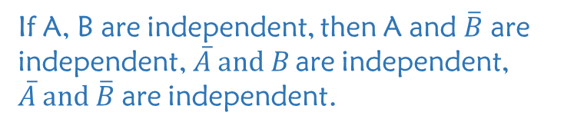
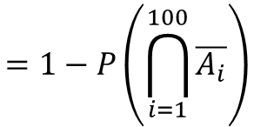
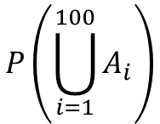
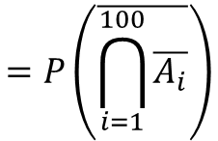
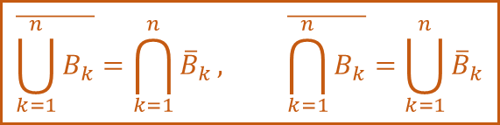
Example: The probability that a person has hepatitis virus (肝炎病毒) in their blood is 0.4%. What is the probability that a sample which mixed 100 people$s’$ blood contains hepatitis virus?
It is the probability of at least person has the virus
只要有一个人有病毒，那么整个混合血就有病毒
Answer:
Let
$$A_{i}=\left\{ith person^{′}s blood contains hepatitis virus\right\}, i=1,2,…,100$$
De Morgan law (摩根律)
Then,
$$\overline{\bigcup_{k=1}^{n}{B_{k}}}=\bigcap_{k=1}^{n}{{\overline{B}}_{k}}, \overline{\bigcap_{k=1}^{n}{B_{k}}}=\bigcup_{k=1}^{n}{{\overline{B}}_{k}}$$
$$P\left(\bigcup_{i=1}^{100}{A_{i}}\right)$$
$$=P\left(\overline{\bigcap_{i=1}^{100}{\overline{A_{i}}}}\right)$$
Based on the real problem, find out whether the events are independent.
Here we assume that they are independent.
$$=1−P\left(\bigcap_{i=1}^{100}{\overline{A_{i}}}\right)$$
$$=1−{0.996}^{100}$$
If A, B are independent, then A and $\overline{B}$ are independent, $\overline{A} and B$ are independent, $\overline{A} and \overline{B}$ are independent.
$$≈0.33$$
Question: How to plan the tests?
By Grouping method, optimally reduce the number of tests and the risk.
Notes:
Suppose only one of the 100 persons has hepatitis virus. If we would like to find out the person, we need 100 tests by using the individual method.
By the grouping method, we need only 1 + 2 + 2 + 2 + 2…

Slide 13
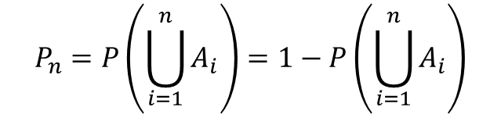
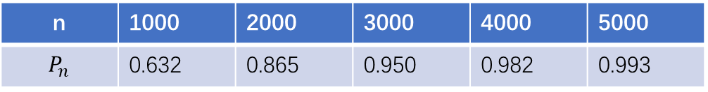

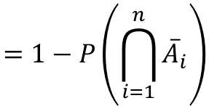
Example: Assume that the probability for a gun to hit a target is p=0.001, what is the probability of hitting the target if n independent guns shoot at the same time?
It is the probability that at least a gun hits the target（只要有一杆枪射中，那么就打中）
Answer:
Let $A_{i}=\left\{ith gun hits the target\right\}, (i=1,2,…,n)$
We know $A_{1},A_{2},…,A_{n}$ are independent from each other.
Thus
$$P_{n}=P\left(\bigcup_{i=1}^{n}{A_{i}}\right)=1−P\left(\bigcup_{i=1}^{n}{A_{i}}\right)$$
$$=1−P\left(\bigcap_{i=1}^{n}{{\overline{A}}_{i}}\right)$$
$$=1−{0.999}^{n}$$
n | 1000 | 2000 | 3000 | 4000 | 5000
$$P_{n}$$ | 0.632 | 0.865 | 0.950 | 0.982 | 0.993
If we increase the number of experiments (guns), no matter how low the probability of hitting the target is, the event (hitting the target) will happen with a high probability.

Slide 14





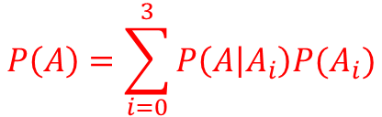



Exercise: There are three antiaircraft guns shooting at an aircraft at the same time. The probabilities of the guns hitting the target are 0.4, 0.5, 0.7. The probability that the aircraft gets shot down after being shot by one gun is 0.2, by two guns 0.6, by three guns 1. What is the probability that the aircraft gets shot down?
“Law of Total Probability”
& independence
Answer:
Let
$$A =\{the aircraft being shot down\}$$
$A_{i}$ are Partitions of the sample space
$$A_{i}=\left\{the aircraft being hit by the ith number of guns\right\}, i=0, 1, 2, 3$$
$$B_{j}=\left\{the aircraft being hit by the jth gun\right\}, j=1, 2, 3$$
$Then P\left(B_{1}\right)=0.4$; $P\left(B_{2}\right)=0.5$; $P\left(B_{3}\right)=0.7$.
Each gun shooting the aircraft is independent to each other
$$A_{0}={\overline{B}}_{1}{\overline{B}}_{2}{\overline{B}}_{3}$$
$$P\left(A_{0}\right)=0.6∗0.5∗0.3=0.09$$
$$A_{1}=B_{1}{\overline{B}}_{2}{\overline{B}}_{3}⋃{\overline{B}}_{1}B_{2}{\overline{B}}_{3}⋃{\overline{B}}_{1}{\overline{B}}_{2}B_{3}$$
$$P\left(A_{1}\right)=0.36$$
$$A_{2}=B_{1}B_{2}{\overline{B}}_{3}⋃{\overline{B}}_{1}B_{2}B_{3}⋃B_{1}{\overline{B}}_{2}B_{3}$$
$$P\left(A_{2}\right)=0.41$$
$$A_{3}=B_{1}B_{2}B_{3}$$
$$P\left(A_{3}\right)=0.4∗0.5∗0.7= 0.14$$
$$P\left(A\right)=\sum_{i=0}^{3}{P\left(A | A_{i}\right)P(A_{i})}$$
By Law of Total Probability
$$=P\left({A|A}_{0}\right)∗P\left(A_{0}\right)+P\left({A|A}_{1}\right)∗P\left(A_{1}\right)+P\left({A|A}_{2}\right)∗P\left(A_{2}\right)+P\left({A|A}_{3}\right)∗P\left(A_{3}\right)$$
$$=0∗0.09+0.2∗0.36+0.6∗0.41+1∗0.14=0.458$$
Notes:
P(A1) = 0.36 要用加奇减偶来算

Slide 15




The concept of system reliability
$$system reliability=P\{system works normally\}$$
Example: A system has 4 components as shown on the right. Assume that the reliability of each component is P and the components are independent from each other. What is the reliability of the system?
I
II
III
IV
I, II are in series串联
III,IV are in series串联
In parallel
并联
Answer:
Let
$$A=\{system works normally\}$$
$$A_{i}=\left\{the ith component works normally\right\}, i=1, 2, 3, 4$$
Then
$$A=A_{1}A_{2}⋃A_{3}A_{4}$$
Independent
The reliability of the system is
$$P\left(A\right)=P(A_{1}A_{2}⋃A_{3}A_{4})$$
$$=P\left(A_{1}A_{2}\right)+P\left(A_{3}A_{4}\right)−P(A_{1}A_{2}⋂A_{3}A_{4})$$
$$=P\left(A_{1}\right)P\left(A_{2}\right)+P\left(A_{3}\right)P\left(A_{4}\right)−P\left(A_{1}A_{2}\right)P(A_{3}A_{4})$$
$$=P^{2}+P^{2}−P^{2}P^{2}=P^{2}(2−P^{2})$$
Notes:
串联： connect in series
并联： connect in parallel

Slide 16
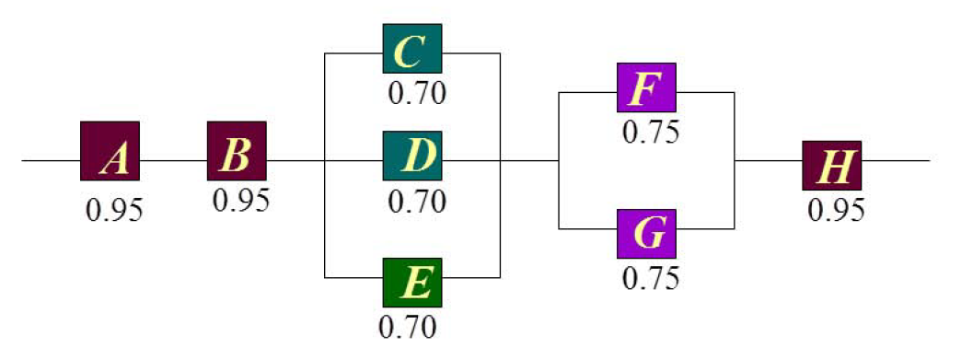
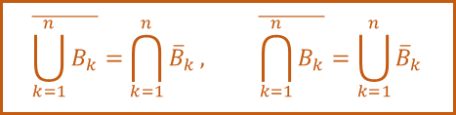
Exercise
In the following cascaded and parallel circuit, A, B, C, D, E, F, G, H are independent components. The numbers labeled under the components are their probabilities of working normally respectively. What is the probability of the circuit to work normally?
$$\overline{\bigcup_{k=1}^{n}{B_{k}}}=\bigcap_{k=1}^{n}{{\overline{B}}_{k}}, \overline{\bigcap_{k=1}^{n}{B_{k}}}=\bigcup_{k=1}^{n}{{\overline{B}}_{k}}$$
Assume W = {the circuit works normally}
P(W)= P(AB) P(C∪D∪E) P(F∪G) P(H)
P(W)=0.95 * 0.95 * 0.973 * 0.9375 * 0.95 = 0.782
$$P\left(C∪D∪E\right)=1−P\left(\overline{C}\right)P\left(\overline{D}\right)P\left(\overline{E}\right)=1−{0.3}^{3}=0.973$$
$$P\left(F∪G\right)=1−P\left(\overline{F}\right)P\left(\overline{G}\right)=1−{0.25}^{2}=0.935$$

Slide 17

Homework
P32: 68,71
P33: 74,77
P34: 79

Slide 18

Thank
You

