Slide 1
Chapter One: Probability
Sample space（样本空间）
Probability measure （概率测度）
Probability computation （概率计算）
Conditional probability （条件概率）
Independence （独立性）

Slide 2
Chapter One: Probability
Sample space（样本空间）
Probability measure （概率测度）
Probability computation （概率计算）
Conditional probability （条件概率）
Independence （独立性）

Slide 3
Random Experiment and sample space
Experiment （试验)
Scientific experiments or observations about some characteristics of something.
Examples
E₁:
flip a coin and count the number of Heads (H) or Tails (T).
E₂:
flip a coin three times and observe the number of Heads(H).
E₃:
roll a dice (骰子) and observe the number shown.
E₄:
select n products from a large number of products （N） and observe the number of defective products (次品).
E₅:
test the lifetime of electronic products from a factory.
E₆:
Observe the average temperature and precipitation (降雨量) of a specific area.
Question
What are the features of these experiments?
Cannot predict the results before those experiments, i.e., the outcomes occur randomly.

Slide 4
Random Experiments and sample space
Experiment （试验)
Scientific observation about some characteristic of some random test.
Features of these Experiments
Experiments can be repeated under the same condition.
The outcome of an experiment may not be unique, but all the possible outcomes are known before the experiments.
It is not sure （uncertain）which outcome will come up before an experiment.
Experiments with the above features are termed
Random Experiments (随机试验)
Notes:
- Or short for “experiments”

Slide 5

Random Experiment and sample space
Example:
E: roll a dice and observe the number shown
Analyze:
Fundamental outcomes (基本结果)
“one ”、 “two ”、… 、“six”；
Possible
Results of E
the number shown is less than three;
the number shown is greater than four.
Composite outcomes (复合结果)

Slide 6
Random Experiment and sample space
Fundamental outcome (indecomposable)
Called Sample values (样本点)
Experiment
Composite outcome (decomposable)
Called Random event, in short Event
Definition:
a set including all sample values in the experiment is called Sample Space Ω (样本空间)
Example:
roll a dice and observe the number shown, the sample space is
Ω = {1, 2, 3, 4, 5, 6}
Example:
flip two coins and observe the occurrence of Heads and Tails, the sample space is
Non-abstract point set (非抽象点集)
Discrete Sample Space (离散样本空间)
Ω={(T, T), (T, H), (H, T), (H, H)}
Example:
record the average daily temperature of Shenzhen, the sample space is
Ω = (-10, 50)
Abstract point set (抽象点集)
Example:
a military airplane throws a bomb at the location (x₀,y₀), observe the area of impact (x, y), which is
Continuous Sample Space (连续样本空间)
Ω = {(x, y)|(x – x₀)² + (y – y₀)²<r² }
Notes:
- Non-abstract point set

Slide 7


Random Experiment and sample space
Fundamental outcome (indecomposable)
Called Sample data (样本点)
Experiment
Composite outcome (decomposable)
Called Random event, in short Event
From the Set Theory (集合论) perspective, an Event is a subset of the Sample Space
Event
(事件)
From the experiment perspective, an Event is composed of fundamental outcomes
Random Event (随机事件)
Definition:
A set of sample points which satisfy some specific condition（s） is called Random Event, or short for Event (事件), and is typically denoted by capital letters A, B, ... X，Y， Z
Example:
roll a dice and observe the points shown, the sample space is
Ω = {1, 2, 3, 4, 5, 6}
Event A: “number is at least three”,
$$A=\{3, 4, 5, 6\}⊂Ω$$
Event B: “minimum or maximum point occurs", then
B = {1, 6} $⊂Ω$

Slide 8



Several special events
Fundamental event:
（基本事件）
Event that is consists of one sample point
{ω}
Certain event:
（必然事件）
Event that happens in every experiment.
$$Ω⊂Ω$$
Impossible event:
（不可能事件）
Event that never happens in experiments.
Ф$(Null Set ⊂Ω)$
Summary: Mathematical description of random experiments
Fundamental outcomes
Fundamental event
Event A happens
Event A
Experiment
Sample points ω
Sample space Ω
Subset A
In an experiment, sample points in A occurs
Denote
A
$$=\{A|A⊂Ω, A is an Event\}$$
Then is called the Event Region (事件域) of an experiment, i.e., a set including all events in the experiment.
A
Notes:
- Calligraphic letter A

Slide 9






Relationship and Arithmetic Among Events
Suppose A, B, A_{k} (k = 1, 2, …) are events,
1.
$$A⊂B$$
If A happens, B must happen
Specifically
$$A=B$$
$$A⊂B and B⊂A$$
2.
$$A∪B=\{ω|ω∈A or ω∈B\}$$
A happens or B happens
At least one of A, B happens is called the Summation (和) or Union (并集) of A and B
$$A⊂B$$
$$A∪B$$

Slide 10
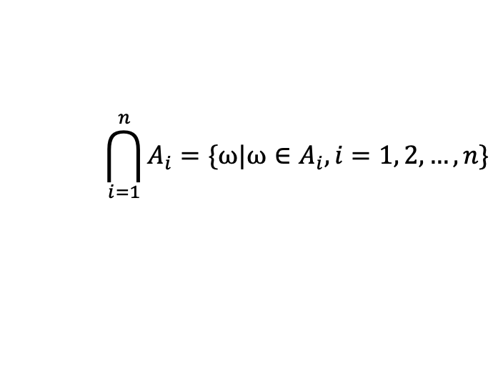

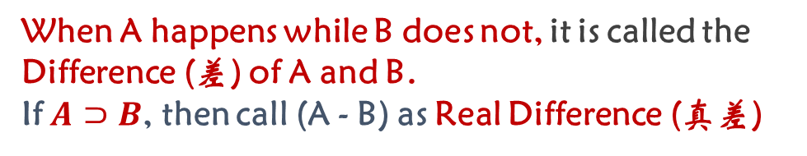


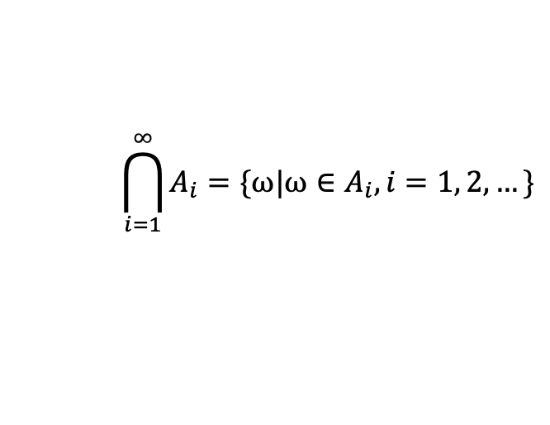

3.
$A∩B=\{ω|ω∈A and ω∈B\}$
A, B happen simultaneously (同时) is called the Production (积) or Intersection (交集) of A and B.
Similarly, we can define the production of n finite events or countable events
$$\bigcap_{i=1}^{n}{A_{i}=\{ω|ω∈A_{i},i=1, 2, …, n\}}$$
$$\bigcap_{i=1}^{∞}{A_{i}=\{ω|ω∈A_{i},i=1, 2, …\}}$$
4.
$$A−B=\{ω|ω∈A and ω∉B\}$$
When A happens while B does not, it is called the Difference (差) of A and B.
If $A⊃B$, then call (A - B) as Real Difference (真差)
$$A∩B$$
$$A−B$$

Slide 11

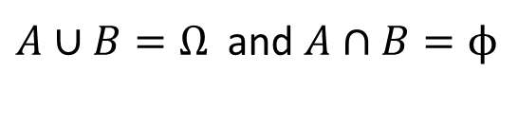



5.
If $A∩B=ϕ (the null set)$
A, B cannot happen simultaneously (同时)，i.e., A and B are contradictory (互斥的) or disjoint (不相交).
6.
If $A∪B=Ω (the sample space) and A∩B=ϕ$
One and only one of A, B must happen. A and B are complementary events (互补事件/对立事件/逆事件).
$$A=Ω−B=\overline{B}=B^{C}$$
$$B=Ω−A=\overline{A}=A^{C}$$
$$A∩B=$$
$A∪B=Ω$ and $A∩B=ϕ$

Slide 12



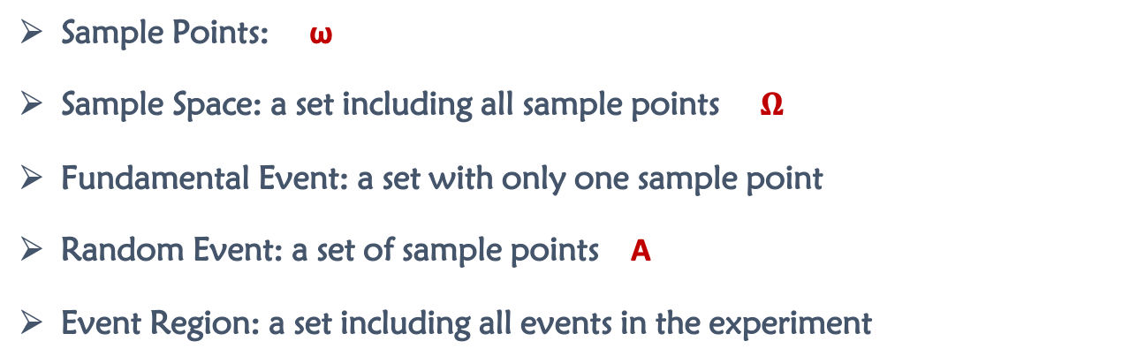



Summary of Important Points
Sample Points: ω
Sample Space: a set including all sample points $Ω$
Fundamental Event: a set with only one sample point
Random Event: a set of sample points A
Event Region: a set including all events in the experiment
{ω}
A
Questions to check your understanding:
$$A⊂B$$
Which event has bigger area?
$$A=B$$
$$A∩B$$
Which one has the summation of the two events? And which one has the product?
$$A∪B$$
$$A∩B=ϕ$$
What do these two cases mean?
$A∪B=Ω$ and $A∩B=ϕ$

Slide 13
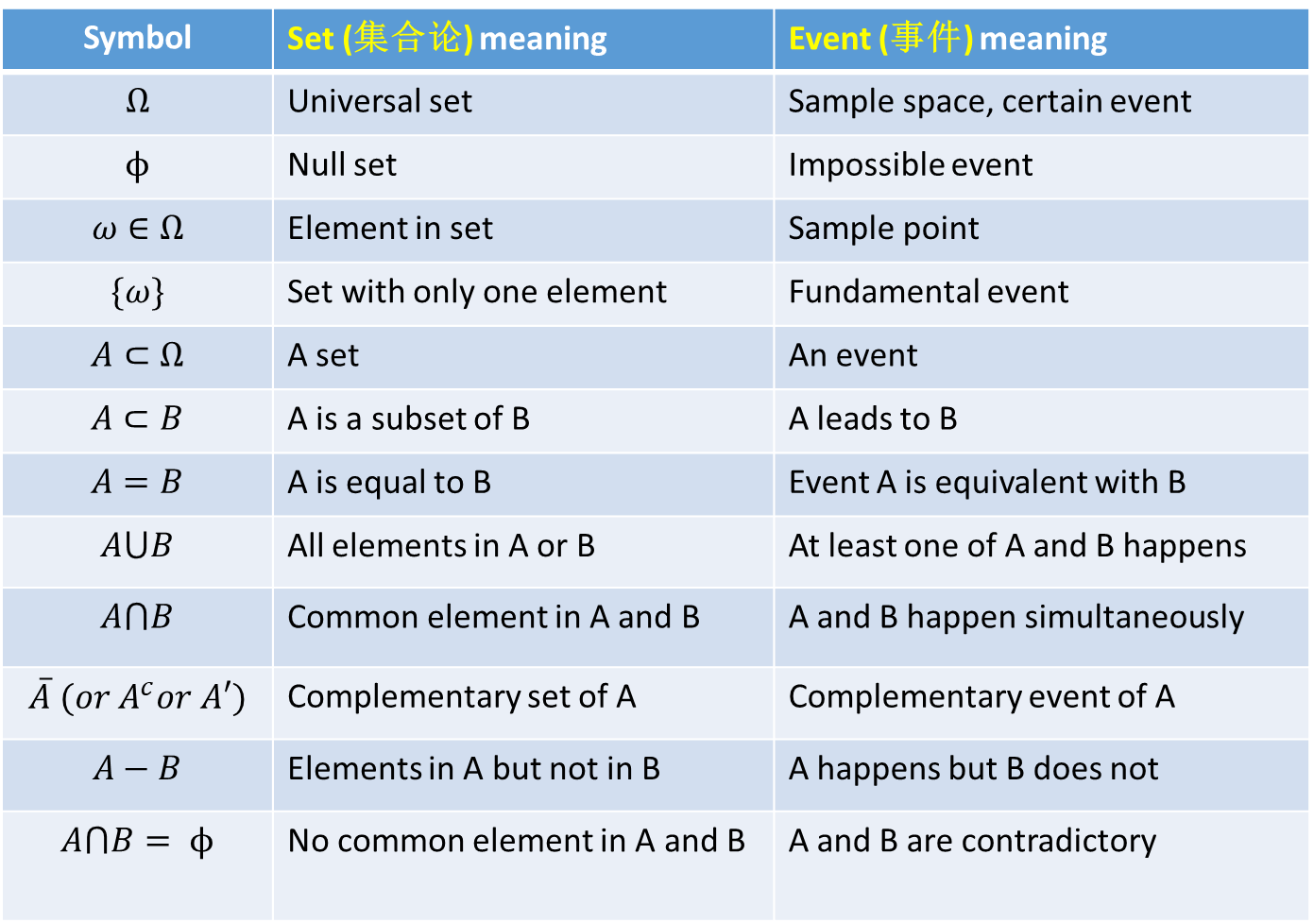
Symbol | Set (集合论) meaning | Event (事件) meaning
$$Ω$$ | Universal set | Sample space, certain event
$$ϕ$$ | Null set | Impossible event
$$ω∈Ω$$ | Element in set | Sample point
$$\{ω\}$$ | Set with only one element | Fundamental event
$$A⊂Ω$$ | A set | An event
$$A⊂B$$ | A is a subset of B | A leads to B
$$A=B$$ | A is equal to B | Event A is equivalent with B
$$A⋃B$$ | All elements in A or B | At least one of A and B happens
$$A⋂B$$ | Common element in A and B | A and B happen simultaneously
$$\overline{A} (or A^{c}or A′)$$ | Complementary set of A | Complementary event of A
$$A−B$$ | Elements in A but not in B | A happens but B does not
$$A⋂B= ϕ$$ | No common element in A and B | A and B are contradictory

Slide 14





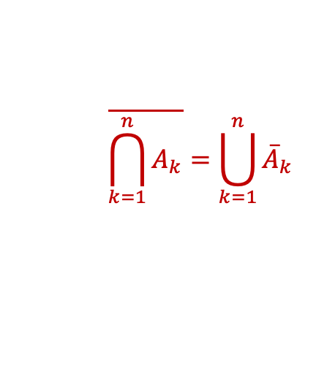

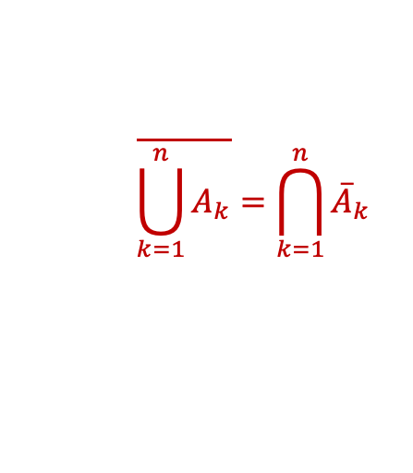
Operation Law in Events
Commutative law
(交换律)
$$A∪B=B∪A, A∩B=B∩A$$
Associative law
(结合律)
$$A∪\left(B∪C\right)=(A∪B)∪C$$
$$A∩\left(B∩C\right)=(A∩B)∩C$$
Distributive law
(分配律)
$$A∪\left(B∩C\right)=(A∪B)∩(A∪C)$$
$$A∩\left(B∪C\right)=(A∩B)∪(A∩C)$$
De Morgan law
(摩根律)
$$\overline{A∪B}=\overline{A}∩\overline{B},\overline{A∩B}=\overline{A}∪\overline{B}$$
$$\overline{\bigcup_{k=1}^{n}{A_{k}}}=\bigcap_{k=1}^{n}{{\overline{A}}_{k}}$$
$$\overline{\bigcap_{k=1}^{n}{A_{k}}}=\bigcup_{k=1}^{n}{{\overline{A}}_{k}}$$
,

Slide 15


$A⋂\left(B⋂C\right)=\left(A⋂B\right)⋂C$ — Associative Law（结合律）diagram
B
A
$$A⋂\left(B⋂C\right)$$
C
=
B
A
$$(A⋂B)⋂C$$
C

Slide 16


$A⋃\left(B⋂C\right)=(A⋃B)⋂(A⋃C)$—Distributive Law (分配律) diagram
B
A
A
C
$$A⋃\left(B⋂C\right)$$
=
B
$$(A⋃B)⋂(A⋃C)$$
A
A
A
C

Slide 17
Letter | Name | Pronounced
A, α | alpha | AHL-fah
Β, β | beta | BE-tah
Γ, γ | gamma | GHAH-mah
Δ, δ | delta | DEL-tah
Ε, ε | epsilon | EHP-see-lon
Ζ, ζ | zita | ZEE-tah
Η, η | ita | EE-tah
Θ, θ | theta | THEE-tah
Κ, κ | kappa | KA-pah
Λ, λ | lamda | LAMb-dah
Μ, μ | mu | miu
Ν, ν | nu | niu
Ξ, ξ | xi | see
Π, π | pi | pee
Ρ, ρ | rho | roh, roe
Σ, σ, ς | sigma | SiG-mah
Τ, τ | tau | tao
Φ, φ | phi | fi
Ψ, ψ | psi | sigh
Ω, ω | omega | oh-MEH-ghah

Slide 18
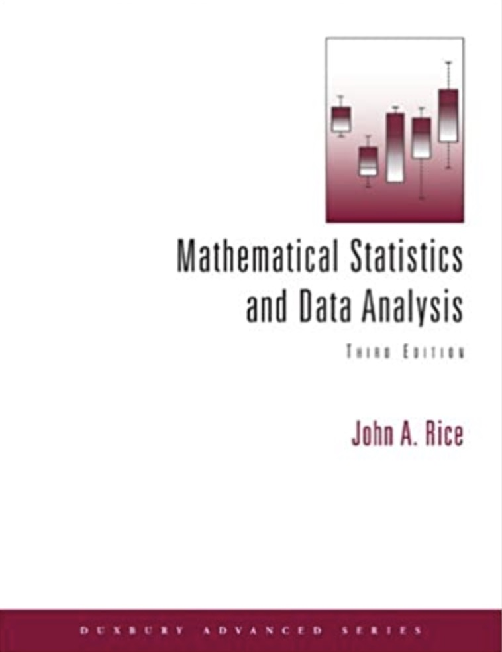
Homework
P27: 2 and 5

Slide 19

Thank
You

