Slide 1
Chapter One Probability
Sample space（样本空间）
Probability measure（概率测度）
Probability computation（概率计算）
Conditional probability（条件概率）
Independence（独立性）
Notes:
Last week, we discussed Random test, Sample space. Then it led to the important terminology Event. Regarding the Event, we learnt Relationship between events and how all the events could be operated in a sample space.
Today we are going to learn Probability measure ………

Slide 2
Chapter One Probability
Sample space（样本空间）
Probability measure（概率测度）
Probability computation（概率计算）
Conditional probability（条件概率）
Independence（独立性）

Slide 3
Probability theory:
To study the statistical regularity of random events（随机事件）
QUESTION 1
What is statistical regularity (统计规律)?
It can be the numerical pattern demonstrated by thousands of experiments.
Described by frequency (频率)
Question 2
What is Probability (概率)?
It describes the possibility of random events in a single experiment,
which satisfies the following properties:
1. It is a fixed value and does not change with individual desire. It can be infinitely repeated so as to identify the value.
2. The value is between 0 and 1, for which the larger the figure the more likely an event is to happen.
Notes:
-它是事件固有的,不随人们主观意愿而改变; 可以在相同条件下通过大量重复试验予以识别和检验;
-符合常情：事件发生可能性大,该值就大,反之就小;不可能事件的值最小(0);必然事件的值最大(1)

Slide 4

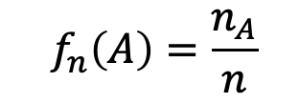



FREQUENCY (频率)
Suppose A is a random event
and we have n repeating experiments.
$n_{A} is t$he number that A happened out of the n experiments
$${ f}_{n}\left(A\right)=\frac{n_{A}}{n}$$
$n_{A}$ is called the Frequency count (频数)
$f_{n}\left(A\right)$ is called the Frequency(频率)
In general,
1. $n_{A}$, $f_{n}\left(A\right)$: their values are“random”
2.$n_{A}$ would be larger as $n$ increases
3. $0≤f_{n}(A)≤1$
？
Is there any statistical regularity for Frequency?

Slide 5
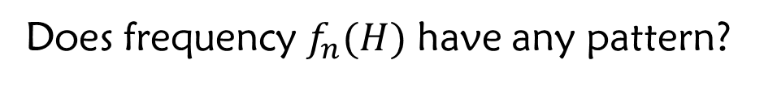
Example 1:
coin tossing experiment
Toss a coin for n times, and define
H={ Get a Head}
Does frequency $f_{n}(H)$ have any pattern?
The famous experiments
Experimenter
De· Morgan
2048
1061
0.5181
Buffon
4048
2048
0.5069
Pearson
12000
6019
0.5016
Pearson
24000
12012
0.5005

Slide 6
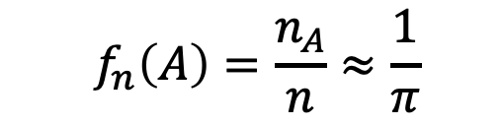
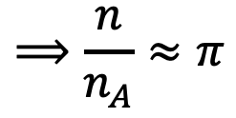

Example 2: “Buffon's needle experiment”
The needle is thrown for n times, it crosses the parallel lines with $n_{A}$times
$${ f}_{n}\left(A\right)=\frac{n_{A}}{n}≈\frac{1}{π}$$
$$⟹\frac{n}{n_{A}}≈π$$
For more examples, please read the Wikipedia Page.
Notes:
下面就是一个简单而巧妙的证明。找一根铁丝弯成一个圆圈，使其直径恰恰等于平行线间的距离d。可以想象得到，对于这样的圆圈来说，不管怎么扔下，都将和平行线有两个交点。因此，如果圆圈扔下的次数为n次，那么相交的交点总数必为2n。现在设想把圆圈拉直，变成一条长为πd的铁丝。显然，这样的铁丝扔下时与平行线相交的情形要比圆圈复杂些，可能有4个交点，3个交点，2个交点，1个交点，甚至于都不相交。由于圆圈和直线的长度同为πl，根据机会均等的原理，当它们投掷次数较多，且相等时，两者与平行线组交点的总数期望也是一样的。这就是说，当长为πl的铁丝扔下n次时，与平行线相交的交点总数应大致为2n。现在转而讨论铁丝长为l的情形。当投掷次数n增大的时候，这种铁丝跟平行线相交的交点总数m应当与长度l成正比，因而有：m=kl，式中k是比例系数。为了求出k来，只需注意到，对于l=πd的特殊情形，有m=2n。于是求得k=（2n)/（πd）。代入前式就有：m≈（2ln)/（πd）从而π≈（2ln)/(dm)，因此m/n=(2l)/(dπ), 当 l=d/2, 则有m/n=1/π.

Slide 7
Example 3: Consider the Frequency of 26 letters used in our life. When the letter number n is big enough, there is some regularity.
Dewey got the following table for 438,023 words that he gathered. Which one is the highest used letter?
letter
字母
字母
频率
频率
frequency
字母
字母
letter
频率
频率
frequency
字母
字母
letter
频率
频率
frequency
字母
字母
letter
频率
频率
frequency
E
E
E
0.1268
0.1268
0.1268
R
R
R
0.0594
0.0594
0.0594
M
M
M
0.0244
0.0244
0.0244
K
K
K
0.0060
0.0060
0.0060
T
T
T
0.0978
0.0978
0.0978
H
H
H
0.0573
0.0573
0.0573
W
W
W
0.0214
0.0214
0.0214
X
X
X
0.0016
0.0016
0.0016
A
A
A
0.0788
0.0788
0.0788
L
L
L
0.0394
0.0394
0.0394
Y
Y
Y
0.0202
0.0202
0.0202
J
J
J
0.0010
0.0010
0.0010
O
O
O
0.0776
0.0776
0.0776
D
D
D
0.0389
0.0389
0.0389
G
G
G
0.0187
0.0187
0.0187
Q
Q
Q
0.0009
0.0009
0.0009
I
I
I
0.0707
0.0707
0.0707
U
U
U
0.0280
0.0280
0.0280
P
P
P
0.0186
0.0186
0.0186
Z
Z
Z
0.0006
0.0006
0.0006
N
N
N
0.0706
0.0706
0.0706
C
C
C
0.0268
0.0268
0.0268
B
B
B
0.0156
0.0156
0.0156
S
S
S
0.0634
0.0634
0.0634
F
F
F
0.0256
0.0256
0.0256
V
V
V
0.0102
0.0102
0.0102
Applications:
The design of keyboards
Decryption (解密)

Slide 8
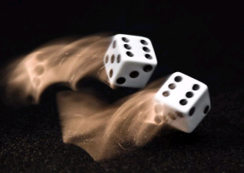
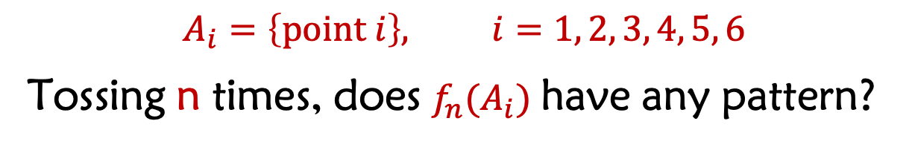
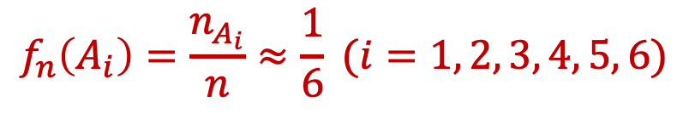
Example 4: In the experiment "dice tossing”
$$A_{i}=\left\{point i\right\}, i=1, 2, 3, 4, 5, 6$$
Tossing n times, does $f_{n}(A_{i})$ have any pattern?
Analysis:
If it is a fair dice, when n is large enough, we should have
$$f_{n}\left(A_{i}\right)=\frac{n_{A_{i}}}{n}≈\frac{1}{6} (i=1, 2, 3, 4, 5, 6)$$

Slide 9
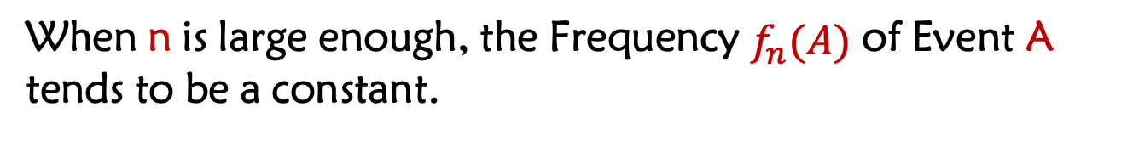
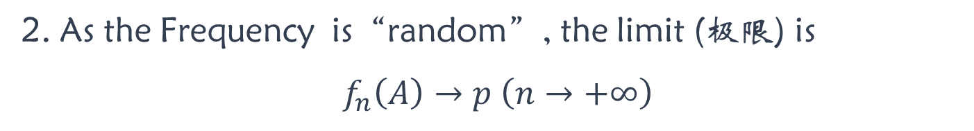

The statistical regularity of random events
When n is large enough, the Frequency $f_{n}(A)$ of Event A tends to be a constant.
$$f_{n}\left(A\right)→p (n→+∞)$$
The stability of Frequency（频率）: Probability（概率）
Notes:
1. The constant p is the possibility that A happens.
2. As the Frequency is“random”, the limit (极限) is
$$f_{n}\left(A\right)→p \left(n→+∞\right)$$
$$We will learn Limit Theorems in Chapter 5$$

Slide 10

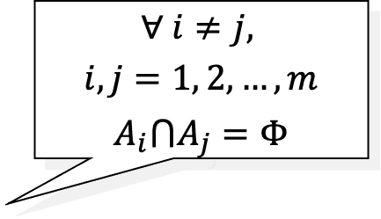

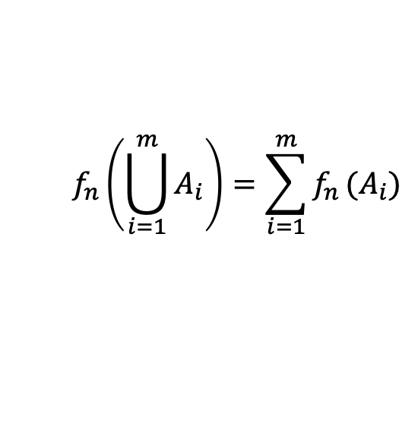

$${ f}_{n}\left(A\right)=\frac{n_{A}}{n}$$
The basic properties (基本性质) of Frequency
$$0≤f_{n}\left(A\right)≤1$$
$$∀ i≠j,$$
$$i,j=1, 2, …, m$$
$$A_{i}⋂A_{j}=Φ$$
$$f_{n}\left(Ω\right)=1$$
?
If $A_{1},A_{2},…,A_{m}$ are Pairwise Disjoint (两两不相容）, then
$$f_{n}\left(\bigcup_{i=1}^{m}{A_{i}}\right)=\sum_{i=1}^{m}{f_{n}}(A_{i})$$
Finite additivity
（有限可加性）
Inducting the definition of Probability
Notes:
这三条性质刻画了频率的本质特征, 启发我们定义事件的概率
Throw a dice, A1 is the event of number 1 coming up; A2 is the event of number 2 coming up……….A6 is the event of number 6 coming up. i=1, 2,…. 6.
Therefore: Properties 2 and 3

Slide 11

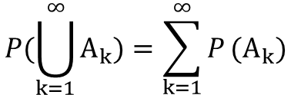

Definition of Probability
Def:
Let A be an event region in $Ω$, $∀A∈$A. If there exists corresponding $P\left(A\right),$
$$and$$
①
Non negative （非负性） ： $P\left(A\right)≥0 (∀A∈\text{A})$
②
Normality （规范性）：$P\left(Ω\right)=1$
③
Countable Additivity （可列可加性）: for any disjoint pairwise event ${\{A_{k}\}}_{k=1}^{∞}$
$$P(\bigcup_{k=1}^{∞}{A_{k})}=\sum_{k=1}^{∞}{P}(A_{k})$$
Then
$P(A)$ is Probability of Event A. ( ) is probability space
It is defined by Kolmogorov in 1933
It is a special function defined on the events.
For example, the length or area of region are nonnegative and additive.
Probability is actually the“measure”for possibility.

Slide 12






Example: Suppose there are three weather possibilities: Sunny, Cloudy, Rainy. It is known that the probability of Sunny is 2 times that of Cloudy, and the probability of Rainy is only half of that of Cloudy. What is the probability of each status?
2
1
1/2
2+1+1/2
2+1+1/2
2+1+1/2
$$\frac{4}{7}$$
$$\frac{2}{7}$$
$$\frac{1}{7}$$
Normalization

Slide 13
S= 2C， R=C/2，S= 2C= 2R
We know S+R+C=1
2C+0.5C+ C=1
7C = 2
C= 2|7
S=4|7
R=1|7

Slide 14

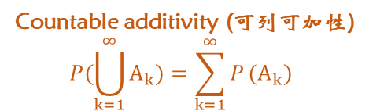



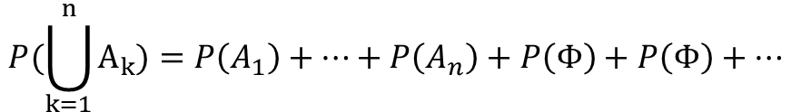
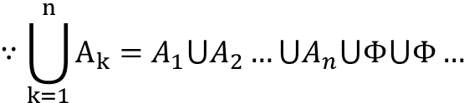
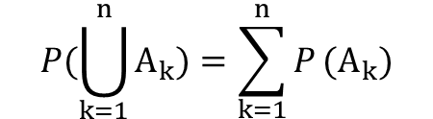
The basic properties of Probability：
Property 1:
$$P\left(ϕ\right)=0$$
Countable additivity (可列可加性)
$$P(\bigcup_{k=1}^{∞}{A_{k})}=\sum_{k=1}^{∞}{P}(A_{k})$$
Proof:
$$∵Φ=Φ⋃Φ⋃Φ…$$
$$∴P\left(Φ\right)=P\left(Φ\right)+P\left(Φ\right)+…$$
Because Probability is a real number, then $P\left(ϕ\right)=0$
Property 2:
If $A_{1},A_{2},…,A_{n}$ which are pairwise disjoint, then
$$P(\bigcup_{k=1}^{n}{A_{k})}=\sum_{k=1}^{n}{P}(A_{k})$$
Finite Additivity（有限可加性）
$$∵\bigcup_{k=1}^{n}{A_{k}=A_{1}⋃A_{2}…⋃A_{n}⋃Φ⋃Φ…}$$
Proof:
By Countable Additivity，we have
$$P(\bigcup_{k=1}^{n}{A_{k})}=P\left(A_{1}\right)+…+P\left(A_{n}\right)+P\left(Φ\right)+P\left(Φ\right)+…$$
=0
$$=P\left(A_{1}\right)+…+P(A_{n})$$
Notes:
事件的和的概率， 等于和的事件概率
The probability of the sum of the events, is equal to the sum of individual event probability

Slide 15




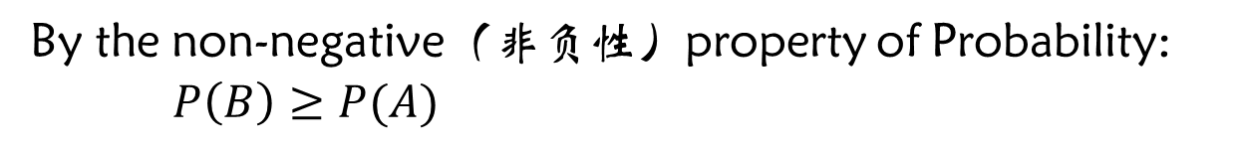

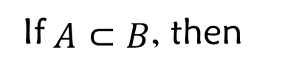

Property 3:
If $A⊂B$, then
$$P\left(B−A\right)=P\left(B\right)−P(A)$$
$$P\left(B\right)≥P(A)$$
Prove:
$$∵A⊂B$$
$$∴B=A⋃(B−A)$$
Since A, B-A are disjoint, also with finite additivity
$$P(\bigcup_{k=1}^{n}{A_{k}}=\sum_{k=1}^{n}{P}(A_{k})$$
$$P\left(B\right)−P(A) =P\left(B−A\right)$$
By the non-negative（非负性）property of Probability:
$P\left(B\right)≥P(A)$
Event and Probability
Probability is the area of a region（区域面积）
Event is the region
（区域）
Notes:
事件的差的概率， 等于事件概率的差
The probability of the difference of two events, is equal to the difference of the two event’s probabilities.

Slide 16


Property 4:
$$0≤P\left(A\right)≤1$$
From the definition of Probability
?

Slide 17
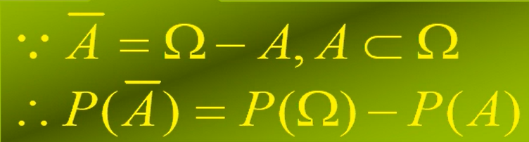

Property 4:
$$0≤P\left(A\right)≤1$$
Property 5:
$$P\left(\overline{A}\right)=1−P(A)$$
?

Slide 18



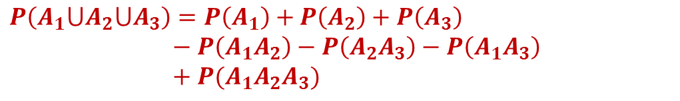
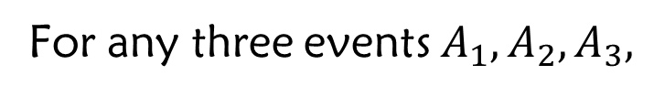
Property 4:
$$0≤P\left(A\right)≤1$$
Property 5:
$$P\left(\overline{A}\right)=1−P(A)$$
$$B$$
Property 6:
Addition Law（加法定律）:
For any events A, B,
$$P\left(A⋃B\right)=P\left(A\right)+P\left(B\right)−P(A∩B)$$
For any three events $A_{1}, A_{2}, A_{3},$
dig
dig
$$A_{1}A_{3}$$
dig
fill
加奇减偶
$$P\left(A_{1}⋃A_{2}⋃A_{3}\right)=P\left(A_{1}\right)+P\left(A_{2}\right)+P\left(A_{3}\right)$$
$− P\left(A_{1}A_{2}\right)−P\left(A_{2}A_{3}\right)−P\left(A_{1}A_{3}\right)$
$+ P(A_{1}A_{2}A_{3})$

Slide 19
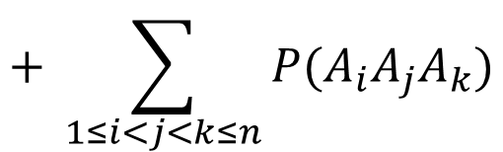
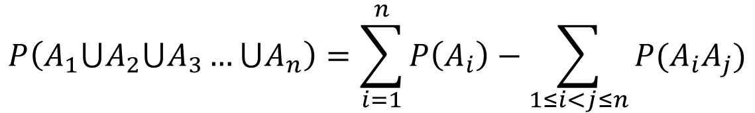


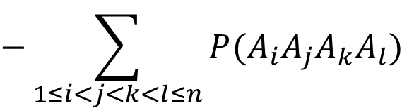
Theorem：
(挖补定理）
Addition Law for multiple events
（多事件的加法定律）
+ All
- two
For n events，we have
$$P\left(A_{1}⋃A_{2}⋃A_{3}…⋃A_{n}\right)=\sum_{i=1}^{n}{P\left(A_{i}\right)−\sum_{1≤i<j≤n}{P(A_{i}A_{j})}}$$
+ three
$$+ \sum_{1≤i<j<k≤n}{P(A_{i}A_{j}A_{k})}$$
$$−\sum_{1≤i<j<k<l≤n}{P(A_{i}A_{j}A_{k}A_{l})}$$
- four
加奇减偶
$$+…$$
“+” for odd number
“–” for even number
$$+{\left(−1\right)}^{n−1}P(A_{1}A_{2}…A_{n})$$

Slide 20
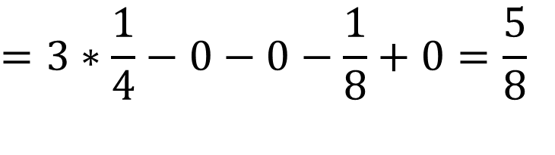
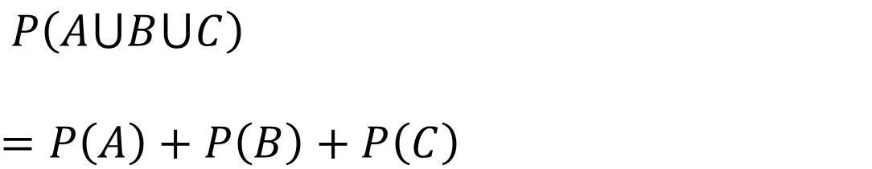
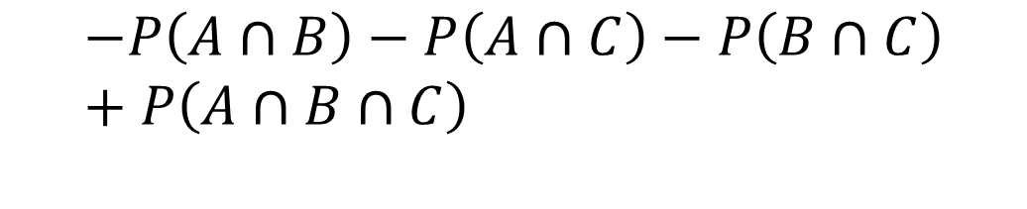
Exercise 1:
Suppose A, B, C are events and satisfy P(A)=P(B)=P(C) =1/4, P(A∩B)=P(B∩C)=0, P(A∩C)=1/8, what is the probability that at least one event happens among A, B, C?
Probability Property 6:
Addition Law
$$P\left(A⋃B⋃C\right)$$
$$=P\left(A\right)+P\left(B\right)+P\left(C\right)$$
$$−P\left(A∩B\right)−P\left(A∩C\right)−P\left(B∩C\right)+P\left(A∩B∩C\right)$$
$$=3∗\frac{1}{4}−0−0−\frac{1}{8}+0=\frac{5}{8}$$

Slide 21


Exercise 2:
Generally, PM2.5 content in the atmosphere is from 0.0 to 120.4 (μg/m³)，and SO₂ content from 0.000 to 0.304 (ppm) (assume PM2.5 and SO₂ are equally scattered within their range). It is known that it will be harmful to human health when PM2.5 content is over 100.5μg/m³ or SO₂ content is over 0.225ppm. Can you get the probability when the air is harmful？
Event A: harmful PM2.5
Event B: harmful SO₂
P(A)
= (120.4 - 100.5)/120.4 = 0.165
SO₂ content (ppm)
P(B) = (0.304 - 0.225)/0.304 = 0.260
P(A∩B) = (120.4-100.5)(0.304-0.225)/
(0.304*120.4)
= 0.043
0.304
B
A∩B
0.225
$$P\left(A⋃B\right)$$
$$=P\left(A\right)+P\left(B\right)−P(A∩B)$$
A
= 0.382
Alternatively, you could apply Complement Events method
0
PM2.5 content (μg/m³)
100.5
120.4

Slide 22
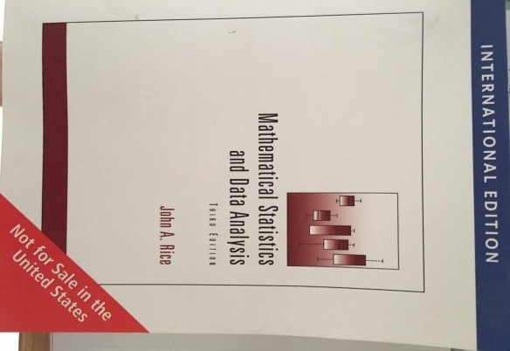
Homework
P27: 7， 8
END

Slide 23
Supplementary questions:
END

Slide 24

The
End

