Slide 1
Chapter One Probability
Sample space（样本空间）
Probability measure（概率测度）
Probability computation（概率计算）
Conditional probability（条件概率）
Independence（独立性）
Notes:
In the previous lectures, we discussed what is random test, what is Sample space. This led to the important terminology Event introduced. How the events could be operated in a sample space was discussed in detail.
Then we learnt Probability Measure, discussed the relationship between frequency and probability. Frequency has random feature, but its limit is Probability. Probability is a constant value between 0 and 1. It refers to an area in a sample space and they can be calculated.
Today we are going to learn Probability Computation ………

Slide 2
Chapter One Probability
Sample space（样本空间）
Probability measure（概率测度）
Probability computation（概率计算）
Conditional probability（条件概率）
Independence（独立性）

Slide 3
Probability computation: counting method
10 balls with the same shape are mixed in a bag and labeled with a number between 1~10, choose one randomly from the bag, then
1
2
3
4
5
6
7
8
9
10
The probability for each ball to be drawn is 1/10.
8
5
1
9
4
6
7
2
3
10

Slide 4
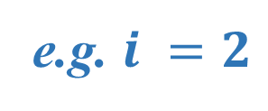
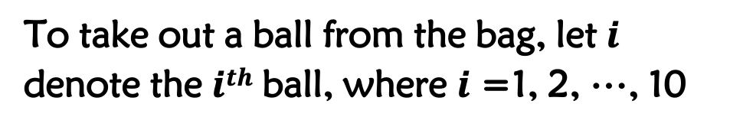
To take out a ball from the bag, let $i$ denote the $ith$ ball, where $i$ =1, 2, …, 10
e.g. $i =2$
2
Then the sample space of this experiment is
Ω={1, 2, …, 10}
and each element appears with the same probability.
We call this experiment
Classical Probability Problem (古典概型).
5
8
6
1
4
9
3
10
7

Slide 5



Definition of Classical probability problems
Let $Ω$ be the sample space of an experiment, if
①
$Ω$ contains finite number of fundamental outcomes:
$$Ω=\{ω_{1},ω_{2},…,ω_{n}\}$$
②
The fundamental outcomes are equally likely（等可能）to happen
$$\frac{1}{n}$$
$$P\left\{ω_{1}\right\}=P\left\{ω_{2}\right\}=…P\left\{ω_{n}\right\}=$$
？
This is called a Classical Probability problem(古典概型).
“Coin tossing”and“dice rolling”are Classical probability problems:
There are finite possible fundamental outcomes.
The probabilities of all fundamental outcomes are equal.
?
How to compute the probability for an event?

Slide 6


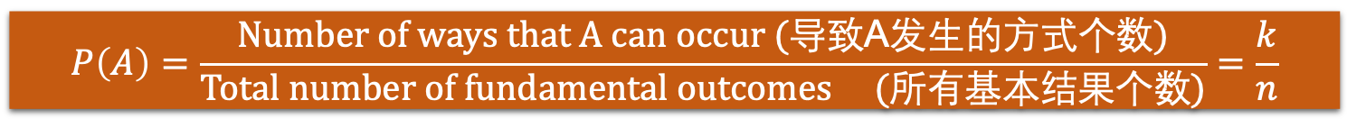


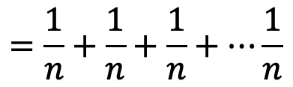
Computing Classical probability
Suppose Event A contains k sample points (样本点), that is
$$A=\{{ω_{i}}_{1},{ω_{i}}_{2},…,{ω_{i}}_{k}\}$$
(i : 1, 2, …, n)
$$=\left\{{ω_{i}}_{1}\right\}⋃\left\{{ω_{i}}_{2}\right\}…⋃\{{ω_{i}}_{k}\}$$
$$∴P\left(A\right)=P\left\{{ω_{i}}_{1}\right\}+P\left\{{ω_{i}}_{2}\right\}+…+P\{{ω_{i}}_{k}\}$$
$$=\frac{1}{n}+\frac{1}{n}+\frac{1}{n}+…\frac{1}{n}$$
$$=\frac{k}{n}$$
$$P\left(A\right)=\frac{Number of ways that A can occur \text{(}\text{导致}\text{A}\text{发生的方式个数})}{Total number of fundamental outcomes (所有基本结果个数)}=\frac{k}{n}$$
$$P\left(A\right)=\frac{Number of benefit event (有利场合数)}{Total number of sample points (样本点总数)}=\frac{k}{n}$$

Slide 7


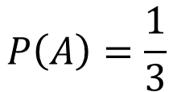



Exercise:
Suppose that a fair coin is thrown twice, find the probability of one Head and one Tail.
$$P\left(A\right)=\frac{Number of ways that A can occur }{Total number of fundamental}=\frac{k}{n}$$
Solution:
The sample space of the experiment is
$$Ω=\{HH,HT,TH,TT\}$$
It is Classical Probability. Event A of“one Head on & one Tail on”contains
$$HT,TH$$
The number of ways that Event A can occur
$$∴P\left(A\right)=\frac{2}{4}=\frac{1}{2}$$
Funny story
In the 18th centenary, the famous French mathematician Darren Bell thought that the sample space was
$$Ω=\{HH,HT,TT\}$$
They are NOTequally likely!
He obtained
$$P\left(A\right)=\frac{1}{3}$$

Slide 8


It was suspected that sex discrimination existed in Law School and Business School when recruiting fresh students. The results of a survey were listed in the following tables：
Law School
Gender | Accepted | Refused | Total | Acceptance rate
F | 8 | 45 | 53 | 15.1%
M | 51 | 101 | 152 | 33.6%
Total | 59 | 146 | 205 | ​
In total
Gender | Accepted | Refused | Total | Acceptance rate
F | 209 | 95 | 304 | 68.8%
M | 143 | 110 | 253 | 56.5%
Total | 352 | 205 | 557 | ​
Business School
Gender | Accepted | Refused | Total | Acceptance rate
F | 201 | 50 | 251 | 80.1%
M | 92 | 9 | 101 | 91.1%
Total | 293 | 59 | 352 | ​
Simpson’s Paradox
Notes:
辛普森悖论（Simpson's Paradox）亦有人译为辛普森诡论，为英国统计学家E.H.辛普森（E.H.Simpson）于1951年提出的悖论，即在某个条件下的两组数据，分别讨论时都会满足某种性质，可是一旦合并考虑，却可能导致相反的结论。
当人们尝试探究两种变量是否具有相关性的时候，比如新生录取率与性别，报酬与性别等，会分别对之进行分组研究。辛普森悖论是在这种研究中，在某些前提下有时会产生的一种现象。即在分组比较中都占优势的一方，会在总评中反而是失势的一方。该现象于20世纪初就有人讨论，但一直到1951年E.H.辛普森在他发表的论文中，该现象才算正式被描述解释。后来就以他的名字命名该悖论。
为了避免辛普森悖论的出现，就需要斟酌各分组的权重，并乘以一定的系数去消除以分组数据基数差异而造成的影响。同时必需了解清楚情况，是否存在潜在因素，综合考虑。
量与质是不等价的，无奈的是量比质来得容易量测，所以人们总是习惯用量来评定好坏，而此数据却不是重要的。
除了质与量的迷思之外，辛普森悖论的另外一个启示是：如果我们在人生的抉择上选择了一条比较难走的路，就得要有可能不被赏识的领悟，所以这算是怀才不遇这个成语在统计上的诠释。
辛普森多样性指数是基于在一个无限大的群落中，随机抽取两个个体，它们属于同一物种的概率是多少这样的假设而推导出来。辛普森在1949年提出过这样的问题：在无限大小的群落中，随机取样得到同样的个体标本，它们的概率是什么呢？如果在加拿大北部寒带森林中，随机选取两株树，属同一种的概率就很高。相反，如果在热带雨林随机取样，两株树同一种的概率很低，他从这个想法出发得出多样性指数。 ^{[3]}

Slide 9





Exercise：Some number of Red and Green balls are mixed in the two boxes as shown in Yellow and Grey as below. You can choose one ball from one of the boxes at random. If it is Red, you win a prize. Which box should you choose？
5R6G
6R3G
11R9G
$$\frac{5}{11}$$
$$\frac{6}{9}$$
3R4G
9R5G
12R9G
$$\frac{3}{7}$$
$$\frac{9}{14}$$

Slide 10




Exercise：Some number of Red and Green balls are mixed in the two boxes as shown in Yellow and Grey below. You can choose one ball from one of the boxes at random. If it is Red, you win a prize. Which box should you choose？
Counter intuitive ! ! !
5R6G
6R3G
11R9G
$$\frac{5}{11}$$
$$\frac{6}{9}$$
$$\frac{11}{20}$$
3R4G
9R5G
12R9G
$$\frac{3}{7}$$
$$\frac{9}{14}$$
$$\frac{12}{21}$$

Slide 11
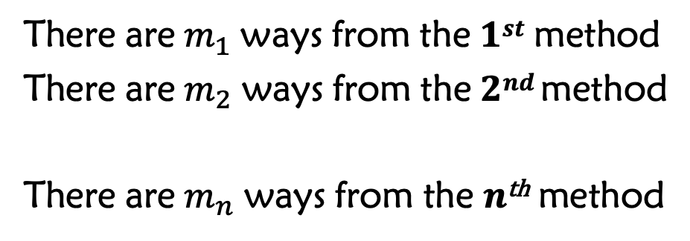




How to count the ways ?
Addition Principle（加法原理）
There are $m_{1}$ ways from the $1st$ method
There are $m_{2}$ ways from the $2nd$ method
There are $m_{n}$ ways from the $n$^{th} method
n different methods
……
$$m_{1}$$
$$m_{2}$$
$$m_{n}$$
The total number of ways is
$$N=m_{1}+m_{2}+…+m_{n}$$
Notes:
For example, from Shenzhen to Beijing, we could take train, flight or coach. Therefore, we have 3 ways to get to Beijing.

Slide 12



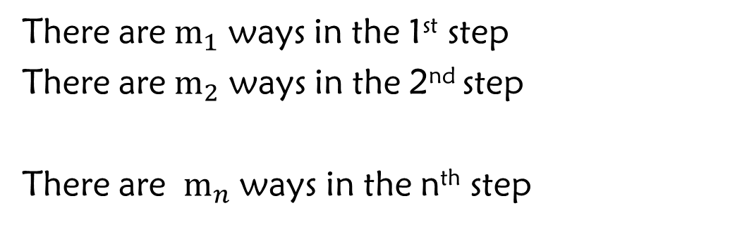

Multiplication Principle（乘法原理）
There are $m_{1}$ ways in the 1st step
There are $m_{2}$ ways in the 2nd step
There are $m_{n}$ ways in the n^{th} step
n different steps
……
$m_{1}$
$m_{2}$
$m_{n}$
The total number of ways is
$$N=m_{1}∙m_{2}…m_{n}$$
Notes:
For example, from Shenzhen to Beijing, there are many stops Guangzhou, Changsha, Shijiazhuang etc. From a stop to another, there should have many different ways.

Slide 13

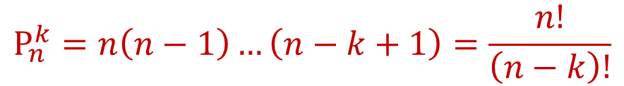
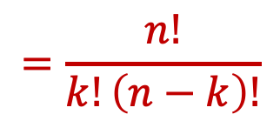

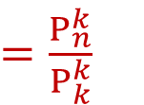

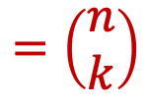

Permutation (排列) and Combination (组合)
Permutation:
Choose $k(≤n)$ objects from n objects and arrange them in a row in a certain order, the number of different ways is
Permutation is related to order.
$$P_{n}^{k}=n\left(n−1\right)…\left(n−k+1\right)=\frac{n!}{\left(n−k\right)!}$$
Full permutation:
When $k=n$，it is called Full Permutation (全排列)
$$P_{n}^{n}=n!$$
Combination:
Choose $k\left(≤n\right)$ objects from n objects, the number of different ways is
$$=\frac{n!}{k!\left(n−k\right)!}$$
Combination is not related to order
$$C_{n}^{k}$$
$=\frac{P_{n}^{k}}{P_{k}^{k}}$
$$=\left(\begin{matrix}n \\ k\end{matrix}\right)$$
Notes:
$$\frac{n\left(n−1\right)…(n−k+1)}{k!}$$

Slide 14
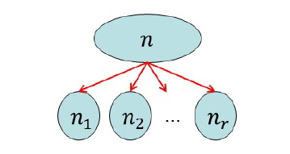
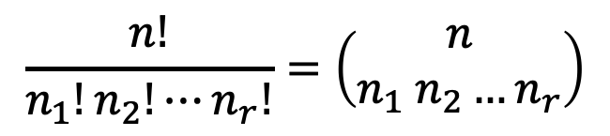
Permutation (排列) and Combination (组合)
In general, randomly divide n balls into r groups, such that the i ^{th} group has n_{i} balls (i =1, 2,… r). The total number of ways in dividing is:
$$\frac{n!}{n_{1}!n_{2}!⋯n_{r}!}=\left(\begin{matrix}n \\ n_{1} n_{2}…n_{r}\end{matrix}\right)$$

Slide 15
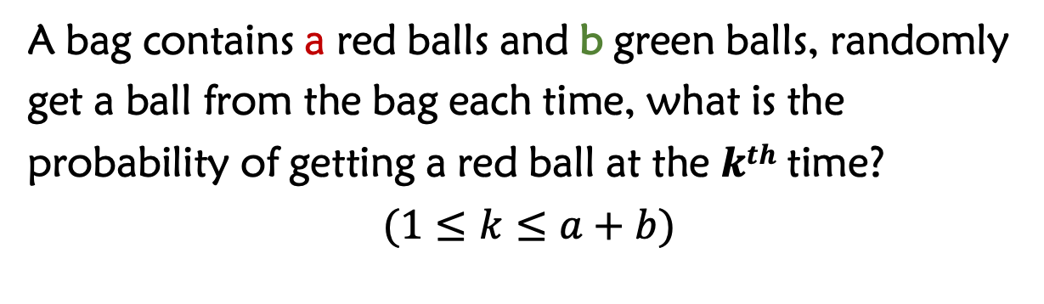
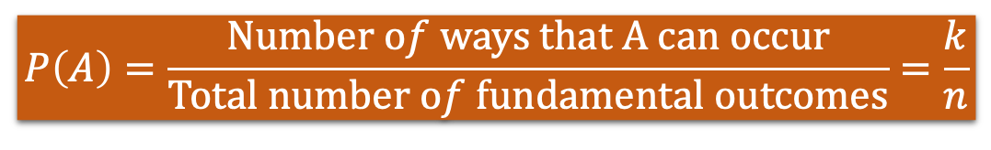
Exercise:
A bag contains a red balls and b green balls, randomly get a ball from the bag each time, what is the probability of getting a red ball at the $kth$ time?
$$(1≤k≤a+b)$$
attention
Solution 1
The balls are distinguishable, apart from color.
Permutation
Solution 2
The balls are indistinguishable, except color.
Combination
$$P\left(A\right)=\frac{Number of ways that A can occur}{Total number of fundamental outcomes}=\frac{k}{n}$$

Slide 16
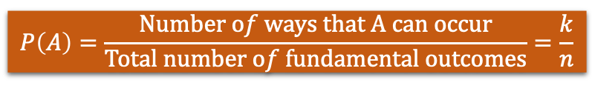
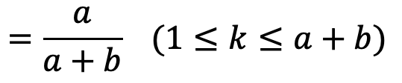
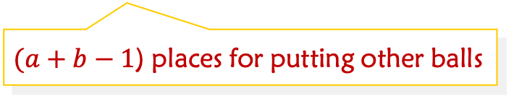
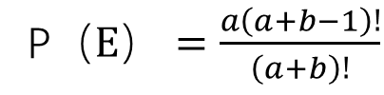

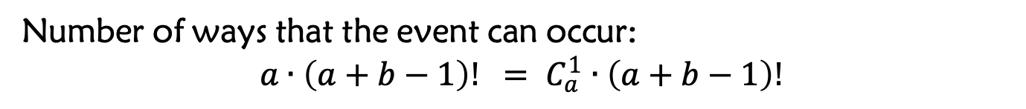
Solution 1:
Suppose the balls are different apart from color, arrange all the balls in a line
Permutation
Fix the the $k$th place to be a red ball
k
One ball is in one place
$(a+b−1$) places for putting other balls
$$P\left(A\right)=\frac{Number of ways that A can occur}{Total number of fundamental outcomes}=\frac{k}{n}$$
Total number of fundamental outcomes: $\left(a+b\right)!$
Number of ways that the event can occur:
$${a∙\left(a+b−1\right)! = C}_{a}^{1}∙\left(a+b−1\right)!$$
P（$E）=\frac{a\left(a+b−1\right)!}{\left(a+b\right)!}$
$$=\frac{a}{a+b} (1≤k≤a+b)$$
The probability is:

Slide 17


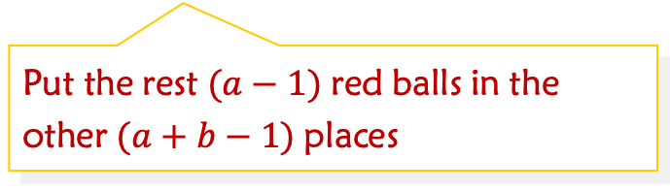

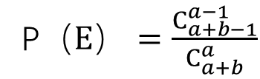
Solution 2:
Suppose the balls are the same except colors, arrange all the balls in a line
Combination
Fix the the $k$th place to be a red ball
k
Only consider the red balls
？
Put the rest $(a−1)$ red balls in the other $(a+b−1)$places
Total number of fundamental outcomes:
$$C_{a+b}^{a}$$
Number of the ways that the event can occur: $C_{a+b−1}^{a−1}$
The probability is
P（$E）=$ $\frac{C_{a+b−1}^{a−1}}{C_{a+b}^{a}}$
$$=\frac{a}{a+b} (1≤k≤a+b)$$
The result is not related to the k !!!

Slide 18

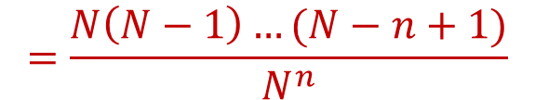



Ball drawing models:
Many practical problems can be considered as this
Example:
Put n balls randomly into $N(≥n)$ boxes, compute the probability of the event that“there is at most one ball in each box”.
Analysis
It is equally likely for each ball to be put into each box, which is Classical Probability.
Total number of fundamental outcomes:
$$N∙N…N=N^{n}$$
The number of ways that the event can occur
(at most one ball in each box)
Permutation
$$P_{N}^{n}=N\left(N−1\right)…[N−\left(n−1\right)]$$
The probability is
$$P（E）=\frac{P_{N}^{n}}{N^{n}}$$
$$=\frac{N\left(N−1\right)…(N−n+1)}{N^{n}}$$
Notes:
The first ball can be put into any of the N boxes, the second ball can be put into the remaining N-1 boxes.

Slide 19
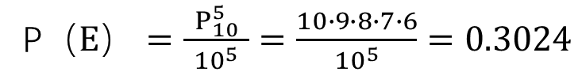
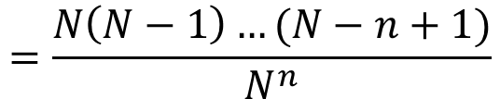
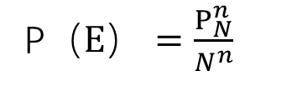
Exercise:
Randomly choose a number from 0, 1, 2,…,9 with replacement, and do it five times. What is the probability to get 5 different numbers?
Permutation
P（$E）=\frac{{ P}_{10}^{5} }{{10}^{5}}=\frac{10∙9∙8∙7∙6}{{10}^{5}}=0.3024$
Ball drawing models
P（$E）=\frac{P_{N}^{n}}{N^{n}}$
$$=\frac{N\left(N−1\right)…(N−n+1)}{N^{n}}$$
Notes:
警告，千万不要去计算e的二进制表达。数学家们猜想e是一个正规数(normal number)，也就是说它包含了任意一个有限长的01串，所有n位长的01串都以相等的概率出现在e的二进制中。
如果你偏要去计算它，你会：
侵犯版权（包括所有书籍、小说、报纸、杂志、网站、音乐、电影、软件，甚至是Windows源码）； 侵犯商标权； 拥有大量国家最高机密； 制造出非法的DVD破解软件； 拥有所有人的身份证号、信用卡号、电话号码和各种密码； 亵渎伊斯兰教（理论上并不是非法的，但你下半辈子得和Salman Rushdie躲在一起）； 亵渎科学论派（非法！问问Keith Henson就知道）。
同时，你的电脑里会包含有目前所有已知的最邪恶的电脑病毒──事实上还包括有所有未知的最邪恶的病毒。 我的电脑上有很多极度私密的文件，我不希望你把它们浏览个遍。 你或许想，我只计算几位就行了；但何必去冒这个险呢？谁也说不准，算到哪一位时你会找到关于Kennedy刺杀案的秘密文件，或者还未发行的最新一部Star Wars的完整拷贝。反正，千万别去算它。 同样的警告还适用于PI、根号2、Euler常数等无理数。

Slide 20

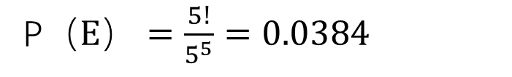

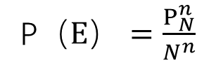
Exercise:
5 soldiers are randomly assigned to destroy 5 targets. Each soldier throws a bomb at a target （once） to destroy the target. Find the probability that all 5 targets are destroyed.
Solution:
Consider throwing 5 bombs to 5 target: 5*5*5*5*5
Destroying the 5 targets is like putting one ball into each box:
$P_{5}^{5}=5!$
Permutation
P（$E）=\frac{5!}{5^{5}}=0.0384$
Soldiers must be collaborative.
Ball drawing models
P（$E）=\frac{P_{N}^{n}}{N^{n}}$
$$=\frac{N\left(N−1\right)…(N−n+1)}{N^{n}}$$

Slide 21
Question？
In a class with 50 students, do you think it is possible that at least two students have the same birthday?
Birthday problem

Slide 22
Birthday problem
Exercise:
There are n students in a class, what is the probability that every student has a different birthday?
n student
n balls
365 days
365 boxes
(Ball drawing models)
P
n
P{everyone has a different birthday}=
365
365
n
We may be more interested in how many students there should be to be very sure that at least two students have the same birthday
n
P{at least two students have the same birthday }=
−
P
1
365
365
n
The probability that at least two people have a same birthday
n | 20 | 25 | 30 | 40 | 50 | 55 | 100
P | 0.41 | 0.57 | 0.71 | 0.89 | 0.97 | 0.99 | 0.9999997
Interesting:
In a class of size n which is more than 100, it is almost sure that at least two people have the same birthday.
A popular problem in Probability. Did you expect this result?

Slide 23

Exercise:
A medical center had 12 times of visiting in a week, and all were on Tuesday and Thursday. Can you infer that there is a restriction for visitors who can visit the center only on Tuesday and Thursday?
solution:
Assume there is no restriction. So each visitor can arrive equally likely in seven days of a week.
12 balls are thrown into two fixed boxes (No. 2, 4)
$$P\left\{12 times of visiting are on Tues and Thurs\right\}=\frac{2^{12}}{7^{12}}$$
$$=0.0000003$$
The probability is so small，the event should not happen.
Practical inference principle: Small probability events are almost impossible to happen.
Then we can infer that there should have a restriction for visitors.
Notes:
关于小概率事件的笑话：据说一个飞机上有炸弹的概率为十万分之一，但某人并不认为这个概率很小。概率小毕竟意味者可能，每天航班这么多，十万分之一确实不是一个小数目。因此，这个人从来不敢坐飞机。有一次，他居然和朋友上了飞机，朋友吃惊地问，你咋不害怕了。他说，飞机上有一个炸弹的概率不是十万分之一么？那么飞机上同时有两个炸弹的概率就是一百亿分之一了，对吧。朋友说，对，一百亿分之一已经很小了。这人说，那好，我自己已经带了一颗炸弹上来。

Slide 24
Matching problem
Exercise:
4 keys are randomly assigned to open 4 different doors, what is the probability of event A ={ at least one door can be opened}?
Solution:
Randomly number the 4 keys and their doors and let:
A_{i}={ the i^{th} key opens the i^{th} door} i=1, 2, 3, 4
P(A)=P(A₁∪A₂∪A₃∪A₄)
=P(A₁)+P(A₂)+P(A₃)+P(A₄)
- P(A₁A₂)-P(A₁A₃)-P(A₁A₄)-P(A₂A₃)-P(A₂A₄)-P(A₃A₄)
+ P(A₁A₂A₃)+P(A₁A₂A₄)+P(A₂A₃A₄)+P(A₁A₃A₄)
- P(A₁A₂A₃A₄)
加奇减偶
“+” for odd number
“–” for even number

Slide 25
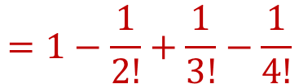


Exercise:
4 keys are randomly assigned to open 4 different doors, what is the probability of event A ={ at least one door can be opened}?
A_{i}={ the i^{th} key opens the i^{th} door} i=1, 2, 3, 4
Solution:
P(A₁)=P(A₂)=P(A₃)=P(A₄)=1/4
P(A₁A₂)=P(A₁A₃)=P(A₁A₄)=P(A₂A₃)=P(A₂A₄)=P(A₃A₄)
=1/4x1/3 =1/12
P(A₁A₂A₃)=P(A₁A₂A₄)=P(A₂A₃A₄)=P(A₁A₃A₄)
=1/4x1/3x1/2 = 1/24
P(A₁A₂A₃A₄)=1/4x1/3x1/2x1/1 = 1/24
P(A)=P(A₁∪A₂∪A₃∪A₄)=4x1/4 - 6x1/12 + 4x1/24 - 1/24=0.625
Matching Problem:
$$=1−\frac{1}{2!}+\frac{1}{3!}−\frac{1}{4!}$$
$$P\left(A\right)$$
$$=0.625$$

Slide 26
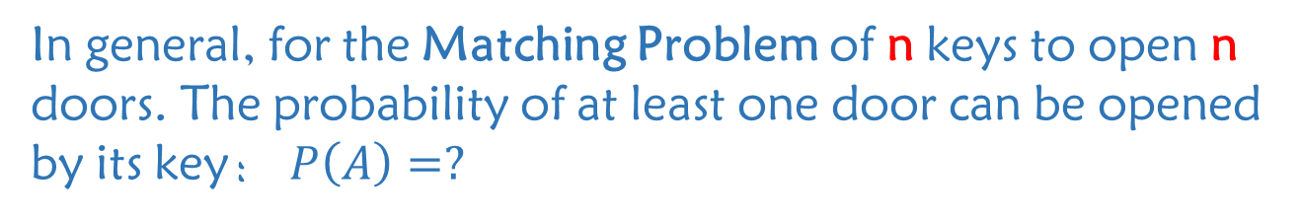


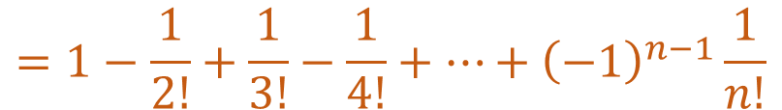
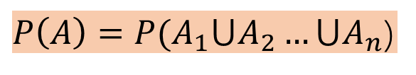
Exercise:
4 keys are randomly assigned to open 4 different doors, what is the probability of event A ={ at least one door can be opened}?
In general, for the Matching Problem of n keys to open n doors. The probability of at least one door can be opened by its key： $P\left(A\right)=?$
?
$P\left(A\right)=P(A_{1}⋃A_{2}…⋃A_{n}$)
$$=1−\frac{1}{2!}+\frac{1}{3!}−\frac{1}{4!}+…+{\left(−1\right)}^{n−1}\frac{1}{n!}$$
$$≈1−e^{−1}$$
It is not associated with the number n of keys/doors.
$$≈0.632$$

Slide 27
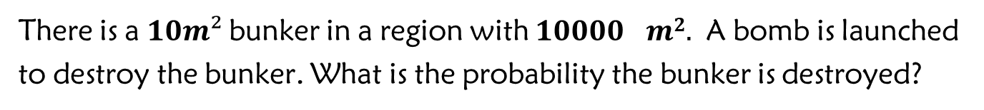

Geometric Probability
Characteristics of Classical Probability:
①
The sample space contains finite number of sample points;
②
The sample points occur with equal probability.
Exercise
There is a $10m²$ bunker in a region with $10000^{}m2.$ A bomb is launched to destroy the bunker. What is the probability the bunker is destroyed?
Analysis
Due to randomness, the bomb is equally likely to land at any point of the area. The successful probability is
P(E)$=\frac{The area of bunker}{The area of region}=\frac{10}{10000}=0.001$
Can we generalize the sample space to have infinite number of sample points, while keeping the equal probability property？

Slide 28

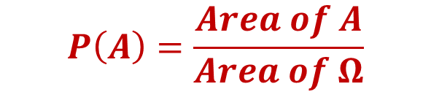

Geometric Probability
Experiment: throw a dot into a bounded region $Ω$
Sample space:
$$Ω$$
Event:
The dot falls into a plane region， $A⊂Ω$
$$P\left(A\right)=\frac{Area of A}{Area of Ω}$$
Probability
It is called Geometric Probability
Notes：
①
The probability of event A is not related to its position, but the area of A. This reflects the idea of “equally likely”.
②
If the sample space is a bounded interval or a bounded region in a space，then the“area”of Event A could be referred to as “length”,“volume”.

Slide 29
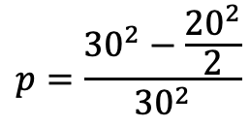





Example
In a military exercise, one construction group A is commanded to build a floating bridge at riverbank for the coming Group B. Assume that Group A will arrive at the riverbank at 7:00-7:30 and spend 20 minutes to build the bridge. Group B will arrive at the riverbank between 7:30 and 8:00. Find the probability that Group B can cross the river immediately when they arrive.
Let 7:00 be the starting point, and x, y the arrival time of Group A and Group B respectively.
The necessary and sufficient conditions that Group B can cross the river are:
y
$$y=x+20$$
60
$$0≤x≤30$$
$$30≤y≤60$$
30
$$x+20≤y$$
20
It is Geometric Probability. The probability is
$$p=\frac{{30}^{2}−\frac{{20}^{2}}{2}}{{30}^{2}}$$
x
$$=\frac{7}{9}$$
0
10
30

Slide 30




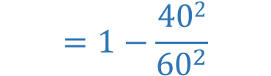

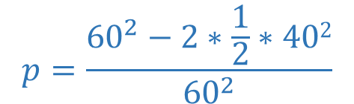
Exercise:
Two persons plan to meet between 7:00 and 8:00 at a park. The person who comes early can wait only for 20 minutes before leaving. Find the probability that the two persons can actually meet together.
Let 7:00 as a starting point.
Denote x, y as the arrival time of the two persons, respectively.
The necessary and sufficient conditions for the two persons to meet are
$$\left\{\begin{aligned}|x−y|≤20 \\ \\ x−y≤20 and \\ y−x≤20\end{aligned}\right.$$
y
$$x−20≤y$$
$$y=x+20$$
$$y≤20+x$$
60
$$y=x−20$$
It is Geometric Probability. The probability is
20
$$p=\frac{{60}^{2}−2∗\frac{1}{2}∗402}{{60}^{2}}$$
$$=1−\frac{402}{{60}^{2}}$$
= 5/9
x
0
20
60
END

Slide 31
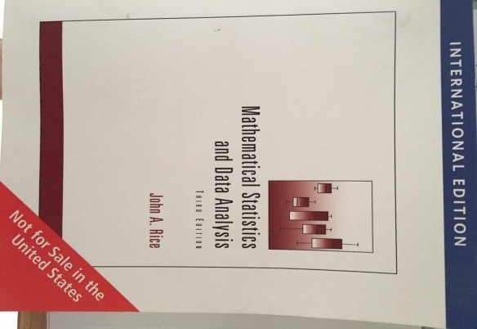
Homework
P27: 12； P29: 29
And the Supplementary Question on the next page

Slide 32
Supplementary Question:
Choose 2r shoes from n pairs of shoes with different sizes (2r<n). Compute the probabilities of the following events.
There are no matching pairs among the 2r shoes.
There is exact ONE matching pair among the 2r shoes.
There are r matching pairs among the 2r shoes.

Slide 33

Thank
You

