Slide 1
Chapter One Probability
Sample space（样本空间）
Probability measure（概率测度）
Probability computation（概率计算）
Conditional probability（条件概率）
Independence（独立性）
Notes:
Last week, we discussed Random test, Sample space. Then it led to the important terminology Event. Regarding the Event, we learnt Relationship between events and how all the vent could be operated in a sample space.
Today we are going to learn Probability measure ………

Slide 2
Chapter One Probability
Sample space（样本空间）
Probability measure（概率测度）
Probability computation（概率计算）
Conditional probability（条件概率）
Independence（独立性）
Notes:
Last week, we discussed Random test, Sample space. Then it led to the important terminology Event. Regarding the Event, we learnt Relationship between events and how all the vent could be operated in a sample space.
Today we are going to learn Probability measure ………

Slide 3



Example:
Student X tossed two coins and let student Y guess. Student Y guessed one head and one tail.
Question: What is the probability that student Y was correct?
Analyze: The sample space is
$$Ω=\{HH,HT,TH,TT\}$$
Let A = {one head and one tail} = {HT,TH}
then $P\left(A\right)=\frac{1}{2}$
Questions: What if student Z who had already known the result and told student Y that there was at least one head on. Then what would the probability that student Y was correct be?
Analyze: let B = {at least one head} = {HH,HT,TH}
Since B happened, the sample space became
$$\tilde{Ω}=Ω⋂B=\left\{HH,HT,TH\right\}$$
$$\frac{2}{3}$$
The probability of A happens knowing B has happened is then

Slide 4
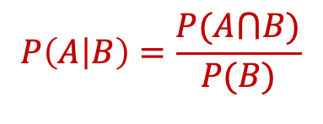

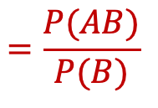

Conditional Probability
Definition: Let A and B be two events with P(B)> 0. Denote
$$P\left(A | B\right)=\frac{P(A⋂B)}{P(B)}$$
$$=\frac{P(AB)}{P(B)}$$
Then $P(A|B)$ is called the conditional probability of event A happening， given event B has happened.
NOTE:
1. Conditional Probability is meaningless when P(B) = 0
The straightforward explanation of Conditional Probability:
Event B happens before Event A;
Event B happens affects Event A.
3. The expression “A|B” is not one Event.
4. $P\left(A | B\right)≥P(AB)$
Notes:
- B发生带来的信息对A的推断的新认识。

Slide 5
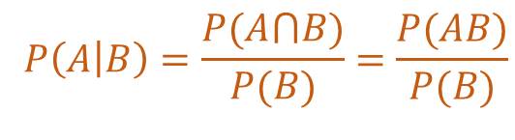






Example:
Student X tossed two coins and let student Y guess. Student Y guessed one head on and one tail on.
Question: What is the probability that student Y was correct?
Analyze: The sample space is
$$Ω=\{HH,HT,TH,TT\}$$
Let A = {one head and one tail} = {HT,TH}
then $P\left(A\right)=\frac{1}{2}$
Questions: What if student Z who had already known the result and told student Y that there was at least one head on. Then what would the probability that student Y was correct be?
Analyze: let B = {at least one head} = {HH,HT,TH}
$$P\left(B\right)=3/4$$
AB = {HT,TH}
$P\left(AB\right)=2/4$ = 1/2
$$=\frac{P(AB)}{P(B)}$$
= $\frac{1/2}{3/4}$
= $\frac{2}{3}$
$$P\left(A | B\right)$$

Slide 6
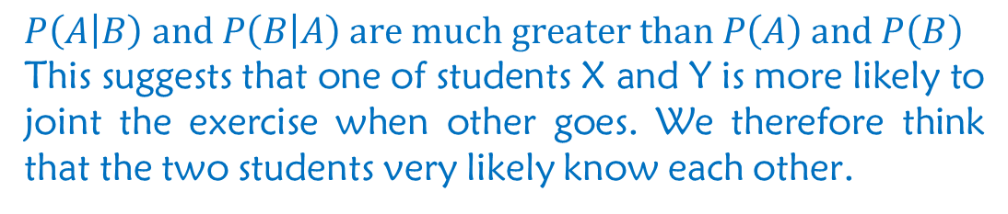


Example: The probabilities of student X and student Y joining an exercise after class is 20% and 18%, respectively. The probability that they both join the exercise after class is 12%. Do you think they know each other ?
Solve:
Let A = {student X joins the exercise after class}
B = {student Y joins the exercise after class}
$$P\left(A\right)=0.20, P\left(B\right)=0.18, P\left(AB\right)=0.12$$
If student X goes, will student Y join in? If Y goes, will X join in?
$$P\left(A | B\right)=\frac{P(AB)}{P(B)}=\frac{0.12}{0.18}=0.67$$
$$P\left(B | A\right)=\frac{P(AB)}{P(A)}=\frac{0.12}{0.20}=0.60$$
$P\left(A | B\right) and P\left(B | A\right) are much greater than P\left(A\right) and P\left(B\right)$
This suggests that one of students X and Y is more likely to joint the exercise when other goes. We therefore think that the two students very likely know each other.

Slide 7

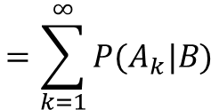


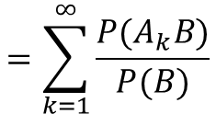
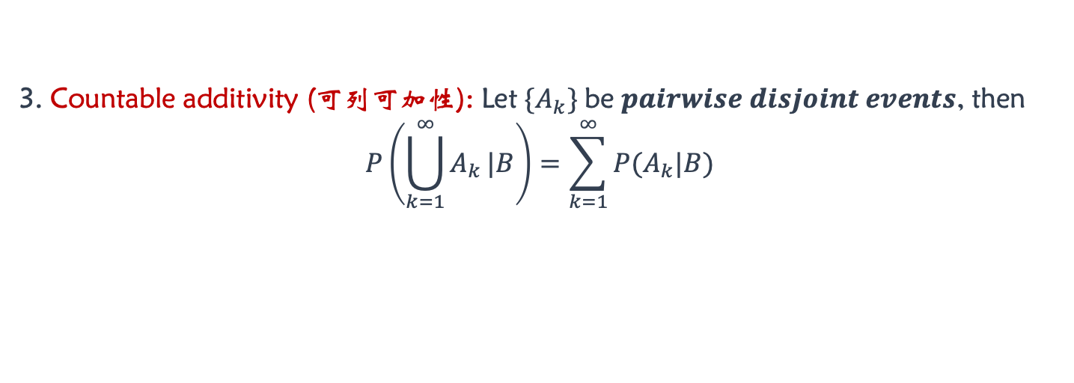



Basic properties of Conditional Probability$P\left(A | B\right)$
Assume $P\left(B\right)>0$, then
1. Non-Negativity (非负性): For any Event A, $P\left(A | B\right)≥0$.
2. Normalization (规范性): For certain event $Ω$, $P\left(Ω | B\right)=1.$
3. Countable additivity (可列可加性): Let $\{A_{k}\}$ be $pairwise disjoint events$, then
$$P\left(\bigcup_{k=1}^{∞}{A_{k}}|B\right)=\sum_{k=1}^{∞}{P(A_{k}|B)}$$
Distributive law（分配律）
$$A⋂\left(B⋃C\right)=(A⋂B)⋃(A⋂C)$$
Prove:
$$P\left(\bigcup_{k=1}^{∞}{A_{k}} | B\right)=\frac{P\{(\bigcup_{k=1}^{∞}{A_{k}})⋂B\}}{P(B)}$$
$$=\frac{P\{\bigcup_{k=1}^{∞}{(A_{k}⋂B)}\}}{P(B)}$$
Countable additivity (可列可加性)
$$P(\bigcup_{k=1}^{∞}{A_{k})}=\sum_{k=1}^{∞}{P}(A_{k})$$
$$∵\left\{A_{k}\right\} \text{are} \text{pairwise} \text{disjoint} \text{events}.$$
$$∴\left\{A_{k}⋂B\right\} are also pairwise disjoint.$$
$$∴P\left(\bigcup_{k=1}^{∞}{A_{k}} | B\right)=\frac{\sum_{k=1}^{∞}{P(A_{k}⋂B)}}{P(B)}$$
$$=\sum_{k=1}^{∞}{\frac{P(A_{k}B)}{P(B)}}$$
$$=\sum_{k=1}^{∞}{P(A_{k}|B)}$$

Slide 8



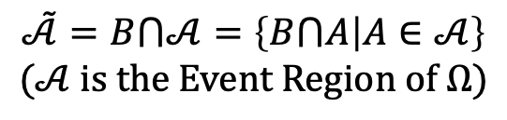
Basic properties of Conditional Probability$P\left(A | B\right)$
Assume $P\left(B\right)>0$, then
1. Non-Negativity (非负性): For any Event A, $P\left(A | B\right)≥0$.
2. Normalization (规范性): For certain event $Ω$, $P\left(Ω | B\right)=1.$
3. Countable additivity (可列可加性): Let $\{A_{k}\}$ be $pairwise disjoint events$, then
$$P\left(\bigcup_{k=1}^{∞}{A_{k}}|B\right)=\sum_{k=1}^{∞}{P(A_{k}|B)}$$
Conditional Probability is a kind of probability.
Question: What do these properties suggest?
Analyze:
$∵$ Event B happened, so the sample space has become
$$\tilde{Ω}=B⋂Ω$$
Event Region
（事件域）
$$\tilde{𝒜}=B⋂𝒜=\left\{B⋂A | A∈𝒜\right\}$$
$$(𝒜 is the Event Region of Ω)$$
The probability of Event $A∈\tilde{𝒜}$ is
$$P_{B}\left(A\right)=P(A|B)$$

Slide 9
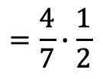
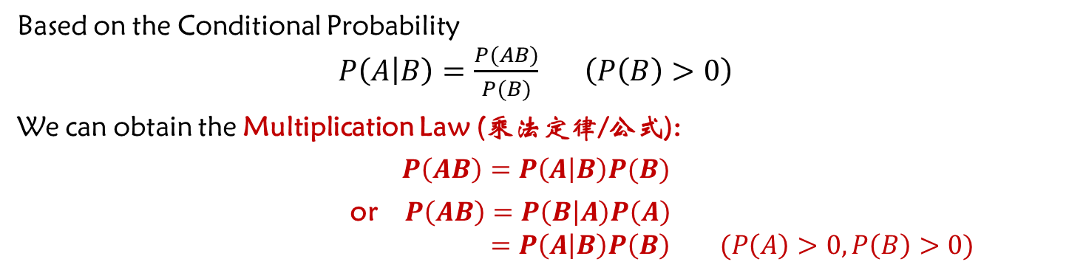

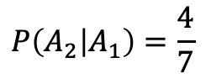

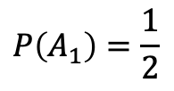


Multiplication Law (乘法定律)
Based on the Conditional Probability
$P\left(A | B\right)=\frac{P(AB)}{P(B)} \left(P\left(B\right)>0\right)$
We can obtain the Multiplication Law (乘法定律/公式):
$$P\left(AB\right)=P\left(A | B\right)P(B)$$
or $P\left(AB\right)=P\left(B | A\right)P\left(A\right)$
$=P\left(A | B\right)P\left(B\right) (P\left(A\right)>0, P\left(B\right)>0)$
Example: There are 2 black balls and 2 white balls in the first bag. There are 3 black and 3 white balls in the second bag. Pick 1 ball from the first bag and put it into the second bag. Then pick 1 ball from second bag. What is the probability that both picks are white ball?
$$P\left(A_{1}A_{2}\right)$$
Solve: let $A_{i}=\left\{i^{th} pick gets a white ball\right\}, (i=1, 2)$
$$P\left(A_{1}\right)=\frac{1}{2}$$
$$P\left(A_{2} | A_{1}\right)=\frac{4}{7}$$
By the Multiplication Law, we have:
$$P\left(A_{1}A_{2}\right)=P\left(A_{2} | A_{1}\right)P(A_{1})$$
$$=P\left(A_{1} | A_{2}\right)P(A_{2})$$
$$=\frac{4}{7}∙\frac{1}{2}$$
$$=\frac{2}{7}$$
Notes:
P（A2|$A1$) = 3/7

Slide 10
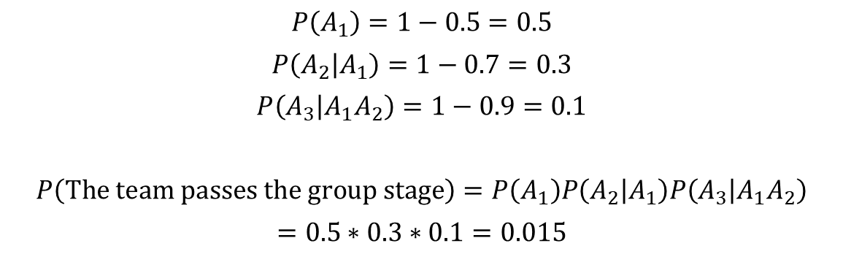
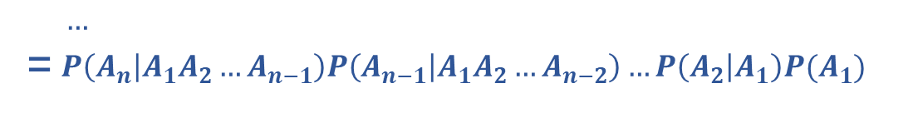
Example: A football team needs to win all three games to pass the group stage (小组赛). The probability that the team fails to pass the group stage at the first game is 0.5, at the second game is 0.7, and at the third game is 0.9. What is the probability that the team passes the group stage?
Solution:
let $A_{i}=\left\{The team wins the i^{th}game\right\}, (i=1, 2, 3)$
$$P\left(A_{1}\right)=1−0.5=0.5$$
$$P\left(A_{2} | A_{1}\right)=1−0.7=0.3$$
$$P\left(A_{3} | A_{1}A_{2}\right)=1−0.9=0.1$$
$$P\left(The team passes the group stage\right)=P\left(A_{1}\right)P\left(A_{2} | A_{1}\right)P\left(A_{3} | A_{1}A_{2}\right)$$
$$=0.5∗0.3∗0.1=0.015$$
In general, if there are n games in the group stage and $P\left(A_{1}A_{2}…A_{n−1}\right)>0$, then
$$P\left(A_{1}A_{2}…A_{n}\right)=P\left(A_{n} | A_{1}A_{2}…A_{n−1}\right)P(A_{1}A_{2}…A_{n−1})$$
$$…$$
=$P\left(A_{n} | A_{1}A_{2}…A_{n−1}\right)P\left(A_{n−1} | A_{1}A_{2}…A_{n−2}\right)…P\left(A_{2} | A_{1}\right)P(A_{1})$

Slide 11


More about the Multiplication Law
In Classical Probability, we learnt the Addition Law in the previous lecture
$$P\left(A⋃B\right)=P\left(A\right)+P\left(B\right)−P(AB)$$
In this lecture, we just learnt the Multiplication Law
$$P\left(AB\right)=P\left(A | B\right)P(B)$$
They are two basic theorems in probability theory. They are the foundation of the further development of probability theory.

Slide 12
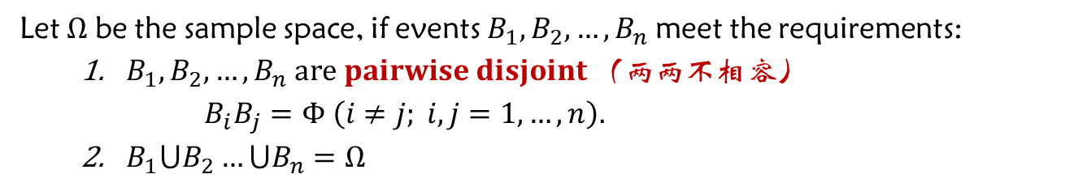


Law of Total Probability (全概率定律)
Question: How to resolve a complex probability problem with the summation of several simple probabilities?
Partition (分划) of the sample space:
Let $Ω$ be the sample space, if events $B_{1},B_{2},…,B_{n}$ meet the requirements:
$B_{1},B_{2},…,B_{n} are pairwise disjoint （两两不相容）$
$B_{i}B_{j}=Φ \left(i≠j; i,j=1,…,n\right).$
$B_{1}⋃B_{2}…⋃B_{n}=Ω$
We call each of $B_{1},B_{2},…,B_{n}$ as a Partition of the sample space $Ω$.
Probability is the "area" of each piece.
In general, $P\left(B_{i}\right)>0$
$P(A)$ equals to the summation of the areas.
Idea: Split $A$ to $B_{1},B_{2},…,B_{n}$ and calculate the summation of their results.
Question: how to split $A$and calculate the summation $P(A)$ ?

Slide 13





Law of Total Probability (全概率定律)
Question: How to resolve a complex probability problem with the summation of several simple probabilities?
Partition (分划) of the sample space:
Let $Ω$ be the sample space, if events $B_{1},B_{2},…,B_{n}$ meet the requirements:
$B_{1},B_{2},…,B_{n} are pairwise disjoint （两两不相容）$
$B_{i}B_{j}=Φ \left(i≠j; i,j=1,…,n\right).$
$B_{1}⋃B_{2}…⋃B_{n}=Ω$
We call each of $B_{1},B_{2},…,B_{n}$ as a Partition of the sample space $Ω$.
For an event A, we have
$$A=A⋂Ω=AB_{1}⋃AB_{2}…⋃AB_{n}$$
Distributive law（分配率）
$$A⋂\left(B⋃C\right)=(A⋂B)⋃(A⋂C)$$
$$P\left(A\right)=P\left(AB_{1}⋃AB_{2}…⋃AB_{n}\right)$$
Multiplication law（乘法定律）
$$P\left(AB\right)=P\left(A | B\right)P(B)$$
$$=P\left(AB_{1}\right)+P\left(AB_{2}\right)+…+P(AB_{n})$$
$$=P\left(A | B_{1}\right)P\left(B_{1}\right)+P\left(A | B_{2}\right)P\left(B_{2}\right)+…+P\left(A | B_{n}\right)P(B_{n})$$
Law of Total Probability

Slide 14



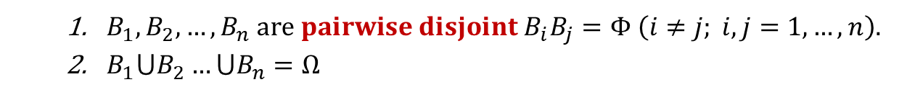


Example: A bag has a red balls and b white balls. Pick a ball from the bag, record the color of the ball and put it back to the bag. At the same time, add another ball with the same color to the bag too. Then pick a ball from the bag again. What is the probability of picking a white ball at the second pick?
Solve: Let
$$A =\left\{getting a white ball at the second pick\right\}$$
What if adding c balls of the same color to the bag ?
$$B_{1}=\left\{getting a white ball at the first pick\right\}$$
$$B_{2}=\left\{getting a red ball at the first pick\right\}$$
Then $B_{1},B_{2}$ is Partitions (分划) of the sample space $Ω.$
$B_{1},B_{2},…,B_{n} are pairwise disjoint B_{i}B_{j}=Φ \left(i≠j; i,j=1,…,n\right).$
$B_{1}⋃B_{2}…⋃B_{n}=Ω$
By the Law of Total Probability, we have:
$$\frac{b+c}{a+b+c}∙\frac{b}{a+b}+\frac{b}{a+b+c}∙\frac{a}{a+b}$$
$$P\left(A\right)=P\left(A | B_{1}\right)P\left(B_{1}\right)+P\left(A | B_{2}\right)P(B_{2})$$
$$=\frac{b+1}{a+b+1}∙\frac{b}{a+b}+\frac{b}{a+b+1}∙\frac{a}{a+b}$$
$$=\frac{b}{a+b}$$
$$=\frac{b}{a+b}$$
Interesting: The probability of getting a white ball at the second pick is the same as the probability of getting a white ball at the first pick. The ball which is added to the bag after the first pick does not affect the result, no matter what color it is.

Slide 15

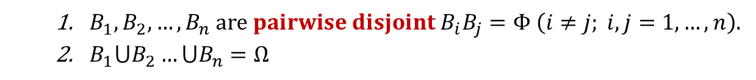
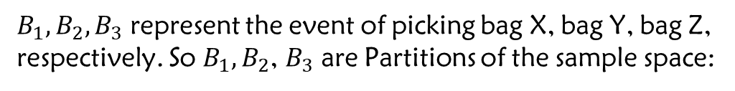


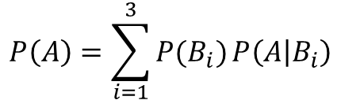
Example: There are 10 bags in total, in which for 2 bags (X ) each has 2 red balls and 2 white balls; for 3 bags (Y ) each has 3 red balls and 2 white balls; and for 5 bags (Z ) each has 2 red balls and 3 white balls. Pick a bag from the 10 bags, then pick a ball from the bag, what is the probability of getting a white ball?
10 Bags
Answer:
Let
$$A=\{getting a white ball\}$$
B_{i}
2
3
5
$B_{1},B_{2},B_{3}$ represent the event of picking bag X, bag Y, bag Z, respectively. So $B_{1},B_{2}$, $B_{3}$ are Partitions of the sample space:
+
+
A
2+2
3+2
2+3
$B_{1},B_{2},…,B_{n} are pairwise disjoint B_{i}B_{j}=Φ \left(i≠j; i,j=1,…,n\right).$
$B_{1}⋃B_{2}…⋃B_{n}=Ω$
By the Law of Total Probability, we have:
$$P\left(A\right)=\sum_{i=1}^{3}{P(B_{i})}P\left(A | B_{i}\right)$$
$$=\frac{2}{10}∙\frac{2}{4}+\frac{3}{10}∙\frac{2}{5}+\frac{5}{10}∙\frac{3}{5}$$
$$=\frac{13}{25}$$
The Law of Total Probability is the weighted average (加权平均) of the probabilities
It is the probability of picking a white ball from the bags X, Y, Z , respectively

Slide 16
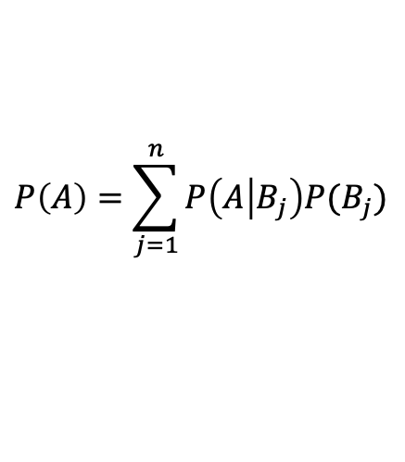
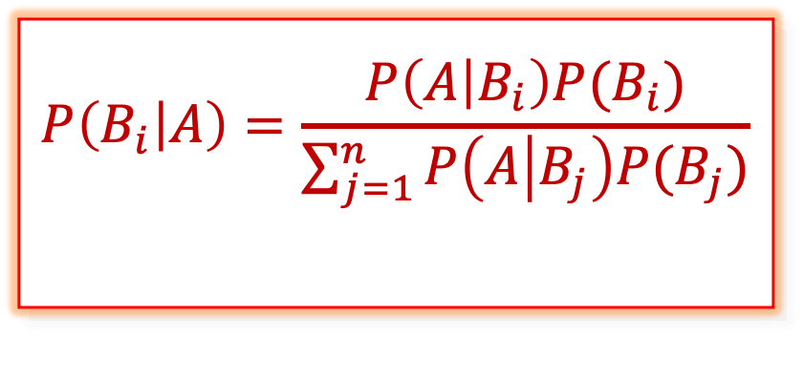

Bayes' Rule (贝叶斯公式)
Assume that $B_{1},B_{2},…,B_{n}$ are Partitions（划分）of the sample space $Ω$, and
$$P\left(A\right)>0, P\left(B_{i}\right)>0 (i=1,2,…,n)$$
By the Multiplication Law (乘法定律) $P\left(AB\right)=P\left(A | B\right)P\left(B\right)=\left(B | A\right)P\left(A\right)$, we have
$$P\left(B_{i} | A\right)P\left(A\right)=P\left(A | B_{i}\right)P\left(B_{i}\right) (i=1,2,…,n)$$
By the Law of Total Probability（全概率公式）, we have
$$P\left(A\right)=\sum_{j=1}^{n}{P\left(A | B_{j}\right)P(B_{j})}$$
Bayes' Rule
(贝叶斯公式)
$$P\left(B_{i} | A\right)=\frac{P\left(A | B_{i}\right)P(B_{i})}{\sum_{j=1}^{n}{P\left(A | B_{j}\right)P(B_{j})}}$$
$$(i=1,2,…,n)$$
Notes:
- The denominator is just P(A)

Slide 17
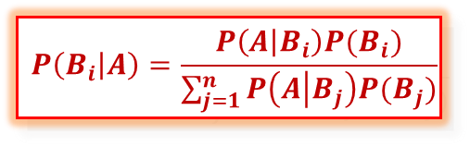
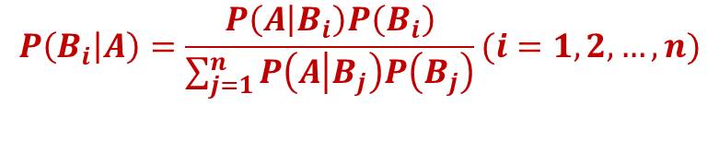

The meaning of Bayes' Rule (贝叶斯公式的实际意义)
$$P\left(B_{i} | A\right)=\frac{P\left(A | B_{i}\right)P(B_{i})}{\sum_{j=1}^{n}{P\left(A | B_{j}\right)P(B_{j})}}$$
Suppose that $\{B_{1},B_{2},…,B_{n}\}$ are the possible "causes" of a test result,
We call $P\left(B_{i}\right) (i=1,2,…,n)$ as Prior Probabilities (先验概率)
If we have an Event A from the test and would like to find the "cause" of the Event by computing
$$P\left(B_{i} | A\right)$$
We call $P(B_{i}|A)$ as Posterior Probabilities (后验概率).
Posterior Probability can be calculated by using the Bayes' rule
$$P\left(B_{i} | A\right)=\frac{P\left(A | B_{i}\right)P\left(B_{i}\right)}{\sum_{j=1}^{n}{P\left(A | B_{j}\right)P\left(B_{j}\right)}}(i=1,2,…,n)$$
Bayes' Rule has been used in networks, classification, diagnosis, estimation, proving, differentiate, inference, etc.

Slide 18



Application of Bayes' Rule (贝叶斯公式的应用)
$$P\left(B_{i} | A\right)=\frac{P\left(A | B_{i}\right)P(B_{i})}{\sum_{j=1}^{n}{P\left(A | B_{j}\right)P(B_{j})}}$$
Example: Automatic computer aided diagnosis system (计算机自动辅助诊断系统)
Assume that $\{B_{1},B_{2},…,B_{n}\}$ are different kinds of “disease”(疾病).
Using statistical methods to confirm the prior probabilities (先验概率):
$$P(B_{i})(i=1,2,…,n)$$
Using medical knowledge to find out the cause probabilities:
$$P(A|B_{i})(i=1,2,…,n)$$
Identify some symptom A（症状A ）, such as body temperature (温度), pulse (脉搏) etc., by taking observation from the patient.
By Bayes' rule, the Posterior probability (后验概率) can be calculated
$$P(B_{i}|A)(i=1,2,…,n)$$
For diseases with higher posterior probabilities, doctors can provide further diagnosis.

Slide 19
Application of Bayes' Rule (贝叶斯公式的应用)
$$P\left(B_{i} | A\right)=\frac{P\left(A | B_{i}\right)P(B_{i})}{\sum_{j=1}^{n}{P\left(A | B_{j}\right)P(B_{j})}}$$
Example: Automatic computer aided diagnosis system (计算机自动辅助诊断系统)
Assume that $\{B_{1},B_{2},…,B_{n}\}$ are different kinds of “disease”(疾病).
Using statistical methods to confirm the prior probabilities (先验概率):
$$P(B_{i})(i=1,2,…,n)$$
（得这种病的概率？）
Using medical knowledge to find out the cause probabilities:
$$P(A|B_{i})(i=1,2,…,n)$$
（什么原因引起这种病？）
Identify some symptom A（症状A ）, such as body temperature (温度), pulse (脉搏) etc., by taking observation from the patient.
By Bayes' rule, the Posterior probability (后验概率) can be calculated
$$P(B_{i}|A)(i=1,2,…,n)$$
（有症状，是什么病？）
For diseases with higher posterior probabilities, doctors can provide further diagnosis.

Slide 20



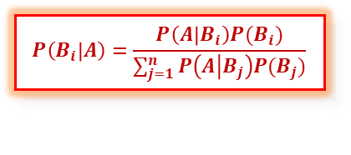








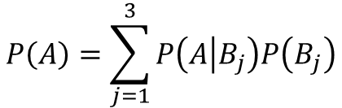


Example: A factory has three workshops which are X, Y and Z. All workshops are producing the same product. Each of the workshops produces 15%, 80% and 5% of the total products, respectively, and their corresponding defective rates are 2%, 1% and 3%. If there is a defective product, which workshop has the highest possibility of having produced it?
$$P\left(B_{1} | A\right)$$
$$P\left(B_{2} | A\right)$$
$$P\left(B_{3} | A\right)$$
$$P\left(B_{i} | A\right)=\frac{P\left(A | B_{i}\right)P(B_{i})}{\sum_{j=1}^{n}{P\left(A | B_{j}\right)P(B_{j})}}$$
Answer: Let
$$A=\{getting a defective product\}$$
$$B_{i}=\left\{the ith workshop produced the product\right\}, i=1, 2, 3$$
Prior:
$$P(B_{i})(i=1,2,…,n)$$
Posterior:
$$P\left(B_{1} | A\right)$$
$$P\left(B_{2} | A\right)$$
$$P\left(B_{3} | A\right)$$
By the Law of Total Probability, we have
$$P\left(A\right)=\sum_{j=1}^{3}{P\left(A | B_{j}\right)P\left(B_{j}\right)}$$
$=0.02∗0.15$+$0.01∗0.80$+$0.03∗0.50$
$$=0.0125$$
By the Bayes' rule, we have:
$$P\left(B_{1} | A\right)=\frac{P\left(A | B_{1}\right)P(B_{1})}{P(A)}$$
$$=\frac{0.02∗0.15}{0.0125}=0.24$$
According to the results, we can see that workshop Y has the highest possibility of having produced this defective product.
$$P\left(B_{2} | A\right)=\frac{0.01∗0.80}{0.0125}$$
$$=0.64$$
$$P\left(B_{3} | A\right)=\frac{0.03∗0.05}{0.0125}$$
$$=0.12$$
Bayesian inference (贝叶斯推断)

Slide 21


Example: According to the collected data analysis, the passing rate of their products is 0.9 when the machine is well adjusted at the beginning of a day; while the passing rate is 0.6 when the machine is malfunctioned. The machine starts every day in the morning with 0.95 probability that it is well adjusted.
Compute the probability that the machine is well adjusted in a day if the first product produced in the morning is qualified?
$$P\left(B | A\right)$$
Answer: Let
{a product is qualified}
$$P\left(B_{i} | A\right)=\frac{P\left(A | B_{i}\right)P(B_{i})}{\sum_{j=1}^{n}{P\left(A | B_{j}\right)P(B_{j})}}$$
{the machine is well adjusted}
;
=
=
=

Slide 22




Example: Cancer diagnosis device
Suppose:
$$A=\{Diagnosis device shows that a person has cancer\}$$
$$B=\{The person does have cancer\}$$
$P\left(A | B\right)=0.95, P\left(\overline{A} | \overline{B}\right)=0.90$. Assume $P\left(B\right)=0.0004$
If the diagnosis device shows that a person has cancer, what is the probability of that he or she do have cancer?
Answer:
By the Bayes' rule, the probability that the person has cancer is
$$P\left(B | A\right)=\frac{P\left(A | B\right)P(B)}{P\left(A | B\right)P\left(B\right)+P\left(A | \overline{B}\right)P(\overline{B})}$$
$$=\frac{0.95∗0.0004}{0.95∗0.0004+0.1∗0.9996}$$
$$=0.0038$$
Based on the calculation, even though the diagnosis device is reliable, the probability of that person has cancer is low.
Notes:
- This is because having cancer is a rare event (with probability 0.0004). The probability in reality is not that low.

Slide 23

Homework
P30: 46
P31：53,54
P32: 63

Slide 24

Thank
You

