Slide 1
Midterm
Window Program Design

Slide 2
Note
Select .NET Framework to create a project
During the exam, course slides from the past will be provided (not including Example Code). However, personal laptops and unnecessary programs and files are prohibited. Cellphones are also not allowed. If found out, it is considered cheating.
If there are concerns about the questions, please raise your hand and ask the TA for help.
If the VS auto complete feature on your computer is turned off, you can turn it on by:
“tools”→”options” → ”text editor" →”all languages" → check ”automatically list members"
Or you can also click Ctrl+J to manually call up the autocomplete list when editing

Slide 3
File Submission
Please place the compressed project file in an obvious spot on the desktop.
One file for a question. Your review doesn’t need to be compressed. It’s the same way of compressing as the assignment.
Please name your submitted project file Q question number_name_student ID
e.g. Q1_P76543210_Wang Xiao Ming.zip
Please raise your hand and ask the TA for help if you want to submit early.

Slide 4
Distribution
Baozi shop 30%
Wordle 30%
4X4 sudoku 40%
Review 5%
Total 105%

Slide 5
Baozi Shop
Q1(30%)

Slide 6
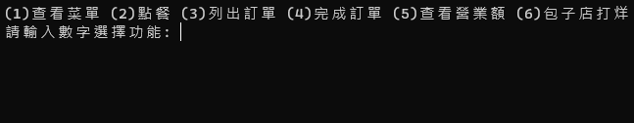
Baozi Shop
View menu(4%)
Make an order (6%)
List the order (5%)
Complete order (6%)
View turnover (5%)
Baozi shop closed (4%)
Only 1-6 will be entered as test data, there’s no need to consider others.

Slide 7
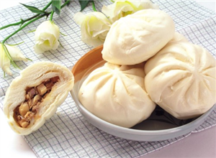
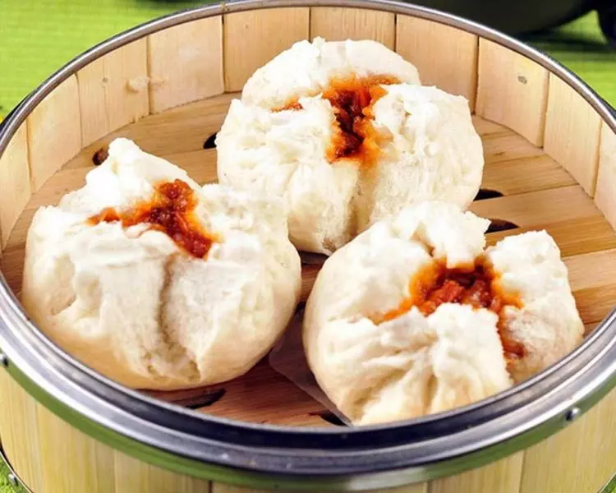

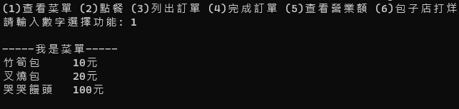
View Menu(4%)
Enter 1 and click enter to print out the menu
Menu content is as follows:
Bamboo shoot bun: NT$10
Char siew bun: NT$20
哭哭饅頭: 100元
View menu
Make an order
List order
complete order
View turnover
Baozi shop closed
Please enter a number to select a function
I am the menu
Bamboo shoot bun NT$10
Char siew bun NT$20
Cry cry steamed bun NT$100
https://i.imgur.com/7ACi6Nr.png
https://www.dachu.co/recipe/231266
https://www.supermarket.com.tw/超軟鮮肉竹筍包-news3-191.html

Slide 8
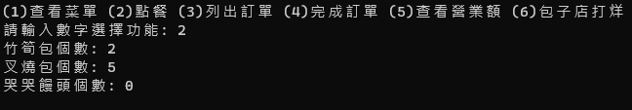
Make an Order(6%)
Enter 2 and click enter to make an order. In order(bamboo shoot bun, char siew bun, cry cry steamed bun), ask the user the number of each kind of bun.
The order number must be recorded(start from 0)。
Only 0 or a positive number can be entered as the number of each bun. The rest can be ignored.
The number of bamboo shoot buns
The number of char siew buns
The number of cry cry steamed buns

Slide 9
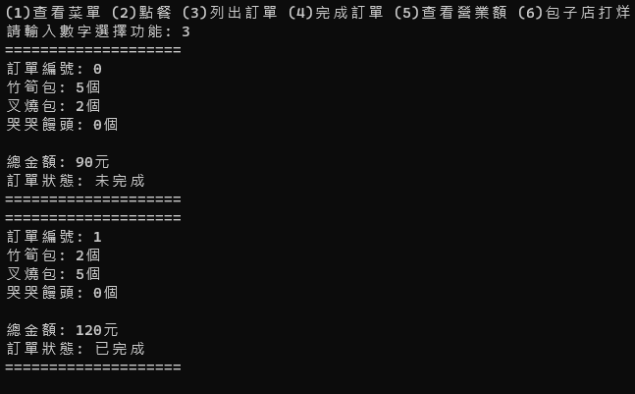
List the Order(5%)
Enter 3 and click enter to list all orders. The orders should include the following information:
Order number
Number of bamboo shoot buns
Number of char siew buns
Number of cry cry steamed buns
Total amount
Order status(completed/uncompleted)
If there are multiple orders, they should be listed in order according to the order number.

Slide 10
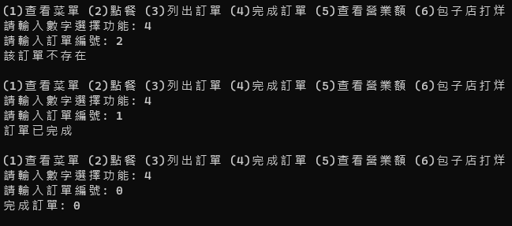
Complete Order(6%)
Enter 4 and click enter. Enter the number of the order to be completed.
If the order doesn’t exist, output: The order doesn’t exist.
If the order status is completed, output: The order is completed.
If the order is not completed, output: order completed: <order number> and change the order status to completed
Please enter a number to select a function
Please enter the order number
The order doesn’t exist
The order is completed
Order completed

Slide 11
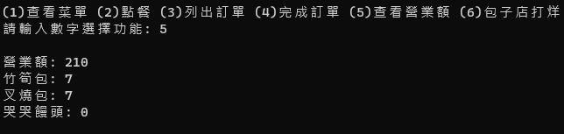
View Turnover(5%)
Enter 5 and click enter to print out the current total turnover. It must include the following:
turnover
The total number of bamboo shoot buns sold
The total number of char siew buns sold
The total number of cry cry buns sold
Only the completed orders are counted. Uncompleted orders are not included.

Slide 12
Baozi Shop Closed(4%)
Enter 6 and click enter to end the program.

Slide 13
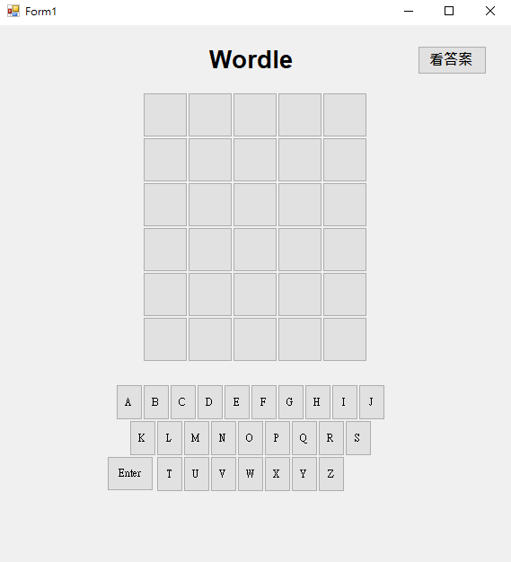
Wordle
Q2(30%)

Slide 14
Wordle Distribution
Randomly select an answer (load wordlist.txt ) and create the see answer – 5 points
Determine whether the spot of the letter is right or wrong– 10 points
Load the keyboard input（backspace can be used to delete the previous letter）- 10 points
Determine whether the entered vocabulary is in the wordlist and have a reminder pop up –5 points

Slide 15
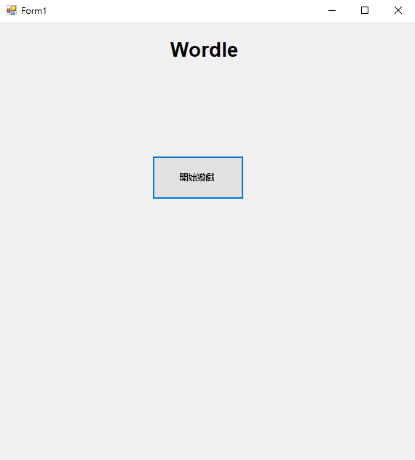
Home Screen
Start game

Slide 16
Start Game
Generate 30 squares
The letters below must also be created

Slide 17
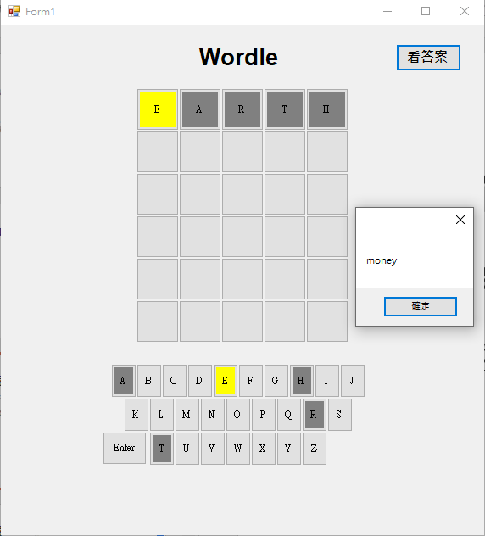
Start Game
See answer
Assuming the answer is money
If guessed EARTH, only ‘E’ is correct but on the wrong spot, so ‘E’ turns yellow and others turn gray.
Click see answer, and use the messageBox to show the answer
confirm

Slide 18
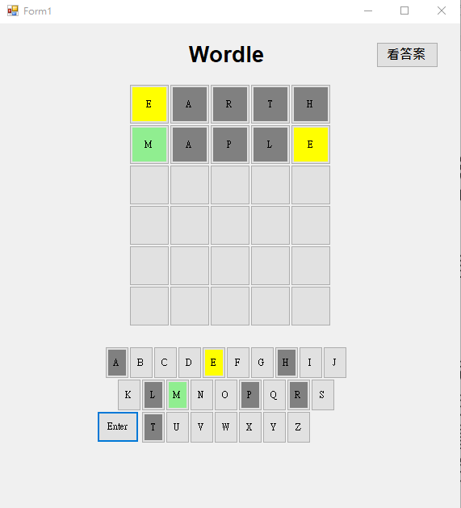
If guessed MAPLE, ’M’ is correct and the spot is correct as well, so it turns green.

Slide 19
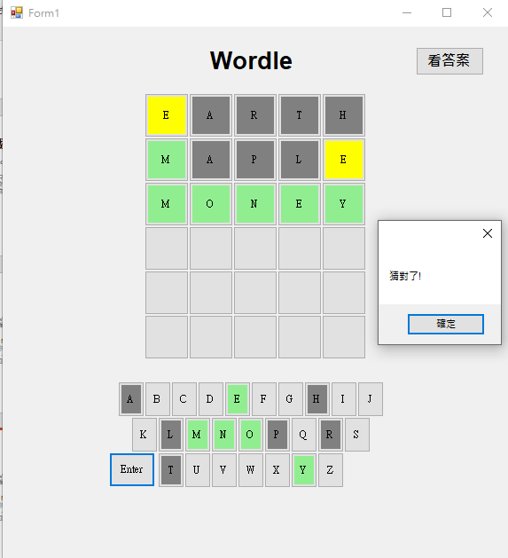
If guessed the right answer, it pops up: Right guess!
Click confirm to end the game.

Slide 20
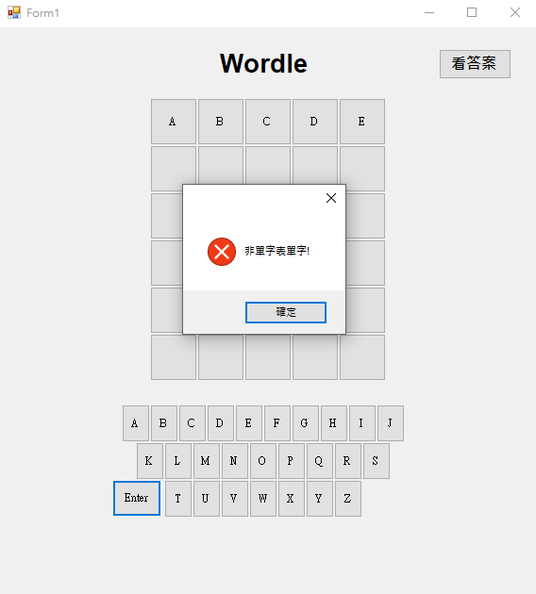
Game Mechanism
Each entered guess must be checked whether it’s a valid word. Must check in the word list whether there is the word you guessed this time. If not, have the messageBox pop up。
Not a word in the word list
confirm

Slide 21
Game Mechanism
Right spot right letter-> green
Wrong spot right letter-> yellow
Both wrong -> gray
Right guess
confirm

Slide 22
Game Mechanism
The user can click backspace to delete the entered letter
The user can use the keyboard to play
After the user guessed and clicked Enter, he/she must be able to guess

Slide 23
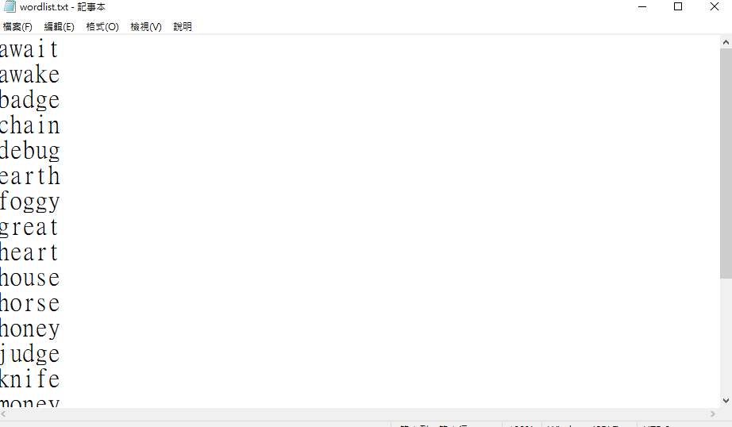
Wordlist Format

Slide 24
4x4 Sudoku
Q3(40%)

Slide 25
Distribution
Interface 5%
Load the file and display 12%
Enter number
Cannot be changed 2%
Invalid number 5%
Fill in normally 5%
Complete game 3%
Save game 8%

Slide 26
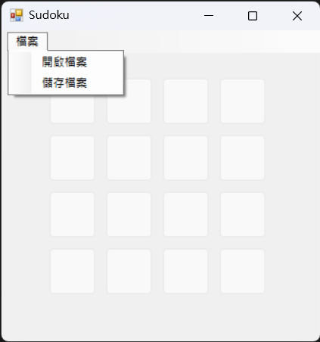
Home Screen(5%)
4 X 4 buttons
All buttons can be disableb
File
Open file
Save file

Slide 27
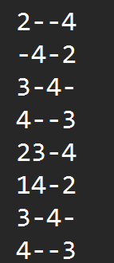
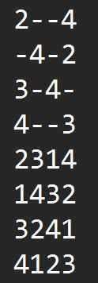
Open File– File Format
Text file (.txt)
The first four rows are questions
The last four rows are saved records
“-” means that there’s no number
Test data follow the format and sudoku rules
There will be no full sudoku test data

Slide 28
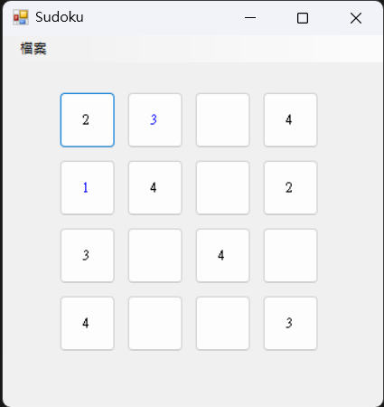
Open File– Show Number(12%)
Click Open file
Open FileDialog to select a file
Load the question file to show numbers on the buttons
Question numbers are in black
Numbers entered by users are in blue
“-” shows blank
Enable all buttons

Slide 29
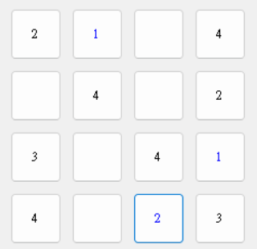
Sudoku Rules
Only numbers 1~4
Numbers in the same palace must not be repeated
Numbers in the same row must not be repeated
Numbers in the same column must not be repeated
Hint: Check which palace the button is in first, then check whether the palace has the same number as the new number
e.g. button (i, j) is at
(i/2, j/2) palace
i row
j column

Slide 30
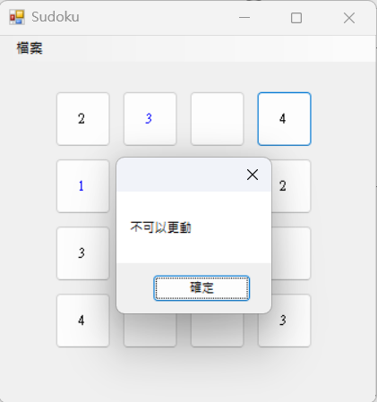
Enter Number – Cannot be Changed (2%)
Click the button, if the button is a black question number, a MessageBox should pop up and show ”cannot be changed”

Slide 31
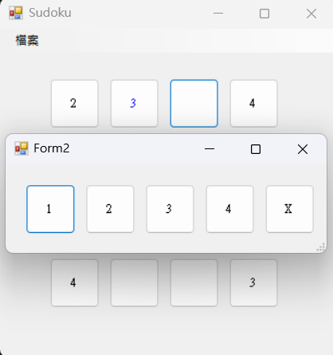
Enter Number
Click the button, if the button is a blue number or blank, a new window should pop up.
Close the new window after completing each action.
There are 5 buttons in the new window, which are 1, 2, 3, 4, 5, X
X represents delete number
Hint: You can use ShowDialog

Slide 32
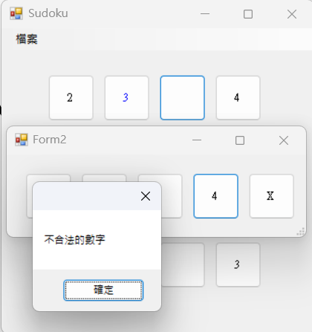
Enter Number – Invalid Number(5%)
Check whether the number clicked follows the sudoku rules. If not, a MessageBox should pop up and show ”invalid number”

Slide 33
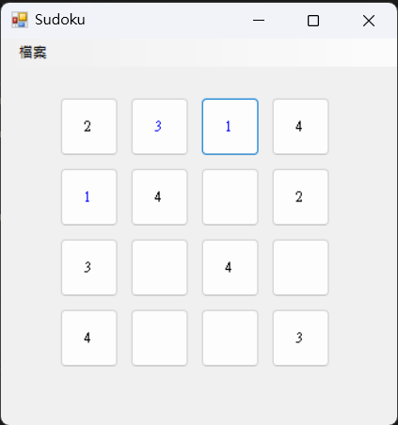
Enter Number– Enter Normally(5%)
If followed the rules, enter the number and show it in blue.
If X is selected, delete the number (no changes for blank)

Slide 34
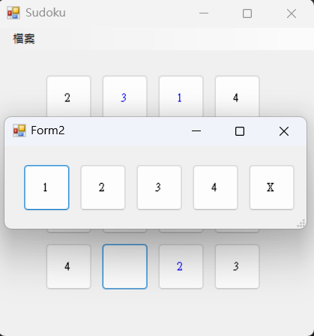
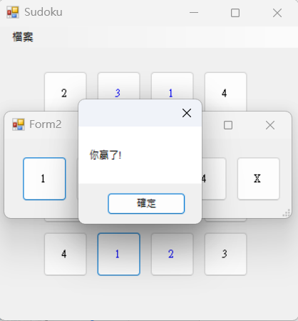
Enter Number – Complete Game (3%)
If all numbers are filled in, have a MessageBox pop up and show ”You won!”. Click confirm to end the program.

Slide 35
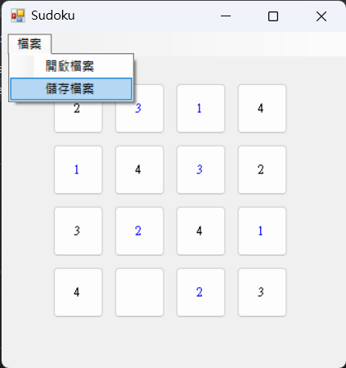
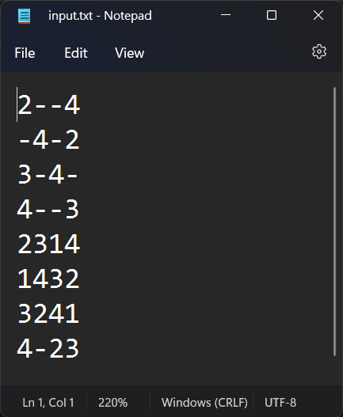
Save File(8%)
Click save file
Write the current status to the original file according to the file format

Slide 36
Review
Q4(5%)

Slide 37
Description
Text file(right click > add > text document)
Please name the file “student ID_review.txt」
E.g. F74012345_review.txt
There are no restrictions for the review. Feel free to use your creativity.

