Slide 1
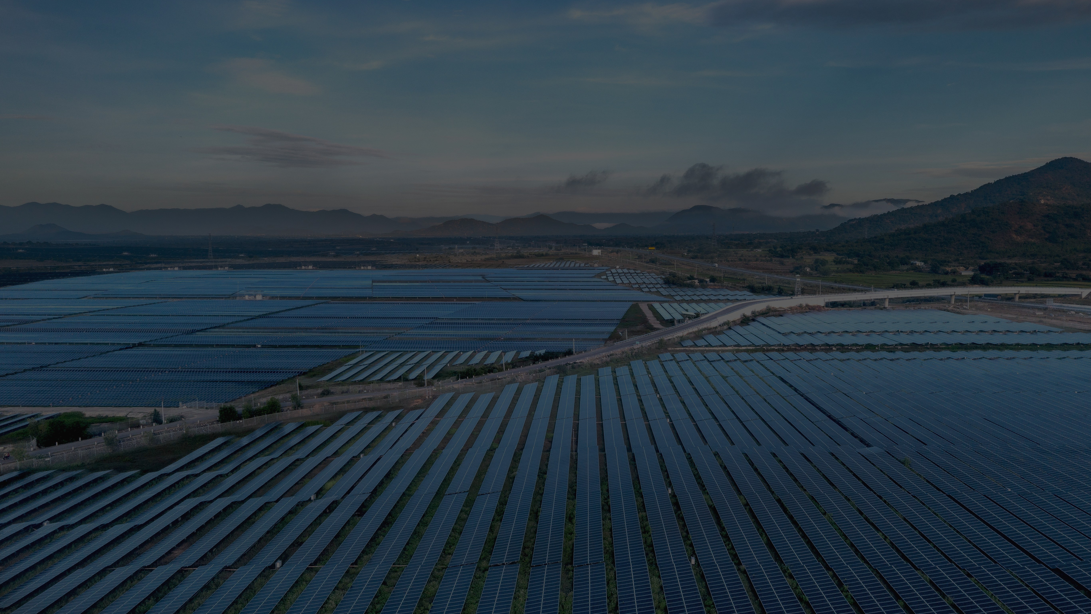
GJW ENERGY
TECHNO-COMMERCIAL PROPOSAL · GJW-TCO-[YYYY]-[NNN]
[SOLAR PV + BESS PLANT]
[CAPACITY] kWp / [kWh] — [SITE NAME], [COUNTRY]
PREPARED FOR
PREPARED BY
DATE
VALIDITY
[CLIENT NAME]
GJW ENERGY LTD
[DD MONTH YYYY]
[30] DAYS
PRIVATE & CONFIDENTIAL

Slide 2
01 — WHO WE ARE
PRINCIPAL-LED. ENGINEER-FIRST.
GJW Energy is a Kenyan engineering and EPC company delivering solar PV, battery storage and grid-integration projects across East Africa. Technical governance on every project is anchored directly by the company's technical leadership — the people who design your system are the people accountable for delivering it.
20+
MWp engineering &
delivery experience
10+
MWh storage
experience
Mandate across Kenya, Tanzania, Uganda, Somalia and Somaliland — EPC, construction, design and technical advisory for industrial, agricultural, hospitality, healthcare and mixed-use clients.
05
territories — regional
delivery experience
20+
years combined team
experience
WHAT THIS MEANS FOR YOU
One accountable engineering lead from first site visit to final acceptance testing. No hand-offs, no brokering — design intent survives construction.
GJW ENERGY — TECHNO-COMMERCIAL PROPOSAL · GJW-TCO-[YYYY]-[NNN]
02

Slide 3

02 — GEOGRAPHICAL PRESENCE
ONE TEAM. FIVE TERRITORIES.
Headquartered in Kenya, with project delivery and development experience across the region — one engineering standard, applied everywhere we work.
01
KENYA
HOME MARKET · EPRA-LICENSED DELIVERY
02
UGANDA
C&I SOLAR & STORAGE
03
TANZANIA
C&I SOLAR & STORAGE
04
SOMALIA
OFF-GRID & DIESEL DISPLACEMENT
05
SOMALILAND
WATER & UTILITY SOLAR
GJW ENERGY — TECHNO-COMMERCIAL PROPOSAL · GJW-TCO-[YYYY]-[NNN]
03

Slide 4
03 — YOUR REQUIREMENT
THE BRIEF, AS WE UNDERSTAND IT.
CLIENT
[CLIENT NAME]
SITE
[SITE / FACILITY], [TOWN], [COUNTRY]
OBJECTIVE
[Reduce grid energy costs / secure supply / displace diesel]
LOAD PROFILE
[Daytime baseload ±XXX kW · peak XXX kVA · XX,XXX kWh/month]
SUPPLY CONTEXT
[Utility grid — utility tariff / outage profile / genset backup]
CONSTRAINTS
[Roof or land availability · outage windows · interconnection limits]
Source: [site visit dated ___ / client data pack / utility bills for ___ months]. Any assumption stated here is confirmed during detailed design and does not alter the fixed price unless the physical scope changes.
GJW ENERGY — TECHNO-COMMERCIAL PROPOSAL · GJW-TCO-[YYYY]-[NNN]
04

Slide 5






04 — THE OFFER AT A GLANCE
ONE SYSTEM. EVERY PART SIZED.
[___] kWp
[___] kWh
[___] MVA
[___] km
[___] kVAR
[___] kVA
SOLAR PV
BATTERY STORAGE (BESS)
TRANSFORMER & DISTRIBUTION
TRANSMISSION LINE
GRID STABILISATION
GENERATOR INTEGRATION
DELIVERY MODEL — EPC · FIXED LUMP-SUM · SINGLE ACCOUNTABLE ENGINEERING LEAD
Blank figures are completed per offer after site assessment — elements not required for your site are marked N/A rather than priced in. Full engineering detail follows in the technical offer.
GJW ENERGY — TECHNO-COMMERCIAL PROPOSAL · GJW-TCO-[YYYY]-[NNN]
05

Slide 6
05 — TECHNICAL OFFER
PROPOSED SYSTEM.
SYSTEM SIZE
[XXX] kWp DC / [XXX] kW AC
PV MODULES
[N × XXX Wp Tier-1 mono / n-type · make per final BOQ]
INVERTERS
[N × XXX kW string inverters · make per final BOQ]
STORAGE (OPTION)
[XXX kWh LFP BESS · hybrid inverter / PCS]
GRID INTERFACE
[Grid-tied / grid-stabilising · protection & synchronisation per utility]
MOUNTING
[Roof / ground-mounted · hot-dip galvanised structure]
MONITORING
[String-level monitoring · remote portal · generation meter]
EST. YIELD
[X,XXX MWh in year one · PR ≥ XX%]
Engineering basis: PVsyst simulation, utility interconnection study and structural verification precede construction. All equipment is Tier-1 with manufacturer warranties registered to the client.
GJW ENERGY — TECHNO-COMMERCIAL PROPOSAL · GJW-TCO-[YYYY]-[NNN]
06

Slide 7
06 — SCOPE OF WORK
ONE CONTRACT. FULL ACCOUNTABILITY.
A
ENGINEERING & DESIGN
Site survey & yield assessment · PVsyst design · single-line diagrams · structural checks · utility application
B
PROCUREMENT
Tier-1 equipment sourcing · factory inspections · logistics & customs · materials received & stored to spec
C
CONSTRUCTION
Civil & structural works · mechanical & electrical installation · grid interconnection · HSE-managed site
D
COMMISSIONING & HANDOVER
Testing & commissioning · acceptance tests with client · as-built dossier · operator training · O&M handover
GJW ENERGY — TECHNO-COMMERCIAL PROPOSAL · GJW-TCO-[YYYY]-[NNN]
07

Slide 8
07 — SCOPE, IN THE OPEN
PRICED IN. NOT SPRUNG ON YOU.
IN OUR PRICE — ITEMS OTHERS HIDE
CLIENT / UTILITY SIDE — FLAGGED UPFRONT
+
Module cleaning walkways & access paths
—
Utility application & connection fees
+
Guard rails & edge protection
—
Grid network reinforcement
+
Roof access — ladders, hatches & steps
—
VAT / import duties — unless expressly stated
+
Safety lines & anchor points
—
Structural roof upgrades beyond the agreed scope
+
Generator integration & synchronisation controls
—
Land works beyond the agreed platform
+
Cable tray, trenching & cable management
+
Earthing & lightning protection
+
As-built documentation, training & handover pack
If it is required to deliver the system properly and safely, it is in our price. Anything outside scope is flagged before signature — never after.
GJW ENERGY — TECHNO-COMMERCIAL PROPOSAL · GJW-TCO-[YYYY]-[NNN]
08

Slide 9
08 — DELIVERY PROGRAMME
BUILT AT UTILITY SCALE AND SPEED.
 | PHASE | TIMELINE
01 | Contract & mobilisation | [WKS 1–2]
02 | Detailed design & utility approvals | [WKS 2–5]
03 | Procurement & logistics | [WKS 4–10]
04 | Construction & installation | [WKS 8–16]
05 | Testing, commissioning & handover | [WKS 16–18]
Programme assumes timely utility approvals and site access. A week-by-week schedule is issued at contract signature and tracked to completion.
GJW ENERGY — TECHNO-COMMERCIAL PROPOSAL · GJW-TCO-[YYYY]-[NNN]
09

Slide 10
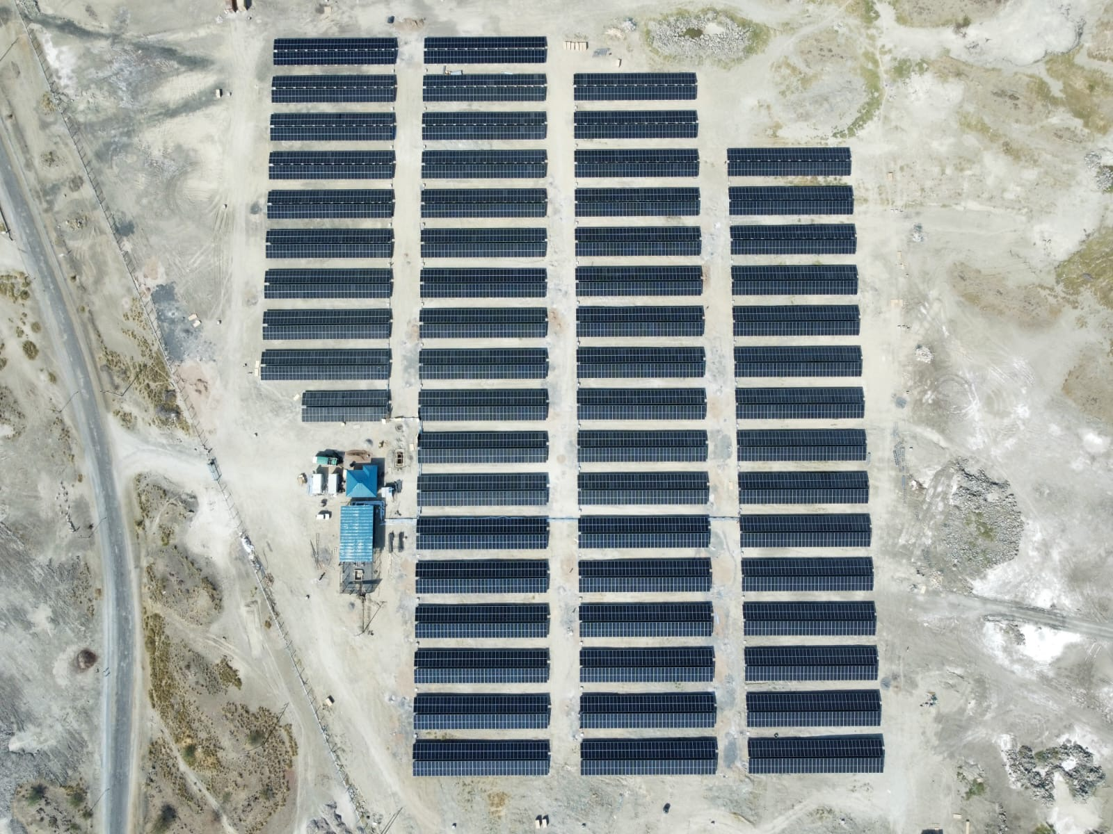
09 — PROOF, NOT PROMISES
DELIVERED BY THIS TEAM.
TATA CHEMICALS · MAGADI, KENYA
5.1 MWp on-grid solar · grid stabilisation · D&T
DEVKI GROUP PORTFOLIO · KENYA
3.8 MWp rooftop across 4 manufacturing sites
TATU CITY SEZ · KENYA
2.05 MW rooftop · 3,468 modules · mixed-use city
SAJ CERAMICS · KENYA
693 kWp rooftop + genset control
KINONDO KWETU · DIANI, KENYA
Off-grid solar PV + BESS · diesel displaced
TATA CHEMICALS MAGADI — 5.1 MWP · COMMISSIONED [2025]
GJW ENERGY — TECHNO-COMMERCIAL PROPOSAL · GJW-TCO-[YYYY]-[NNN]
10

Slide 11
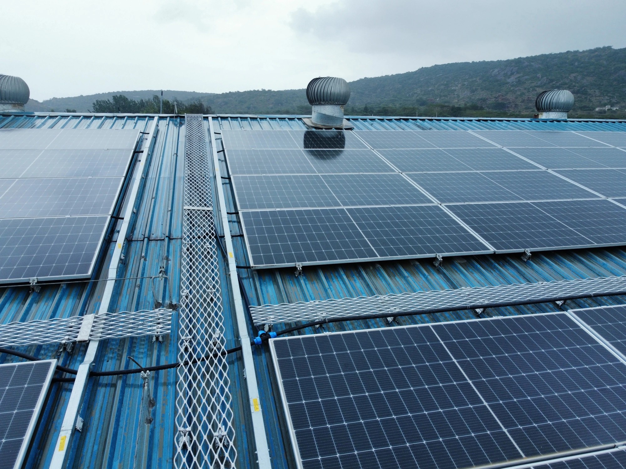
10 — FOR EPCs & IPPs
YOUR INSTALLATION PARTNER
ON THE GROUND.
International and regional EPCs and IPPs engage GJW Energy as their construction arm in East Africa. We install to your design, under your governance — with QA/QC documentation your lenders can audit, and white-label delivery under your brand.
M&E INSTALLATION CREWS
MV/LV BALANCE OF PLANT
LICENSED, HSE-MANAGED TEAMS
CABLING, SWITCHGEAR, TRANSFORMERS
QA/QC · ITPs · HSE
TESTING & COMMISSIONING
TO YOUR STANDARD, AUDIT-READY
PUNCH-LIST & HANDOVER SUPPORT
WHITE-LABEL DELIVERY
EPRA-LICENSED COMPLIANCE
UNDER YOUR BRAND, NDA-FRIENDLY
LOCAL STATUTORY COVERAGE
WALKWAYS, SAFETY LINES & CABLE MANAGEMENT — INSTALLED, NOT IMPROVISED
DELIVERY MODEL — YOUR CONTRACT · YOUR GOVERNANCE · OUR CREWS ON YOUR SITE
GJW ENERGY — TECHNO-COMMERCIAL PROPOSAL · GJW-TCO-[YYYY]-[NNN]
11

Slide 12
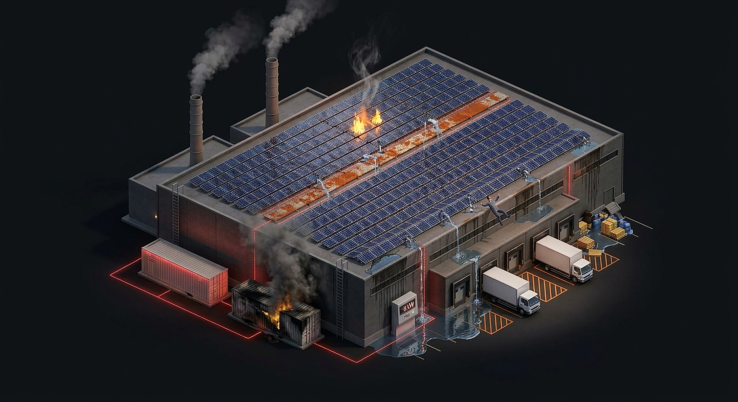
11 — THE ALTERNATIVE
THE LOWEST CAPEX ISN'T
ALWAYS THE LOWEST COST.
Cheap solar fails quietly at first — then all at once. What a cut-price installation leaves off the BOQ returns as fire risk, corrosion, water damage and an unsafe roof. The repair bill arrives with interest.
PANEL FIRE
CORRODED WALKWAYS
POOR DC CONNECTIONS IGNITE
MILD STEEL, NOT ALUMINIUM
WATER INGRESS
NO GUARDRAILS
FAILED ROOF PENETRATIONS
NO SAFETY LINES — A FALL WAITING
WHAT CHEAP SOLAR BECOMES — ZERO OUTPUT, FAILED PLANT, UNSAFE ROOF
THERMAL RUNAWAY
0 kW OUTPUT
UNDER-SPEC BESS VENTS & BURNS
PRODUCTION METER READS ZERO
GJW ENERGY — TECHNO-COMMERCIAL PROPOSAL · GJW-TCO-[YYYY]-[NNN]
12

Slide 13
12 — COMMERCIAL OFFER
PRICED ONCE. PRICED PROPERLY.
 | SCOPE LINE | AMOUNT
1 | Engineering, design & approvals | [USD —]
2 | Equipment supply — PV, inverters[, BESS], BOS | [USD —]
3 | Civil, structural & electrical installation | [USD —]
4 | Grid interconnection & protection | [USD —]
5 | Testing, commissioning & handover | [USD —]
6 | [Optional: year-one O&M & performance monitoring] | [USD —]
 | SUBTOTAL — SUPPLY & INSTALL (EXCL. VAT) | [USD —]
 | TOTAL CONTRACT PRICE (INCL. TAXES AS STATED) | [USD —]
Fixed, lump-sum turnkey price. No variation unless physical scope changes. Currency: [USD/KES] · price basis: [DDP site / ex-works + install].
GJW ENERGY — TECHNO-COMMERCIAL PROPOSAL · GJW-TCO-[YYYY]-[NNN]
13

Slide 14
13 — COMMERCIAL TERMS
CLEAR TERMS. NO SURPRISES.
30%
40%
20%
10%
CONTRACT SIGNATURE & MOBILISATION
MAJOR EQUIPMENT DELIVERED TO SITE
MECHANICAL COMPLETION
COMMISSIONING & ACCEPTANCE
VALIDITY
This offer remains open for [30] days from the date of issue.
WARRANTIES
Modules [12/25] yrs product & performance · inverters [5–10] yrs · workmanship [2] yrs.
PERFORMANCE
Year-one yield per PVsyst P50 estimate · measured at the generation meter.
EXCLUSIONS
Utility connection fees · grid reinforcement · unforeseen civils · VAT unless stated.
GOVERNING TERMS
[FIDIC-based / client contract] · Kenyan law · amicable resolution then arbitration.
GJW ENERGY — TECHNO-COMMERCIAL PROPOSAL · GJW-TCO-[YYYY]-[NNN]
14

Slide 15
14 — OPTIONAL · ANNUAL O&M
BUILT PROPERLY. KEPT PERFORMING.
INCLUDED IN THE ANNUAL PLAN
+
Scheduled preventive maintenance — [2] visits / year
ANNUAL O&M PLAN
[USD —] / YEAR
+
Module cleaning — [N] cycles / year
+
24/7 remote monitoring & monthly performance report
OR [USD —] PER kWp PER YEAR
+
Breakdown response within [48] hours
ADD-ONS
Extended warranty wrap — [OPT]
Additional cleaning cycles — [OPT]
Security & guarding — [OPT]
+
Spare-parts management & warranty administration
+
Annual performance review against the P50 yield estimate
O&M clients hold priority breakdown response. Systems we maintain carry our name — we keep them performing.
GJW ENERGY — TECHNO-COMMERCIAL PROPOSAL · GJW-TCO-[YYYY]-[NNN]
15

Slide 16
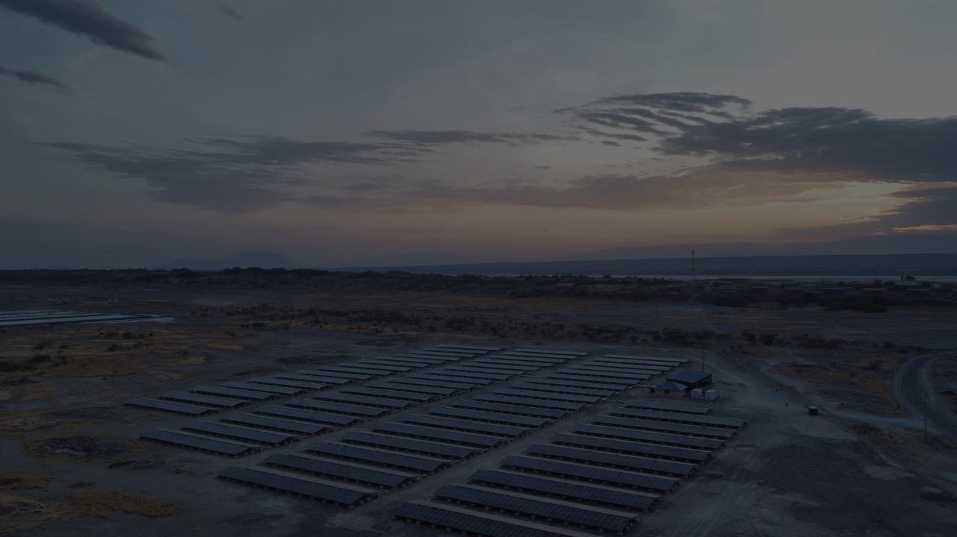
GJW ENERGY
NEXT STEPS
Your sector. Your site.
Built properly, once.
01
Site visit & data confirmation — [week of ___]
INFO@GJWENERGY.CO.KE
+254 722 660 630
NAIROBI, KENYA
GJWENERGY.CO.KE
02
Final BOQ & contract signature
03
Mobilisation within [2] weeks of signature
GJW ENERGY — TECHNO-COMMERCIAL PROPOSAL · GJW-TCO-[YYYY]-[NNN]
16

