Slide 1

Software Design and Development I
CSCI1581-Fall22
Lab-07
Objects & Classes
Instructor: Rasha Alshawi
Notes:
University of New Orleans • Department of Computer Science • Rasha Alshawi (ralshawi@uno.edu)

Slide 2


Object Oriented Programming OOP
Why Do We Need OOP??

Slide 3
OOP VS Procedural Programming
Previously we had the procedural programming that is divided into a set of methods (also known as functions).
The program contains set of variables that hold data,
and methods that perform operations on these variables.
Program
F()
Var
F()
Var
Notes:
Previously we had the procedural programming that divides into a set of functions.

Slide 4
OOP VS Procedural Programming
The problem in this approach is:
As your program grows, you will have many methods that perfume different operations.
Program
F()
F()
F()
F()
F()
F()
F()
F()
F()
F()
F()

Slide 5

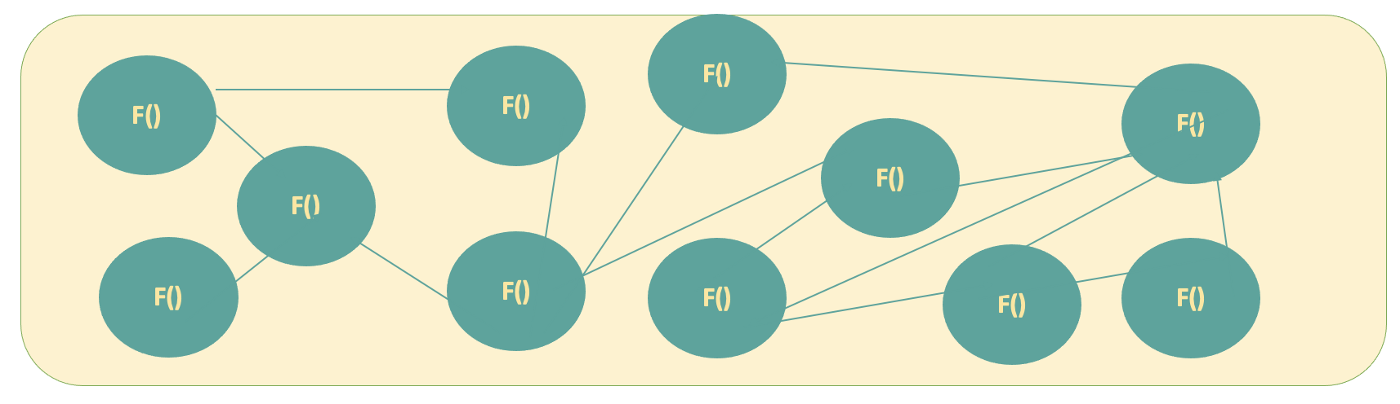
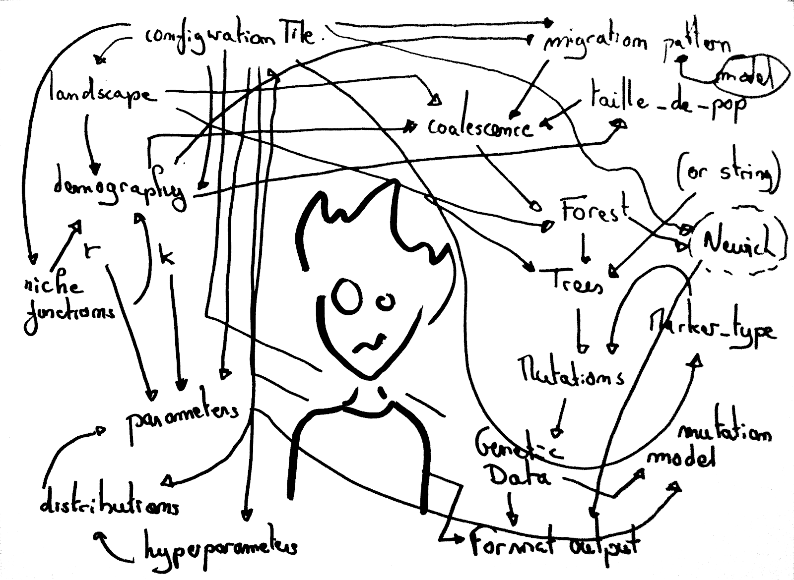
OOP VS Procedural Programming
This is known as: Spaghetti code
Spaghetti code is unstructured code that can be caused by several factors such as:
Lack of programming style rules.
Software engineers with insufficient ability or experience.
It is hard to maintain and debug

Slide 6
Object Oriented Programming OOP
OOP is a coding style that combines group of related variables and methods into a unit
Class 1
Class 2
F()
Var
F()
Var
Class 3
F()
Var

Slide 7

Object Oriented Programming OOP
OOP allows to break the program into the bit-sized problems that can be solved easily (one object at a time).
It produce better quality software and lesser maintenance cost.
and Make Your Life Easier !!!!

Slide 8
Object Oriented Programming OOP (Summary)
OOP is faster and easier to execute.
OOP provides a clear structure for the programs.
Reduce repetition.
Makes the code easier to maintain, modify and debug.
Procedural programming involves writing methods that perform operations on the data. While OOP involves creating objects that contain both data and methods.
Notes:
Summary

Slide 9
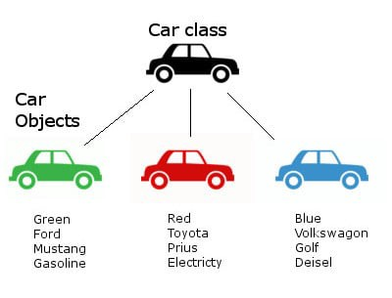
Object Oriented Programming OOP
Classes and Objects
A class is a template for objects, or a "blueprint" for creating objects.
an object is an instance of a class.
Classes consist of attributes and methods.
Example: in real life, a BMW is an object from Car class. The car has attributes, such as weight and color, and methods, such as start, drive and park.
When the individual objects are created, they inherit all the attributes and methods from the class.
Note: Attributes = Variables
Class attributes are variables within a class
Attributes also knows as fields
Notes:
Ref: https://www.w3schools.com/java/java_classes.asp

Slide 10
Object Oriented Programming OOP
Java is an object-oriented programming language (class-based).
import java.util.Scanner; // Import the Scanner class
Scanner object= new Scanner (System.in); // Create a Scanner object
Object
type
Object name
Input source: console
()→Constructor
new keyword creates an object and allocates memory to the new objects at runtime.
// create a new object from Scanner class
Note: the class determines the object type.
Notes:
Note: OOP languages are diverse, but the most popular ones are class-based, meaning that objects are instances of classes, which also determine their types.
A class is a data type

Slide 11

Object Oriented Programming OOP
Classes consist of:
Attributes
Methods → Constructor
What is a Constructor?
A constructor in Java is a special method that is used to initialize objects.
The constructor is called when an object of a class is created.
It can be used to set initial values for object attributes:
new Scanner (System.in);
We can overload the constructor according to what we need.
Notes:
If you create multiple objects of one class, you can change the attribute values in one object, without affecting the attribute values in the other:

Slide 12
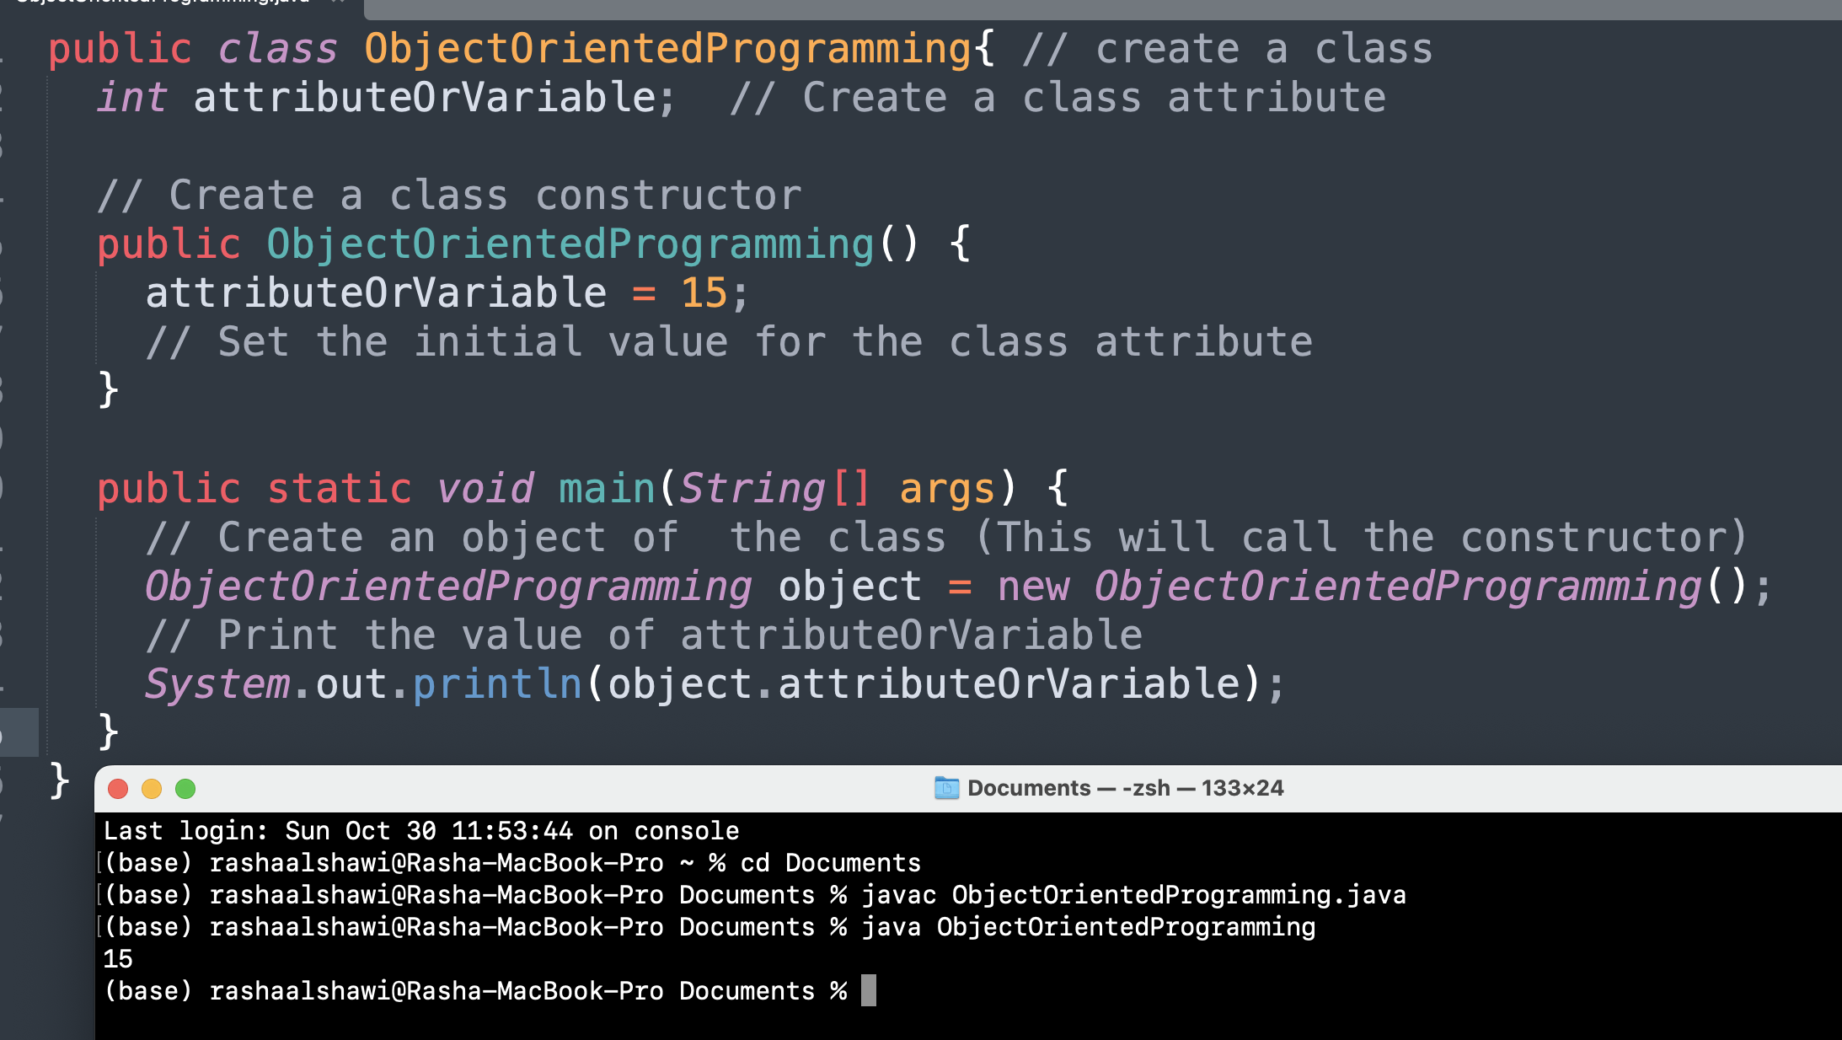
Object Oriented Programming OOP
Create a Constructor:
Constructor's name must match the class name, and it cannot have a return type (or even void).
Accessing the class attribute
Notes:
All classes have constructors by default: if you do not create a class constructor yourself, Java creates one for you. However, then you are not able to set initial values for object attributes.

Slide 13
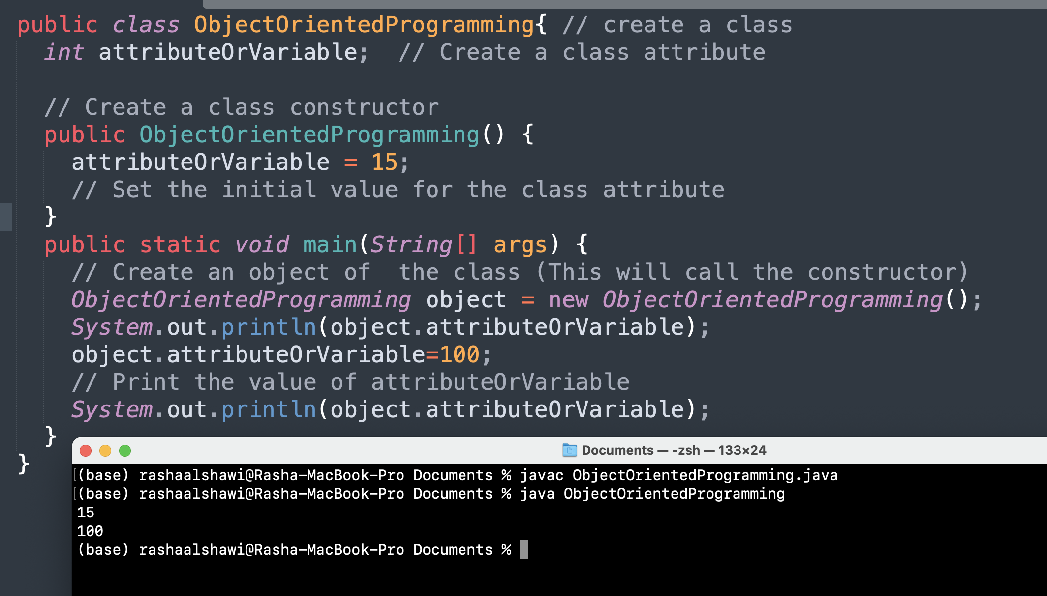
Object Oriented Programming OOP
We can Modify the class attributes as follows:
15 is the original value.
100 is the updated value.

Slide 14
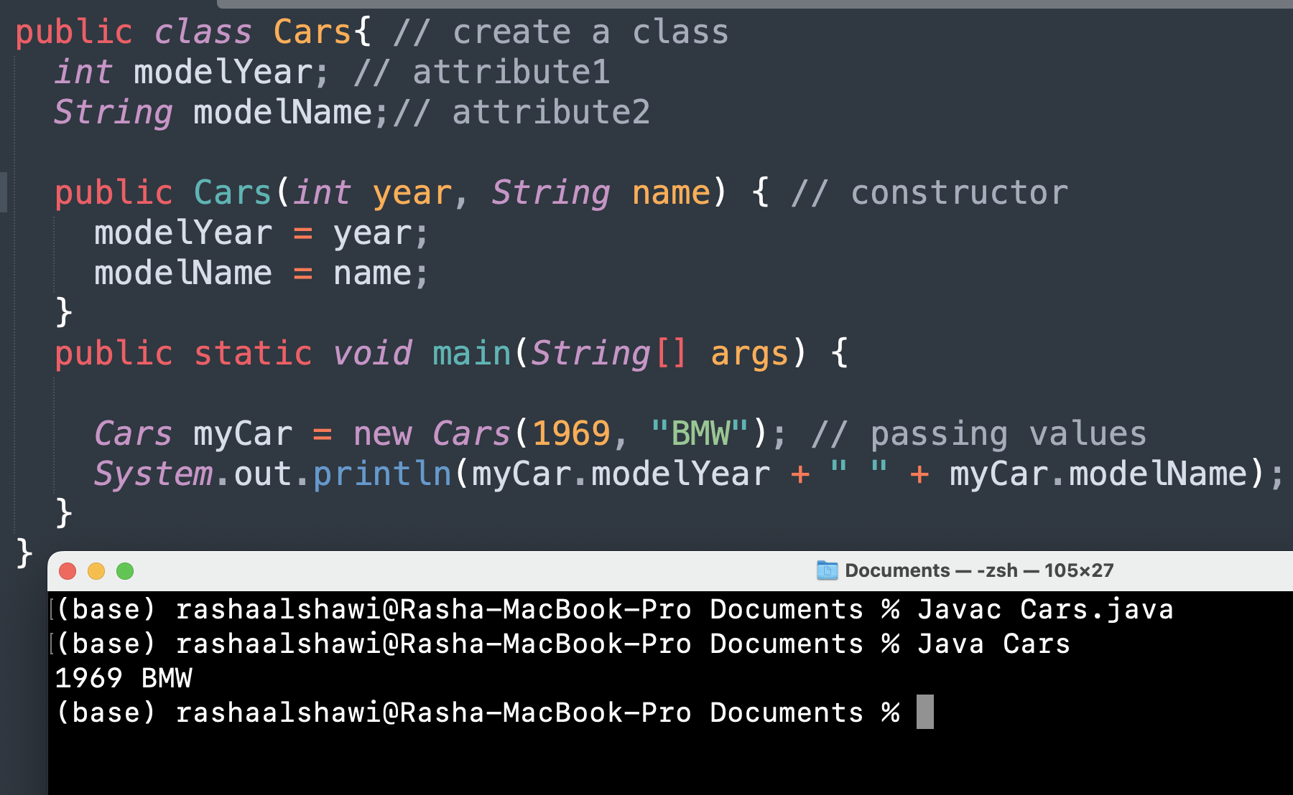
Object Oriented Programming OOP
The following code adds two variables to the constructor. Inside the constructor we set the variables to the class attributes. When we call the constructor, we pass values to the constructor which will set the value of the class attributes.

Slide 15
Object Oriented Programming OOP
In class-based OOP, there is usually a special name such as this used to refer to the current object.
this keyword refers to the current object in a method or constructor.
The most common use of this keyword is to eliminate the confusion between class attributes and parameters with the same name: example.
Note: this doesn’t work with static methods
Notes:
Variables or methods declared with access modifier private are accessible only to methods of the class in which they’re declared.
A class’s non-static methods are known as instance methods

Slide 16

Object Oriented Programming OOP
“this” can also be used to:
Invoke current class constructor
Invoke current class method
Return the current class object
Pass an argument in the method call
Pass an argument in the constructor call
Note: When you create an object from the class, the object will take the place of this.

Slide 17
Object Oriented Programming OOP
Note: We can also Overload the constructor using this keyword:
// the first constructor
public Car (int modelYear, String modelName){
this.modelYear= modelYear;
this.modelName= modelName;
}
// the second constructor. I want to initialize default values
public Car (){
this( 1999, “Mercedes”); // when using this(), Jave understands that you’re invoking a constructor.
// it knows the exact constructor based on the types that you’re passing
}
Note: in this approach the “this” line, must be the first line in your constructor.
Notes:
This case if we left the constructor empty when initializing an object, the default will be 1999, “Mercedes”

Slide 18
Object Oriented Programming OOP
Getter and Setter methods:
We can encapsulate the attributes in our class by making them private.
To make them accessible to the outside objects we need to define public methods know as getters and setters.
Getter gets the attributes values and setter initializes and sets their values.
In encapsulation, the variables of a class will be hidden from other classes and can be accessed only through the methods of their current class. Therefore, it is also known as data hiding.
To achieve encapsulation in Java −
Declare the variables of a class as private.
Provide public setter and getter methods to modify and view the variables values.
Notes:
getter and setters are accessors and mutators
method overriding occurs when a subclass (child class) has the same method as the parent class.

Slide 19
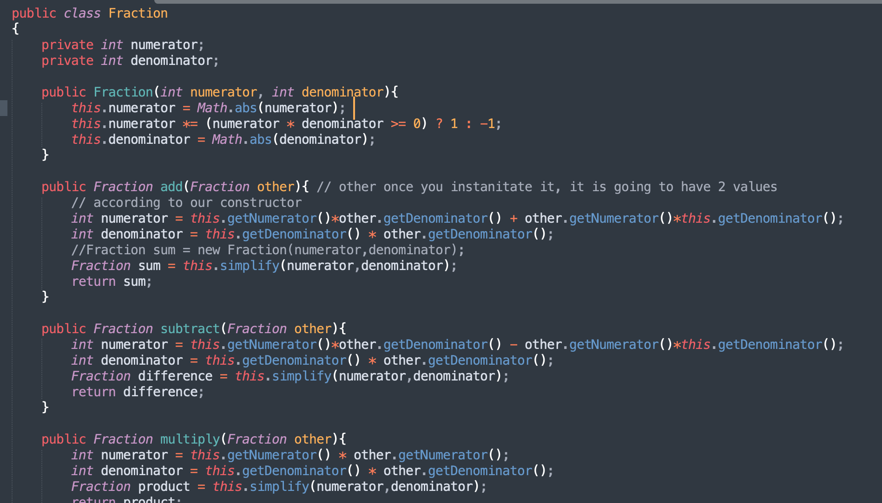
Object Oriented Programming OOP

Slide 20
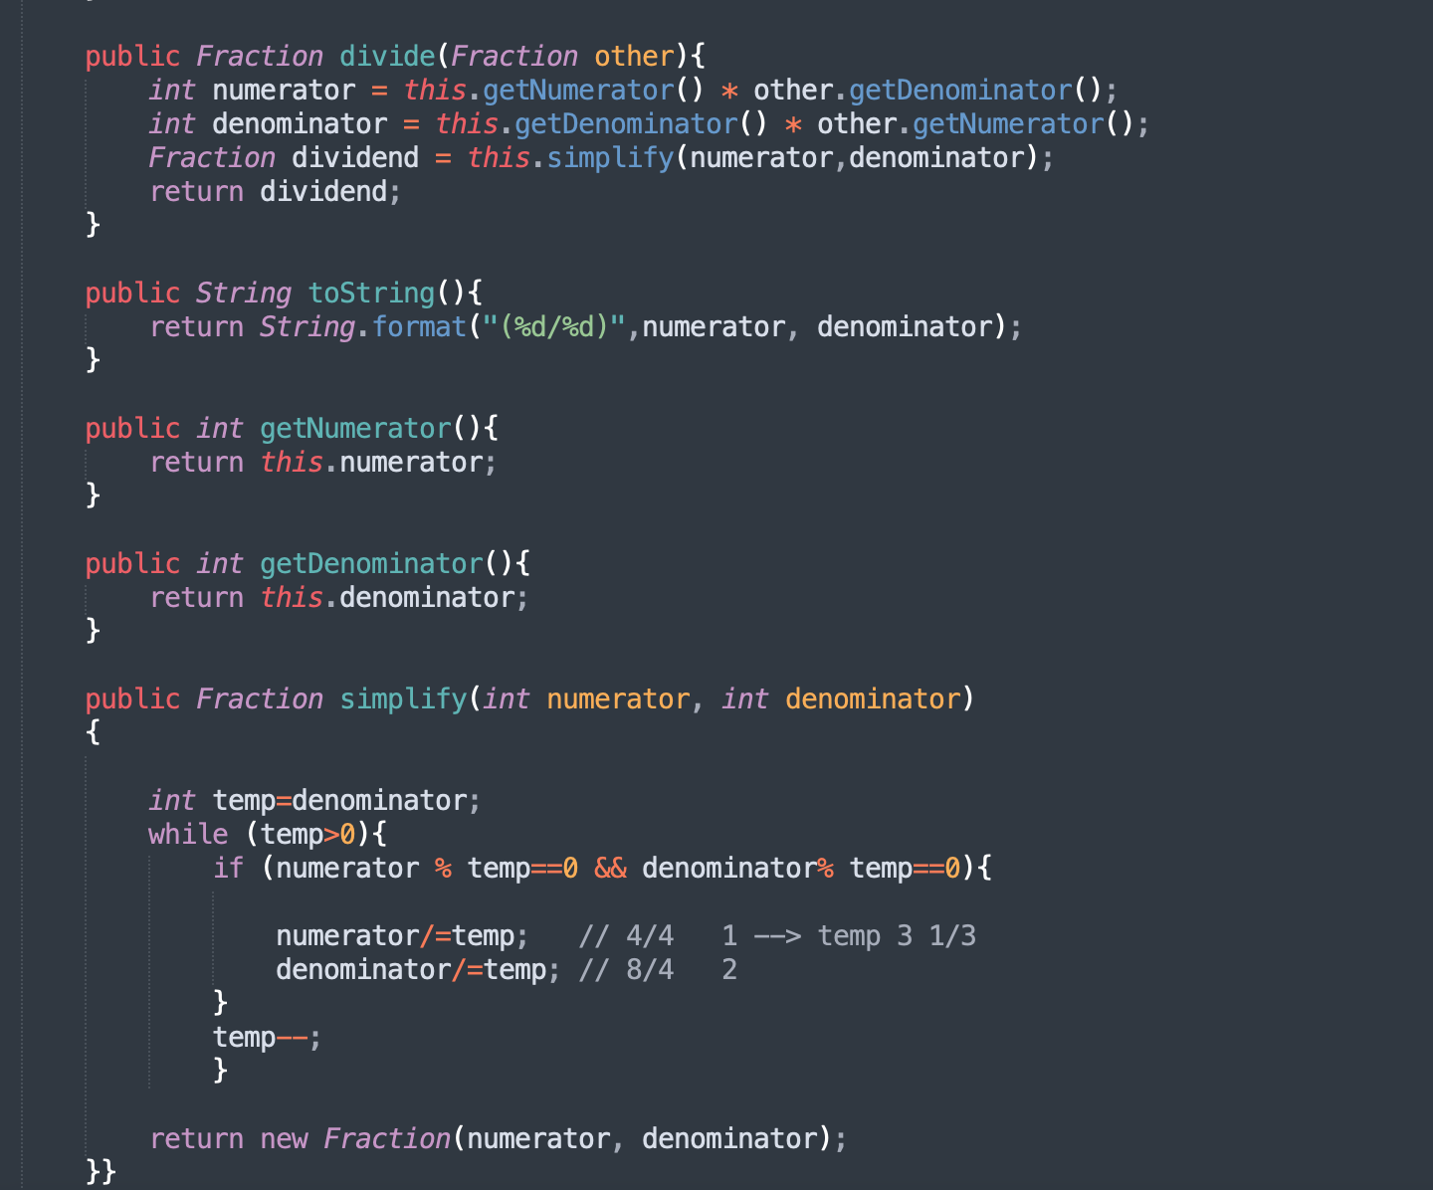
Object Oriented Programming OOP

Slide 21

Submission
Push your java code to Gitlab
Gitlab
Make sure to add your .java files into a directory named Lab07 and zip it. Then go to Autolab and submit it to Lab07. If you do not receive 10 points for the solution, let your instructor know so that they can help you troubleshoot it.
Autolab

Slide 22
End
To Do: Solve and submit the rest problems in Lab07 file.

