Slide 1

Relations

Slide 2
What is a relation?
A relation is proposition about two values
= is the proposition that two values are equal
< is the proposition that the first value is less than the second value
Let β be an arbitrary type, and r be a binary relation on elements of type, β.
In Lean: variable {β : Type} variable (r : β → β → Prop) variables x y : β #check r x y
This is prefix notation

Slide 3
Infix notation
Infix notation is when the relation can be used between the two values instead of before them
local infix `R`:50 := r
local infix `≺`:50 := r
The number 50 defines the precedence
#check x R y
#check x ≺ y
See equality example

Slide 4
Possible properties that relations can have
Reflexive (e.g., x = x)
Symmetric (e.g., x = y → y = x)
Transitive (e.g., x = y ∧ y = z → x = z)
See Lean proofs for equality
Any relation that has all 3 of the above is an equivalence relation

Slide 5
Does equivalence mean equal?
Are there relations that are equivalent besides equal?
Consider mod 12 equivalence:
def mod_12_equiv : ℕ → ℕ → Prop :=
λ x y, x % 12 = y % 12
See proofs of that it is an equivalence

Slide 6
Other possible relation properties
Total (e.g., x ≤ y ∨ y ≤ x)
Irreflexive (e.g., ¬(x < x))
Anti-symmetric (e.g., x ≤ y ∧ y ≤ x → x = y)
Connected (e.g., x ≠ y → x < y ∨ y < x)
Empty relation (e.g., x ∞ y, where ∞ is the relation that the first argument is both less than and greater than the second argument)

Slide 7
Relation properties summary
Reflexive: ∀x, x R x
Symmetric: ∀ x y, x R y → y R x
Transitive: ∀ x y z, x R y ∧ y R z → x R z
Total: ∀ x y, x R y ∨ y R x
Irreflexive: ∀x, x R x → false
Anti-symmetric: ∀ x y, x R y ∧ y R x → x = y
Connected: ∀ x y, x ≠ y → x R y ∨ y R x
Empty: ∀ x y, x R y → false

Slide 8
Exercises
Which properties do the following relations hold of: (a) reflexive, (b) symmetric, (c) transitive, (d) total, (e) irreflexive, (f) anti-symmetric, (g) connected, (h) empty
=
a, b, c
<
c, e, f*, g (* indicates a proof from false elimination, AKA a “vacuous” proof)
≤
a, c, d, f, g
≠
b, e, g
“left-hand side (LHS) equals 0 * right-hand side (RHS)”
c, f
“LHS equals 1 + RHS”
e, f*
“LHS < RHS and RHS < LHS”
b*, c*, e*, f*, h

Slide 9
Subrelation
Subrelation is a property between two relations
For example, < is a subrelation of ≤, because x < y → x ≤ y
def subrelation (q r : β → β → Prop) := ∀ ⦃x y⦄, q x y → r x y
Is < a subrelation of <?
Yes!
All relations are subrelations of themselves
All empty relations are subrelations of any relation

Slide 10
Relations as sets of 2-tuples
Conceptually, we can also think of a relation as a set of 2-tuples
Why does this make sense?
What is a set?
A set is a proposition about a value
Conceptually, the proposition is about whether that value is in the set
What is a relation?
A relation is a proposition about two values
Conceptually, whether the relation holds for those two values
Note, however, that the syntax is different

Slide 11
Successor Relation
Let us define a relation R as R¹
For example imagine the relation “is one or two less than” as defined over the naturals
It contains the 2-tuples {(0, 1), (0, 2), (1, 2), (1, 3), (2, 3), (2, 4), (3, 4), (3, 5), etc.}
Now let us define R² (or R ◦ R) as the relation having left-hand elements equal to the left-hand elements of the tuples in R¹, and right-hand elements equal to the corresponding right-hand elements of the right-hand elements in R¹
E.g., from above this would be “is two, three, or four less than”
It contains the 2-tuples {(0, 2), (0, 3), (0, 4), (1, 3), (1, 4), (1, 5), etc.}
R³ (or R ◦ R²) is the relation having left-hand elements having left-hand elements equal to the left-hand elements of the tuples in R¹, and right-hand elements equal to the corresponding right-hand elements of the right-hand elements in R²
E.g., from the above this would be “is three, four, five, or six less than”
It contains the 2-tuples {(0, 3), (0, 4), (0, 5), (0, 6), (1, 4), (1, 5), (1, 6), (1, 7), etc.}

Slide 12
Successor Relation in Lean
def successor: (β → β → Prop) → (β → β → Prop) :=
begin
assume r,
exact λ(x y: β), ∃(b: β), (r x b) ∧ (r b y)
end

Slide 13
Exercises
Provide R² given the following R¹ definitions
R¹ = “LHS is one less than RHS”
R² = “LHS is two less than RHS”
R¹ = “LHS is twice the RHS”
R² = “LHS is four times RHS”
R¹ = “LHS is two or three times the RHS”
R² = “LHS is four, six, or nine times the RHS”
Provide R³ given the following R¹ definitions
R¹ = “LHS is one less than RHS”
R³ = “LHS is three less than RHS”
R¹ = “LHS is two or three times the RHS”
R³ = “LHS is 8, 12, 18, or 27 times the RHS”

Slide 14
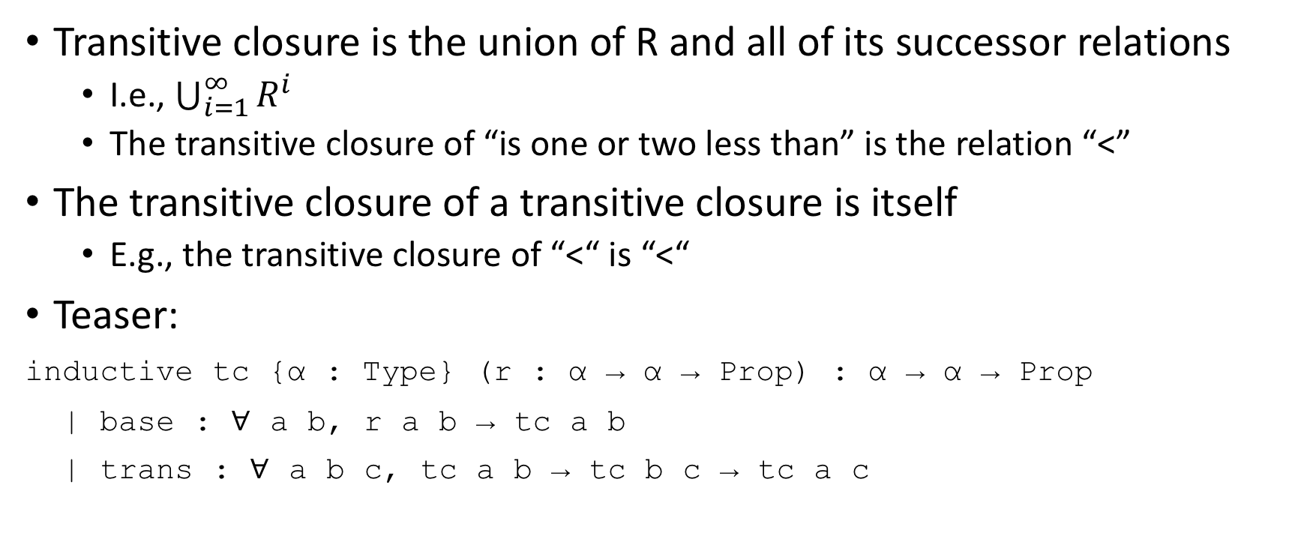
Transitive Closure
Transitive closure is the union of R and all of its successor relations
I.e., $\bigcup_{i=1}^{∞}{R^{i}}$
The transitive closure of “is one or two less than” is the relation “<”
The transitive closure of a transitive closure is itself
E.g., the transitive closure of “<“ is “<“
Teaser:
inductive tc {α : Type} (r : α → α → Prop) : α → α → Prop
| base : ∀ a b, r a b → tc a b
| trans : ∀ a b c, tc a b → tc b c → tc a c

Slide 15
Exercises
What is the transitive closure of the following:
R¹ = “LHS is one less than RHS”
TC = <
R¹ = “LHS is zero or one less than RHS”
TC = ≤
R¹ = “LHS is two more than RHS”
TC = ∃n: ℕ, n > 0 ∧ LHS = 2n + RHS
R¹ = “LHS is two more or two less than RHS”
TC = “LHS has same parity as RHS and is not equal to the RHS” AKA “LHS is even iff RHS is even and LHS is odd iff RHS is odd (and they’re not equal)” AKA ∃n: ℤ, i ≠ 0 ∧ LHS = 2i + RHS

Slide 16

Fin

