Slide 1
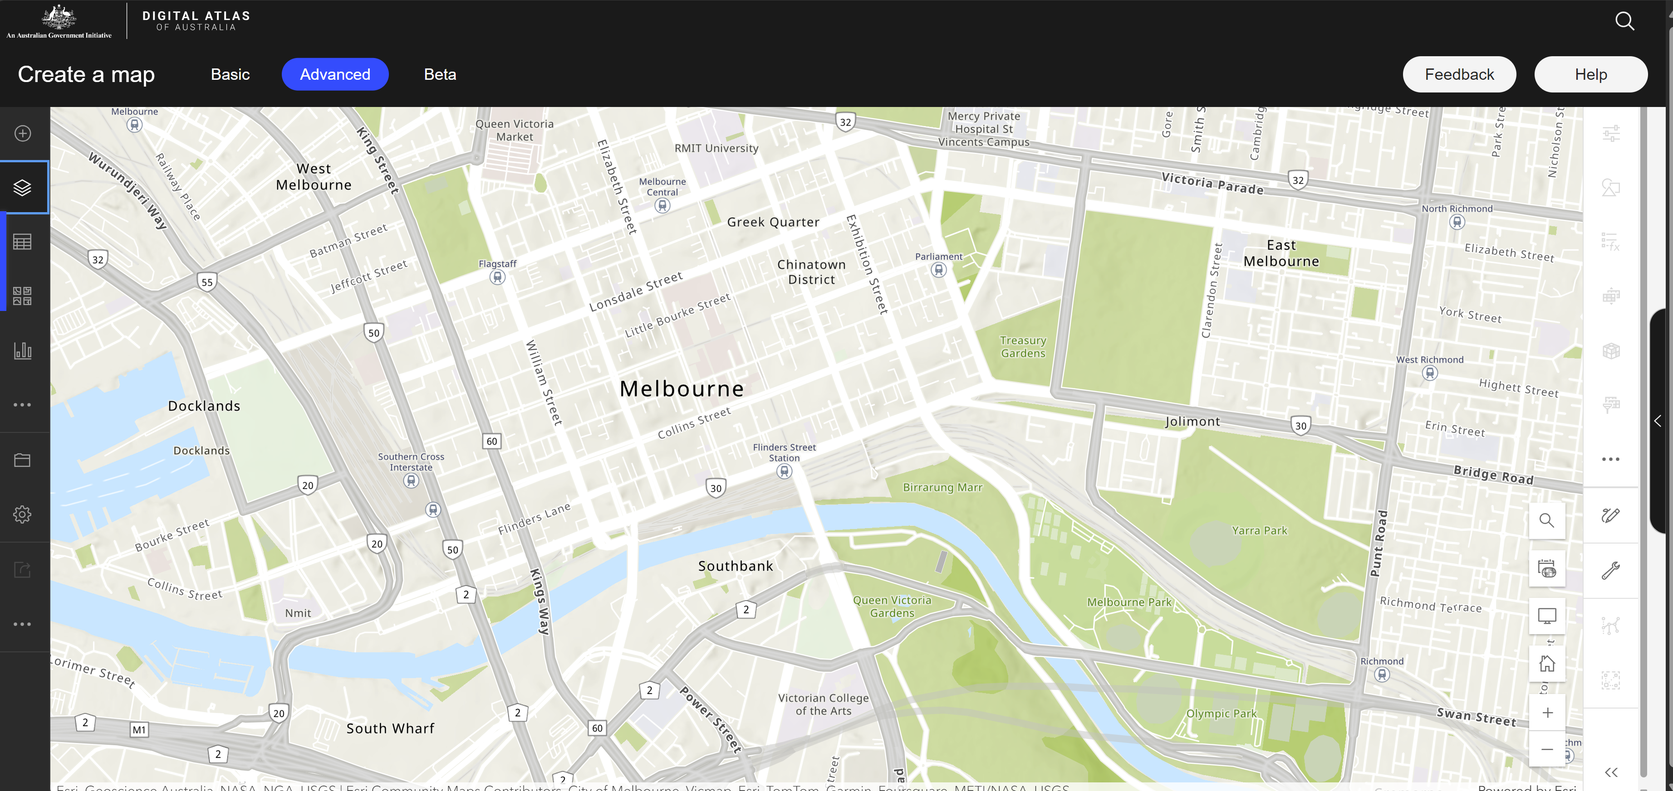


UrbIA: Urban Insights Atlas
Localised Data
Digital Atlas of Australia API/Data
Open Road Crash Data
Traffic Volume Data
Train Service Passenger Counts
Park PIR Counters
[etc]
Approval/Disapproval
Feedback
Additional Insights
Safety Insights
Capacity Forecast Insights
Sustainability/Mobility Insights
Public Utilisation Insights

