Slide 1
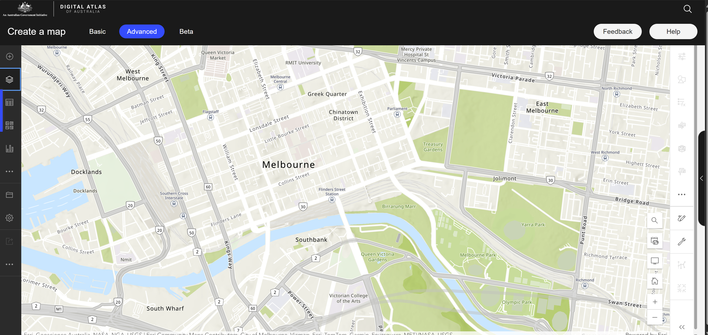


UrbIA: Urban Insights Atlas
Localised Data
Open Road Crash Data
Traffic Volume Data
Train Service Passenger Counts
Park PIR Counters
[etc]
Safety Insights
Capacity Forecast Insights
Sustainability/Mobility Insights
Public Utilisation Insights
Approval/Disapproval
Feedback
Additional Insights

