Slide 1
Lecture 1 Introduction The Economic Approach

Slide 2
Hon. Kenneth Madison Hayne, Financial Services Royal Commission

Slide 3
Introduction to the Economics of Strategy
Enron Corporation is a nice example of a failure, despite being lauded for a prolonged period of time.
Organisational design – characterised by poor incentives and management/ decision making structure. Who was making decisions? Was there any oversight or checks and balances?
Short term goals – performance measures encouraged excessive risk taking that ultimately was a key reason for its failure. A focus on short term goals.
Both of these represent important internal characteristics of an organisation.
“ ..(S)uccessful firms assign decision rights in ways that effectively link decision-making authority with the relevant information for making good decisions..”

Slide 4
Introduction to the Economics of Strategy
In the case of Enron, there are three aspects that are identified and will inform much of the discussion this semester.
The assignment of decision rights in the firm.
The methods of rewarding individuals.
The structure of the of the systems to evaluate performance of individuals and business units.
It is these organisational architecture and related issues that will form the focus of the material we cover this semester.

Slide 5
Introduction to the Economics of Strategy
What else might be important for success or failure?
Which markets to enter – what is the nature of the market?
How to enter markets (and how to deter entry by others)
Product differentiation – making sure you are different to your rivals
Input mix
Pricing
Competition versus cooperation…..
Economics can offer insight into a whole range of these issues including
Pricing
Advertising
Scale
Organisational architecture….

Slide 6
Introduction to the Economics of Strategy
These are effectively relationships within the firm/ organisation and between the firm and external agents…
The firm
Interactions with external agents
What to sell (what mkets to enter)
How to price
Quality choices
Advertising…
Interactions within the organisation
Who to hire
Tasks to assign to individuals/ groups
How to reward them
Monitor them?....

Slide 7
Introduction to the Economics of Strategy
Why economics?
“ ..(E)conomics provides a theory to explain the way individuals make choices..”
Economics is all about choice - emphasises that incentives matter
In this unit we will examine how economics can provide insight into value creation
We want to go beyond the black box
Inputs
The firm or technology
Outputs

Slide 8
Introduction to the Economics of Strategy
We need to think about the following, amongst other things, using economics:
Centralisation versus decentralisation within the firm.
Bundling tasks – which tasks to bundle and how
Bundling jobs into business decision units
Objective versus subjective performance measures.
Incentive compensation schemes
The make versus buy decision …what the firm actually does!
How it interacts with customers (pricing) and competitors.
The challenge will be construct simple models that shed light on each of these and use our models to help explain what works, what doesn’t, and why.
Of course, in doing so we will consider those relationships between economic agents both inside and outside the firm/ organisation.

Slide 9
Introduction to the Economics of Strategy
The context in which all of this discussion will be taking place is what we might think of the bread and butter of economics. Concepts such as:
Supply and demand
Market structure
Optimisation decisions such as utility maximisation and cost minimisation
Strategic interaction, both inside the firm and with other economic agents outside the firm.
Asymmetric information.
We will discuss some of these but you need to be aware of these and how to use math to express such relationships in a formal manner. We will do this step-by-step as we analyse strategic business relationships.

Slide 10
Introduction to the Economics of Strategy
When considering what happens within the firm and how to organize those relationships within the firm, two principles that will be critical as we move through the material this semester:
Incentives matter – recall that economists generally see agents acting in their own self interest
Asymmetric information – Your employee knows some things that you don't. The CEO knows things that shareholders don't. Teams members know some things that others don't. You know things that your rivals don't.….
So what will be important? To return to the Enron example,
Assignment of decision rights
The reward system
Performance evaluation

Slide 11
The economic approach
Economics is about understanding choices or decisions.
It helps understand why analysts at Merrill Lynch rated a ‘piece of crap’ highly for clients
In general economic agents respond to incentives..
So what might the incentives have been for stock analysts to overrate stocks that Merrill Lynch assessed for clients?
Any analogies in the news at the moment?

Slide 12
The Economic Model of Behaviour
The economic model of human behaviour is one of constrained optimisation.
Individuals maximize utility subject to a budget constraint
Firms maximize profit subject to a production constraint
Managers maximize their ‘payoff’ subject to the constraints that they act under.
In each case individuals compare costs and benefits at the margin. They go ahead with decision as long as the marginal benefit is greater than the marginal cost (MB > MC).

Slide 13
The Economic Model of Behaviour
We can apply this to a whole range of decision making scenarios for the firm/ organization and within the firm.
Advertising – how much, across media…
Effort in making sales
The decision to engage in illicit trades ala Jerome Kerviel at Societe Generale
The MB represents the additional profit earned ≈ genius status.
The MC is potential loss and greater probability of detection and sanctions in the form of incarceration.
Aside: are people always so calculating and rational? ... Perhaps not

Slide 14
The Economic Model of Behaviour
Some of the implications of the economic model of behaviour.
Sunk costs are irrelevant, only avoidable costs matter – consider the choice of tennis versus sales effort when you have purchased a tennis club membership.
Calculations can be time consuming – perhaps individuals adopt a more heuristic approach
Opportunity costs are what matter from an economic and indeed strategic point of view
Time is money
Classic case of time or capital invested into a business.

Slide 15
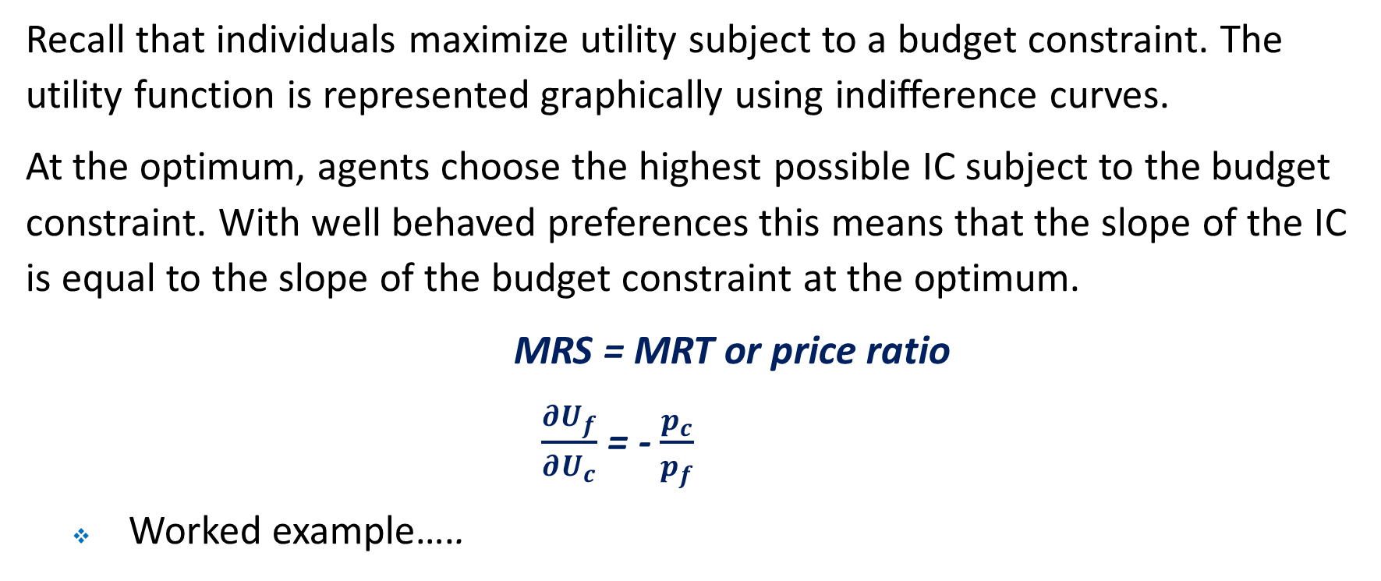
Individual Choice
Recall that individuals maximize utility subject to a budget constraint. The utility function is represented graphically using indifference curves.
At the optimum, agents choose the highest possible IC subject to the budget constraint. With well behaved preferences this means that the slope of the IC is equal to the slope of the budget constraint at the optimum.
MRS = MRT or price ratio
$\frac{∂U_{f}}{∂U_{c}}$ = - $\frac{p_{c}}{p_{f}}$
Worked example…..

Slide 16
Clothing
12
At optimum, MRS equals the MRT or price ratio
Of course if things change so to does the decision …
0
Food
0
18
24

Slide 17
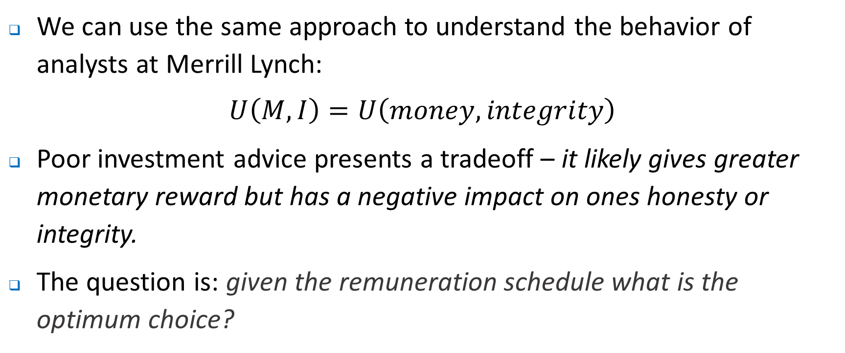
How to use this approach …
We can use the same approach to understand the behavior of analysts at Merrill Lynch:
$$U\left(M,I\right)=U\left(money, integrity\right)$$
Poor investment advice presents a tradeoff – it likely gives greater monetary reward but has a negative impact on ones honesty or integrity.
The question is: given the remuneration schedule what is the optimum choice?
+
+

Slide 18
The diagram here looks very much like the previous one where the choice was over food and clothes.
Think about how we characterize this decision….
$
Max
Of course if things change so to does the decision …
What might we be missing in this story?
0
Integrity
0

Slide 19
How to use this approach …
It may be the case, of course, that in trying to influence outcomes what is really important is the preferences (or indifference curves) of the individuals.
This is likely to present different and arguably more challenging problems.
Why?

Slide 20
How to use this approach …
The economic model of behavior is very stylized and part of the challenge if we are thinking about strategic relationships within organisations is asking what else might motivate behaviour?
What are the other models?
Money matters – intuitive but does it really happen like this? Think Red Cross, staff at visitor info centres…
Happy-is-productive model – happy employees is what counts and happy employees exert effort. So, you should ….
Good citizen model – incentive pay is less important because individuals inherently want to do a good job for the organisation.
Product of the environment – treat people poorly and they behave poorly. Either change the way you teat people, or change the people (the rotten apples in the case of Merill Lynch.)
What might be the implications of these?

Slide 21
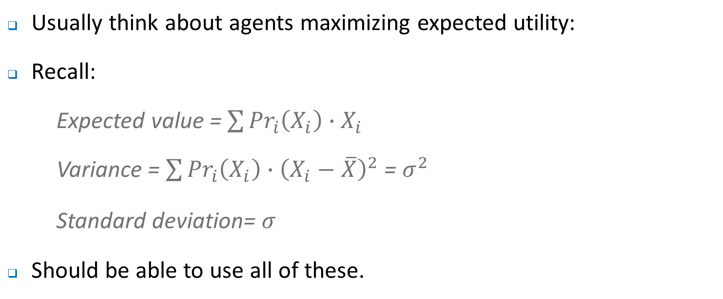
Decision making under uncertainty
Usually think about agents maximizing expected utility:
Recall:
Expected value = $\sum{{Pr}_{i}\left(X_{i}\right)∙X_{i}}$
Variance = $\sum{{Pr}_{i}\left(X_{i}\right)∙{\left(X_{i}−\overline{X}\right)}^{2}}$ = $σ^{2}$
Standard deviation= $σ^{}$
Should be able to use all of these.

Slide 22
Decision making under uncertainty
Most people are risk averse compared with being risk loving, i.e. prefer less risk or uncertainty.
Can show this using indifference curves.

Slide 23
E(value)
Direction utility
Risk premium - difference between the expected value of a risky income stream and its certainty equivalent
100,000
Risk premium = $20,000
80,000
0
σ (in dollars)
0
81,650

Slide 24
Decision making under uncertainty
Consider two payment schemes.
Salary = $80,000; σ=0. Expected value = $80,000.
Salary + performance bonus with σ=81,650. Expected value = $100,000.
Indifferent between them.
Certainty equivalent – value of a certain payment that gives same expected utility as risky proposition.
Risk premium = EV - CE.

Slide 25
Multi-period Models
Easy to generalize the question of choice to one where we consider the choice over consuming today versus consuming tomorrow, i.e. an intertemporal allocation.
Consider the simple example of Mary who is making a decision about how to allocate her savings and higher future income from studying a Masters program.
Undergrad qualification - salary of $25,000.
Savings of $25,000 -effectively consumption today if undertaking study.
Post grad qualification – salary of $75,000. Effectively salary tomorrow if study occurs
Interest rate of 5% for borrowers and savers.

Slide 26
C₂
101,250
Assume the endowment is given by $25,000 today and $75,000 tomorrow.
75,000
Depending on preferences the individual could be a saver or a borrower
0
C₁
0
25,000
96,428

Slide 27
C₂
101,250
Of course if the environment changes, i.e. the interest changes, the optimal choice could also change
75,000
0
C₁
0
25,000
96,428

Slide 28
Multi-period Models
Fisher Separation theorem.
Consider what happens in the presence of perfect capital markets, i.e. zero TCs, no taxes and perfect information.
‘Everyone will agree that an investment should be made irrespective of time preferences’, i.e. simply borrow or lend to smooth consumption consistent with intertemporal preferences.
Financing of investment can be separated from the investment decision itself.
This result, indeed an understanding of inter-temporal tradeoffs will be useful this semester.

Slide 29
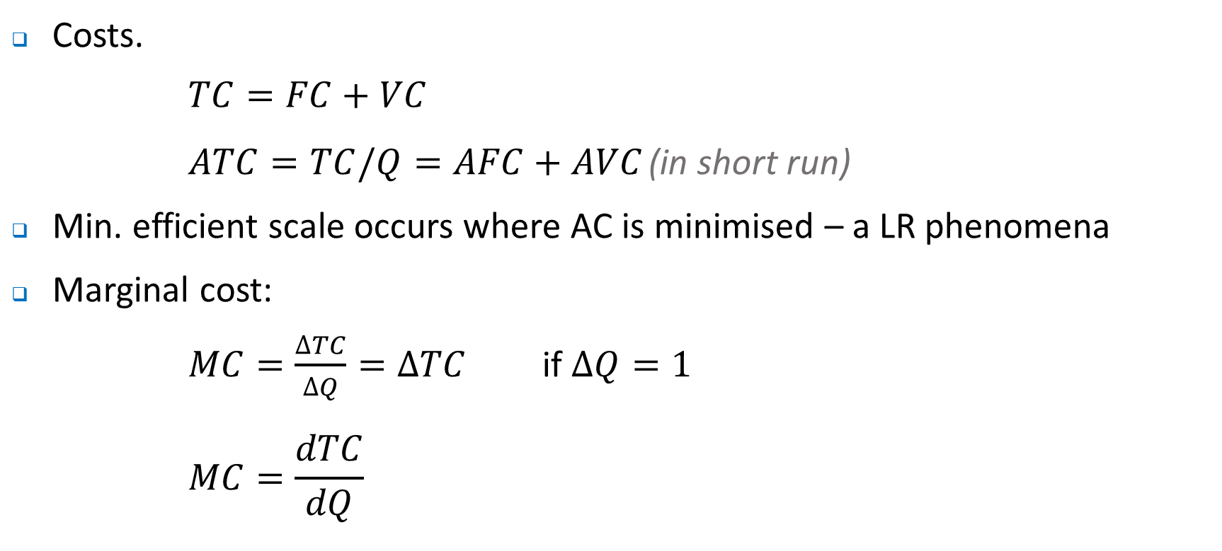
Some other basics
Costs.
$$TC=FC+VC$$
$ATC=TC/Q=AFC+AVC$ (in short run)
Min. efficient scale occurs where AC is minimised – a LR phenomena
Marginal cost:
$MC=\frac{∆TC}{∆Q}=∆TC$ if $∆Q=1$
$$MC=\frac{dTC}{dQ}$$

Slide 30

Some other basics
Recall,
$If MC>AC, AC is ↑ing$
$$If MC<AC, AC is ↓ing$$
$If MC=AC, AC is minimised$
Note that this gives rise to the familiar U-shaped cost curves

Slide 31
$
Marginal cost
Average cost
100
0
Q
0
2,000

Slide 32
Some other basics
Economic profit versus accounting profit, with the former taking account the opportunity costs of decisions.
Demand follows from the optimisation of economic agents:
Think of it as relationship between P and Q
Law of demand
Note that the height of the demand curve tells us about the willingness of individuals to pay

Slide 33

Some other basics - elasticity
Own price elasticity of demand:
$$η=\frac{dQ}{dP}∙\frac{P}{Q}$$
$$η<1, demand is inelastic$$
$$η>1, demand is elastic$$
Revenue:
$$TR=P\left(Q\right)Q$$
$$MR=P(Q)\left[1−\frac{1}{η}\right]$$

Slide 34
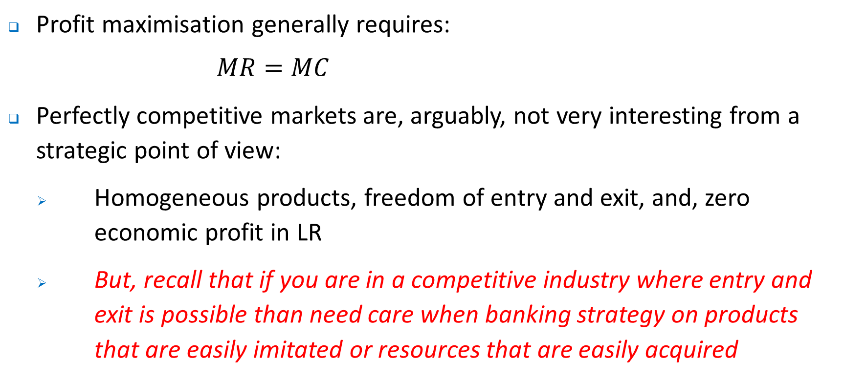
Some other basics - elasticity
Profit maximisation generally requires:
$$MR=MC$$
Perfectly competitive markets are, arguably, not very interesting from a strategic point of view:
Homogeneous products, freedom of entry and exit, and, zero economic profit in LR
But, recall that if you are in a competitive industry where entry and exit is possible than need care when banking strategy on products that are easily imitated or resources that are easily acquired

Slide 35
Some other basics – Game Theory
A theme that comes up again and again this semester is that we think about strategic relationships between agents in a range of settings.
Need to consider the response of rivals or other players. Examples:
Pricing
Investment
Market entry and entry deterence
Product development
Advertising
Wage negotiations (or more generally input suppliers)

Slide 36
Some other basics – Game Theory
Usually solve strategic problems using the tools of game theory.
Look for a Nash Equilibrium
That is, a situation where neither economic agent (player in the game) has any incentive to unilaterally change their behaviour given the behaviour of other players.
Each player is doing the best they can given the strategies of other players.
Many different types of games that defined by their rules.

Slide 37
Cigarette advertising
Consider the following advertising game for BAT and Imperial
 |  | BAT
 |  | Don’t Advertise | Advertise
Imperial | Don’t Advertise | ($50, $50) | ($20, $60)
 | Advertise | ($60, $20) | ($27, $27)

Slide 38
Some other basics – Game Theory
Game above is really just a rebadged Prisoners dilemma in which the (strictly) dominant strategy is to expand.
Notice how this does not maximise surplus from the view of the players – we can then think about how firms such as these might actually get to a better outcome. Any thoughts?
Of course, this is a game in which we (implicitly) assumed that players make their decisions simultaneously.
Consider what happens when players have to make decisions sequentially.

Slide 39
Some other basics – Game Theory
 |  |  | No expand | ($18, $18)
 | No expand |  | Small | ($15, $20)
 |  |  | Large | ($9, $18)
 |  |  | No expand | ($20, $15)
 | Small |  | Small | ($16, $16)
 |  |  | Large | ($8, $12)
 |  |  | No expand | ($18, $9)
 | Large |  | Small | ($12, $8)
 |  |  | Large | ($0, $0)
Beta
Alpha
Beta
Beta

Slide 40
So what are some the lessons from today?
We will be using economics to help explain the behaviour of organisations viv-a-vis those outside the firm (competitors, potential competitors, regulators, customers etc), and, to understand what goes on inside the firm.
In each case, the economic approach helps us understand what does (or does not) work.
Economics can present a very stylised description of the world – be critical and open-minded!

Slide 41
Some things to think about
If you read the introduction to McAfee (Competitive Solutions), there is a description of how AOL dominated the early days of ISPs and the WWW.
Why?
In turn why did it decline as an internet powerhouse?
AMAZON is worth around $900bn for a period last week – not bad for a company that is around two decades old.
What helped make this possible? Will it suffer the same fate as AOL?
What about Facebook? Worth $600bn early last week (a little less at $500bn later in the week)….

Slide 42
Where to next?
Next week we will examine market structure.
What are the different types of market structure?
What opportunities and challenges do different markets offer?
What strategies work in different market structures?

