Slide 1
Lecture 2 Market Structure

Slide 2
Market Structure - Outline
Why study markets?
Perfect competition.
Monopoly.
Monopolistic Competition.
Oligopoly - Cournot, Betrand and Stackleberg.

Slide 3
Market Structure - Reading
Besanko et al (2010), Economics of Strategy, Ch. 8 (focus on pp. 212-229).
McAfee (2002), Competitive Solutions, Ch. 2 (esp. pp. 27-34). (https://opac.library.usyd.edu.au/search~S4?/amcafee/amcafee/1%2C26%2C57%2CB/frameset&FF=amcafee+r+preston&1%2C%2C8 )

Slide 4
Understanding Market Structure
Why is understanding market structure important?
Pricing
Entry and exit decisions
Product positioning in the price-quality space
Advertising
Product design…..
In each case decision will be shaped by the market structure or environment that firm operates and the appropriate strategies will be formed by those considerations.

Slide 5
Understanding Market Structure
Consider what has happened to the at home entertainment market in Australia over the past five years
How has the market changed?
How have existing firms responded?
“Foxtel's price cuts boost subscribers to 2.8 million, but at a cost ” SMH August 13 2015.
“How the last video stores are surviving in the age of Netflix” https://www.commercialrealestate.com.au/news/how-the-last-video-stores-are-surviving-in-the-age-of-netflix/

Slide 6
Market Structures
Perfect competition
Monopoly
Monopolistic competition
Oligopoly.

Slide 7
Market or Industry Structures
McAfee characterizes the alternative market structures as follows, based on the size and number of competitors.
Fragmented – similar to perfect competition in which the behaviour of competitors can be considered independent of a firms own actions. Exist in part because of important incentives they provide – think of the owner operator of a restaurant.
Dominant firm – akin to monopoly. May reflect scale considerations, but are subject to the winds of technological change – consider the television/ entertainment industry in Australia.

Slide 8
Market or Industry Structures
Tight oligopolies – two to three industry players. Examples include Coke and Pepsi; Woolworths and Coles in Australia; Boeing and Airbus. The lower number of firms offer opportunities for more cooperation amongst industry players
Loose oligopolies – an industry with few entry/ exit barriers. Generally has more four to five industry players. McAfee suggests that examples include major oil companies. As industry grows in numbers, so does the challenge of coordination across players.

Slide 9
Market Structures
Defined by:
Number and size of buyers, sellers and potential entrants.
Note that we think about potential entrants as those firms that pose a credible threat of market entry.
The degree of product differentiation
The amount and cost of information about product price and quality.
Conditions for entry and exit of firms.

Slide 10
Perfect Competition or Competitive Markets
Provides a benchmark and is only a model.
Characteristics
Large number of potential buyers and sellers.
Product homogeneity
Rapid dissemination of information at low cost
Freedom of entry and exit.
The market for soybeans?

Slide 11
Perfect Competition or Competitive Markets
Fierce price competition and firms earning zero economic profit.
What do firms do in such markets?
Hypothesised to act as price takers using the marginal principle to maximize profit by choosing an outcome where MB = MC.
Marginal Revenue = Marginal cost
Note that in the short run and the long run the decisions are slightly different because some costs are sunk or unavoidable
In the LR firms that remain in the industry earn zero economic profit but positive accounting profit.
You should be familiar with the relevant diagrams for such a market – to the extent we cover them in tutorials!

Slide 12
Perfect Competition or Competitive Markets
Are there any strategic considerations in such a market?
Yes!
Strong competitive forces tend to reduce profits over time.
Advantages might accrue to incumbents or early entrants, even if only temporary
Implications for advertising, product positioning, investment, entry and exit decisions, and, staking out a space in the market which must be protected in the LR.
Think about the shale oil industry over the past 5 years ….

Slide 13
Perfect Competition or Competitive Markets
July 2016

Slide 14
Perfect Competition or Competitive Markets
Perfect comp. is a benchmark - real lesson is that advantages are transitory
Note that even in markets with competition, thinking like an economist is useful. Consider the following example (adopted from Brickley):
“The WSJ reported that United was not covering the costs on flights between San Francisco and Washington D.C. The cost per flight was identified and included fuel, pilots, food etc. There was also a share of the costs associated with running the airport in each city such as baggage handlers, gate charges etc. Suppose that the fares from these flights do not cover these latter costs.”
What should United do? Why?

Slide 15
Barriers to Entry
Barriers to entry are a precursor to market power – much of this is derived from Brickley ch. 6.
Note that high cost or the large investment required is not a barrier to entry per se.
What types of things do represent barriers to entry? First consider what might be important for shaping an entry decision ….
Effect of entry on prices – what affects this? Hint: Think of incumbents…
Incumbent advantages – what might they be or include?
What if I fail and I have to leave the industry – exist costs.

Slide 16
Barriers to Entry
Incumbent advantages
Precommitment contracts - distribution, raw materials etc. Limit opportunities for new entrants in terms of suppliers & customers
Licenses and patents – legal barriers to entry
Pioneering brand advantages or switching costs – potentially particularly important in case of experience goods that require use to understand quality. Where this can be assessed prior to purchase the advantages of incumbents is lower.
Learning curve effects ….

Slide 17
AC per unit ($AC)
Think about the magnitude of learning benefits in terms of ‘slope’, i.e. how much average costs decline as cumulative output doubles.
When cumulative output equals Q_{x}, average cost of production is AC₁. When cumulative output doubles AC decreases to AC₂, so ratio of ACs is AC₂/AC₁. If AC₁=80 and AC₁=72, slope is 0.90 so doubling output reduces costs by 10 percent
Average cost falls with cumulative production.
AC₁
Slope here is AC₂/AC₁
AC₂
0
Cumulative production
0
Q_{x}
2Q_{x}

Slide 18
Barriers to Entry
Learning Curve
Distinct from economies of scale
Really derived from notion of a product life cycle. Products go through a process of introduction, growth, maturity and decline….
Evidence – ‘median slope of the Learning curve is about 0.8’, so a doubling of cumulative output tends to reduce costs by around 20%. That is, AC₂ is around 80 percent of AC₁.
Potentially has important effects on marginal cost and this should be factored in when considering whether to take on a contract.
Learning curve effects ….airline industry

Slide 19
Barriers to Entry
Incumbent reactions
Specific assets – what are they and how are they likely to be used? Assets that have more value in their current use relative to next best alternative…
Scale economies – important for understanding minimum efficient scale and what will happen when a new firm enters the market
Reputation effects – will an incumbent actually carry out a threat to cut prices?
Excess capacity – why might this might be so important?
You might not expect to fail but if you do …you face exit costs such as environmental cleanup, pension funds etc…

Slide 20
Barriers to Entry
The examples above are not exhaustive, McAfee lists the following (amongst others) as representing or reinforcing entry barriers. Many are similar to those listed above:
Large min. efficient scale relative to industry size
Variety of differentiated products in the market meaning that the product space is already filled
Consumer switching costs and networks – QWERTY, Microsoft, VHS….
Brands and reputation
Limited access to distribution channels
Limited access to raw materials (eg Alcoa).
Government regulations.

Slide 21
Monopoly
Usually think of a single seller facing a (downward sloping) market demand curve.
MR is also downward sloping.
Hypothesised to act as price makers, maximize profit in simplest case by choosing point where:
Marginal Revenue = Marginal cost
In general there are better pricing options than this.
Moreover, monopoly has welfare implications.

Slide 22
Monopolistic Competition
Hybrid between monopoly and perfect competition.
Characterised by:
Multiple firms with an assumption that the firm’s actions do not affect the actions of other firms – no strategic interaction
Product heterogeneity
Freedom of entry and exit
Examples include retail shops, books, movies and Thai restaurants in Newtown.
Q^{n}: In each of these cases how do firms differentiate or position themselves in the market?

Slide 23
Monopolistic Competition
Firms face downward sloping demand curve and hence have market power.
Q^{n}: What does this mean literally? Raise your price and ….
If firms in the market are generating profit then you tend to get entry and imitation
In the long run we expect that firms in the industry earn zero economic profit.
This gives rise to the standard monopolistic competition diagram.

Slide 24
Monopolistic Competition

Slide 25
Monopolistic Competition
A richer model of monopolistic competition distinguishes between vertical and horizontal differentiation:
Vertical differentiation – product is unambiguously better or worse than competing products. Examples…cleaning power of dishwashing detergent
Horizontal differentiation – product is preferred by only some consumers. Examples…scent in dishwashing detergent
Consider horizontal differentiation & think about it in a spatial/ geographic sense, i.e. think about a street along which take-away food shops might be located or positioned.

Slide 26
100 hungry customers evenly distributed along street
0
10
L
R
Esme’s sandwich shop
Jose’s taco shop

Slide 27
Monopolistic Competition
Suppose that the cost of travelling a kilometer is $0.50.
Further assume that both shops initially charge $5 per item.
Now suppose that Esme drops her prices to $4.00 while Jose does not change his behaviour.
What do you think will happen?
Why?

Slide 28
Monopolistic Competition
Recall that the cost of travelling a kilometer is $0.50.
Consider an individual who lives M kilometres from Esme’s and therefore (10-M) kilometres from Jose’s.
For this consumer the cost of visiting Esme’s is: (4 + 0.5M)
For this consumer the cost of visiting Jose’s is: (5 + 0.5(10-M))
These costs are equal when M = 6
What do you think is the implication of this?
Why?

Slide 29
Monopolistic Competition
So how many customers will Esme’s get now?
How about Jose’s?
What might affect the number of customers each shop gets as the price differential changes? Think about what costs are driving behaviour
A case of horizontal differentiation with idiosyncratic preferences – tastes differ by one individual to the next depending on location. Think about clothes and how idiosyncratic preferences might differ across individuals
How important do you think search costs, i.e. the cost associated with finding about alternatives might be for this model.
How might search costs be reduced by Esme?

Slide 30
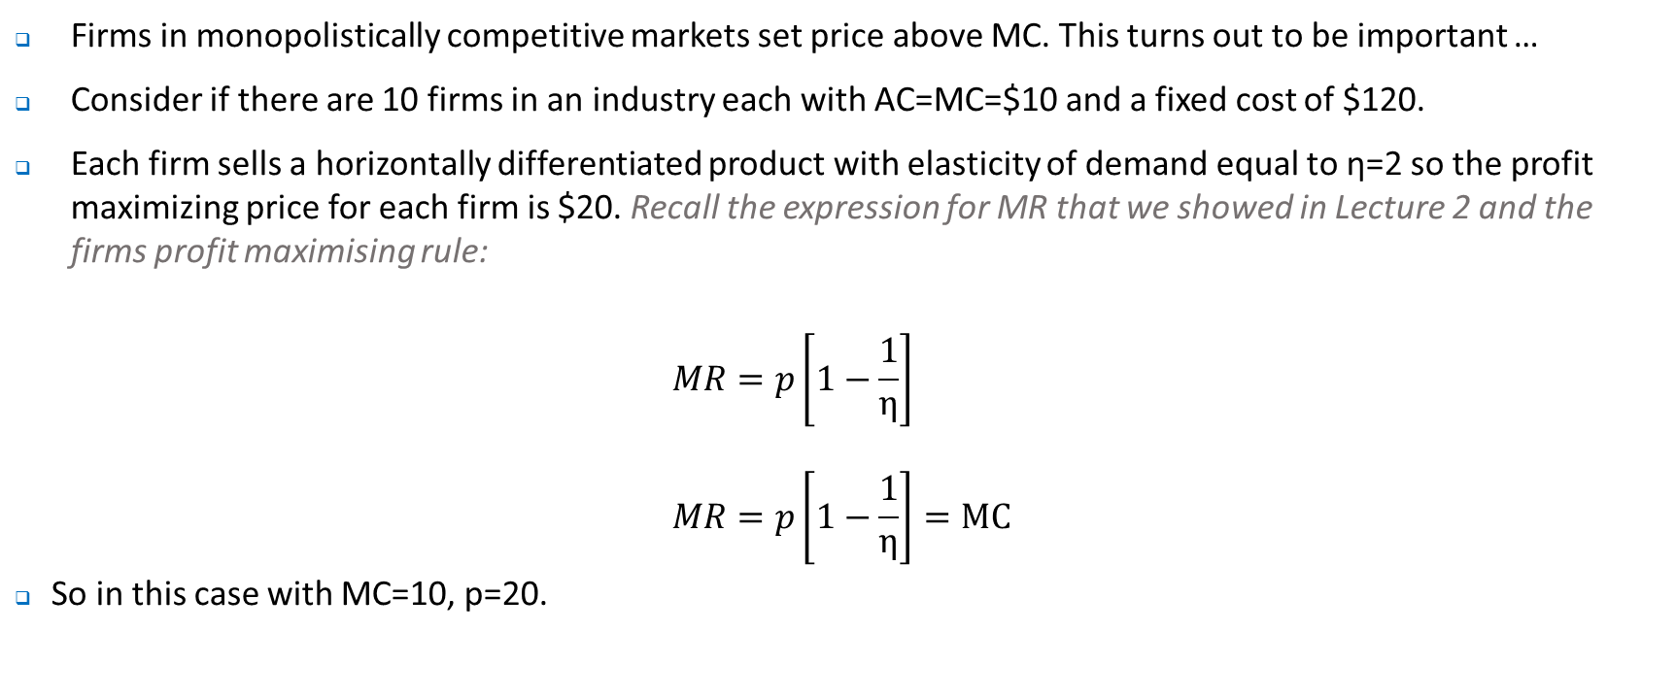
Monopolistic Competition – the entry decision
Firms in monopolistically competitive markets set price above MC. This turns out to be important …
Consider if there are 10 firms in an industry each with AC=MC=$10 and a fixed cost of $120.
Each firm sells a horizontally differentiated product with elasticity of demand equal to η=2 so the profit maximizing price for each firm is $20. Recall the expression for MR that we showed in Lecture 2 and the firms profit maximising rule:
$$MR=p\left[1−\frac{1}{η}\right]$$
$$MR=p\left[1−\frac{1}{η}\right]=MC$$
So in this case with MC=10, p=20.

Slide 31
Monopolistic Competition – the entry decision
Firms in monopolistically competitive markets set price above MC. This turns out to be important …
Consider if there are 10 firms in an industry each with MC=$10 and a fixed cost of $120.
Each firm sells a horizontally differentiated product with elasticity of demand equal to η=2 so the profit maximizing price for each firm is $20 as per the previous slide.
Assume market demand of 240 is evenly distributed across firms. Revenues for each firm is $480, costs $360 and profits $120.
But profits lead to ….

Slide 32
Monopolistic Competition – the entry decision
Entry keeps occurring until profits are dissipated.
Assume that the own price elasticity of demand is unchanged.
In the LR we would expect to see 20 firms in the industry, each selling 12 units and earning zero economic profit. See tutorial question.
Some have argued that monopolistic competition is wasteful, in part because when new firms enter each incurs additional fixed costs that can be avoided if the incumbents simply remain.
What does this fail to take account of?

Slide 33
Oligopoly
Classic examples include industries like automobiles, steel, cereal and airlines.
Characterized by:
‘Few’ firms amongst which there is strategic interaction
Products may be homogeneous or there may be heterogeneity
Some barrier to entry
What does strategic interaction mean?
Think about Coles, Woolworths and milk….

Slide 34
Oligopoly
Important to understand that there are many different types of oligopoly.
How do we model this strategic interaction?
Number of ways, with the simplest being the following ….

Slide 35
Oligopoly – Nash Equilibrium
Consider the following pricing game for WonCo and Tulnc …
 |  | Tulnc
 |  | Price Low | Price High
WonCo | Price Low | ($20, $40) | ($40, $0)
 | Price High | ($200, $250) | ($400, $200)

Slide 36
Oligopoly
The Nash Equilibrium in the above game represent the non-cooperative solution in that each firms makes its best choice (maximize profits) given the behaviour of the other firm.
Note that the outcome above does not represent the best outcome for the firms….
Why?
How might a better outcome be achieved?
Would it work? Why or why not?

Slide 37
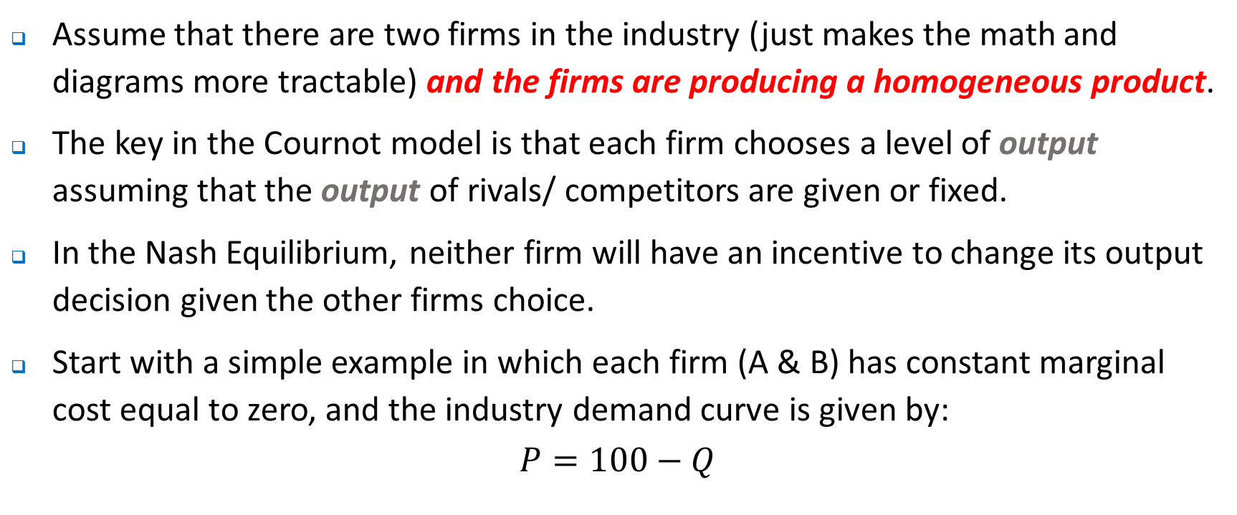
Oligopoly – the Cournot Model
Assume that there are two firms in the industry (just makes the math and diagrams more tractable) and the firms are producing a homogeneous product.
The key in the Cournot model is that each firm chooses a level of output assuming that the output of rivals/ competitors are given or fixed.
In the Nash Equilibrium, neither firm will have an incentive to change its output decision given the other firms choice.
Start with a simple example in which each firm (A & B) has constant marginal cost equal to zero, and the industry demand curve is given by:
$$P=100−Q$$

Slide 38
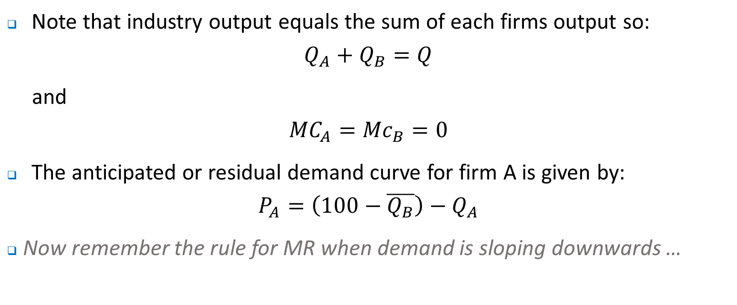
Oligopoly – the Cournot Model
Note that industry output equals the sum of each firms output so:
$$Q_{A}+Q_{B}=Q$$
and
$${MC}_{A}={Mc}_{B}=0$$
The anticipated or residual demand curve for firm A is given by:
$$P_{A}=\left(100−\overline{Q_{B}}\right)−Q_{A}$$
Now remember the rule for MR when demand is sloping downwards …

Slide 39
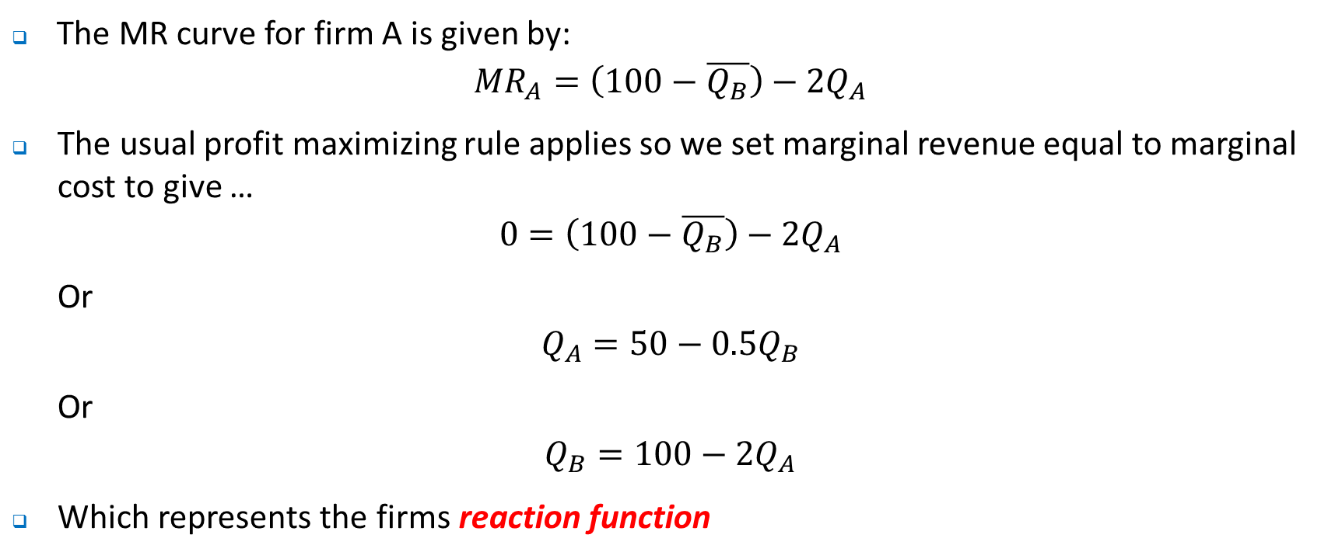
Oligopoly – the Cournot Model
The MR curve for firm A is given by:
$${MR}_{A}=\left(100−\overline{Q_{B}}\right)−{2Q}_{A}$$
The usual profit maximizing rule applies so we set marginal revenue equal to marginal cost to give …
$$0=\left(100−\overline{Q_{B}}\right)−{2Q}_{A}$$
Or
$$Q_{A}=50−0.5Q_{B}$$
Or
$$Q_{B}=100−2Q_{A}$$
Which represents the firms reaction function

Slide 40
Q_{B}
Firm A’s reaction function or best response function. It tells us what Firm A should do (in terms of quantity choice) in response to a choice by Firm B. Note that here when firm B produces more, Firm A’s best response is to produce less.
100
Of course, if you repeat the analysis you get an analogous RC for B (shown in green).
The point where the two RCs intersect represents the NE – neither A nor B will have any incentive to change behaviour (output) given the choice of the other firm.
50
33.33
Firm B’s reaction function
0
Q_{A}
0
33.33
50
100

Slide 41
Oligopoly – the Cournot Model
So what can we say about the outcome here?
Output is lower and price higher than what it would be under perfect competition.
Output is higher and price lower than what it would be under monopoly.
Firms could achieve ‘a better outcome’ but this would require …
Think about what the result would look like if there were three, four, ….. firms.

Slide 42
Oligopoly – the Betrand Model
Assume that there are two firms in the industry.
The key in the Betrand model is that each firm chooses a level of price assuming that the price of rivals/ competitors are given or fixed.
In the Nash Equilibrium, neither firm will have an incentive to change its pricing decision given the other firms choice.
Start with a simple example in which each firm (A & B) has positive marginal cost equal to 10.
What does the market outcome (or Nash Equilibrium) look like?

Slide 43
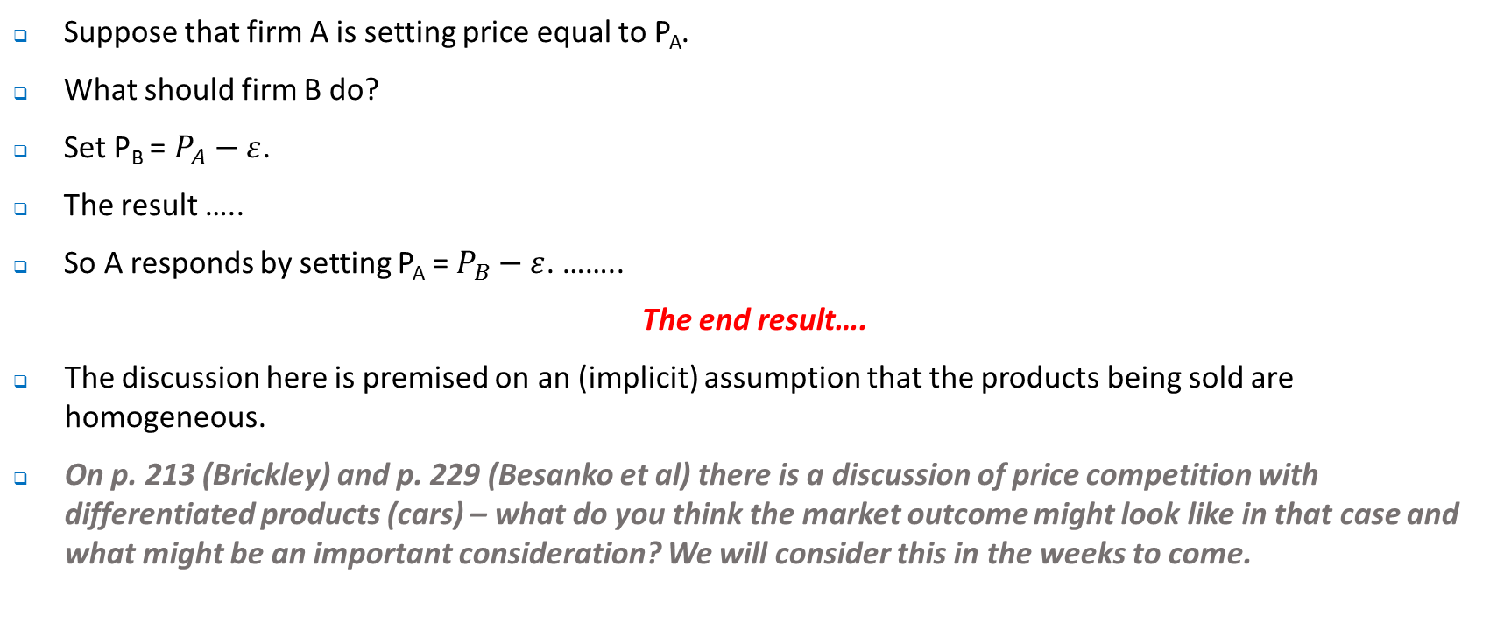
Oligopoly – the Betrand Model
Suppose that firm A is setting price equal to P_{A}.
What should firm B do?
Set P_{B} = $P_{A}−ε$.
The result …..
So A responds by setting P_{A} = $P_{B}−ε$. ……..
The end result….
The discussion here is premised on an (implicit) assumption that the products being sold are homogeneous.
On p. 213 (Brickley) and p. 229 (Besanko et al) there is a discussion of price competition with differentiated products (cars) – what do you think the market outcome might look like in that case and what might be an important consideration? We will consider this in the weeks to come.

Slide 44
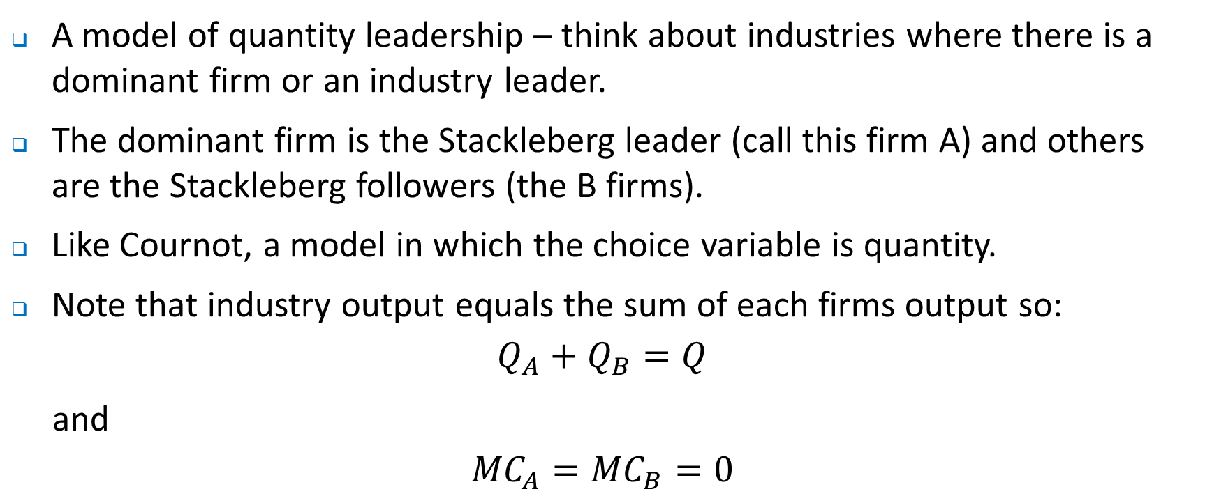
Oligopoly – the Stackleberg Model
A model of quantity leadership – think about industries where there is a dominant firm or an industry leader.
The dominant firm is the Stackleberg leader (call this firm A) and others are the Stackleberg followers (the B firms).
Like Cournot, a model in which the choice variable is quantity.
Note that industry output equals the sum of each firms output so:
$$Q_{A}+Q_{B}=Q$$
and
$${MC}_{A}={MC}_{B}=0$$

Slide 45
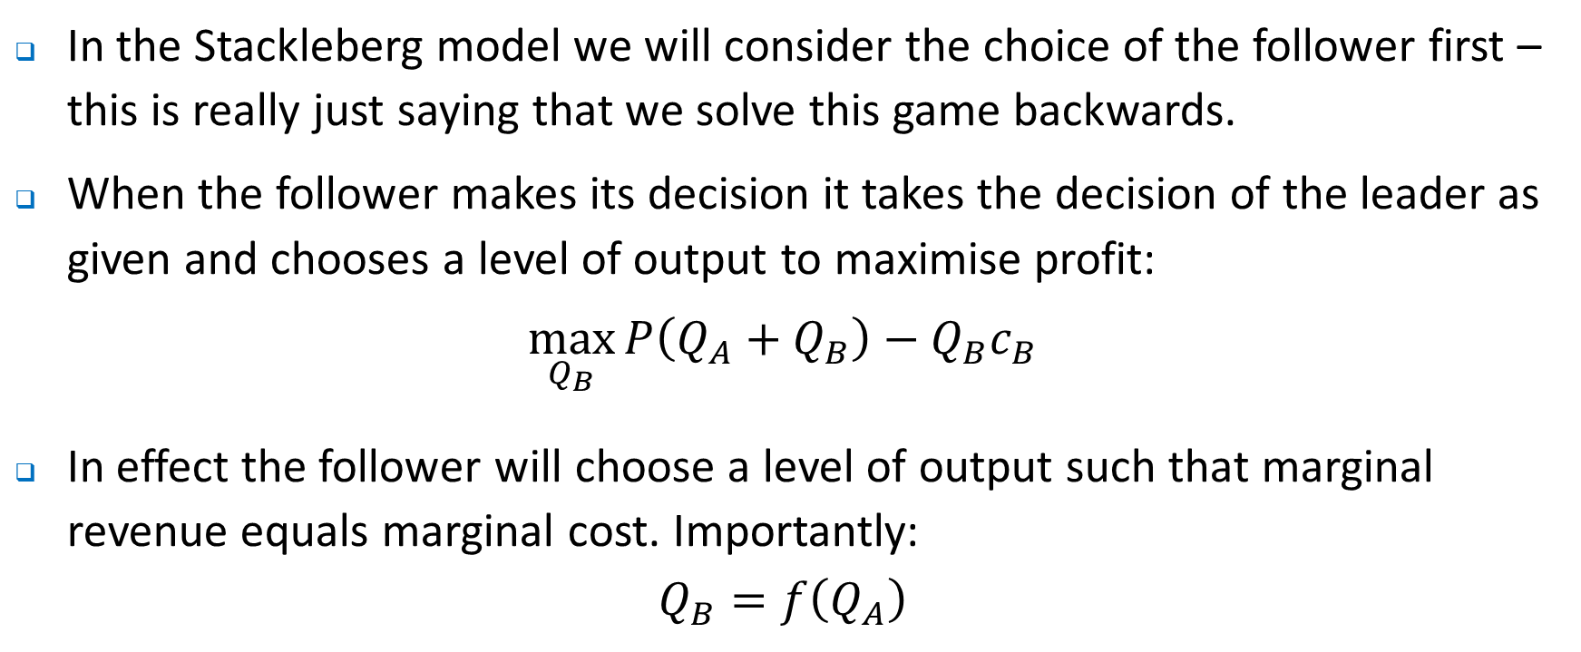
Oligopoly – the Stackleberg Model
In the Stackleberg model we will consider the choice of the follower first – this is really just saying that we solve this game backwards.
When the follower makes its decision it takes the decision of the leader as given and chooses a level of output to maximise profit:
$$\max_{Q_{B}}{P\left(Q_{A}+Q_{B}\right)}−Q_{B}c_{B}$$
In effect the follower will choose a level of output such that marginal revenue equals marginal cost. Importantly:
$$Q_{B}=f\left(Q_{A}\right)$$

Slide 46
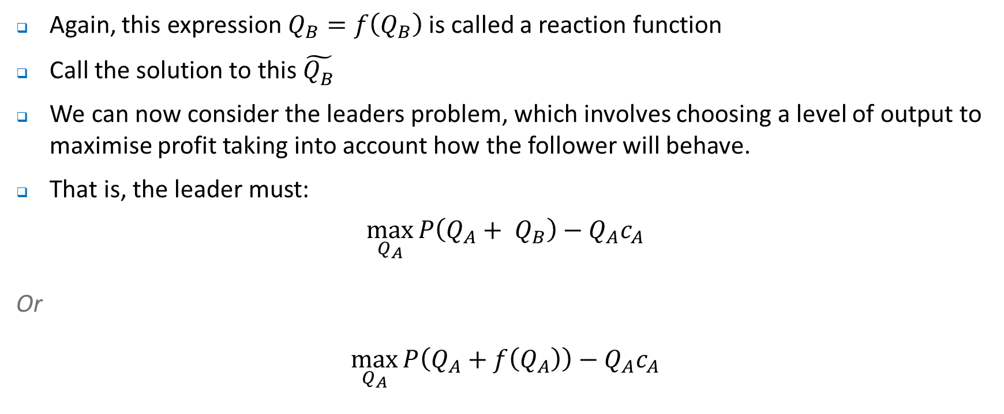
Oligopoly – the Stackleberg Model
Again, this expression $Q_{B}=f\left(Q_{B}\right)$ is called a reaction function
Call the solution to this $\tilde{Q_{B}^{}}$
We can now consider the leaders problem, which involves choosing a level of output to maximise profit taking into account how the follower will behave.
That is, the leader must:
$$\max_{Q_{A}}{P\left(Q_{A}+ Q_{B}\right)}−Q_{A}c_{A}$$
Or
$$\max_{Q_{A}}{P\left(Q_{A}+f\left(Q_{A}\right)\right)}−Q_{A}c_{A}$$

Slide 47
Oligopoly – the Stackleberg Model
If the above looks confusing, don’t worry as it’s the intuition that is important.
Worked example – see tutorial.

Slide 48
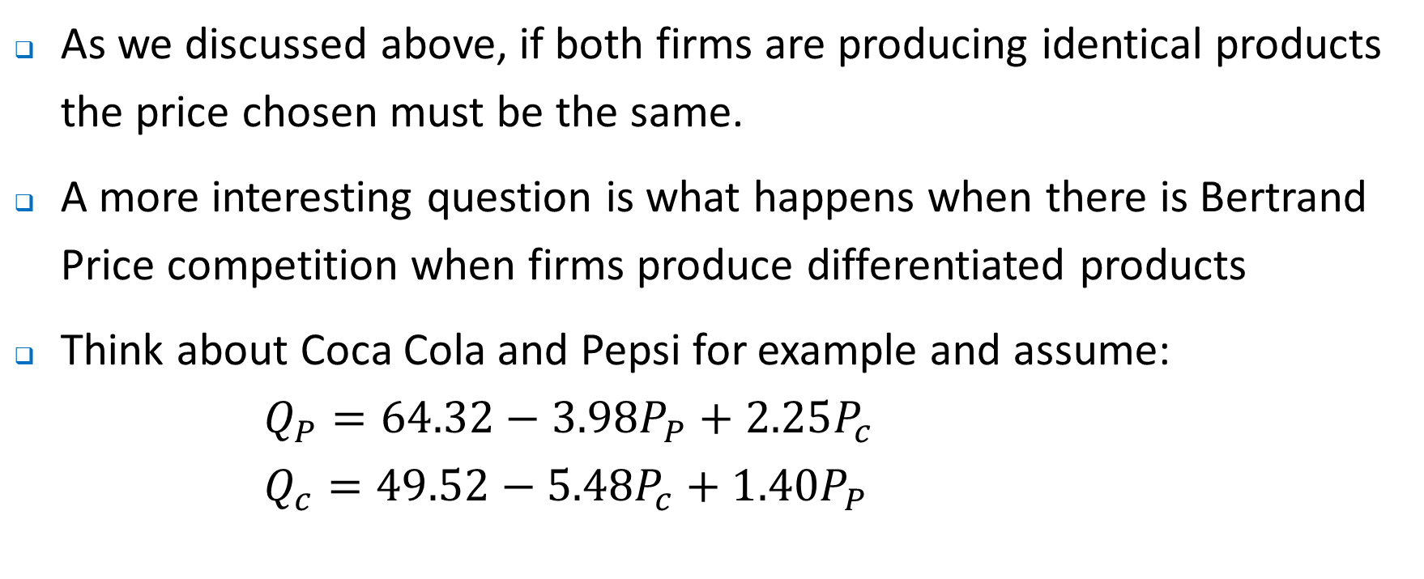
Oligopoly – Bertrand Models with Differentiated products
As we discussed above, if both firms are producing identical products the price chosen must be the same.
A more interesting question is what happens when there is Bertrand Price competition when firms produce differentiated products
Think about Coca Cola and Pepsi for example and assume:
$$Q_{P}=64.32−{3.98P}_{P}+2.25P_{c}$$
$$Q_{c}=49.52−{5.48P}_{c}+1.40P_{P}$$

Slide 49
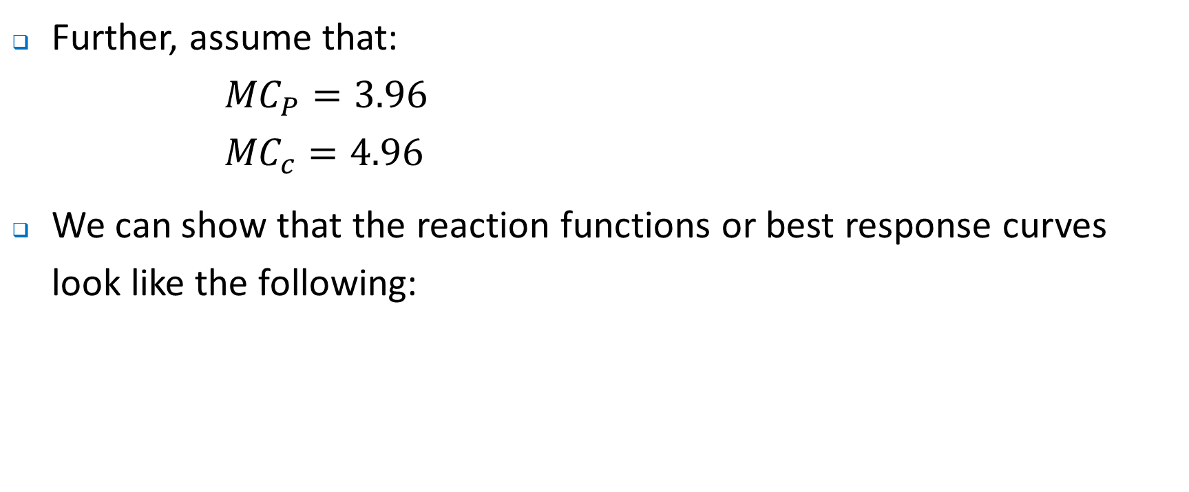
Oligopoly – Bertrand Models with Differentiated products
Further, assume that:
$${MC}_{P}=3.96$$
$${MC}_{c}=4.96$$
We can show that the reaction functions or best response curves look like the following:

Slide 50
P_{C}
So what does this really tell us?
Pepsi’s reaction function
8.11
Coke’s reaction function
6.49
0
P_{P}
0
10.44
12.72

Slide 51
Oligopoly – so what does this all mean…
The lesson here is that how you set up the relationship between firms is important.
Quantity choices might be conceived as questions about capacity – think about Cournot oligopolists competing as ‘capacity constrained price setters’. That is, they choose a price to sell all after having chosen a capacity. Alternatively, production decisions are made in advance and firms are committed to selling all of their output even if it requires price to fall.
Bertrand competition might be thought of as a situation where firms are not capacity constrained and can meet demand at whatever price emerges.
Are any of these relevant? Think about banking in Australia….

Slide 52
Where to next?
Next week we look – games.
Useful for understanding and analyzing business decision making.
Considerations will include:
What is a game and how do we solve them?
What types of situations can we apply game theory to?

