Slide 1
Lecture 3 Game Theory

Slide 2
Game Theory- Outline
Why study game theory?
Simultaneous non repeated games
Mixed strategy equilibria and best response curves
Sequential interactions
Repeated interactions
Repeated interactions with teammates
Auctions

Slide 3
Game Theory - Reading
Besanko and Braeutigam (2002), Microeconomics – An Integrated Approach, Ch. 14.

Slide 4
Why Study Game Theory?
Helps us understand interaction between economic agents…
Between firms
Within firms
Firm and its customers
Firms and its suppliers
Today, will go through some simple approaches to solving different types of games, some of which might look familiar.
Also try to identify some real world examples where game theory provides insight into behaviour and outcomes.

Slide 5
Lets begin by playing a couple of games…
First let me tell you a story about some students who I believe were trying to avoid an exam…
The day before the exam there was a big cricket match. Both students were big cricket fans.
Both students asked to write a supplementary as they claimed that they went for a bike ride on a tandem the day before the exam, the bike got a flat tyre and they were delayed in returning home and therefore couldn’t sit the exam on the following day.
The first question in the exam was:
Which tyre had the puncture?
Next, you are considering taking over an existing firm. All you know is that its value is somewhere between 0 and $100m, with a uniform distribution.
Whatever its worth to the existing owner, its worth 1.5 times that much to you
How much will you bid for it?

Slide 6
Why Study Game Theory?
Focus on optimising behaviour or decision making when all players are rational.
That is, each player is attempting to anticipate rival (or other players) action and reaction.
Focus is on non-cooperative games
Situation where negotiation and enforcement of binding contracts is not possible.
Cooperative game theory - players or agents can negotiate binding contracts that allow them to plan and implement joint strategies.

Slide 7
Simultaneous move, one-shot games
Make decisions without knowing the action of your rival.
Usually write out in strategic or normal form – use a payoff matrix
Can finds the outcome of such interaction by considering dominant strategies…
A strategy that is optimal for a firm to choose irrespective of what its rival does.
Many examples, some of which we have already seen this semester...

Slide 8
Simultaneous move, one-shot games
Consider the following pricing game for Boeing and Airbus (numbers represent profits)
 |  | Airbus
 |  | Low price | High price
Boeing | Low price | ($500, $500) | ($1000, $0)
 | High price | ($0, $1000) | ($750, $750)

Slide 9
Simultaneous move, one-shot games
What if there is no dominant strategy?
Look for a Nash Equilibrium
A set of strategies (or actions) in which each firm is doing the best it can given the actions of its rival.
No player has an incentive to unilaterally deviate from their actions – no profitable unilateral deviations.
A dominant strategy equilibrium is a Nash equilibrium.

Slide 10
Simultaneous move, one-shot games
Consider the pricing game for Boeing & Airbus when there is understanding about the r/ship between Boeing & US government – effectively change the rules & therefore the payoffs
Effectively captures the idea that for strategic defense reasons the US government wants to make sure Boeing remains in business.
Airbus has a dominant strategy but Boeing no longer does
 |  | Airbus
 |  | Low price | High price
Boeing | Low price | ($500, $500) | ($1000, $0)
 | High price | ($600, $1000) | ($750, $750)

Slide 11
Simultaneous move, one-shot games
What if there are more than two possible strategies and no dominant strategy?
Can solve for or identify the NE in the usual way
 |  |  | Toyota
 |  | Large | Small | Don’t build
 | Large | (0,0) | (12,8) | (18,9)
Honda | Small | (8,12) | (16,16) | (20,15)
 | Don’t build | (9,18) | (15,20) | (18,18)

Slide 12
Simultaneous move, one-shot games
It may also help to eliminate dominated strategies..
A strategy is (weakly) dominated when the player has another strategy that gives it a (weakly) higher payoff no matter what the other player does
 |  |  | Toyota
 |  | Large | Small | Don’t build
 | Large | (0,0) | (12,8) | (18,9)
Honda | Small | (8,12) | (16,16) | (20,15)
 | Don’t build | (9,18) | (15,20) | (18,18)

Slide 13
Simultaneous move, one-shot games
Finding Nash Equilibrium in two person games in five steps.
If both players have a dominant strategy – these constitute their NE strategies.
If one player has a dominant strategy this is their NE strategy, then find the other players best response to identify NE.
If neither player has a dominant strategy, eliminate dominated strategies.
Identify best responses for each player.
Look for an equilibrium in mixed strategies – see later

Slide 14
Simultaneous move, one-shot games
Are such games ever useful? Perhaps, think about how firms might behave if faced with an opportunity to lower costs and seek a competitive advantage
Consider the problem faced by the major tobacco companies in the 1970s.
The firms could advertise or not. If you don’t advertise but your rivals do, their profits increase by at round 20% and vice-versa.
Game has a single NE as there are dominant strategies (see next slide).
The US government imposed an advertising ban on TV (amongst other health related measures).
Big 4 tobacco companies spend $315m on advertising in 1970, and $252m in 1971 – profits rose by $91m.
Effectively the companies gave up on one possible strategy by agreeing to cease TV advertising (Example from Gardner)

Slide 15
Simultaneous move, one-shot games
Cigarette advertising game – dominant strategy equilibrium was removed as a possible outcome, benefitting the cigarette companies
 |  | BAT
 |  | Don’t Ad | Advertise
Imperial | Don’t ad | ($50, $50) | ($20, $60)
 | Advertise | ($60, $20) | ($27, $27)

Slide 16
Why the Nash Equilibrium
Recall that the standard approach in economics is to try to identify the equilibrium.
The Nash Equilibrium is self-enforcing or stable – by definition neither of the parties has a unilateral incentive to change behaviour.
Will a NE always arise -maybe or maybe not.
More likely when there is a natural focal point – ‘a reasonable and obvious way to behave’ or, ‘one NE that has some sort of special appeal’.
Raising the right hand or the left, writing from right to left, ….

Slide 17
Coordination games
In a competitive setting coordination can often be very profitable.
Obvious example comes out of the pricing game, but there are other examples where firms will benefit from choosing a similar technology or standard.
Higher overall demand for the product occurs because component costs are lower for example.
Revisit the Boeing and Airbus interaction but assume that there are two types of technology that could be adopted that is termed Alpha and Beta.
As we will see, in this game there are two NE – no clear focal point.
But with communication its possible that the firms signal their intention to adopt a particular technology and there would be no reason not to do so.

Slide 18
Simultaneous move, one-shot games
Consider the game between Boeing & Airbus making a decision about using a common communications technology
 |  | Airbus
 |  | Alpha | Beta
Boeing | Aplha | ($100, $100) | ($50, $50)
 | Beta | ($50, $50) | ($100, $100)

Slide 19
Simultaneous move, one-shot games
Coordination or precommitment can be profitable, but can be difficult if….
Many players.
Precommitment is costly and benefits differ across firms.
If precommitment is to occur, it has to be credible..
Perhaps Boeing can sign a contract with parts supplier & publicly announce such a decision
 |  | Airbus
 |  | Alpha | Beta
Boeing | Alpha | ($100, $50) | ($40, $40)
 | Beta | ($25, $25) | ($50, $100)

Slide 20
Coordination games
There are other examples.
Consider the digital technology problem – manufacturers and TV stations wanted to coordinate but were stuck in the less desirable outcome (see p. 305 Brickley).
The government (along with technology developments) helped
Car plans in Australia during the 1980s and 1990s ….

Slide 21
Mixed Strategy Equilibria
To this point considered pure strategy equilibria.
Sometimes randomization can be best strategy
How to think about a mixed strategy:
Choose H (a quantity or price) with probability p.
Choose L (a quantity or price) with probability (1-p).
In our sales example, we said choose a price equal to <p with prob. F(p) – see later.
Start with a simple problem.

Slide 22
Mixed Strategy Equilibria
Think about the advertising problem & decision to commit to a campaign.
Could be positive or negative.
No dominant strategy and no NE in pure strategies.
 |  | Airbus
 |  | Negative | Positive
Boeing | Negative | ($10, -$10) | (-$10, $10)
 | Positive | (-$10, $10) | ($10, -$10)

Slide 23
Mixed Strategy Equilibria
Suppose that both firms randomise between two options with probability 0.5.
Here we have a zero sum game:
If Boeing gains $10, Airbus loses 10, and vice versa.
Lets suppose Boeing chooses one strategy with prob. > 0.5, the Airbus can choose the other strategy and gain more than 50% of the time
Consider if Boeing goes negative p=0.6 of the time.
Airbus gains 60 percent of the time by always going positive.
E(P_{Airbus})=0.6*(10)+0.4*(-10) = 2>0
E(P_{Boeing})=0.6*(-10)+0.4*(10) =- 2<0

Slide 24
Mixed Strategy Equilibria
So what should Boeing do?
The only way they can achieve a payoff that is independent of Airbus’s action is to randomise with prob. p=0.50. Consider if Airbus chooses a positive campaign with prob. p:
0.5p becomes the prob that Boeing matches Airbus’s positive campaign.
0.5(1-p) becomes the prob that Boeing matches Airbus’s negative.
Probability of Boeing winning equals 0.5p + 0.5(1-p) = 0.5.
Probability of Boeing losing equals 0.5p + 0.5(1-p) = 0.5.
Therefore Boeing’s payoff is independent of what Airbus does..

Slide 25
Pricing– Strategic Considerations
Consider why stores sometimes have sales – give rise to a dispersion of prices.
Consider a town with two stores each with 1,000 loyal customers (who always shop there) and an additional 1,000 shoppers who go where prices are lowest. Think of these as informed and uninformed customers.
Shoppers pay up to $2 for paper towels for which the MC is $1.
What should the firms do?

Slide 26
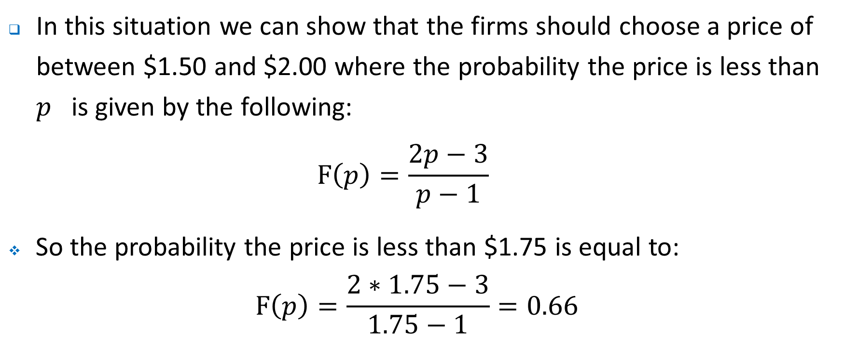
Mixed Strategy Equilibria
In this situation we can show that the firms should choose a price of between $1.50 and $2.00 where the probability the price is less than $p$ is given by the following:
$$F\left(p\right)=\frac{2p−3}{p−1}$$
So the probability the price is less than $1.75 is equal to:
$$F\left(p\right)=\frac{2∗1.75−3}{1.75−1}=0.66$$

Slide 27
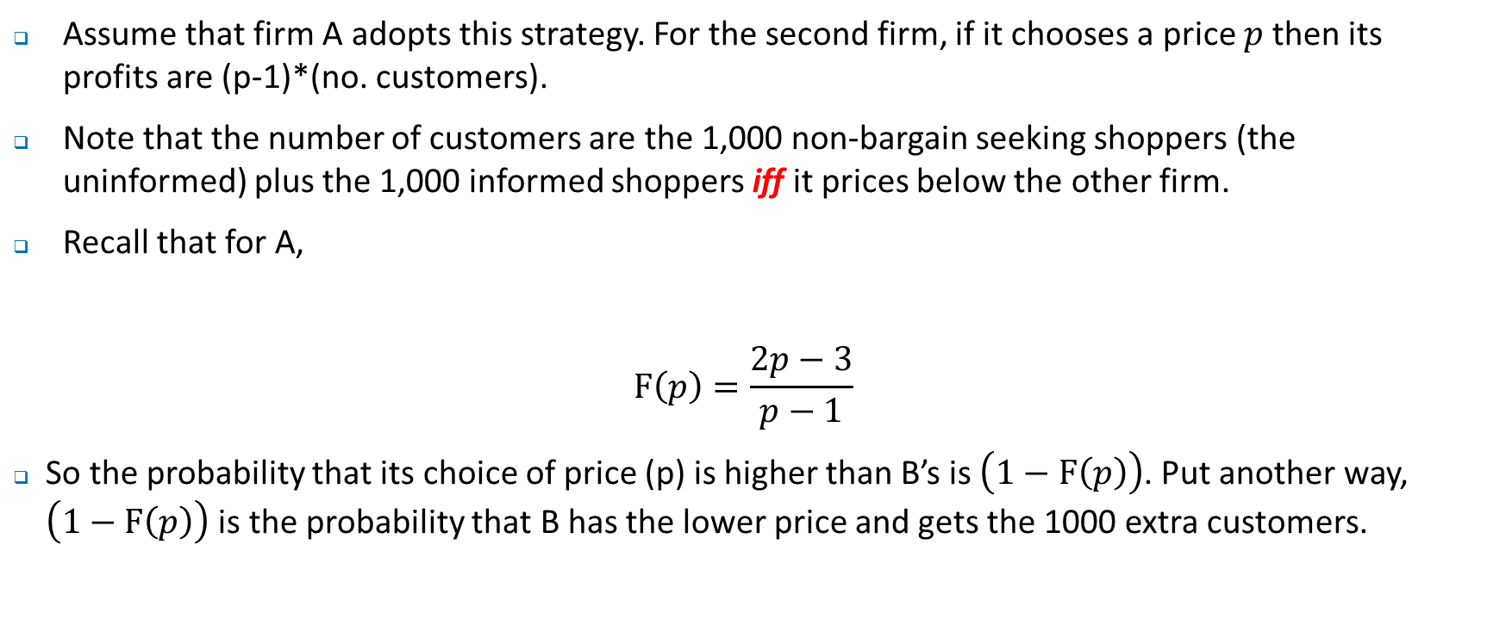
Mixed Strategy Equilibria
Assume that firm A adopts this strategy. For the second firm, if it chooses a price $p$then its profits are (p-1)*(no. customers).
Note that the number of customers are the 1,000 non-bargain seeking shoppers (the uninformed) plus the 1,000 informed shoppers iff it prices below the other firm.
Recall that for A,
$$F\left(p\right)=\frac{2p−3}{p−1}$$
So the probability that its choice of price (p) is higher than B’s is$\left(1−F\left(p\right)\right)$. Put another way, $\left(1−F\left(p\right)\right)$ is the probability that B has the lower price and gets the 1000 extra customers.

Slide 28
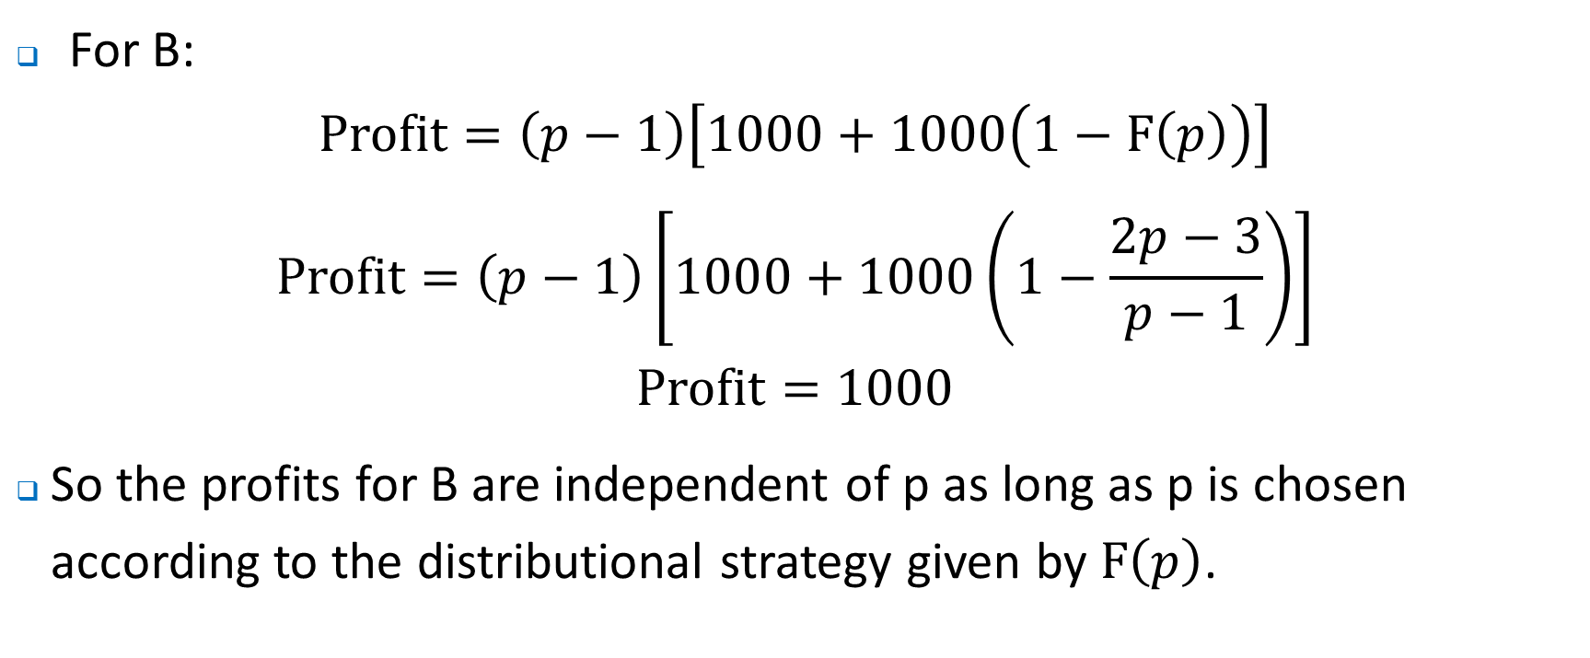
Mixed Strategy Equilibria
For B:
$$Profit=\left(p−1\right)\left[1000+1000\left(1−F\left(p\right)\right)\right]$$
$$Profit=\left(p−1\right)\left[1000+1000\left(1−\frac{2p−3}{p−1}\right)\right]$$
$$Profit=1000$$
So the profits for B are independent of p as long as p is chosen according to the distributional strategy given by $F\left(p\right)$.

Slide 29
Mixed Strategy Equilibria
So what is the intuition and lesson here?
We are thinking about a game where the firms are randomly choosing a price – in effect randomly choosing to have a sale. They might have a sale one week in every three and so set the price less than $1.75 once every three weeks.
The question is whether this is the best strategy and what does it mean for the other firm – will they respond and how to do they respond?
What we showed was the equilibrium set of strategies.

Slide 30
Mixed Strategy Equilibria
So now lets consider some other examples.
Consider the market niche game in which firms try to carve out a market niche – note that this is no longer a zero-sum game.
Two pure strategy equilibria.
 |  | Pure Water Co
 |  | Enter | Don’t enter
Eau Claire | Enter | (-$50, -$50) | ($100, $0)
 | Don’t enter | ($0, $100) | ($0, $0)

Slide 31
Mixed Strategy Equilibria
So what should each firm do? That is what mixed strategy is optimal?
The key to solving this is to note that:
“Every pure strategy that is played as part of a mixed strategy Nash equilibrium has the same expected value”
Let p₁(enter) be prob. that firm 1 enters, and p₁(stay out) be prob. that firm 1 does not enter.
Let p₂(enter) be prob. that firm 1 enters, and p₂(stay out) be prob. that firm 2 does not enter.
Firm 1’s profit if it chooses the pure strategy of entering while 2 uses a mixed strategy:
EV₁(enter) = p₂(enter)(-50) + p₂(stay out)(100)
Suppose Firm 1 chooses the pure strategy of not entering while 2 uses a mixed strategy. This gives a payoff of 0.
Now, we want to set the payoffs for frim 1 under both pure strategies equal to each other:
EV₁(enter) = EV₁(stay out) , or
p₂(enter)(-50)+ p₂(stayout)(100)=0

Slide 32
Mixed Strategy Equilibria
Now, we want to set the payoffs for frim 1 under both pure strategies equal to each other:
EV₁(enter) = EV₁(stay out) , or
p₂(enter)(-50)+ p₂(stayout)(100)=0 (i)
But note that:
p₂(enter) + p₂(stay out)=1 (ii)
Solving for (i) and (ii)
p₂(enter)=2/3 & p₂(stayout)=1/3
Note firms 1’s expected payoff:
EV₁(enter) = 2/3*(-50)+1/3*(100) = EV₁(stay out) = 0
So applying the same approach to firms 2, the equilibrium strategy is 2/3 probability on entering market.

Slide 33
Mixed Strategy Equilibria
So now lets consider some another examples.
Consider the market niche game in which firms try to carve out a market niche – note that this is no longer symmetric.
Again, two pure strategy equilibria.
 |  | Pure Water Co
 |  | Enter | Don’t enter
Eau Claire | Enter | (-$50, -$50) | ($150, $0)
 | Don’t enter | ($0, $100) | ($0, $0)

Slide 34
Mixed Strategy Equilibria
So what should each firm do? That is what mixed strategy is optimal?
Let p₁(enter) be prob. that firm 1 enters, and p₁(stay out) be prob. that firm 1 does not enter.
Let p₂(enter) be prob. that firm 1 enters, and p₂(stay out) be prob. that firm 2 does not enter.
Firm 1’s profit if it chooses the pure strategy of entering while 2 uses a mixed strategy:
EV₁(enter) = p₂(enter)(-50) + p₂(stay out)(150)
Suppose Firm 1 chooses the pure strategy of not entering while 2 uses a mixed strategy. This gives a payoff of 0.
Now, we want to set the payoffs for firm 1 under both pure strategies equal to each other:
EV₁(enter) = EV₁(stay out) = 0, or
p₂(enter)(-50)+ p₂(stayout)(150)=0 (i)

Slide 35
Mixed Strategy Equilibria
But note that:
p₂(enter) + p₂(stay out)=1 (ii)
Solving for (i) and (ii)
p₂(enter)=3/4 & p₂(stayout)=1/4
Note firms 1’s expected payoff:
EV₁(enter) = 3/4*(-50)+1/4*(100) = EV₁(stay out) = 0
So applying the same approach to firm 2, the equilibrium strategy for firm 1 is 2/3 probability on entering market.

Slide 36
Mixed Strategy Equilibria
Of course we can construct a simple example of our sales model using the same principles (assuming 50 uninformed and 120 informed buyers).
Think about a choice between everyday low pricing versus sales.
Two pure strategy equilibria (assume SP=500, NP=600, cost=450).
 |  | Big W
 |  | No sale | Sale
Target | No sale | ($7500, $7500) | ($7500, $8500)
 | Sale | ($8500, $7500) | ($5500, $5500)

Slide 37
Mixed Strategy Equilibria
So what should each firm do? That is what mixed strategy is optimal?
Let p(NP) be prob. charging normal price.
Let p(SP) be prob. charging sale price.
Big W’s profit if it chooses the pure strategy of charging a sale price while 2 (Target) uses a mixed strategy:
EV (SP) = 8500 p_{Target} (NP) + 5500 p_{Target}(SP)
Suppose Firm 1 (Big W) chooses the pure strategy of normal pricing while 2 uses a mixed strategy. This gives a payoff of 7500.
Now, we want to set the payoffs for firm 1 (Big W) under both pure strategies equal to each other:
EV (NP) = EV (SP) = 7500, or
p_{Target}(NP)(8500)+ p_{Target}(SP)(5500)=7500 (i)

Slide 38
Mixed Strategy Equilibria
But note that:
p_{Target} (SP) + p_{Target} (NP)=1 (ii)
Solving for (i) and (ii)
p_{Target} (SP)=1/3 & p_{Target}(NP)=2/3
Note firms 1’s (BigWs) expected payoff:
EV (SP) = 1/3*(5500)+2/3*(8500) = EV₁(NP) = 7500
So applying the same approach to firm 2 (Target), the equilibrium strategy for firm 1 (Big W) is 1/3 probability of having a sale.

Slide 39
Mixed Strategy Equilibria
We an also approach this using best response curves…:
Consider the following game.
Lets try to identify the best response curves
 |  | Big W
 |  | No sale | Sale
Target | No sale | ($7500, $7500) | ($7500, $8500)
 | Sale | ($8500, $7500) | ($5500, $5500)

Slide 40
Mixed Strategy Equilibria
Let r be prob. that Target plays no sale, and (1-r) be prob. it plays sale
Let c be prob. that BigW plays no sale, and (1-c) be prob. it plays sale
Consider:
.
Combination | Probability | Payoff to Target
No sale, no sale | rc | 7500
Sale, no sale | (1-r)c | 8500
No sale, Sale | r(1-c) | 7500
Sale, Sale | (1-r)(1-c) | 5500

Slide 41
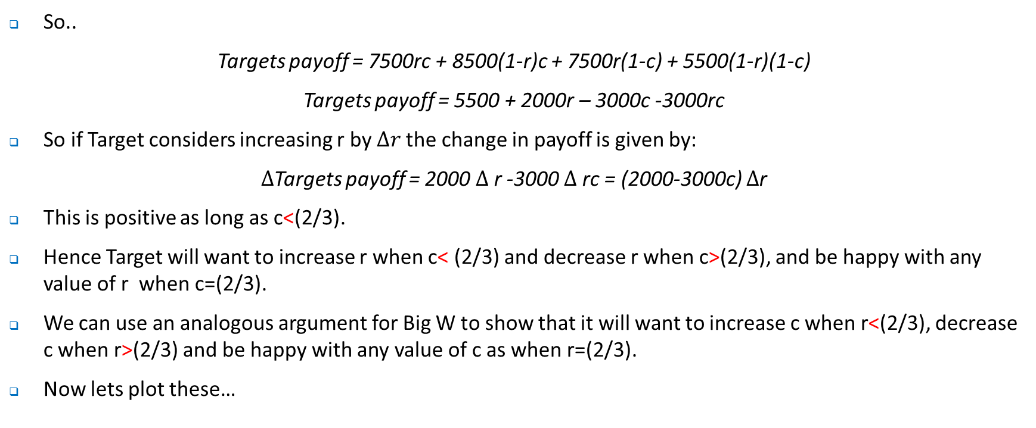
Mixed Strategy Equilibria
So..
Targets payoff = 7500rc + 8500(1-r)c + 7500r(1-c) + 5500(1-r)(1-c)
Targets payoff = 5500 + 2000r – 3000c -3000rc
So if Target considers increasing r by $∆r$the change in payoff is given by:
$∆$Targets payoff = 2000 $∆$r -3000 $∆$rc = (2000-3000c) $∆$r
This is positive as long as c<(2/3).
Hence Target will want to increase r when c< (2/3) and decrease r when c>(2/3), and be happy with any value of r when c=(2/3).
We can use an analogous argument for Big W to show that it will want to increase c when r<(2/3), decrease c when r>(2/3) and be happy with any value of c as when r=(2/3).
Now lets plot these…

Slide 42
Mixed Strategy Equilibria
We can identify Big W’s best response curve, recall it will want to increase c when r<(2/3), decrease c when r>(2/3) and be happy with any value of c as when r=(2/3)
1
2/3
We can identify Targets best response curve, recall it will want to increase r when c<(2/3), decrease r when c>(2/3) and be happy with any value of r when c=(2/3)
c
Where the curves cross correspond to the pure strategy NE, and the mixed strategy NE
0
2/3
1
r

Slide 43
Mixed Strategy Equilibria
The best response curves has been seen previously – think about the Cournot oligopoly.
In each case the reaction functions simply told us what the best response for each of the firms was to the choice of the other firm.
When those best response curves intersected the choices were consistent and none of the players had any incentive to unilaterally change their behavior.

Slide 44
Sequential Decision Making
We have come across sequential decision making previously…
 |  |  | Alpha | ($100, $50)
 | Alpha
 |  |  | Beta | ($40, $40)
 |  |  | Alpha | ($25, $25)
 | Beta
 |  |  | Beta | ($50, $100)
Airbus
Boeing
Airbus

Slide 45
Sequential Decision Making
First, make sure you can draw such games in extensive form.
Solve via backward induction – just as we did with the Stackelberg model
Here we want to identify the SNPE – Subgame Nash Perfect Equilibria.
A subgame is a part of a game that can be played as a game itself. A collection of nodes and branches that:
Begins at a single node
Contains every successor node.
Contains all the relevant information
Why is the concept of subgame important? Threats exhibit a lack of credibility of at the time that they are to be carried out, the player does not maximise utility by carrying out the threat.
A Nash Equilibrium is subgame perfect if every player plays the Nash Equilibrium on each and every subgame

Slide 46
Sequential Decision Making
Here a threat by Airbus to always choose Beta is simply not credible as it is not SP
 |  |  | Alpha | ($100, $50)
 | Alpha
 |  |  | Beta | ($40, $40)
 |  |  | Alpha | ($25, $25)
 | Beta
 |  |  | Beta | ($50, $100)
Airbus
Boeing
Airbus

Slide 47
Sequential Decision Making
The Boeing – Airbus game is an example of a situation where there is a first mover advantage, just as there was in the Stackelberg problem.
We can also identify situations in which there are second mover advantages.
Example

Slide 48
Commitment
One way that a threat can be made credible is through some form of commitment.
For a commitment to be credible in general we would expect that it would
Be visible
Be understood by rivals .
Be credible – for example through some aspect of irreversibility such as capacity expansion in assets that are can not be redeployed or an agreement which makes a credible commitment not to compete on price.
Lets consider commitment and competition between firms using the Cournot models that we have used previously.

Slide 49
Commitment
We can distinguish between:
Strategic substitutes – recall the Cournot model in which we have downward sloping reaction functions. The best response to an increase in quantity by one firm was to decrease your own quantity. For a strategic substitute, the more that your rival chooses the less you should choose.

Slide 50
Q_{B}
100
Firm A’s reaction function
Cournot quantity competition
50
33.33
Firm B’s reaction function
0
Q_{A}
0
33.33
50
100

Slide 51
Commitment
We can distinguish between:
Tough commitments – those that are bad for competitors. For example the expansion of production facilities in a Cournot model.
Soft commitments – those that are good for competitors. For example the elimination of production facilities in a Cournot model.
Competition may be Bertrand or Cournot.

Slide 52
Commitment
Consider a commitment such as adopting a product innovation that reduces variable production cost or one about positioning a product in the market. Assume that is such that rivals are aware of it and it cannot be reversed and is therefore credible.
Consider the following timing:
Stage 1 – firm A makes commitment.
Stage 2 – firms compete through quantity choices (Cournot).
Assume new equilibrium is reached quickly.

Slide 53
Commitment - Cournot competition
Outcome depends on whether commitment is tough or soft.
Tough – firm A will produce more than if it had not made commitment. That is, a rightward shift in the reaction function. The effect will be to see firm B respond by reducing its own output causing market price to be higher – the beneficial strategic effect could outweigh negative direct effect. Note that the direct effect here is negative – suppose the NPV in the absence of a response is negative.
Hence, the firm should go ahead and make commitment notwithstanding its negative direct effect.

Slide 54
Q_{B}
Firm A’s reaction function
100
Cournot quantity competition
50
33.33
Firm B’s reaction function
0
Q_{A}
0
33.33
50
100

Slide 55
Commitment - Cournot competition
Outcome depends on whether commitment is tough or soft.
Soft – suppose that a firm enters another market and in doing so raises its cost of production. Firm A will produce less than if it had not made commitment. That is, a leftward shift in the reaction function. The effect will be to see firm B respond by increasing its own output– there is a negative strategic effect here.
Firm should go ahead and make commitment only if the beneficial effect (entry into new market) exceeds negative strategic effect.

Slide 56
Q_{B}
Firm A’s reaction function
100
Cournot quantity competition
50
33.33
Firm B’s reaction function
0
Q_{A}
0
33.33
50
100

Slide 57
Repeated Interaction
With repeated interaction new equilibria can be supported.
Why?
Agents can cooperate and that cooperation can be sustained through punishment. That punishment and the cost of it might consist of the loss in long run profits from not cooperating as agreed.
Cooperation is more likely:
The larger are the LR gains c.f. short run advantage
When monitoring is less costly
The expected length relationship is longer

Slide 58
Repeated Interaction
Consider two employees assigned to a team, Anna and Bert.
Payoff matrix is shown on next slide, with payoffs reflecting the utility from exerting effort, along with the disutility of effort.
Nash equilibrium is shown.
Really just a Prisoner’s Dilemma

Slide 59
Single Period Setting
Anna and Bert.
Can work or shirk.
Solution is that they both shirk – may be able to relate to this with some of your colleagues…..
 |  | Bert
 |  | Shirk | Work
Anna | Shirk | ($1000, $1000) | ($3000, $0)
 | Work | ($0, $3000) | ($2000, $2000)

Slide 60
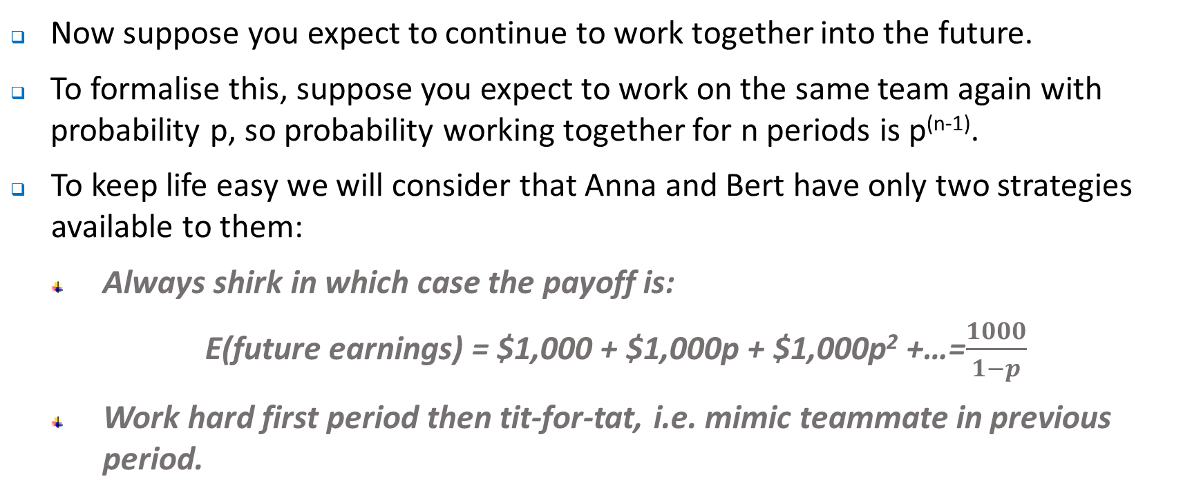
Repeated Interaction
Now suppose you expect to continue to work together into the future.
To formalise this, suppose you expect to work on the same team again with probability p, so probability working together for n periods is p^{(n-1)}.
To keep life easy we will consider that Anna and Bert have only two strategies available to them:
Always shirk in which case the payoff is:
E(future earnings) = $1,000 + $1,000p + $1,000p² +…=$\frac{1000}{1−p}$
Work hard first period then tit-for-tat, i.e. mimic teammate in previous period.

Slide 61
Repeated Interaction
Anna and Bert.
Can work or shirk.
If Anna and Bert think the other will shirk then ..
But if they each think the other will play tit-for-tat
 |  | Bert
 |  | Always Shirk | Work then Tit-for-tat
Anna | Always Shirk | ($1000/(1-p), $1000/(1-p)) | ($2000+$1000/(1-p), -$1000 +$1000/(1-p))
 | Work then Tit for tat | (-$1000 +$1000/(1-p), $2000+$1000/(1-p)) | ($2000/(1-p), $2000/(1-p))

Slide 62
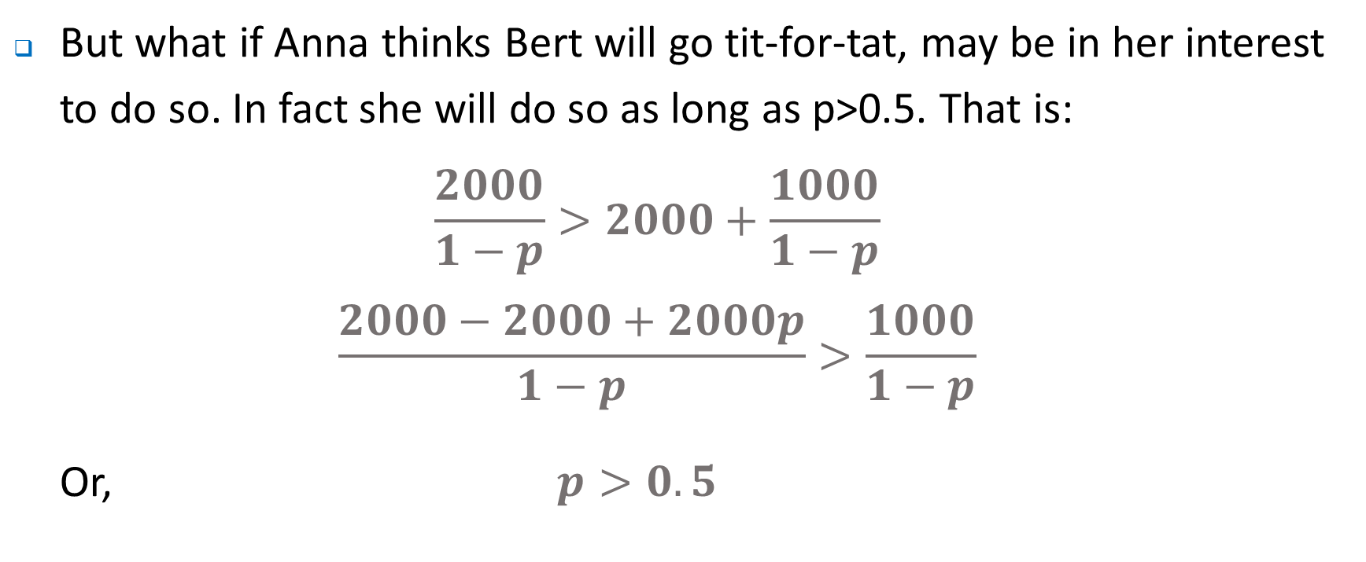
Repeated Interaction
But what if Anna thinks Bert will go tit-for-tat, may be in her interest to do so. In fact she will do so as long as p>0.5. That is:
$$\frac{2000}{1−p}>2000+\frac{1000}{1−p}$$
$$\frac{2000−2000+2000p}{1−p}>\frac{1000}{1−p}$$
Or, $p>0.5$

Slide 63
Single Period Setting
Anna and Bert.
So if p=1/3.
Shirking
 |  | Bert
 |  | Shirk | Work
Anna | Shirk | ($1500, $1500) | ($3500, $500)
 | Work | ($500, $3500) | ($3000, $3000)

Slide 64
Single Period Setting
Anna and Bert.
So if p=3/4.
Initial expectations matter
So what should a firm do …?
 |  | Bert
 |  | Shirk | Tit-for-tat
Anna | Shirk | ($4000, $4000) | ($6000, $3000)
 | Tit-for-tat | ($3000, $6000) | ($8000, $8000)

Slide 65
Auctions
Auctions are really just games – the design of auctions can be important for organisations given they are often used to allocate resources.
Consider – what is the best bidding strategy in a private value auction
Lets consider a very simple example of a Vickery auction – a second price sealed bid auction, ala eBay.
The question is, what is the optimal bidding strategy?
To tell the truth…!

Slide 66
Auctions – second price sealed bid
You Win
You Lose
Your bid
Others’ bids
higher
Your value

Slide 67
Auctions – bidding higher than valuation
Case 1
Case 2
Case 3
No difference
No difference
Lose money

Slide 68
Auctions – bidding lower than valuation
Case 1
Case 2
Case 3
No difference
No difference
Lose money

Slide 69
Auctions
Now lets consider a common value auction.
Bidders for target firm are told that value of firm is uniformly distributed between 0 and 1.
1 in a 100 chance its value was 0.12
1 in a 100 chance its value was 0.56, etc
0
0.12
0.56
0.56
1.00

Slide 70
Auctions
Bidders also told that what ever value the firm has to the seller, it will be worth 1.5 times that to the buyer.
Think of this as you as the buyer can do better than the current owner at maximising value). That is, you purchased a firm that was worth 0.56 to the seller, then it was worth 0.84 (=0.56  1.5) to the buyer.
In general, we expect the seller to sell the firm if the offer made by the buyer > value to the seller
The question is, what is the optimal bidding strategy?

Slide 71
Auctions
Assume that the buyer chooses a bid of 0.48 (note this is chosen entirely randomly, and we could have chosen any figure between 0 and 1 and the argument we set out below will continue to hold)
If the bidder offers 0.48, the seller will only sell if the value to the seller is < 0.48. In this case, the average value of the firm (to the seller) will only be 0.24.
Why? Consider how the value of the firm is distributed assuming its value is < 0.48.

Slide 72
Auctions
Note although the average value of the firm (to the seller) will only be 0.24, the average value to the buyer will be 0.36 (=0.24  1.5).
If the buyer pays 0.48 for something worth only 0.36, s/he will lose.
The winners curse
1 in a 48 chance its value was 0.05
1 in a 48 chance its value was 0.28, etc
0
0.05
0.28
0.40
0.48

Slide 73
Auctions
Intuition
As a buyer, you only get to buy the item if you bid more than it is worth (to the seller). Given uncertainty about its true value (asymmetric information), you will tend to bid too much and lose..
Q^{n}: What is the best strategy for the buyer?

Slide 74
Where to next?
Next week we focus on the relationship between a firm and its customers and the role of pricing.

