Slide 1
Lecture 4
Pricing

Slide 2
Pricing- Outline
Market power & profit maximising pricing
Two part tariffs
Personalized pricing
Price discrimination
Yield Management
Strategic considerations - Sales
Real world examples - throughout

Slide 3
Pricing - Reading
Perloff and Brander (2016), Managerial economics,
Ch. 10 McAfee (2002), Competitive Solutions, Ch. 11.

Slide 4
Pricing Behaviours
Firms adopt many different pricing strategies
Offer a variety of versions of products.
Rebates via an online code
Mac versions of software may be priced higher
Packets 50 cheques @ $1.13 each, 2000 cheques @ $0.13 each.
Envelopes & cheque combos priced lower than individual purchases of items
McAfee notes that American Airlines changes airfares ½ million times a day.

Slide 5
Pricing Behaviours
In each case the question is:
Why?
The answer of course is pretty simple…..
Firms want to maximise profits and good pricing strategies is just one way to do this

Slide 6
Pricing Behaviours
Recall that in a competitive market price = MC
For price to exceed MC, firms must have market power, which means ….
Assume that firms price to maximise profits
Begin by considering the easiest problem, namely the choice of price or quantity to maximise profit in a single period - an innocuous assumption if the business environment is stationary.

Slide 7
Pricing Behaviours
Profit maximisation for the firm with market power requires….
Marginal revenue = Marginal cost
Note that such a strategy leaves some consumer surplus on the table

Slide 8
Single Price Monopolist – Classic Presentation
There are a number of features of this diagram including….
Demand curve
Relationship between the MC and AC curves
Profit maximising choice
Make sure you understand:
Why the demand curve slopes downwards
The intuition behind the profit maximising choice

Slide 9
Pricing Behaviours
Limitations of such an approach
Everyone faces the same price which limits options and profits.
One product being sold
A single period problem
Strategic considerations re competing products – think about the Bertrand problem. Perhaps more challenging, think about a Bertrand problem when products are differentiated.

Slide 10
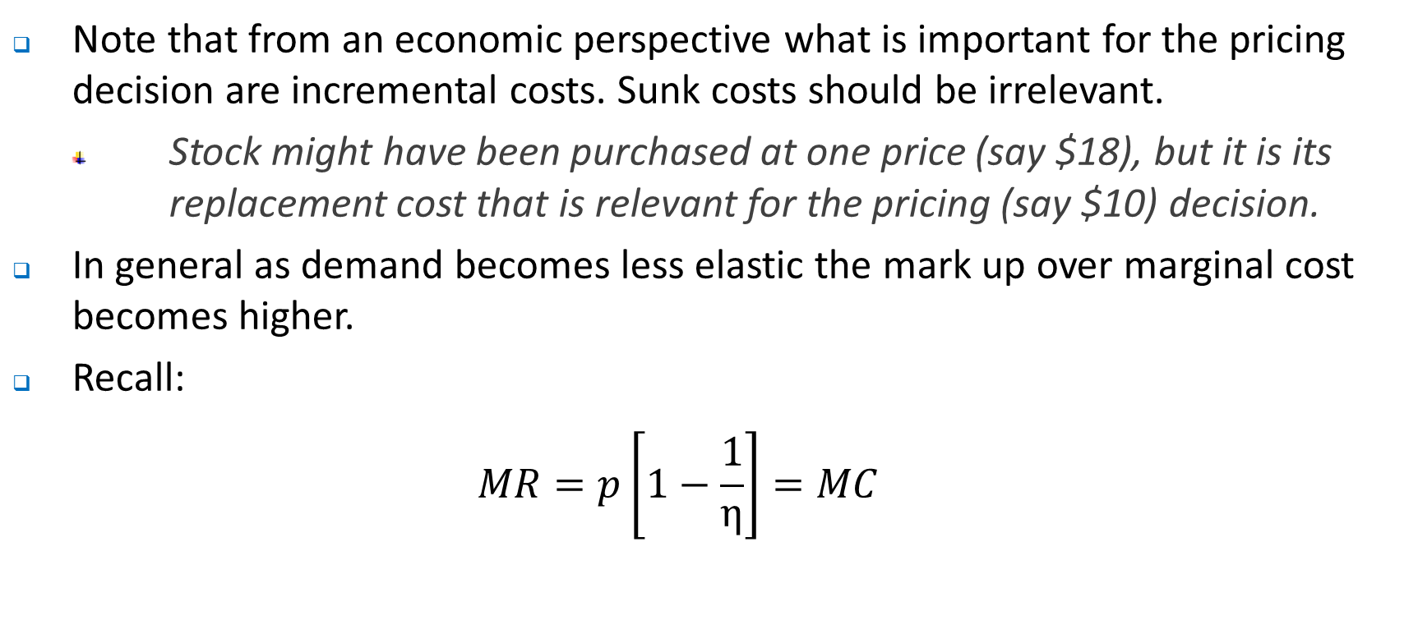
Profit maximising pricing
Note that from an economic perspective what is important for the pricing decision are incremental costs. Sunk costs should be irrelevant.
Stock might have been purchased at one price (say $18), but it is its replacement cost that is relevant for the pricing (say $10) decision.
In general as demand becomes less elastic the mark up over marginal cost becomes higher.
Recall:
$$MR=p\left[1−\frac{1}{η}\right]=MC$$

Slide 11

Profit maximising pricing
So:
$$\frac{MC}{P}=\left[1−\frac{1}{η}\right]$$
$$\frac{MC}{P}=\left[\frac{η−1}{η}\right]$$
$$\frac{P}{MC}=\left[\frac{η}{η−1}\right]$$
$$\lim_{η→∞}{\frac{P}{MC}=\lim_{η→∞}\left[\frac{η}{η−1}\right]=1}$$

Slide 12
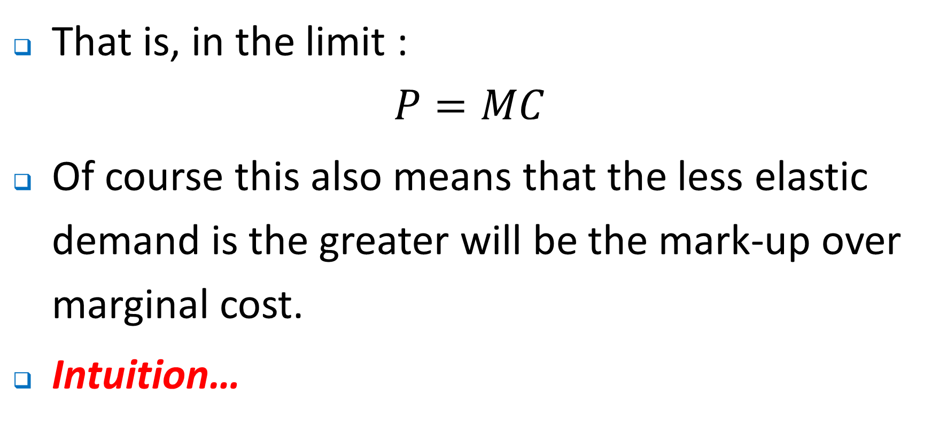
Profit maximising pricing
That is, in the limit :
$${P=MC}$$
Of course this also means that the less elastic demand is the greater will be the mark-up over marginal cost.
Intuition…

Slide 13
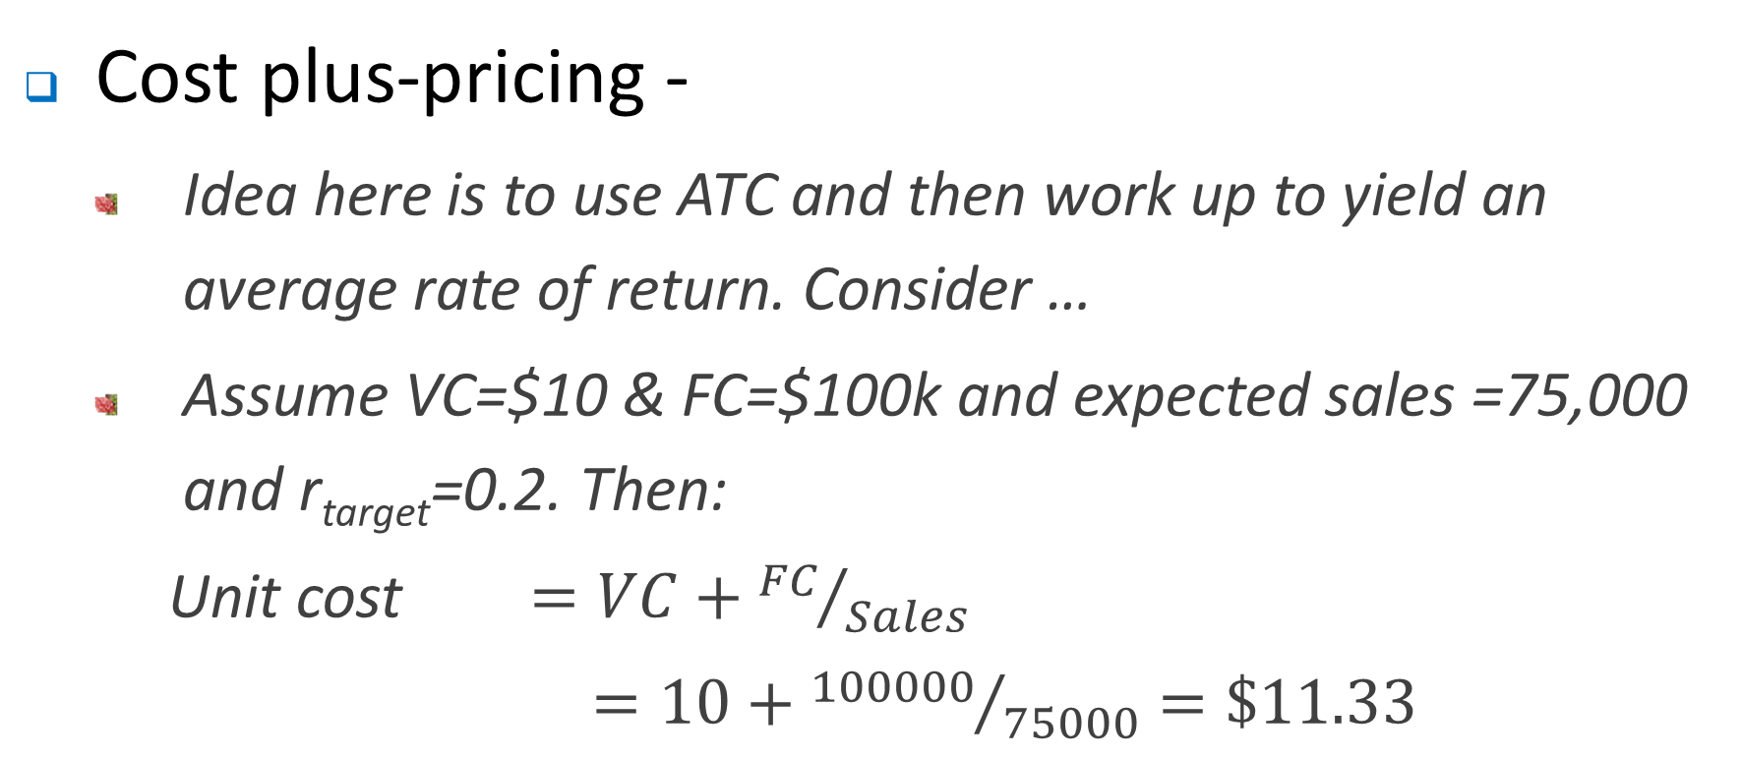
Profit maximising pricing – rules of thumb
Cost plus-pricing -
Idea here is to use ATC and then work up to yield an average rate of return. Consider …
Assume VC=$10 & FC=$100k and expected sales =75,000 and r_{target}=0.2. Then:
Unit cost $=VC+{FC}/{Sales}$
$=10+{100000}/{75000}=\$11.33$

Slide 14
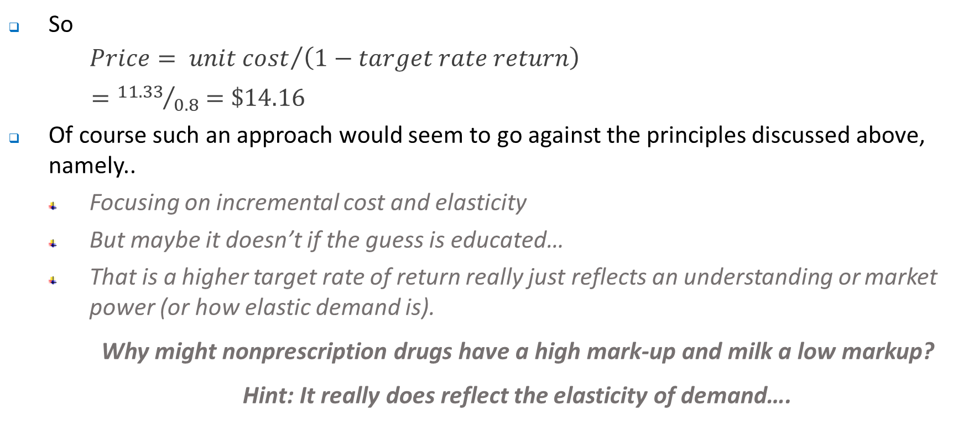
Profit maximising pricing – rules of thumb
So
$$Price= {unit cost}/{\left(1−target rate return\right)}$$
$={11.33}/{0.8}=\$14.16$
Of course such an approach would seem to go against the principles discussed above, namely..
Focusing on incremental cost and elasticity
But maybe it doesn’t if the guess is educated…
That is a higher target rate of return really just reflects an understanding or market power (or how elastic demand is).
Why might nonprescription drugs have a high mark-up and milk a low markup?
Hint: It really does reflect the elasticity of demand….

Slide 15
Profit maximising pricing – block pricing
Assume initially that the firm faces homogeneous consumers. Makes life substantially easier.
Block pricing – charge a different price per unit depending on the quantity purchased.
Common example is that of clothes - buy the first item at full price and get the second one for 50% off. Look around shops and there are many real world examples such as clothes, wine, groceries.
Why does this work?

Slide 16
Price ($)
Key here is that the demand curve can be interpreted as a willingness to pay curve – total wtp given by integral under d curve
Willingness to pay for first item is $20, and the wtp to pay for the second is $15, so the wtp for two items is $35.
Two sell two units at a single price requires a price of $15 each. Alternatively, sell the first one for $20 and two for $32. As long as MC is lower than $12 the block pricing strategy delivers higher profits.
20
15
0
Quantity
0
1
2

Slide 17
Profit maximising pricing – two part tariffs
Traditionally used by phone companies, electricity companies, golf clubs etc. Razor manufacturers also adopt this approach.
Fixed charge or access fee
Per unit charge.
Again many real world examples
Consider the following very simple example when MC is constant…

Slide 18
Price ($)
Again, here is that the demand curve can be interpreted as a willingness to pay curve – total wtp given by integral under d curve
If the price were equal to MC, the total willingness to pay would be given by the blue area
With a two-part tariff the per unit cost can be set equal to MC generating revenue given by the red area.
The access fee can be set equal to the consumer surplus generated by the price = MC, generating revenue given by the green area.
0.12
0
Quantity
0
200

Slide 19
Profit maximising pricing – two part tariffs
With heterogeneous consumers the problem becomes a little more complex.
Suppose we have two types of buyers – a high and low type.
If we set per unit price = MC, the best we can do is to set the fixed fee at the CS of the low type consumer.
In general, it will be better to set price higher than MC and set the fixed fee at the lower of the CS

Slide 20
Profit maximising pricing – heterogeneous customers
Usually think about price discrimination or value based prices. That is prices unrelated to costs of production.
Requirements:
Customer heterogeneity
Some way of charging different customers different prices. Maybe because different customer types can be identified (1st or 3rd degree price discrimination), or, through 2nd degree price discrimination where customers effectively reveal type …
No arbitrage – this may or may not be simple both from a legal and practical point of view.

Slide 21
Profit maximising pricing – heterogeneous customers
Why might arbitrage be difficult or impossible?
Nature of item and transportation costs
Legal impediments to resale - drugs
Personalised prices – electricity generators
Thin markets – airline tickets at one point.
Informational problems

Slide 22
First degree price discrimination
Simply charge willingness to pay for each customer.
The challenge…?
Is it ever surmountable?
Electricity utilities
Consider the Panama canal and the questions asked about size of ship, number of crew, the nature of the goods carried….
So what might we expect to happen following recent change in price of oil?
“Cheap Oil is Taking Shipping Routes Back to the 1800s” < http://www.bbc.com/future/story/20160303-cheap-oil-is-taking-shipping-routes-back-to-the-1800s >

Slide 23
Price ($)
Key here is that the demand curve can be interpreted as a willingness to pay curve. Hence the height of the demand curve gives the wtp of each buyer.
Charge $490k to the first buyer
500,000
490,000
Charge $480K to the second buyers etc
480,000
To the penultimate and final buyer, charge their willingness to pay of $55k and $50k respectively
50,000
0
Quantity
0
45

Slide 24
Third degree price discrimination
Group pricing or third degree price discrimination.
Simply separate the market into the appropriate number of groups – it doesn’t have to be two. Then behave like a monopolist (or more generally maximise profit as a single price monopolist) in each of the separate sub markets.
That is, set MR = MC in each of the separate markets
What types of items might this work best for?
How might you distinguish between different types or groups of buyers?

Slide 25
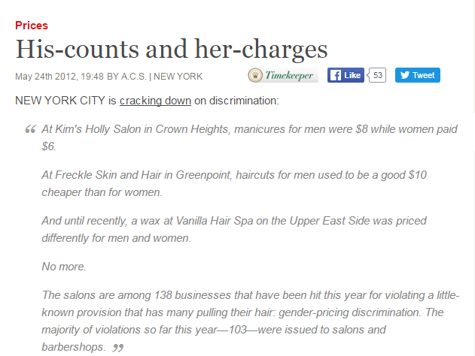
Third degree price discrimination
Can be used for many types of products inc. books (how?), clothes (how?) & haircuts
Might a firm face problems with such an approach?

Slide 26
Second degree price discrimination
Sometimes the problem is that you don’t really know who you are selling to – is it a local or a non-local, a senior citizen or a student… ?.
We want to charge different buyers different prices but there is a problem with this. If we ask people will do the sensible thing and ….
LIE!
Of course in other cases it might just simply be illegal to charge different prices to different groups.

Slide 27
Second degree price discrimination
So what to do?
Let customers choose, but in doing so make them an offer they cannot refuse.
We saw this everywhere– Stata Corporation offers at least 6 options for buyers of its software depending on size of software and whether one wants a perpetual or annual license.
Similarly, car manufacturers offer a range of models that are priced differently depending on the number of extras.

Slide 28
Second degree price discrimination
So how does it work?
Assume that each buyer buys one version of software and they choose the edition that gives them the greatest level of consumer surplus.
Consider the following valuations placed on tax software by different users.
Consider why different types of buyers have different valuations and what they represent.
Assume, just to keep life simple that the MC of production is zero

Slide 29
Second degree price discrimination
 | Individual | Self employed
Income tax software (Basic) | 20 | 35
Income tax + (Deluxe) | 20 | 100
No consider different pricing options
P_{B}=20 (for individuals) & P_{D}=100 (for Self-employed)
P_{B}=20 & P_{D}=84
P_{B}=20 & P_{D}=86
P_{D}=100
P_{B}=20

Slide 30
Second degree price discrimination
 | Individual | Self employed
Income tax software (Basic) | 20 | 35
Income tax + (Deluxe) | 20 | 100
No consider different pricing options
P_{B}=20 & P_{D}=100
Think about this as the ideal outcome in which the seller sold the software to each buyer at their valuation. In this case:
Individual buys the Basic & Self-employed buys the Deluxe.
Profits = $120

Slide 31
Second degree price discrimination
 | Individual | Self employed
Income tax software (Basic) | 20 | 35
Income tax + (Deluxe) | 20 | 100
No consider different pricing options
P_{B}=20 & P_{D}=84
Think about this as this as a menu that is presented to each potential buyer. In this case:
Individual buys the Basic & Self-employed buys the Deluxe.
Why?
Profits = $104

Slide 32
Second degree price discrimination
No consider different pricing options
P_{B}=20 & P_{D}=86
Think about this as this as a menu that is presented to each potential buyer. In this case:
Individual buys the Basic & Self-employed buys the Basic.
Why?
Profits = $40
 | Individual | Self employed
Income tax software (Basic) | 20 | 35
Income tax + (Deluxe) | 20 | 100

Slide 33
Second degree price discrimination
No consider different pricing options
P_{D}=100
Think about this as this as a menu that is presented to each potential buyer. In this case:
Individual buys nothing & Self-employed buys the Deluxe.
Why?
Profits = $100
 | Individual | Self employed
Income tax software (Basic) | 20 | 35
Income tax + (Deluxe) | 20 | 100

Slide 34
Second degree price discrimination
No consider different pricing options
P_{B}=20
Think about this as this as a menu that is presented to each potential buyer. In this case:
Individual buys the Basic & Self-employed buys the Basic.
Why?
Profits = $40
 | Individual | Self employed
Income tax software (Basic) | 20 | 35
Income tax + (Deluxe) | 20 | 100

Slide 35
Second degree price discrimination
We can also think about menu pricing or second degree price discrimination using demand curves.
The key here is that the area under the demand curve represents the willingness to pay for individuals.
Again the key is to ensure that each individual purchases the appropriate (i.e. profit maximising) option.
Consider the following example.

Slide 36
Second degree price discrimination
P
P
Q^{n}: How much is consumer A willing to pay for 5 hours of talk time?
Q^{n}: How much is consumer B willing to pay for 10 hours of talk time?
10
10
Q
Q
5
10

Slide 37
Second degree price discrimination
Suppose that two plans are offered – the budget (5 hours talk time per month) and deluxe (10 hours talk time) at prices of $25 for the budget and $50 for the deluxe.
Person A buys the budget, as does person B.
Why?
Suppose that two plans are offered – the budget (5 hours talk time per month) and deluxe (10 hours talk time) at prices of $25 for the budget and $35 for the deluxe.
Person A buys the budget, and person B buys the deluxe.
Why?

Slide 38
Profit maximising pricing – other strategies
So how else do you get people to pay more or give up more of their consumer surplus?
Rebates and coupons – why do they work and how do they work?
Examples…
Rebates offered to switchers – credit cards.

Slide 39
Profit maximising pricing – other strategies
How might you benefit from offering more than one product?
Think about what McDonalds, Microsoft and Foxtel have in common…bundling
The way to think about it is that you offer more than one object for sale, and demands or valuations differ across individuals
Easy to show it can lead to higher profits. Assume we have MC=$10 for ease of exposition

Slide 40
Profit maximising pricing – Bundling
Now consider two different pricing options
P_{A} = 40 & P_{T} = 40
P_{B}=100 – that is a bundle at $100 that includes both channels.
 | Malcolm | Tony
The Trump Apprentice Network | 60 | 40
World Series Triathalon (Deluxe) | 40 | 60

Slide 41
Profit maximising pricing – Bundling
 | Malcolm | Tony
The Trump Apprentice Network | 60 | 40
World Series Triathalon (Deluxe) | 40 | 60
Now consider two different pricing options
P_{A}=40 & P_{T} =40
In this case both Tony and Malcolm purchase each channel, so total revenue is $160 and profits are $120
P_{B}=100
In this case both Tony and Malcolm purchase the bundle, so total revenue is $200 and profits are $160

Slide 42
Profit maximising pricing – Bundling
 | Marg. Cost | Aaron | Brigette | Chuck | Dorothy
Word Processor | 0 | 120 | 110 | 90 | 30
Spreadsheet | 0 | 30 | 90 | 110 | 120
Now consider optional or mixed bundling (Assume MC=AC=0)
P_{W} = 90 & P_{SS}= 90 (no bundling)
P_{Bundle} = 150 (bundling)
P_{Bundle} = 200, P_{W} = 120 & P_{SS} = 120 (optional bundling)

Slide 43
Profit maximising pricing – Bundling
 | Marg. Cost | Aaron | Brigette | Chuck | Dorothy
Word Processor | 0 | 120 | 110 | 90 | 30
Spreadsheet | 0 | 30 | 90 | 110 | 120
Now consider no bundling
P_{W} = 90 & P_{SS}= 90
Buyers of each product are circled
Profits = 540 = 270 + 270 = (3 x 90 )+(3 x 90 )

Slide 44
Profit maximising pricing – Bundling
 | Marg. Cost | Aaron | Brigette | Chuck | Dorothy
Word Processor | 0 | 120 | 110 | 90 | 30
Spreadsheet | 0 | 30 | 90 | 110 | 120
Now consider bundling:
P_{Bundle} = 150
Buyers of each product are circled
Profits = 600 = 4x150

Slide 45
Profit maximising pricing – Bundling
 | Marg. Cost | Aaron | Brigette | Chuck | Dorothy
Word Processor | 0 | 120 | 110 | 90 | 30
Spreadsheet | 0 | 30 | 90 | 110 | 120
Now consider optional bundling
P_{W} = 120, P_{SS} = 120 & P_{Bundle} = 200
Buyers of each product are circled
Profits = 2 x 200 + (2 x 120) = 640

Slide 46
Profit maximising pricing – Other Strategies
Now consider some other strategies
Adobe makes its pdf reader freely available
Learning curve effects might mean that a lower price is acceptable on an order, even if it exceeds current MC
The current MC for computer chips is $2.50 but the firm believes its MC will fall to $2.00 after producing another 100k chips. Existing orders add up to 200k and an order is placed for 10k chips at $2.00. Should it accept the order even though the price < MC?
Yes, because the new order reduces future production costs in such a way so that the incremental cost of producing the order is $20, taking into account the future reduction in costs of $5000

Slide 47
Profit maximising pricing – Yield management
Discussion to this point has largely been static, but don’t live in a static world.
Airlines are the masters of changing prices over time – also works for services such as hotel rooms
Think about dynamic price discrimination, revenue management or yield management
Why dynamic? Because booking a ticket now precludes the option of booking it later at a higher price. The flexibility or option value is lost when a ticket is booked.

Slide 48
Profit maximising pricing – Yield management
Goal yield management is to maximise willingness to pay.
Consider simple problem of how many seats to keep for higher paying business travelers who pay P_{F} , a higher price than leisure or discount travelers (P_{D})
Q^{n}: how many seats to ‘reserve for business travelers’, or put another way, when to stop selling discount seats?
Suppose q out of Q seats have been sold, so (Q – q) remain.
Should all additional passengers pay P_{F} ?

Slide 49
Profit maximising pricing – Yield management
The math is set out in McAfee, but lets not focus on that too much….
The key issue is that airlines must weigh up leaving some seats at a higher price and selling those passengers who are willing to pay a high price at the very last minute (such as business passengers), or simply selling seats at a low price and almost certainly filling up the plane with budget conscious (tourist) travelers.

Slide 50
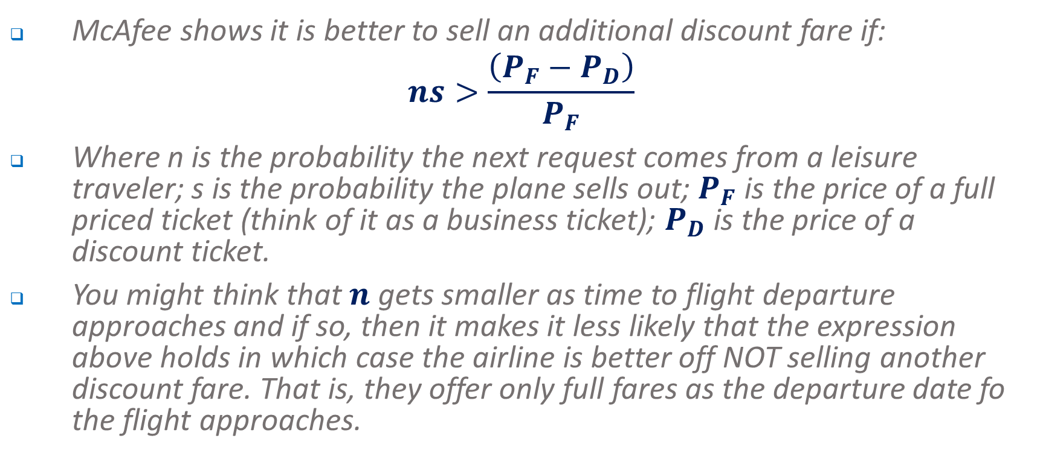
Profit maximising pricing – Yield management
McAfee shows it is better to sell an additional discount fare if:
$$ns>\frac{\left(P_{F}−P_{D}\right)}{P_{F}}$$
Where n is the probability the next request comes from a leisure traveler; s is the probability the plane sells out; $P_{F}$ is the price of a full priced ticket (think of it as a business ticket); $P_{D}$ is the price of a discount ticket.
You might think that $n$ gets smaller as time to flight departure approaches and if so, then it makes it less likely that the expression above holds in which case the airline is better off NOT selling another discount fare. That is, they offer only full fares as the departure date fo the flight approaches.

Slide 51
Price Dispersion - Sales
Last week we considered a models of sales.
We discussed sales in the context of game theory or strategic decision making.
In that case, we argued that by choosing a particular pricing rule the level of profits gained were independent of the price chosen and frequency of sales.
Given all firms followed the same rule, this meant that the firm could not change its behaviour (choose a different price or frequency of sales) to get higher profits.
Hence, there was no incentive for a firm to unilaterally change its behaviour so as to increase profits.

Slide 52
Price Dispersion - Sales
Consider sales model using the same principles (50 uninformed for each store and 120 informed buyers who only purchase if product is on sale).
Think about choice b/w everyday low pricing (NP) versus sales (SP).
Two pure strategy equilibria (assume SP=500, NP=600, cost=450).
 |  | Big W
 |  | No sale | Sale
Target | No sale | ($7500, $7500) | ($7500, $8500)
 | Sale | ($8500, $7500) | ($5500, $5500)

Slide 53
Price Dispersion - Sales
So what should each firm do? That is what mixed strategy is optimal? (DON’T WORRY ABOUT THE MATH HERE!!)
Let p(NP) be prob. charging normal price & let p(SP) be prob. charging sale price
p (NP) + p(SP) = p (NP) + [1- p(NP) ] = 1
Big W’s profit if it chooses the pure strategy of charging a sale price (SP ) while Target uses a mixed strategy:
EV (SP) = 8500p_{Target} (NP) + 5500p_{Target} (SP)
Suppose Big W chooses pure strategy of NP while Target uses a mixed strategy. This gives a payoff of 7500.
EV (NP) = 7500p (NP) + 7500p(SP)=7500
To identify mixed strategy equilibrium set payoffs for Big W under both pure strategies equal to each other:
EV (NP) = EV (SP) = 7500, or
p_{Target}(NP)(8500)+ p_{Target}(SP)(5500) = 7500 (i)

Slide 54
Price Dispersion - Sales
But note that:
p_{Target} (SP) + p_{Target} (NP)=1 (ii)
Solving for (i) and (ii)
p_{Target} (SP)=1/3 & p_{Target} (NP)=2/3
Note firms Target’s expected payoff:
EV (SP) = 1/3*(5500)+2/3*(8500) = EV₁(stay out) = 7500
So applying the same approach to Target, the equilibrium strategy for Big W is 1/3 probability of having a sale, i.e. p_{BigW}(SP)=1/3 & p_{BigW}(NP)=2/3 .

Slide 55
Price dispersion– Strategic Considerations
So that if the two firms choose randomly to have a sale with these probabilities, then we can show that the other firm has no incentive to change its own behaviour….
Implications?
Arise from competition over informed and uninformed customers.
Don’t necessarily represent the beginnings of price war.
Causes prices to fluctuate randomly.
Have distributions that are stable over time

Slide 56
Where to next?
Next week we look at Product Differentiation.

