Slide 1
Lecture 5 Product Differentiation

Slide 2
Product Differentiation- Outline
Transaction costs
What is value
How to create or increase it and capture it.
Diversification
Product differentiation

Slide 3
Product Differentiation - Reading
McAfee (2002), Competitive Solutions, Ch. 4.
https://opac.library.usyd.edu.au/search~S1/?searchtype=t&searcharg=competitive+solutions&searchscope=3&sortdropdown=-&SORT=D&extended=0&SUBMIT=Search&searchlimits=&searchorigarg=tcompetitive+solutions
Some parts of Brickley Ch. 8, but focus on lecture notes. .

Slide 4
Value Creation – Transaction Costs
Have not considered transactions costs so far – but yet they enter into almost every transaction between economic agents that we are concerned with.
What are they? Think about them in this context as the cost of interacting with other economic agents – in this case the firm and its customers. There are many definitions and examples and will include:
Search costs for consumers
Transport costs for buyers and sellers
Costs of learning product characteristics
Costs of negotiating and drafting contract for sellers.
Why are they important?
Consider the following supply and demand curve….

Slide 5
There are two supply curves here – one is the supply curve in the presence of TCs for producers, the other is the supply curve in the event that TCs are zero.
As usual, we can identify producer and consumer surplus – make sure you are familiar with what these are, check next slide
Price ($)
There are two demand curves here – one is the demand curve in the presence of TCs for consumers, the other is the demand curve in the event that TCs for consumers are zero.
We can also identify the consumer borne and the producer borne transaction costs
P*
In this case the question we really want to ask is what would happen if those TCs were reduced?
15
0
Quantity
0
Q*

Slide 6
Value Creation
First question is … what is value?
Simply think of it as the sum of producer and consumer surplus.
Net value to consumer is (wtp – price), i.e. CS.
Similarly, net value to seller is (price – MC), i.e. PS.
Hence total value equals (wtp – MC), i.e. TS.
It is important to note how to think about willingness to pay.
For cons. - reflects utility derived from consumption of good/ service
For business buyers it reflects the next best alternative – sugar versus corn syrup in soft drink production
As we have already considered in the context of pricing, it is important to note that wtp will vary over buyers.

Slide 7
Value Creation
How to create value?
In the context of the demand and supply curve diagram above a firm could:
Lower production costs or producer TCs
Reduce consumer TCs and shift the effective demand curve to the right
Otherwise shift demand
Create new products

Slide 8
Value Creation
Producer and production transaction costs
Walmart and Amazon in their warehousing and distribution networks; minimizing inventory costs; airlines turn around planes more rapidly and thereby reduce costs
Consumer transaction costs
Layout of stores; Amazon; Online booking for airline tickets; sellers offering try before you buy, thereby reducing the cost of identifying the product characteristics and quality
Increasing demand
Increasing product quality – with a caveat….
Pricing complements ….

Slide 9
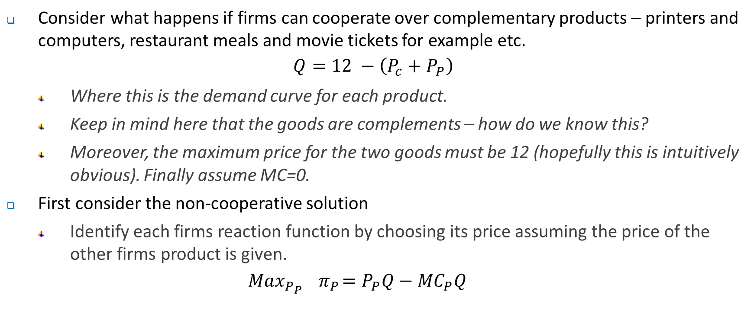
Value Creation
Consider what happens if firms can cooperate over complementary products – printers and computers, restaurant meals and movie tickets for example etc.
$$Q=12 −\left(P_{c}+P_{P}\right)$$
Where this is the demand curve for each product.
Keep in mind here that the goods are complements – how do we know this?
Moreover, the maximum price for the two goods must be 12 (hopefully this is intuitively obvious). Finally assume MC=0.
First consider the non-cooperative solution
Identify each firms reaction function by choosing its price assuming the price of the other firms product is given.
$${Max}_{P_{P}}{ π}_{P}=P_{P}Q−{MC}_{P}Q$$

Slide 10
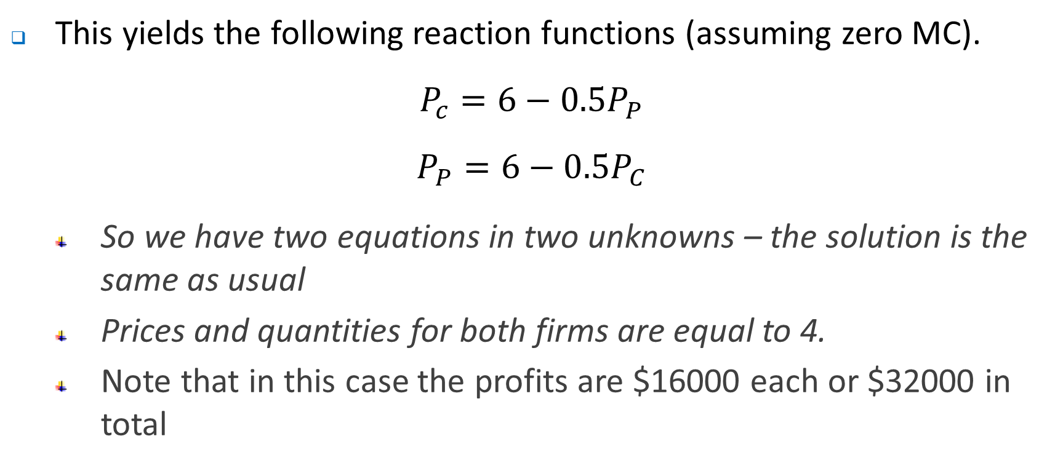
Value Creation
This yields the following reaction functions (assuming zero MC).
$$P_{c}=6−0.5P_{P}$$
$$P_{P}=6−0.5P_{C}$$
So we have two equations in two unknowns – the solution is the same as usual
Prices and quantities for both firms are equal to 4.
Note that in this case the profits are $16000 each or $32000 in total

Slide 11
P_{P}
12
CompuIncs’s (manufacturer of the computer) reaction function
In the non-cooperative solution, each firm take the others price as given and choose a price to maximize profits
6
4
PrintCo’s (manufacturer of the printer) reaction function
0
P_{C}
0
4
6
12

Slide 12
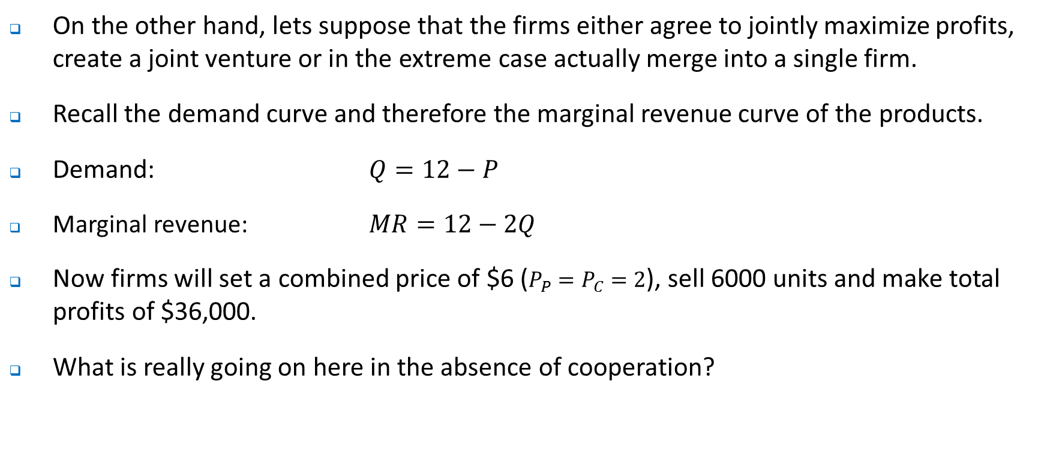
Value Creation
On the other hand, lets suppose that the firms either agree to jointly maximize profits, create a joint venture or in the extreme case actually merge into a single firm.
Recall the demand curve and therefore the marginal revenue curve of the products.
Demand: $Q=12−P$
Marginal revenue: $MR=12−2Q$
Now firms will set a combined price of $6 ($P_{P}=P_{C}=2$), sell 6000 units and make total profits of $36,000.
What is really going on here in the absence of cooperation?

Slide 13
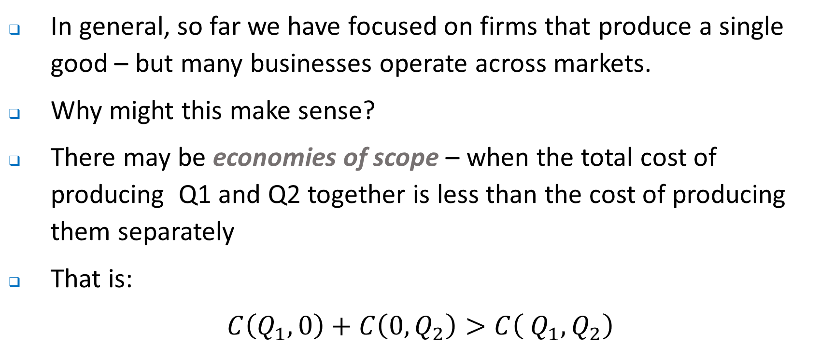
Diversification
In general, so far we have focused on firms that produce a single good – but many businesses operate across markets.
Why might this make sense?
There may be economies of scope – when the total cost of producing Q1 and Q2 together is less than the cost of producing them separately
That is:
$C\left(Q_{1},0\right)+C\left({0, Q}_{2}\right)>C\left({{ Q}_{1}, Q}_{2}\right)$

Slide 14
Diversification
Why diversification potentially offers positive economies, there will also be costs.
We shall consider some of these as we begin to discuss organisational structure in the next couple of weeks.

Slide 15
Product Differentiation
Lets return to the original question, how might you create and capture value?
One strategy is product differentiation
By making your self different or creating some uniqueness, i.e. offering a product no one else sells.
By doing so you create some market power.
Have already encountered this in the context of monopolistic competition and will build on that model.
Note that this could come through market entry or it could come from creating a new product in an existing market

Slide 16
Product Differentiation
Q^{n}: How to differentiate?
Quality differentiation – think of this as what we described as vertical differentiation. Everyone agrees the product is better.
Variety – horizontal differentiation.
Could think about horizontal differentiation as a choice over location – some people prefer to consume take-away closer to home ala Esme and Jose.

Slide 17
Product Differentiation
Recall that previously we considered the choice of location as capturing geographic location, and more importantly, that location was exogenous or fixed.
100 hungry customers evenly distributed along street
0
10
L
R
Esme’s sandwich shop
Jose’s taco shop

Slide 18
Product Differentiation
We don’t need to confine our differentiation to that of geography or physical location.
Consider …
Breakfast Cereals
Not sweet
Sweet
Chips
Healthy
Heart attack inducing
Movies
Period drama
Action

Slide 19
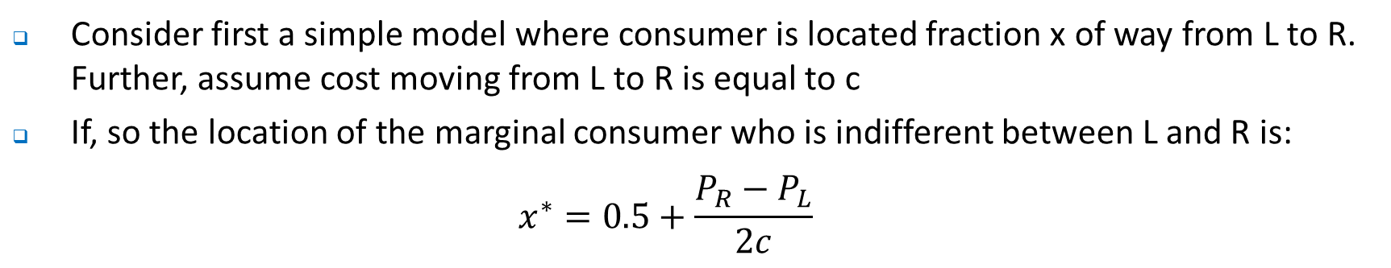
Product Differentiation
Consider first a simple model where consumer is located fraction x of way from L to R. Further, assume cost moving from L to R is equal to c
If, so the location of the marginal consumer who is indifferent between L and R is:
$$x^{∗}=0.5+\frac{P_{R}−P_{L}}{2c}$$
100 hungry customers evenly distributed along street
0
10
L
R
Esme’s sandwich shop
Jose’s taco shop

Slide 20
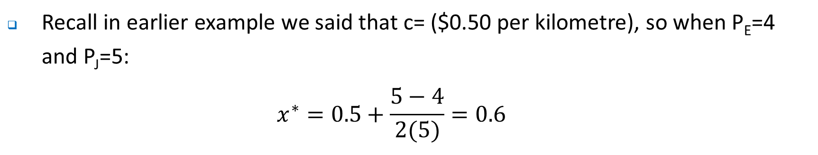
Product Differentiation
Recall in earlier example we said that c= ($0.50 per kilometre), so when P_{E}=4 and P_{J}=5:
$$x^{∗}=0.5+\frac{5−4}{2(5)}=0.6$$
100 hungry customers evenly distributed along street
0
6
10
L
x*
R
Esme’s sandwich shop
Jose’s taco shop

Slide 21
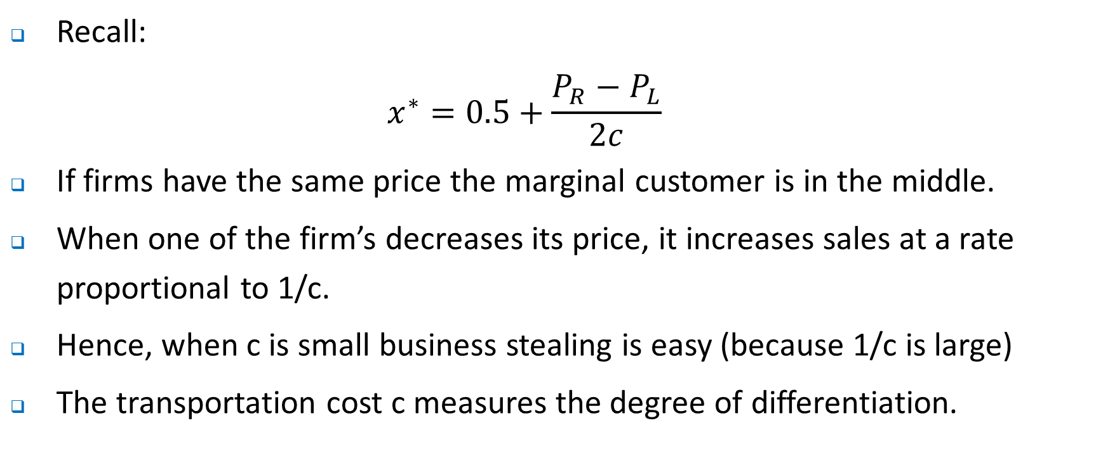
Product Differentiation
Recall:
$$x^{∗}=0.5+\frac{P_{R}−P_{L}}{2c}$$
If firms have the same price the marginal customer is in the middle.
When one of the firm’s decreases its price, it increases sales at a rate proportional to 1/c.
Hence, when c is small business stealing is easy (because 1/c is large)
The transportation cost c measures the degree of differentiation.

Slide 22
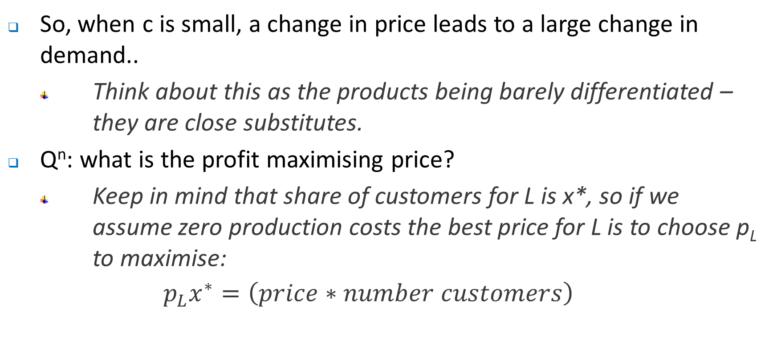
Product Differentiation
So, when c is small, a change in price leads to a large change in demand..
Think about this as the products being barely differentiated – they are close substitutes.
Q^{n}: what is the profit maximising price?
Keep in mind that share of customers for L is x*, so if we assume zero production costs the best price for L is to choose p_{L} to maximise:
$$p_{L}x^{∗}=\left(price∗number customers\right)$$

Slide 23
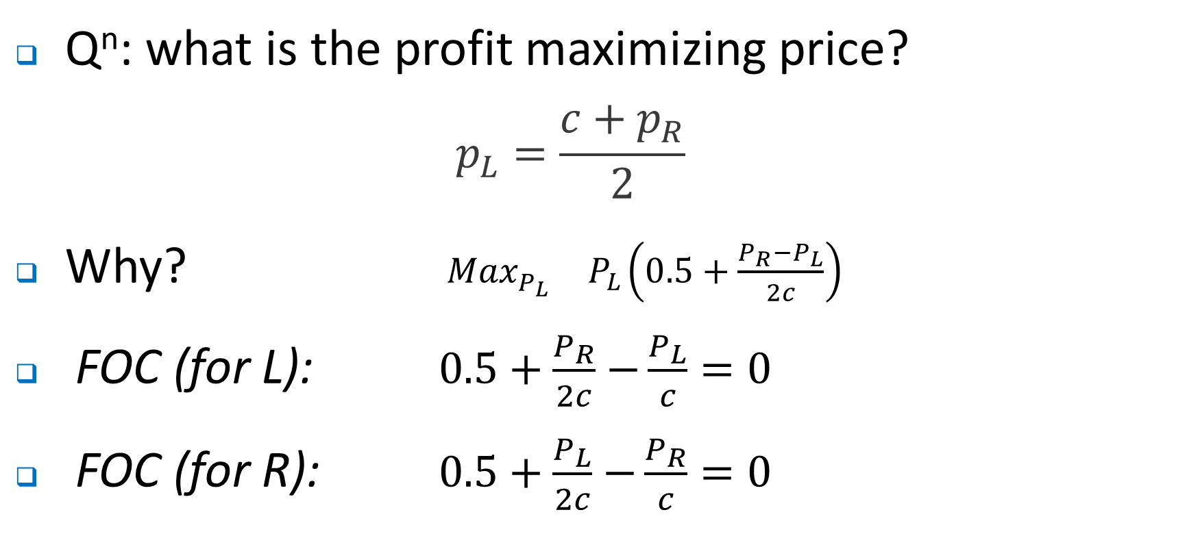
Product Differentiation
Q^{n}: what is the profit maximizing price?
$$p_{L}=\frac{c+p_{R}}{2}$$
Why? ${ {Max}_{P_{L}}^{}{ P}_{L}\left(0.5+\frac{P_{R}−P_{L}}{2c}\right)}^{}$
FOC (for L): $0.5+\frac{P_{R}}{2c}$ $−\frac{P_{L}}{c}=0$
FOC (for R): $0.5+\frac{P_{L}}{2c}$ $−\frac{P_{R}}{c}=0$

Slide 24
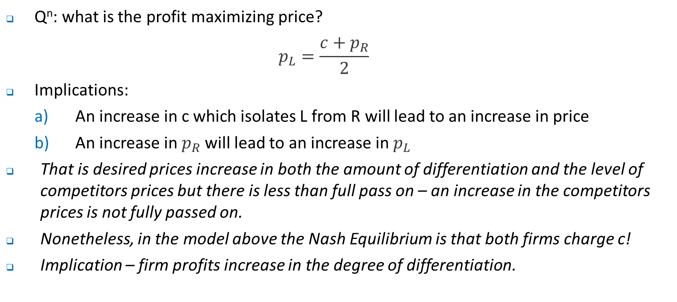
Product Differentiation
Q^{n}: what is the profit maximizing price?
$$p_{L}=\frac{c+p_{R}}{2}$$
Implications:
An increase in c which isolates L from R will lead to an increase in price
An increase in $p_{R}$ will lead to an increase in $p_{L}$
That is desired prices increase in both the amount of differentiation and the level of competitors prices but there is less than full pass on – an increase in the competitors prices is not fully passed on.
Nonetheless, in the model above the Nash Equilibrium is that both firms charge c!
Implication – firm profits increase in the degree of differentiation.

Slide 25
Product Differentiation – Endogenous location
Now ask what the model looks like if we hold prices constant. In this case the model becomes one of location choice.
Moving from L to R, this causes the marginal consumer to move from the L to the R.
Similarly, the firms on the R will have an incentive to move to the L, causing the marginal consumer to move from the R to the L….
L
R

Slide 26


Product Differentiation - Endogenous location
Q^{n}: where to the firms end up?
In the middle
This is why it is claimed that many firms end up offering something similar.
This reasoning is not just confined to firms, but also political parties who try to capture the middle ground.
Hence, we see two candidates who are very similar…
Or maybe not …….

Slide 27
Product Differentiation - Endogenous Location
Note that this result applies for two firms but not for many.
Suppose that there were four firms and they were all in the middle.
What do you think might happen?
Why?
So what might the result end up looking like?

Slide 28
Product Differentiation - Endogenous location
Consider what happens with four firms.
Assume that if firms are located at the same point they end up splitting the market. See next weeks tutorial but we would expect in this case…
Firms 1 and 2
Firms 3 and 4
0
0.25
0.75
1

Slide 29
Product Differentiation - Endogenous Prices
Q^{n}: What happens when prices are adjustable along with firm location?
When prices are flexible you want to be further away from your rivals.
When firms choose best responses (for fixed location) the price was equal to set price equal to c – the transportation cost between the two locations.
The higher this distance is the greater is the price and the greater are the profits for each of the firms.
The key constraint is that when you get further away from each other, what is likely to happen?

Slide 30
Product Differentiation - Endogenous Prices
Q^{n}: What does your location do to other firms price?
Turns out that when you move further away from your competitor you tend to increase your own price and also help your competitor.
Why?
Intuitively, for the competitor, the competition is further away and it has a higher price!
But then, the firm that moves away also gets a flow on benefit of the competitor raising its own price.

Slide 31
Product Differentiation - Endogenous Prices
So what does this mean for the real world?
McAfee identifies how an increase in legroom in one airline (American) was mostly copied by the others, but not all.
LCCs didn’t match majors in increasing legroom, but they should be able to increase price as there was less competition in the budget space.
But American’s optimal response to the increase in prices by the LCCs was to itself increase prices by a smaller amount, etc etc
See discussion in http://www.wsj.com/articles/why-the-big-three-airlines-are-so-much-the-same-1470850460

Slide 32
Product Differentiation
So what other patterns do we see?
Turns out that similar firms often locate near each other:
Fast food outlets.
Starbucks coffee outlets -
Car yards - Parramatta Road
Broadway
Business conglomerate where the customers are and customers go to where the businesses are
Sometimes there are complementarities in the products they sell such as on Broadway – people go there to see shows over the course of the year.

Slide 33
Product Differentiation
The lesson here?
Sometimes maximum differentiation works, other times it doesn’t.

Slide 34
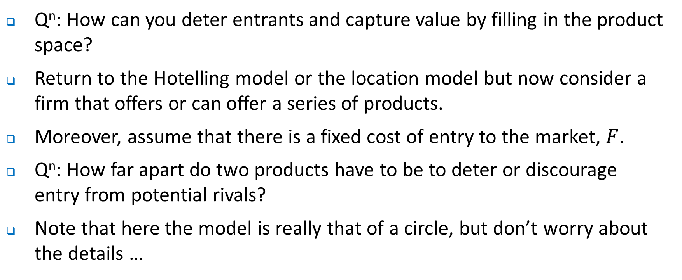
Product Differentiation - Preemption
Q^{n}: How can you deter entrants and capture value by filling in the product space?
Return to the Hotelling model or the location model but now consider a firm that offers or can offer a series of products.
Moreover, assume that there is a fixed cost of entry to the market, $F$.
Q^{n}: How far apart do two products have to be to deter or discourage entry from potential rivals?
Note that here the model is really that of a circle, but don’t worry about the details …

Slide 35
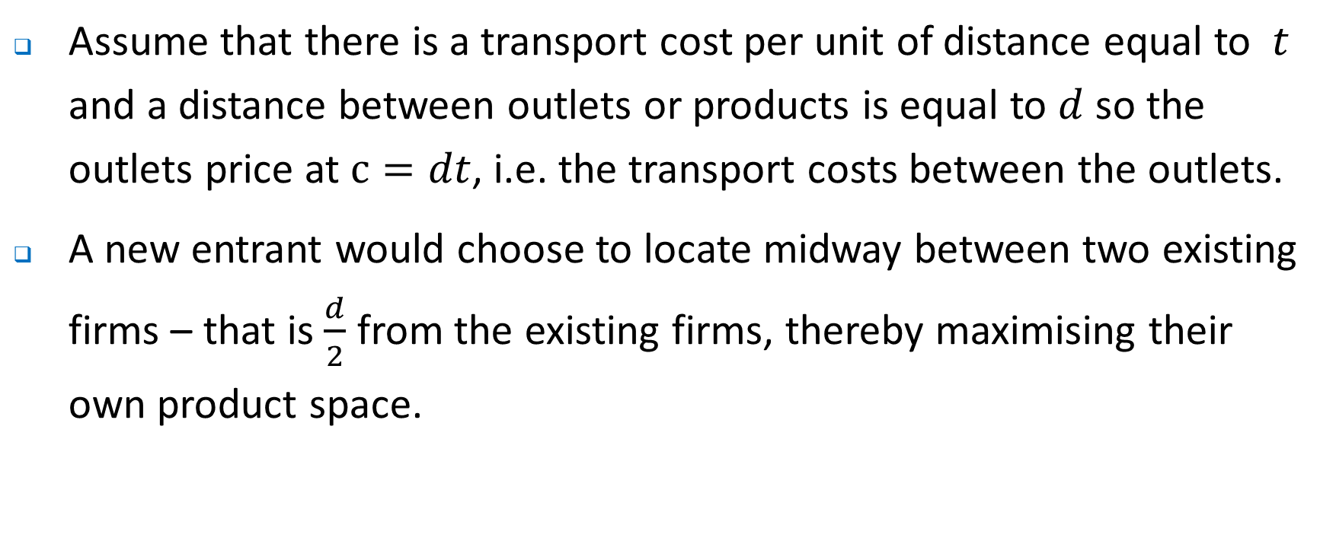
Product Differentiation - Preemption
Assume that there is a transport cost per unit of distance equal to $t$ and a distance between outlets or products is equal to $d$ so the outlets price at $c=dt$, i.e. the transport costs between the outlets.
A new entrant would choose to locate midway between two existing firms – that is $\frac{d}{2}$ from the existing firms, thereby maximising their own product space.

Slide 36
Product Differentiation - Preemption
L’s market
E’s market has length d/2
R’s market
L
R
d/2
d/2

Slide 37
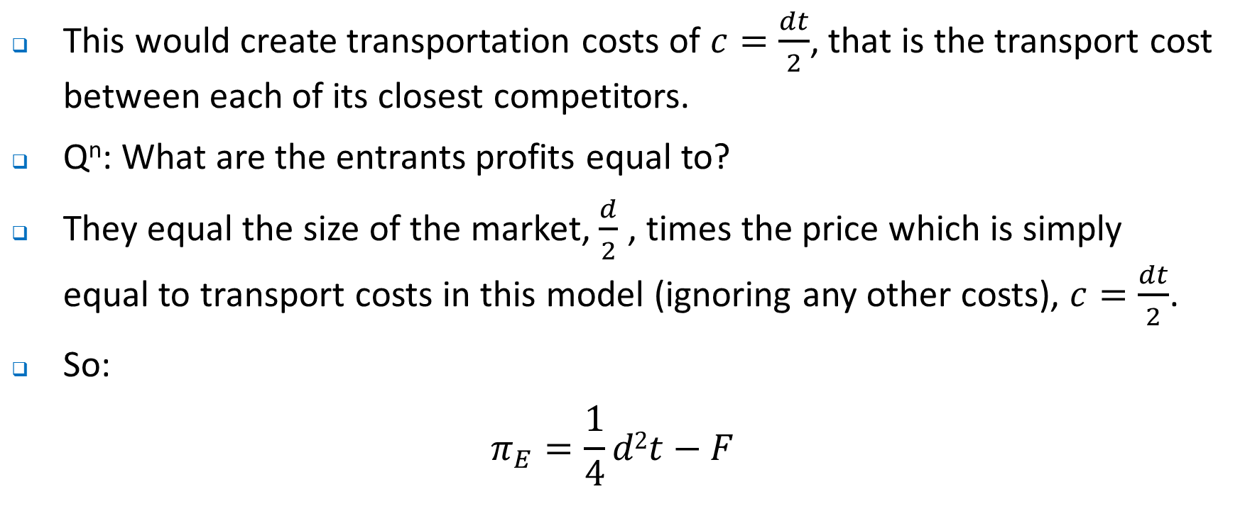
Product Differentiation - Preemption
This would create transportation costs of $c=\frac{dt}{2}$, that is the transport cost between each of its closest competitors.
Q^{n}: What are the entrants profits equal to?
They equal the size of the market, $\frac{d}{2}$ , times the price which is simply equal to transport costs in this model (ignoring any other costs), $c=\frac{dt}{2}$.
So:
$$π_{E}=\frac{1}{4}d2t−F$$

Slide 38
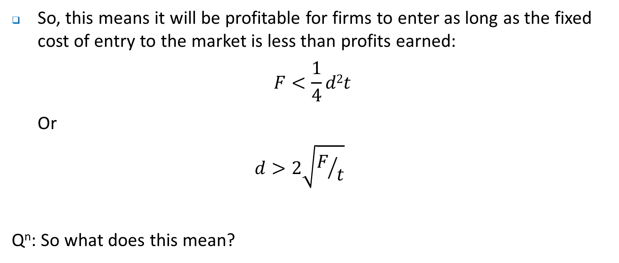
Product Differentiation - Preemption
So, this means it will be profitable for firms to enter as long as the fixed cost of entry to the market is less than profits earned:
$$F<\frac{1}{4}d2t$$
Or
$$d>2\sqrt{F/t}$$
Q^{n}: So what does this mean?

Slide 39
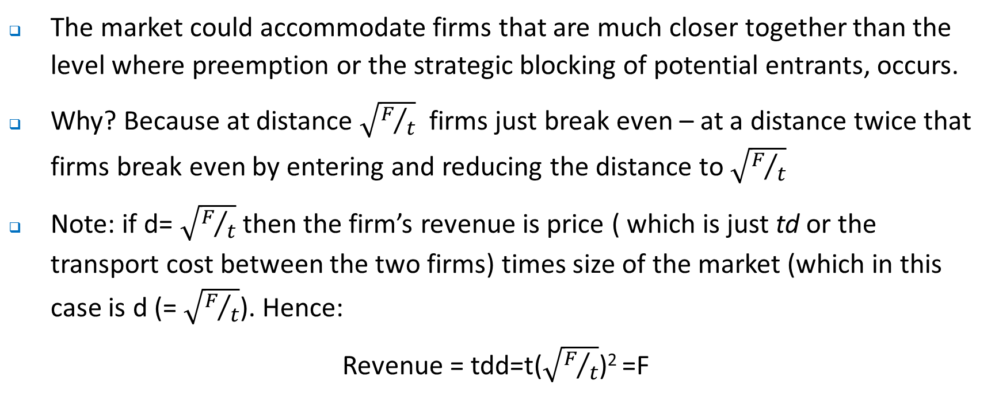
Product Differentiation - Preemption
The market could accommodate firms that are much closer together than the level where preemption or the strategic blocking of potential entrants, occurs.
Why? Because at distance $\sqrt{F/t}$ firms just break even – at a distance twice that firms break even by entering and reducing the distance to $\sqrt{F/t}$
Note: if d= $\sqrt{F/t}$then the firm’s revenue is price ( which is just td or the transport cost between the two firms) times size of the market (which in this case is d (= $\sqrt{F/t}$). Hence:
Revenue = tdd=t($\sqrt{F/t}$)² =F

Slide 40
Product Differentiation - Preemption
Preemption can occur with fewer products than would be sold in a competitive equilibrium with zero profits – the intuition is that by preempting you ‘tie up’ the available product space in such a way that after entry, the entrant is worse off than they would be in a competitive outcome, i.e. earning zero economic profits.

Slide 41
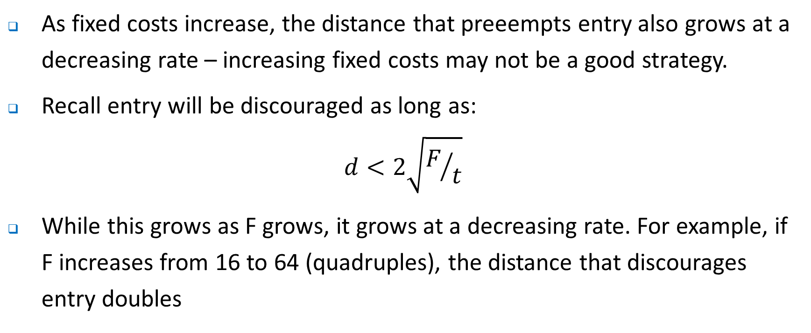
Product Differentiation - Preemption
As fixed costs increase, the distance that preeempts entry also grows at a decreasing rate – increasing fixed costs may not be a good strategy.
Recall entry will be discouraged as long as:
$$d<2\sqrt{F/t}$$
While this grows as F grows, it grows at a decreasing rate. For example, if F increases from 16 to 64 (quadruples), the distance that discourages entry doubles

Slide 42
Product Differentiation - Preemption
What types of fixed costs might act in this way to discourage entry?
You might think that some regulations represent a fixed cost that increases the burden on an entrant – these have to be increased by a lot to discourage entry.
Preemption – effectively filling the product space might be a better strategy particularly if its done at a low cost. What you do is effectively ensure that the distance between yourself and rivals is small enough to discourage entry.
Moreover, in a dynamic sense it may provide opportunities for firms to generate reputations around response to the entry of new firms that discourages such actions.

Slide 43
Where to next?
Next week we look start thinking about the firm, especially what a firm is, and what happens inside the firm.

