Slide 1
Lecture 6 What is a firm? Incentive Conflicts & Contracts

Slide 2
Outline
Discuss the view of the firm as a focal point of a series of contracts
Consider alternative views of the firm
Identify how contracts can resolve incentive conflicts
Differentiate adverse selection and moral hazard
Discuss agency costs
Consider implicit contracts and how they can sustain cooperation

Slide 3
Outline
Reading: Hart, O., 1989. An Economist's Perspective on the Theory of the Firm. Columbia Law Review, 89(7), pp. 1757-74.
Brickley, Smith Zimmerman, Managerial Economics and Organizational Architecture, Ch. 10. (To be added to Canvas)
http://web.mit.edu/rgibbons/www/ (Lecture Note 2: Relational Contracts )

Slide 4
The Sweet Life - Firms Misbehaving Badly…
RJR-Nabisco management had a ‘sweet life’.
Four questions to consider…
Managers do not always maximise profits – why? Think about management problems inside the firm
Besides the conflicts between shareholders and managers, what other conflicts might there be?
How can unproductive activities be curtailed?
Given unproductive activities can be curtailed, why do they still happen?
Let’s try to answer these questions by reconsidering our model of the firm

Slide 5
The Firm..
Use administrative fiat rather than the price mechanism to allocate resources.
Why?
Exchange or transactions in markets incur contracting costs which include search and information costs, bargaining and decision costs, drafting and enforcement costs…
Why does the price mechanism or markets work so well?
Uses information and knowledge efficiently – how is this captured?
Provides strong incentives
Which begs the question why do we have firms at all?
Per Coase, the aforementioned contracting costs are potentially important

Slide 6
The Firm
Our model of firms to this point is clearly wrong...
Single actor making profit maximising decisions.
Also, sometimes firms can use internal pricing systems to allocate resources – transfer pricing.
Lets think about different ways we can view the firm…

Slide 7
The Firm: Neoclassical model
Think of the firm as a set of production plans.
Strengths:
Nice from math perspective, rigourous but rudimentary.
Tractable – allows modelling how exo. changes affect firm behaviour
Useful for thinking about strategic behaviours under imperfect comp
Inputs
The firm or technology
Outputs

Slide 8
The Firm: Neoclassical model
Think of the firm as a set of production plans.
Weaknesses:
Says little or nothing about internal workings of firm – how decisions made etc
Ignores conflicts within the firm
No insight into what are the boundaries of the firm – no insight into mergers, splitting of firms into smaller firms, structure. Discussion of economies of scale does not really suffice.
Inputs
The firm or technology
Outputs

Slide 9
The Firm: Principal-agent theory
Builds on Neo-C model and emphasizes the role of incentive mechanisms.
Highlights conflicts defined by asymmetric information and limited observation. Manager makes choices that owners do not observe and may be in his/ her interests rather than that of the owners.
Owners cannot contract manager to maximise profit, but must use incentive schemes to align interests.
Strengths:
Enriches Neo-C model by recognising relationships in firm
Acknowledges challenges of resolving conflicts within firm

Slide 10
The Firm: Principal-agent theory
Weaknesses:
Doesn’t help in explaining boundaries of firm
Doesn’t provide insight into boundaries of the firm.
Hart discusses the example of Fisher Body and its relationship with GM. The former was a parts supplier to the latter.
The problem was that Fisher potentially had perverse incentives to make investments in equipment and machinery.

Slide 11
The Firm: Principal-agent theory
This led to a problem seen as once an investment was made, it might have been possible for one of the parties (GM or Fisher) to exploit their position of strength
While PA theory sheds light on what an optimal incentive scheme might look like – should Fisher and GM agree to a profit sharing scheme for example?
What it does not tells us whether the firms should merge, remain separate or something in between (a joint venture perhaps)
Principal-agent theory helps us understand optimal incentives contracts but not organisational form.

Slide 12
The Firm: Transaction Cost Economics
Building blocks are the TCs that are faced by agents when they ‘interact’.
TCs will sometimes be lower when the transaction is internalised – but this requires authority to make decisions
Authority and bureaucratic degree is what defines the firm, but there are costs and benefits that need to be considered when deciding whether to internalise a relationship into the firm rather than undertake it in the market. Those costs include error and rigidity costs
Strengths:
Provides insight into where the boundaries of the firm – where the costs and benefits of internalising versus externalising transactions are equalised.

Slide 13
The Firm – Transaction Cost Economics
Weaknesses:
TCs remain somewhat ambiguous – they may be important for Relationship Specific Investments (RSIs), i.e. those investments that have a lower value outside of the relationship for which the investment is made. Bringing the contract inside the firm might mitigate this. RSIs give rise to perverse incentives that can be partially resolved by internalising the transaction.
Questions remain - how is a refusal to do what is asked (by an employee for example) resolved?

Slide 14
The Firm: Nexus of Contracts
Think about the firm as a nexus of contracts with the common thread that the firm is always one of the parties to the contract.
Contracts from an economists perspective don’t need to be ‘enforceable legal agreement’ (lawyers definition).
Rather think of them as relationships characterised by reciprocal expectations and behaviour. Contracts can be implicit or explicit so an ‘understanding may arise that an employee who does a good job will get promoted’ (Brickley et al, p. 332).
Strengths:
Makes clear that there is a series of relationships that make up the firm
Weaknesses:
Doesn’t necessarily help us understand why firms take particular forms.

Slide 15
The Firm: Nexus of Contracts
Employee
Suppliers
Labour unions
Insurance providers
The firm
Owners
Bond holders
Banks/ lenders
Customers

Slide 16
The Firm: Property Rights Approach
Focus on non-human i.e. physical assets - control over these impacts of usage and division surplus.
Understanding the PRs are critical for identifying the incentives of agents when comprehensive long term contracts cannot be written.
What does this mean?
If Fisher is a separate company then GM must get Fishers agreement to supply more parts – Fisher has control over the non human assets and cannot be forced to do so. The story is different if Fisher is part of and owned by GM. When Fisher is independent, they (both manager and to a lesser extent employees) can ‘withhold’ labour and other assets.
This will have implications for the types of investments that GM and Fisher might make.
That is, the residual rights of control over assets will have implications for asset usage & division of surplus in a relationship.
“..(W)hen contracts are incomplete, the boundaries of firms are matter in that these boundaries determines who owns and controls which assets..”

Slide 17
The Firm: Property Rights Approach
Strengths:
Helps explain boundaries of the firm – complementary assets should be located within a firm to avoid hold up problems and reduce potential incentive problems
Weaknesses:
Doesn’t really incorporate information about separation of ownership and control.

Slide 18
Incentive Conflicts
Return to the fundamental story that economics tells us about …
Utility maximising economic agents.. managers are no different.
More generally, collection of parties that contract with firm are unlikely to have interests that are aligned.
E.g. actions that max. managers utility won’t in general be actions that max. utility of s/holders or owners.
What types of conflicts arise in firms?
Those between the owner and the manager the conflicts include ….
Effort choice – who really wants to work hard of they don’t have to?
Perks – we all enjoy the company car, the conference in exotic locations ….
Risk exposure – managers portfolio (both fin. & human capital) is different from that of firm’s owners
Different horizons
Overinvestment and empire building
What other types of conflicts might arise with other contracting parties? (Hint: think about other groups who are party to the contracts that make up the firm)

Slide 19
Incentive Problems and Contracts
How to resolve conflicts within (and outside) the firm?
Contracts are one important control mechanism, … but there are others including …
Contracts define an organization's architecture – who makes what decisions, and the rewards and penalties which flow from them.
As we shall see, implicit and explicit contracts can be used to align interests
Lets begin be considering a really simple (and somewhat unrealistic) example where there are no contracting costs

Slide 20
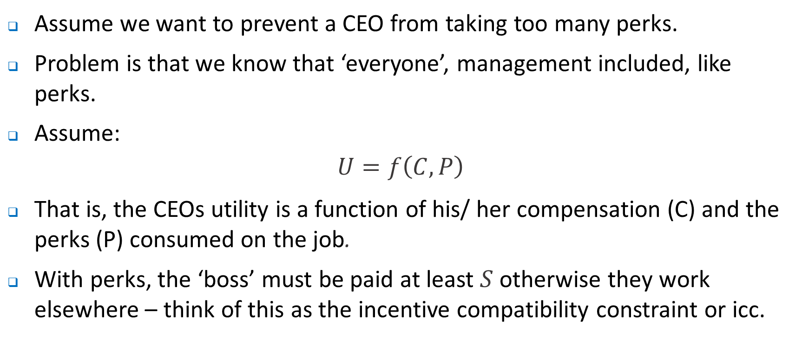
Incentive Problems and Contracts
Assume we want to prevent a CEO from taking too many perks.
Problem is that we know that ‘everyone’, management included, like perks.
Assume:
$$U=f\left(C,P\right)$$
That is, the CEOs utility is a function of his/ her compensation (C) and the perks (P) consumed on the job.
With perks, the ‘boss’ must be paid at least $S$otherwise they work elsewhere – think of this as the incentive compatibility constraint or icc.

Slide 21
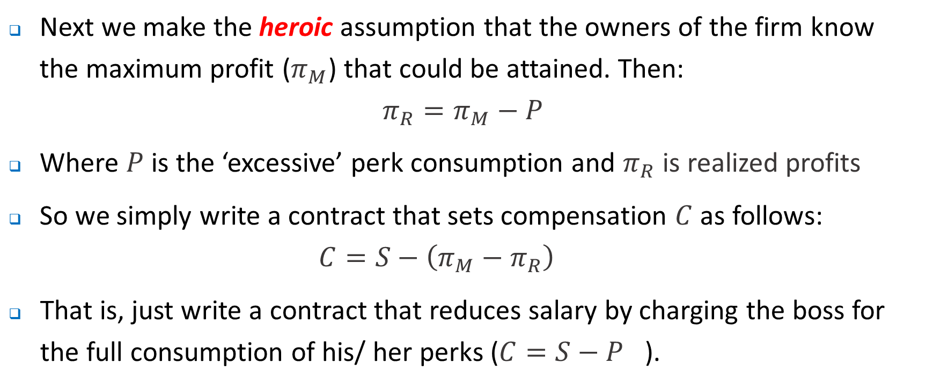
Incentive Problems and Contracts
Next we make the heroic assumption that the owners of the firm know the maximum profit ($π_{M}$) that could be attained. Then:
$$π_{R}=π_{M}−P$$
Where $P$ is the ‘excessive’ perk consumption and $π_{R}$ is realized profits
So we simply write a contract that sets compensation $C$ as follows:
$${C=S−\left(π_{M}−π_{R}\right)}_{}$$
That is, just write a contract that reduces salary by charging the boss for the full consumption of his/ her perks (${C=S−P}_{}$).

Slide 22
Cash compo ($)
S
At optimum, MRS equals the MRT=1
An interesting question might be whether this is always the case… and for what reasons
C*
Here the contract aligns the incentives of the manager and owner – whatever he consumes in perks is lost in salary.
0
$, exp. On perks
0
P*
S

Slide 23
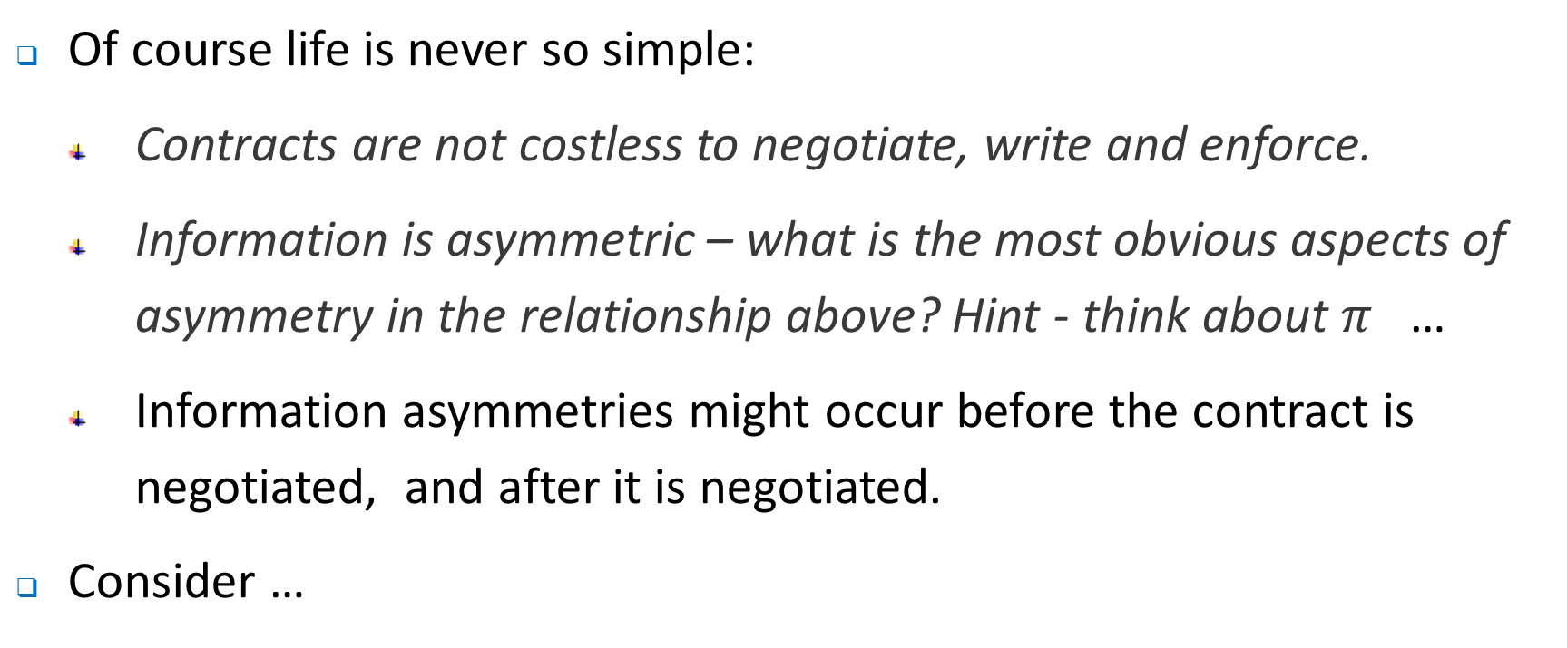
Incentive Problems and Contracts
Of course life is never so simple:
Contracts are not costless to negotiate, write and enforce.
Information is asymmetric – what is the most obvious aspects of asymmetry in the relationship above? Hint - think about $π_{}$…
Information asymmetries might occur before the contract is negotiated, and after it is negotiated.
Consider …

Slide 24
Post-contractual information problems
Agency relationship, i.e. relationships between principal and an agent:
Shareholders and Boards of Directors.
Boards delegate decision making authority to senior executives.
Tasks are assigned to successively lower level of employees ….
Agency problems arise because the interests of the principal-agent are not perfectly aligned.
Moreover, asymmetric information means that these contracting problems cannot be resolved costlessly. Monitoring costs will be incurred and bonding costs might be borne by agents.
Residual loss is the loss in gains from trade that result from the conflicts of interest in the agency relationship.

Slide 25
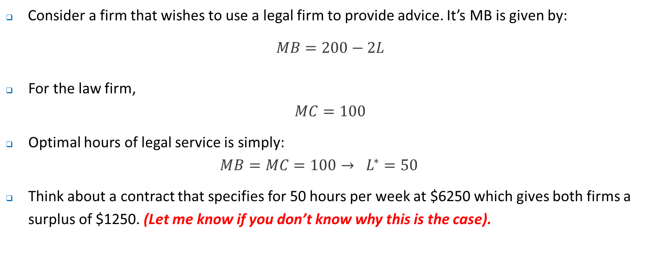
Post-contractual information problems
Consider a firm that wishes to use a legal firm to provide advice. It’s MB is given by:
$$MB=200−2L$$
For the law firm,
$$MC=100$$
Optimal hours of legal service is simply:
$$MB=MC=100→ L^{∗}=50$$
Think about a contract that specifies for 50 hours per week at $6250 which gives both firms a surplus of $1250. (Let me know if you don’t know why this is the case).

Slide 26
MC/ MB ($)
200
Surplus which is split equally.
Why?
100
0
L
0
50
100

Slide 27
Post-contractual information problems
What if the firm cannot easily (or at high cost) verify the amount of work that is actually done? If no contracting ends up occurring the potential surplus from the transaction is lost entirely.
Perhaps more realistically, they monitor the work of the law firm at a cost of $400 per week. The law firm may incur similar (bonding) costs to document its work. Think about the bonding costs as insurance costs that are paid by the agent that compensates the principal if the agent does not do the right thing – it might simply be a cost designed to ‘prove’ the work is done.
Will this resolve a problem of overbilling?

Slide 28
Post-contractual information problems
Probably not. Suppose that after 40 hours of legal work (more than under the no monitoring/ bonding regime) the law firm still bills for 50 hours. Anticipating this, the firm requiring legal services contracts for 50 hours but at a lower price of $5200 – less than when there are no incentive problems.
End result demonstrated in next slide…,

Slide 29
MC/ MB ($)
200
Surplus after taking into account agency costs ($1600).
Costs incurred by each company - $400 each.
These also reduce the surplus from the transation
Residual loss – loss of surplus that occurs because not efficient to resolve incentive problem completely. In this case equal to $100
100
0
L
0
40
100

Slide 30
Post-contractual information problems
So the net benefit for each company now is $800 – recall that previously it was $1250
The company that wanted the legal services gets $6,400 – ($5200) - $400
The company that provided the legal services gets $5,200 – ($40 x 100) - $400
Note that here, as in the original problem, the assumption was that the parties to the transaction split the gains from trade

Slide 31
Precontractual Information Problems
Bargaining failures – sometimes because of information asymmetries mutually advantageous trades are simply never made….think about bargaining between agents where surplus exists but is not generated.
Adverse selection – tendency of an agent with private information which affects the potential trading partners costs or benefits to extend an offer to the potential trading partner….
Classic case is insurance – health insurance is a case in point, but it applies to all types of policies.
Various ways to overcome them, but none are perfect. Moreover, they can often be costly.
Market for lemons is a classic example. Recall the problem here, and the potential solution.

Slide 32
Precontractual Information Problems
In the context of postcontractual information problems, the classic one is moral hazard
Moral hazard– one of the agents that are party to a contract acts opportunistically after the contract has been entered interest. That is, the agent acts in their own interests and inconsistently with the interests of the principal.
Insurance – car insurance is a case in point, but it applies to all types of policies.
Various ways to overcome them, but none are perfect. Moreover, they can often be costly.

Slide 33
Implicit Contracts and Reputational Concerns
We have already encountered reputational concerns in the case of Anna and Bert …
Recall….

Slide 34
Single Period Setting
Anna and Bert.
Can work or shirk.
Solution is that they both shirk – may be able to relate to this with some of your colleagues…..
 |  | Bert
 |  | Shirk | Work
Anna | Shirk | ($1000, $1000) | ($3000, $0)
 | Work | ($0, $3000) | ($2000, $2000)

Slide 35
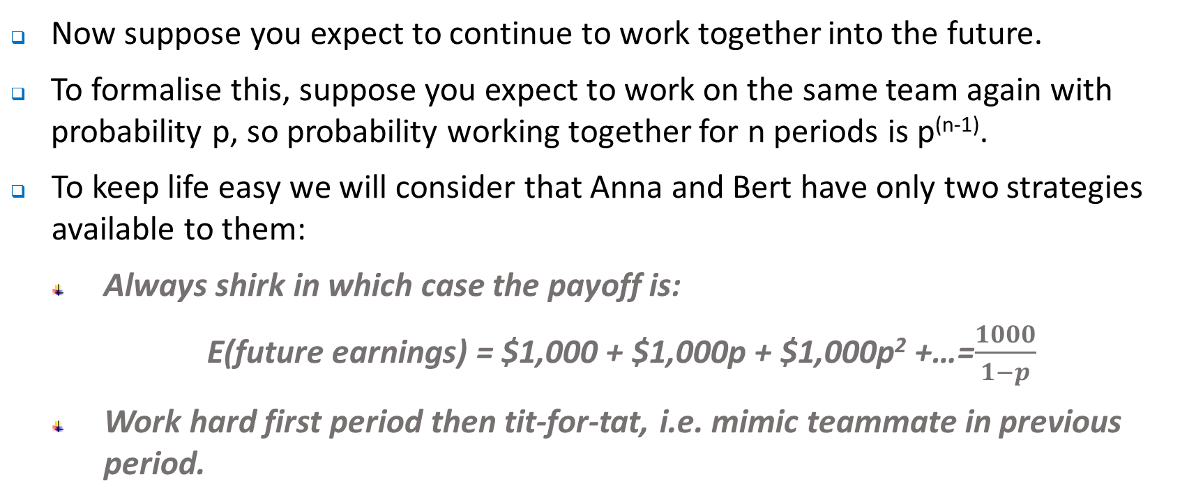
Repeated Interaction
Now suppose you expect to continue to work together into the future.
To formalise this, suppose you expect to work on the same team again with probability p, so probability working together for n periods is p^{(n-1)}.
To keep life easy we will consider that Anna and Bert have only two strategies available to them:
Always shirk in which case the payoff is:
E(future earnings) = $1,000 + $1,000p + $1,000p² +…=$\frac{1000}{1−p}$
Work hard first period then tit-for-tat, i.e. mimic teammate in previous period.

Slide 36
Repeated Interaction
Anna and Bert.
Can work or shirk.
If Anna and Bert think the other will shirk then ..
But if they each think the other will play tit-for-tat it is in the interests of each to do so…
 |  | Bert
 |  | Always Shirk | Work then Tit-for-tat
Anna | Always Shirk | ($1000/(1-p), $1000/(1-p)) | ($2000+$1000/(1-p), -$1000 +$1000/(1-p))
 | Work then Tit for tat | (-$1000 +$1000/(1-p), $2000+$1000/(1-p)) | ($2000/(1-p), $2000/(1-p))

Slide 37
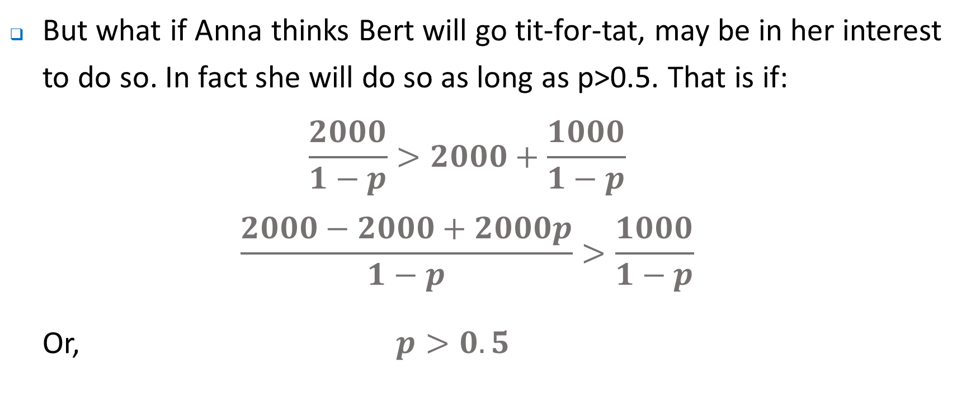
Repeated Interaction
But what if Anna thinks Bert will go tit-for-tat, may be in her interest to do so. In fact she will do so as long as p>0.5. That is if:
$$\frac{2000}{1−p}>2000+\frac{1000}{1−p}$$
$$\frac{2000−2000+2000p}{1−p}>\frac{1000}{1−p}$$
Or, $p>0.5$

Slide 38
Single Period Setting
Anna and Bert.
So if p=3/4 – two equilibria are possible.
Initial expectations matter
So what should a firm do …? What expectations might it foster?
 |  | Bert
 |  | Shirk | Tit-for-tat
Anna | Shirk | ($4000, $4000) | ($6000, $3000)
 | Tit-for-tat | ($3000, $6000) | ($8000, $8000)

Slide 39
Implicit Contracts and Reputational Concerns
Now lets consider another example.
Implicit contracts – promises and understandings that are not formalised within legal documents.
Promises of a promotion for a job well done
Understandings that quality will be maintained.
Implicit contracts – how can they be ‘enforced’?
Reputational concerns might be very important – each parties reputation must be valuable enough to ensure contracts are adhered to.
Consider …

Slide 40
Implicit Contracts and Reputational Concerns
Consider a simple ‘trust game’ in which one party decides whether or not to trust the other party when they promise that they will be rewarded if they work hard. Could also be used as a model of a bonus based on subjective performance evaluation.
 |  |  | Honour | ($1, $1)
 | Trust
 |  |  | Betray | (-$1, $2)
 | Not trust | ($0, $0)
Player 2
Player 1

Slide 41
Implicit Contracts and Reputational Concerns
Now consider what happens if we play the game repeatedly
Assume that the interest rate for the purpose of discounting equals r.
Assume players play a ‘trigger strategy’ (similar to Bert and Anna)
Player 1: play ‘Trust’ in first period. Thereafter if all moves in all previous periods have been ‘Trust and Honour’, play ‘Trust’. Otherwise play ‘Not Trust’.
Player 2: If Player 1 plays ‘Trust’ this period, play ‘Honour’ if all moves in all previous periods have been ‘Trust and Honour’, otherwise play ‘Betray’.
An unforgiving set of strategies
What happens?
Trigger strategies are a Nash Equilibrium of the infinitely repeated game as long as player 2 is patient enough (or the interest rate is sufficiently small).

Slide 42
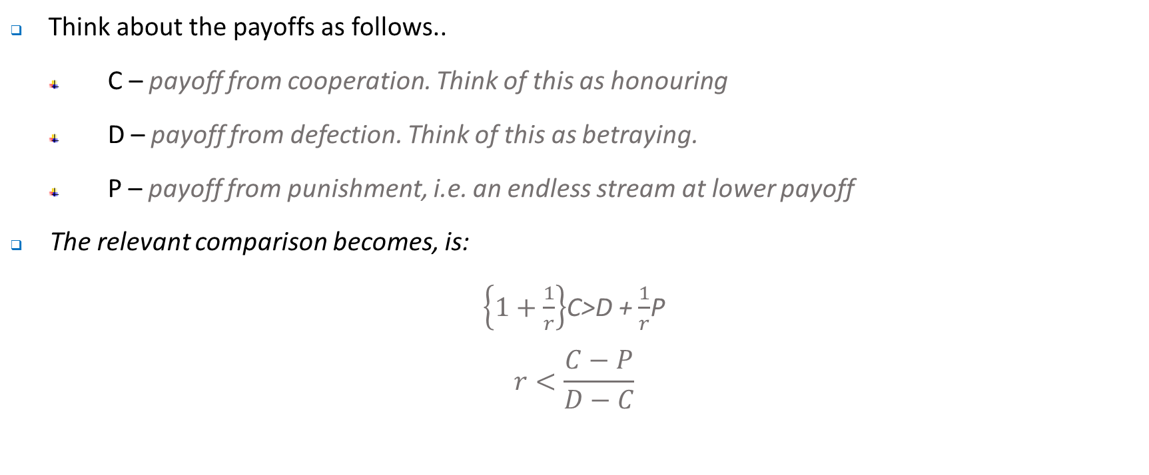
Implicit Contracts and Reputational Concerns
Think about the payoffs as follows..
C – payoff from cooperation. Think of this as honouring
D – payoff from defection. Think of this as betraying.
P – payoff from punishment, i.e. an endless stream at lower payoff
The relevant comparison becomes, is:
$\left\{1+\frac{1}{r}\right\}$C>D + $\frac{1}{r}$P
$$r<\frac{C−P}{D−C}$$

Slide 43
Implicit Contracts and Reputational Concerns
So if r is sufficiently small then it is optimal to cooperate.
Some lessons…
‘Grow the value’ of the relationship – (C-P). A cooperative outcome is more likely if the parties do better together than apart
Be aware that at some point the calculation might change. – no layoffs pledge was unsustainable when PCs reduced the demand for mainframes, the implicit contract between IBM and its employees broke down (see Gibbons note).
From the previous point – know when to quit.

Slide 44
Where to next?
Begin to think more about the firms organisational architecture

