Slide 1
Lecture 7 Organisational Architecture & Decision Making

Slide 2
Reading
You should read Jensen and Meckling (1995) ‘Specific and General Knowledge and Organisational Structure’, Journal of Applied Corporate Finance 8(2), pp. 4-18
Chapter 5, Lazear, E. and M. Gibbs (2007) ‘Personnel Economics in Practice’, Wiley. (available on Canvas)
Chapters 11-13 of Brickley, Smith Zimmerman, Managerial Economics and Organizational Architecture. (Optional)

Slide 3
Outline
Why firms?
Identify distinction between general and specific knowledge
Consider implications for organisational structure and decision making
Appendix: alternative architectural structure of a firm. Non examinable
Appendix: Describe the costs and benefits with different firm or organisational structures. Non examinable

Slide 4
Markets and Firms
Consider the fundamental problem for ‘markets’ or the firm:
Produce output customers want at the lowest possible cost.
Adam Smith referred to the ‘Invisible Hand’
The key thing was that a decentralised economy could be very efficient.
Much more so than a ‘centrally planned’ one ala the Soviet Union.
Why?

Slide 5
Markets and Firms
Markets are a form of collective intelligence, i.e. a powerful information system that is not easily replicated.
Markets:
Effectively use dispersed knowledge.
Provide powerful incentives
Great sources of innovation and adaptation.

Slide 6
Markets and Firms
Does this mean central planning is useless?
Maybe, maybe not.
Easy to think of situations where markets don’t allocate resources very well:
Economies of scale and natural monopoly.
Public good problems.
Externalities, both positive and negative. For example positive network externalities or technology spillovers.

Slide 7
Markets and Firms
So how does this relate to the firm?
Focus on knowledge or information and how it is used.
Markets help resolve information and incentive problems via the price mechanism – but this is ‘suspended in firms’.
Ideally a firm will structure itself and have systems and processes in place so that:
Uses both central and local knowledge effectively.
Decisions are coordinated as needed.
Provide strong incentives to make well coordinated decisions.
Individuals in the organisation innovate and adapt.
That is it will achieve a balance of centralised and decentralised decision making.

Slide 8
Markets and Firms
So what happens in firms?
An organisational architecture/ structure defined by the set of implicit and explicit contracts that define the firm will:
Specify decision rights vis-a-vis job descriptions.
Performance evaluations will identify who is doing a ‘good’ job.
Compensation schemes will reward (and punish) decision makers.
Over the next few weeks we will discuss each of these components of organisational structure/ architecture.
So what are the costs and benefits of more decentralised decision making in firms?

Slide 9
Centralisation and Decentralisation
Consider a very simple example of a firm that operates across two markets – Perth and Sydney.
Suppose that there is a CEO (In Sydney) and local managers in Perth and Sydney. Brickley et al use an example of ‘Automart’ – which sells automobiles across two markets.
Who should have power over pricing decisions?
Should it be the CEO? That is should it be centralised? Why?
What might be the benefits of decentralising the decision to the local manager?

Slide 10
Markets and Firms
How might pricing decisions in each market be allocated?
The CEO could specify prices in both markets (centralisation).
The decision could b decentralised to each local manager.
The decision for both markets could be decentralised to a single local manager.
Any decentralisation could have limits impose on them….
So what are the costs and benefits of such approaches and decentralised versus centralised decision-making more generally?

Slide 11
Centralisation and Decentralisation
Benefits of centralisation or centralised decision making:
Economies of scale or public goods – there may be ignored at ‘local’ level, e.g. advertising or purchasing decisions.
Avoids some difficult incentive issues – you need to incentivise local decision makers
Better use of ‘central knowledge’
Coordination – allows complementarities and interdependencies to be factored into the decisions in the case of centralisation

Slide 12
Centralisation and Decentralisation
Benefits of decentralisation or decentralised decision making:
Save management time for really important (strategic) decisions.
Develop management skills.
Creates a more enriched job environment and potentially an important training and motivation incentive tool.
Avoids need to transmit information - this may be costly in time and money terms
Exploits specific knowledge – allowing more rapid responses to changes in market conditions.

Slide 13
Knowledge
Consider the distinction between:
General knowledge - knowledge that is inexpensive to transmit
Specific knowledge - knowledge that is costly to transmit among agents.
Because of the cost of transmitting it, specific knowledge creates two challenges:
The rights assignment problem – who should exercise a decision right?
Control or agency problems – how to ensure the agent acts in a manner consistent with the interests of the agent.

Slide 14
Alienability
In a capitalist economy (markets) the problem posed by knowledge is solved via alienability. Decision rights are alienable:
They can be sold and the proceeds of sale captured by the owner.
This is what is really meant by term property right.
This of course is not what happens in organisations where decision rights and their alienability are generally not delegated.
So how do organisations solve the rights assignment and control problem? Through some alternative systems and procedures.
Ultimately, distribution of knowledge and decision rights is central to understanding organisations and organisational structure

Slide 15
Knowledge – the fundamental problem
There is a given fixed amount of knowledge that is available at any one point in time. Given the capacities of humans - storing, processing, transmitting and receiving knowledge is costly.
In some cases we want to colocate the knowledge with the decision authority to make decisions. How to do this? We could move the knowledge to the decision maker, or the assign the decision making authority to the knowledge holder.
In a market economy – the ‘best’ outcome is achieved by optimising decisions on the part of individuals whereby decision rights are acquired or knowledge is acquired by those with decision rights

Slide 16
Knowledge – the cost of transfer
The more costly knowledge is to transfer, the more specific it is. The less costly it is to transfer knowledge the more general it is.
Note here that transfer is more than ‘buying a book’ – it requires understanding the knowledge and how to use it.
In many cases specific or idiosyncratic knowledge is accumulated as a by-product of engaging in everyday activities. Think about it as all the nitty gritty detail. But is costly to transmit in part because time is money – you need to take advantage of it immediately to profit from any arbitrage opportunities.
Ultimately knowledge can be transferred - the question is whether the gains from doing so outweigh the costs of doing so.

Slide 17
Knowledge – the cost of transfer
General knowledge can be transmitted quickly through summary stats – prices and quantities are good examples.
But note the very different types of knowledge required depending on what you want to achieve – it you want to fill a half-empty tanker than what you need to do have knowledge about times and locations, space that is available and perhaps who wants to use it. But if you are thinking of a business of doing this the knowledge requirements are very different to those of the entrepreneurs wanting to make some cash in a particular case.

Slide 18
Decision Rights
Decision right – the right to decide on and take an action.
What does ‘ownership’ over the decision right actually mean? It means you have the right to dispose of something and retain the proceeds. What is sold is actually a bundle of decision rights around that article rather than the article per se.
Jensen and Meckling refer to these as alienable rights. We can also think about them as property rights.
The key thing is that a market system provides incentives to ensure that these rights end up in the hands of those who value them most highly.

Slide 19
What Alienability Does
Alienability is a combination of the right to transfer/ sell, and the right to capture the proceeds of exchange. It is the foundation of markets and the means by which knowledge and decision rights are collocated. It, alienability, solves the rights assignment problem and the control problem.
That is, alienability ensures that markets result in:
Knowledge is colocated with decision rights
Effectively controls decision makers by determining what they can and cannot do

Slide 20
What Alienability Does
The key thing is that alienability and the process of voluntary exchange ensures that knowledge and decision rights are allocated in an optimal way.
What’s more, market prices reflect the capital value of those rights and ensure they are allocated efficiently because they:
Measure performance of those who have the decision rights to how assets are used.
Effectively reward or punish holders of the decision rights

Slide 21
What Alienability Does
But, think about a firm where this alienability of decision rights is suspended!
Why? What is the benefit of such an arrangement?
Perhaps there are benefits from economies of scale or scope, or the reduction in TCs. That is, firms must gain a net benefit from the suppression of the alienability of decision rights.
Perhaps more importantly, the organisation or firm allows the knowledge to be collated under one ‘hat’.
Nonetheless the problem remains: how to ensure that the benefits associated with alienability are not lost in the firm. In particular, the incentives to make good decisions by virtue of the capitalised value of the decision right being incurred by the holder of the decision right.

Slide 22
What Must Firms do?
What must firms do?
They must tradeoff or balance:
Information Costs – information cannot be centralised other than at very high costs. There must be decentralisation so that the decision rights are assigned to those with the information needed to make good decisions. Information costs will fall as decision rights are assigned to those who have the specific knowledge required to support good decisions.
Agency costs – the sum of the costs of designing, implementing and maintaining an appropriate incentive control system plus any residual loss.

Slide 23
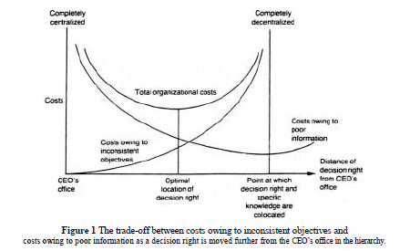
What Must Firms Do?
The firm will want to minimise total organisational costs – those associated with poor information and inconsistent incentives or agency costs. This is demonstrated in figure 1 in Jensen & Meckling.

Slide 24
What Must Firms Do?
How?
They can achieve this trade-off by designing an appropriate incentive and control system. That is a set of rules.
This will involve ensuring that the ‘right’ hierarchy is in place and that the appropriate rules and incentives that government decision rights are in place alongside this. There will of course, be some ‘optimal amount of decentralisation’.

Slide 25
So What Does the Firm Do?
Partition decision rights.
Create a control system that measures performance and provides incentives.
How to partition decision rights? There is a discussion of means by which this might be achieved including job descriptions and ‘internal common law’, budgeting, rules and regulations within the organisation etc.
How to create control systems and incentives? Specify appropriate performance measures and a reward/ punishment system. Of course, different ways of doing this creates different sometimes undesirable incentives. If we think about a ‘cost centre’ in an organisation for example, what might be the problem with measuring performance by simply focussing on cost?

Slide 26
Who makes decisions?
Suppose a plant manager is told to cut costs by 10 percent.
Decisions can be characterised in four stages:
Initiatives – identification of options (cutting staff, better terms from suppliers etc).
Ratification – choose among different options.
Implementation – ask what tactics to use, i.e. how to achieve desired outcome.
Monitoring
You may wish to:
Decentralise (i) and (iii) – sometimes referred to as decision management.
Centralise (ii) and (iv) – for (ii), want to ensure consistency with other actions - sometimes referred to as decision control.

Slide 27
Who makes decisions?
Balances use of specific and general knowledge and recognise incentives.
Brickley et al. refer to the presence of a board of directors in some organisations.
While the CEO has responsibility for decision management (the initiation and implementation of major projects for example), the board exercises decision control by ratifying and monitoring decisions.
Such an arrangement has the potential to mitigate potential incentive problems.
Of course, this may not be an option in smaller organisations but in those cases, the incentive problem is often much more muted.

Slide 28
Flat versus Hierarchical Structures
So what type of decision making structure should a firm adopt?
Flat structures give individuals control over decision making.
Hierarchical structures allow ‘higher levels’ to veto lower level decisions
Consider what each offers…

Slide 29
The Error Trade-off
Consider a firm that is weighing up whether to branch out into a new line of clothing.
Two types of errors could be made:
False positive – accept an unprofitable option.
False negative – reject a profitable option.
Trade-off is possible because it is always possible to avoid one type of errors.
‘Always reject’ means there is no false positives; ‘always accept’ means there is no false negatives.

Slide 30
The Error Trade-off
False negative error: reject a good project given that it is good
Reject all projects
1
Accept all projects
False positive error: accept a bad project given that it is bad
1

Slide 31
What Authority Structure to Use?
Hierarchy
Flat
Gladys
Gladys
Willie
Willie
Under a flat structure, either the lower level employee or other employee (Gladys) can make a decision to accept or not.
Under a hierarchical structure, the lower level employee makes recommendations that are accepted or not. That authority lies ‘further up’ the hierarchy with Gladys.

Slide 32
Authority Structures
Hierarchical – reduces false positives (accept a bad project) and increases false negatives (reject good proposals) .
Flat– reduces false negatives and increases false positives
Why?
With a hierarchical structure two sets of eyes go over a project so test is more stringent.
Fewer decisions will be made – hence less opportunity to accept unprofitable projects and fewer good projects assessed and accepted.
An alternative might be a ‘second opinion’ – both review all projects and then:
Agreement means decision is made.
Disagreements resolved by some other rule.

Slide 33
Authority Structures and Errors
False negative error: reject a good project given that it is good
Under a second opinion structure, even if Willie rejects a proposal Gladys still reviews it. So, if half the time the good projects end up being accepted, then there will be fewer false negative. But there may also be more false positives because a project rejected by Willie gets a second look and might be accepted.
1
Hierarchical structure
Second opinion structure
Flat structure
False positive error: accept a bad project given that it is bad
1

Slide 34
Payoffs
One question is what type of structure to use.
Consider a firm facing a small upside risk and a large downside risk.
Frequency
Payoff

Slide 35
Payoffs
Doing job well gives a small payoff.
Doing a bad job is catastrophic, i.e. $bn loss in the case of Exxon Valdez where alcohol was a consideration. The ‘project’ here is deciding to proceed before being sober.
Want to minimise false positives (accepting an unprofitable ‘project’) and willing to accept higher levels of false negatives (rejecting profitable options).
Proceeding while intoxicated and having an accident is a false positive (i.e. accept the ‘challenge’ of going through straits even though it leads to an accident)
Sobering up before proceeding when proceeding would not have led to an accident is a false negative (reject proceeding even though you may make it through the strait without an accident)
In this situation wat to reject false positives because they are so costly, therefore a hierarchical structure is better.

Slide 36
Payoffs
Consider a firm facing a small downside risk and a large upside risk.
Frequency
Payoff

Slide 37
Payoffs
Doing ‘job well’ gives a large payoff.
Doing a bad job means there is only a small loss – the investment in the project is limited.
Flat structure that give individuals the opportunity to make decisions and little supervision reduces the likelihood of a false negative – i.e. rejecting a profitable project
Think about start up firms where there are opportunities that can potentially lead to large payoffs.
Encourages creativity.

Slide 38
Making Better Decisions
Recall our earlier characterisation – how do we get to the dotted line?
False negative error: reject a good project given that it is good
1
False positive error: accept a bad project given that it is bad
1

Slide 39
Making Better Decisions
Doing so is costly and requires investing in some ‘technology’ such as better evaluators.
Consider the example discussed in Lazear (pp. 134-36)
Planes can take the ‘quick route’ through a storm but at the risk of an accident.
Alternatively, they can take the long way around the storm.
Assume that a crash is associated with a large loss of $1bn.
Discuss previously suggests that a hierarchical structure works best here because of the large downside risk. But here the situation is a little different.
WHY?
Hint: think about the pilots our interests and how they align with that of the airline.

Slide 40
Making Better Decisions
Consider the expected cost of going through the storm:
Expected cost = (10⁻⁵)(-$1bn) + $17,000 = $27,000.
Note that the costs here are the cost of the crash (probability weighted) and the fuel
Expected cost = (10⁻⁵)(-$1bn) + $17,000 = $27,000.
Expected cost = $10,000 + $17,000 = $27,000.
Consider the expected cost of going around the storm:
Expected cost = (10⁻⁹)(-$1bn) + $20,000 = $20,001
Here it is all good and a hierarchical arrangement (where the pilot radios in for instructions) is not needed. A flat structure works fine.

Slide 41
Making Better Decisions
Here the probability of a false positive error is zero - an unprofitable choice is not taken when it would have resulted in a crash.
But, a false negative error occurs with probability 1. The shorter route is always rejected even when it would not have led a crash.
Now suppose that the firm can buy some technology that helps determine if it is safe to avoid a storm. Assume that the technology forecasts that the route through the storm be taken 9999/10000.
Hence the probability of crash when the a ‘fly through the storm recommendation’ is equal to 1 in 100 million. But if the advice to avoid the storm is rejected, then the probability of a crash is 1 in 10.
 |  |  | Probability crashing when going
 |  |  | Through | Around
Probability recommendation | Go through | 0.9999 | 10⁻⁸ | 10⁻⁹
 | Avoid | 10⁻⁴ | 10⁻¹ | 10⁻⁹

Slide 42
Making Better Decisions
The technology allows better decisions to be made.
With a positive recommendation (fly through the storm) the expected cost of the trip through the storm is:
Expected cost = (10⁻⁸)(-$1bn) + $17,000 = $17,010.
It is still the case that the expected cost of going around the storm:
Expected cost = (10⁻⁹)(-$1bn) + $20,000 = $20,001

Slide 43
Making Better Decisions
Two questions to consider:
Should the technology be purchased
This will depend on its cost.
If purchased what type of authority structure should be put in place?
No longer necessarily the case that the a flat structure is ideal. The pilot may not make the same assessment as the technology.

Slide 44
Making Better Decisions
The lesson:
The interplay between information, decision making structures and incentives is critical.
With central information available, a hierarchical structure is more likely to make sense.
When not decentralisation is better.
But decentralisation works when the interests of the decision maker (the agent) and the principal are aligned.

Slide 45
What’s next?
We still need to consider:
The reward mechanisms
Performance evaluation systems
Over the remainder of the semester we will consider each of these features of the organisational architecture of the firm.

Slide 46
Appendix: Decision Rights - Bundling Tasks
Incentive issues – assignment of tasks and definition of bundles of tasks may be important for incentives.
What might be the challenges here?
Too much effort on specific tasks that are easily measured and rewarded
Consider the problems which might occur in the context of a sales and service situation.
Accountability – how can it be enhanced?
What then is the answer?
Complementarities are likely to be important – does it make sense to bundle sales/ services tasks across customer groups?

Slide 47
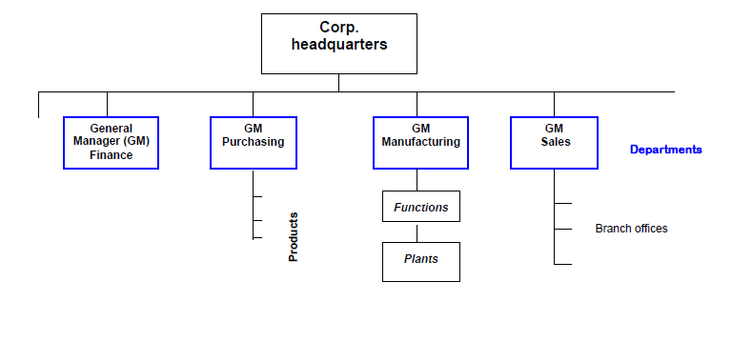
Appendix: Decision Rights - Bundling Tasks
The discussion at this low level really leads to the broader question of how firms are structured.
There are alternatives, consider ….
Functional grouping of activities such as manufacturing, sales etc
Gives rise to the U-form organisation –

Slide 48
Appendix: Decision Rights - Bundling Tasks
The discussion at this low level really leads to the broader question of how firms are structured.
There are alternatives, consider ….
Functional grouping
Benefits - Coordination within functional units, functional expertise and a career path exists. Also take advantage of economies of scale.
Costs – coordination across units including re activities. Employees focussing on their patch of territory.

Slide 49
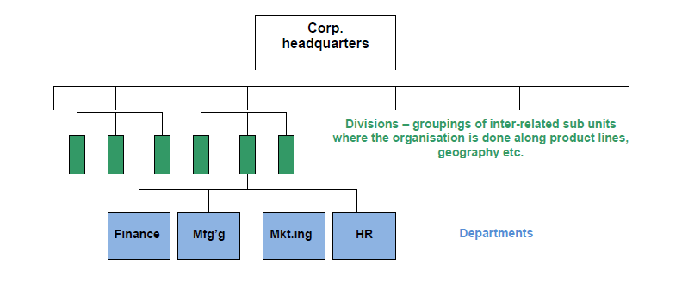
Appendix: Decision Rights - Bundling Tasks
Grouping jobs by product or geography?
Gives rise to the M-form or multi-division organisation.

Slide 50
Appendix: Decision Rights - Bundling Tasks
Grouping products by product or geography?
Gives rise to the M-form or multi-division organisation. Need to weigh up…
Benefits – decision rights located where specific knowledge is. Rewards may be based on functional or geographical unit performance, creating better incentives.
Costs – Territory disputes and interdependencies might be ignored.

Slide 51
Appendix: Decision Rights - Bundling Tasks
There are other alternatives
Network organisations …
Matrix organisations.
These are discussed in the textbook where there are descriptions around the benefits and costs of alternative structures.
Have we come across what we might think of a network organisation earlier this semester, i.e. one based on work groups that are assigned specific task that once completed, lead to the formation of new work groups….
Zappos perhaps?

