Slide 1
Lecture 8 Getting and Keeping the Right People

Slide 2
Outline
Chapters 1 and 2 of Lazear – Personnel Economics in Practice; Chapter 14 of Brickley
Who do you want to hire?
Discuss how the remuneration systems attract, retains and motivates employees
Distinguish specific and general human capital
Describe internal labour markets
Discuss efficiency wages and promotion tournaments.

Slide 3
Outline
What we are really talking about tonight is an important relationship inside the firm. That is the relationship between the employer (think of this as the firm or the organisation) and the employee.
We consider some aspects of this relationship today, and then additional considerations over the coming weeks.

Slide 4
Getting and keeping the right people..
An organisation faces a daunting challenge in attracting the right employees, hiring them and then retaining them.
In Brickley there is a discussion about an investment bank that was decimated by the 9/11 terrorist attack.
The physical assets of the firm were largely unimportant – it was its people and its ‘wetware’ or ‘its knowledge’, that was critical to its success pre and post September 11.
The right employees, if motivated, will increase the value of an organisation.
This lecture focuses on the attraction and retention of employees.

Slide 5
First Question – who to hire.
Consider the problem faced by a bank in hiring someone. Assume there are two candidates:
Lars – good pedigree, i.e. degree in economics, MBA, summer internship. Certain he can generate $200,000 in revenue per year.
Bjork – appears to be extremely talented but you are not sure. She may be a star and generate $500,000 in revenue (prob. = 0.5), or be a dud and generate a $100,000 loss each year (prob. = 0.5).
Salary for either is $100,000 per year
Who should you hire?
Why?

Slide 6
First Question – who to hire.
Looking at expected value of revenue generated by each candidate doesn’t help.
Suppose talents are revealed at end of first year and either employee is expected to work at firm for 10 years.
Who should you hire?
Why?

Slide 7
First Question – who to hire.
 | Lars |  | Net payoff $1m (at end 10 years)
 |  |  | Net payoff $4m
 | Bjork
 |  |  | Net payoff = -$200,000
Retain
Prob=1/2
Expected value = $1.9m (0.5 x $4m + 0.5 x -200k)
Fire after year 1
Prob=1/2

Slide 8
First Question – who to hire.
So go for the risky option because you can always fire or ‘let go’.
This may be counter intuitive – we often argue that risk is a bad thing so if the expected values are the same go with the ‘safe’ option.
But this is a simple model, we might need to consider:
Downside risk – the greater the downside risk, the less profitable to go with the risky option. The larger the potential loss, the less attractive is Bjork (as an employee)
Upside risk – the greater the upside risk, the more profitable to go with the risky option.
Terminations costs – we have ignored these, but they may be substantial.

Slide 9
First Question – who to hire.
But this is a simple model, we might need to consider:
Risk aversion – we simply assumed the firm was risk neutral which may or may not be accurate.
Probation – its length could easily change the calculation.
Length of evaluation – the longer it is the greater the potential risk the firm exposes itself to.
Length of employment – also affects the value of making a hire, a star who stays a long time is valuable.

Slide 10
First Question – who to hire.
This model is perhaps a little too simple – what else haven’t we considered?
Consider:
If Bjork is a star, what is likely to happen? In the long run what might this mean for the firm which hires her?
Of course it is not so simplistic – there may be asymmetric information that you can benefit from and retain a star.
Even if Bjork is a star and you cannot hide that fact, it may be the case she is not a star elsewhere – firm specific productivity.

Slide 11
Next Question – what standards to apply?
Should you always hire the best workers?
Why?
Consider:
If University graduates are about 28% more productive than HS graduates we should also consider..
…the wage that must be paid.

Slide 12
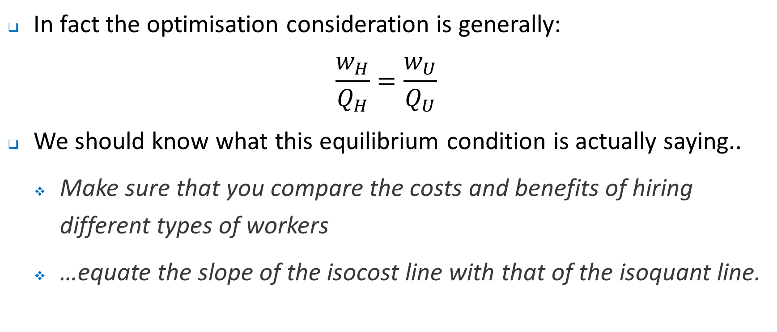
Next Question – what standards to apply?
In fact the optimisation consideration is generally:
$$\frac{w_{H}}{Q_{H}}=\frac{w_{U}}{Q_{U}}$$
We should know what this equilibrium condition is actually saying..
Make sure that you compare the costs and benefits of hiring different types of workers
…equate the slope of the isocost line with that of the isoquant line.

Slide 13
Next Question – what standards to apply?
What mix of ‘high’ and ‘low’ workers to hire needs some considered thought.
One consideration that is likely to be important is the nature of production. We should ask ourselves if:
Productivity is independent of co-workers: in which case the approach is as described above.
Productivity depends on co-workers: in this case it will in general be profitable to hire better quality workers (up to a point).
Productivity of workers depends on something else (capital): we are now back to something like the original specification.

Slide 14
Next Step – the recruitment process
If a firm decides that it will make some hires it then faces at least two challenges:
How to ‘weed out’ the undesirable applicants?
How to attract the right types of applicants?
The real problem here is that firms face a problem of adverse selection – applicants know what type of ‘person’ they are, but the firm doesn’t.
Aside: adverse selection is common in markets such as insurance and lemons…. Really a problem of asymmetric information.
How to overcome this information asymmetry?

Slide 15
Next Step – the recruitment process
Use credentials….
CVs – look at education, work experience etc
How costly was the credential to attain? Might be an important consideration
As noted the real problem here is that firms face a problem of adverse selection – applicants know what type of ‘person’ they are, but the firm doesn’t. One potential way around this is through signalling, such as offering a warranty or a bond.
Organisations might screen applicants – screening tests are however, costly and imperfect.
Generally screening is more profitable when:
The test is more effective – more discriminating.
The stakes are higher – see Investment/ Commercial Bank example in Lazear.

Slide 16
Next Step – the recruitment process
But screening creates a cost for you…
If an employee has passed your screening procedure then they must be good and will demand …?
Screening can take many forms:
Simple tests – but perhaps these can be gamed.
A probation period – but this might be costly for the firm.
Fixed term contracts

Slide 17
Next Step – the recruitment process
What else might help you choose the right employee?
With an appropriate offer, the right employee might signal to you that they are the ‘right employee’.
How?
By incurring a cost that the ‘wrong type of employee’ won’t. For e.g., by accepting an offer that defers high compensation only after you have ‘proved yourself’.
This is a process that we will discuss in more detail later. The intuition here is that if a potential employee needs to prove him or herself, this will generally be costly. For employees who experience a high cost to send a signal, they may not take an offer that provides higher pay only after showing you how good they are.

Slide 18
Contracting Objectives
Remember that we thought about the firm as a series of contracts. One of the most important of these set of contracts is that between the firm and its employees.
Many aspects of the employment relationship are implicit.
A good contract will be one that maximizes the size of the pie to be shared, allowing both the firm or organisation and the employee to be better off.
For the owner of the firm and the employee, each must receive at least their reservation level of utility…
For the owner of the firm, that is the return on capital in the next best alternative (industry).
For the employee, that is the wage in the next best alternative job

Slide 19
The Level of Pay
Consider the basic competitive model. Assume..
The labour market is competitive – wages are given so effectively supply curve of labour is perfectly elastics..
Market wages can be observed costlessly
Individuals are identical in training and skills
All jobs are identical
No long term contracts – just spot markets
Monetary compensation only – no fringe benefits
Then we see the following outcome…

Slide 20
Wage($)
w*
Wage
MRP = (MPP)x(MR) = incremental revenue
0
E, (amt labour)
0
E*

Slide 21
The Level of Pay - Employees
We know this model is inadequate. For one workers are not homogeneous.
Rather they have different skills or human capital. We could discuss a model of how individuals invest in human capital weighing up the costs and benefits of doing so – really a question for a course in labour economics.
There are of course, different types of human capital:
General human capital – skills and education that is valued equally by an array of firms. Examples…?
Specific human capital – skills and education that is valued more highly by one employer compared to an alternative employer. Examples...?
Which one do you think firms are interested in paying for, and why?

Slide 22
The Level of Pay - Jobs
Not all jobs are created equally. Some jobs are:
Dangerous
Unpleasant
Boring and repetitive….(chicken wing breaker for example)
To attract people to such jobs we usually think about jobs as paying a compensating differential. Consider...
Unskilled workers have a choice between two jobs:
The first job offers clean and safe working conditions.
The second job is in a dirty noisy factory
In this case, a wage of $15 per hour in both jobs could not be an equilibrium. Why?
If the second job must pay $17.50 per hour, to attract workers then the compensating wage differential is $2.50 per hour.

Slide 23
The Level of Pay - Jobs
The theory of compensating wage differential has some nice features.
Some jobs are inherently unpleasant and compensating wage differentials can be used to attract people to those jobs.
Of course, the right people are likely to self-select into unpleasant jobs, which is another bonus.
They force employers to make choices about whether to have higher labour costs or make some other type of adjustment such as …
We also assumed that there was perfect information about what wages are paid. This is not always the case. Moreover, there is information asymmetry on both sides of the market. This can have important implications for:
Number of applications for openings.
Turnover and training costs

Slide 24
Internal Labour Markets
What is wrong with the description so far?
Firms do invest in general training and individuals invest in specific training.
Wages are rarely reduced...
What are we missing?
Firms use internal labour markets:
Outside hiring is used to fill entry level jobs. Existing employees move to fill vacancies within the firm - promotions are important for example.
Importantly, many of these behaviours are based on long term relational contracts.
Moreover, recall how we described as what happens in firms as being determined by administrative rules and understandings.

Slide 25
Internal Labour Markets
Why use internal labour markets and in particular long–term employment relationships that are not necessarily formalised?
Firm-specific human capital – potentially provide greater incentive for individuals to make this type of investment.
Motivation – long term r/ships can encourage individuals to work hard.
Learning benefits for the employer and the employee.
Of course internal labour markets may come at a cost – potential for people to be promoted to the level of their incompetence (the Peter Principle)

Slide 26
Internal Labour Markets - Pay
In a long term relationship, employees look beyond their immediate payoff.
Suppose that a firm does not pay the market wage initially, but that compensation increases over time.
What is important is the NPV of the earnings profile – the career earnings path.
There are at least three ways this could be done:
Efficiency wages.
Upwards sloping earnings profiles.
Promotions tournaments.
Lets consider each of these

Slide 27
Internal Labour Markets – Efficiency wages
In many jobs it is difficult or costly to monitor a worker. In the absence of monitoring you might expect the self interested worker to shirk.
Of course, one way to overcome this might be to pay the worker piece rates, but this will not always be possible.
Ask yourself what might be the benefits and costs or piece rates?
What to do?
Pay the worker a high wage!
Why?

Slide 28
Internal Labour Markets – Efficiency wages
In fact, efficiency wage models suggest that you actually pay the worker a wage above that which they could get in the next best alternative.
As long as you can monitor individuals occasionally at a reasonable cost, this should lead to lower levels of shirking.
These wage premiums are what are generally referred to as efficiency wages.

Slide 29
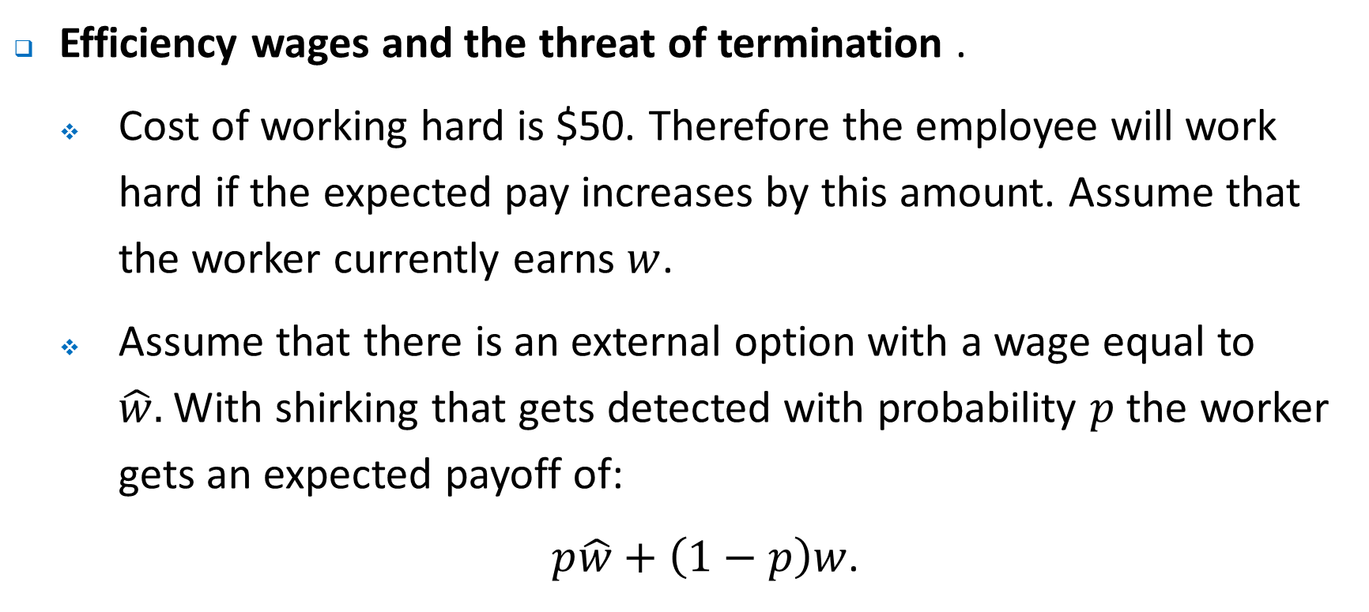
Internal Labour Markets – Efficiency wages
Efficiency wages and the threat of termination .
Cost of working hard is $50. Therefore the employee will work hard if the expected pay increases by this amount. Assume that the worker currently earns $w$.
Assume that there is an external option with a wage equal to $\hat{w}.$With shirking that gets detected with probability $p$ the worker gets an expected payoff of:
$p\hat{w}+\left(1−p\right)w$.

Slide 30
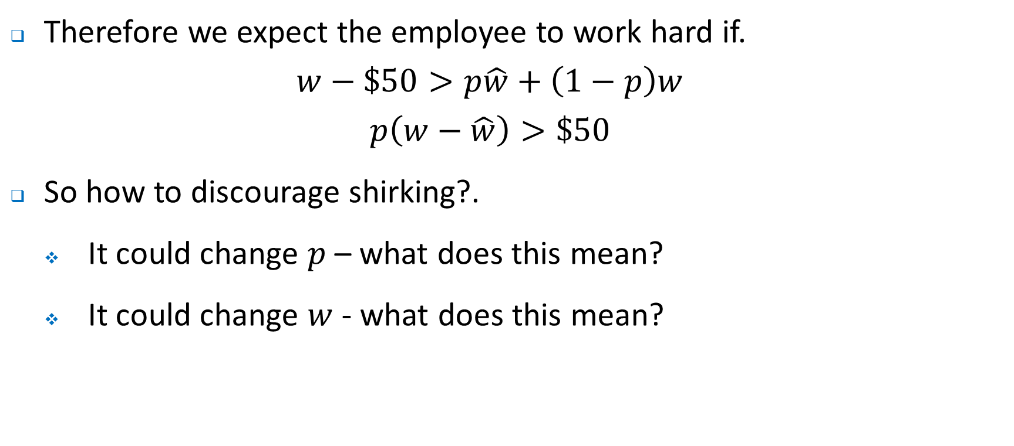
Internal Labour Markets – Efficiency wages
Therefore we expect the employee to work hard if.
$$w−\$50>p\hat{w}+\left(1−p\right)w$$
$$p\left(w−\hat{w}\right)>\$50$$
So how to discourage shirking?.
It could change $p$ – what does this mean?
It could change $w$ - what does this mean?

Slide 31
Internal Labour Markets – Efficiency wages
These offer benefits both at the hiring stage and also in internal labour markets. Some benefits include
Attracting better employees – providing a larger pool of applicants
Building better employee commitment- with higher wages workers are less likely to quit. In turn firms may be more likely to offer training and demand longer hours from employees.
Create a greater perception of equity – employees may feel that an employer that is doing well is ‘sharing’ the surplus and put in greater effort.

Slide 32
Internal Labour Markets – Efficiency wages
Of course, there are potentially some other implications of efficiency wages
Unemployment
Differences in wages being paid to observationally equivalent workers across industries.
Greater productivity, lower levels of dismissals.

Slide 33
Internal Labour Markets – Efficiency wages
Is there any evidence that firms pay efficiency wages – that is, above market wages (or other benefits)
The Ford Motor company is often cited as the classic example.
With introduction of assembly lines, large workforce of relatively unskilled labour that exhibited high rates of turnover (370%!); high absenteeism. In 1913, wages rates were about $2.50 per day.
From January 1914 wage rates increased to $5.00 per day for workers who had been employed for 6 months or more.
The effect?
Quit rate fell by 87%, discharges fell by 90%, and absenteeism fell by 75%.
There were other factors at work, but nonetheless this is a salutary lesson in the incentive provided by higher wages.

Slide 34
Internal Labour Markets – Job Seniority
Another common mechanism is for an employee to not have a flat earnings profile over their tenure with a firm – compensation increases more rapidly than productivity.
In general, in the initial stages of the employment relationship workers are paid below their MRP (underpaid) , and more than their MRP (overpaid) in later years.
Why does this work?
Employees know they are in an ongoing relationship – they receive less now in expectation that they will receive more in the future.
Consider….

Slide 35
Annual compensation and MRP ($)
Compensation
MRP
Note that for the compensation package to be competitive, it must be the case that the NPV of the blue area must equal the NPV of the yellow area.
C₂
C₁
MRP = (MPP)x(MR) = incremental revenue
0
Tenure at firm
0
r*

Slide 36
Internal Labour Markets – Job Seniority
Note that in general we would expect that workers become more productive over time. That is, as they garner experience.
What are the potential benefits of such an approach?
Worker sorting – the offer of higher wages in the future will attract workers who are likely to stay and in doing so, work hard enough to avoid redundancy.
If younger workers work hard, then this may reduce monitoring costs
Young employees have incentives to make firm specific investments, work hard to avoid being fired.
Older workers will not risk shirking given the possibility that they may get fired and earn less elsewhere.

Slide 37
Internal Labour Markets – Job Seniority
What are the potential challenges of such an approach?
Such an approach depends crucially on trust - the reputation of the firm will be critical
This might have implications for redundancy rules, FILO…
It might also have implications for retirement policies – it may for example require mandatory retirement but this has potentially become more difficult to require.

Slide 38
Internal Labour Markets – Promotions
Firms are typically hierarchical – this provides opportunities for individuals to move up the ‘pyramid’ as it were.
How? Usually have three characteristics
Winner is uncertain.
The winner takes all.
Based on relative performance rather than absolute measure.
Consider the following model of promotion where we think about the reward for effort being the promotion…

Slide 39
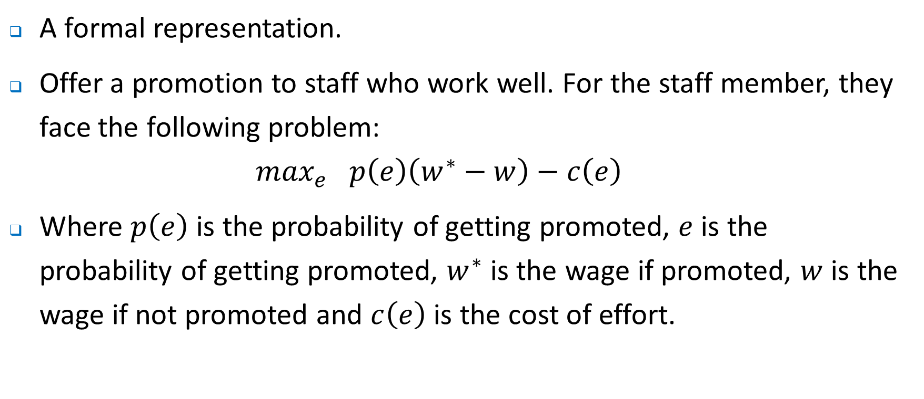
Internal Labour Markets – Promotions
A formal representation.
Offer a promotion to staff who work well. For the staff member, they face the following problem:
$$\max_{e} p\left(e\right)\left(w^{∗}−w\right)−c\left(e\right)$$
Where $p\left(e\right)$ is the probability of getting promoted, $e$ is the probability of getting promoted, $w^{∗}$ is the wage if promoted, $w$ is the wage if not promoted and $c\left(e\right)$ is the cost of effort.

Slide 40
Internal Labour Markets – Promotions
In general we expect effort to increase as the wage rise increases.
Offering a promotion tournament also has a number of other benefits
May be possible to offset additional players by simply using higher ‘prizes’.
Incrementally larger prizes can be used as promotions occur.
Commits firm to performance reviews of employees – promoting the wrong person can have consequences.
Possible that common shocks that affect all employees who can be promoted will be filtered out through a process of relative performance evaluation

Slide 41
Internal Labour Markets – Promotions
Of course there are potential drawbacks…
Using relative performance measures can reduce cooperation – you may want to undermine the competition
Potentially limited, crude and discrete – where does it leave the losers? In fact, if losers are treated poorly then an organization may have trouble attracting ‘players or contestants’ in the first place.
The Peter Principle might apply – see above.
Do you really want a promotion? Maybe, maybe not depending on the responsibilities that come with it.
Influence costs can potentially be high

Slide 42
The Salary- Fringe Benefit Mix
While health insurance is not a big part of the compensation package offered for Australian employees (c.f. the discussion in Brickley which discusses the US), other consideration such as superannuation/ pensions, leave entitlements etc are.
In general employees do not value fringe benefits equally to cash in hand – why?
Tax considerations
How an equivalent amount of cash would actually be spent
Employers may or may not be indifferent about the mix of salary and fringe benefits
Tax considerations
Who applies and how they behave

Slide 43
Salary ($)
S
Reservation utility for employee
S*
Iso-cost line for the firm
0
$, exp. Fringe benefits
0
F*
S

Slide 44
The Salary- Fringe Benefit Mix
Of course, the tradeoff doesn’t have to be a one-to-one exchange.
It may be cheaper for firms to offer some types of fringe benefit either for tax reasons or because of discounts associated with the purchase of the item.
While the diagram changes a little, the basic idea remains the same – the firms will offer a mix of salary and fringe benefits that minimizes its costs, while ensuring that the reservation utility of the employee is satisfied.

Slide 45
Salary ($)
S
Reservation utility for employee
S^
Iso-cost line for the firm
0
$, exp. Fringe benefits
0
F^
S

Slide 46
Where to next?
Incentive compensation
After that we will consider performance evaluation..

