Slide 1
Lecture 9 Incentive Compensation

Slide 2
Outline
Chapter 15 of Brickley et al.
How might incentive schemes work?
The Basic Principal-Agent problem
Optimal Incentive Schemes
The Challenge of Multi-tasking.

Slide 3
Incentive Schemes Gone Wrong..
Consider the experience of DuPont’s Fibres Division in the late 1980s.
Placed up to 6 percent of annual pay into an ‘at-risk pool’ for around 20,000 employees
Then, if profits beat forecasts, a bonus of k x (at risk pool) was paid.
.. Otherwise, no bonus was paid
In 1990 real earnings growth of >4% had to be attained to have bonus paid
The plan was abandoned less than two years into its three year schedule when employees were faced with the entire loss of the ‘at risk pool’
The Gulf War of 1990 did not help with matters, nor did general economic conditions.

Slide 4
Lessons from the DuPont Experience..
Possibility 1 - Maybe incentive plans on this scale (in excess of 20,000 employees) often don’t work…
Possibility 2 - Perhaps the scheme was simply poorly designed….
Can you think of some of the problems that might have characterised the DuPont plan?
Weak relationship between effort and reward
External factors beyond the control of any individual likely impacted on the probability the bonus was paid.
Implications…?

Slide 5
The Basic Incentive Problem
The problem is one that have already discussed this semester – recall that we discussed organisational design (allocation of decision rights) and in doing so, identified a key challenge was the agency problem created by delegating decision rights.
The interests of the owners and employees is not always aligned
More generally, the interest of principals and agents is not generally aligned.
The example used in the text is of AssemCo.
The owner wants the employees to put in higher effort and work diligently.
Employees prefer to take breaks and work at a more leisurely pace.
Consider the problem of motivating an individual worker over a one week period when they can potentially put in 40 hours of effort.

Slide 6
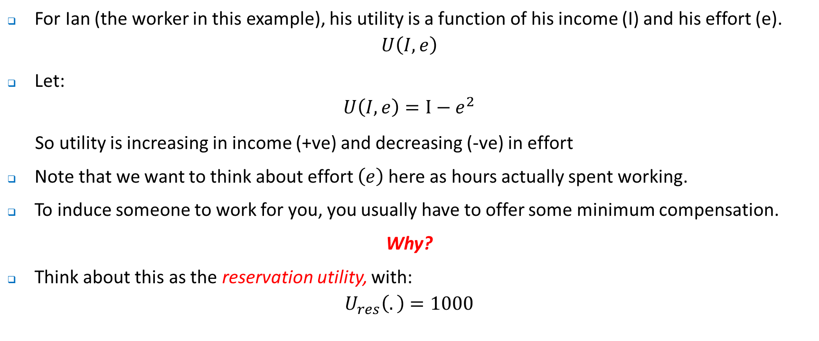
The Basic Incentive Problem
For Ian (the worker in this example), his utility is a function of his income (I) and his effort (e).
$$U\left(I, e\right)$$
Let:
$$U\left(I, e\right)=I−e^{2}$$
So utility is increasing in income (+ve) and decreasing (-ve) in effort
Note that we want to think about effort $\left(e\right)$here as hours actually spent working.
To induce someone to work for you, you usually have to offer some minimum compensation.
Why?
Think about this as the reservation utility, with:
$$U_{res}\left(.\right)=1000$$

Slide 7
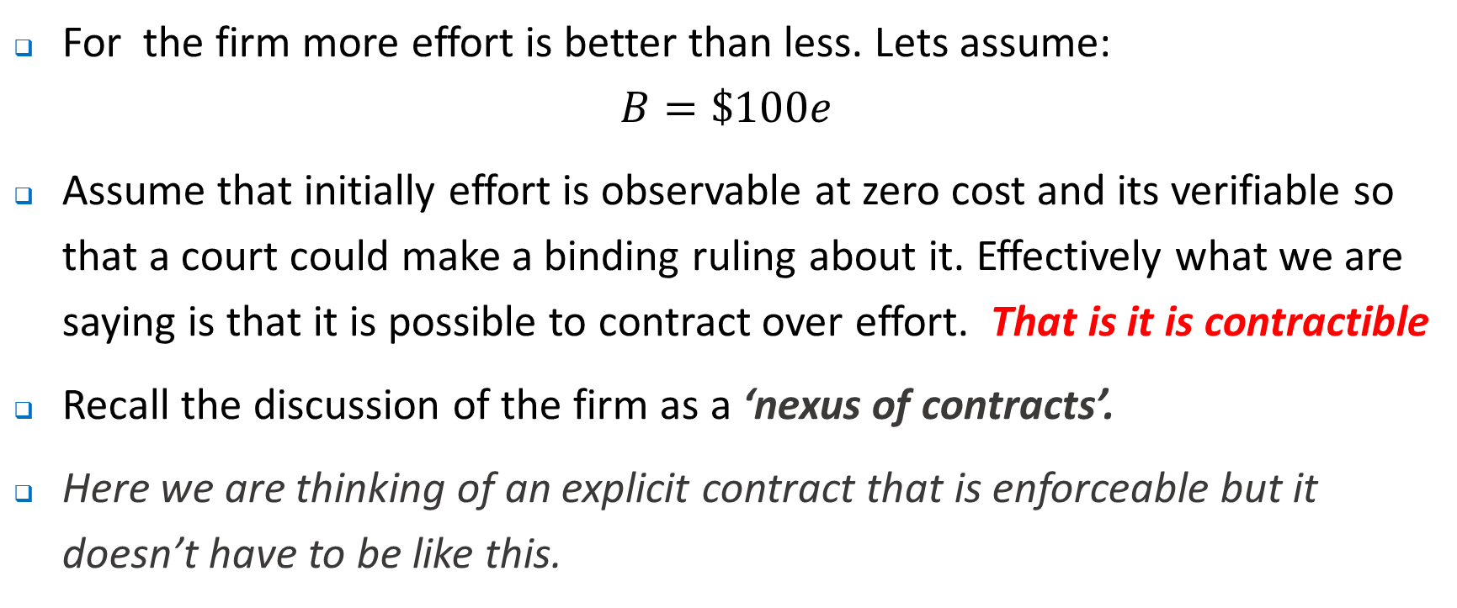
The Basic Incentive Problem
For the firm more effort is better than less. Lets assume:
$$B=\$100e$$
Assume that initially effort is observable at zero cost and its verifiable so that a court could make a binding ruling about it. Effectively what we are saying is that it is possible to contract over effort. That is it is contractible
Recall the discussion of the firm as a ‘nexus of contracts’.
Here we are thinking of an explicit contract that is enforceable but it doesn’t have to be like this.

Slide 8
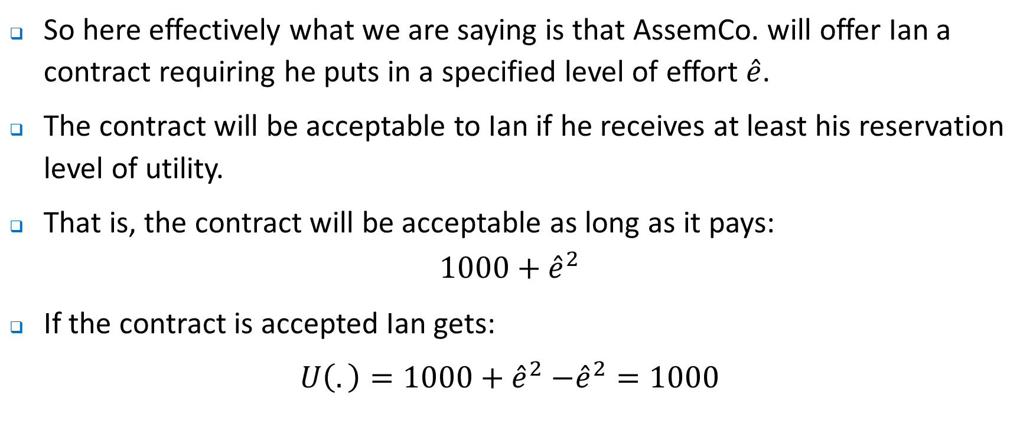
The Basic Incentive Problem
So here effectively what we are saying is that AssemCo. will offer Ian a contract requiring he puts in a specified level of effort $\hat{e}$.
The contract will be acceptable to Ian if he receives at least his reservation level of utility.
That is, the contract will be acceptable as long as it pays:
$$1000+{\hat{e}}^{2}$$
If the contract is accepted Ian gets:
$U\left(.\right)=1000+{\hat{e}}^{2}$ $−{\hat{e}}^{2}=1000$

Slide 9
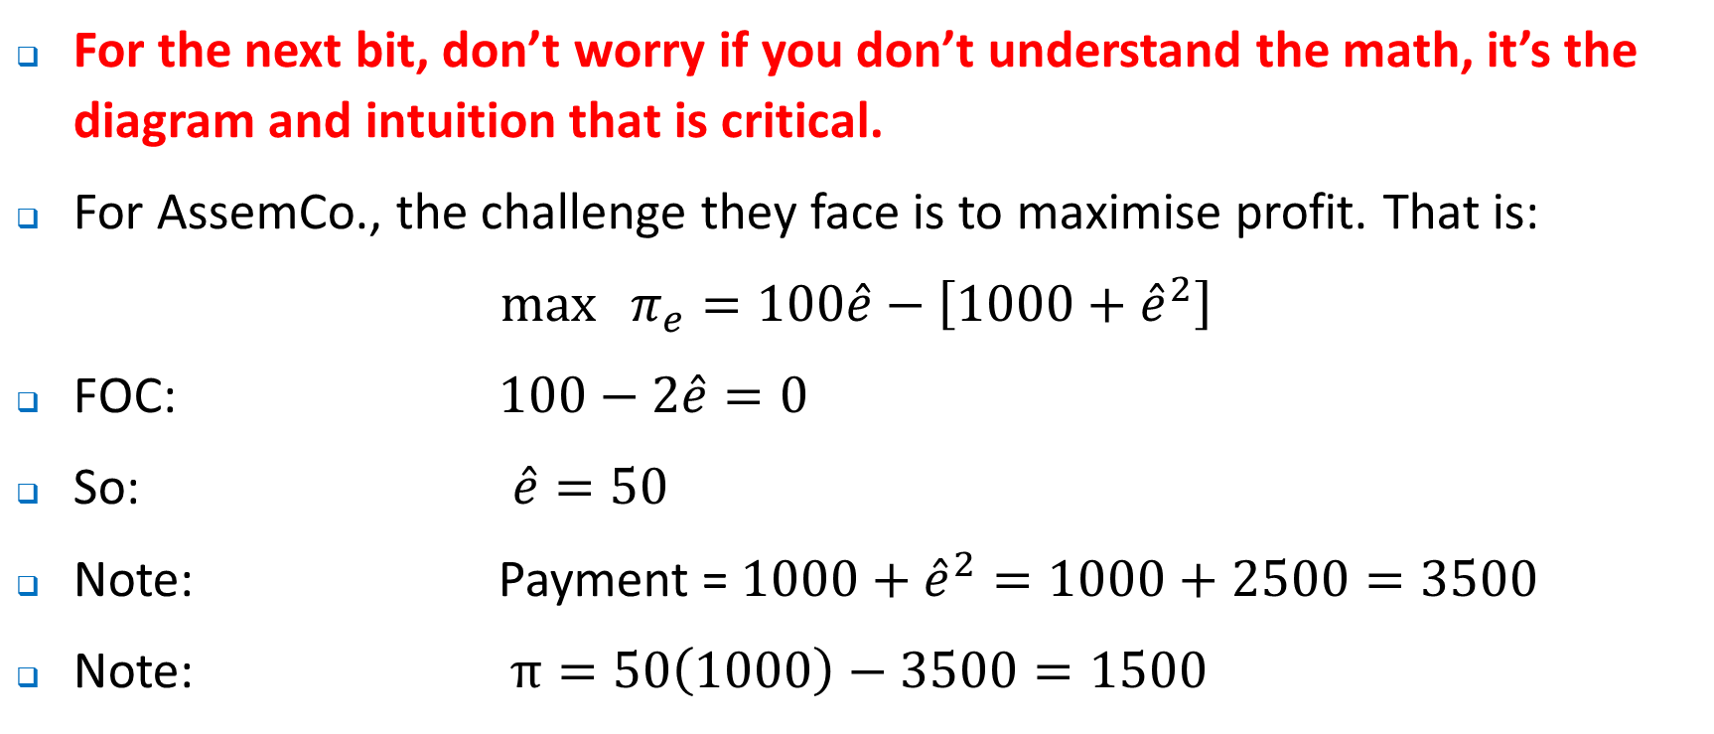
The Basic Incentive Problem
For the next bit, don’t worry if you don’t understand the math, it’s the diagram and intuition that is critical.
For AssemCo., the challenge they face is to maximise profit. That is:
${\max{π}}_{e}=100\hat{e}−\left[1000+{\hat{e}}^{2}\right]$
FOC: $100−2\hat{e}=0$
So: $\hat{e}=50$
Note: Payment = $1000+{\hat{e}}^{2}=1000+2500=3500$
Note: $π=50\left(1000\right)−3500=1500$

Slide 10
Benefits & costs ($)
Benefit of effort: $100e
Cost of effort: $1000 + e²
5000
Firm profit = $1500
3500
1000
0
e (effort)
0
e*=50

Slide 11
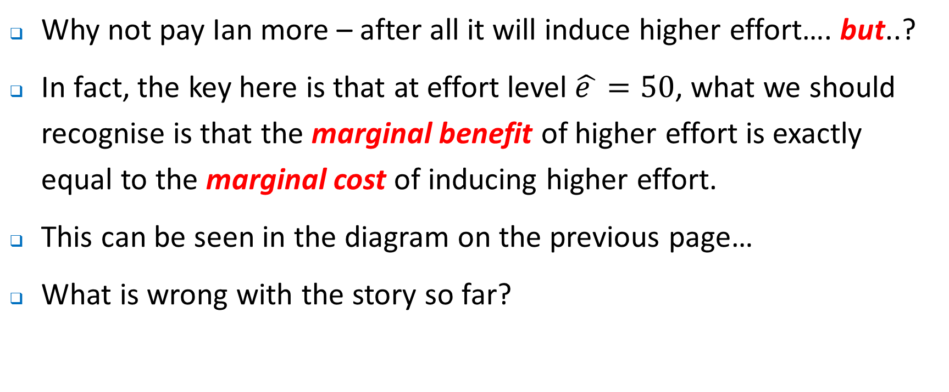
The Basic Incentive Problem
Why not pay Ian more – after all it will induce higher effort…. but..?
In fact, the key here is that at effort level $\hat{e }=50$, what we should recognise is that the marginal benefit of higher effort is exactly equal to the marginal cost of inducing higher effort.
This can be seen in the diagram on the previous page…
What is wrong with the story so far?

Slide 12
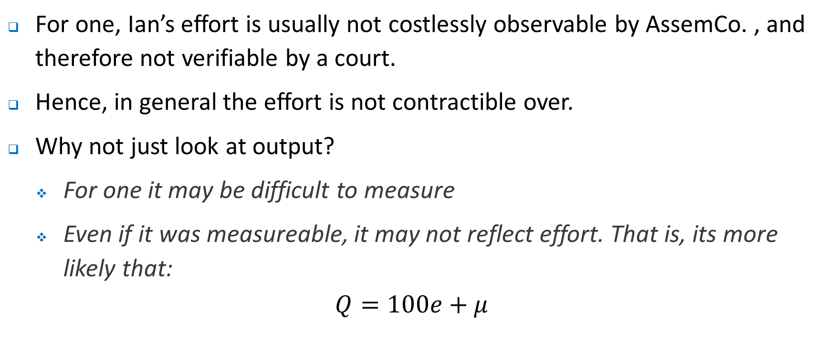
The Basic Incentive Problem
For one, Ian’s effort is usually not costlessly observable by AssemCo. , and therefore not verifiable by a court.
Hence, in general the effort is not contractible over.
Why not just look at output?
For one it may be difficult to measure
Even if it was measureable, it may not reflect effort. That is, its more likely that:
$$Q=100e+μ$$

Slide 13
The Basic Incentive Problem
There are at least three lessons that we can draw:
Incentive problems exist because the interests of the firm/ employer and the employee diverge. The principal-agent problem.
Incentive conflicts do not cause problems when effort is contractible – so with DuPont they could have simply specified the appropriate level of effort for which a bonus was payable if it was the case that the actions of employees were costlessly observable.
In choosing the optimal action the costs to the employee from higher effort and the benefits to the firm in terms of higher profits need to be balanced. Recall we have discussed the idea of compensating differentials previously

Slide 14
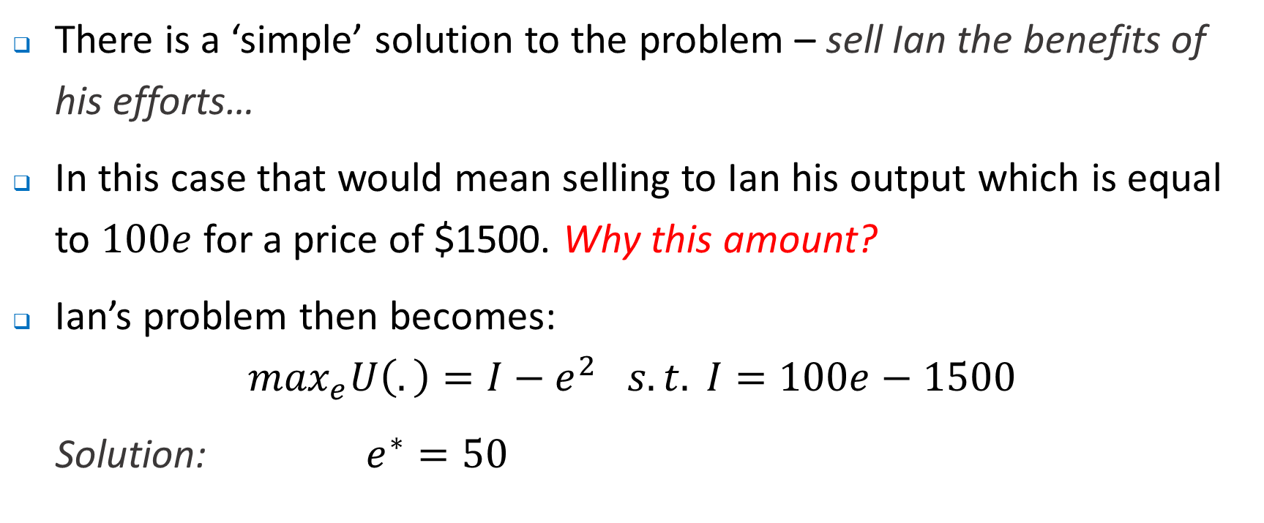
Incentives from Ownership
There is a ‘simple’ solution to the problem – sell Ian the benefits of his efforts…
In this case that would mean selling to Ian his output which is equal to $100e$for a price of $1500. Why this amount?
Ian’s problem then becomes:
$$\max_{e}U\left(.\right)=I−e^{2} s.t. I=100e−1500$$
Solution: $e^{∗}=50$

Slide 15
Incentives from Ownership
In fact, this is what we see in the ‘real world’ all the time – many jobs are ‘sold’.
Franchisees – effectively the franchisee buys the right to a future stream of profits generated by his or her efforts.
Think about the incentives which such arrangements provide. At the same time, what constraints are imposed on the franchisees?.
More generally, a majority of businesses (at least by number) are owner operated.
Of course there are limits from such an arrangement …

Slide 16
Limits from Ownership
There are of course limits from simply atomising the employment relationship so all individuals are effectively owner-operated firms:
Wealth constraints – few managers (or individuals more generally) have the resources to buy their share of the firm
Risk aversion – typically individuals are risk averse. Owners expose themselves to the inherent risks associated with the business environment. Employees avoid ( to some extent) the risk associated with risky environments
Team production – output or the results from an individuals efforts depend on not just the individuals own effort. Identifying the output from any one individual may be difficult or impossible.
Lets consider the problem of risk sharing …this is important when thinking about the agency problem…..

Slide 17
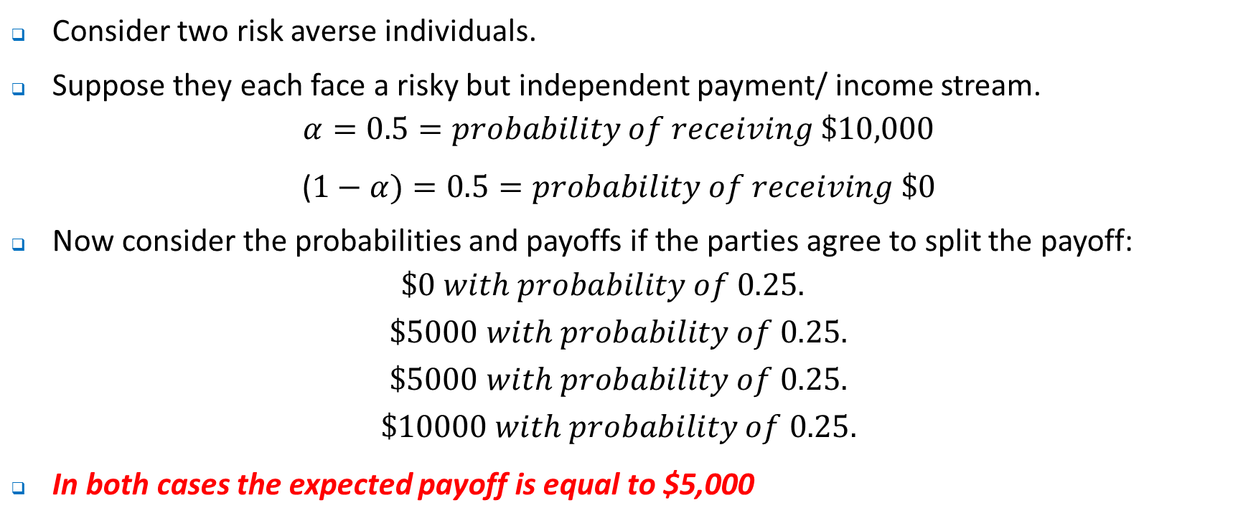
Optimal Risk Sharing
Consider two risk averse individuals.
Suppose they each face a risky but independent payment/ income stream.
$$α=0.5=probability of receiving \$10,000$$
($1−α)=0.5=probability of receiving \$0$
Now consider the probabilities and payoffs if the parties agree to split the payoff:
$$\$0 with probability of 0.25.$$
$$\$5000 with probability of 0.25.$$
$$\$5000 with probability of 0.25.$$
$$\$10000 with probability of 0.25.$$
In both cases the expected payoff is equal to $5,000

Slide 18
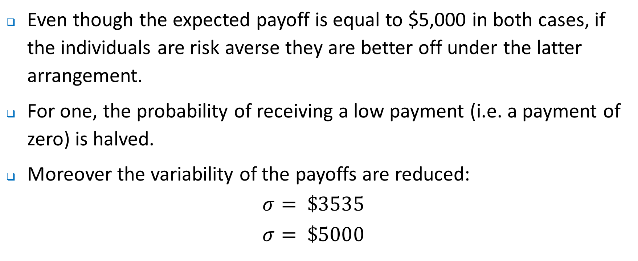
Optimal Risk Sharing
Even though the expected payoff is equal to $5,000 in both cases, if the individuals are risk averse they are better off under the latter arrangement.
For one, the probability of receiving a low payment (i.e. a payment of zero) is halved.
Moreover the variability of the payoffs are reduced:
$$σ= \$3535$$
$$σ= \$5000$$

Slide 19
Optimal Risk Sharing
We know that individuals generally avoid risky outcomes:
Insurance
Buying into mutual funds or share portfolios
Moreover, there is an opportunity for a Pareto improving trade if those who are more risk tolerant can pay purchase the risky income stream for a fixed amount. Then the risk averse individual is better off (by being paid their certainty equivalent) and the risk lover is also better off by being compensated for taking on additional risk.
For example, one individual (the risk neutral one) could purchase the risky income stream (with expected value of $5000) for $4500. If the certainty equivalent for the risk averse person is <$4500, both parties are better off.

Slide 20
Effective Incentive Contracts
What will an effective incentive contract do? At least two things:
Provide incentives – that is it will motivate employees to put in greater effort. Pay should be related to performance.
Share risk efficiently – this may require that employees are paid a fixed salary, or more likely that they will be compensated appropriately for the risk that they assume.
Clearly there is a tradeoff in achieving these two aims – when incentives are greater, so too will be the level of risk the employee is exposed to.
Essentially we have a moral hazard problem – when the employer ‘insures’ the employee against risk the incentive to perform is reduced.

Slide 21
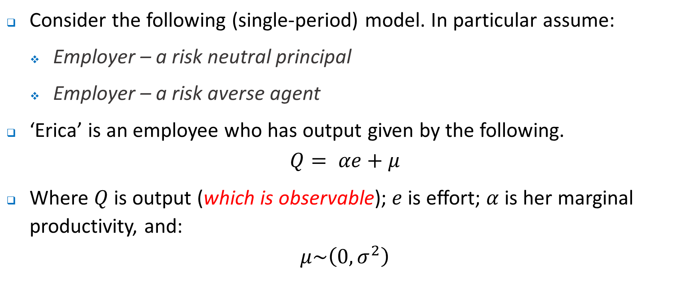
Principal-Agent Model
Consider the following (single-period) model. In particular assume:
Employer – a risk neutral principal
Employer – a risk averse agent
‘Erica’ is an employee who has output given by the following.
$$Q= αe+μ$$
Where $Q$is output (which is observable); $e$is effort; $α$ is her marginal productivity, and:
$$μ\sim \left(0, σ_{}^{2}\right)$$

Slide 22
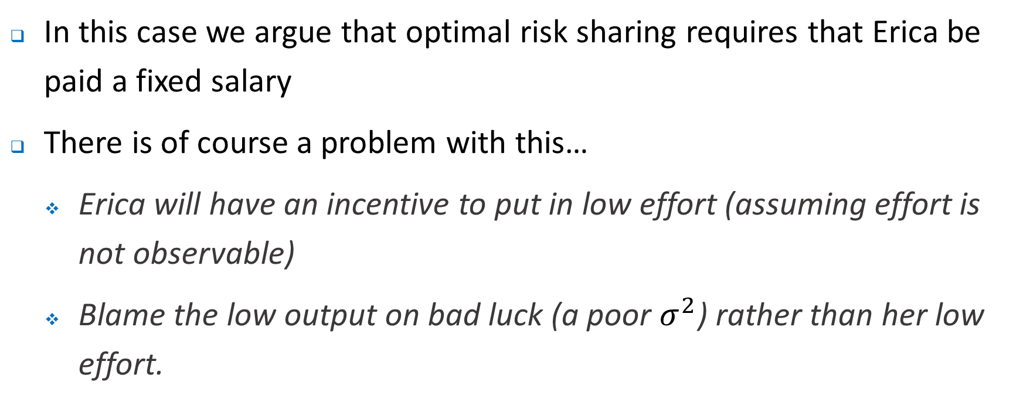
Principal-Agent Model
In this case we argue that optimal risk sharing requires that Erica be paid a fixed salary
There is of course a problem with this…
Erica will have an incentive to put in low effort (assuming effort is not observable)
Blame the low output on bad luck (a poor $σ_{}^{2}$) rather than her low effort.

Slide 23
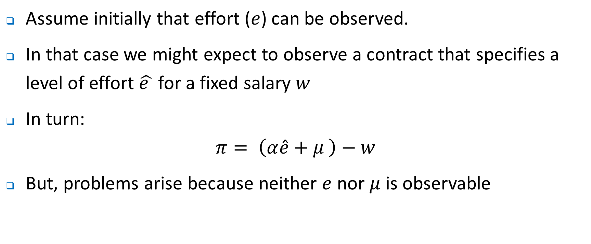
Principal-Agent Model
Assume initially that effort ($e$) can be observed.
In that case we might expect to observe a contract that specifies a level of effort $\hat{e }$ for a fixed salary $w$
In turn:
$$π= \left(α\hat{e}+μ \right)−w$$
But, problems arise because neither $e$ nor $μ$ is observable

Slide 24
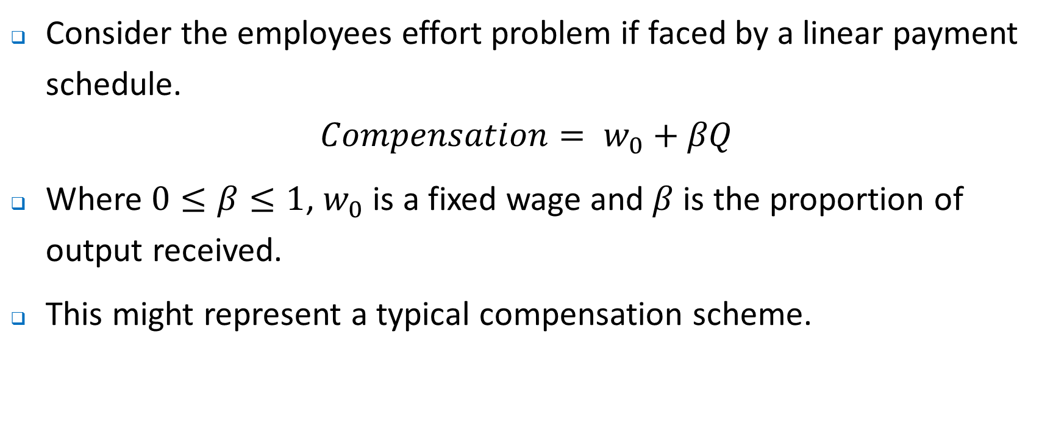
Principal-Agent Model
Consider the employees effort problem if faced by a linear payment schedule.
$$Compensation= w_{0}+βQ$$
Where $0≤β≤1$, $w_{0}$ is a fixed wage and $β$ is the proportion of output received.
This might represent a typical compensation scheme.

Slide 25
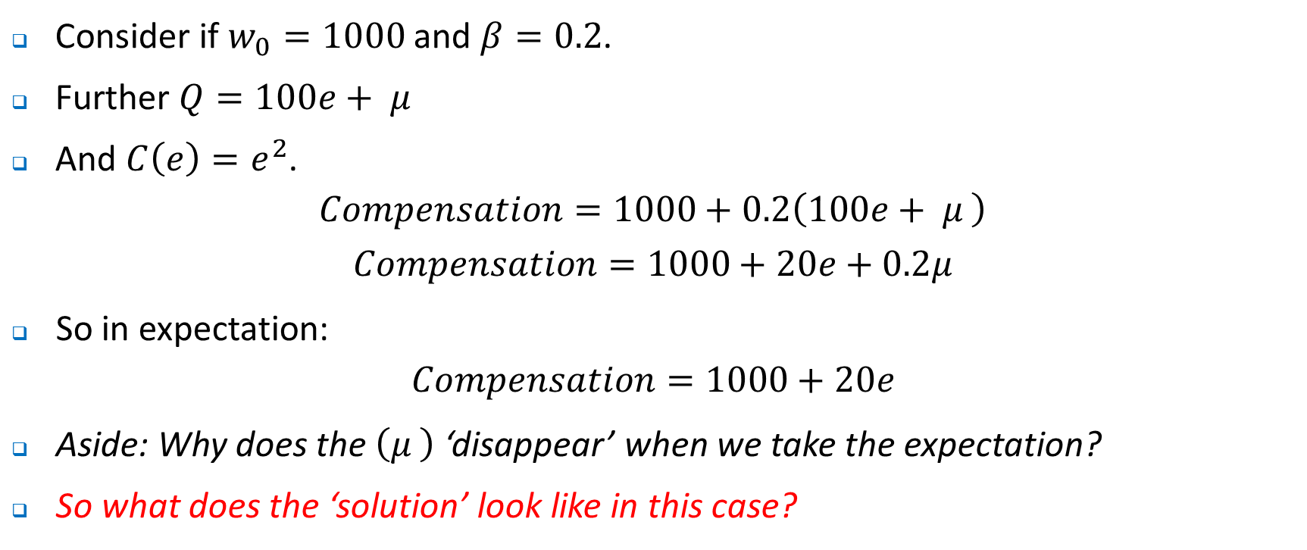
Principal-Agent Model
Consider if $w_{0}=1000$ and $β=0.2$.
Further $Q=100e+ μ$
And $C\left(e\right)=e^{2}$.
$$Compensation=1000+0.2\left(100e+ μ \right)$$
$$Compensation=1000+20e+0.2μ$$
So in expectation:
$$Compensation=1000+20e$$
Aside: Why does the $\left(μ \right)$ ‘disappear’ when we take the expectation?
So what does the ‘solution’ look like in this case?

Slide 26
($)
Cost of effort
Compensation: $1000+20e
1200
1000
0
e (effort)
0
e*=10

Slide 27
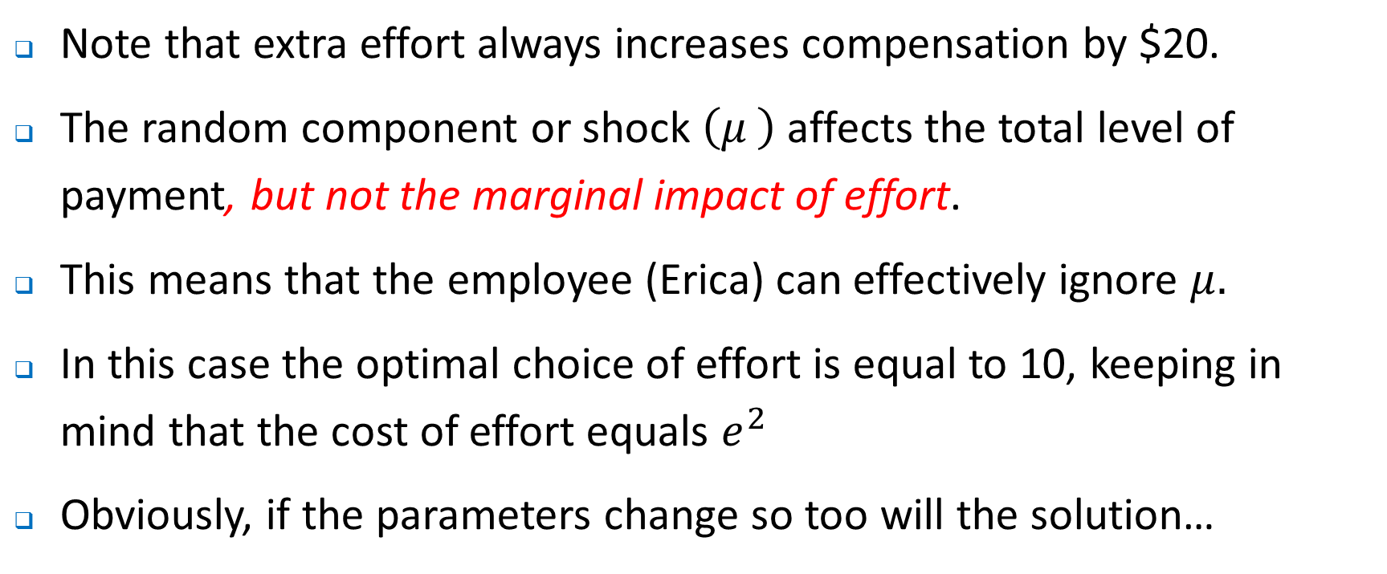
Principal-Agent Model
Note that extra effort always increases compensation by $20.
The random component or shock $\left(μ \right)$affects the total level of payment, but not the marginal impact of effort.
This means that the employee (Erica) can effectively ignore $μ.$
In this case the optimal choice of effort is equal to 10, keeping in mind that the cost of effort equals $e^{2}$
Obviously, if the parameters change so too will the solution…

Slide 28
($)
Intercept change
Slope change
1200
1000
0
e (effort)
0
e*=10
e^=15

Slide 29
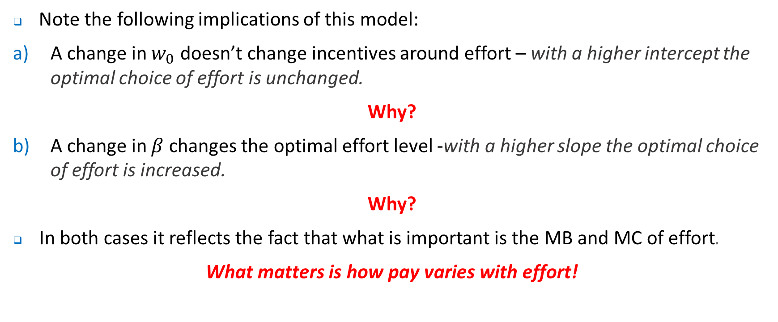
The Principal-Agent Model
Note the following implications of this model:
A change in $w_{0}$ doesn’t change incentives around effort – with a higher intercept the optimal choice of effort is unchanged.
Why?
A change in $β$ changes the optimal effort level -with a higher slope the optimal choice of effort is increased.
Why?
In both cases it reflects the fact that what is important is the MB and MC of effort.
What matters is how pay varies with effort!

Slide 30
The Principal-Agent Model
Two issues to consider:
Recall our discussion at the very beginning of semester around the ’happy is productive’ model – what does that model say about the principal-agent framework we have just spelt out?.
How does the model we have just described relate to the efficiency wage model described last week – here there is a direct cost of not working hard (your pay is lower!).
What happened when you didn’t work hard in the efficiency wage model?

Slide 31
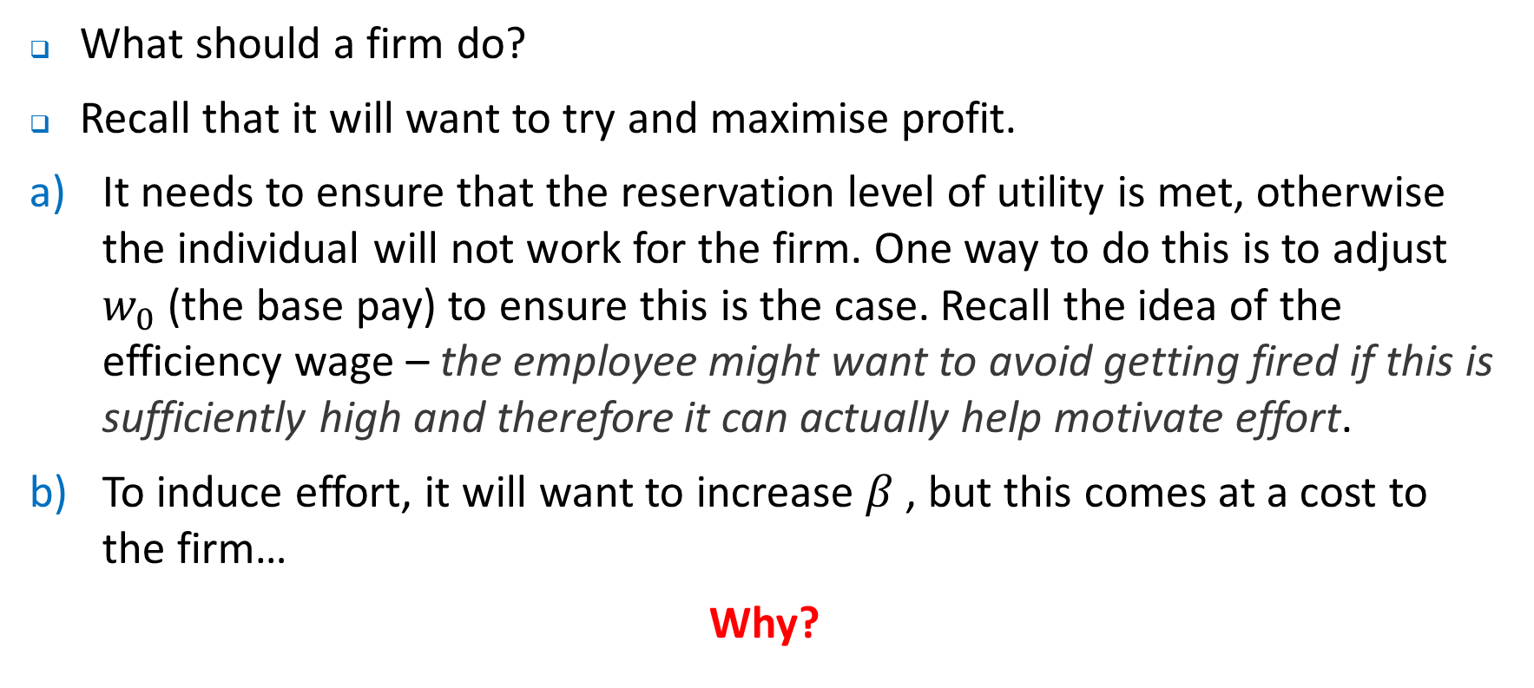
The Optimal Contract
What should a firm do?
Recall that it will want to try and maximise profit.
It needs to ensure that the reservation level of utility is met, otherwise the individual will not work for the firm. One way to do this is to adjust $w_{0}$ (the base pay) to ensure this is the case. Recall the idea of the efficiency wage – the employee might want to avoid getting fired if this is sufficiently high and therefore it can actually help motivate effort.
To induce effort, it will want to increase $β$ , but this comes at a cost to the firm…
Why?

Slide 32
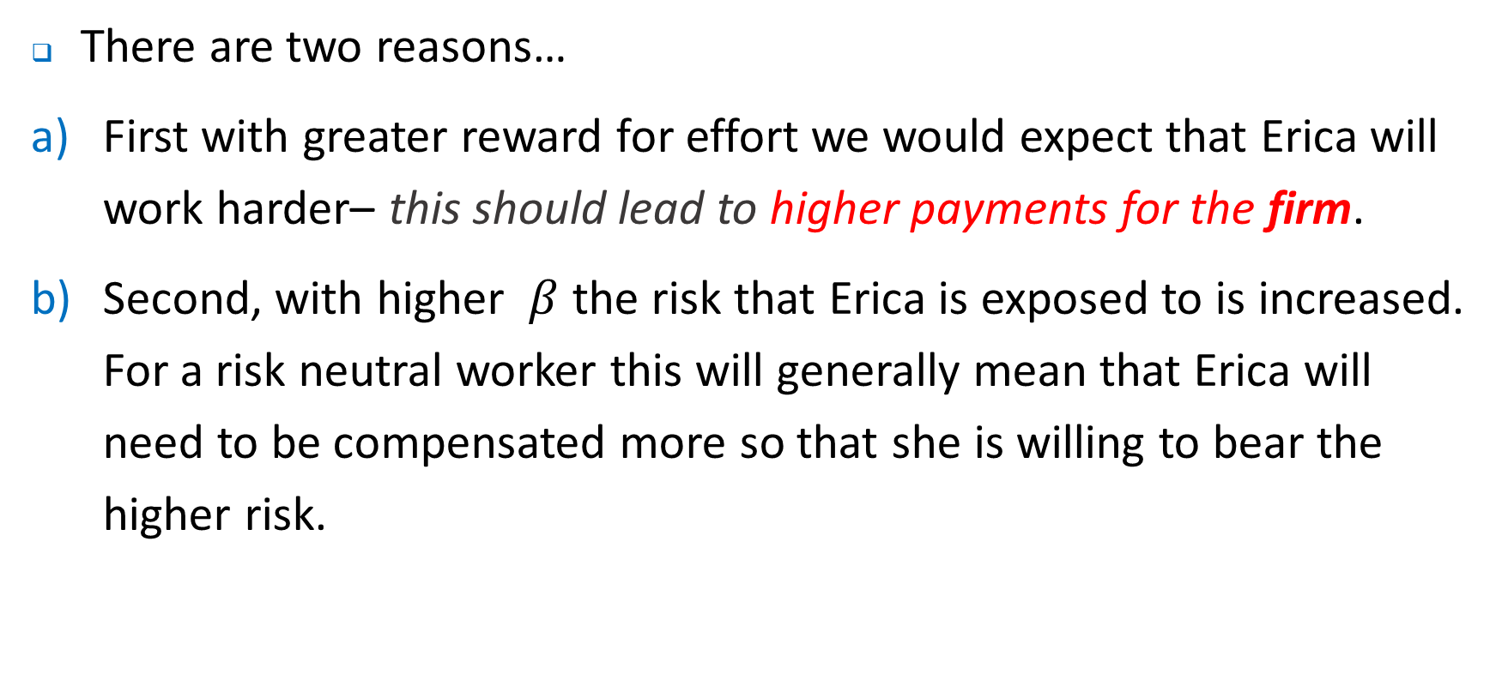
The Optimal Contract
There are two reasons…
First with greater reward for effort we would expect that Erica will work harder– this should lead to higher payments for the firm.
Second, with higher $β$ the risk that Erica is exposed to is increased. For a risk neutral worker this will generally mean that Erica will need to be compensated more so that she is willing to bear the higher risk.

Slide 33
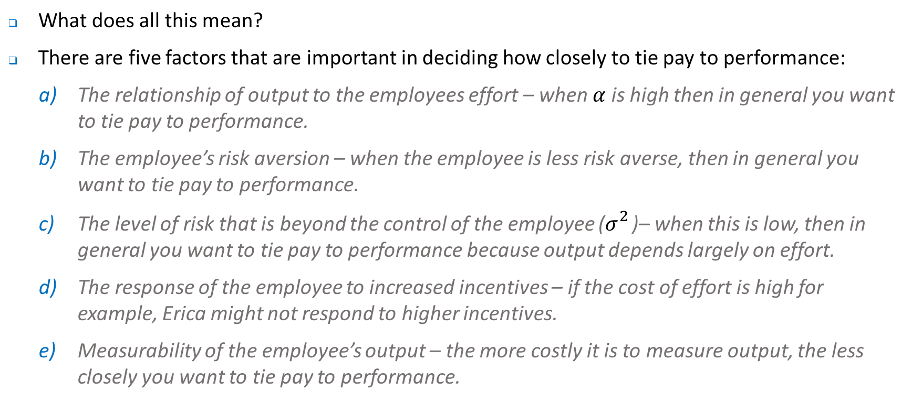
The Optimal Contract
What does all this mean?
There are five factors that are important in deciding how closely to tie pay to performance:
The relationship of output to the employees effort – when $α$ is high then in general you want to tie pay to performance.
The employee’s risk aversion – when the employee is less risk averse, then in general you want to tie pay to performance.
The level of risk that is beyond the control of the employee ($σ_{}^{2}$)– when this is low, then in general you want to tie pay to performance because output depends largely on effort.
The response of the employee to increased incentives – if the cost of effort is high for example, Erica might not respond to higher incentives.
Measurability of the employee’s output – the more costly it is to measure output, the less closely you want to tie pay to performance.

Slide 34
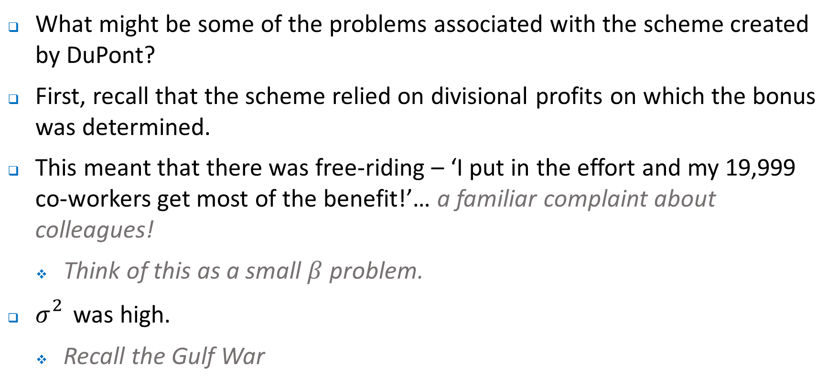
Why did DuPonts Scheme Fail?
What might be some of the problems associated with the scheme created by DuPont?
First, recall that the scheme relied on divisional profits on which the bonus was determined.
This meant that there was free-riding – ‘I put in the effort and my 19,999 co-workers get most of the benefit!’… a familiar complaint about colleagues!
Think of this as a small $β$ problem.
$σ_{}^{2}$ was high.
Recall the Gulf War

Slide 35
Informativeness Principle
In designing compensation contracts, theory suggests that it is productive to include all performance indicators that provide additional information about the employee’s effort assuming that such indicators can be included at low cost. Doing so reduces the cost of inefficient risk bearing and generally leads to a more efficient effort choice.
Above we have assumed that the only measure of the employees performance is output – this is clearly not the case
Example, it may be useful to use information about the performance of co-workers, i.e. to include measures of relative performance
What might have been the benefits of doing so in the case of DuPont? How might it have been implemented in the DuPont case?

Slide 36
Group Incentive Pay
Payoffs can be tied to performance of teams, business unit, firm
Performance can be measured by stock prices, accounting earnings or business unit costs
Why use this approach?
Difficulty measuring individual performance
Group pay may encourage cooperation and teamwork
Performance monitoring can be encouraged among team members.
Retention valued workers and it may increase the amount of firm specific investment by employees if it discourages quits
Reduction in contracting costs by matching compensation with team performance – it may be the case that when an individuals performance is correlated with the that of the team, this type of remuneration automatically adjusts and helps retain staff who may be faced with external offers.

Slide 37
Group Incentive Pay
What might be some of the difficulties associated with such an approach?
Free riding
Limited incentives – witness the experience of DuPont

Slide 38
Multitasking
McAfee focuses on the challenge of a convenience store that wants fresh bread delivered twice daily. The tasks required might include:
Planning the route
Driving the truck
Maintaining the truck
A firm might use an independent contractor to undertake the task, or they may use an employee
Q^{n}: What might be some of the implications of each approach?

Slide 39
Multitasking
Independent contractors – have authority where employees don’t such as choice of route; owns truck; usually has some incentive payment; looks after truck and chooses whether to carry other items.
Employees– company may set route; company owns truck; hourly wage; truck maintained by company and company chooses what can and cannot be carried.
Think about why these arrangements are in place and what incentives they create:
To look after truck
Choose an appropriate route
Incentives for side activities
Multitasking focuses on the challenge of designing an incentive compensation scheme when there are a myriad of potentially conflicting goals.

Slide 40
Multitasking
Key issues to consider in multitasking:
Measurement errors – can performance/ activities or output be measured accurately? For example, can you measure if the truck driven carefully? If not, can you define incentives that encourage such behaviour?
Substitution across tasks – incentives for one task will tend to reduce performance on other tasks. Be careful of providing strong incentives on one dimension (such as delivery time for an employee) only
Risk – if risk is increased, then employees or independent contractors need to be compensated
These considerations also have important implications for the design of jobs – want to bundle tasks that have similar characteristics re monitoring activities.

Slide 41
Multitasking
As noted, most jobs have more than one dimension – for example, research, teaching and administration.
Consider an employee who has two tasks:
Consider a payment scheme that provides for piece rates plus a bonus for quality. That is, both a quantity and quality component.
For the next bit, don’t worry if you don’t understand the math, it’s the diagram and intuition that is critical.
Assembly
Quality check

Slide 42
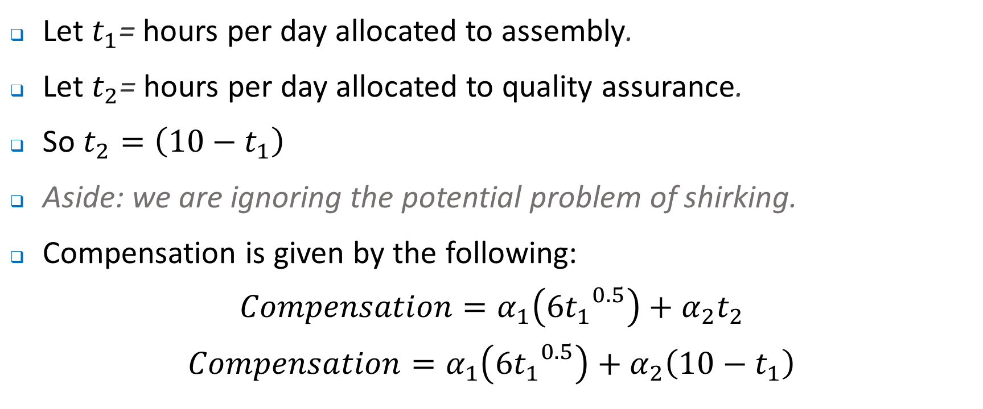
Multitasking
Let $t_{1}$= hours per day allocated to assembly.
Let $t_{2}$= hours per day allocated to quality assurance.
So $t_{2}=\left({10−t}_{1}\right)$
Aside: we are ignoring the potential problem of shirking.
Compensation is given by the following:
$$Compensation=α_{1}\left({{6t}_{1}}_{}^{0.5}\right)+α_{2}t_{2}$$
$$Compensation=α_{1}\left({{6t}_{1}}_{}^{0.5}\right)+α_{2}\left(10−t_{1}\right)$$

Slide 43
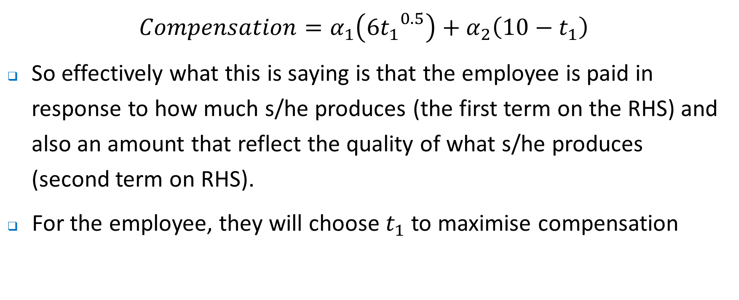
Multitasking
$$Compensation=α_{1}\left({{6t}_{1}}_{}^{0.5}\right)+α_{2}\left(10−t_{1}\right)$$
So effectively what this is saying is that the employee is paid in response to how much s/he produces (the first term on the RHS) and also an amount that reflect the quality of what s/he produces (second term on RHS).
For the employee, they will choose $t_{1}$ to maximise compensation

Slide 44
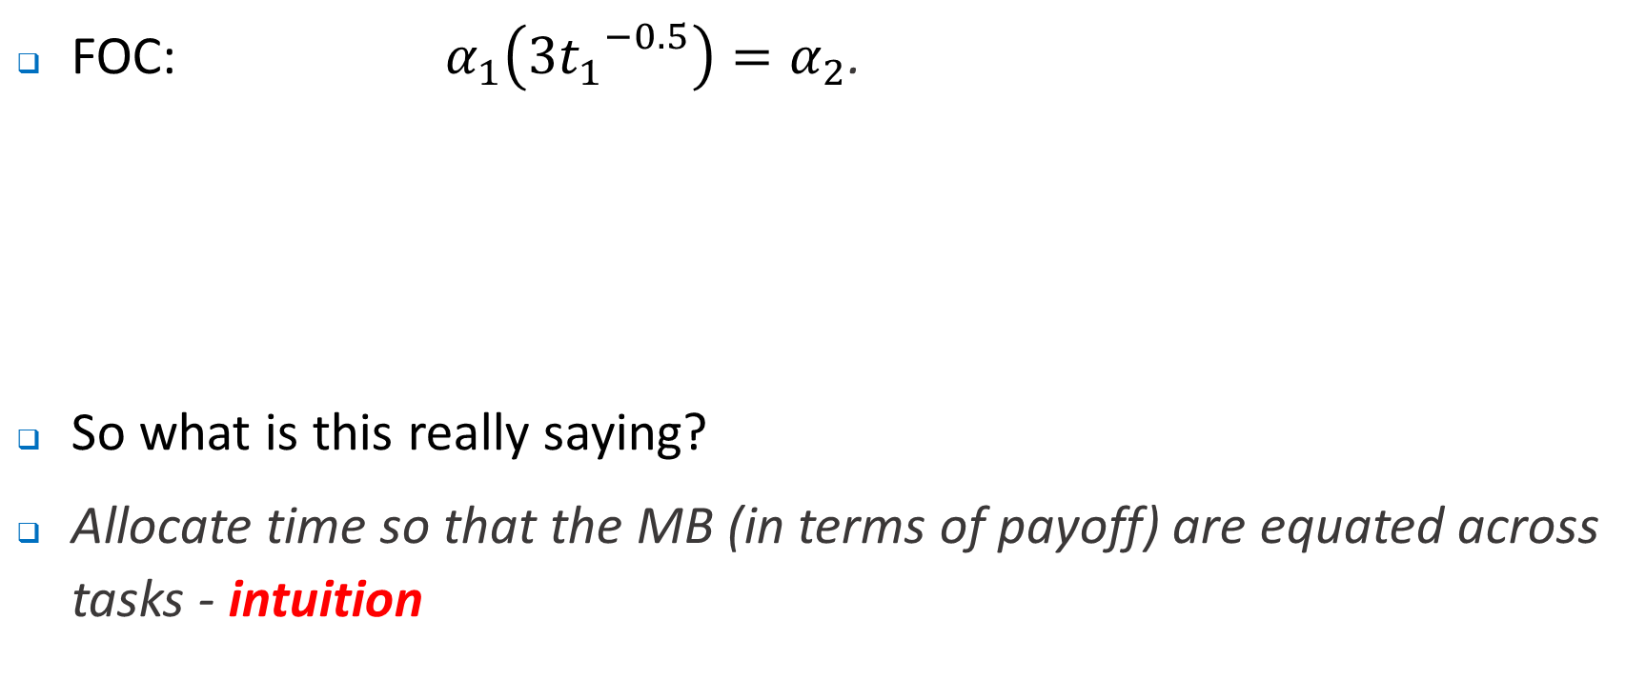
Multitasking
FOC: $α_{1}\left({{3t}_{1}}_{}^{−0.5}\right)=α_{2}$.
So what is this really saying?
Allocate time so that the MB (in terms of payoff) are equated across tasks - intuition
Marginal benefit from higher output
Marginal benefit from higher quality

Slide 45


($)
MB quantity i.e. $α_{1}\left({{3t}_{1}}_{}^{−0.5}\right)$
α₂
MB quality i.e. $α_{2}$
0
t₁
0
t₁*

Slide 46
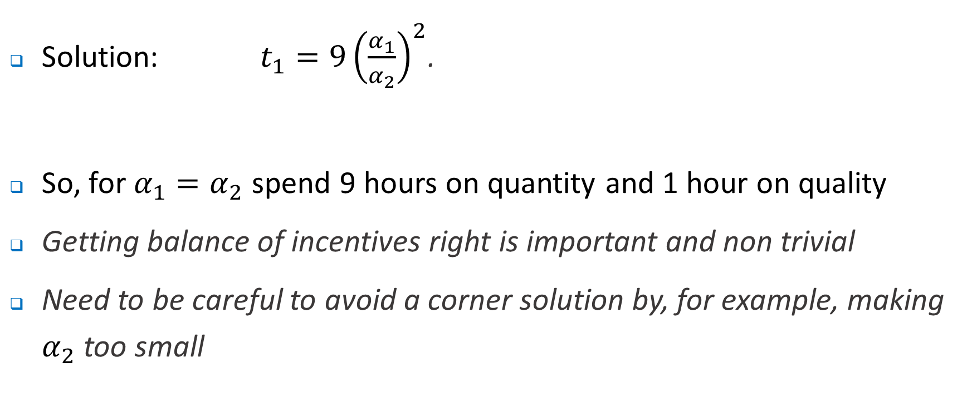
Multitasking
Solution: $t_{1}=9{\left(\frac{α_{1}}{α_{2}}\right)}^{2}$.
So, for $α_{1}=α_{2}$ spend 9 hours on quantity and 1 hour on quality
Getting balance of incentives right is important and non trivial
Need to be careful to avoid a corner solution by, for example, making $α_{2}$ too small

Slide 47


($)
MB quantity i.e. $α_{1}\left({{3t}_{1}}_{}^{−0.5}\right)$
Low α₂
MB quality i.e. low $α_{2}$
0
t₁
0
t₁*

Slide 48
So what does all this mean?
First, note that incentive pay schemes take many forms:
Piece rates and commissions
Bonuses
Prizes
Promotions
Profit sharing plans etc

Slide 49
So what does all this mean?
Moreover, incentive schemes may be useful in eliciting information and resolving some other challenges for firms:
What types of employees are likely to take on jobs with incentive based pay schemes?
Is it possible, for example, to design incentive based pay schemes so that only hard working individual, or high skilled individuals apply for jobs?
Perhaps yes, thereby at least partially overcoming the information asymmetry associated with hiring and firing
Do incentives work?
Why or why not?

Slide 50
Where to next?
Performance Evaluation–Tutorial next week based on this weeks lecture.
Vertical Integration (following week).
Tutorial following week based on this performance measures.
Wrap up – Tutorial based on this vertical integration.

