Slide 1
Lecture 10 Performance Evaluation

Slide 2
Outline
Chapter 16 (ignore. pp. 525-27) and 17 (ignore pp. 560-64) of Brickley et al.
Individual Performance Evaluation
The Ratchet Effect and the Horizon problem
Relative Performance Evaluation
Divisional Performance Evaluation
Transfer Pricing.

Slide 3
Individual Performance Evaluation at Lincoln
Lincoln Electric Company was a successful company – it had a highly developed performance evaluation regime tied to remuneration.
Two components to employee incentive scheme:
For production employees wages based entirely on piece rates
Year end bonus that was up to 100% of regular compensation
Performance Evaluation System
Pieces produced – the piece rate system. Note that this could be subject to manipulation, but there were well developed rules about how it was to operate
Merit rating – reflected the employees dependability, quality of output, ideas and cooperation etc as assessed by immediate supervisor.

Slide 4
Individual Performance Evaluation at Lincoln
As noted Lincoln had operated successfully for many years.
There were a number of features of how it operated that made it successful:
Evaluation systems were linked with the reward system – that is, the output from the performance evaluation system (pieces produced) were used in the reward system.
Performance evaluation used both objective (units produced) and subjective (dependability and reliability) measures of performance.
Failure to recognise how the three components of the firms organisational architecture (the decision rights system; its reward system and performance evaluation system) were closely linked led to large losses in new markets. There were of course other issues, but these were important.. A failure to understand how the components of organisational architecture complemented each other.
Why might this be the case?

Slide 5
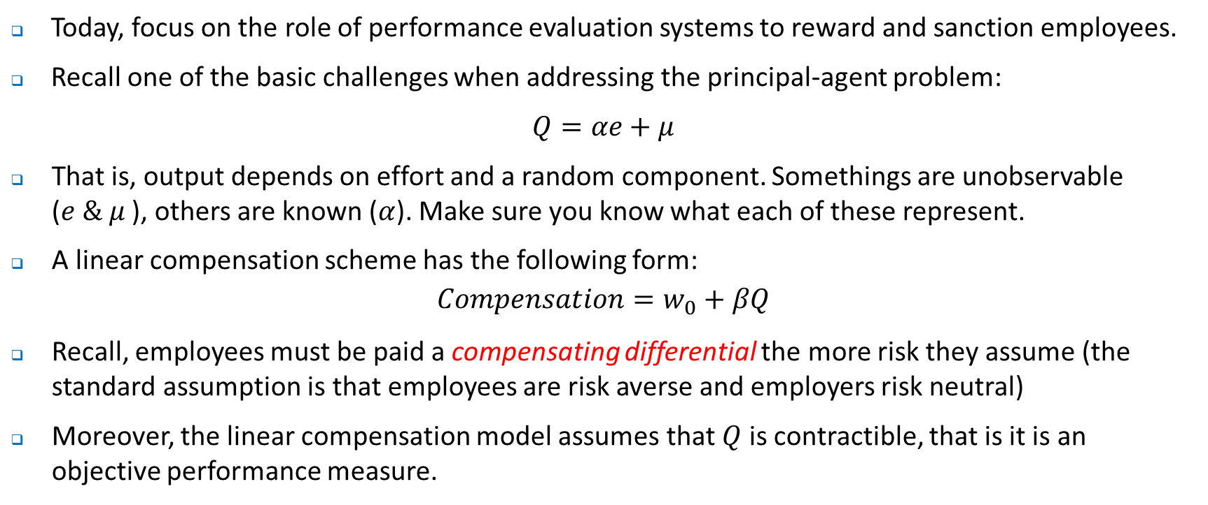
Individual Performance Evaluation
Today, focus on the role of performance evaluation systems to reward and sanction employees.
Recall one of the basic challenges when addressing the principal-agent problem:
$Q=αe+μ$
That is, output depends on effort and a random component. Somethings are unobservable ($e \& μ$ ), others are known ($α$). Make sure you know what each of these represent.
A linear compensation scheme has the following form:
$$Compensation=w_{0}+βQ$$
Recall, employees must be paid a compensating differential the more risk they assume (the standard assumption is that employees are risk averse and employers risk neutral)
Moreover, the linear compensation model assumes that $Q$ is contractible, that is it is an objective performance measure.

Slide 6
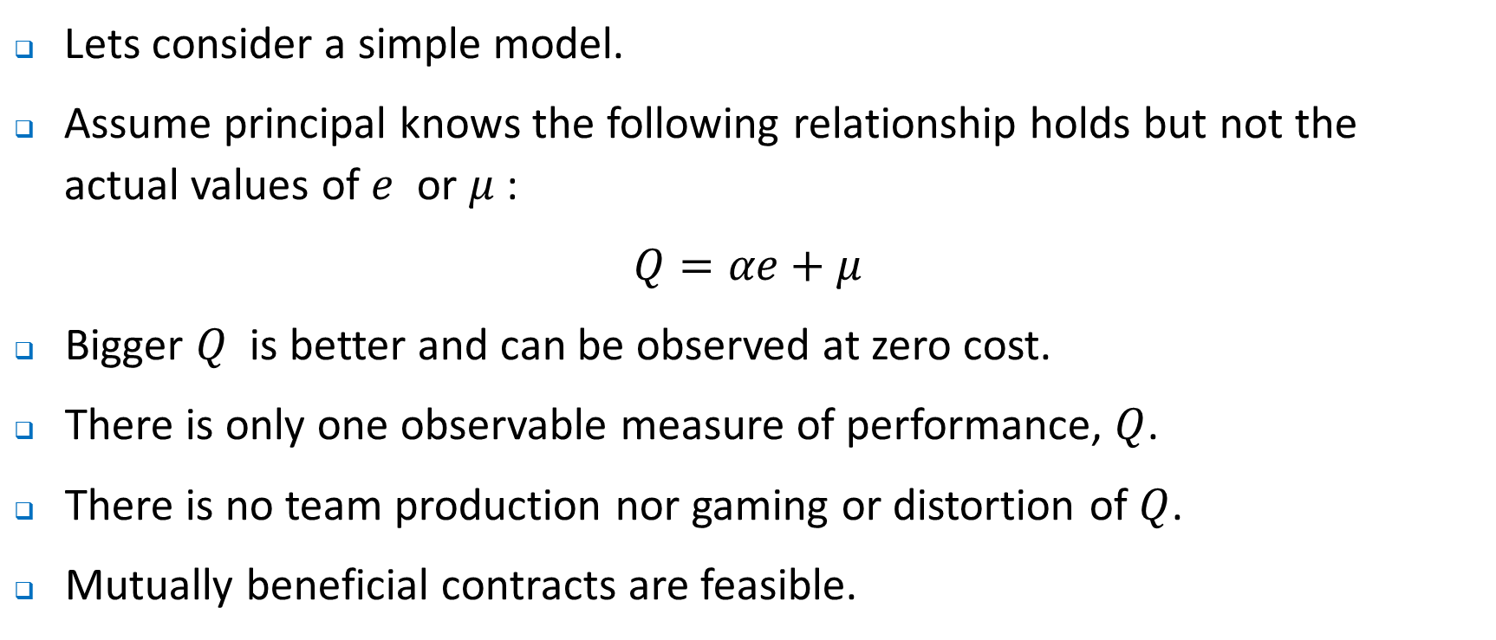
Individual Performance Evaluation
Lets consider a simple model.
Assume principal knows the following relationship holds but not the actual values of $e$ or $μ$:
$Q=αe+μ$
Bigger $Q$ is better and can be observed at zero cost.
There is only one observable measure of performance, $Q$.
There is no team production nor gaming or distortion of $Q$.
Mutually beneficial contracts are feasible.

Slide 7
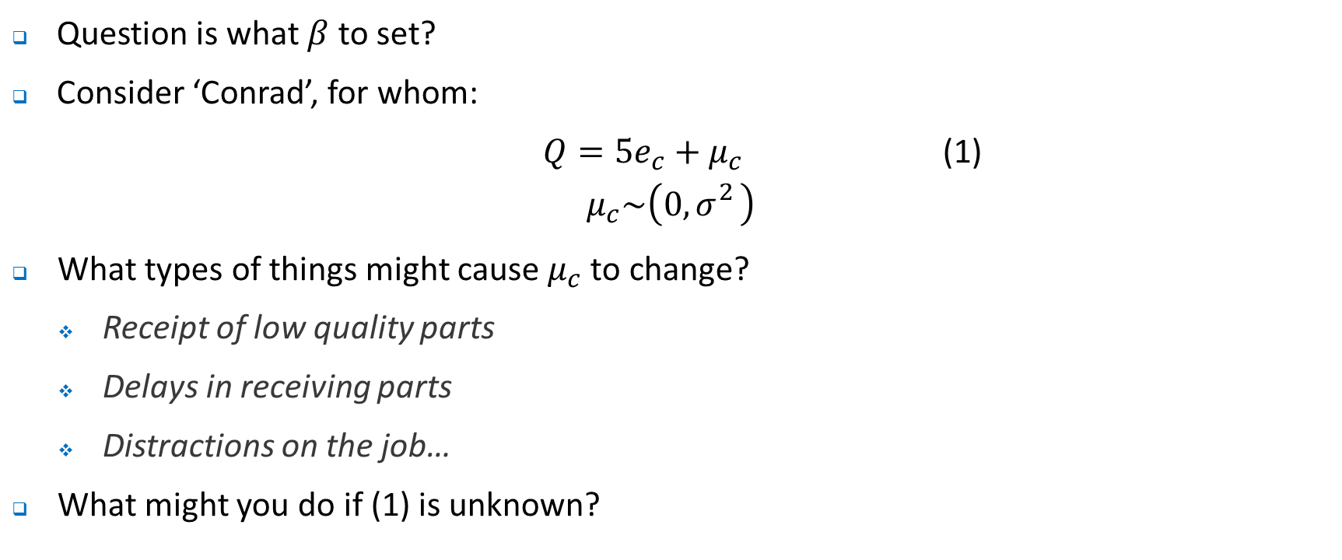
Individual Performance Evaluation
Question is what $β$ to set?
Consider ‘Conrad’, for whom:
$Q=5e_{c}+μ_{c}$ (1)
$$μ_{c}\sim \left(0, σ_{}^{2}\right)$$
What types of things might cause $μ_{c}$ to change?
Receipt of low quality parts
Delays in receiving parts
Distractions on the job…
What might you do if (1) is unknown?

Slide 8
Individual Performance Evaluation
What might you do if (1) is unknown?
You might use a ‘time and motion’ study:
Might have to be redone periodically – why?
Expensive
Potential bias – why?
Analysis of historical data:
Leads to a perverse incentive associated with the ‘ratchet effect’ associated with basing this years standard of performance on last years performance
The potential problem is pretty obvious.
Examples ….(Ontario Hospitals; sales person incentives; productivity improvements deferred in auto plants).

Slide 9
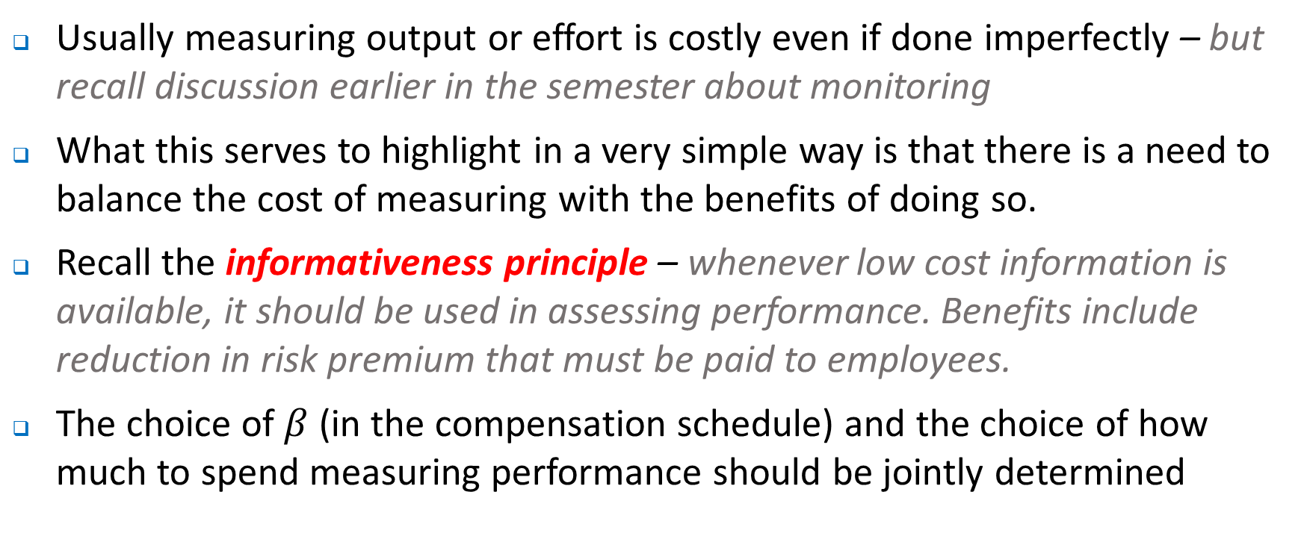
Measurement Costs of IPE
Usually measuring output or effort is costly even if done imperfectly – but recall discussion earlier in the semester about monitoring
What this serves to highlight in a very simple way is that there is a need to balance the cost of measuring with the benefits of doing so.
Recall the informativeness principle – whenever low cost information is available, it should be used in assessing performance. Benefits include reduction in risk premium that must be paid to employees.
The choice of $β$ (in the compensation schedule) and the choice of how much to spend measuring performance should be jointly determined

Slide 10
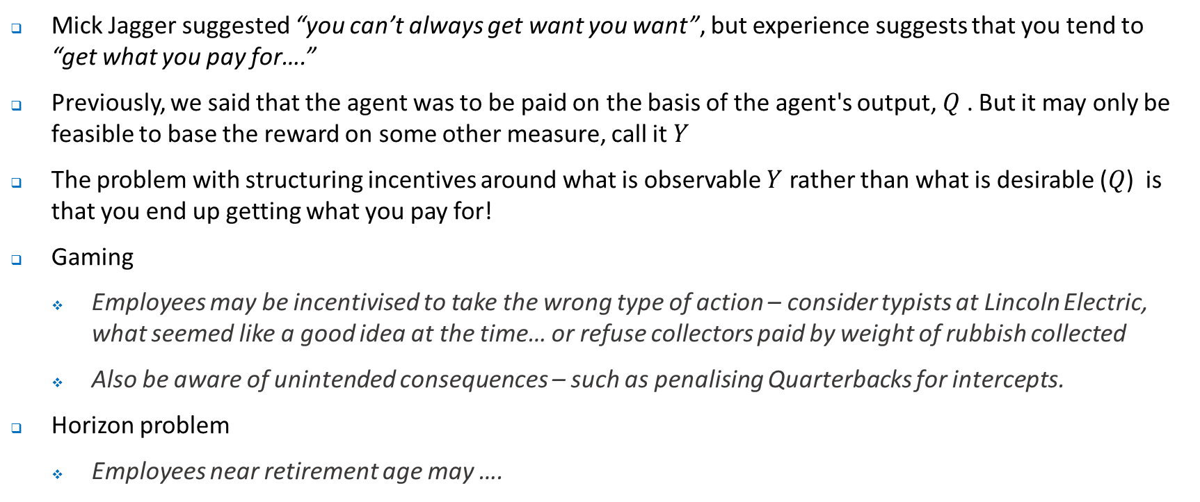
Opportunism
Mick Jagger suggested “you can’t always get want you want”, but experience suggests that you tend to “get what you pay for….”
Previously, we said that the agent was to be paid on the basis of the agent's output, $Q$ . But it may only be feasible to base the reward on some other measure, call it $Y$
The problem with structuring incentives around what is observable $Y$ rather than what is desirable ($Q$) is that you end up getting what you pay for!
Gaming
Employees may be incentivised to take the wrong type of action – consider typists at Lincoln Electric, what seemed like a good idea at the time… or refuse collectors paid by weight of rubbish collected
Also be aware of unintended consequences – such as penalising Quarterbacks for intercepts.
Horizon problem
Employees near retirement age may ….

Slide 11
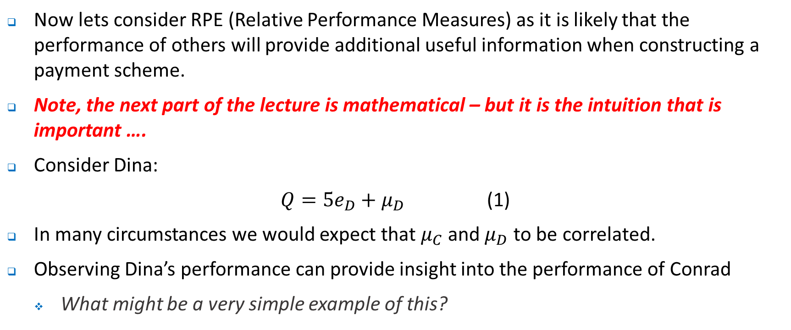
Relative Performance Evaluation
Now lets consider RPE (Relative Performance Measures) as it is likely that the performance of others will provide additional useful information when constructing a payment scheme.
Note, the next part of the lecture is mathematical – but it is the intuition that is important ….
Consider Dina:
$Q=5e_{D}+μ_{D}$ (1)
In many circumstances we would expect that $μ_{C}$ and $μ_{D}$ to be correlated.
Observing Dina’s performance can provide insight into the performance of Conrad
What might be a very simple example of this?

Slide 12
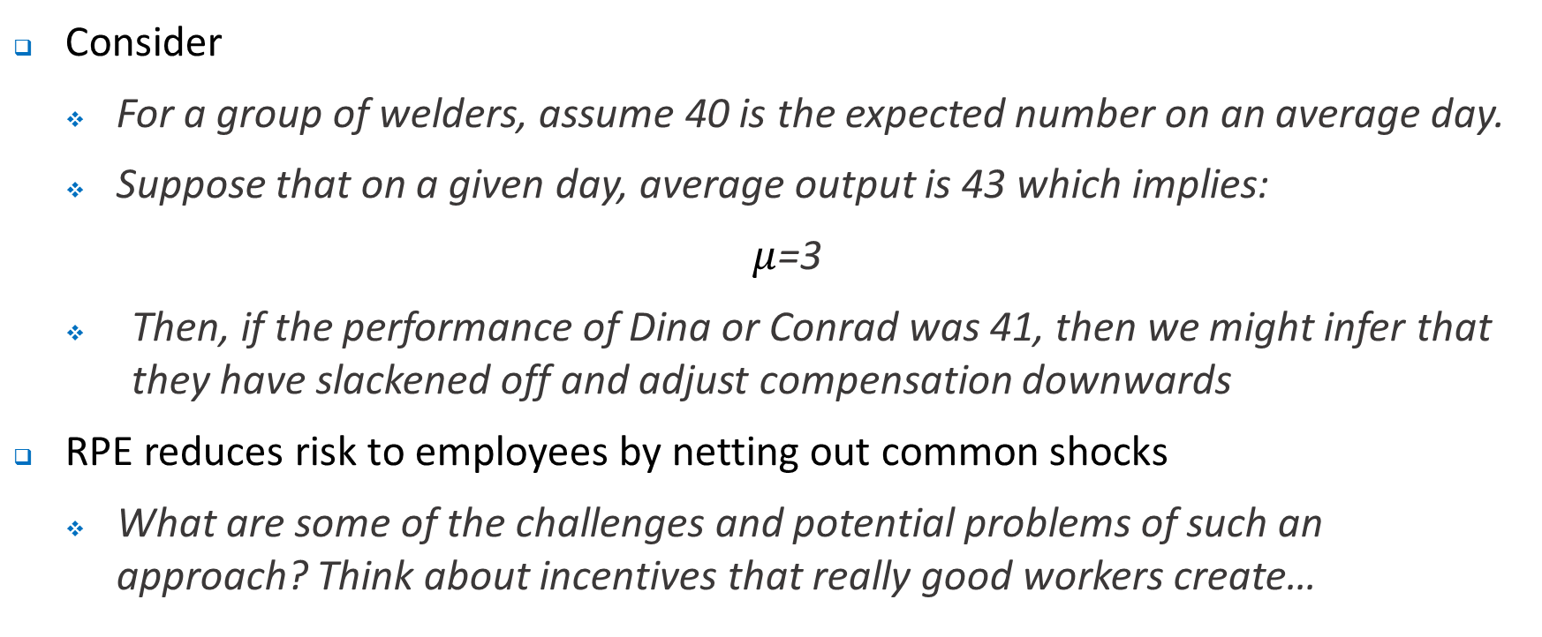
Relative Performance Evaluation
Consider
For a group of welders, assume 40 is the expected number on an average day.
Suppose that on a given day, average output is 43 which implies:
$μ$=3
Then, if the performance of Dina or Conrad was 41, then we might infer that they have slackened off and adjust compensation downwards
RPE reduces risk to employees by netting out common shocks
What are some of the challenges and potential problems of such an approach? Think about incentives that really good workers create…

Slide 13
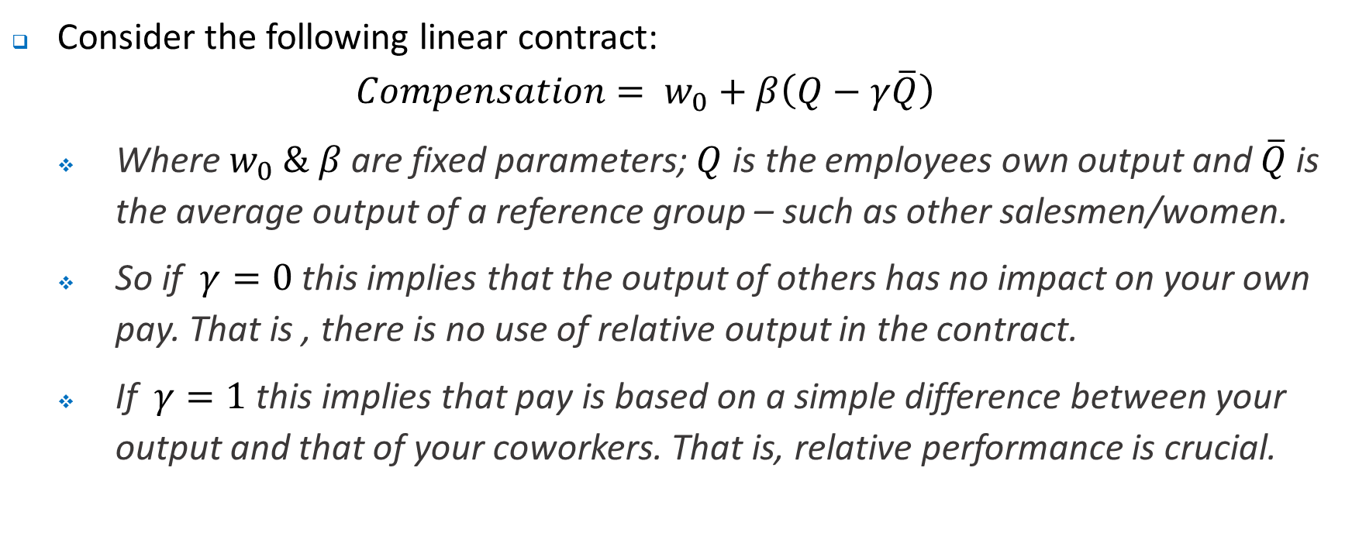
Relative Performance Contract
Consider the following linear contract:
$$Compensation= w_{0}+β\left(Q−γ\overline{Q}\right)$$
Where $w_{0} \& β$ are fixed parameters; $Q$ is the employees own output and $\overline{Q}$ is the average output of a reference group – such as other salesmen/women.
So if $γ=0$this implies that the output of others has no impact on your own pay. That is , there is no use of relative output in the contract.
If $γ=1$this implies that pay is based on a simple difference between your output and that of your coworkers. That is, relative performance is crucial.

Slide 14
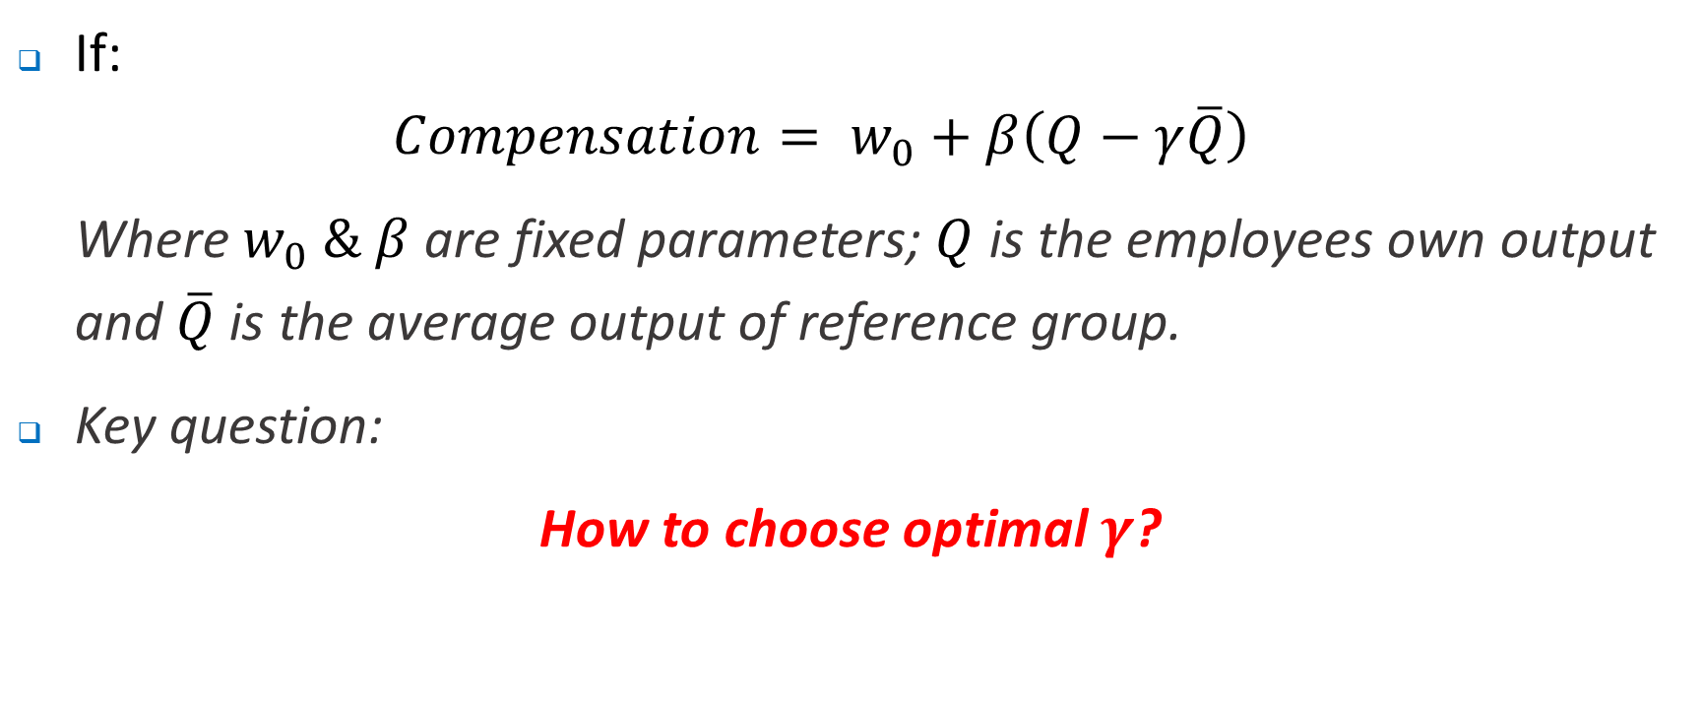
Relative Performance Contract
If:
$$Compensation= w_{0}+β\left(Q−γ\overline{Q}\right)$$
Where $w_{0} \& β$ are fixed parameters; $Q$ is the employees own output and $\overline{Q}$ is the average output of reference group.
Key question:
How to choose optimal $γ$?

Slide 15
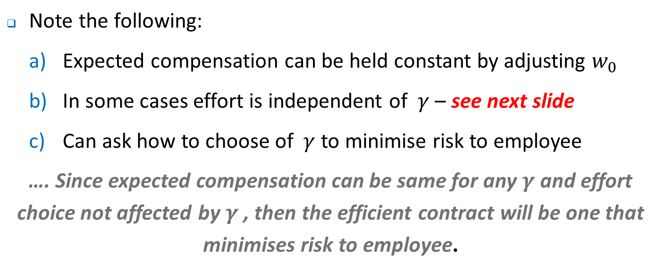
Relative Performance Contract
Note the following:
Expected compensation can be held constant by adjusting $w_{0}$
In some cases effort is independent of $γ$ – see next slide
Can ask how to choose of $γ$ to minimise risk to employee
…. Since expected compensation can be same for any $γ$ and effort choice not affected by $γ$ , then the efficient contract will be one that minimises risk to employee.

Slide 16
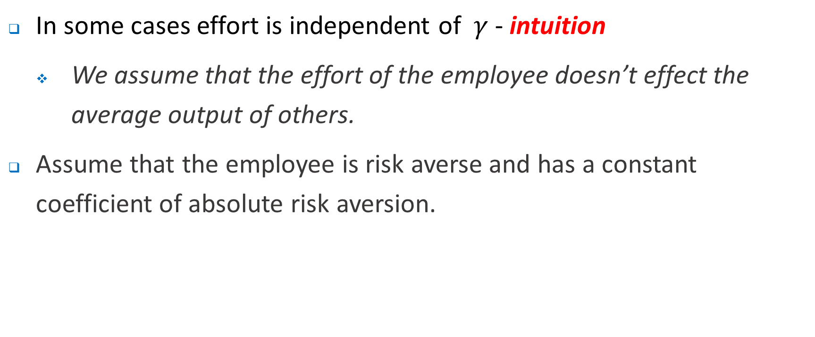
Relative Performance Contract
In some cases effort is independent of $γ$ - intuition
We assume that the effort of the employee doesn’t effect the average output of others.
Assume that the employee is risk averse and has a constant coefficient of absolute risk aversion.

Slide 17
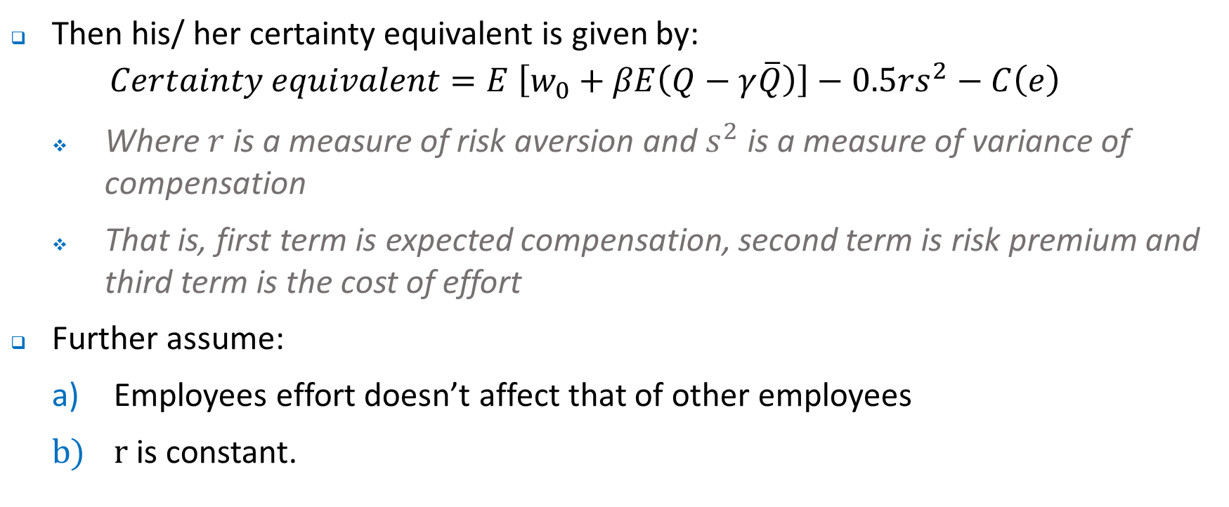
Relative Performance Contract
Then his/ her certainty equivalent is given by:
$$Certainty equivalent=E \left[w_{0}+βE\left(Q−γ\overline{Q}\right)\right]−0.5rs^{2}−C\left(e\right)$$
Where $r$ is a measure of risk aversion and $s^{2}$ is a measure of variance of compensation
That is, first term is expected compensation, second term is risk premium and third term is the cost of effort
Further assume:
Employees effort doesn’t affect that of other employees
$r$ is constant.

Slide 18
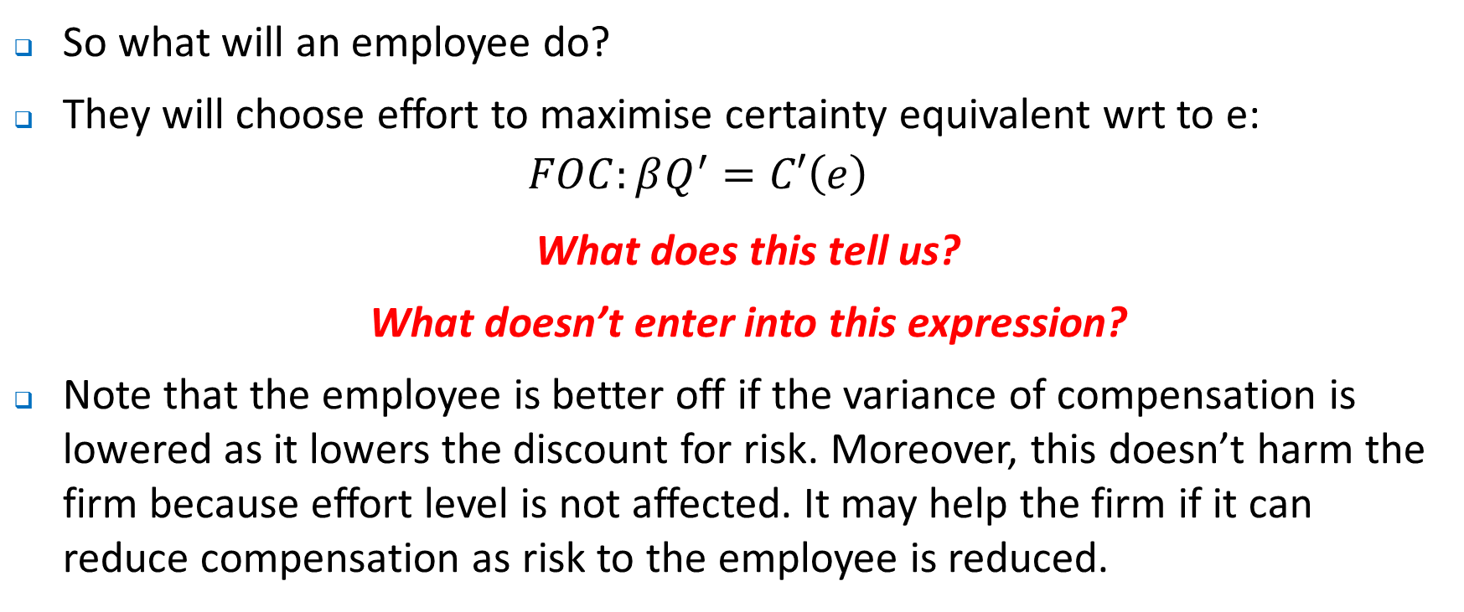
Relative Performance Contract
So what will an employee do?
They will choose effort to maximise certainty equivalent wrt to e:
$$FOC:βQ^{′}=C′\left(e\right)$$
What does this tell us?
What doesn’t enter into this expression?
Note that the employee is better off if the variance of compensation is lowered as it lowers the discount for risk. Moreover, this doesn’t harm the firm because effort level is not affected. It may help the firm if it can reduce compensation as risk to the employee is reduced.

Slide 19
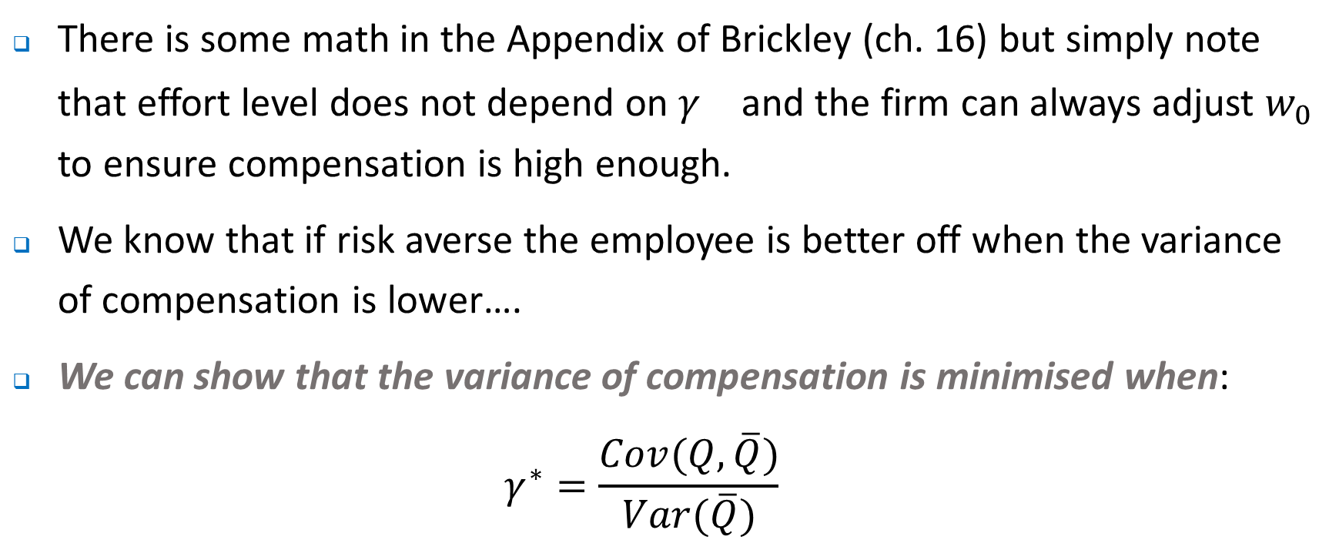
Relative Performance Contract
There is some math in the Appendix of Brickley (ch. 16) but simply note that effort level does not depend on $γ^{}$ and the firm can always adjust $w_{0}$ to ensure compensation is high enough.
We know that if risk averse the employee is better off when the variance of compensation is lower….
We can show that the variance of compensation is minimised when:
$$γ^{∗}=\frac{Cov(Q,\overline{Q})}{Var(\overline{Q})}$$

Slide 20
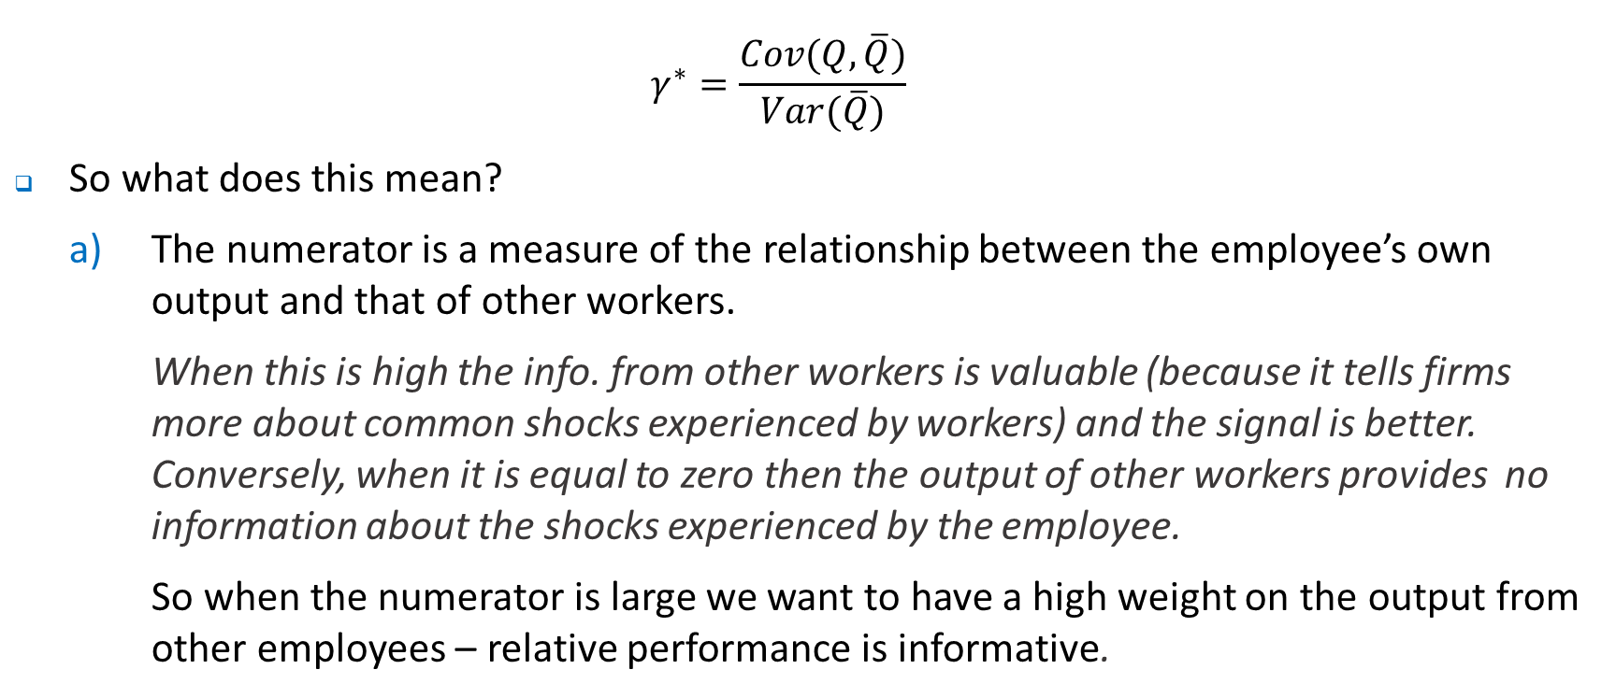
Relative Performance Contract
$$γ^{∗}=\frac{Cov(Q,\overline{Q})}{Var(\overline{Q})}$$
So what does this mean?
The numerator is a measure of the relationship between the employee’s own output and that of other workers.
When this is high the info. from other workers is valuable (because it tells firms more about common shocks experienced by workers) and the signal is better. Conversely, when it is equal to zero then the output of other workers provides no information about the shocks experienced by the employee.
So when the numerator is large we want to have a high weight on the output from other employees – relative performance is informative.

Slide 21
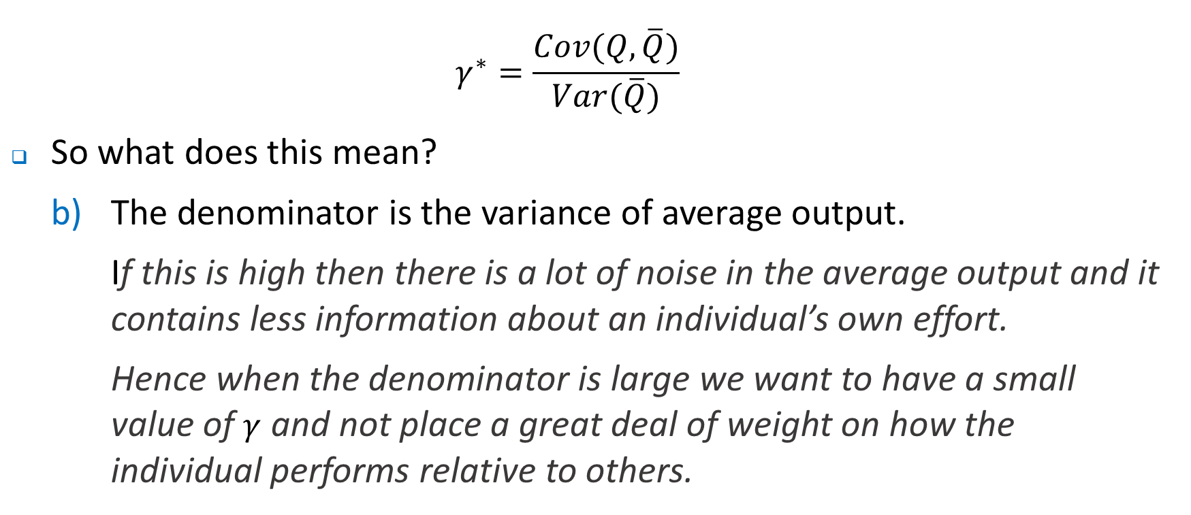
Relative Performance Contract
$$γ^{∗}=\frac{Cov(Q,\overline{Q})}{Var(\overline{Q})}$$
So what does this mean?
The denominator is the variance of average output.
If this is high then there is a lot of noise in the average output and it contains less information about an individual’s own effort.
Hence when the denominator is large we want to have a small value of $γ$ and not place a great deal of weight on how the individual performs relative to others.

Slide 22
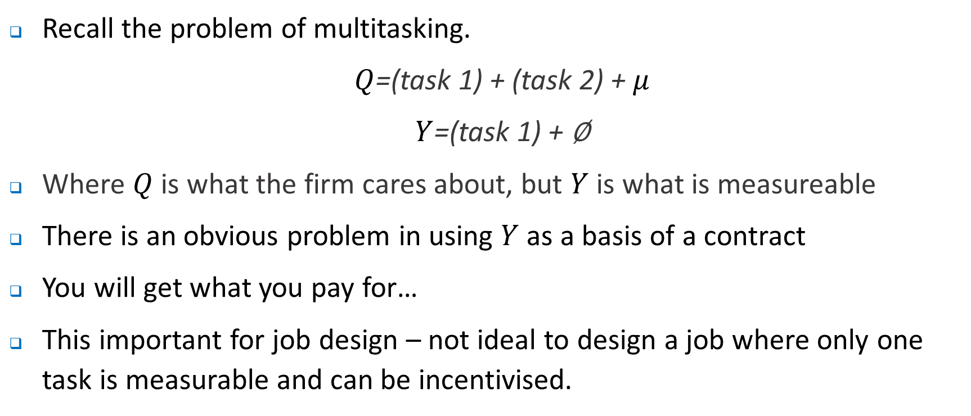
Subjective Performance Evaluation
Recall the problem of multitasking.
$Q$=(task 1) + (task 2) + $μ$
$Y$=(task 1) + ∅
Where $Q$ is what the firm cares about, but $Y$ is what is measureable
There is an obvious problem in using $Y$ as a basis of a contract
You will get what you pay for…
This important for job design – not ideal to design a job where only one task is measurable and can be incentivised.

Slide 23
Subjective Performance Evaluation
But this also has potential important implications for subjective performance evaluation
Potential to assess on a more diverse range of tasks, some of which are difficult to measure - being part of a team, being cooperative etc.
Possible subjective measures include:
Standard rating systems – see discussion in text
Goal based systems – see discussion in text
Also, think about problems with subjective evaluation approaches:
Shirking among supervisors – how might they respond?
Forced distributions of employee performance – might generate what problems?
Influence costs

Slide 24
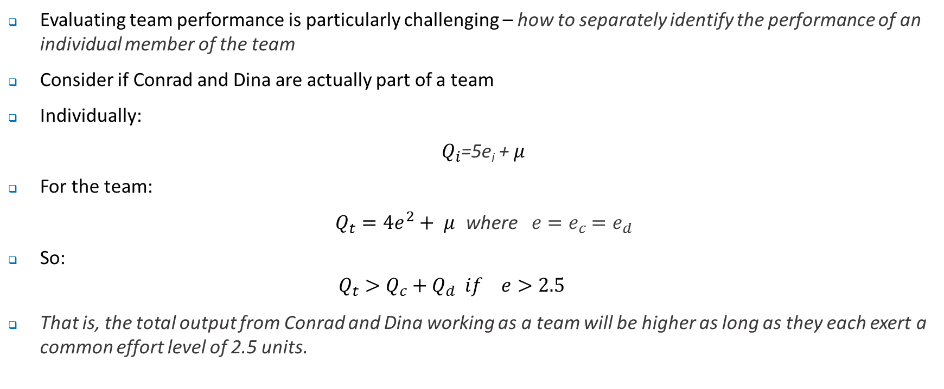
Evaluating Team Performance
Evaluating team performance is particularly challenging – how to separately identify the performance of an individual member of the team
Consider if Conrad and Dina are actually part of a team
Individually:
$Q_{i}$=5e_{i} + $μ$
For the team:
$Q_{t}=4e^{2}+ μ$ where $e=e_{c}$ $=e_{d}$
So:
$$Q_{t}>Q_{c}+Q_{d} if e>2.5$$
That is, the total output from Conrad and Dina working as a team will be higher as long as they each exert a common effort level of 2.5 units.

Slide 25
Expected output
Team output
Sum individual outputs
25
0
Individual e (effort)
0
e=2.5

Slide 26
Evaluating Team Performance
So why is evaluating team output so difficult?
Recall the fundamental problem of team work.
What types of approaches might be used? Do these create problems?

Slide 27
Divisional Performance Evaluation
Recall that firms can be structured in various ways.
See Appendix to lecture 8: U form, M form and Matrix form
With any organisational structure comes a particular partition of decision rights or decision making power.
In turn, decisions over issues such as R&D, pricing, capital expenditure etc need to be made and evaluated.

Slide 28
Divisional Performance Evaluation
Different ways in which the sub-units within an organisation can be characterised:
Cost Centres – assigned the ‘decision right’ to produce a stipulated level of output with authority to choose the mix of inputs. Possible objectives to measure cost centre performance:
Minimise cost for a given level of output.
Maximise output for a given budget
Fine as long as ….
Potential problems include ….
What if cost centres were asked to minimise average cost?

Slide 29
Divisional Performance Evaluation
Different ways in which the sub-units within an organisation can be characterised:
Expense Centres – assigned the ‘decision right’ to maximise level of output (often a service) with fixed budget.
Output tends to be measured more subjectively and this can create problems.
Revenue Centres – may be given the objective of maximising revenue for a given price (or quantity) and budget for personnel and expenses.
Revenue maximisation generally requires finding point where MR=0.
This potentially is a problem – why? Hint: Think about the profit maximisation rule

Slide 30
Divisional Performance Evaluation
Different ways in which the sub-units within an organisation can be characterised:
Profit Centres – composed of several cost/ expense and revenue centres. Provided with a fixed capital budget and allocated decision rights for input mix, product mix and prices or quantities.
Key issue is that of transfer pricing.
Also, what happens when profit centres compete – what will be maximised? Think about externalities.

Slide 31
Divisional Performance Evaluation
Different ways in which the sub-units within an organisation can be characterised:
Investment Centres – have control over capital expenditures.
Measure of performance may be return on assets – ratio of accounting net income divided by total assets invested in the investment centre.
However, this potentially creates distortions depending on performance measure

Slide 32
Transfer Pricing
When one division transfers something (a good or service) to another, it usually charges a transfer price. Key question is:
What should that price be?
Important because: “The choice of transfer-pricing method does not merely reallocate total company profits among business units, but affects the firms total profits”
May encourage inappropriate outsourcing if the price is set too high, too much internal investment if the price is too low.
We ignore tax issues, but note that these are likely to be important. For example, IKEA and firms that shift profits back to Ireland or Singapore…

Slide 33
Transfer Pricing – perfect information
What is the correct transfer price:
“The optimal transfer price for a product or service is its opportunity cost – the value foregone by not using the product transferred in its next best alternative”
Transfer pricing with costless information:
Assume MC = $3 and that the US plant has excess capacity.
Making in US and transferring it to Europe means it can be sold @ $5.
Not manufacturing means saving $3 but foregoing $5 in European revenue
Manufacturing in US and transferring gives net receipt of $2.
Here the opportunity cost or resources foregone by transferring it from the US to Europe is $3 which in this case is the actual marginal cost of production.

Slide 34
Transfer Pricing – perfect information
But what if the US division could sell the intermediate input for $6 in the United States? That is, the marginal revenue from selling it to an external firm in the United States is $6.
Further assume that it does not have excess capacity and so cannot sell in the US and to the European profit centre.
In this case, the opportunity foregone by transferring it to the European profit centre is not $3 (the MC of production), but rather $6 (which is actually the MR foregone).
…Here, it would be optimal to sell externally rather than transfer…
By setting price equal to opportunity cost, the European division will purchase (and the US division sell) just the right amount

Slide 35
Transfer Pricing – asymmetric information
Previously assumed we knew:
MC of production
Intermediaries external price
European MR
Excess capacity in the US.
These may be known or they may not be known – in fact we would expect in a large organisation that this information would be distributed among different individuals/ organisational units. Hence the decentralisation of decision rights.
Lets consider the problem when one part of a firm (call it the Manufacturing division) has some information which is important in context of a transfer pricing decision.

Slide 36
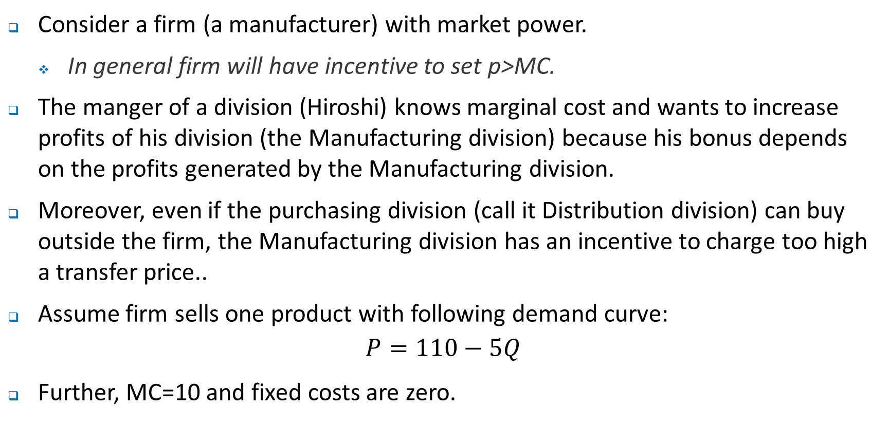
Transfer Pricing – asymmetric information
Consider a firm (a manufacturer) with market power.
In general firm will have incentive to set p>MC.
The manger of a division (Hiroshi) knows marginal cost and wants to increase profits of his division (the Manufacturing division) because his bonus depends on the profits generated by the Manufacturing division.
Moreover, even if the purchasing division (call it Distribution division) can buy outside the firm, the Manufacturing division has an incentive to charge too high a transfer price..
Assume firm sells one product with following demand curve:
$$P=110−5Q$$
Further, MC=10 and fixed costs are zero.

Slide 37
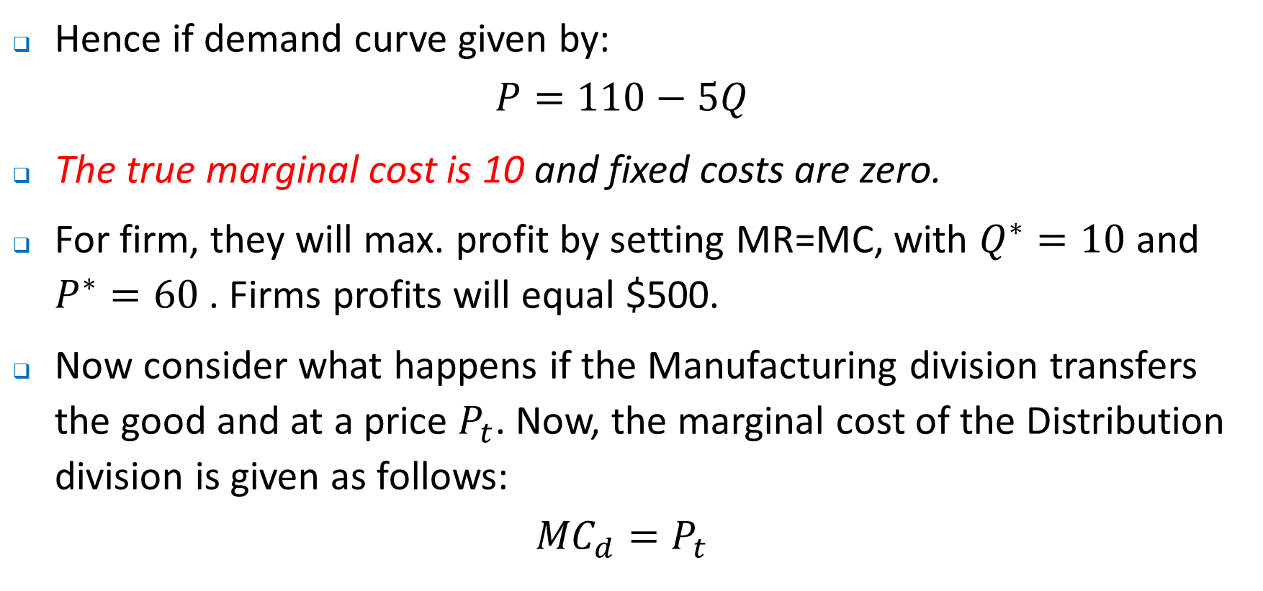
Transfer Pricing – asymmetric information
Hence if demand curve given by:
$$P=110−5Q$$
The true marginal cost is 10 and fixed costs are zero.
For firm, they will max. profit by setting MR=MC, with $Q^{∗}=10$ and $P^{∗}=60$ . Firms profits will equal $500.
Now consider what happens if the Manufacturing division transfers the good and at a price $P_{t}$. Now, the marginal cost of the Distribution division is given as follows:
$${MC}_{d}=P_{t}$$

Slide 38
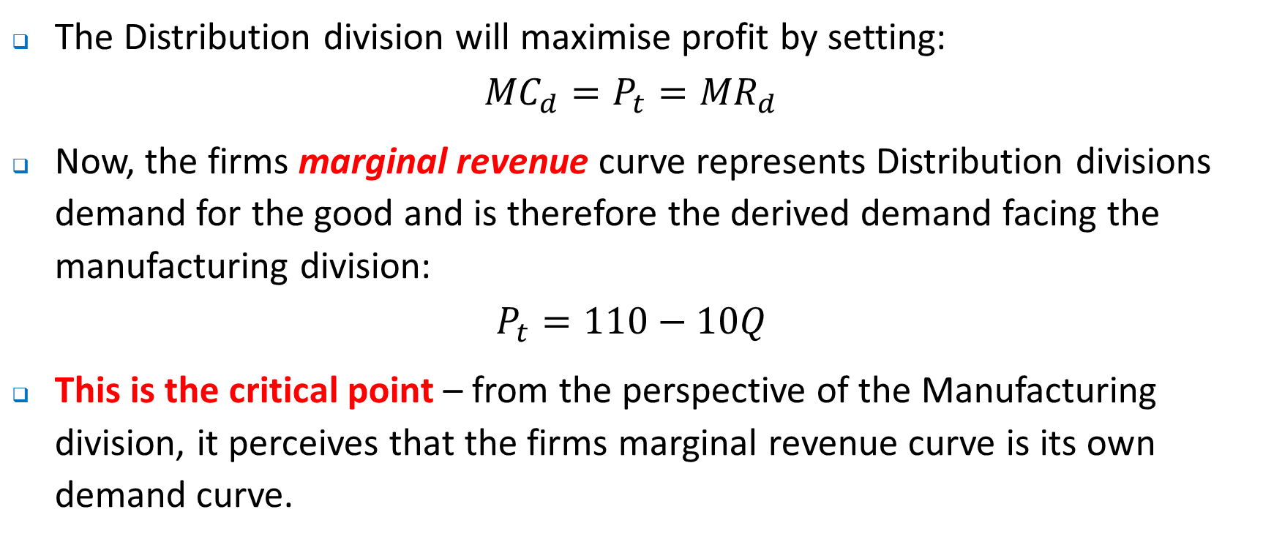
Transfer Pricing – asymmetric information
The Distribution division will maximise profit by setting:
$${MC}_{d}=P_{t}={MR}_{d}$$
Now, the firms marginal revenue curve represents Distribution divisions demand for the good and is therefore the derived demand facing the manufacturing division:
$$P_{t}=110−10Q$$
This is the critical point – from the perspective of the Manufacturing division, it perceives that the firms marginal revenue curve is its own demand curve.

Slide 39
Transfer Pricing – asymmetric information
110
Manufacturing
110
Distribution
10
Q
Q
5.5
11
22
11

Slide 40
Transfer Pricing – asymmetric information
Now assume that manufacturing sets the transfer price – it effectively has monopoly power and its decisions cannot be monitored because of costly information.
What does manufacturing do in terms of price and quantity?

Slide 41
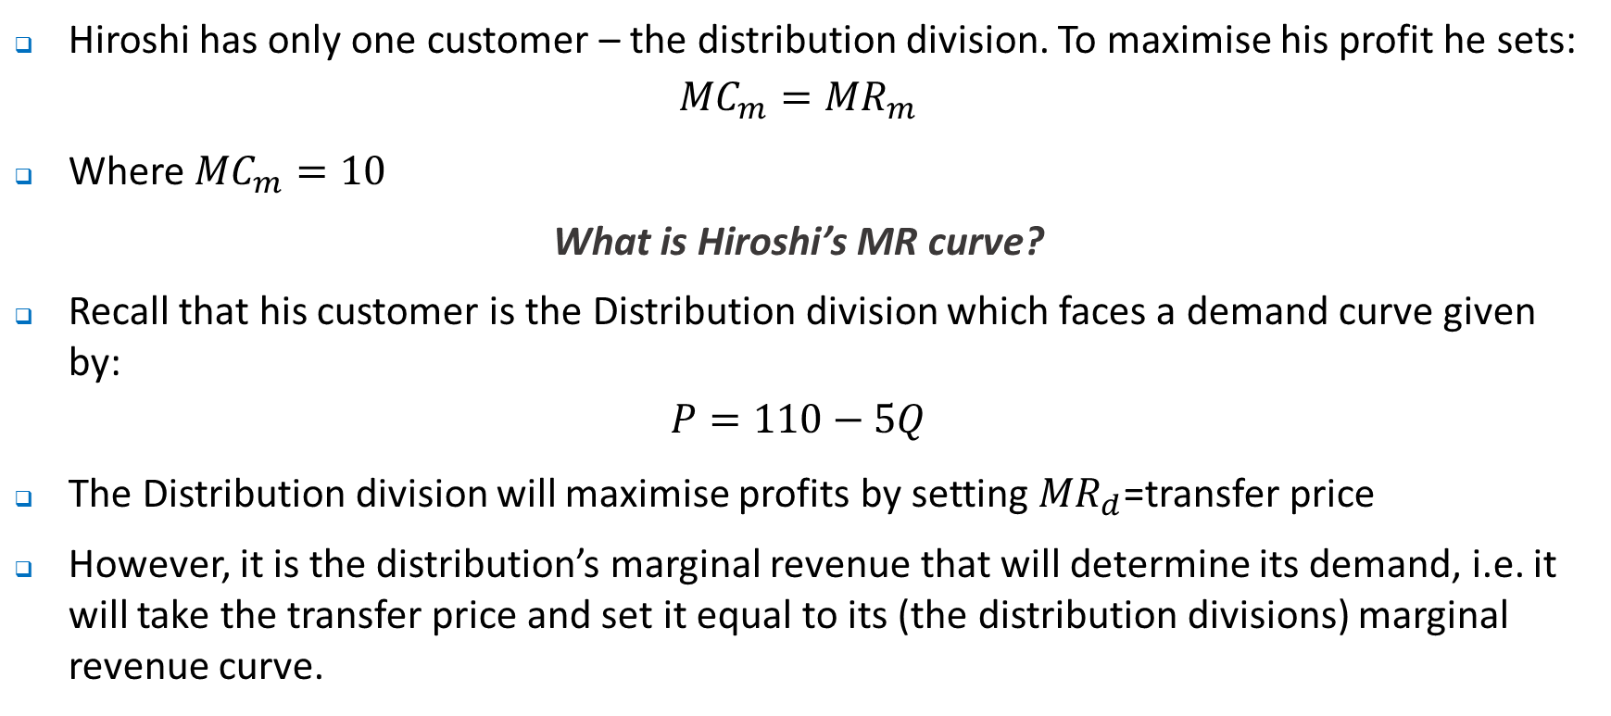
Transfer Pricing – asymmetric information
Hiroshi has only one customer – the distribution division. To maximise his profit he sets:
$${MC}_{m}={MR}_{m}$$
Where ${MC}_{m}=10$
What is Hiroshi’s MR curve?
Recall that his customer is the Distribution division which faces a demand curve given by:
$$P=110−5Q$$
The Distribution division will maximise profits by setting ${MR}_{d}$=transfer price
However, it is the distribution’s marginal revenue that will determine its demand, i.e. it will take the transfer price and set it equal to its (the distribution divisions) marginal revenue curve.

Slide 42
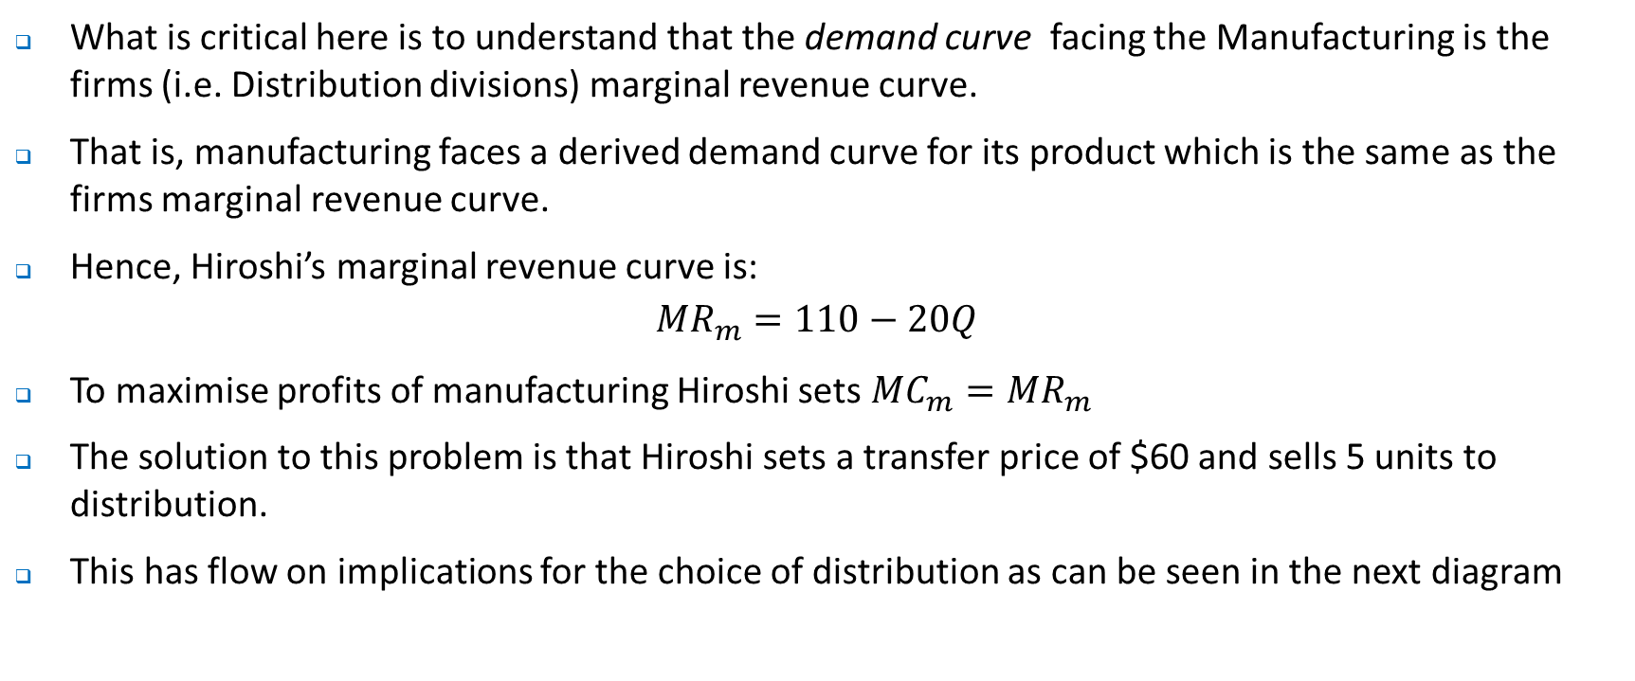
Transfer Pricing – asymmetric information
What is critical here is to understand that the demand curve facing the Manufacturing is the firms (i.e. Distribution divisions) marginal revenue curve.
That is, manufacturing faces a derived demand curve for its product which is the same as the firms marginal revenue curve.
Hence, Hiroshi’s marginal revenue curve is:
$${MR}_{m}=110−20Q$$
To maximise profits of manufacturing Hiroshi sets ${MC}_{m}={MR}_{m}$
The solution to this problem is that Hiroshi sets a transfer price of $60 and sells 5 units to distribution.
This has flow on implications for the choice of distribution as can be seen in the next diagram

Slide 43
Transfer Pricing – asymmetric information
110
Manufacturing
110
Distribution
85
60
MC_{m}=60
10
Q
Q
5
11
5
22

Slide 44
Transfer Pricing – asymmetric information
When the correct transfer price of $10 was charged, firm profits equalled $500.
Now, firm profits equal $375, with manufacturing reporting profits of $250 and distribution of $125.
We can think of this as a problem similar to double marginalisation - successive monopolies (this time inside the firm) reduce the quantity traded and decrease overall profit.
Basic problem is that with a transfer price of $60, the opportunity cost to the firm of producing extra units of output are overstated.
If Hiroshi was ‘honest’ and reported a marginal cost of $10 and charged this as the transfer price, then manufacturing’s profits would be equal to …?

Slide 45
Transfer Pricing – asymmetric information
Think about what is happening here. There are a number of problems:
Asymmetric information.
Structure of rewards and performance evaluation – creates incentive to distort prices.
Challenge associated with where relevant knowledge lies about the capacity of divisions to sell internally and externally which will impact on the opportunity cost calculation
Who has the decision rights around pricing

Slide 46
Transfer Pricing – asymmetric information
Per Holmstrom and Tirole:
“The economists first instinct is to set the transfer price equal to MC. But it may be difficult to find out MC. As a practical matter, MC information is rarely known to anyone in the firm, because it depends on opportunity costs that vary with capacity use. And even if MC information is available, there is no guarantee that it would be revealed in a truthful fashion for the purpose of determining an optimal transfer price”

Slide 47
How to set transfer prices
Use market based prices – should lead to correct make-versus-buy decision
What might be the problem with such an approach, i.e. think about how many firms the market can sustain and its implications for average cost? What other issues such as synergies might such an approach ignore?
Use marginal cost transfer prices – i.e. the value of resources foregone to produce the last unit.
What might be the problem with such an approach, i.e. think about cost structures – how might these challenges be met? What if MC is not constant – what challenges might this lead to?

Slide 48
How to set transfer prices
Use full-cost based transfer prices
Are there any advantages of such an approach? What problems might this resolve? What problems might it create? What types of inefficiencies might it create?
Use negotiated transfer prices –
What might be the problem with such an approach, i.e. think about cost structures – how might these challenges be met? What if MC is not constant – what challenges might this lead to?

Slide 49
Where to next?
Vertical Integration.
Tutorial following week based on this performance measures.
Wrap up – Tutorial based on this vertical integration.

