Slide 1
Lecture 11 Vertical Integration – Boundaries of the Firm

Slide 2
Outline
Chapter 19 Brickley et al.
Recommended reading: Lecture Notes 3 and 4 Gibbons (http://web.mit.edu/rgibbons/www/ )
The firm as a vertical chain of production
Discuss the ‘Make versus Buy Decision’ and identify benefits of alternatives
Define ‘Firm Specific Assets’ and the ‘Hold Up’ problem.
Describe ‘Double Mark Up’ problems.

Slide 3
Vertical Chain of Production
Can think about a firm as a ‘vertical chain’. A vertically integrated firm participates in more than one successive stage of the vertical chain
Note that the example used in the textbook refers to computers, but approach obviously applies more generally.. For e.g., furniture manufacturers that could own the forests and retail stores…
Raw materials
Support Services
Accounting
Finance
Human resources
Legal
Marketing
Transport & storage
Intermediate inputs
Assembly
Transport & storage
Distribution ,Sales & Service

Slide 4
Vertical Chain of Production
A key question for the firm is:
What to do in house versus what to outsource?
The vertical boundaries of the firm define the activities that the firm itself performs as opposed to what it purchases from independent firms in the marketplace.
It is important to note that the trade-off between technical efficiency (cost minimisation) and agency efficiency (minimisation of coordination costs etc) – perhaps technical efficiency is best achieved by buying on the market. Alternatively, can agency costs be minimised when activities are done in house?
Optimal vertical organization requires that the sum of technical inefficiencies and agency inefficiencies are minimized.

Slide 5
Vertical Chain of Production
Apple and many others are examples of firms that do much outsourcing. Nike and Reebok do little or no production itself. Typical US manufacturer outsources 70-80 percent of its finished product.
Can think about forwards or downstream integration (Alcoa making aluminum foil) or backwards / upstream integration (HBO/ Netflix produced own programs)
Why might this be important?
Implications for decision rights – outsourcing reassigns decisions rights re assets & employees across firms.
Implications for compensation and performance evaluation systems – indeed compensation levels are one reason much outsourcing occurs offshore.
Presents the question why outsource and what might be the right level of outsourcing?
What are the implications of outsourcing?

Slide 6
Vertical Chain of Production
As noted, when firms occupy more than one step in the production process we refer to them as ‘vertically integrated’.
The choice of whether to do something in-house versus outsourcing is not a binary choice.
Rather there is a spectrum of choices available to firm:
Non market transactions
Market transactions
Spot market
Long term contracts
Vertical integration

Slide 7
Vertical Chain of Production
Long term contracts themselves can take on a variety of forms.
For example:
Standard supply and distribution contracts.
Joint ventures.
Lease contracts.
Franchise agreements
Strategic alliances.

Slide 8
Make versus Buy – some common fallacies
Firms should make an asset rather than buy it if it is a source of competitive advantage for the firm – should just buy it if cheaper to do so. If it is truly a source of competitive advantage and is easily available on the market then perhaps…
Buy rather than make to avoid costs of making it – it doesn’t avoid those costs.
Make to avoid paying profit margin to intermediary – really want to compare economic and accounting profits. Ask yourself, what are the opportunity costs of producing the item?
Avoid high prices during peak demand or scarce supply – there are other options such as creating capital reserve to insulate against price fluctuations.

Slide 9
Benefits of Using Spot Markets or ‘Buying’
Generally speaking will offer a good outcome if such markets are competitive
Get the item at the lowest possible cost in the long run – recall that competitive markets lead to price equal to the minimum of the LRAC curve
Get the advantage of any economies of scale and learning economies that might be available
Don’t, in general, have to worry about providing incentives or motivating employees, i.e. avoid bureaucracy and agency costs – somebody else’s problem. Such problems might be particularly severe in a large vertically integrated organisation.

Slide 10
Benefits of Non Market Transactions – ‘Making’
Contracting Costs – potentially high when engaged in market transactions
That is, buying something on the market can be costly….
Why?
Contracts are incomplete because of:
Bounded rationality on the part of contracting parties – just not possible to identify every possible contingency
Difficulties specifying or measuring performance
Asymmetric information
More generally, contract law leaves many issues to be determined (in the event of a dispute).

Slide 11
Benefits of Non Market Transactions - Making
A key issue facing firms using the market (i.e. contracts) is the challenge of ’firm or relationship’ specific assets…
“Assets that are substantially more valuable in their current use than in their next best alternative use.”
“..(A)n investment made to support a given transaction…”
Examples include – Alaskan oil pipeline, a coal mine located next to a power station, software written for a particular firm….
In each case the asset has more limited uses outside its current or designated use. Usually, the asset will have been made to support a particular contract

Slide 12
Relationship Specific Investments & Hold Up
Q^{n}: Where does specificity derive from?
Site specificity – asset is useful to only a limited set of buyers or suppliers because of location, e.g. coal mine or parts of a steel mill.
Physical specificity – asset is useful to only a limited set of buyers or suppliers because of design, e.g. specialised tool making equipment for car manufacturers.
Human-asset specificity – transaction requires specialised knowledge on part of parties to the transaction, e.g. knowledge acquired to write software for a company that has specific procedures.
Dedicated assets – asset expansion necessitated by few buyers, e.g. chip manufacturer, investments made by a port owner.

Slide 13
Relationship Specific Investments & Hold Up
Q^{n}: Why does specificity create challenges?
Consider the following situation:
A firm makes an investment of $50,000 in a machine tool to make a specific component for XYZ Inc.
Assume that variable cost of production is $1 and the life of the machine is 50,000 units.
Requires payment of $2 per item to break even…
But what might happen after contract signed and the investment has been made?
Incentive exists for buyer to argue that ‘circumstances have changed’ and to force a seller to accept as little as $1 per piece
Hold-up problem
One way to think about the problem here is that after the investment has been made it is a sunk cost and one of the parties can exploit this.
The implication …..

Slide 14
Relationship Specific Investments & Hold Up
Define some concepts:
RSI (Relationship Specific Investment) – the amount of your investment that you cannot recover if the contract does not go ahead as planned
Rent – the profit you expect to get if the contract goes ahead as planned
Quasi-Rent – the profit is the extra profit that you get if the contract goes ahead as planned, versus the profit you get if you had to turn to your next best alternative.

Slide 15
Relationship Specific Investments & Hold Up
Consider a worked example – consider if you contemplate making an investment to produce an auto part such as radiators of a particular shape for Audi:
C – average variable cost of making part when 1 million parts are produced
I – annual payment on loan used to finance investment, i.e. annualised cost of investment
Therefore, cost making 1 million parts is: I + 1,000,000c
P_{m} (>C) – price that modified part could be sold to Fiat for total revenue of 1,000,000P_{m}
I>1,000,000(P_{m} - C) so don’t recover investment in this case
Relationship specific investment is that part of the investment that is specific to Audi, viz.
I – 1,000,000(P_{m} - C)
i.e. that part of the investment that’s not recovered if you don’t do business with Audi as contracted.

Slide 16
Relationship Specific Investments & Hold Up
Suppose you contemplate making an investment to produce an auto part such as radiators of a particular shape for Audi:
C – $3
I – $8,500,000
P_{m} – $4 (the price received in the next best opportunity, Fiat)
Relationship specific investment
I – 1,000,000(P_{m} - C) = $7,500,000
That is, the RSI is that part of the investment that is not recovered if you do not do business with Audi as contracted.

Slide 17
Relationship Specific Investments & Hold Up
Suppose that Audi agrees to buy the radiators at a price P* and thereby generate revenue of 1,000,000P* if contract goes ahead as planned.
Further, assume I<1,000,000(P* - C) so you should build plant as it is profitable
Rent equals: 1,000,000(P* - C) – I
That is, rent equals the profit you expect to get when contract goes ahead as planned.
If contract falls through after investment made, should still go ahead as long as you cover variable costs (which we assumed you do).
Quasi-rent extra profit you get if the contract goes ahead as planned versus what you receive from the next best alternative:
[1,000,000(P* - C) – I] - [1,000,000(P_{m} - C) – I] =1,000,000(P* - P_{m})

Slide 18
Relationship Specific Investments & Hold Up
A firm ‘holds up’ its trading partner if it attempts to renegotiate the the terms of a deal when contracts are incomplete.
Assume I=8,500,000, P*=12, P_{m}=4 and C =3.
That is, generate revenue of 1,000,000P*
At original price, rent equals $500,000 (= I – [P*x1,000,000 – Cx1,000,000])
Quasi-rent equals (12-4)1,000,000 = 8,000,000.
Assume Audi attempts to renegotiating price from $8 to $4, Audi will have increased own profits by $4,000,000 and transferred half quasi-rent to itself.
Your own profits fall from $500,000 to -$3,500,000 – clearly in retrospect you should not have made the investment.

Slide 19
Relationship Specific Investments & Hold Up
There are many cases of hold up in the ‘real world’.
Perhaps the most famous is the Fisher Body GM example in which Fisher Body made the chassis for GM cars
GM approached Fisher and asked Fisher to make the necessary investments – of course such a request left both parties hostage to a potential hold up problem.
While a contract was signed between Fisher and GM whereby Fisher was protected via clauses specifying price as a markup over variable cost, this created incentives for Fisher Body to …..
Eventually GM purchased Fisher at a high cost.

Slide 20
Relationship Specific Investments & Hold Up
As an aside, more recent evidence suggests that the actual experience of the two firms is not as simple as suggested above.
Rather the relationship between the firms was somewhat more complex and that it was not a simple case of hold-up as described above.

Slide 21
Relationship Specific Investments & Hold Up
Furthermore, the GM Fisher Body example highlights that hold up is a two-way street, the upstream ‘owner of an asset’ can take actions that are inefficient but nonetheless benefit itself.
As we will see in a numerical example later, ownership/ vertical integration doesn’t necessarily solve the problem of hold up.
Gibbons suggests that relational contracts between firms, not just those within firms, might also be important to address some of the issues associated with incomplete (formal) contracts.
Ultimately, we argue that vertical integration is one way that the hold up problem can be resolved, but it may create different types of problems….

Slide 22
Benefits of Non Market Transactions – ‘Making’
The hold up problem may be alleviated with vertical integration – that is the use of non-market transactions.
Obviates the need to worry about ‘new circumstances’ and contract renegotiation
An alternative would be long term contracts, but these come with costs and benefits discussed below in more detail …

Slide 23
Benefits of Non Market Transactions – ‘Making’
Reasons other than hold-up
Quality Issues.
Quality might be difficult to test for
Once contract has been signed, the supplier might cut costs and curtail quality notwithstanding contract stipulations. Alternatively, a firm may establish a reputation for high quality ….
Avoiding externalities .
Recall what an externality is….
Downstream firms such as distributors might try to free ride on the efforts of upstream manufacturers and fail to invest in customer quality.

Slide 24
Benefits of Non Market Transactions – ‘Making’
Reasons other than hold-up
Coordination
Such considerations may be particularly important in which case market transactions have the potential to be especially inefficient. Think about fashion houses, or the need to coordinate prices
Similarly the value of proprietary information may dictate that non-market transactions are a better approach

Slide 25
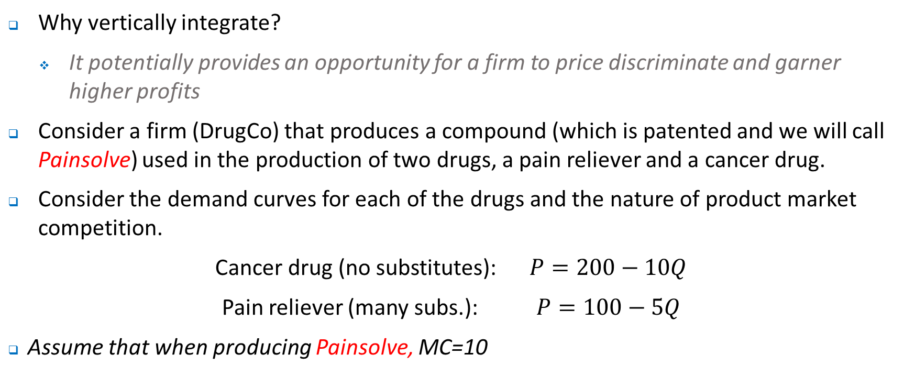
Why Vertically Intergrate? Market Power
Why vertically integrate?
It potentially provides an opportunity for a firm to price discriminate and garner higher profits
Consider a firm (DrugCo) that produces a compound (which is patented and we will call Painsolve) used in the production of two drugs, a pain reliever and a cancer drug.
Consider the demand curves for each of the drugs and the nature of product market competition.
Cancer drug (no substitutes): $P=200−10Q$
Pain reliever (many subs.): $P=100−5Q$
Assume that when producing Painsolve, MC=10

Slide 26
Market Power
Assume that a drug manufacturer can use Painsolve to produce either product (the cancer drug or the pain reliever) at zero marginal cost.
Competition among manufacturers will drive the drive the retail price of the pain reliever and the cancer drug down to the manufacturers MC which in this case is the wholesale price charged by DrugCo for Painsolve.
Note that what this means is that the demand curves that DrugCo faces for Painsolve is the same as the demand curves for the pain reliever & cancer drug.
Ideally, DrugCo would prefer that profits are maximised by setting MR = MC in each market….That is, set a price for the compound when it is sold to pain reliever manufacturers and cancer drug manufacturers

Slide 27
Market Power
Make sure you understand what is happening, viz Painsolve is sold to producers of cancer drug & pain reliever at different prices
200
Cancer drug
Pain reliever
100
105
55
MC=10
MC=10
Q
Q
What is the problem with such an approach?

Slide 28
Market Power
So what to do?
One possibility is to integrate forward into the pain reliever market
That is, price the pain reliever at $55 in retail market and sell the base drug as $105 in the wholesale market
Arbitrage is avoided as long as the ‘pain reliever’ cannot be converted into the ‘cancer drug’
Q^{n}: What is the problem of integrating forward into the cancer drug market (setting price at $105) and selling compound at $55 in wholesale market…?
Other considerations might include…
Tax - remember what we said about transfer pricing
Reliability of supply
Proprietary information

Slide 29
Vertical Integration vs. Long Term Contracts
What type of non-market transaction to use?
Consider a firm (AutoCorp) that wishes to purchase car bodies.
Consider the choice between two alternatives – vertical integration versus long term contracting
If a complete contract could be specified then it would not matter if AutoCorp manufactured their own car bodies or purchased them through the long term contract
Problems include:
Difficulty in specifying all possible contingencies
Can be expensive to negotiate contracts
Contract enforcement can be expensive

Slide 30
Vertical Integration vs. Long Term Contracts
Consideration 1: Ownership and Investment incentives.
Recall the PR view of the firm – ownership or PRs determine residual use of assets
Vertical integration keeps ownership right for relevant assets within a single firm unlike long term contracts
This might have important implications for decisions around investments that are made.

Slide 31
Vertical Integration vs. Long Term Contracts
Consideration 2: Specific Assets and Vertical Integration.
Specific investments place the investor in a tenuous position
Recall the case of GM and Fisher Body
Similarly, consider the problem faced by the potential supplier to AutoCorp (a producer of new autos), viz BodyWorks (which makes the chassis)
BodyWork may have to construct a plant near AutoCorp’s factory.
Asset specificity places BodyWork in a tenuous position because it will be exposed to risk that AutoCorp tries to rewrite the contract opportunistically.
This would reduce the incentive for BodyWorks to make investments
By the same token, AutoCorp could act opportunistically – how?

Slide 32
Vertical Integration vs. Long Term Contracts
Specific Assets and Vertical Integration.
So what does history tell us? Well, GM eventually acquired Fisher Body.
But why is it not always the case that vertical integration is preferred to long term contracting?
Will likely depend on the specificity of the asset. When assets are less specific, markets are more likely to produce efficient outcomes. Put another way, when asset specificity increases the benefits of vertical integration increase - bauxite mines & aluminium smelters for example
When there is greater uncertainty, specific assets pose particular problems. That is, it becomes more challenging to specify in a contract what should happen in the event of various contingencies.
Hence, when uncertainty is low in general it is best to rely on market exchange, but as the degree of specificity increases, non-market transactions (integration) becomes more attractive.

Slide 33
Vertical Integration vs. Long Term Contracts
Uncertainty
Market Transaction
 | Vertical integration
Asset Specificity

Slide 34
Vertical Integration vs. Long Term Contracts
Asset Ownership
The discussion above makes clear that hold up problems can cut both ways.
Effectively both AutoWorks and BodyCorp (or for that matter GM and Fisher Body) can act opportunistically in the even that there is a long-term, albeit incomplete, contract.
To resolve problems like those discussed above it is possible that AutoCorp buy BodyWorks or vice-versa, i.e there is vertical integration.
Does it matter which ownership structure arises?
Yes

Slide 35
Asset Ownership – why it matters….
Consider how ownership structures might impact on investment incentives, i.e. effort …
To do this we will use a different example…
AGT manufactures modems. CCC makes an important input (circuit boards) for AGT.
Assume AGT is CCC’s only customer and the sole supplier for AGT.

Slide 36
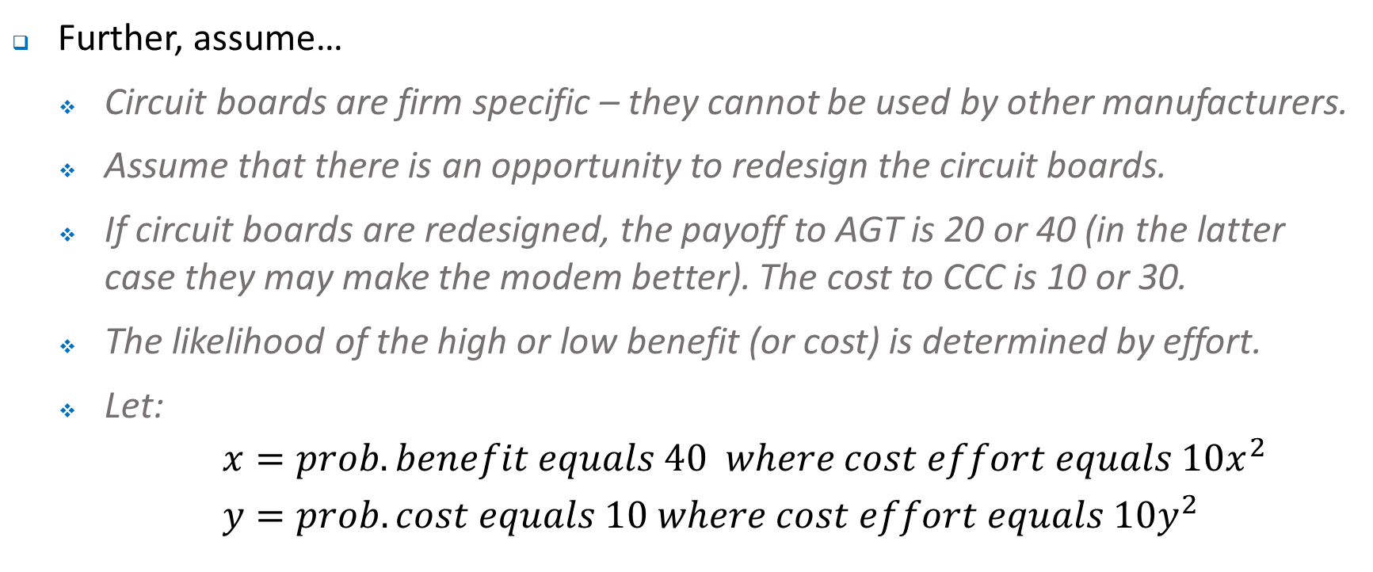
Asset Ownership – why it matters….
Further, assume…
Circuit boards are firm specific – they cannot be used by other manufacturers.
Assume that there is an opportunity to redesign the circuit boards.
If circuit boards are redesigned, the payoff to AGT is 20 or 40 (in the latter case they may make the modem better). The cost to CCC is 10 or 30.
The likelihood of the high or low benefit (or cost) is determined by effort.
Let:
$$x=prob. benefit equals 40 where cost effort equals 10x^{2}$$
$$y=prob. cost equals 10 where cost effort equals 10y^{2}$$

Slide 37
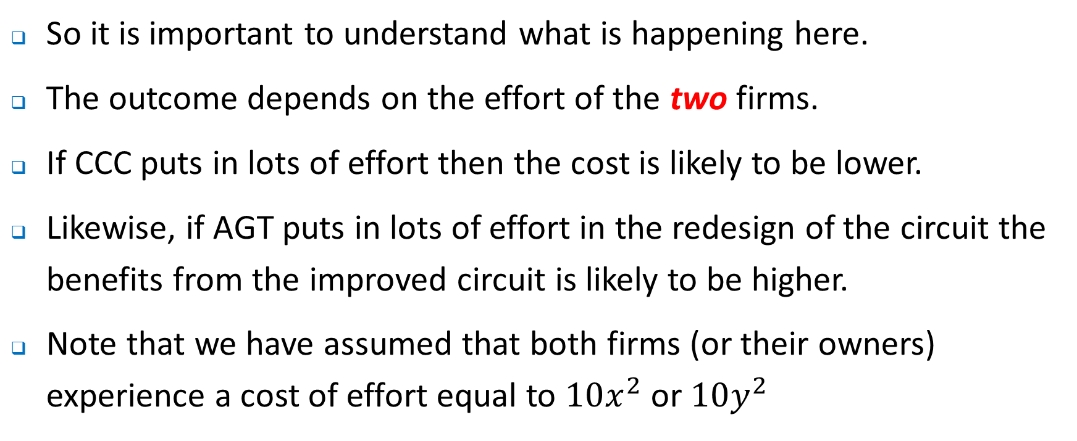
Asset Ownership – why it matters….
So it is important to understand what is happening here.
The outcome depends on the effort of the two firms.
If CCC puts in lots of effort then the cost is likely to be lower.
Likewise, if AGT puts in lots of effort in the redesign of the circuit the benefits from the improved circuit is likely to be higher.
Note that we have assumed that both firms (or their owners) experience a cost of effort equal to $10x^{2}$ or $10y^{2}$

Slide 38
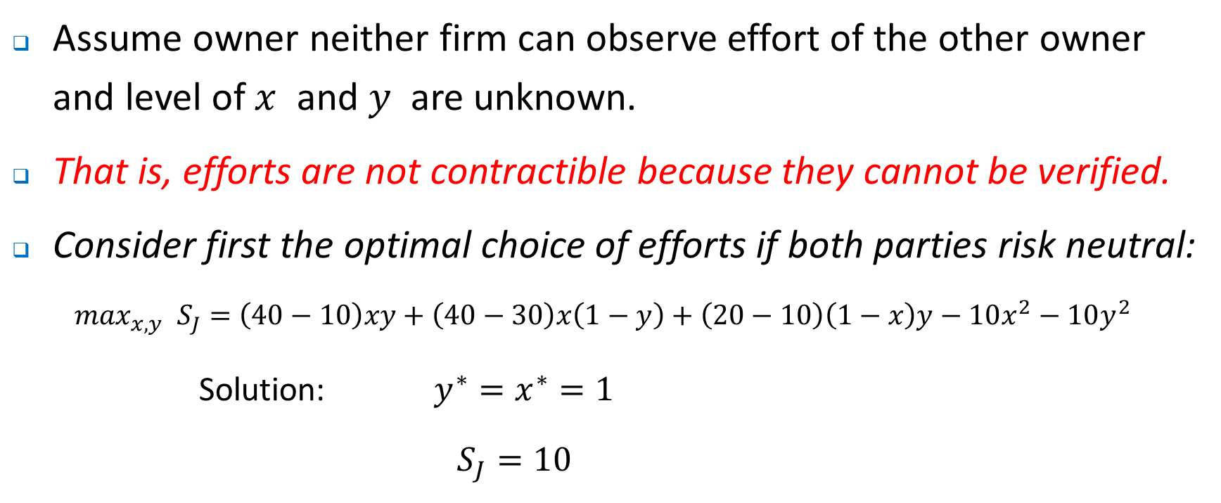
Asset Ownership – why it matters….
Assume owner neither firm can observe effort of the other owner and level of $x$ and $y$ are unknown.
That is, efforts are not contractible because they cannot be verified.
Consider first the optimal choice of efforts if both parties risk neutral:
$$\max_{x,y} S_{J}=\left(40−10\right)xy+\left(40−30\right)x\left(1−y\right)+\left(20−10\right)\left(1−x\right)y−10x^{2}−10y^{2}$$
Solution: $y^{∗}=x^{∗}=1$
$$S_{J}=10$$

Slide 39
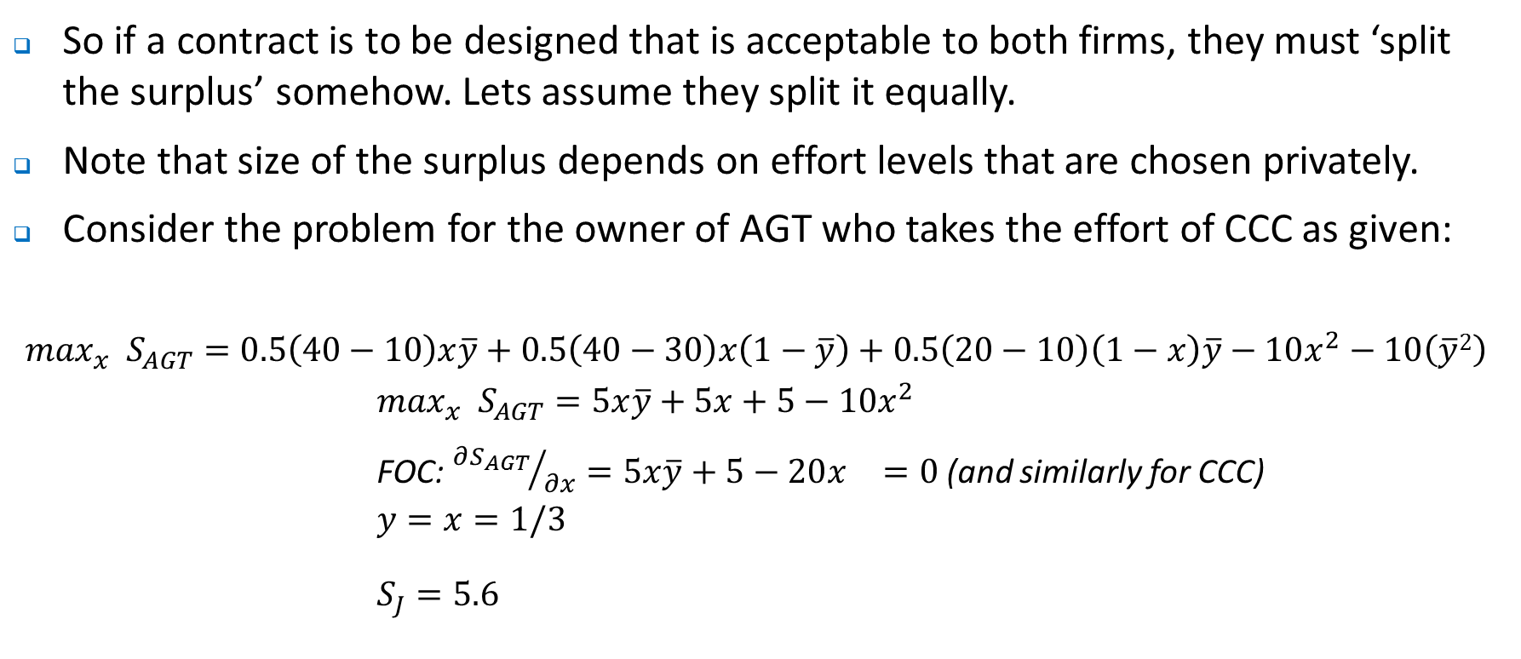
Asset Ownership – why it matters….
So if a contract is to be designed that is acceptable to both firms, they must ‘split the surplus’ somehow. Lets assume they split it equally.
Note that size of the surplus depends on effort levels that are chosen privately.
Consider the problem for the owner of AGT who takes the effort of CCC as given:
$$\max_{x} S_{AGT}=0.5\left(40−10\right)x\overline{y}+0.5\left(40−30\right)x\left(1−\overline{y}\right)+0.5\left(20−10\right)\left(1−x\right)\overline{y}−10x^{2}−10\left(\overline{y}2\right)$$
$$\max_{x} S_{AGT}=5x\overline{y}+5x+5−10x^{2}$$
FOC: ${∂S_{AGT}}/{∂x}=5x\overline{y}+5−20x^{}=0$ (and similarly for CCC)
$$y=x=1/3$$
$$S_{J}=5.6$$

Slide 40
Asset Ownership – why it matters….
What's really happening here is that both parties incur the full cost of their own effort, but receive only ½ of the benefit (from higher value or lower cost).
Essentially, both of the parties will put in effort levels that maximise their own payoff given the effort of the other party – each will free ride and choose effort levels below that which maximise joint surplus.

Slide 41
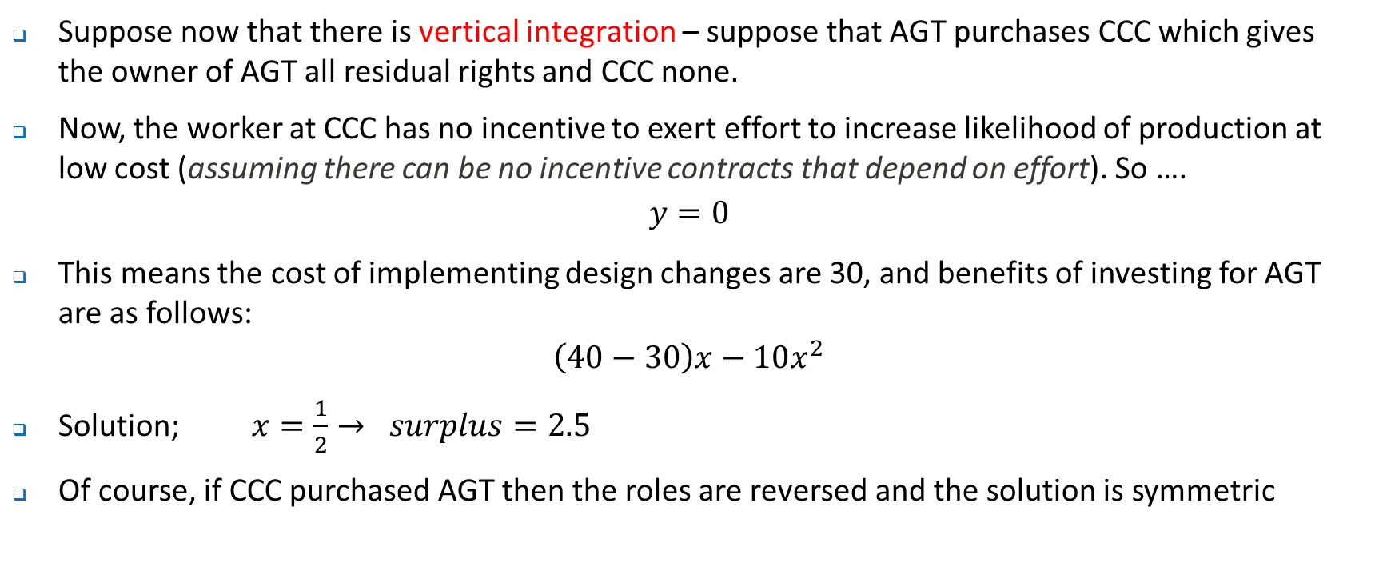
Asset Ownership – why it matters….
Suppose now that there is vertical integration – suppose that AGT purchases CCC which gives the owner of AGT all residual rights and CCC none.
Now, the worker at CCC has no incentive to exert effort to increase likelihood of production at low cost (assuming there can be no incentive contracts that depend on effort). So ….
$$y=0$$
This means the cost of implementing design changes are 30, and benefits of investing for AGT are as follows:
$$\left(40−30\right)x−10x^{2}$$
Solution; $x=\frac{1}{2}→ surplus=2.5$
Of course, if CCC purchased AGT then the roles are reversed and the solution is symmetric

Slide 42
Asset Ownership – why it matters….
So what is the lesson here?.
Vertical integration is not superior to a long term contract
Here, separate ownership actually gives more value than integration.
Here it is the investments in effort that are impacted by organizational structure, and it is ownership that gives the greatest incentives.
When might it be better to provide strong incentives to one party and weaker incentives to the other party?
What else have we ignored? Hint: think about what we discussed in week 9 and 10…

Slide 43
Contracting with Distributors
Recall the free rider problem we noted previously in a variety of contexts.
Distributors are likely to have little incentive to invest in sales efforts as they can free ride off the reputation of a brand name.
Responses could include…
Vertical integration.
Alternatively, use contracts that have specific provisions about:
Advertising provisions – how could they be structured? What are the potential problems with handing such decisions to the franchisor?
Exclusive territory provisions – how do they eliminate the free-riding problem? Might they create some perverse incentives?
Consider ….

Slide 44
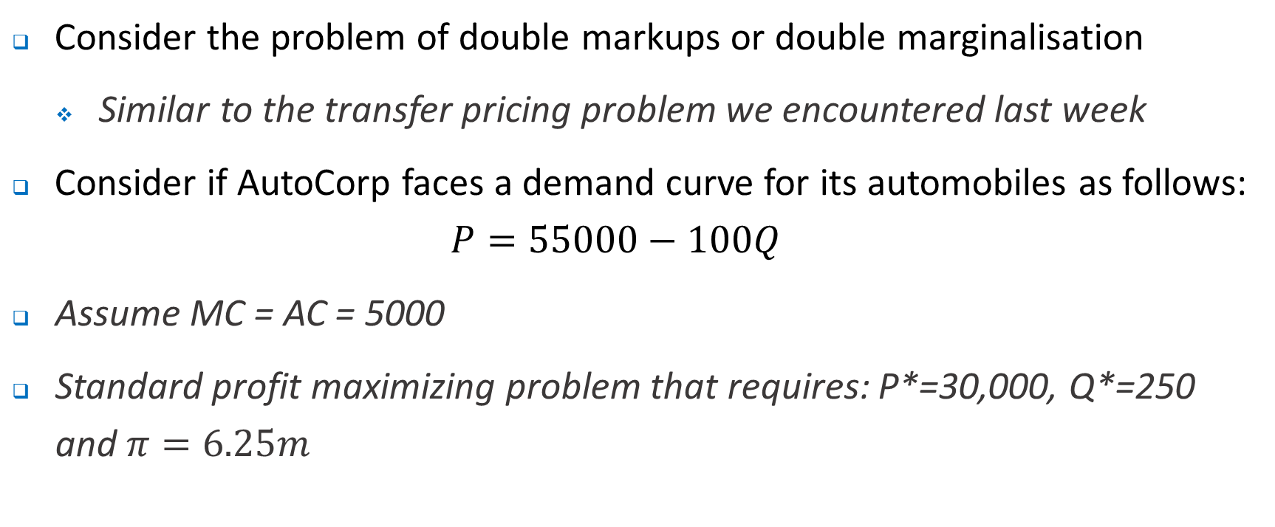
Contracting with Distributors
Consider the problem of double markups or double marginalisation
Similar to the transfer pricing problem we encountered last week
Consider if AutoCorp faces a demand curve for its automobiles as follows:
$$P=55000−100Q$$
Assume MC = AC = 5000
Standard profit maximizing problem that requires: P*=30,000, Q*=250 and $π=6.25m$

Slide 45
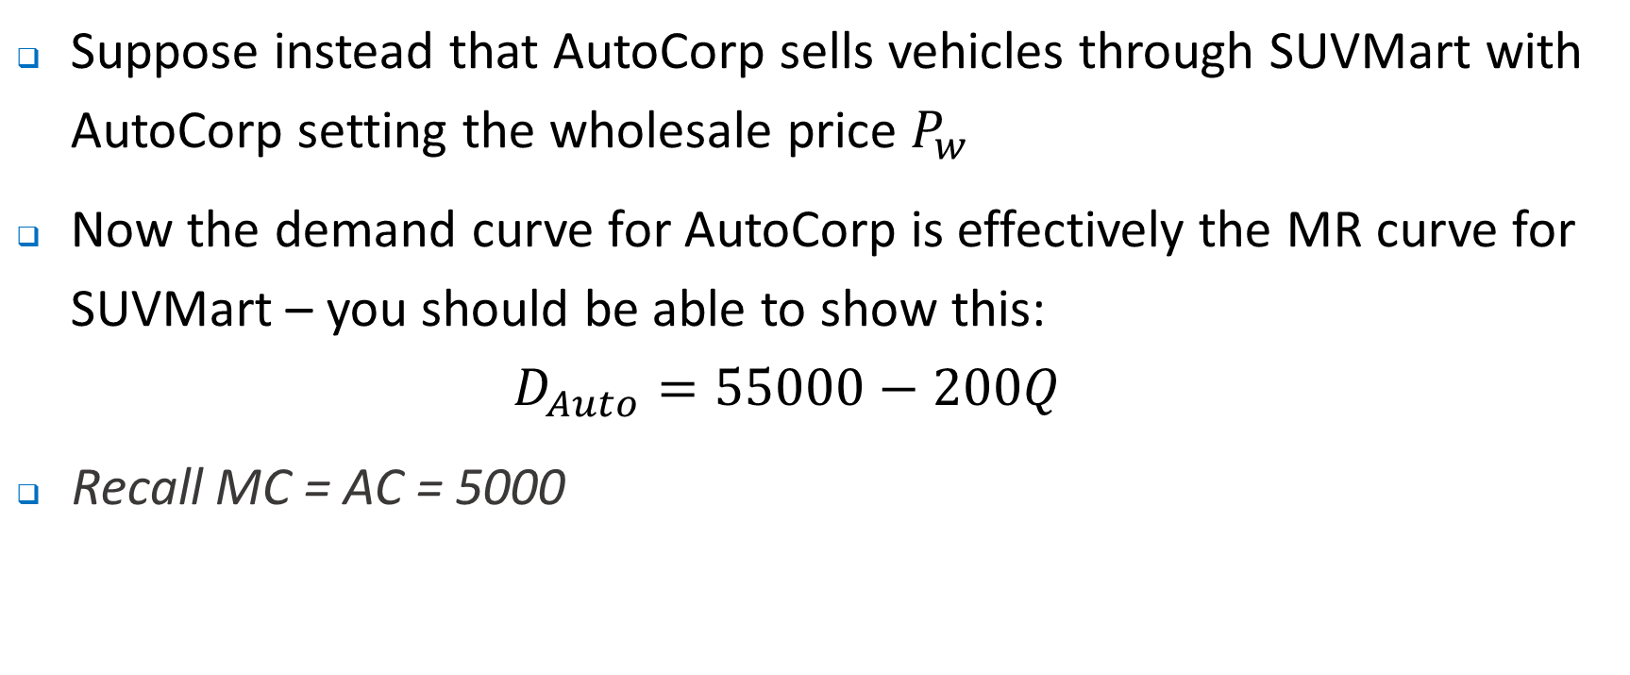
Contracting with Distributors
Suppose instead that AutoCorp sells vehicles through SUVMart with AutoCorp setting the wholesale price $P_{w}$
Now the demand curve for AutoCorp is effectively the MR curve for SUVMart – you should be able to show this:
$$D_{Auto}=55000−200Q$$
Recall MC = AC = 5000

Slide 46
Double Markup
55000
SUVMart
P_{w1}=MC₁
P_{w2}=MC₂
P_{w3}=MC₃
P_{w4}=MC₄
Q
125
275

Slide 47
Double Markup
55000
55000
SUVMart
AutoCorp
30000
30000
P_{w1}=MC₁
5000
Q
Q
125
275
125
275

Slide 48
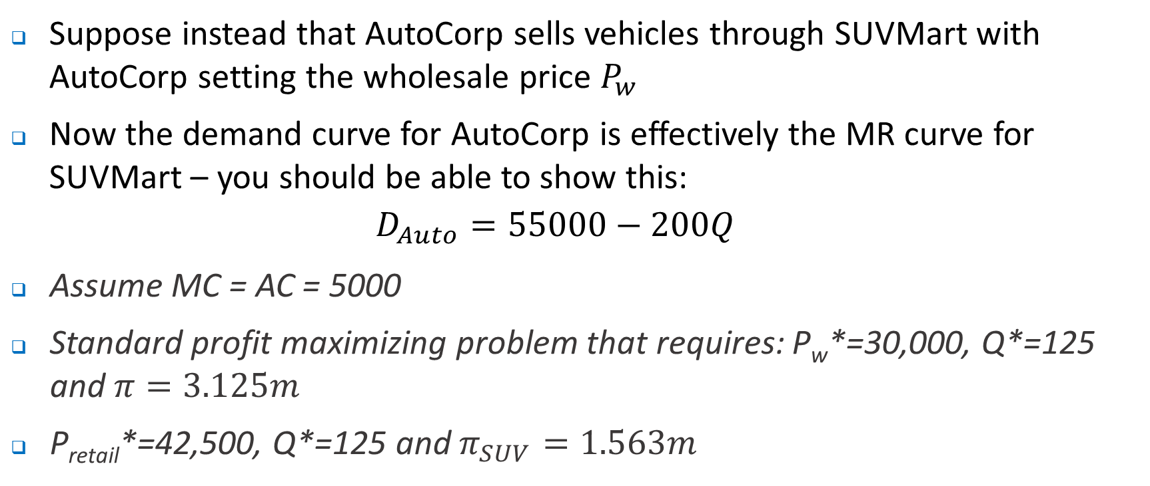
Contracting with Distributors
Suppose instead that AutoCorp sells vehicles through SUVMart with AutoCorp setting the wholesale price $P_{w}$
Now the demand curve for AutoCorp is effectively the MR curve for SUVMart – you should be able to show this:
$$D_{Auto}=55000−200Q$$
Assume MC = AC = 5000
Standard profit maximizing problem that requires: P_{w}*=30,000, Q*=125 and $π=3.125m$
P_{retail}*=42,500, Q*=125 and $π_{SUV}=1.563m$

Slide 49
Double Markup
55000
55000
42500
AutoCorp
SUVMart
30000
30000
5000
Q
Q
125
275
125
275

Slide 50
Contracting with Distributors
What’s really happening here?
When AutoCorp sells directly to public they look at the demand curve for vehicles and choose price/ quantity to maximise profit.
When they sell via SUVMart, if they set the wholesale price equal to MC then SUVMart captures all the profits. To capture some of the profits AutoCorp increase the price at which they sell to SUVMart and in turn reduce they amount that SUVMart sells as the local monopolist.
Total profits will be lower in the latter case

Slide 51
Double Markup
How to solve this problem?
It would be possible, for example, for AutoCorp to set a two part tariff – what would that look like?
For example, an upfront ‘franchise fee’ of $3.125m what would AutoCorp do?
What might be the problems and challenges with such an arrangement?
Alternatively, what would happen if SUVMart agrees to purchase at least 250 automobiles at a price above $5000?
Consider for example if the price was $17,500, what are the resultant profits for each of the firms?
In this case, SUVMart simply sells the cars at the highest possible price – identified from the demand curve and each firm receives a net profit of $12,500 on each car.
What must occur for the ‘quota’ approach to work?

Slide 52
Where to next?
Wrap up – Tutorial next week and discussion of exam.

