Slide 1

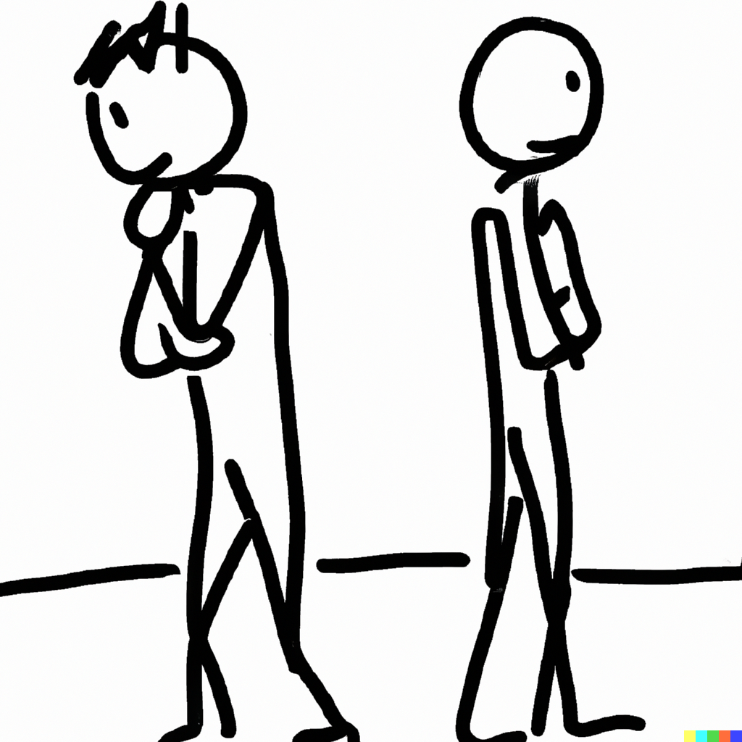
Preferences
Notes on Behavioural Economics
Jason Collins

Slide 2
Strong
≻

Slide 3
Strong
Weak
≻
≽

Slide 4

Strong
Weak
Indifference
≻
≽
$$∼$$

Slide 5
bananas ≻ apples

Slide 6
bananas ~ oranges

Slide 7
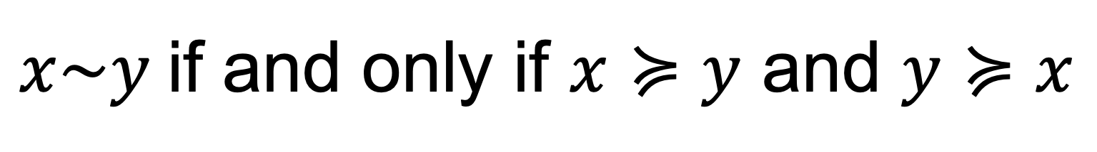
$x\sim y$if and only if $x≽y$ and $y≽x$

Slide 8
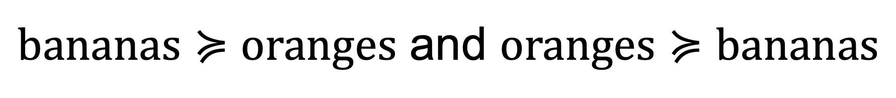
$bananas≽oranges$ and $oranges≽bananas$

