Slide 1


Utility
Notes on Behavioural Economics
Jason Collins

Slide 2
Banana — 3
Orange — 2
Apple — 1

Slide 3
Banana — 3
Orange — 2
Apple — 1
Banana — 300
Orange — 2
Apple — 1

Slide 4

$$u\left(∙\right)$$

Slide 5
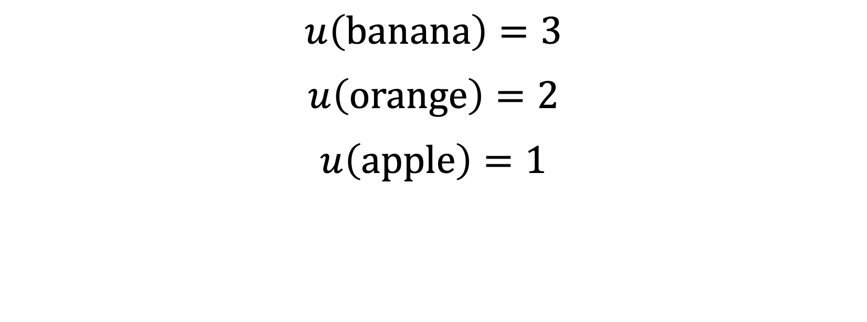
$u\left(banana\right)=3$
$u\left(orange\right)=2$
$u\left(apple\right)=1$

Slide 6

$$x≽y⇔u\left(x\right)≥u\left(y\right)$$
$$x≻y⇔u\left(x\right)>u(y)$$
$$x∼y⇔u\left(x\right)=u\left(y\right)$$

Slide 7

$$u(banana)=3>2=u(orange)⟺banana≻orange$$

