Slide 1

Level-k thinking
Notes on Behavioural Economics
Jason Collins

Slide 2
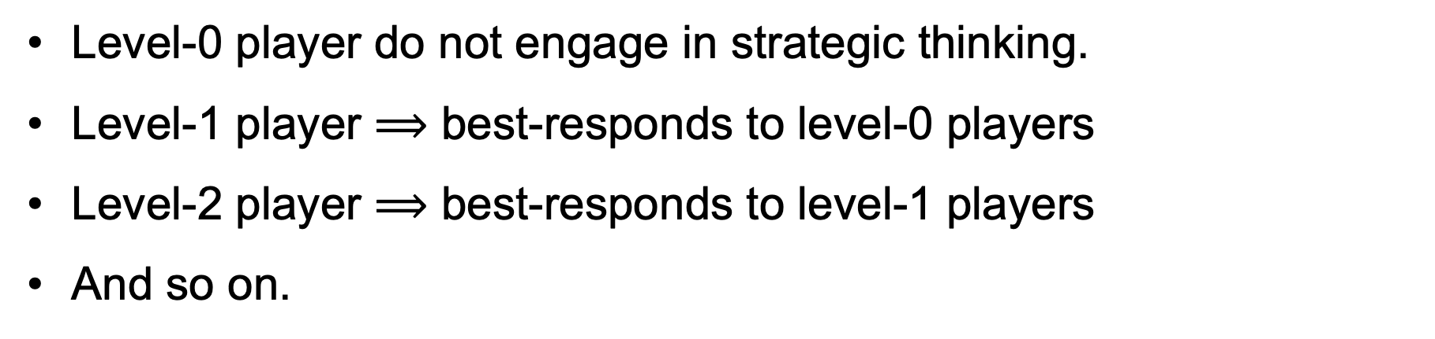
Level-k player $⟹$ best-responds to level-(k-1) players
Level-0 player do not engage in strategic thinking.
Level-1 player $⟹$ best-responds to level-0 players
Level-2 player $⟹$ best-responds to level-1 players
And so on.

Slide 3
[P]rofessional investment may be likened to those newspaper competitions in which the competitors have to pick out the six prettiest faces from a hundred photographs, the prize being awarded to the competitor whose choice most nearly corresponds to the average preferences of the competitors as a whole; so that each competitor has to pick, not those faces which he himself finds prettiest, but those which he thinks likeliest to catch the fancy of the other competitors, all of whom are looking at the problem from the same point of view. It is not a case of choosing those which, to the best of one’s judgment, are really the prettiest, nor even those which average opinion genuinely thinks the prettiest. We have reached the third degree where we devote our intelligences to anticipating what average opinion expects the average opinion to be. And there are some, I believe, who practise the fourth, fifth and higher degrees.
Keynes (1936)

Slide 4
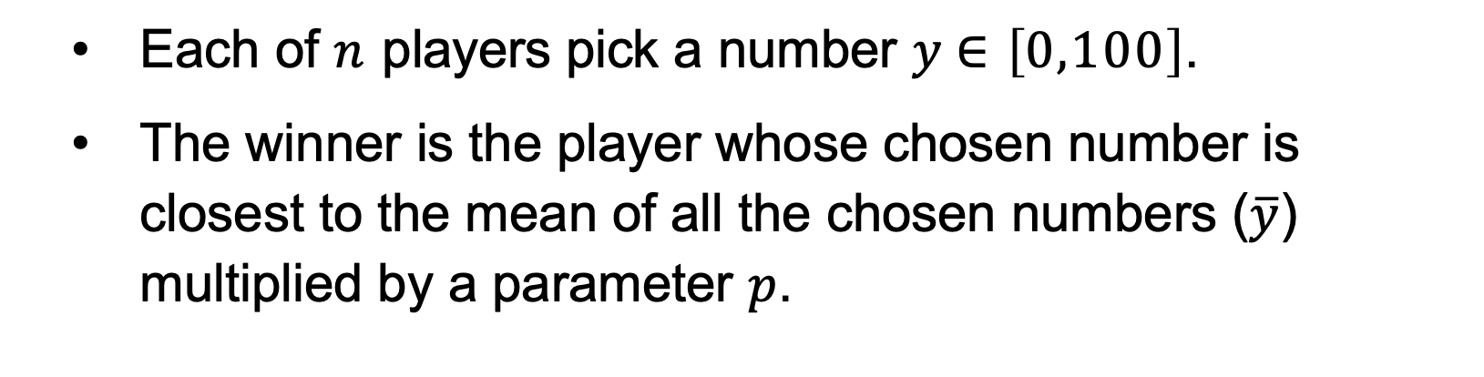
The p-beauty contest
Each of $n$ players pick a number $y∈\left[0,100\right]$.
The winner is the player whose chosen number is closest to the mean of all the chosen numbers ($\overline{y}$) multiplied by a parameter $p$.

Slide 5
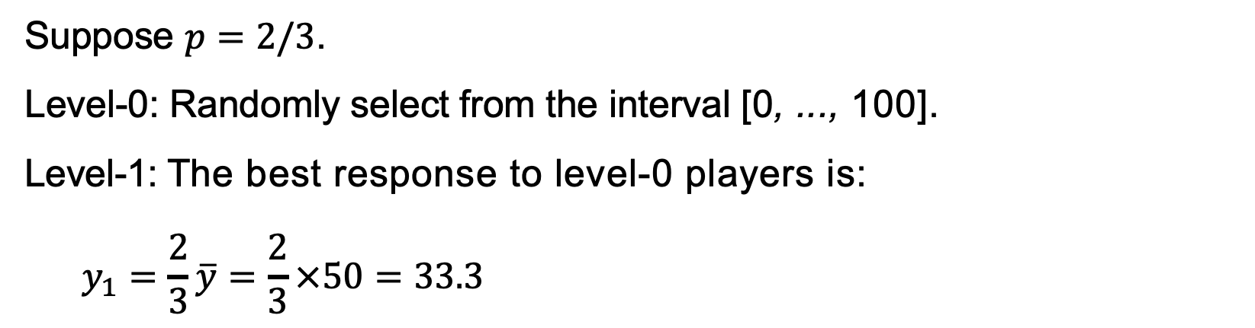
The p-beauty contest
Suppose $p=2/3$.
Level-0: Randomly select from the interval [0, ..., 100].
Level-1: The best response to level-0 players is:
$$y_{1}=\frac{2}{3}\overline{y}=\frac{2}{3}×50=33.3$$

Slide 6
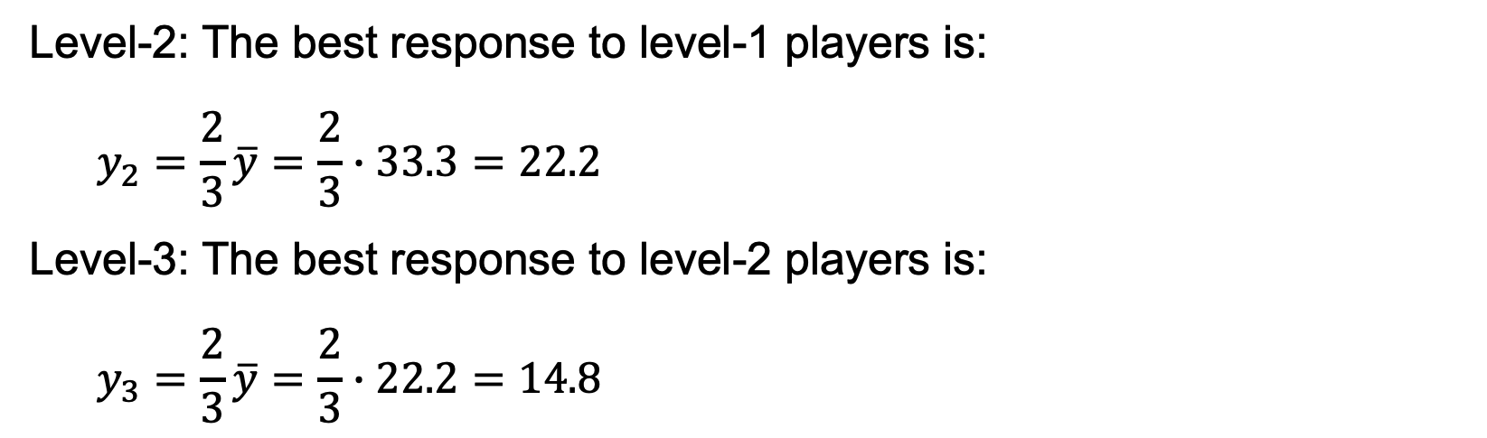
The p-beauty contest
Level-2: The best response to level-1 players is:
$$y_{2}=\frac{2}{3}\overline{y}=\frac{2}{3}∙33.3=22.2$$
Level-3: The best response to level-2 players is:
$$y_{3}=\frac{2}{3}\overline{y}=\frac{2}{3}∙22.2=14.8$$

Slide 7
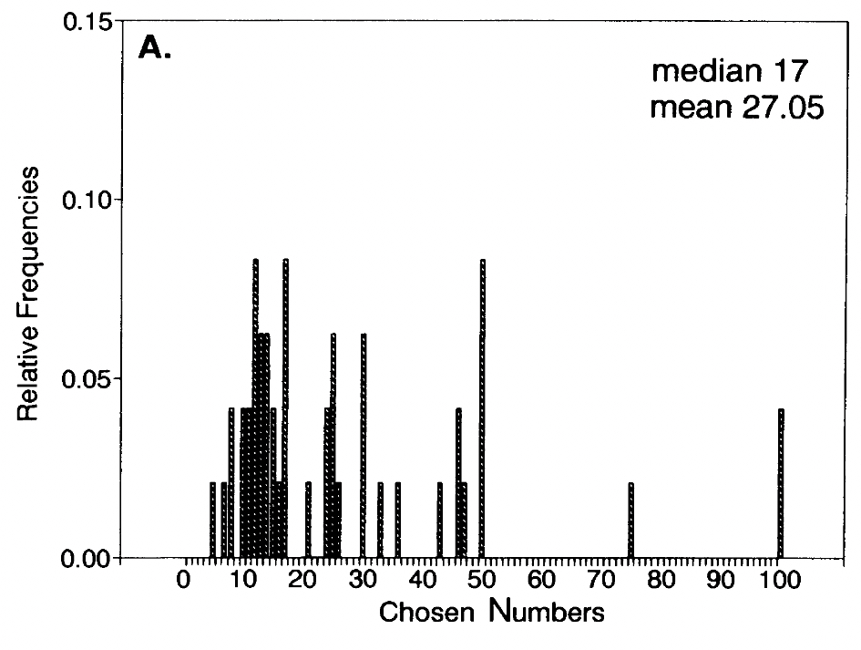
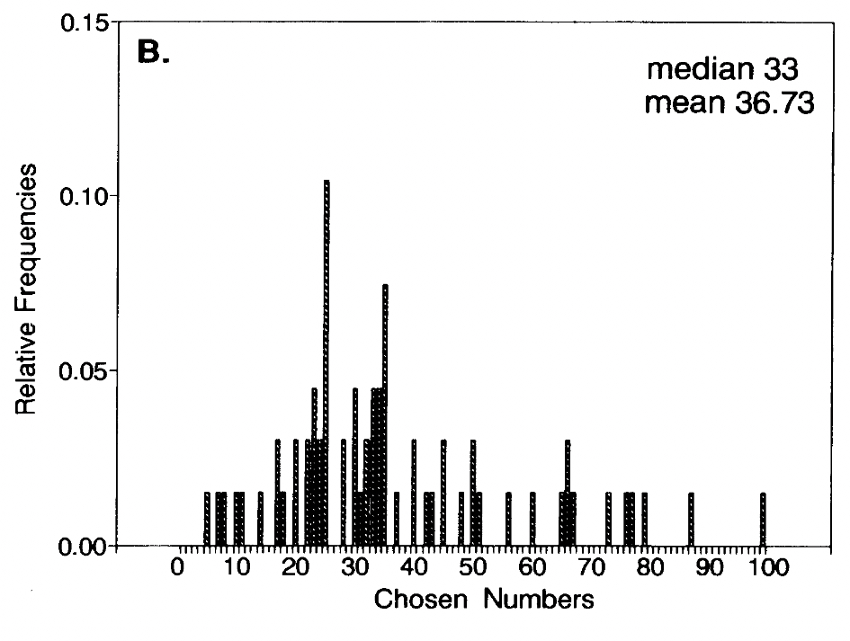


$$p=1/2$$
$$p=2/3$$

Slide 8
The assignment game
 |  | Player B
 |  | Work | Shirk
Player A | Work | 7,4 | 1,9
 | Shirk | 9,-1 | 0,0

Slide 9
The assignment game
 |  | Player B
 |  | Work | Shirk
Player A | Work | 7,4 | 1,9
 | Shirk | 9,-1 | 0,0

Slide 10
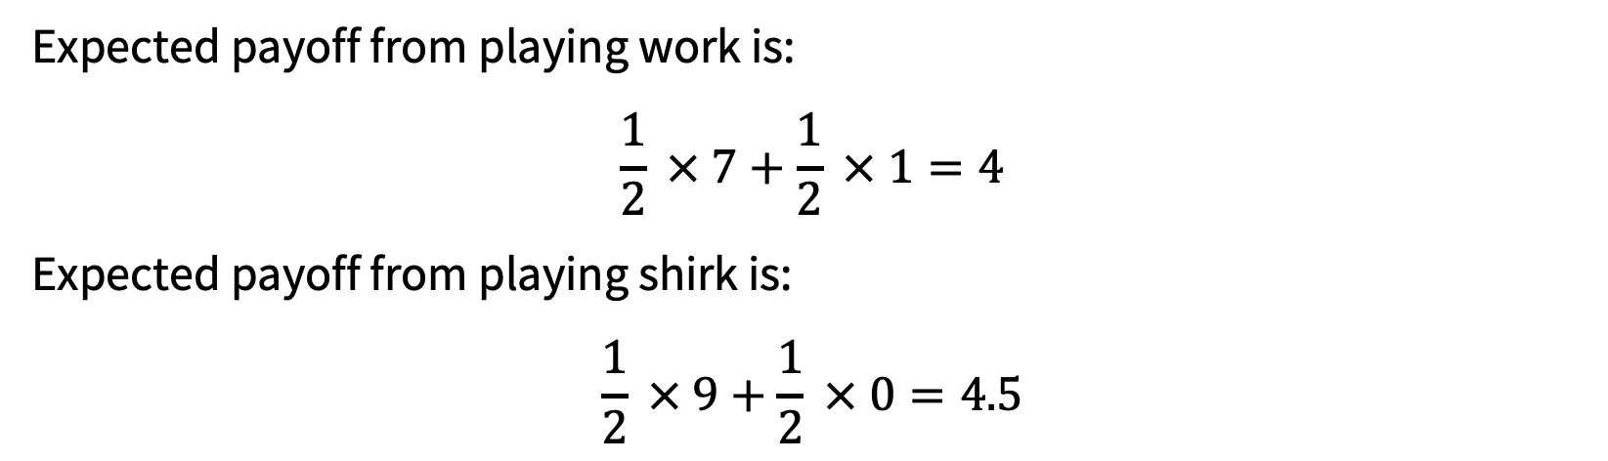
Level-1 player A
Expected payoff from playing work is:
$$\frac{1}{2} × 7+\frac{1}{2} × 1=4$$
Expected payoff from playing shirk is:
$$\frac{1}{2} × 9+\frac{1}{2} × 0=4.5$$

Slide 11
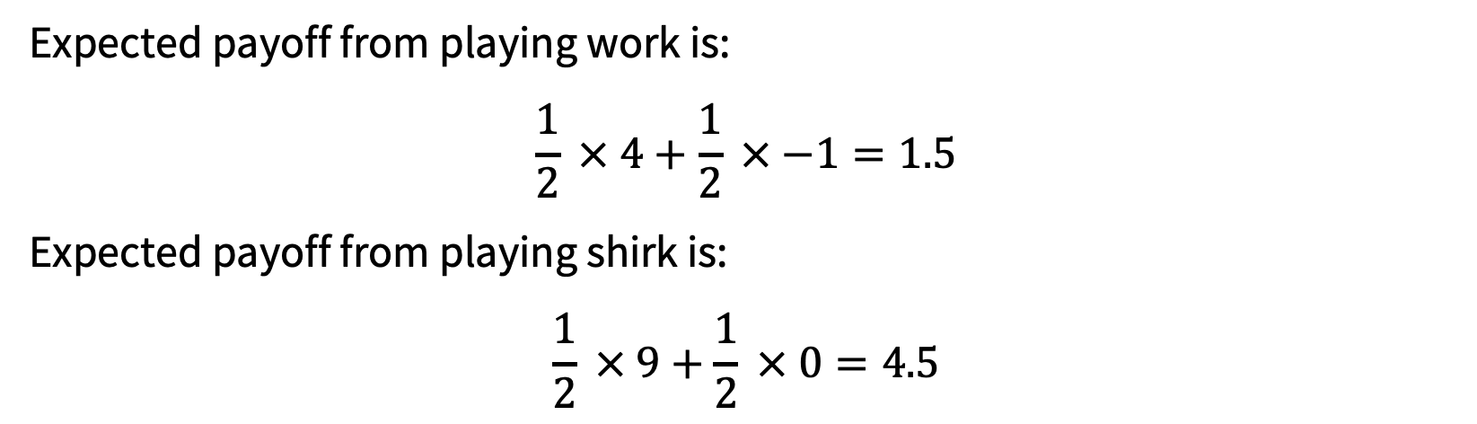
Level-1 player B
Expected payoff from playing work is:
$$\frac{1}{2} × 4+\frac{1}{2} × −1=1.5$$
Expected payoff from playing shirk is:
$$\frac{1}{2} × 9+\frac{1}{2} × 0=4.5$$

Slide 12
Level-k | Player A | Player B
k = 0 | Random | Random
k = 1 | Shirk | Shirk
k = 2 | Work | Shirk
k = 3 | Work | Shirk
k = 4 | Work | Shirk

Slide 13
A
B
A
B
A
B
(6,5)
(1,0)
(0,2)
(3,1)
(2,4)
(5,3)
(4,6)

Slide 14
Assume a level-0 player passes until the end.
A
B
A
B
A
B
(6,5)
(1,0)
(0,2)
(3,1)
(2,4)
(5,3)
(4,6)

Slide 15
Level-1 player B: take at (4,6) as the level-0 player A would pass until then.
A
B
A
B
A
B
(6,5)
(1,0)
(0,2)
(3,1)
(2,4)
(5,3)
(4,6)

Slide 16
Level-1 player A: take at (6,5) as the level-0 player B will keep passing.
A
B
A
B
A
B
(6,5)
(1,0)
(0,2)
(3,1)
(2,4)
(5,3)
(4,6)

Slide 17
Level-2 player B: take at (4,6) as the level-1 player A passes.
A
B
A
B
A
B
(6,5)
(1,0)
(0,2)
(3,1)
(2,4)
(5,3)
(4,6)

Slide 18
Level-2 player A: take at (5,3) as a level-1 player B would take at (4,6).
A
B
A
B
A
B
(6,5)
(1,0)
(0,2)
(3,1)
(2,4)
(5,3)
(4,6)

Slide 19
Level-3 player B: take at (2,4) as the level-1 player A will take at (5,3).
A
B
A
B
A
B
(6,5)
(1,0)
(0,2)
(3,1)
(2,4)
(5,3)
(4,6)

Slide 20
Level-3 player A: take at (5,3) as a level-2 player B would take at (4,6).
A
B
A
B
A
B
(6,5)
(1,0)
(0,2)
(3,1)
(2,4)
(5,3)
(4,6)

