Slide 1

Reciprocity
Notes on Behavioural Economics
Jason Collins

Slide 2
Reciprocity
Instrumental reciprocity
Intrinsic reciprocity

Slide 3


Slide 4
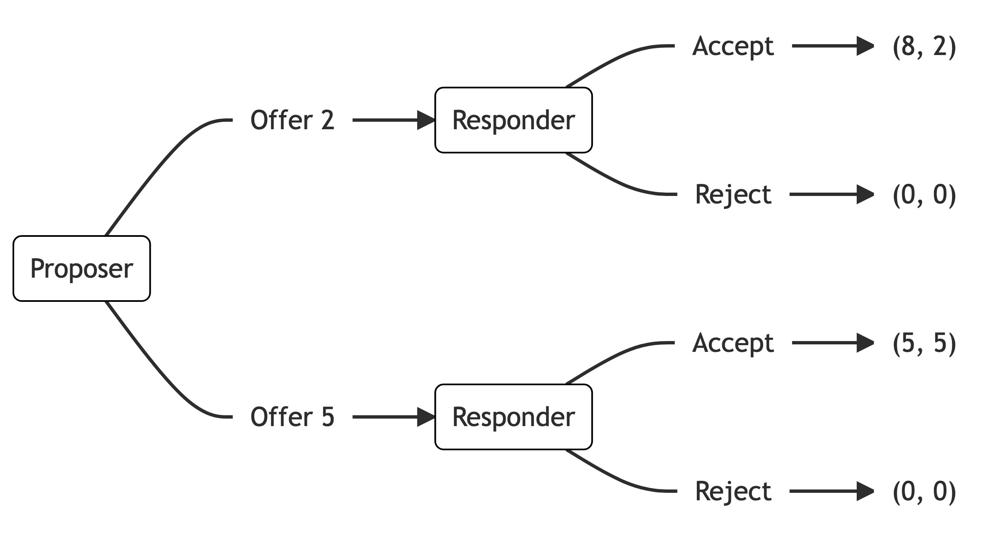
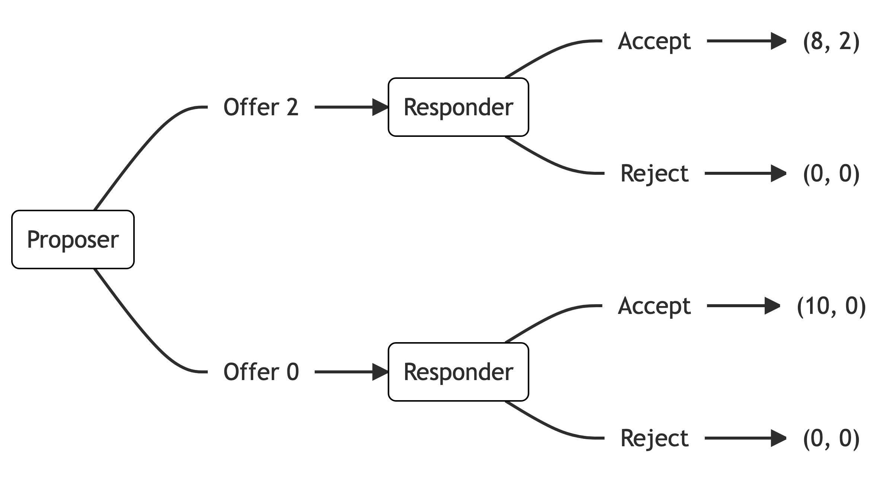

Slide 5


Slide 6
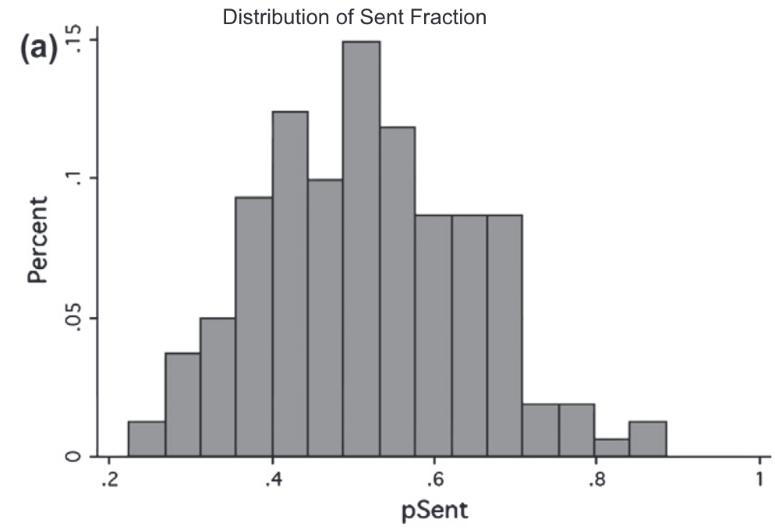
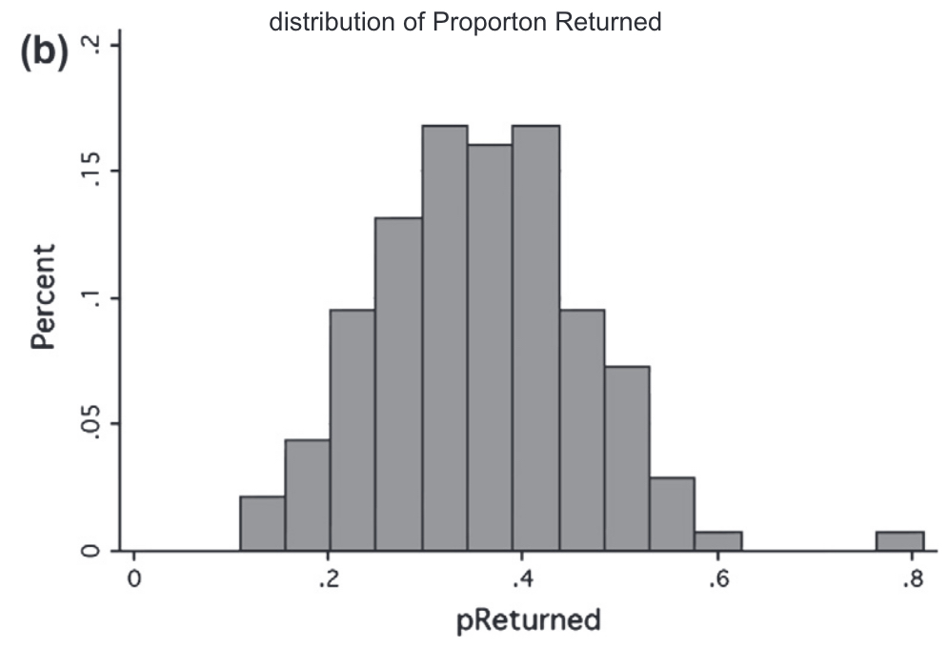

Slide 7
