Slide 1

Reputation
Notes on Behavioural Economics
Jason Collins

Slide 2
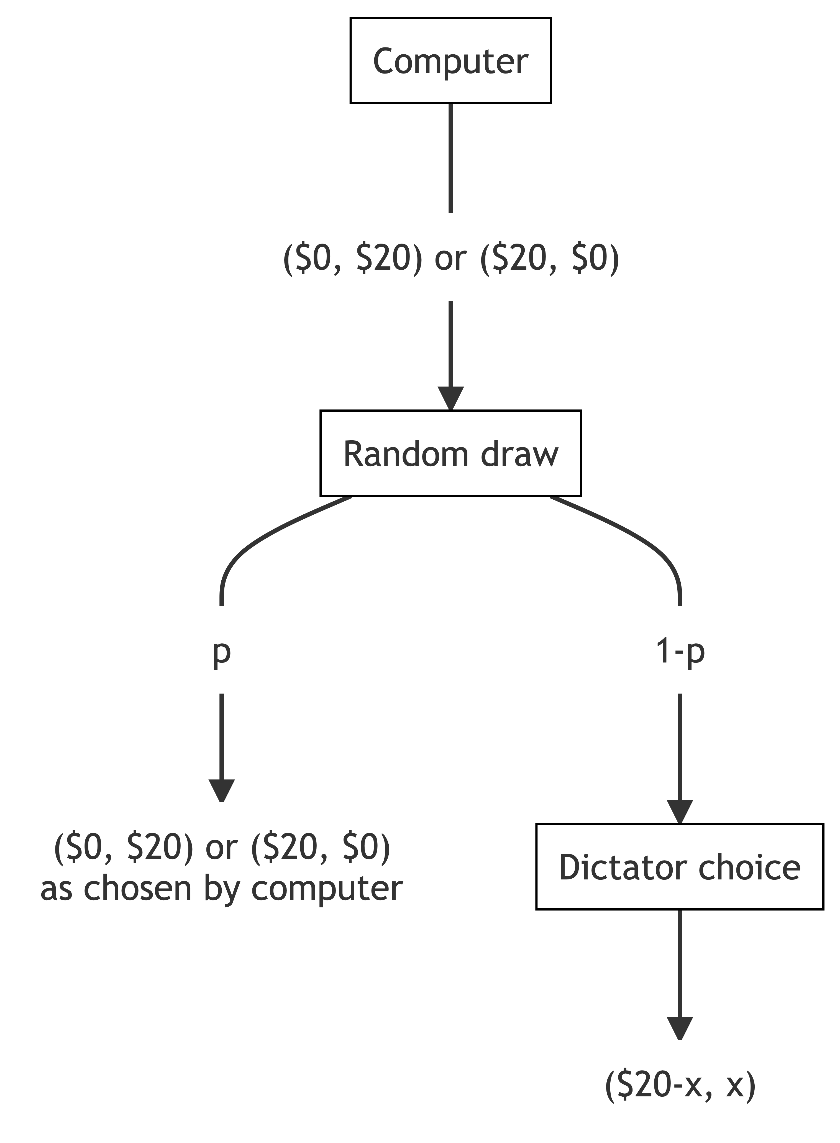

Slide 3
