Slide 1

Social preferences
Notes on Behavioural Economics
Jason Collins

Slide 2
Social preferences
Distribution: the division of resources
Reputation: what other people think
Reciprocity: the intentions and actions of others

Slide 3
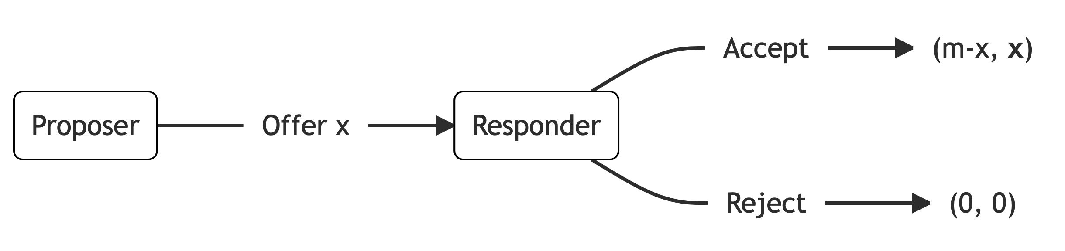
The ultimatum game

Slide 4
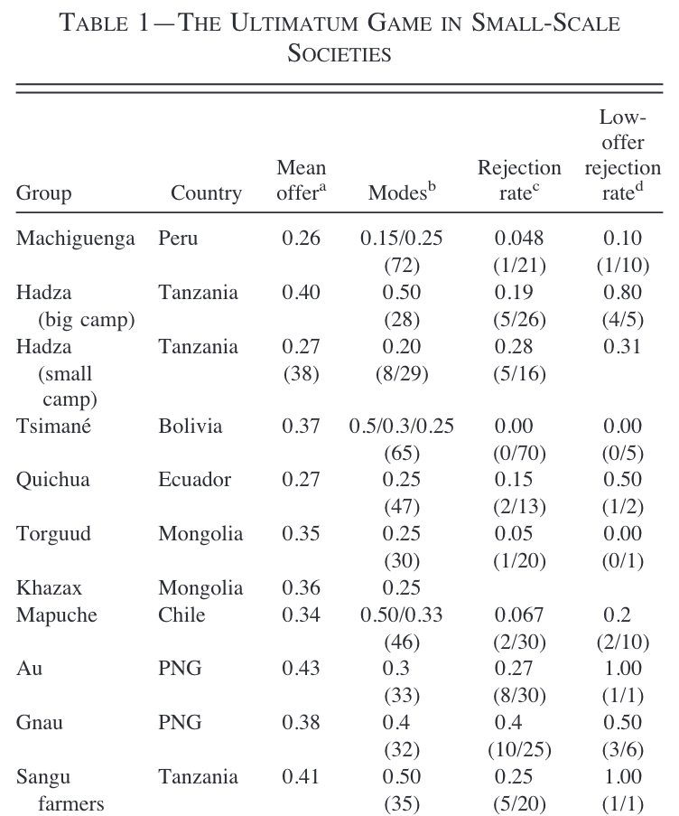
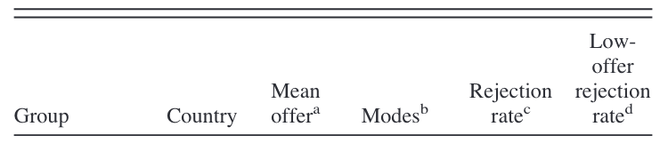
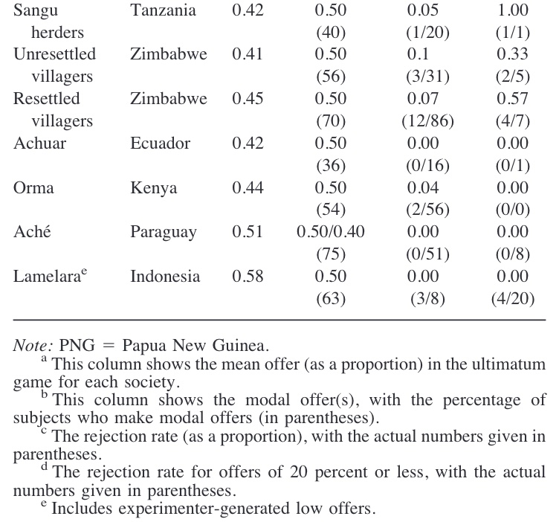

Slide 5
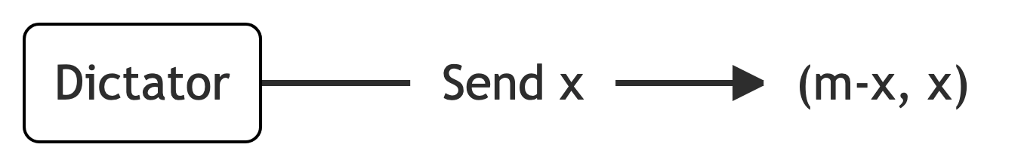
The dictator game

Slide 6
