Slide 1

Absurd rates of risk aversion
Notes on Behavioural Economics
Jason Collins

Slide 2
Absurd rates of risk aversion
I offer you the following one-off bet by flipping a coin:
Head: You win $110
Tail: You lose $100

Slide 3

Absurd rates of risk aversion
$$⟹$$
Turn down: Turn down:
Head: You win $110 Head: You win $1 billion
Tail: You lose $100 Tail: You lose $1000

Slide 4
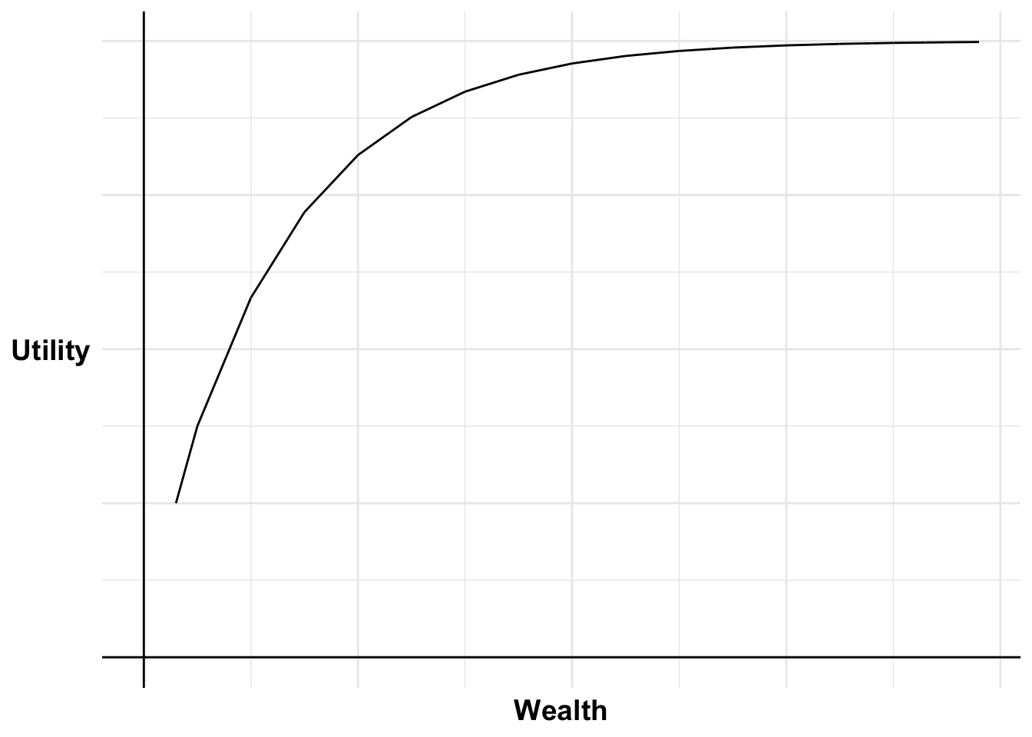
Absurd rates of risk aversion

Slide 5
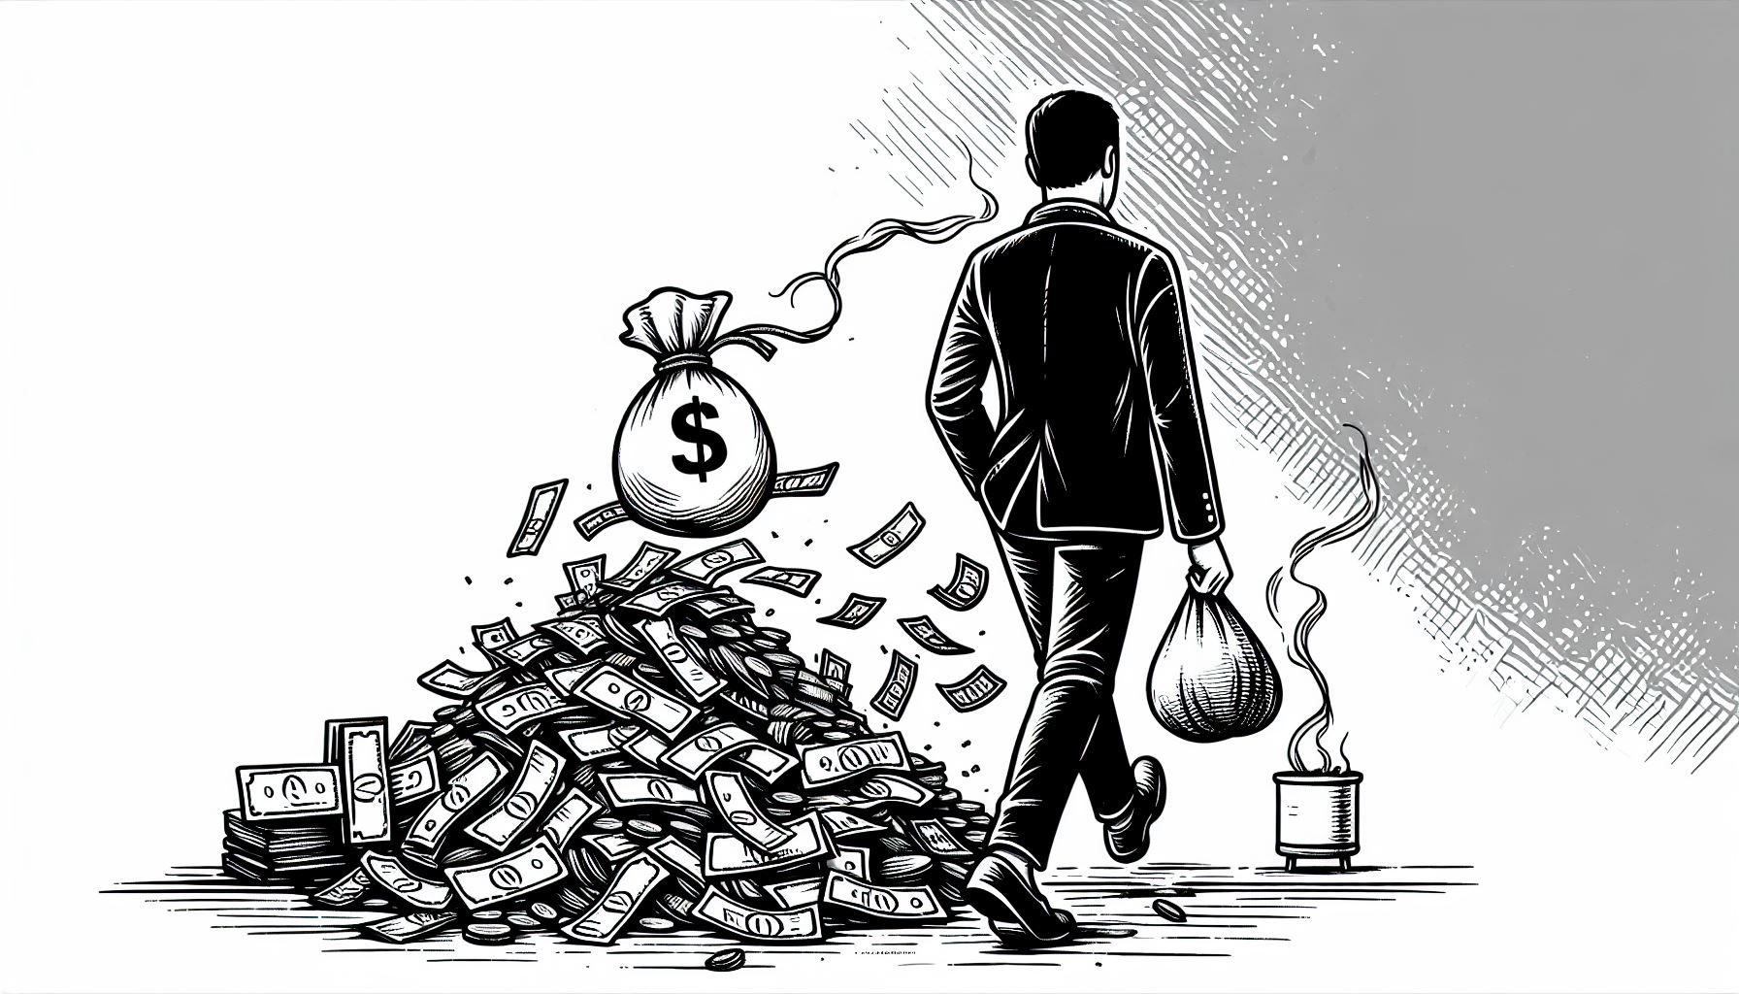
Absurd rates of risk aversion
A 50-50 bet to:
Win $150
Lose $100

Slide 6
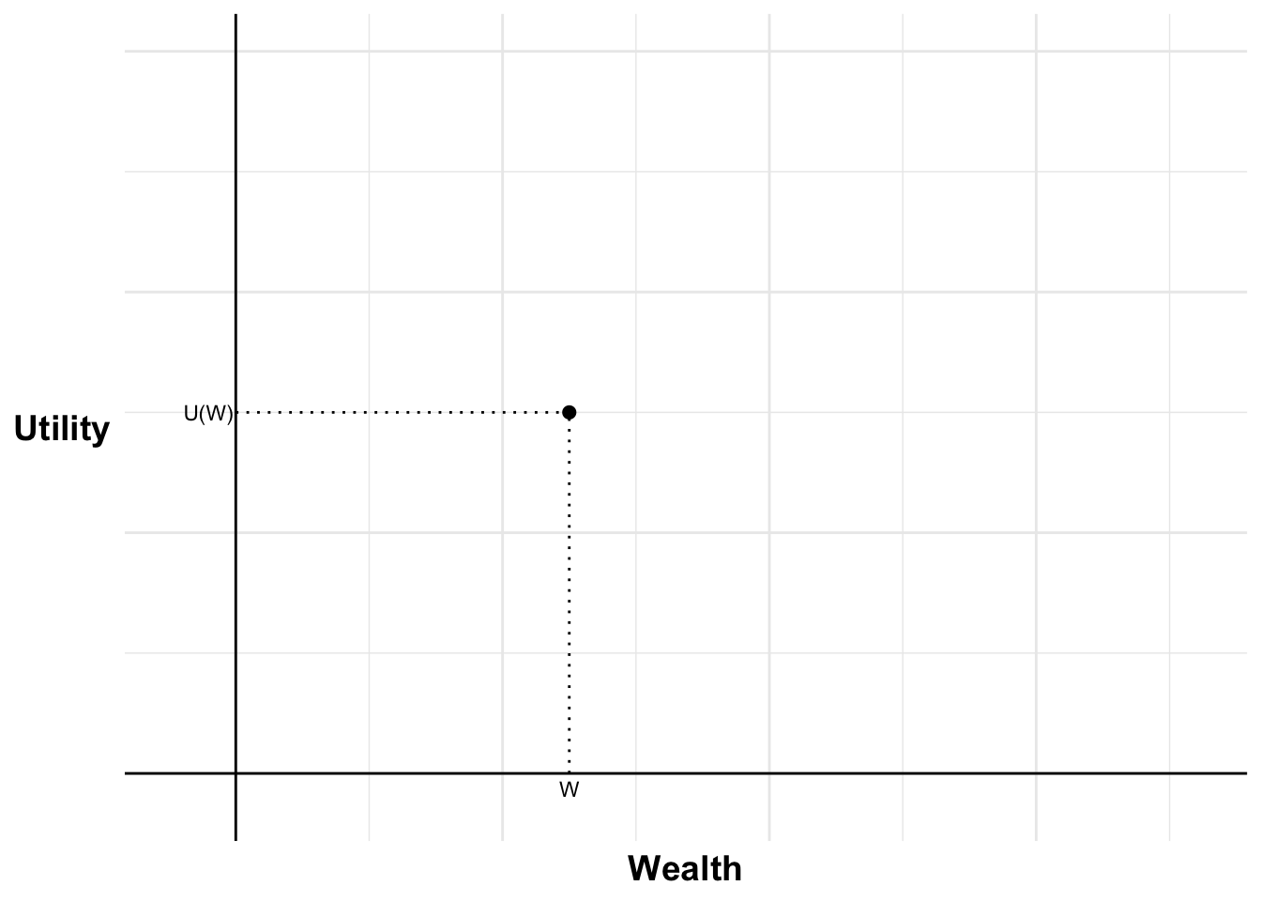
Absurd rates of risk aversion

Slide 7
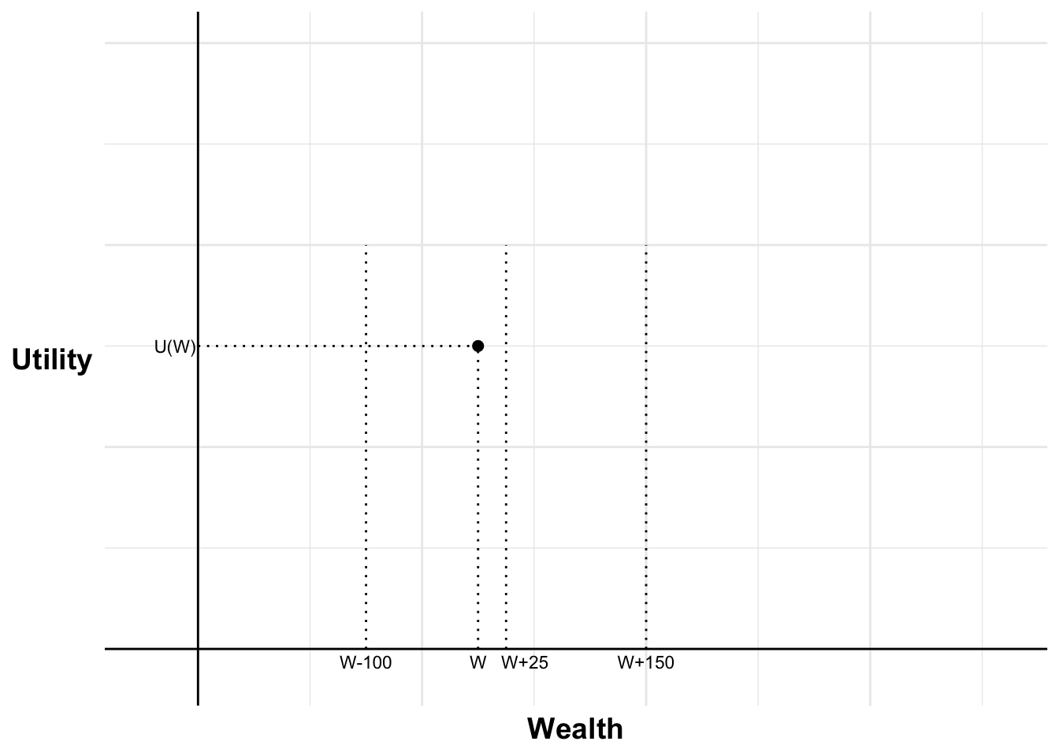
Absurd rates of risk aversion

Slide 8

Absurd rates of risk aversion

Slide 9
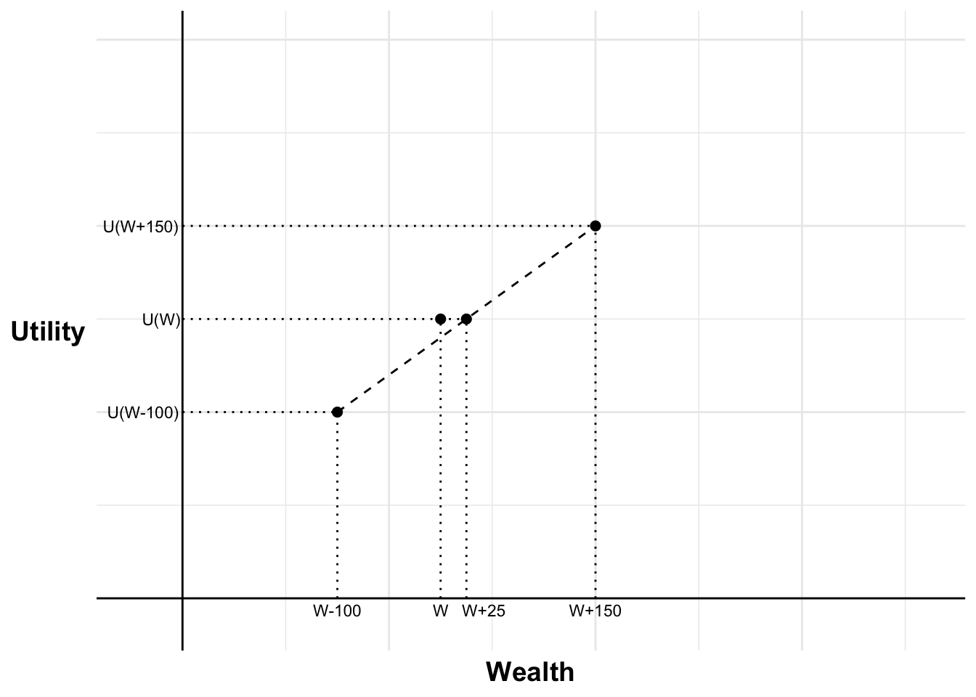
Absurd rates of risk aversion

Slide 10
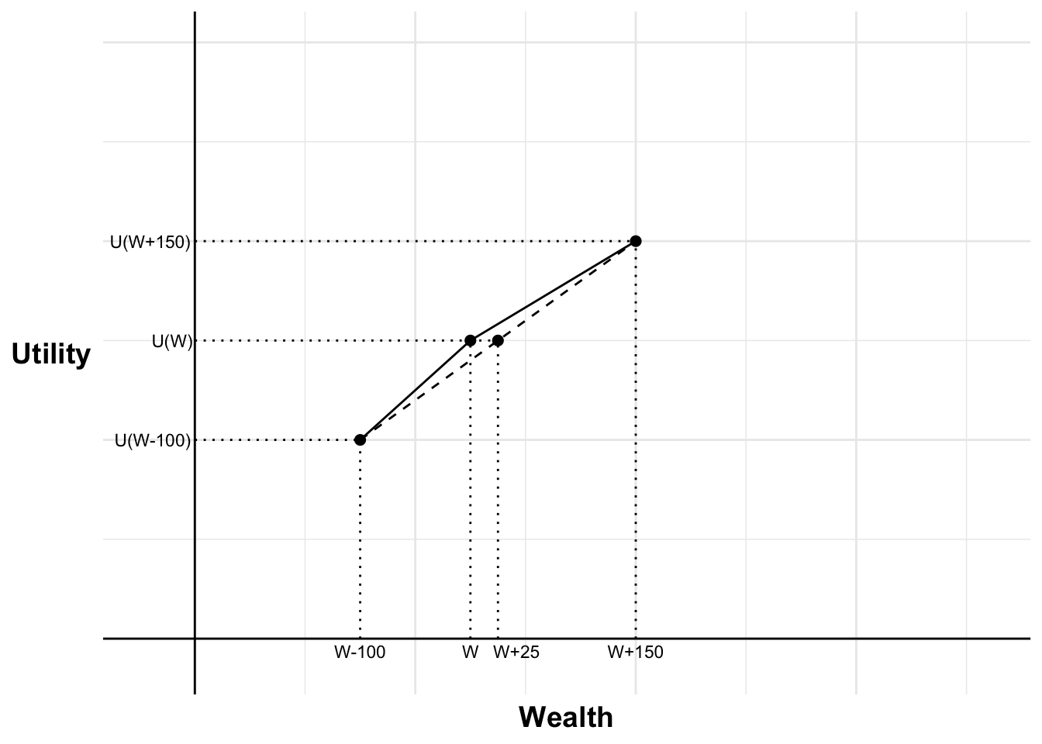
Absurd rates of risk aversion

Slide 11
Absurd rates of risk aversion
$$U\left(W+150\right)−U\left(W\right)≤U\left(W\right)−U(W−100)$$

Slide 12
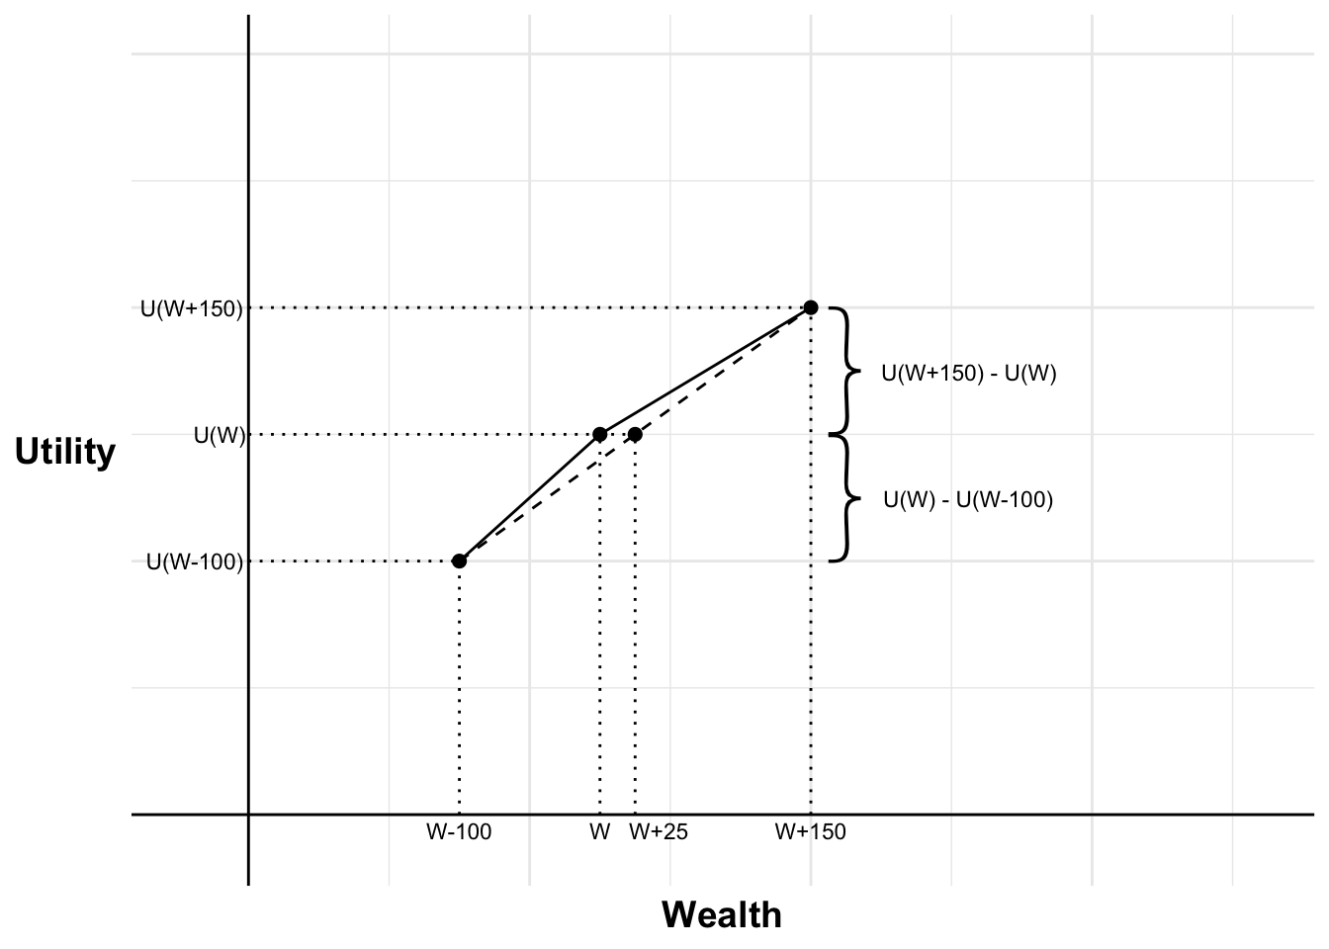
Absurd rates of risk aversion
$$U\left(W+150\right)−U\left(W\right)≤U\left(W\right)−U(W−100)$$

Slide 13
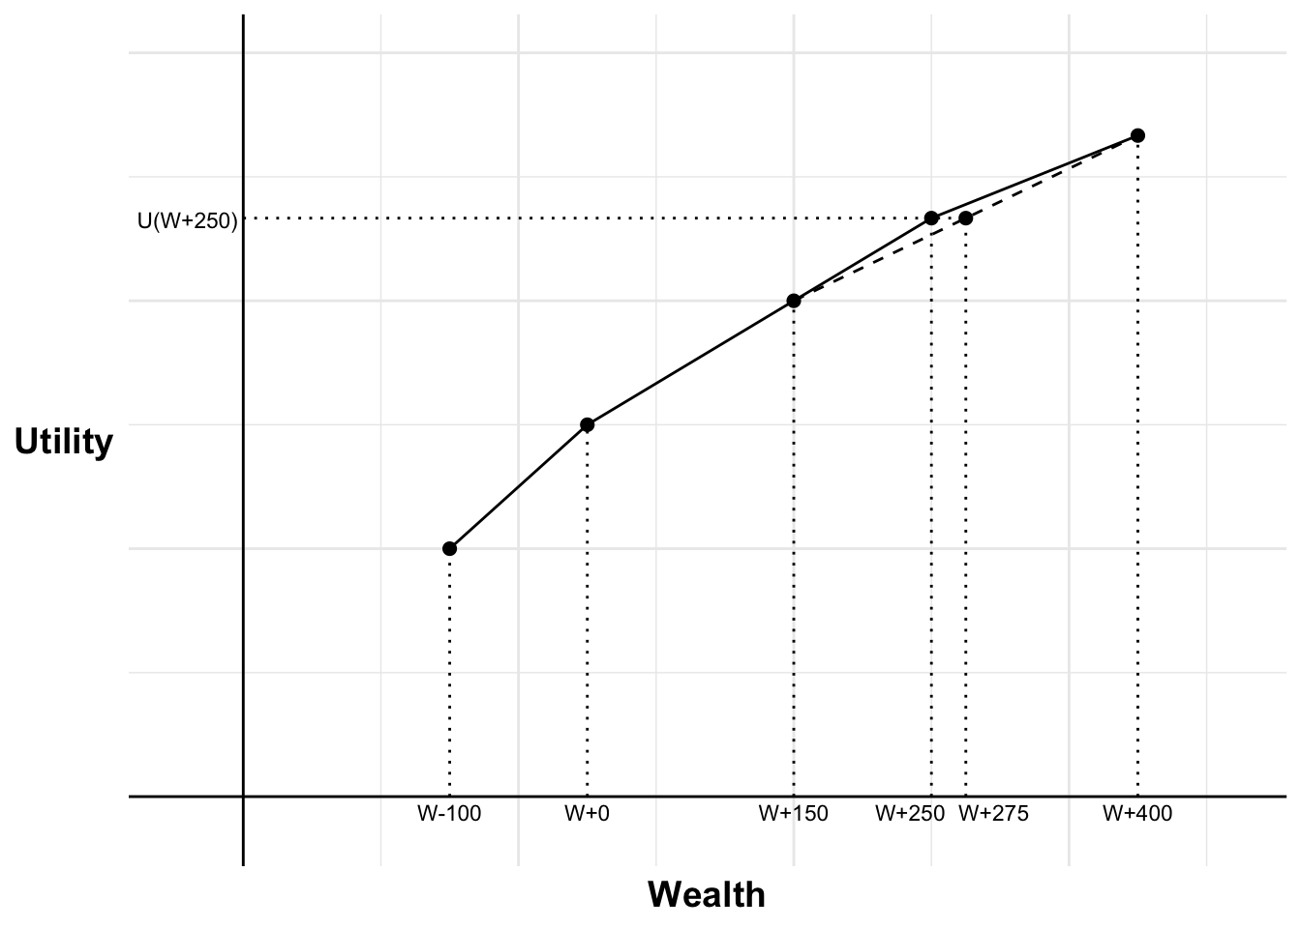
Absurd rates of risk aversion

Slide 14
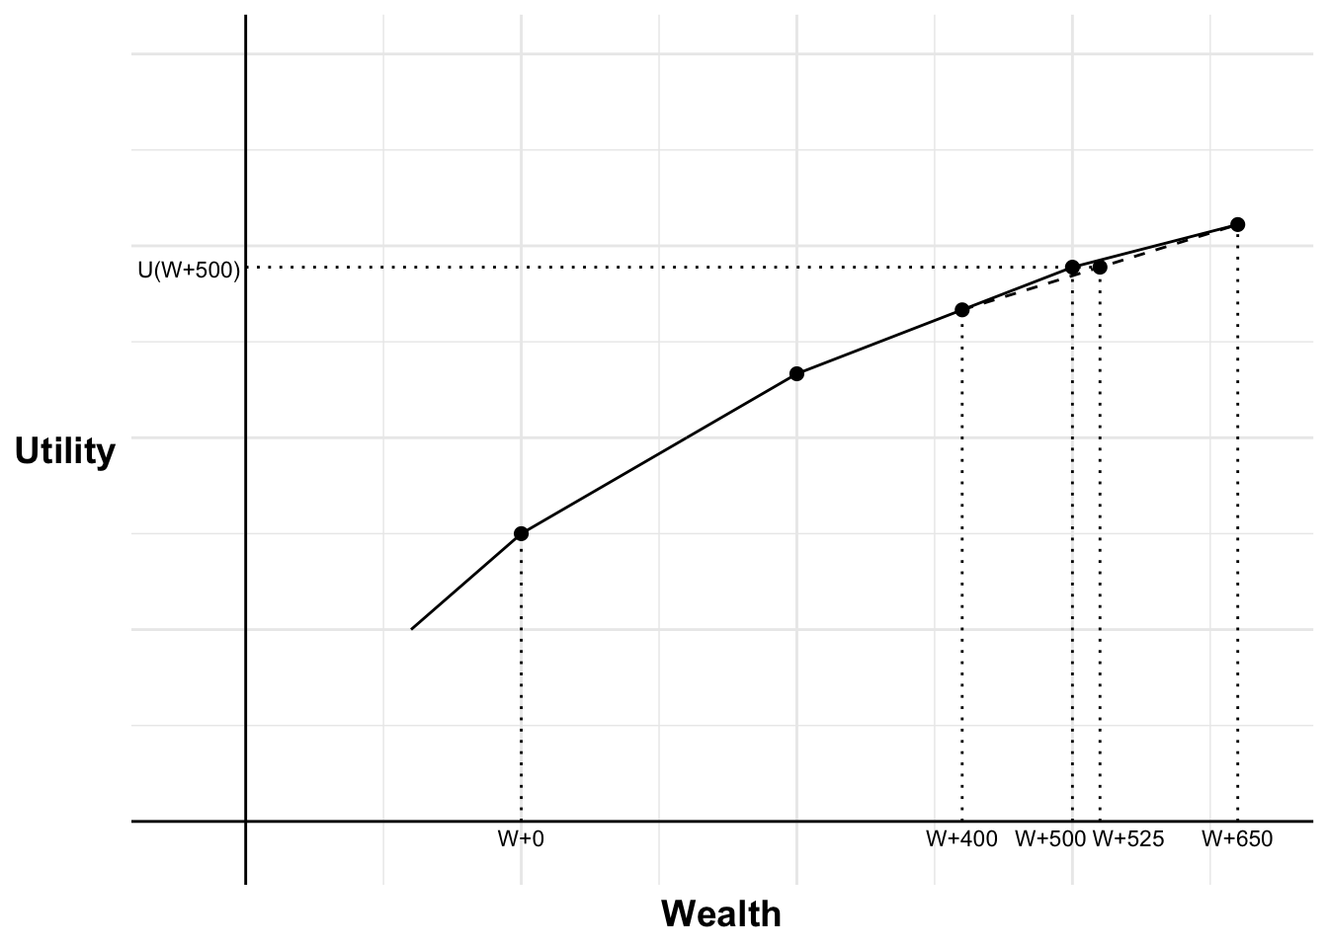
Absurd rates of risk aversion

Slide 15
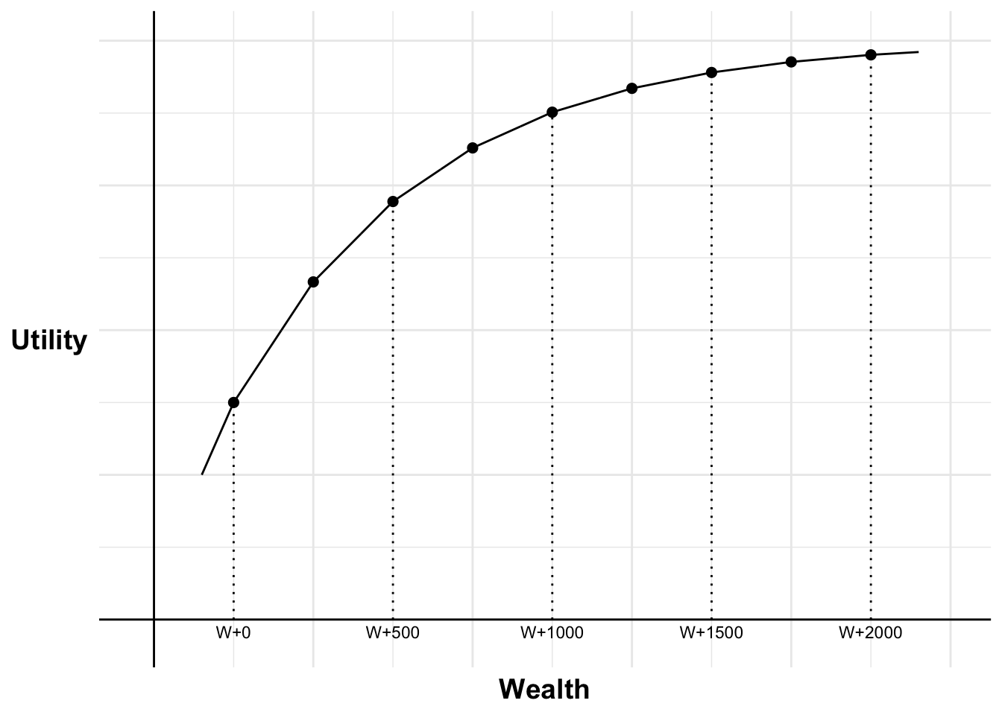
Absurd rates of risk aversion

Slide 16
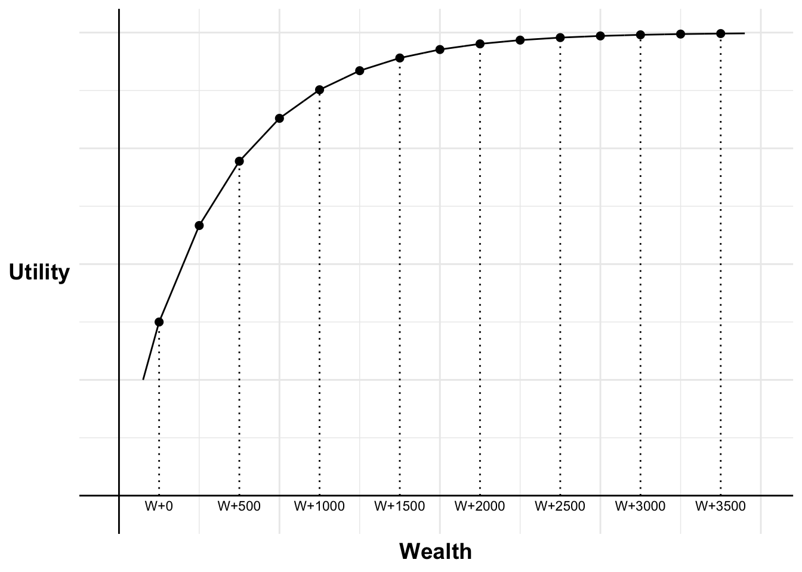
Absurd rates of risk aversion

