Slide 1

The Allais Paradox
Notes on Behavioural Economics
Jason Collins

Slide 2
Choice 1
Bet A: Bet B:
$2500 with probability 33% $2400 with probability 100%
$2400 with probability 66%
$0 with probability 1%

Slide 3
Choice 2
Bet C: Bet D:
$2500 with probability 33% $2400 with probability 34%
$0 with probability 67% $0 with probability 66%

Slide 4
Choice 1
Bet A: Bet B:
$2500 with probability 33% $2400 with probability 100%
$2400 with probability 66%
$0 with probability 1%

Slide 5
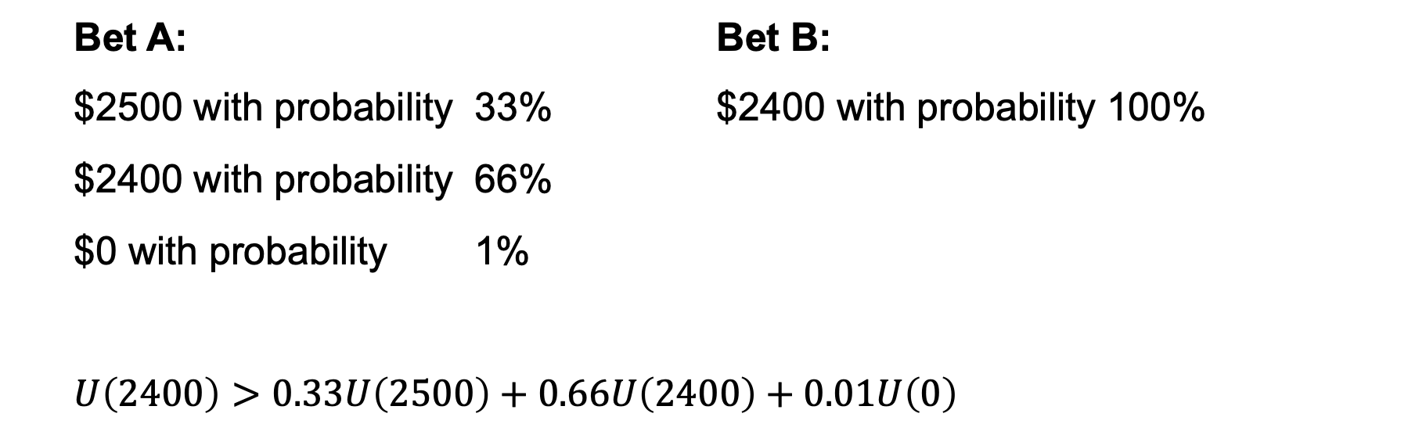
Choice 1
Bet A: Bet B:
$2500 with probability 33% $2400 with probability 100%
$2400 with probability 66%
$0 with probability 1%
$$U\left(2400\right)>0.33U\left(2500\right)+0.66U\left(2400\right)+0.01U\left(0\right)$$

Slide 6
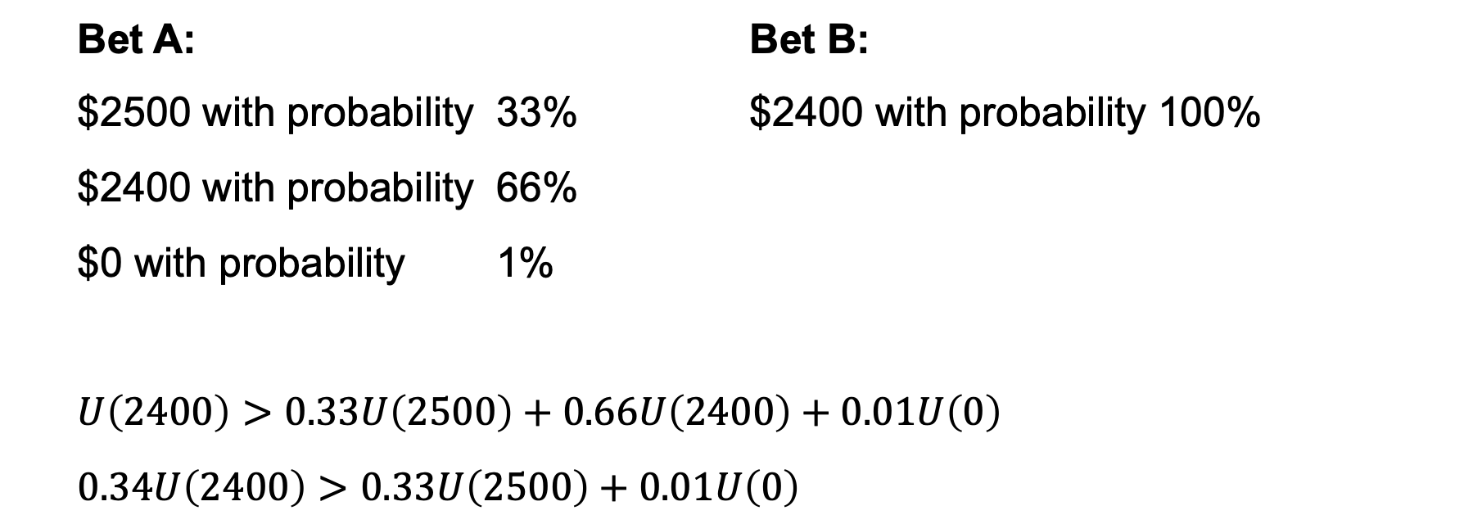
Choice 1
Bet A: Bet B:
$2500 with probability 33% $2400 with probability 100%
$2400 with probability 66%
$0 with probability 1%
$$U\left(2400\right)>0.33U\left(2500\right)+0.66U\left(2400\right)+0.01U\left(0\right)$$
$$0.34U\left(2400\right)>0.33U\left(2500\right)+0.01U\left(0\right)$$

Slide 7
Choice 2
Bet C: Bet D:
$2500 with probability 33% $2400 with probability 34%
$0 with probability 67% $0 with probability 66%

Slide 8
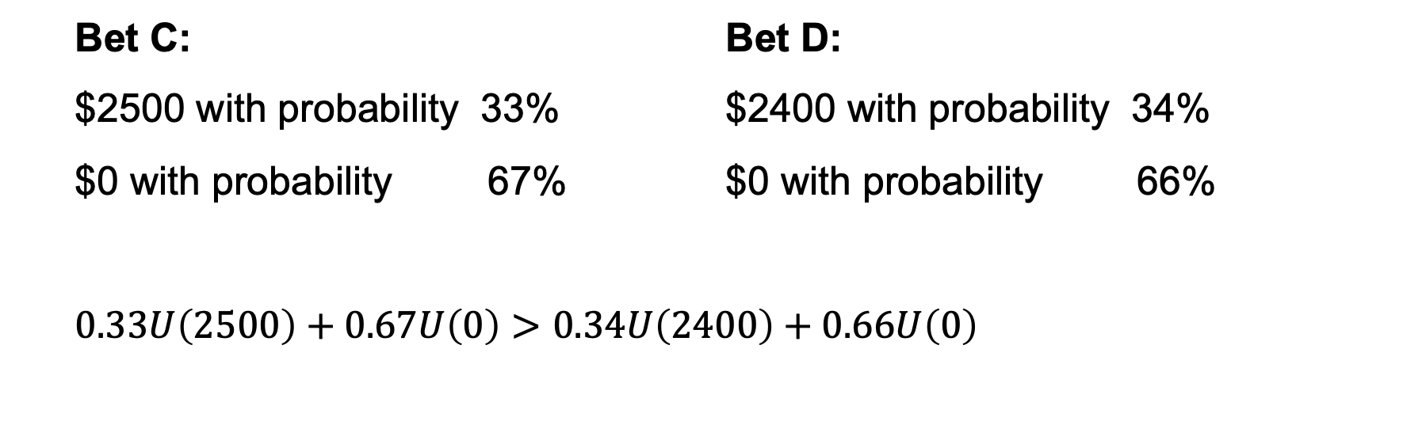
Choice 2
Bet C: Bet D:
$2500 with probability 33% $2400 with probability 34%
$0 with probability 67% $0 with probability 66%
$$0.33U\left(2500\right)+0.67U\left(0\right)>0.34U\left(2400\right)+0.66U\left(0\right)$$

Slide 9
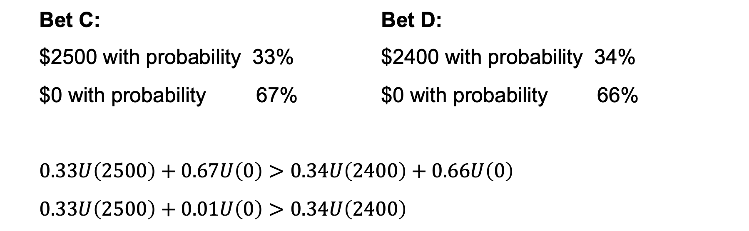
Choice 2
Bet C: Bet D:
$2500 with probability 33% $2400 with probability 34%
$0 with probability 67% $0 with probability 66%
$$0.33U\left(2500\right)+0.67U\left(0\right)>0.34U\left(2400\right)+0.66U\left(0\right)$$
$$0.33U\left(2500\right)+0.01U\left(0\right)>0.34U\left(2400\right)$$

Slide 10
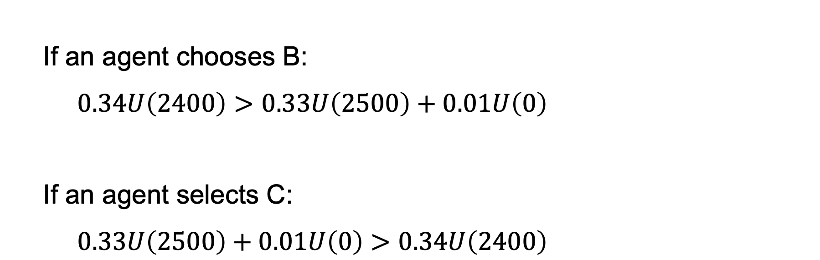
The Allais Paradox
If an agent chooses B:
$$0.34U\left(2400\right)>0.33U\left(2500\right)+0.01U\left(0\right)$$
If an agent selects C:
$$0.33U\left(2500\right)+0.01U\left(0\right)>0.34U\left(2400\right)$$

Slide 11
Choice 1 |  |  |  | Choice 2
A |  | B |  | C |  | D
Payoff | Chance | Payoff | Chance | Payoff | Chance | Payoff | Chance
$2400 | 66% | $2400 | 100% | $0 | 67% | $0 | 66%
$0 | 1% | Nothing | 1% |  |  | $2400 | 34%
$2500 | 33% | $5 million | 10% | $2500 | 33%

Slide 12
Choice 1 |  |  |  | Choice 2
A |  | B |  | C |  | D
Payoff | Chance | Payoff | Chance | Payoff | Chance | Payoff | Chance
$2400 | 66% | $2400 | 100% | $0 | 67% | $0 | 66%
$0 | 1% | Nothing | 1% |  |  | $2400 | 34%
$2500 | 33% | $5 million | 10% | $2500 | 33%
Choice 1 |  |  |  | Choice 2
A |  | B |  | C |  | D
Payoff | Chance | Payoff | Chance | Payoff | Chance | Payoff | Chance
$2400 | 66% | $2400 | 66% | $0 | 66% | $0 | 66%
$0 | 1% | $2400 | 34% | $0 | 1% | $2400 | 34%
$2500 | 33% | $5 million | 10% | $2500 | 33%

Slide 13
Choice 1 |  |  |  | Choice 2
A |  | B |  | C |  | D
Payoff | Chance | Payoff | Chance | Payoff | Chance | Payoff | Chance
$2400 | 66% | $2400 | 100% | $0 | 67% | $0 | 66%
$0 | 1% | Nothing | 1% |  |  | $2400 | 34%
$2500 | 33% | $5 million | 10% | $2500 | 33%
Choice 1 |  |  |  | Choice 2
A |  | B |  | C |  | D
Payoff | Chance | Payoff | Chance | Payoff | Chance | Payoff | Chance
$2400 | 66% | $2400 | 66% | $0 | 66% | $0 | 66%
$0 | 1% | $2400 | 34% | $0 | 1% | $2400 | 34%
$2500 | 33% | $5 million | 10% | $2500 | 33%

Slide 14
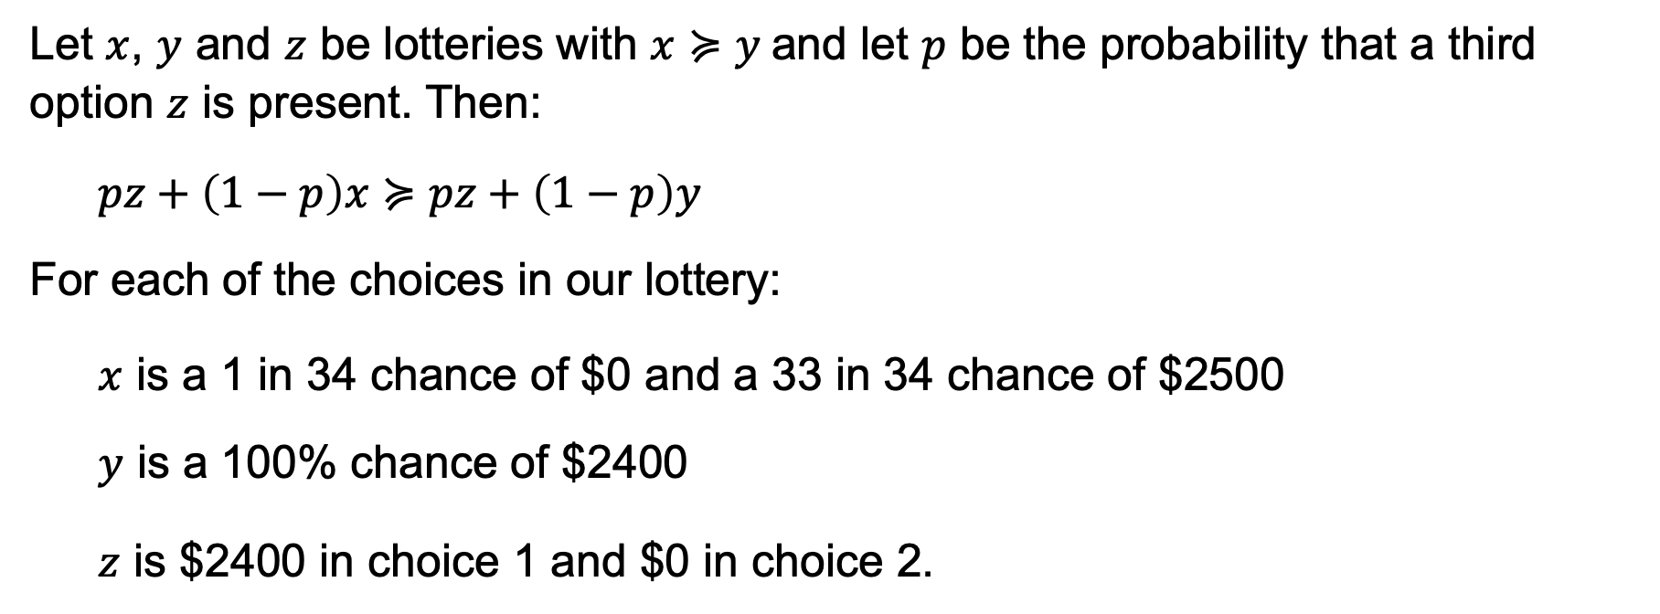
The Allais Paradox
Let $x$, $y$ and $z$ be lotteries with $x≽y$and let $p$ be the probability that a third option $z$ is present. Then:
$$pz+\left(1−p\right)x≽pz+\left(1−p\right)y$$
For each of the choices in our lottery:
$x$ is a 1 in 34 chance of $0 and a 33 in 34 chance of $2500
$y$ is a 100% chance of $2400
$z$ is $2400 in choice 1 and $0 in choice 2.

Slide 15
Choice 1 |  |  |  | Choice 2
A |  | B |  | C |  | D
Payoff | Chance | Payoff | Chance | Payoff | Chance | Payoff | Chance
$2400 | 66% | $2400 | 66% | $0 | 66% | $0 | 66%
$0 | 1% | $2400 | 34% | $0 | 1% | $2400 | 34%
$2500 | 33% | $5 million | 10% | $2500 | 33%

