Slide 1

Attitudes toward risk
Notes on Behavioural Economics
Jason Collins

Slide 2
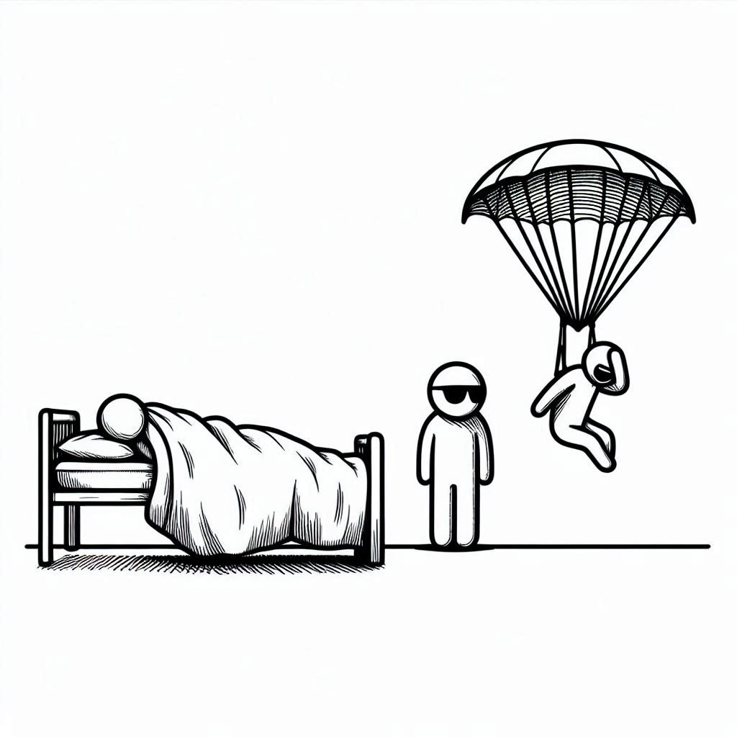
Attitudes toward risk
Risk averse
Risk neutral
Risk seeking

Slide 3
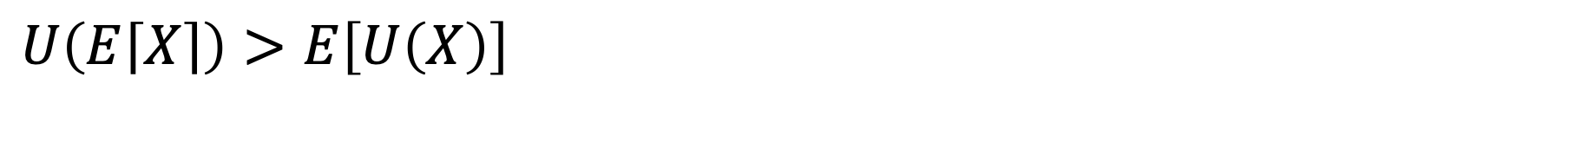
Risk averse
$$U\left(E\left\lceil X\right\rceil \right)>E\left[U\left(X\right)\right]$$

Slide 4
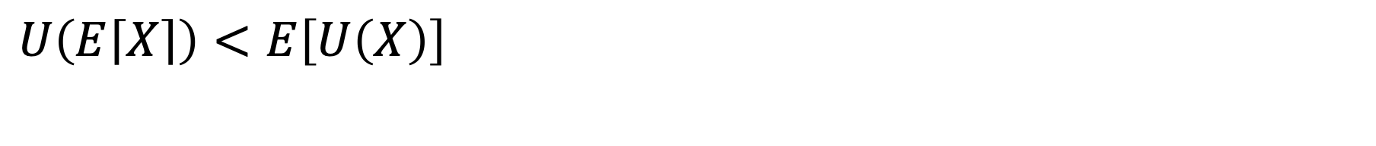
Risk seeking
$$U\left(E\left\lceil X\right\rceil \right)<E\left[U\left(X\right)\right]$$

Slide 5
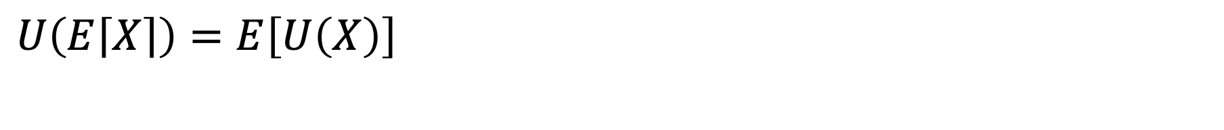
Risk neutral
$$U\left(E\left\lceil X\right\rceil \right)=E\left[U\left(X\right)\right]$$

Slide 6
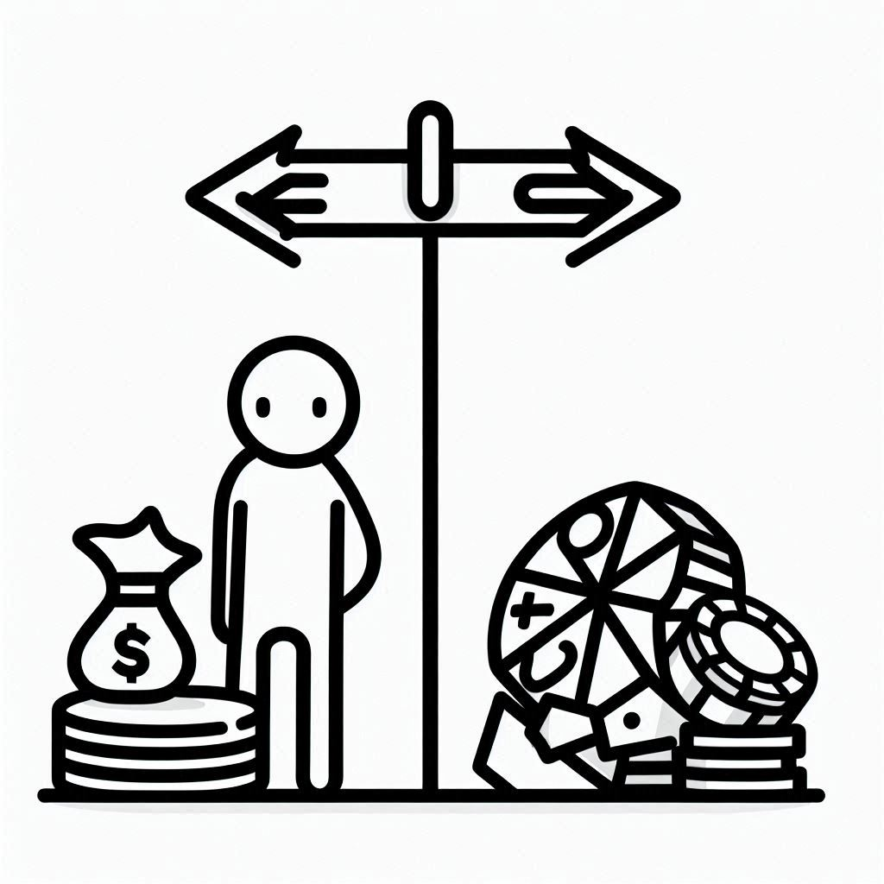
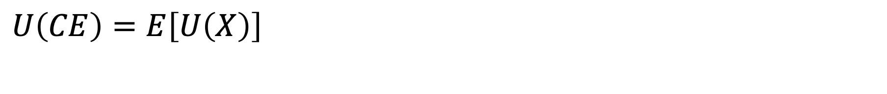
Certainty equivalent
$$U\left(CE\right)=E\left[U\left(X\right)\right]$$

Slide 7
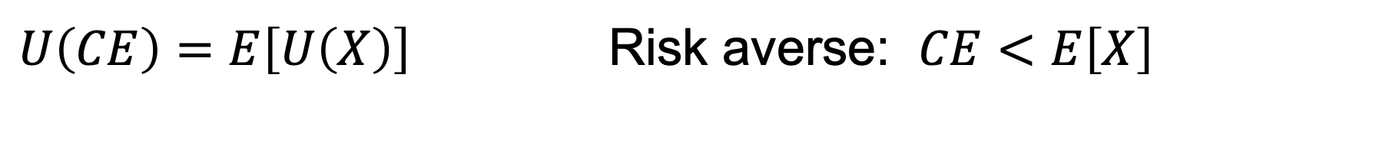
Certainty equivalent
$U\left(CE\right)=E\left[U\left(X\right)\right]$ Risk averse: $CE<E\left[X\right]$

Slide 8
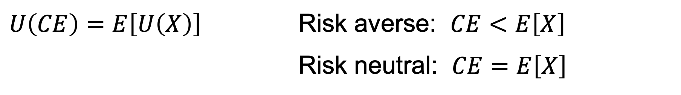
Certainty equivalent
$U\left(CE\right)=E\left[U\left(X\right)\right]$ Risk averse: $CE<E\left[X\right]$
Risk neutral: $CE=E\left[X\right]$

Slide 9
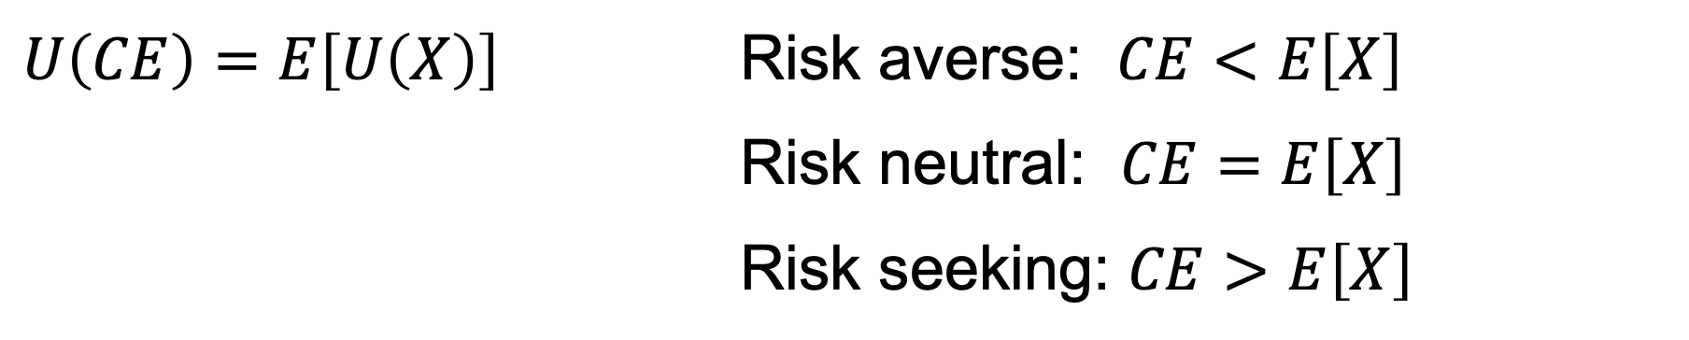
Certainty equivalent
$U\left(CE\right)=E\left[U\left(X\right)\right]$ Risk averse: $CE<E\left[X\right]$
Risk neutral: $CE=E\left[X\right]$
Risk seeking: $CE>E\left[X\right]$

Slide 10
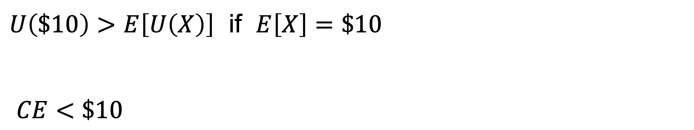
Risk averse
$U\left(\$10\right)>E\left[U\left(X\right)\right]$ if $E\left[X\right]=\$10$
$CE<\$10$

Slide 11
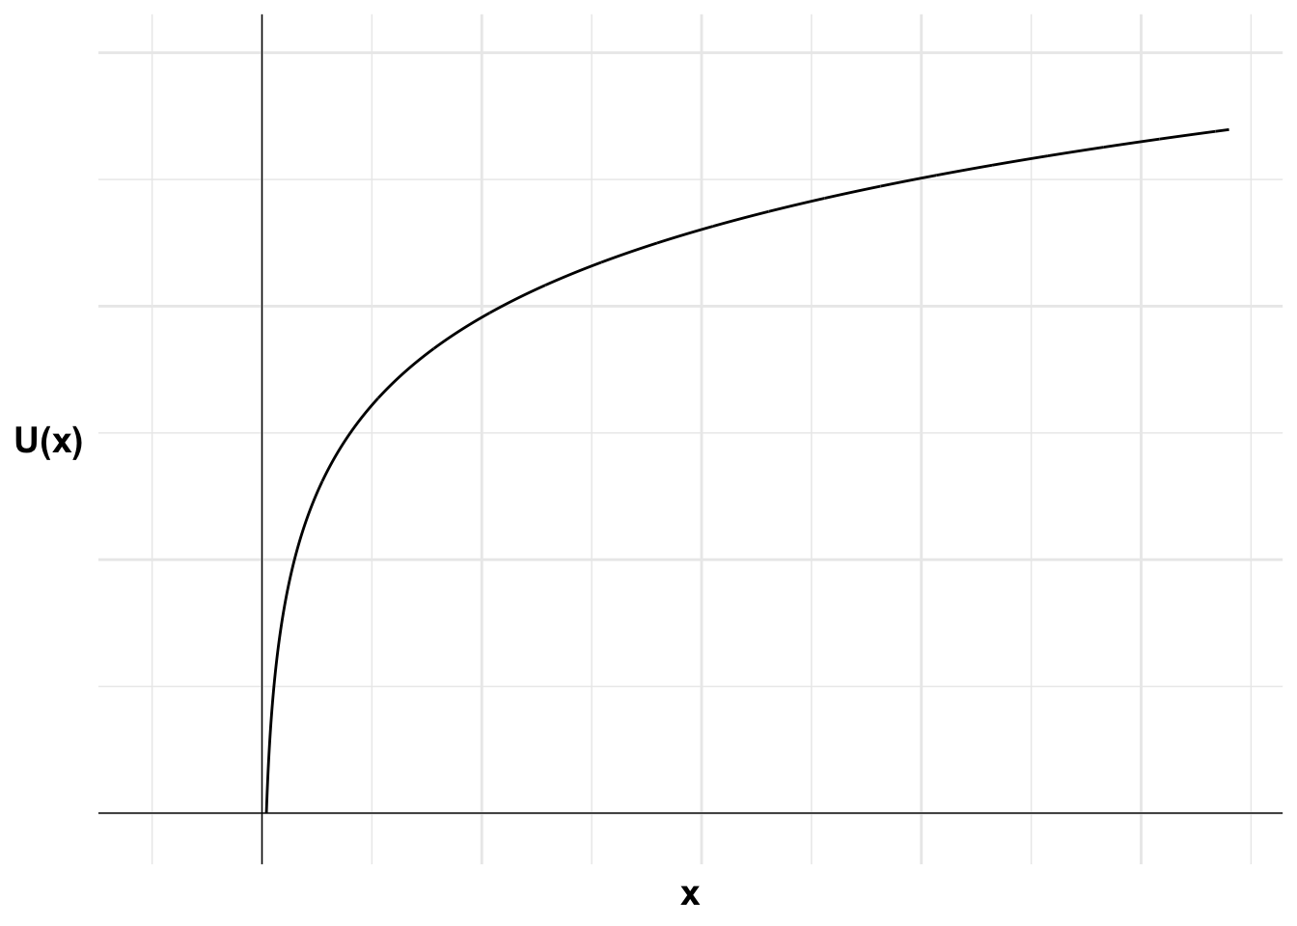
Risk averse

Slide 12
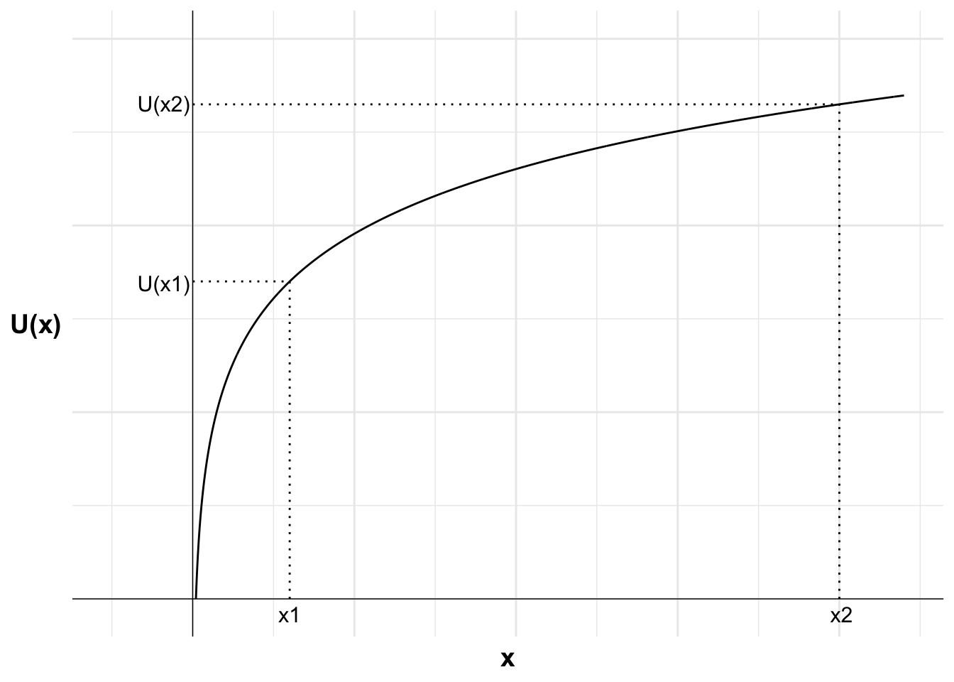
Risk averse

Slide 13
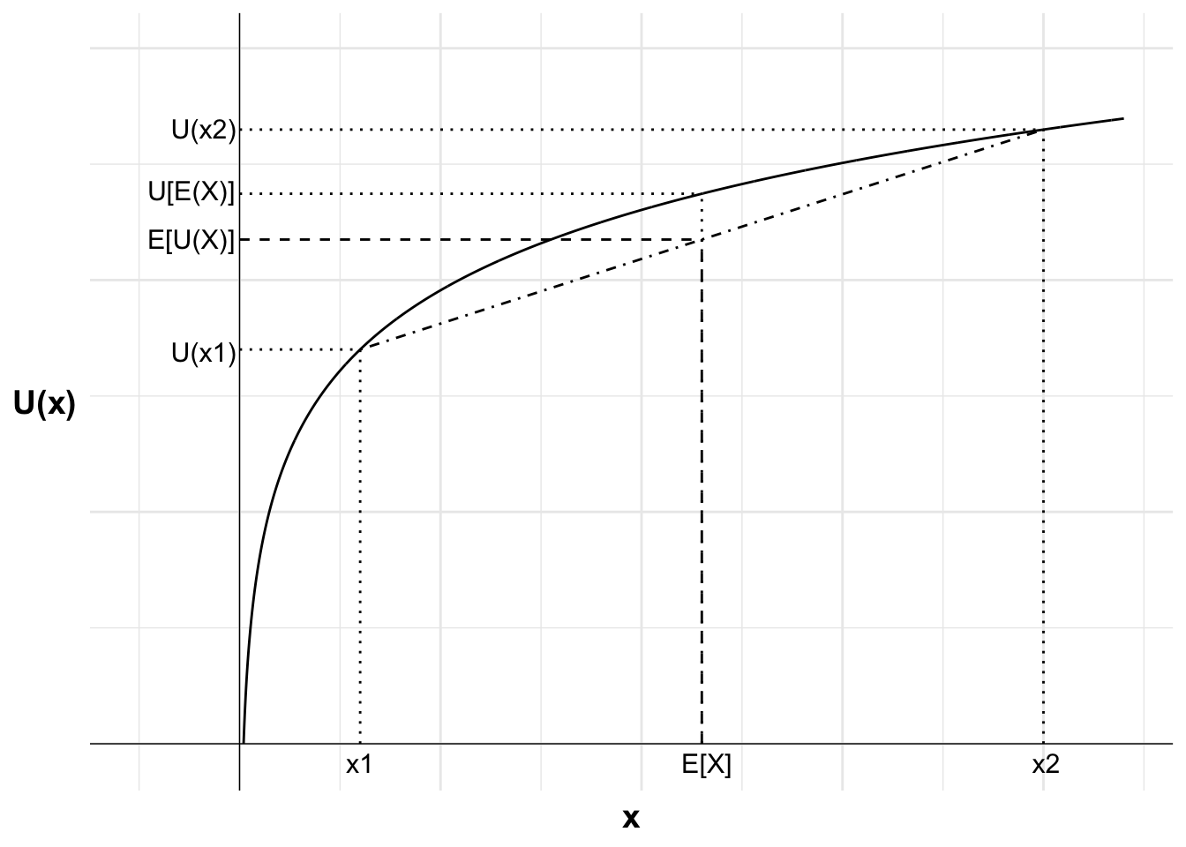
Risk averse

Slide 14
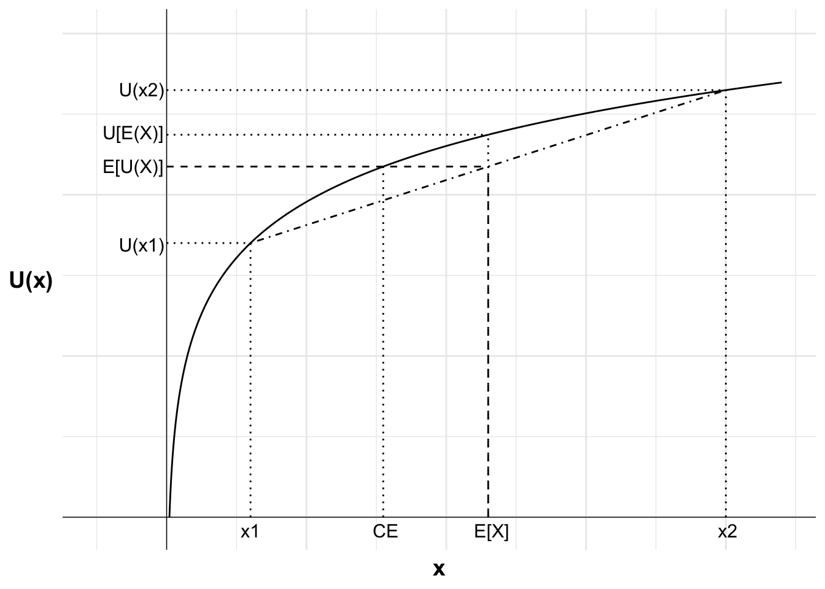
Risk averse

Slide 15
Risk aversion
Absolute risk aversion
Relative risk aversion

Slide 16
Absolute risk aversion
Would you accept a 50:50 bet to win $20, lose $10?
Constant absolute risk aversion (CARA): always respond in the same way, whatever their wealth.

Slide 17
Relative risk aversion
Would you accept a 50:50 bet to win 50% of your wealth, lose 40% of your wealth?
Constant relative risk aversion (CRRA): always respond in the same way, whatever their wealth.

Slide 18

Constant relative risk aversion

Slide 19
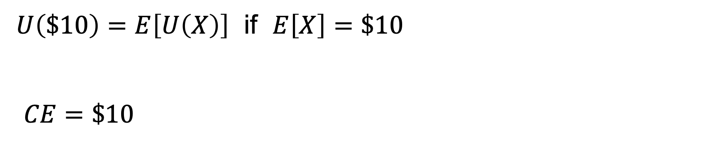
Risk neutral
$U\left(\$10\right)=E\left[U\left(X\right)\right]$ if $E\left[X\right]=\$10$
$CE=\$10$

Slide 20
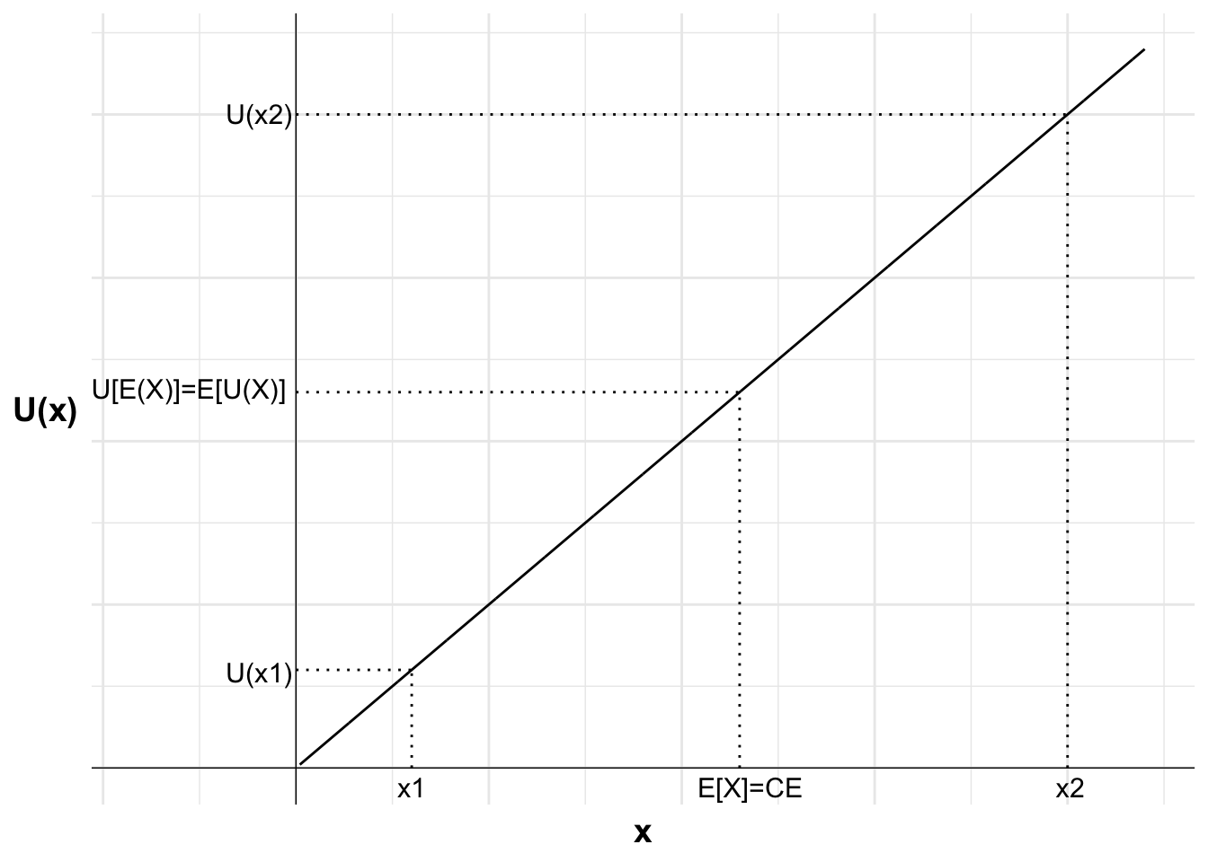
Risk neutral

Slide 21
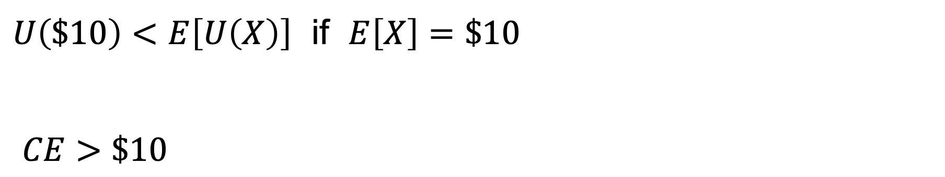
Risk seeking
$U\left(\$10\right)<E\left[U\left(X\right)\right]$ if $E\left[X\right]=\$10$
$CE>\$10$

Slide 22
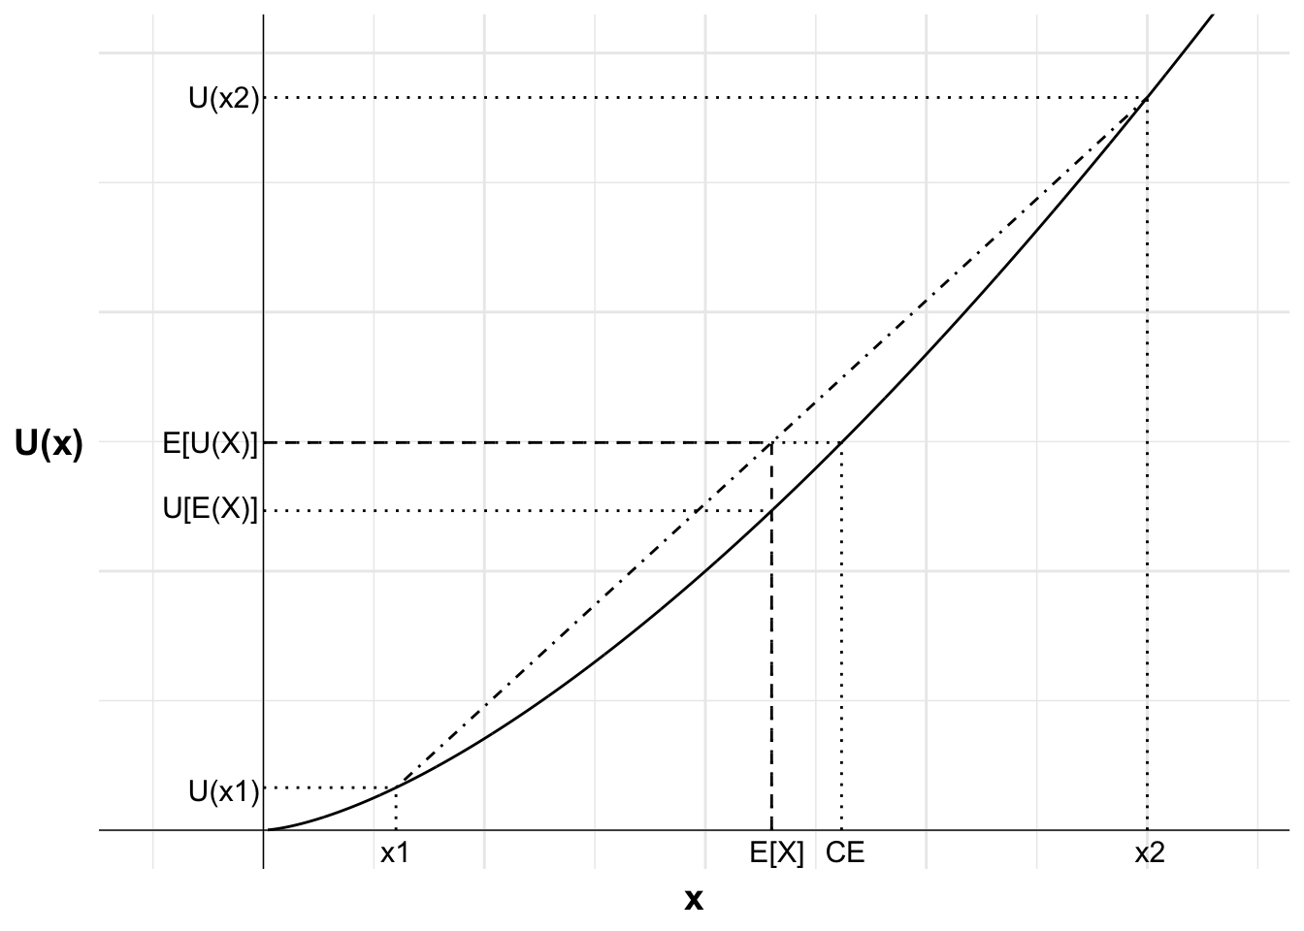
Risk seeking

