Slide 1

Auxiliary axioms for expected utility theory
Notes on Behavioural Economics
Jason Collins

Slide 2
Auxiliary axioms
Utility is calculated over total wealth
Non-satiation
Monotonicity
Convexity
Diminishing marginal utility

Slide 3
Reference point of zero wealth

Slide 4
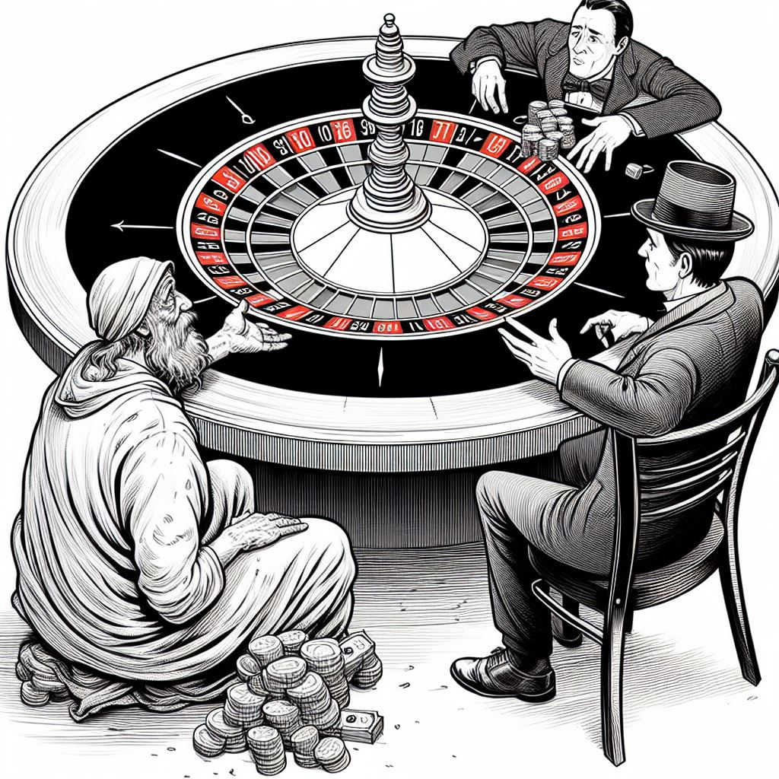

Slide 5

Reference point of zero wealth
$$U\left(\$10\right) U(−\$10)$$

Slide 6

Reference point of zero wealth
$$U\left(W+\$10\right) U(W−\$10)$$

Slide 7
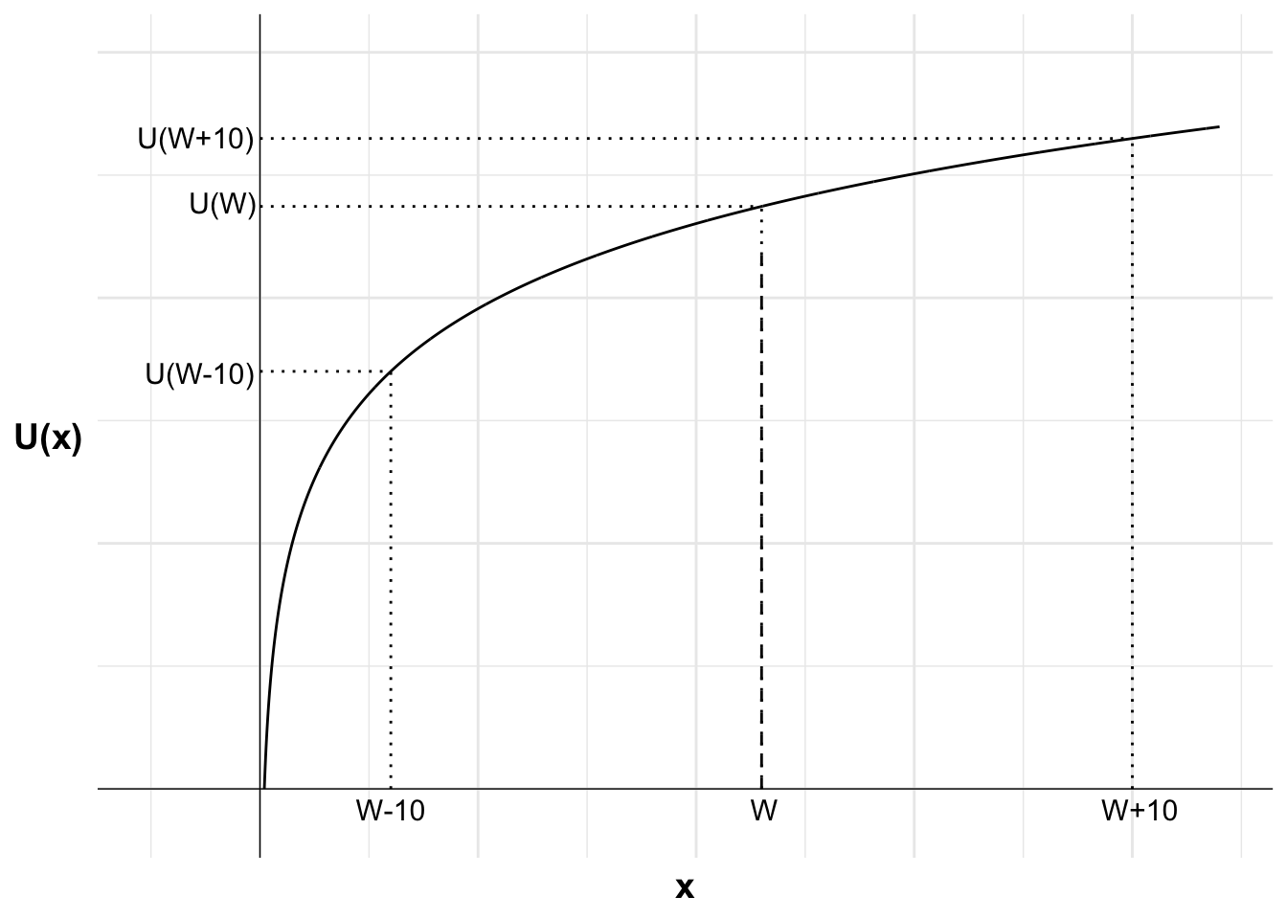
Reference point of zero wealth

Slide 8

Non-satiation

Slide 9
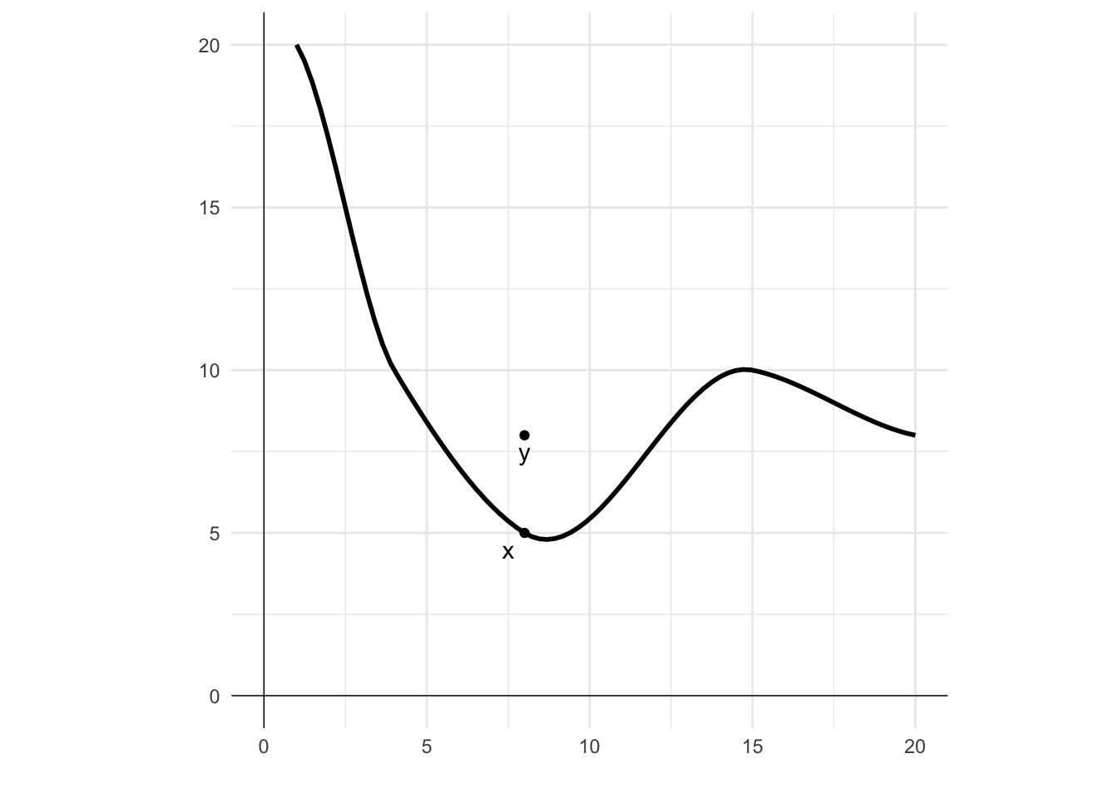
Non-satiation

Slide 10
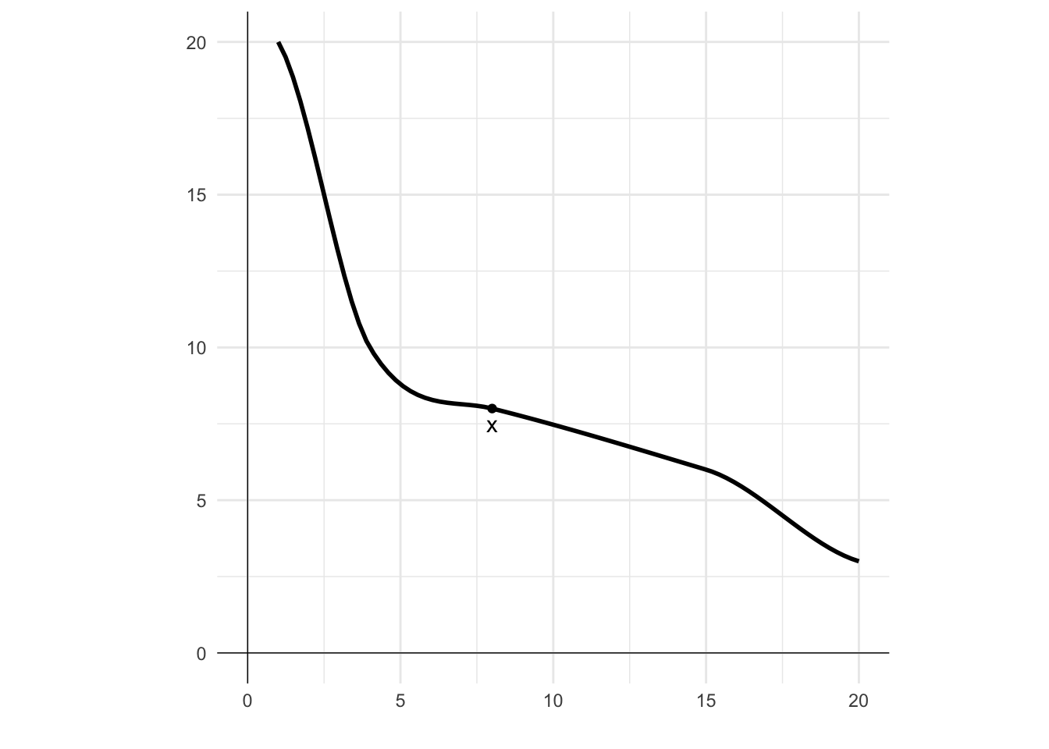
Monotonicity

Slide 11
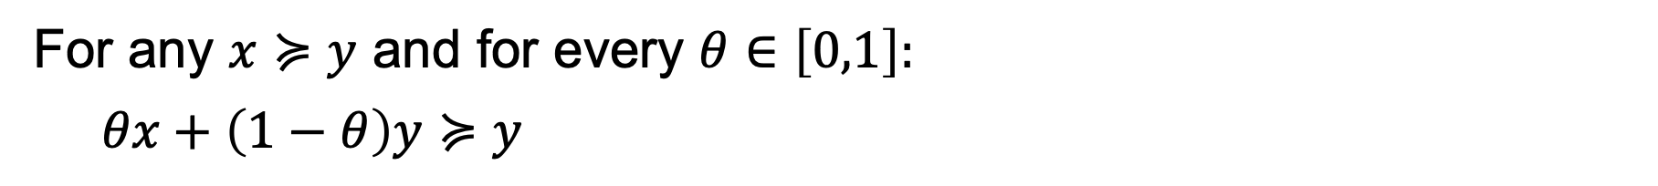
Convexity
For any $x≽y$ and for every $θ∈\left[0,1\right]:$
$$θx+\left(1−θ\right)y≽y$$

Slide 12
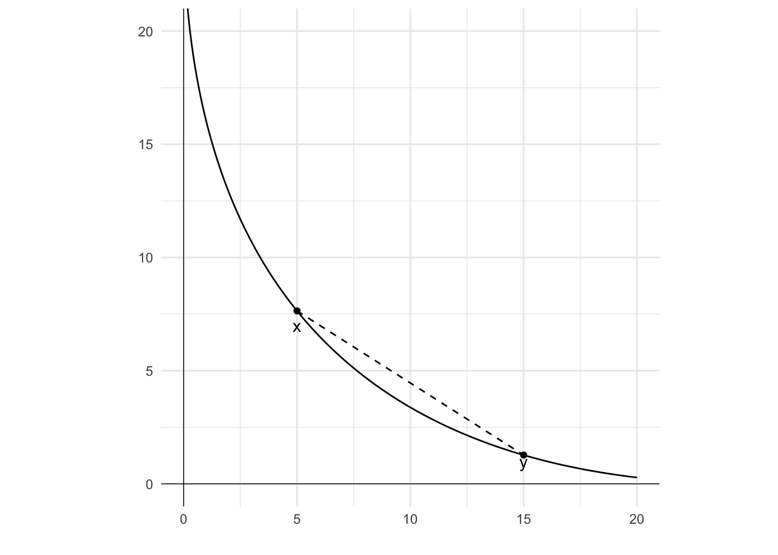
Convexity

Slide 13
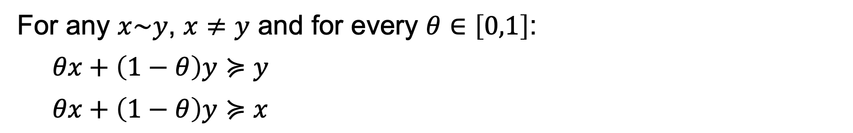
Strict convexity
For any $x\sim y$, $x≠y$ and for every $θ∈\left[0,1\right]$:
$$θx+\left(1−θ\right)y≽y$$
$$θx+\left(1−θ\right)y≽x$$

Slide 14
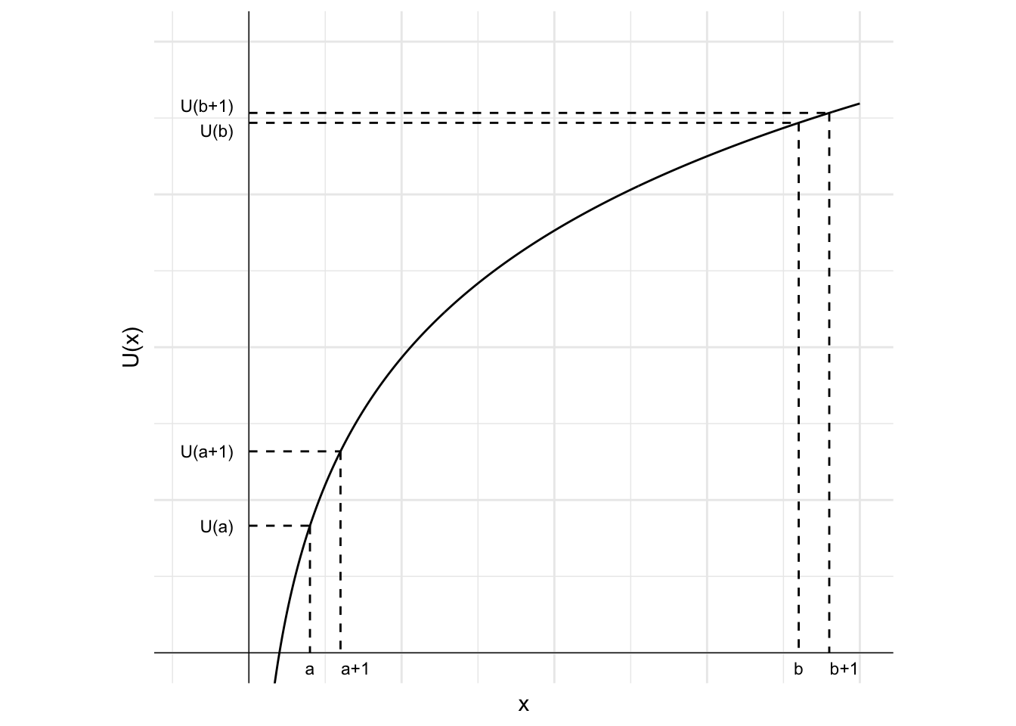
Diminishing marginal utility

