Slide 1

Continuity
Notes on Behavioural Economics
Jason Collins

Slide 2
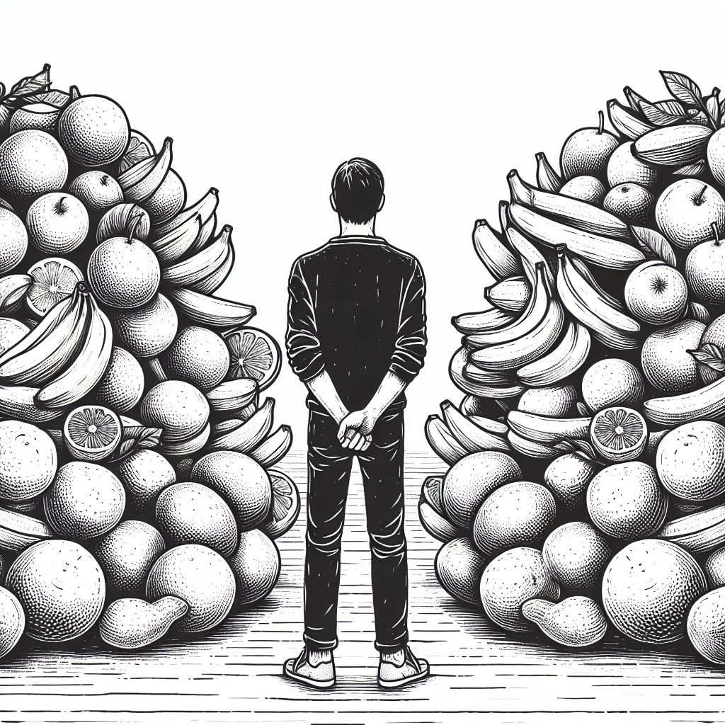

Slide 3
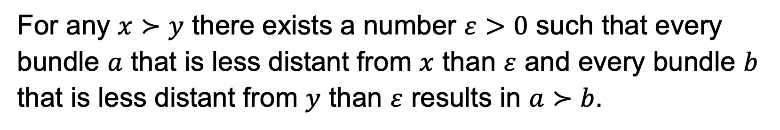
Continuity
For any $x≻y$ there exists a number $ε>0$ such that every bundle $a$ that is less distant from $x$ than $ε$ and every bundle $b$ that is less distant from $y$ than $ε$ results in $a≻b$.

Slide 4
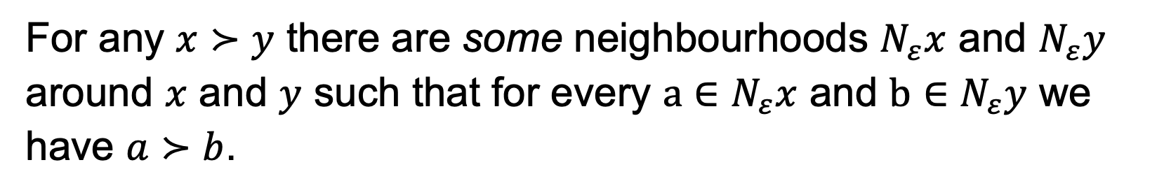
Continuity
For any $x≻y$ there are some neighbourhoods $N_{ε}x$ and $N_{ε}y$ around $x$ and $y$ such that for every $a∈N_{ε}x$ and $b∈N_{ε}y$ we have $a≻b$.

Slide 5
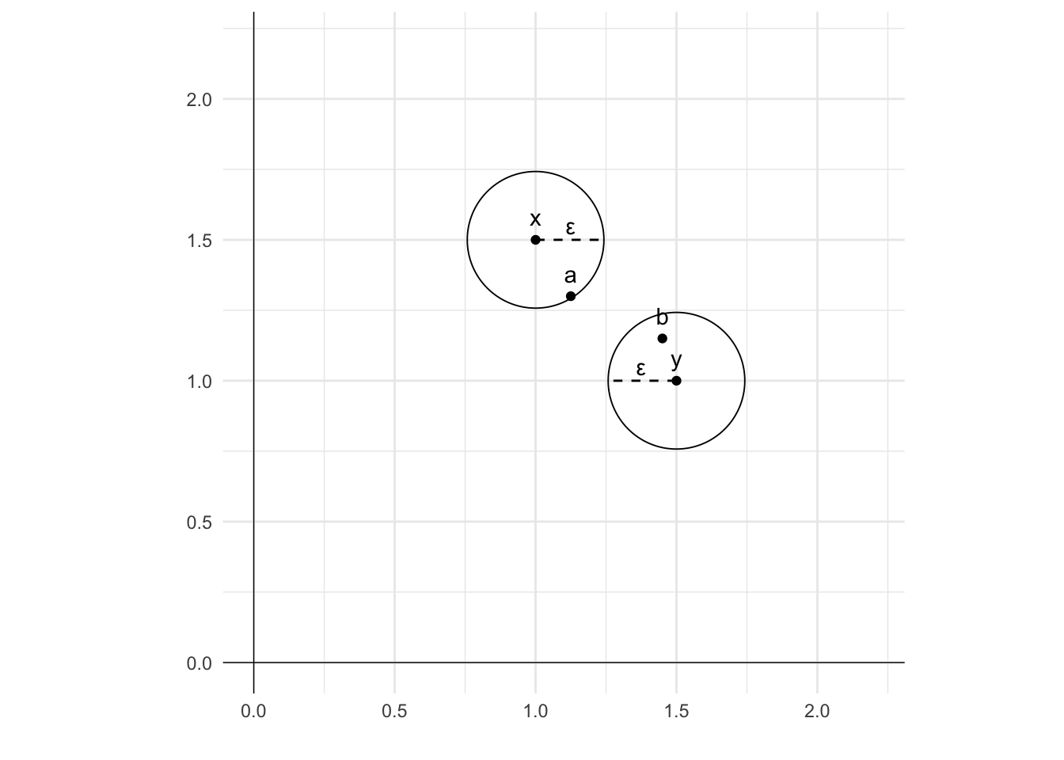
Continuity

Slide 6
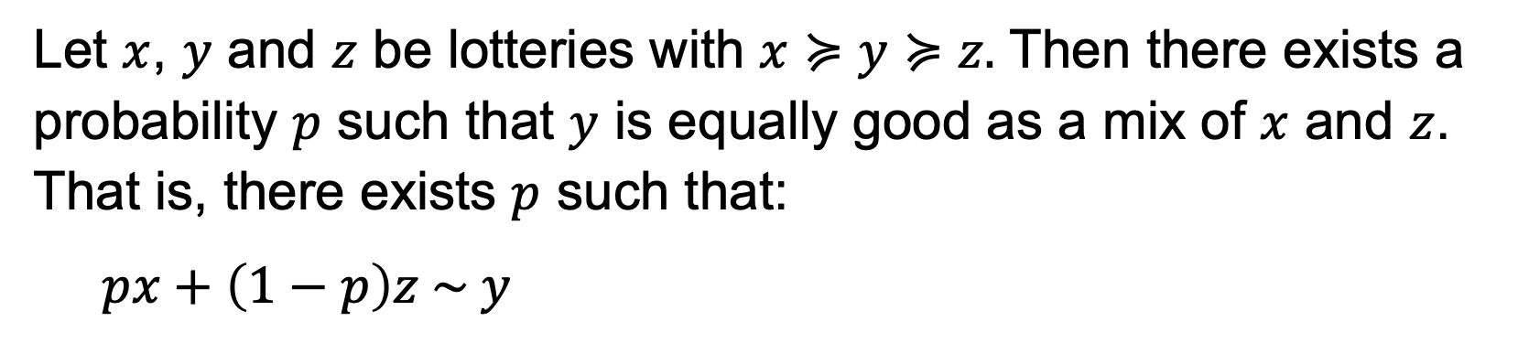
Continuity
Let $x$, $y$ and $z$ be lotteries with $x≽y≽z.$ Then there exists a probability $p$ such that $y$ is equally good as a mix of $x$ and $z$. That is, there exists $p$ such that:
$$px+\left(1−p\right)z \sim y$$

Slide 7
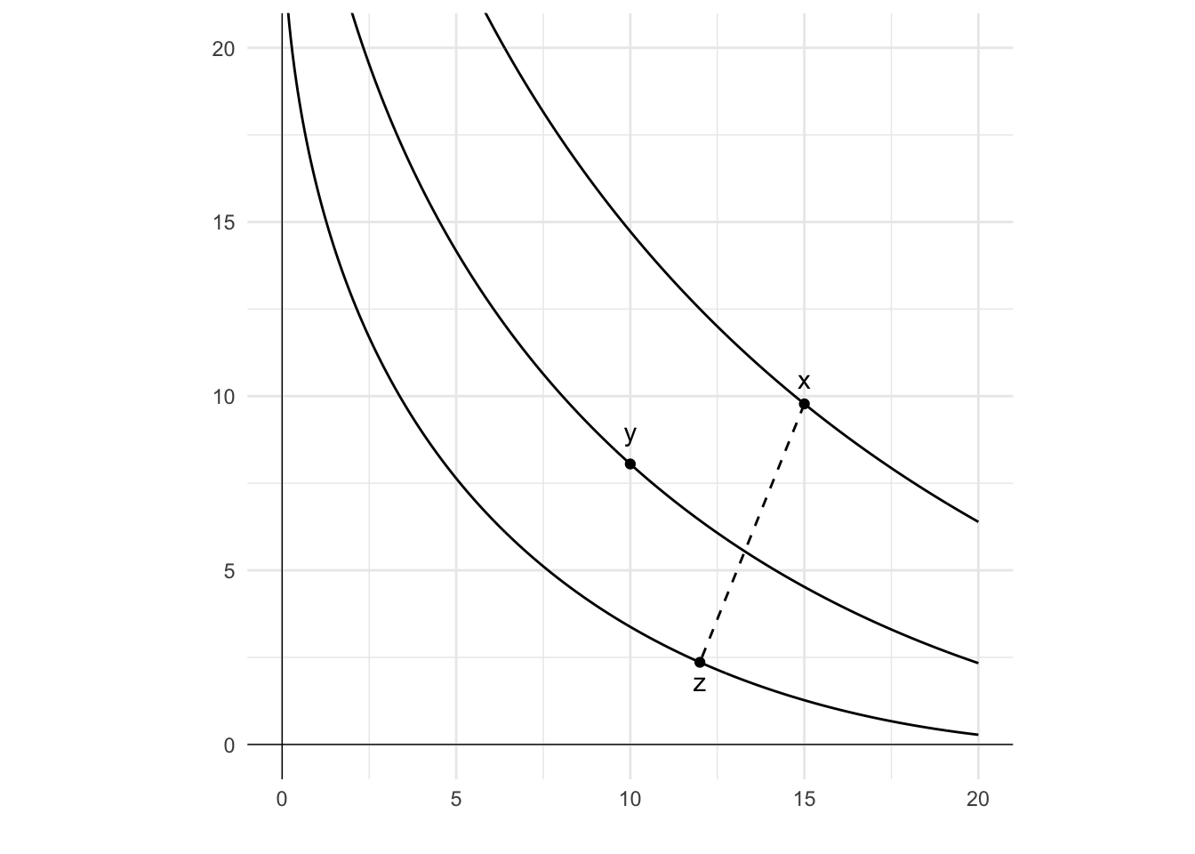
Continuity

Slide 8
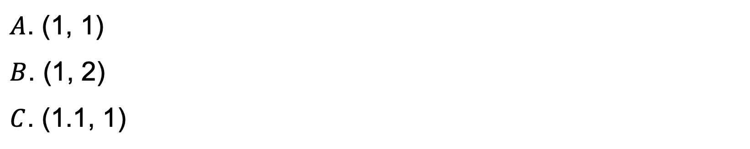
Lexicographic preferences
$A$. (1, 1)
$B$. (1, 2)
$C$. (1.1, 1)

Slide 9
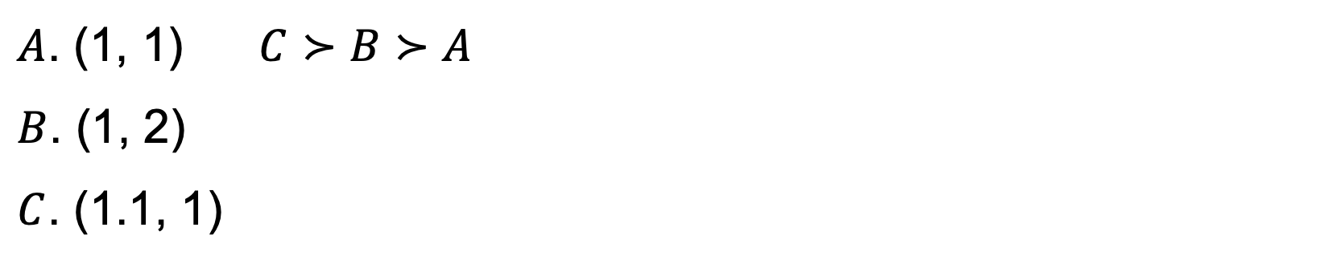
Lexicographic preferences
$A$. (1, 1) $C≻B≻A$
$B$. (1, 2)
$C$. (1.1, 1)

Slide 10
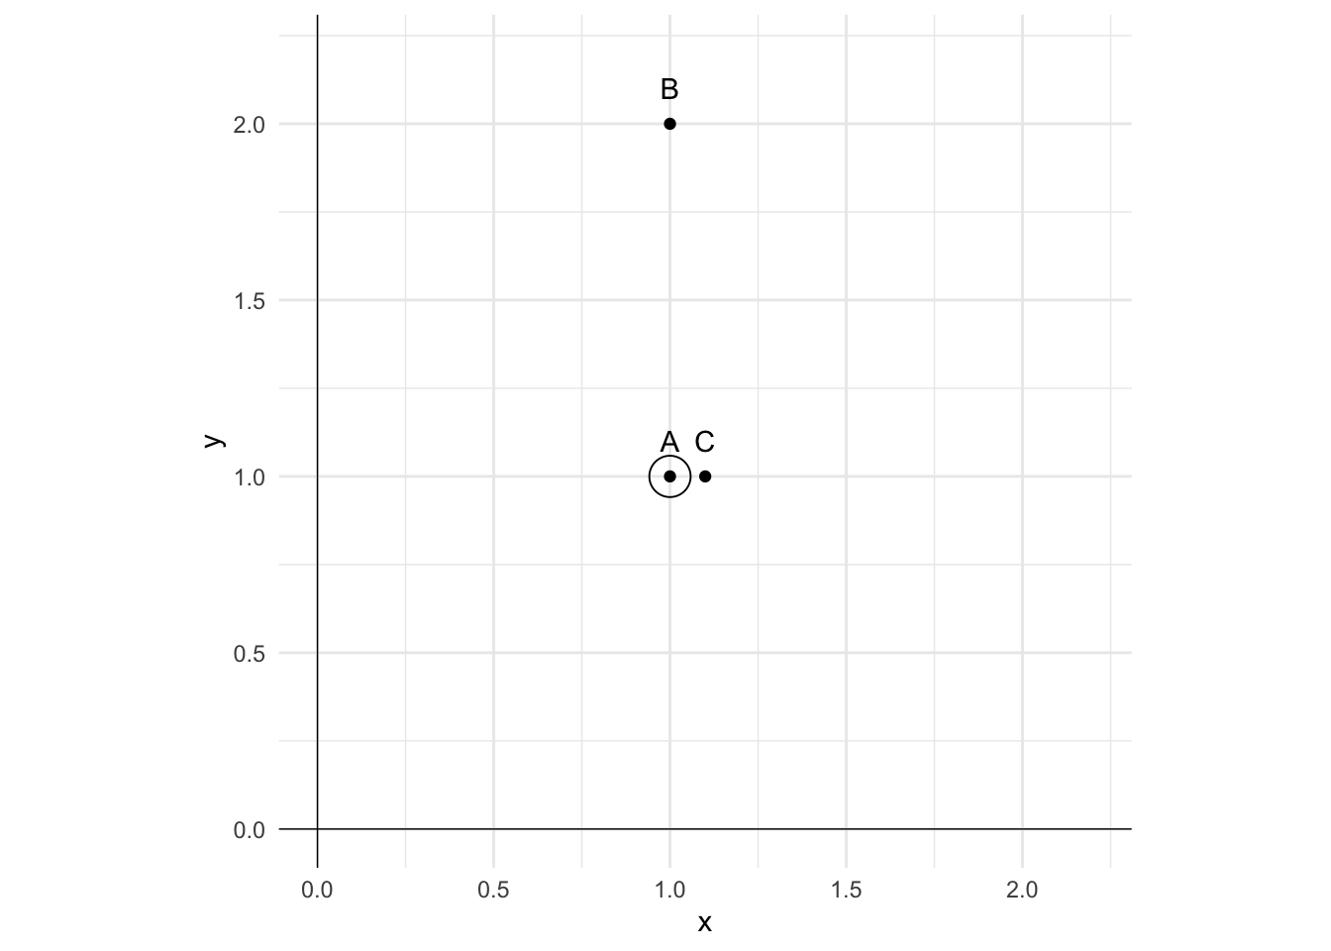
Lexicographic preferences
$A$. (1, 1) $C≻B≻A$
$B$. (1, 2)
$C$. (1.1, 1)

Slide 11
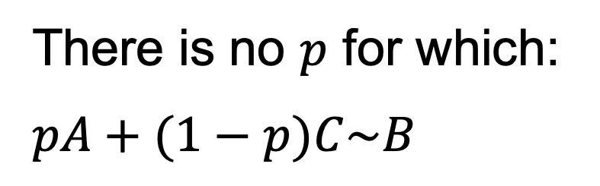
Lexicographic preferences
There is no $p$ for which:
$$pA+(1−p)C\sim B$$
$A$. (1, 1) $C≻B≻A$
$B$. (1, 2)
$C$. (1.1, 1)

